Slide 1
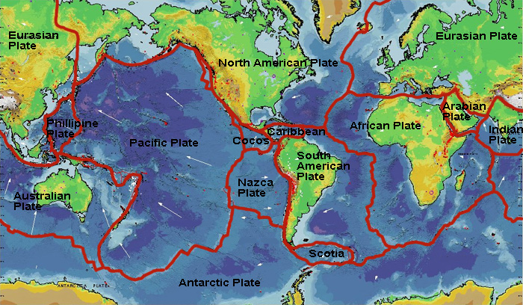
Unit 4: Earth Science
Section 4.1 Plate Tectonics

Slide 2
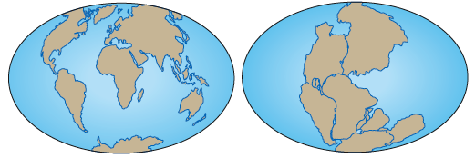
Evidence for Continental Drift
Early maps of the world made it look as though the continents might fit together like puzzle pieces.
German Scientist, Alfred Wegener suggested that continents had once been part of a supercontinent named Pangaea, that later broke up.
Like pieces of a jigsaw puzzle, the continents
fit together into one, large whole.
Notes:
Greek: Pan –all,
pan –all, gaea – world) show image
Besides the fit of the continents, Wegener and his supporters collected a great deal of evidence for the continental drift hypothesis. Wegener found that this evidence was best explained if the continents had at one time been joined together.

Slide 4
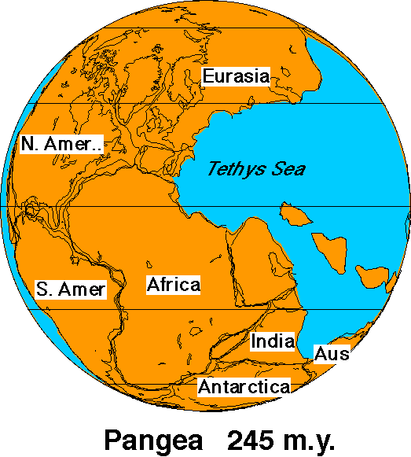
I. Wegner’s Theory of Continental Drift
States that these pieces of land moved apart over millions of years and formed the separate continents we know today.

Slide 5
Fixism
Wegener’s theory was rejected at first.
Because people could not see the continents moving, they assumed they have been in same location since Earth first formed.
This is the idea of fixism.

Slide 6
Evidence of continental drift includes:
1. There were matching geologic features:
Rocks and mountain ranges of eastern North American and western Europe are similar.

Slide 7
Evidence of Continental Drift
When maps of continents are brought together, their mountain ranges form a single continuous range of the same age and style of formation throughout.
Notes:
Wegener also matched up mountain ranges that had the same rock types, structures, and ages, but that are now on opposite sides of the Atlantic Ocean. The Appalachians of the eastern United States and Canada, for example, are just like mountain ranges in eastern Greenland, Ireland, Great Britain, and Norway. Wegener concluded that they formed as a single mountain range that was separated as the continents drifted.

Slide 8
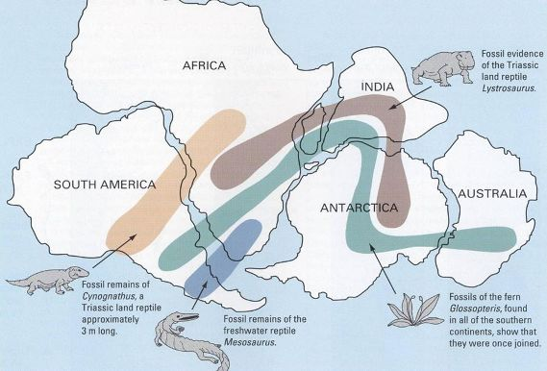
Evidence for Continental Drift
2. There were matching fossils on different continents suggesting these continents were once joined..
Notes:
Coal deposits
He found fossils of the same species of extinct plants and animals in rocks of the same age, but on continents that are now widely separated. Wegener suggested that the continents could not have been in their current positions because the organisms would not have been able to travel across the oceans. For example, fossils of the seed fern Glossopteris are found across all of the southern continents. But the plants' seeds were too heavy to be carried across the ocean by wind. Mesosaurus fossils are found in South America and South Africa, but the reptile could only swim in fresh water. Cynognathus and Lystrosaurus were reptiles that lived on land. Both of these animals were unable to swim, let alone swim across wide seas! Their fossils have been found across South America, Africa, India and Antarctica. Wegener proposed that the organisms had lived side by side, but that the lands had moved apart after they were dead and fossilized.

Slide 9
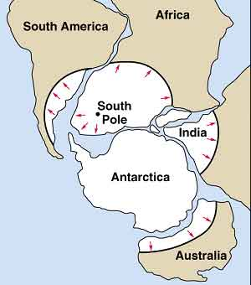
Evidence for Continental Drift
3. Climatic evidence: Continents had different climates in the past:
such as glaciers on
warm continents like
Africa.
Notes:
Recap: Evidence
Continents fit together like a puzzle
Matching geological structures and rocks
Matching fossils
Similar climates
Wegener also looked at evidence from ancient glaciers. Large glaciers are most commonly found in frigid climates, usually in the far northern and southern latitudes. Using the distribution of grooves and rock deposits left by ancient glaciers on many different continents, Wegener traced the glaciers back to where they must have started. He discovered that if the continents were in their current positions, the glaciers would have formed in the middle of the ocean very close to the equator. Wegener knew that this was impossible! However, if the continents had moved, the glaciers would have been centered over the southern land mass much closer to the South Pole.
Wegener also found evidence for his hypothesis from warm climate zones. Coral reefs and the swamps that lead to the formation of coal are now found only in tropical and subtropical environments. But Wegener discovered ancient coal seams and coral reefs in parts of the continents that were much too cold today. The coral reef fossils and coal had drifted to new locations since the coal and coral formed.

Slide 10
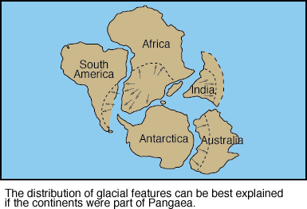
Evidence for Continental Drift
or Coal deposits in Antarctica (now too cold for plants to grow)
Notes:
Recap: Evidence
Continents fit together like a puzzle
Matching geological structures and rocks
Matching fossils
Similar climates
Wegener also looked at evidence from ancient glaciers. Large glaciers are most commonly found in frigid climates, usually in the far northern and southern latitudes. Using the distribution of grooves and rock deposits left by ancient glaciers on many different continents, Wegener traced the glaciers back to where they must have started. He discovered that if the continents were in their current positions, the glaciers would have formed in the middle of the ocean very close to the equator. Wegener knew that this was impossible! However, if the continents had moved, the glaciers would have been centered over the southern land mass much closer to the South Pole.
Wegener also found evidence for his hypothesis from warm climate zones. Coral reefs and the swamps that lead to the formation of coal are now found only in tropical and subtropical environments. But Wegener discovered ancient coal seams and coral reefs in parts of the continents that were much too cold today. The coral reef fossils and coal had drifted to new locations since the coal and coral formed.

Slide 11
In your own words describe continental drift hypothesis
How did Wegener support his hypothesis ?
Why do you think he chose this type of information?
Why was the continental drift hypothesis rejected?

Slide 12
II. Theory of Plate Tectonics
Wegener’s evidence of continental drift did not explain how entire continents could change locations, so his theory was rejected by scientists of his time.
Notes:
Although Wegener's evidence was sound, most geologists at the time rejected his hypothesis of continental drift. These scientists argued that there was no way to explain how solid continents could plow through solid oceanic crust. At the time, scientists did not understand how solid material could move. Wegener's idea was nearly forgotten until technological advances presented puzzling new information and gave scientists the tools to develop a mechanism for Wegener’s drifting continents.
Earth’s outer layer is divided into "plates" that move around across the earth's surface relative to each other, like slabs of ice on a lake.
Tectonic Plates = large movable slabs of rock
Plates move about 8cm a year, like fingernails

Slide 13
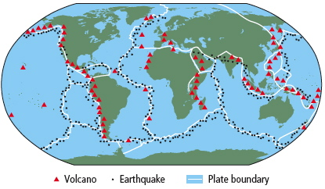
Evidence Continents Still Move
It was noted that earthquakes and volcanoes appear in certain patterns
Volcanoes: openings in Earth’s surface, that spew gases and melted rock when active
Earthquake: sudden, ground-shaking release of built-up energy at or under Earth’s surface.
Volcanoes are frequently found on boundaries between tectonic
plates.
See pages 510 - 512

Slide 14
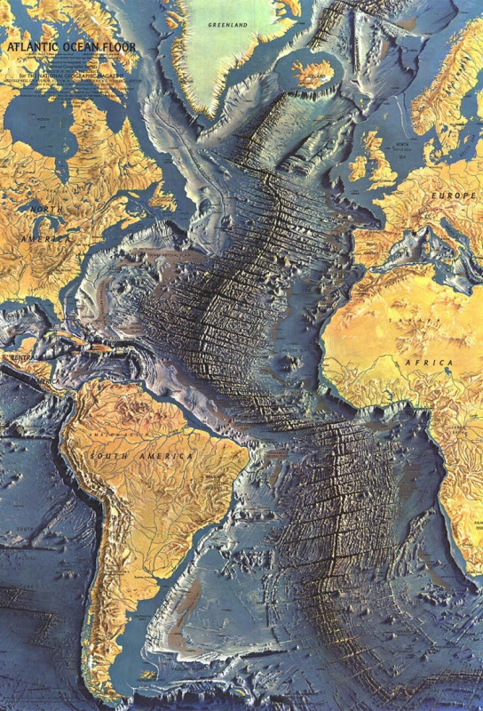
Evidence Continents Still Move
Oceanographers discovered a long mountain range running north-south down the length of the Atlantic Ocean floor called the Mid-Atlantic Ridge
Rock samples indicated the youngest rocks appeared closest to the ridge.
Notes:
Mapping of the ocean floor revealed the Mid-Atlantic Ridge, a long mountain range running down the middle of the Atlantic Ocean.
Rocks taken from the Mid-Atlantic Ridge were younger than other ocean rocks
Sediments along the ridge became thicker farther away from the ridge.
Due to sea floor spreading.

Slide 15
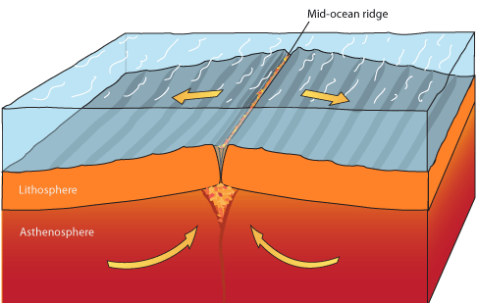
Sea Floor Spreading helps explain continental drift
Seafloor spreading is a process that occurs at mid-ocean ridges, where new oceanic crust is formed through volcanic activity and then gradually moves away from the ridge.
Notes:
Magma – molten rock from beneath Earth’s surface- rises because it is less dense than the surrounding. The magma cools and hardens when it breaks through Earth’s surface at a spreading ridge form new sea floor new magma coming up pushes odler rock aside like a converyer belt

Slide 16
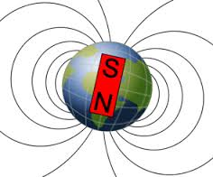
Paleomagnetism – study of magnetic properties in rocks
Earth has north and south magnetic poles and a magnetic field.
Iron and other magnetic metals in rocks align with these field lines.
Over thousands of years
the poles may reverse.
Ancient rocks often
preserve the strength and
direction of Earth’s magnetic
field when rocks were formed.
Notes:
Magnetic field due to motion of liquid iron in planets interior.

Slide 17
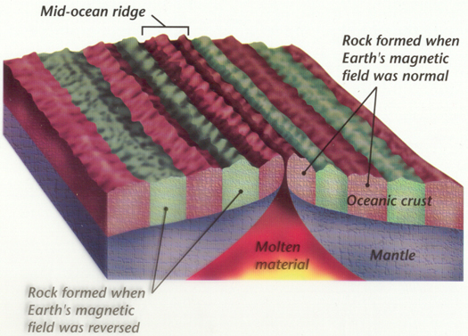
Magnetic Striping
Oceanographers found patterns of stripes in the direction the iron-containing minerals pointed on the sea floor, called magnetic striping.
This pattern was
repeated on both
sides of the
Mid-Atlantic Ridge
Notes:
Paleomagnetism shows that iron-based rocks along the
ridges are striped with reversing magnetic fields.

Slide 18
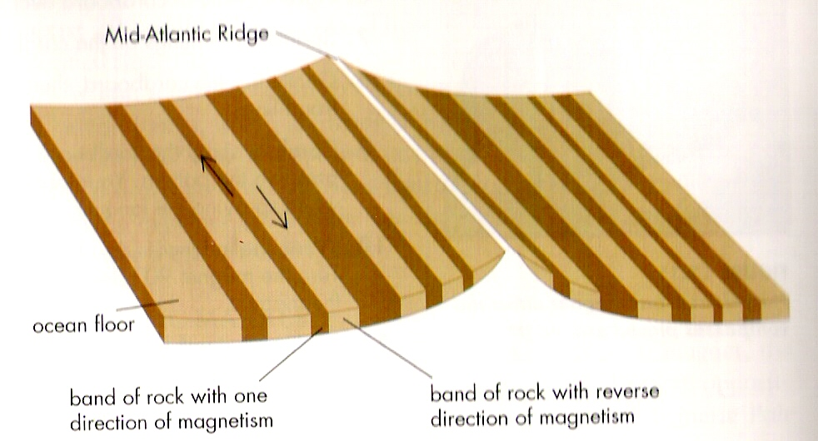
Paleomagnetism: the direction of the Earth’s magnetic polarity experiences a magnetic reversal over thousands of years; these reversals have produced matching bands on either side of the Mid-Ocean Ridge
This evidence suggests that new layers of ocean rocks form at the mid-ocean ridge, and then those layers are then pushed outwards towards in a process called sea-floor spreading
Notes:
skip

Slide 19
Sea Floor Spreading: An Explanation
Hess suggested that magma rose to form new rock at certain places.
Magma (melted rock) rises and falls like warm and cold liquids.
The convection currents of magma formed a spreading ridge where they broke through Earth’s crust.
Like a “new crust” conveyer belt
Magnetic striping of basalt rock shows long stripes of new rock moving away from ocean ridges and also reveals the direction of Earth’s magnetic field at that time.

Slide 20
Theory of Plate Tectonics
J. Tuzo Wilson combined the concepts of sea floor spreading and paleomagnetism to explain continental drift to develop the Plate Tectonic Theory
He proposed chains of volcanic islands such as the Hawaiian Islands formed when a tectonic plate passed over a stationary hot spot.
Geologic Hot spot is an area where molten rock rises to Earth’s surface.

Slide 21
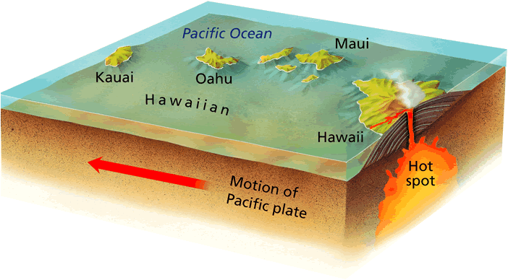

Slide 22
Plate Tectonic Theory
Wilson thought that continents must break up at certain areas, moves across Earths surface and then rejoin.
His hypothesis explained the formation of mountain and ocean basins and the cause of earthquakes and volcanic eruptions.

Slide 23
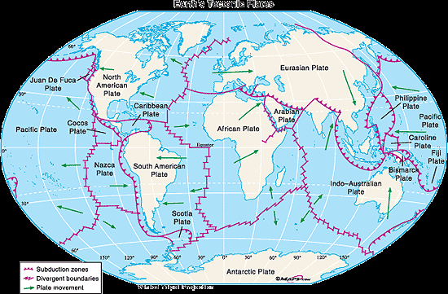
Plate Tectonic Theory:
The Earth’s surface is broken into large plates that move apart, and then rejoin, sliding over hot, plastic rock below.
There are about a dozen major tectonic plates and many smaller ones.

Slide 24
Plate Tectonics: A unifying theory
The theory of plate tectonics explains many of he features and events that take place at and below Earths surface:
Explains how and why sea floor spreading occurs,
How, why, where earthquakes, volcanoes and formation of mountains occur.

