Slide 1
Crime Scene Basics
Forensic Science
T. Trimpe 2006 http://sciencespot.net

Slide 2
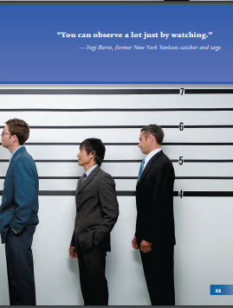

Slide 3
Forensic Science
Forensic Science is the use of science to help solve crimes:
study of blood under a microscope,
analysis of a victim’s stomach contents to see how long he has been dead, and where hey might have eaten his last meal.
Forensic scientists examine and analyze evidence from crime scenes and elsewhere to develop objective findings that can assist in the investigation and prosecution of perpetrators of crime or absolve an innocent person from suspicion.
Notes:
Forensic science is the use of science to help solve questions in a legal sense. Forensic scientists collect, preserve, and analyze scientific evidence during the course of an investigation. While some forensic scientists travel to the scene of the crime to collect the evidence themselves, others occupy a laboratory role, performing analysis on objects brought to them by other individuals. This could involve the study of blood under a microscope, or the analysis of a victim's stomach contents to see how long he's been dead, and where he might have eaten his last meal. There are many other examples. The key point here is the use of SCIENCE. You will learn about many of the scientific principles investigating officers and forensic scientists use on the job, and some of the technologies they use as well.

Slide 4
Learning Goals
Describe what is meant by physical evidence and give examples.
Distinguish individual evidence from class evidence.
Determine the significance of class evidence.
Notes:
The value of indirect and direct evidence in a court of law. •
That eyewitness accounts have limitations. •
What physical evidence can and cannot prove in court. •
That the forensic scientist’s main goal is to fi nd a unique source for the evidence.

Slide 5
key terms
Evidence
Direct evidence
Circumstantial evidence
Class characteristic
Individual characteristics
Locard's Principle of Exchange
probability
chain of custody

Slide 6
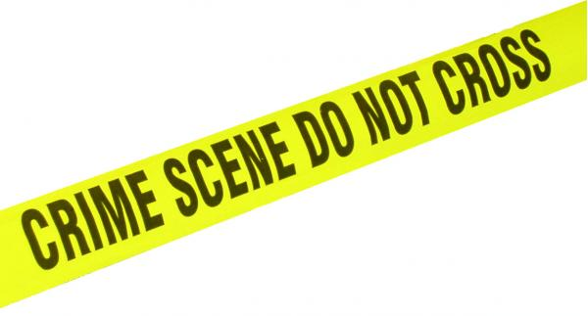
Crime Scene Vocabulary
CRIME SCENE: Any physical location in which a crime has occurred or is suspected of having occurred.
PRIMARY CRIME SCENE: The original location of a crime or accident.
SECONDARY CRIME SCENE: An alternate location where additional evidence may be found.
SUSPECT: Person thought to be capable of committing a crime.
ACCOMPLICE: Person associated with someone suspected of committing a crime.
ALIBI: Statement of where a suspect was at the time of a crime.
Source: http://www3.sc.maricopa.edu/ajs/crime_scene_technician.htm

Slide 7
A Suspect will have:
Motive: A motive is a reason for committing the crime. Possible motives are passion, jealousy, greed, and revenge. Motive is usually determined through interviews and research.
Opportunity: A suspect who can be placed at the scene of the crime, or was able to get to the scene of the crime within a certain time frame, can be said to have had opportunity.
Means: A suspect considered by investigators to have been able to commit the crime can be said to have had means.

Slide 8
Crime Scene Personnel
POLICE OFFICERS are typically the first to arrive at a crime scene. They are responsible for securing the scene so no evidence is destroyed and detaining persons of interest in the crime.
The CSI UNIT documents the crime scene in detail and collects any physical evidence.
The DISTRICT ATTORNEY is often present to help determine if any search warrants are required to proceed and obtains those warrants from a judge.
The MEDICAL EXAMINER (if a homicide) may or may not be present to determine a preliminary cause of death.
SPECIALISTS (forensic entomologists, anthropologists, or psychologists) may be called in if the evidence requires expert analysis.
DETECTIVES interview witnesses and consult with the CSI unit. They investigate the crime by following leads provided by witnesses and physical evidence.
Source: http://science.howstuffworks.com/csi.htm

Slide 9
Specialists
At the morgue, a forensic pathologist examine the body for more evidence and a cause of death.
Among other things, he finds a bullet.
Later at the lab, firearms experts determine the bullet was fired from a gun belonging to the victim’s husband.
A forensic chemist also uncovers traces of fresh gunpowder on the husband’s clothing.
Shoeprints from the scene are also found to match the husband’s.

Slide 10
Who is involved?
You’re hiking through the woods when you come upon the body of a young woman half hidden in the bushes. Her hair is drenched with blood and she isn’t breathing. You call 9-1-1.
What happens next?

Slide 11
Emergency personnel check the victim for signs of life
Police tape off the crime scene and comb the area for evidence.
Coroner arrives and confers the victim is dead.
The body is placed in a long plastic bag and is removed from the crime scene.

Slide 12
CRIME SCENE INVESTIGATION PROCEDURES
Preservation of Life - if there is a victim who is severely injured, that person is helped immediately
Secure the Crime Scene - removing all unnecessary people from the area and creating a physical barrier so the general public cannot enter. Why? This prevents physical evidence from being contaminated (e.g., moved, removed, damaged, or altered). Contaminated evidence may ruin the case.
Identification Officer is called to the scene.
Notes:
There are certain procedures that authorities attending a crime scene must follow. The first priority is preservation of life: if there is a victim who is severely injured, that person is helped immediately. The attending police officers then secure the crime scene. This means removing all unnecessary people from the area and creating a physical barrier so the general public cannot enter. Securing the crime scene prevents physical evidence from being contaminated (e.g., moved, removed, damaged, or altered). Contaminated evidence may ruin the case.

Slide 13
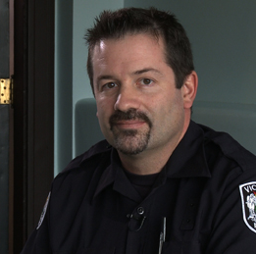
Meet Forensic Specialist
Jonathan Sheldan is an identification officer with Victoria Police Dept.
Performs 4 main duties:

Slide 14
IDENTIFICATION OFFICER’S DUTIES:
Duty #1 Ensure the Crime Scene is Secure.
Make sure the area has been properly secured by the first attending police officers.
May need to widen or reduce the area that needs to be sealed off.
No one can enter or leave this secure area unless Identification Officer says so.
https://media.openschool.bc.ca/assets/k12/science/forensics/videos/js_csi.mp4
Notes:
When Jonathan arrives at the crime scene, the first thing he does is make sure the area has been properly secured by the first attending police officers. Sometimes Jonathan will instruct these officers to widen or reduce the area that needs to be sealed off. No one can enter or leave this secure area unless Jonathan says so.

Slide 15
Duty#2: Search Crime Scene
According to Locard's principle of exchange, a suspect always leaves physical evidence at a crime scene.

Slide 16
Locard’s Principle: Trace Evidence
Wherever he steps, whatever he touches, whatever he leaves, even unconsciously, will serve as a silent witness against him.
Not only his fingerprints or his footprints, but his hair, the fibers from his clothes, the glass he breaks, the tool mark he leaves, the paint he scratches, the blood or semen he deposits or collects.
All of these and more, bear mute witness against him.

Slide 17
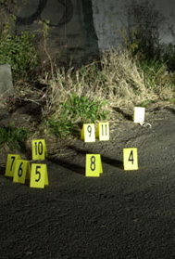
Duty#2: Search Crime Scene
After the crime scene is properly secured, an identification officer like Jonathan does a thorough visual search for that evidence.
Physical evidence may include things like tire tracks, gunshot residue, drugs, blood, or hair.
Location of each piece of evidence is marked with a numbered card:
Notes:
An identification officer will be removed from the case if he or she is connected to it in any way (e.g., knows the victim).

Slide 18
Did you know?
An identification officer will be removed from the case if he or she is connected to it in any way (e.g., knows the victim).
Why?

Slide 19
Duty #3: Document the Evidence
Take photographs, draw sketches, write detailed notes, and shoot video.
  Creates a detailed record of the crime scene.
  Allows the forensics lab to visualize the crime scene accurately.
  Allows the courts to visualize the crime scene accurately.
  Shows where evidence was found and where it was in relation to other pieces of evidence.
  https://media.openschool.bc.ca/assets/k12/science/forensics/videos/js_collection.mp4
Notes:
Next, Jonathan thoroughly documents each piece of evidence. To do this he takes photographs, draws sketches, writes detailed notes, and shoots video. It is important that Jonathan properly document the crime scene for several reasons:

Slide 20
Duty #4: Collect and Preserve the Evidence
Collect the evidence Into containers to preserve it.
Wear gloves
Label each container with a detailed description of what the evidence is and when and where it was found.
Writes name on the container so other people will know who collected it.
ID Officer may analyze some of this evidence or send the rest to the forensics lab for testing.
Notes:
Next, Jonathan puts on disposable gloves and carefully collects the evidence. He places the evidence in containers to preserve it. Jonathan labels each container with a detailed description of what the evidence is and when and where he found it. Jonathan also writes his name on the container so other people will know that he collected it. Jonathan may analyze some of this evidence himself. He will send the rest of it to the forensics lab for testing.

Slide 21
CHAIN OF CUSTODY
The collection of evidence begins a process called the chain of custody.
The chain of custody is a written, witnessed record that describes:
  WHO handled the evidence.
  WHEN each person handled it (date and time).
  WHY the evidence was handled.
  WHAT changes, if any, were made to the evidence from the time it was collected until the time it is presented in court.

Slide 22
Chain of Custody – why it’s important
Establishes proof that the evidence that is collected is the same evidence that is presented later in a court of law.
If the chain of custody is not maintained, the defense might argue that somebody could have tampered with the evidence.
The judge will then generally rule that this evidence cannot be used.
https://media.openschool.bc.ca/assets/k12/science/forensics/videos/js_custody.mp4

Slide 23
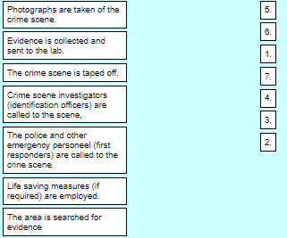
Place these in order
Notes:
Call police
Preservation of life:
Secure – tape off
Call in ID
Search, Photo,
Bag and tag
EF C D GAB

Slide 24
Crime Scene Protocol
Step 1: Interview
The first step in investigating a crime scene is to interview the first officer at the scene or the victim to determine what allegedly happened, what crime took place, and how was the crime committed. This information may not be factual information but it will give the investigators a place to start.
Step 2: Examine
The second step in the investigation of a crime scene, which will help identify possible evidence, identify the point of entry and point of exit, and outline the general layout of the crime scene.
Step 3: Document
The third step in the protocol involves creating a pictorial record of the scene as well as a rough sketch to demonstrate the layout of the crime scene and to identify the exact position of the deceased victim or other evidence within the crime scene.
Step 4: Process
This is the last step in the protocol. The crime scene technician will process the crime scene for evidence, both physical and testimonial evidence. It is the crime scene technicians responsibility to identify, evaluate and collect physical evidence from the crime scene for further analysis by a crime laboratory.
https://www.youtube.com/watch?v=JgzdhUAJrBA
Adapted from http://www.feinc.net/cs-proc.htm

Slide 25
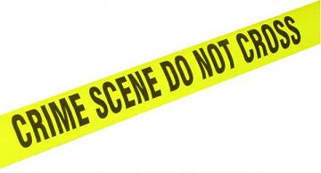
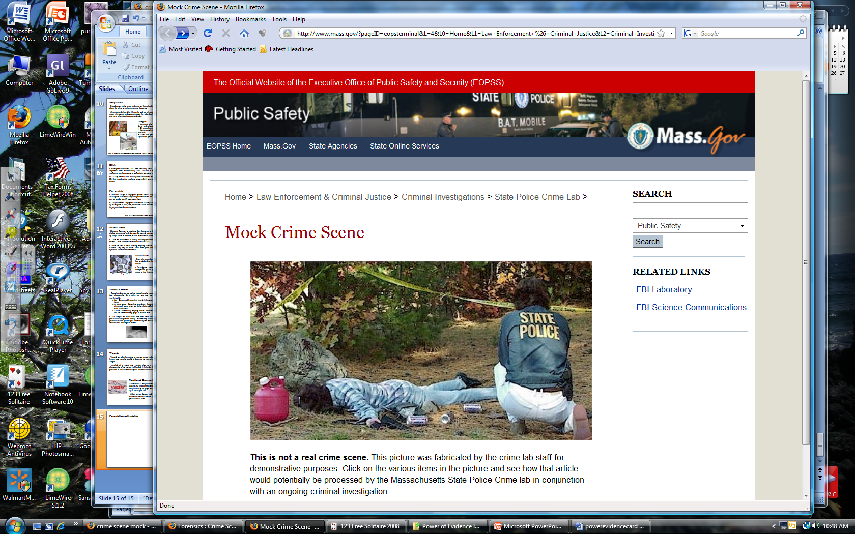
What evidence would you collect?
Mock Crime Scene: http://www.masss.gov

Slide 26
Direct Evidence Circumstantial Evidence
eyewitness accounts, police videos, and confessions.
any type of physical, chemical, or biological evidence that links a suspect to a crime.
Sometime referred to as "physical evidence".

Slide 27
Is one better than the other?
In court, more weight is obviously given to direct evidence.
However, if enough circumstantial evidence can be gathered that points to one suspect, then it's possible the judge or jury can be convinced that the suspect is guilty.

Slide 28
Eyewitness
Eyewitness accounts can provide important evidence leading to the arrest of a criminal.
Juries are heavily influenced by eyewitness identification.
How accurate are eyewitnesses?
What might influence their accuracy?

Slide 29
What could affect Accuracy of Eyewitness?
  The crime scene may have been too dark,
  the encounter may have been too brief, or the
  presence of a weapon may have diverted the eyewitness’s attention.
  The stress and fear involved in witnessing a crime may sharpen some people’s focus and confuse others.
  Errors in the memory process are also common.
  The time between the crime and questioning of the witness can affect what he or she remembers.
  New information can influence memory, as when, for example, viewing mug shots or being asked leading or suggestive questions.
  These kinds of new information can actually change the memory of a witness, even one who is trying to be fair and honest.

Slide 30
Physical Evidence
Physical: weapons, documents, and footprints.
Chemical: drugs, gun powder residues, and other chemicals
Biological: blood, body fluids, DNA, plant matter.

Slide 31
Physical Evidence
Can prove a crime has been committed
Can help establish the identity of victim or suspect
Can connect a suspect or victim to the crime scene
Is more reliable than eyewitness testimony
○ Can support a suspect’s or victim’s story or…
○ Contradict information provided to investigators

Slide 32
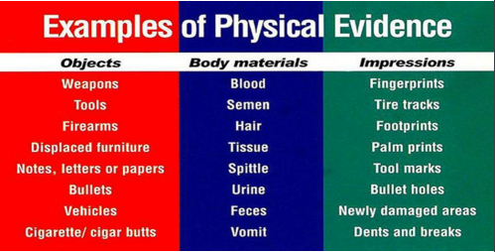

Slide 33
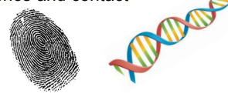
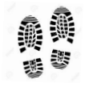
Physical Evidence:
Individual Evidence
Evidence unique to one specific person
Establishes a single source of evidence and contact
Class Evidence
Evidence that is not unique to a single person or source
Can still help to group evidence and narrow down suspect list

Slide 35
Use the chart to the right to answer the following questions
1. Which of the examples in the chart would lead investigators to exactly one suspect?
2. Which of the examples would lead to a lot of suspects if found by a crime scene investigator?

Slide 36
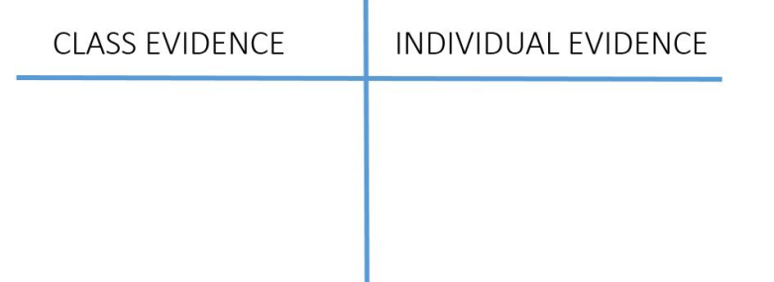
Fill in the T-chart, indicating which evidence are class evidence and which types are individual evidence..

Slide 37
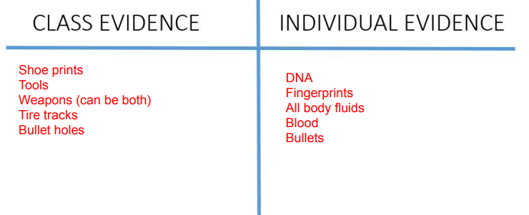

Slide 38
1. Fingerprints, Palm Prints, blood, semen, spittle, bullets
2. Tire tracks, dents and breaks, bullet holes, tools, weapons

Slide 39
Physical Evidence is further classified
Circumstantial Evidence links someone to the crime, but it doesn't prove they did it.
Notes:
In the Mayberry crime, a bullet removed from the victim's body matched ones from her husband's gun. While this may suggest the husband shot her, it doesn't prove it. The evidence is circumstantial because someone else may have fired the gun.

Slide 40
Probability
used to determine the likelihood that certain evidence can be linked to a person or place.

Slide 41
Example
Witnesses report seeing a person wearing a blue shirt and driving a green car a parking lot cause an accident and then run into a nearby store.
Police arrive and note the following: 1 in 10 cars in the parking lot are green, 1 in 3 people in the store are wearing blue shirts, and there are 100 people in the store.
The probability of these three circumstances occurring together are the product of their total probabilities meaning that only 1 in every 3000 people would be in the store AND have a green car AND be wearing a blue shirt.
(1 x 10 x 3 x 100)

Slide 42
Identify 6 procedural errors in the following crime scene
Murder on Mayberry Street

Slide 43
Murder on Mayberry Street
An identification officer is called to the scene of a murder at 231 Mayberry Street. As he pulls up, he realizes it's the home of his daughter's best friend. The officer rushes in and goes to her body. He checks her pulse, but she's dead. She's lying on her side, so he turns her over to see if there's any evidence on her. He notices that she's been shot in the neck. The officer covers her with a blanket, then proceeds to look around the room. He finds a bullet casing, but doesn't touch it. As he bends down to look at it, he notices a gun lying under the dining room table. Carefully, he puts a pen in the muzzle and lifts it up, making sure that he doesn't touch the gun with his fingers. The officer returns the gun to its original position then sits down on the couch to wait for his boss, who will likely be in charge of the investigation.
Notes:
Identify 6 procedural errors

Slide 44
Three Big Investigative Errors
Failing to identify and collect all the available evidence and information,
Failing to effectively analyze the evidence and information collected to identify suspects and form reasonable grounds to take action, and
Becoming too quickly focused on one suspect or one theory of events and ignoring evidence of other viable suspect or theories that should be considered.

Slide 45
Practice
Evidence and Procedures Worksheet

Slide 46
Chain of Custody
https://youtu.be/IGPZy_P8KsU
1.5 mi
Need something better
http://cms.gavirtualschool.org/Shared/Science/ForensicScience/03%20Forensic%20Evidence/index.html
Continue here

Slide 47
More Practice
Why is it important to find physical evidence at a crime scene (and not just rely on human testimony)?
What types of evidence are going to be most important, if trying to verify who was at a particular location?
Is class evidence useful? Explain.
Give an example of a piece of evidence that can sometimes be class evidence, but sometime individual.

Slide 48
Answer
Why is it important to find physical evidence at a crime scene (and not just rely on human testimony)? Eyewitness accounts are not always 100% reliable. Also, suspects and victims can be dishonest about what occured. Physical evidence cannot be disputed, it is either present or not.
2. What types of evidence are going to be most important, if you were trying to verify who was at a particular location? If attempting to verify that a particular person was at a particular location, individual evidence would be best. Usually this would include some type of evidence that contains DNA. Hair root, blood, spit, etc.would all be examples of this.
3. Is class evidence useful? Explain. YES!!! It still can help us narrow down our suspect list or rule out certain individuals.
4. Give an example of a piece of evidence that can sometimes be class evidence, but sometimes individual. There are many types of evidence that can be both. Sometimes this depends on the actual details of the evidence. For example, a shoe print, if found in mud in PERFECT conditions to leave an impression, could leave details that show individual markings on the bottom of that shoe. Normally, a shoeprint would only be able to tell you the size of the shoe, make, and model of the shoe.

Slide 49
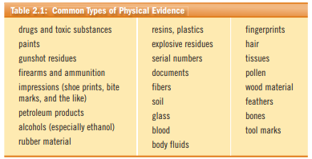
Notes:
Perhaps the earliest recorded analysis of physical evidence took place when Archimedes (287–212 BC) was consulted by the Greek king, who suspected that some of his wealth was made of an alloy rather than pure gold.

Slide 50
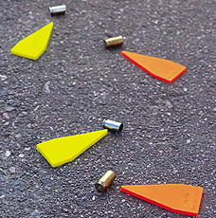
What will evidence collected at a scene do for the investigation?
May prove that a crime has been committed
Establish key elements of a crime
Link a suspect with a crime scene or a victim
Establish the identity of a victim or suspect
Corroborate verbal witness testimony
Exonerate the innocent.
Give detectives leads to work with in the case
Source: http://www3.sc.maricopa.edu/ajs/crime_scene_technician.htm

Slide 51
Investigating the Evidence
Forensic Science disciplines at the
Illinois State Police Crime Labs
Drug Chemistry – Determines the presence of controlled substances and the identification of marijuana
Trace Chemistry - Identification and comparison of materials from fires, explosions, paints, and glass.
Microscopy – Microscopic identification and comparison of evidence, such as hairs, fibers, woods, soils, building materials, insulation and other materials.
Biology/DNA – Analysis of body fluids and dried stains such as blood, semen, and saliva.
Toxicology – Tests body fluids and tissues to determine the presence of drugs and poisons.
Latent Prints - Identification and comparison of fingerprints or other hidden impressions from sources like feet, shoes, ears, lips or the tread on vehicle tires.
Ballistics (Firearms) – Study of bullets and ammunition through the comparison of fired bullets, cartridges, guns, and gunpowder patterns on people and objects.
Toolmarks – Examines marks left by tools on objects at a crime scene or on a victim, such as a hammer used to break a door or a screwdriver used to pick a lock.
Questioned Documents - Examination of documents to compare handwriting, ink, paper, writing instruments, printers, and other characteristics that would help to identify its origin.
Source: http://www.isp.state.il.us/forensics/

Slide 52
Check your Understanding
The essential questions for this module are as follows:
What is the difference between direct and circumstantial evidence?
Are some types of evidence more valuable than others?
Can the significance of evidence be calculated?
In what ways are fingerprints developed, stored and used in solving crimes?
Why are fingerprint unique to each individual?
What information can a victim provide to a forensic investigation after death?
Why are insects sometimes referred to as "the first witness"?

Slide 53
Want more info?
https://pressbooks.bccampus.ca/criminalinvestigation/chapter/chapter-1-introduction/

Slide 54
Class vs Individual evidence
Class characteristics would consist of treads on new tires or shoes, blood types, and unused bullets.
Class: https://youtu.be/rX0zbPKWU_Q
2.5min
https://youtu.be/bpLZ6bL-hf0
Individual characteristics include DNA evidence, fingerprints, and striation marks on bullets that have been fired.

Slide 55
Dr. Edmond Locard established the idea of the exchange principle which states that when contact occurs between two items, there will always be a transfer of evidence which could be used to link an individual to a crime.

Slide 56
Want more info?
https://pressbooks.bccampus.ca/criminalinvestigation/chapter/chapter-1-introduction/

