Slide 1
Matter Unit
What is matter?
How can we describe matter?
BC Science 8 Text p246-249

Slide 2
What is matter?
How would you classify the following images?

Slide 3
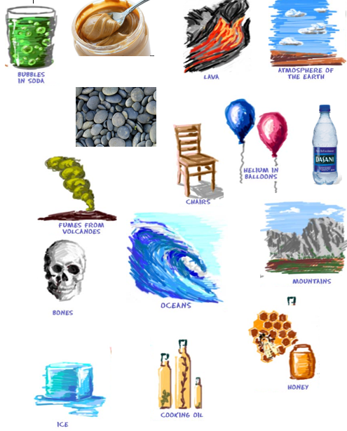
Notes:
How do we define Matter? What IS Matter?

Slide 4
What is matter?
Any substance that has mass and volume.
A substance is s kind of matter with uniform (same ) properties
Mass is the amount of matter in a substance or object.
Volume is the amount of space matter takes up.
Matter: https://www.youtube.com/watch?v=ELchwUIlWa8
Notes:
What happens when you light a candle?

Slide 5
What isn’t matter?
Notes:
What isn’t matter? Think of a candle. Then think of a lit candle.
What happens when you light a candle?

Slide 6
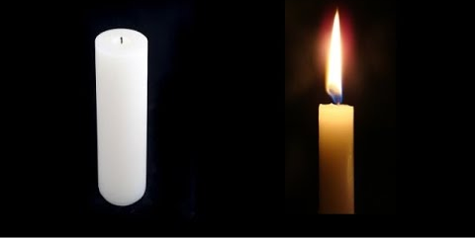
What isn’t matter?
What isn’t matter? Think of a candle. Then think of a lit candle.
Notes:
What happens when you light a candle?

Slide 7
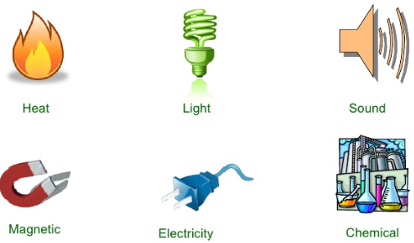
What isn't matter?
ENERGY has no mass and no volume
Eg. Light, heat, sound.
Notes:
Candle demo
Everything in the universe is either matter or energy.

Slide 8
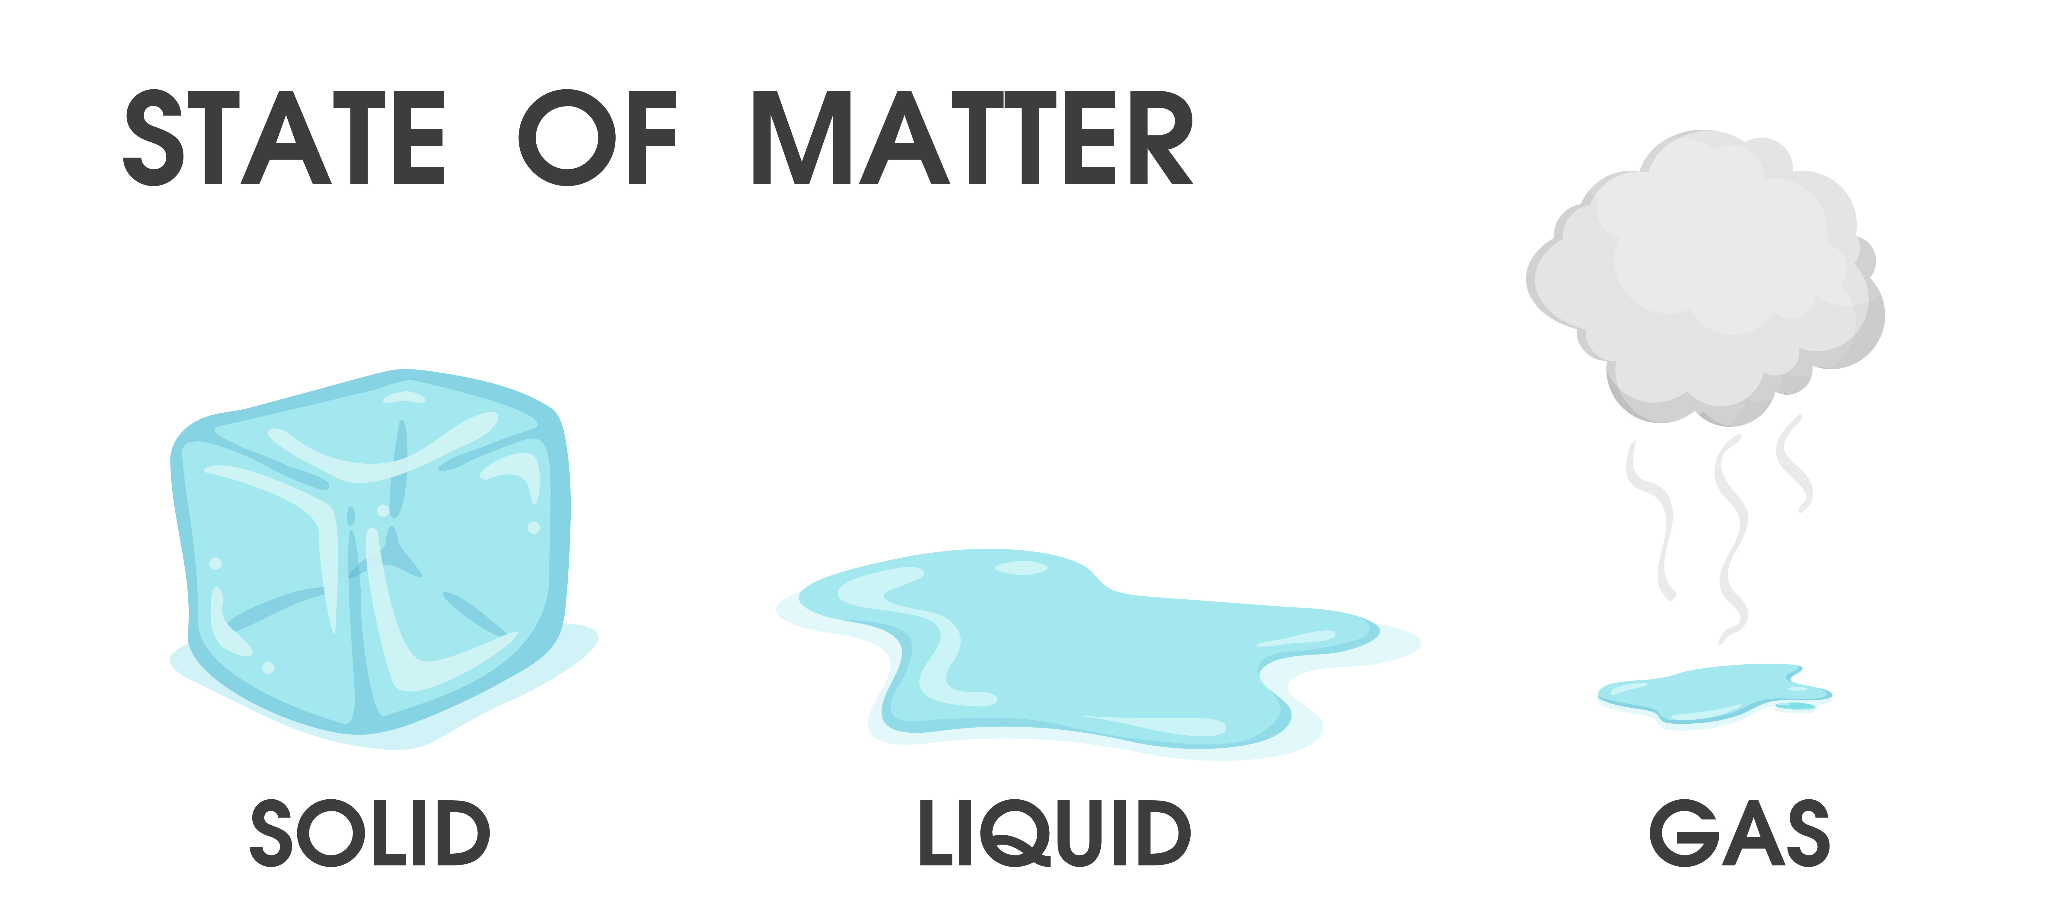
Matter exists in different STATES

Slide 9
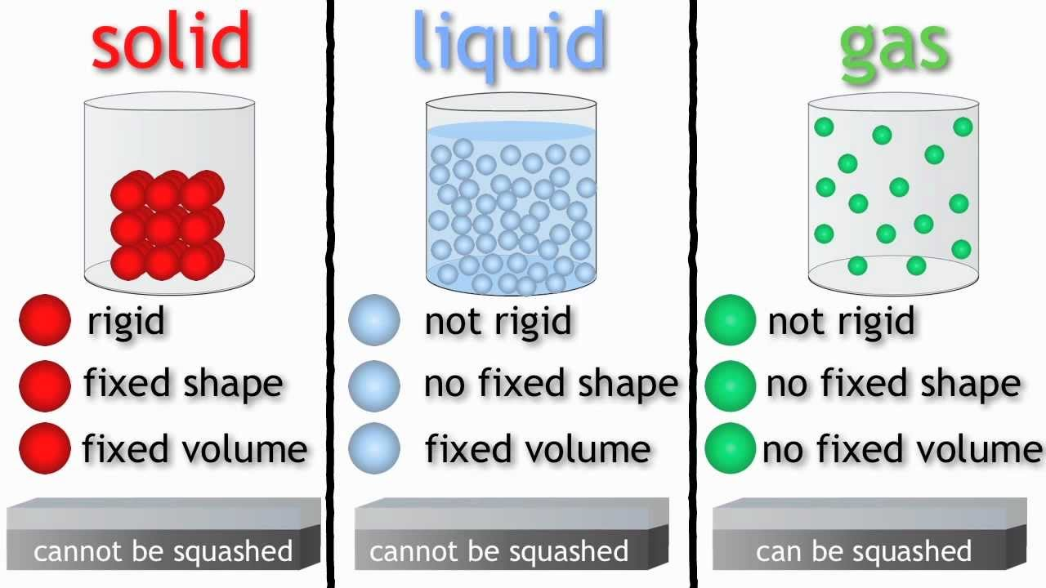
Solids
  Hold theirs shape
  Has a constant or fixed volume (amount of space it takes up)
  Examples: wood, silver, stone, plastic
  can be hard like a rock, soft like fur, a big rock like an asteroid, or small rocks like grains of sand.

Slide 10
Liquids
  Take the shape of its container
  Has a constant volume ( can not be squished into smaller space)
  Examples: oil, juice, antifreeze, gasoline

Slide 11
Gas
  Takes the shape of container
  No fixed volume – takes volume of container, not dependent on gravity
  Can be compressed (squished into smaller space)
  Examples: air, helium, hydrogen

Slide 12
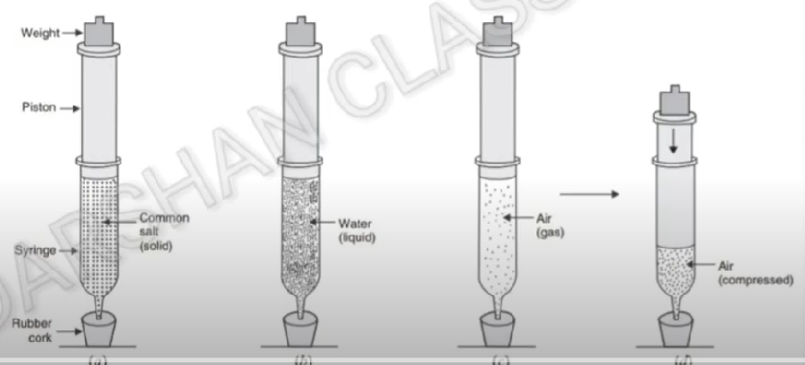
a

Slide 14
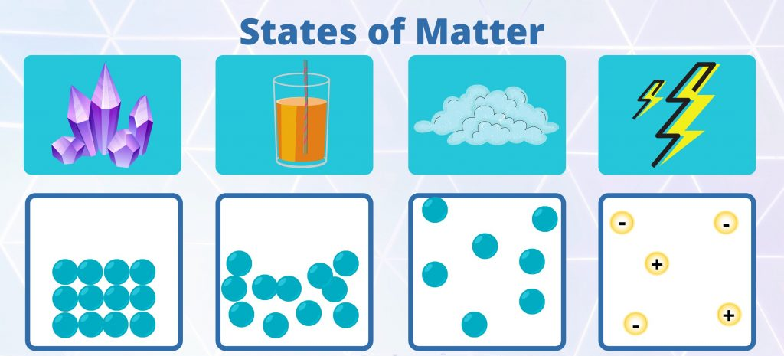
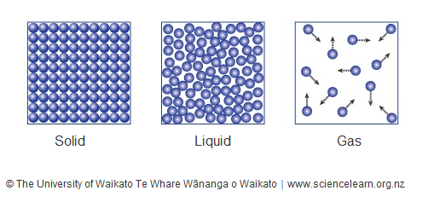
There is actually a fourth state of matter: Plasma

Slide 15
The Fourth State: Plasma
  Does not have a defined shape and volume (similar to gas)
  Have different electrical properties than gases
  Examples: the Sun; visible fork of a lightening bolt; glowing gas of a neon sign

Slide 16
Discussion Questions
Gives two examples of solids, liquids, and gases.
Which state of matter does plasma most resemble and why?

Slide 17
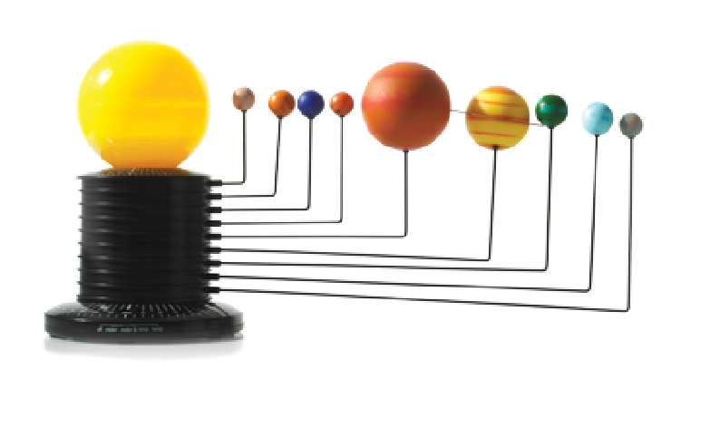
Models of Matter
Science uses models to explain behaviour, especially of things that are hard to see because they are too small or too BIG
A MODEL is a verbal, mathematical, or visual representation of a scientific structure or process
Notes:
Model – simple depiction
Theory – scientifically studied concept that in most cases has been researched and proven

Slide 18
Models and Theories
A model can be used to develop a THEORY
Figure 2.14: A model of the Sun and planets.
Notes:
model: a verbal, mathematical, or visual representation of a scientific structure or process

Slide 19
Models and Theories
Theory:
  A scientific explanation that has been supported by consistent, repeated experimental results
  Can be modified if new experimental data arise
  Never considered to be proven
  What is the difference between a model and a theory?
Notes:
theory: a scientific explanation that has been supported by consistent, repeated experimental results

Slide 20
Modelling Matter Demo
What is 1 + 1?
100 + 100 = ?
100 mL sand + 100 mL sand = ?
100 mL marbles + 100 mL sand = ?
Write down your predictions at the bottom of your page

Slide 21
Demo
What is 1 + 1?
100 + 100 = ?
100 mL sand + 100 mL sand = ?
100 mL marbles + 100 mL sand = ?
100 mL water + 100 mL sand =

Slide 22
Demo
What is 1 + 1?
100 + 100 = ?
100 mL sand + 100 mL sand = ?
100 mL marbles + 100 mL sand = ?
100 mL water + 100 mL sand =
100 mL water + 100 mL sand + 100 mL marbles =

Slide 23
Debrief

Slide 24
Kinetic Molecular Theory of Matter (KMT):
1. All matter is made up of very small particles
Notes:
2. Different substances have different particles.
5. The attraction between particles decreases with an increase in distance.

Slide 25
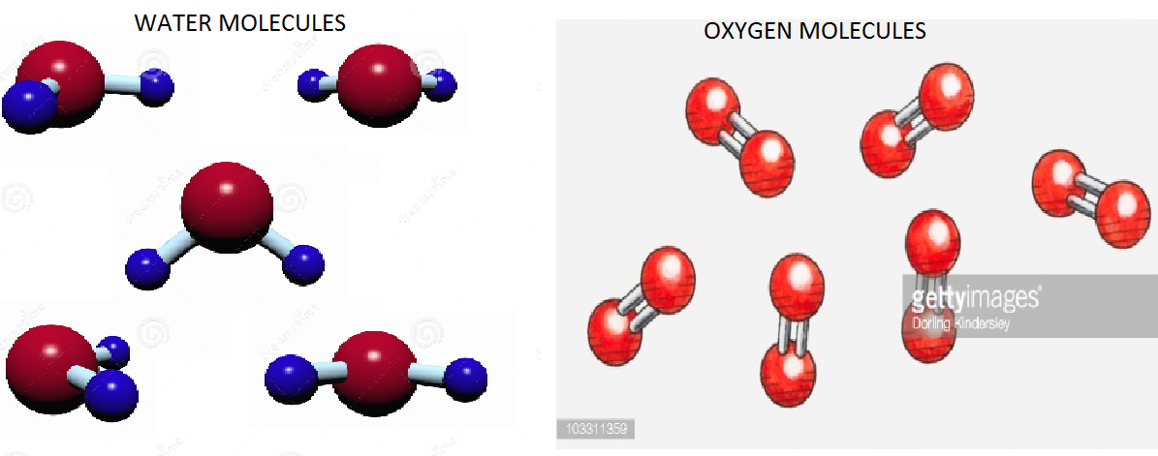
Example
All the water molecules are the same, but are different than the oxygen molecules

Slide 26
Kinetic Molecular Theory of Matter (KMT):
1. All matter is made up of very small particles
2. There are spaces between the particles.
3.
Notes:
2. Different substances have different particles.
5. The attraction between particles decreases with an increase in distance.

Slide 27
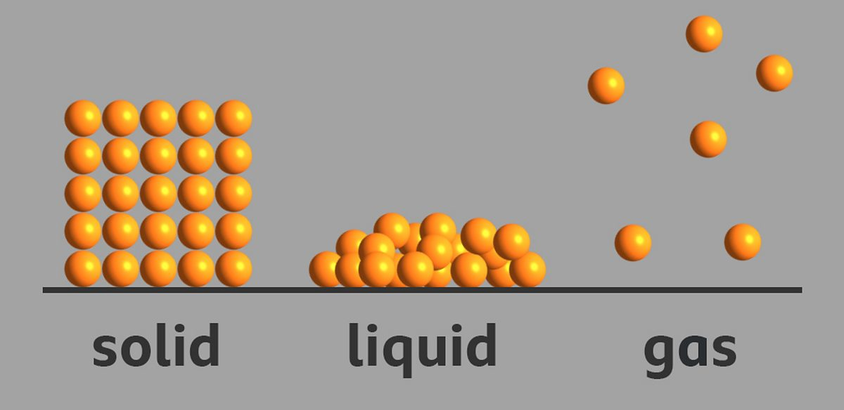
KMT
2. There are spaces between the particles.
The amount of space between the particles is different for different states of matter.
Eg. Gases have more space between particles than solids.

Slide 28
Kinetic Molecular Theory of Matter (KMT):
1. All matter is made up of very small particles (pieces)
2. There are spaces between the particles.
3. The particles are always moving (in constant motion)
Notes:
2. Different substances have different particles.
5. The attraction between particles decreases with an increase in distance.

Slide 29
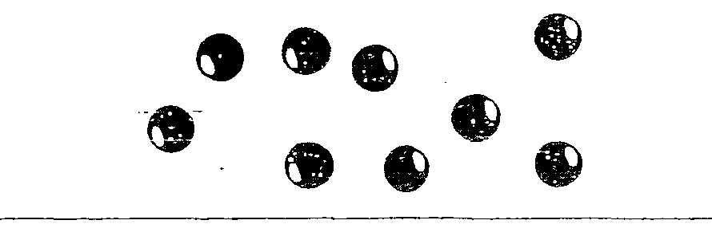
KMT
3. Particles are always moving.

Slide 30
Particles are in constant motion
Gas particles move more than particles solids

Slide 31
Kinetic Molecular Theory of Matter (KMT):
All matter is made up of very small particles
Different substances have different particles.
2. There are spaces between the particles.
3. The particles are always moving (in constant motion)
4. The particles move because they have Energy. The more energy the particles have, the faster they move.
Kinetic Energy is the energy of motion.
Notes:
2. Different substances have different particles.
5. The attraction between particles decreases with an increase in distance.

Slide 32
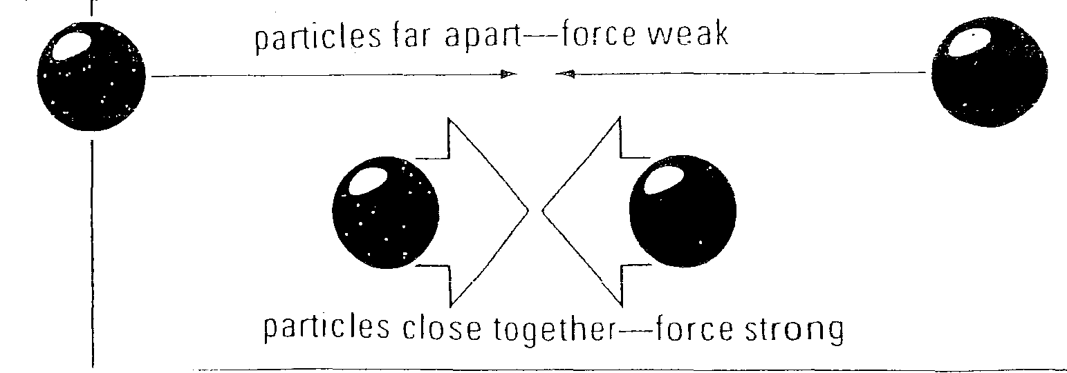
Principals of the Particle Theory of Matter
5. Particles attract each other. The forces of attraction are stronger when the particles are closer together.
Notes:
The strength of the attraction depends on the particle.

Slide 33
Kinetic Molecular Theory of Matter (KMT):
1. All matter is made up of very small particles
2. There are spaces between the particles.
3. The particles are always moving (in constant motion)
4. The particles move because they have Energy. The more energy the particles have, the faster they move.
Notes:
2. Different substances have different particles.
5. The attraction between particles decreases with an increase in distance.

Slide 34
Principals of the Particle Theory of Matter
5. Particles attract each other. The forces of attraction are stronger when the particles are closer together.
Notes:
The strength of the attraction depends on the particle.

Slide 35
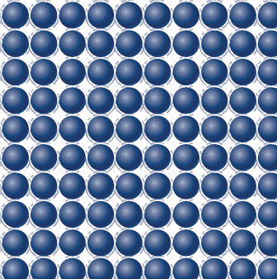
Solids
  Particle spacing: Tightly packed (very close together)
  Particle Movement: Vibrate but do not move around
  Energy: Low amount of energy
  Attractive Forces: Strong
Figure 2.15: Particles in a Solid

Slide 36
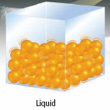
Liquids
Particles are still close together but slightly farther apart than in solids.
Particles can slide past each other.
have slightly more energy than solids
Attractive forces: less than solids but more than gasses

Slide 37
GASES
Very far apart.
Particles have more energy than solids and liquid and therefore are more spread out than in liquid
Very little attraction between particles
Gases can fill a container of any size or shape and is NOT dependent on gravity
Eg. Atmosphere, oxygen

Slide 38
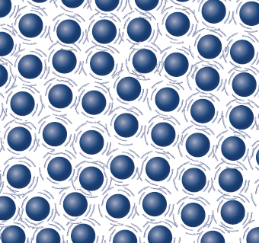
Check your understanding: Be able to:
Describe the particles of the three states of matter in terms of how they move and the spaces between them.
It is easy to compress (reduce the volume of) a gas, but solids and liquids cannot be compressed very much.
Use the KMT to explain why.

Slide 39
Check your understanding
In what ways does a model differ from a theory?
Summarize the kinetic molecular theory of matter.

Slide 40
Practice
KMT and states of Matter WS

Slide 41
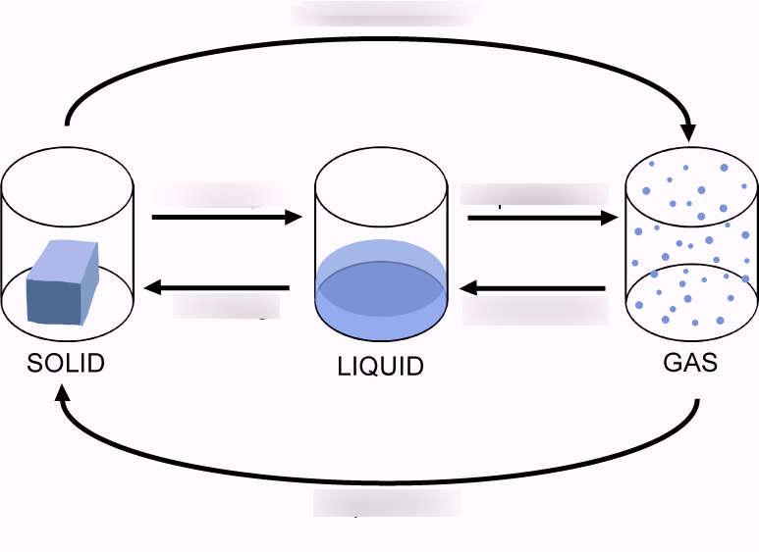
Matter changes state

Slide 42
Changing States of Matter

Slide 43
Changing States of Matter
When matter changes state it is call a phase change
Chemical structure does not change
E.g. Water is H2O regardless if it is solid, liquid, gas

Slide 44
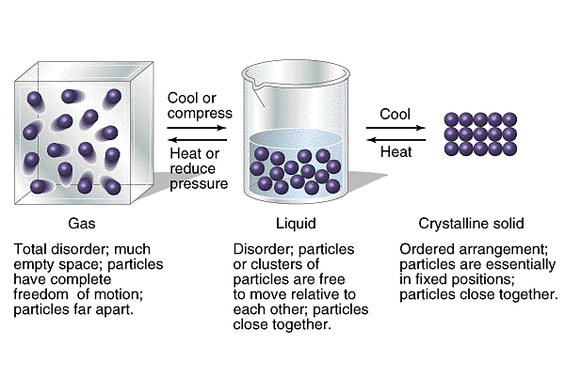
Label your diagram

Slide 45
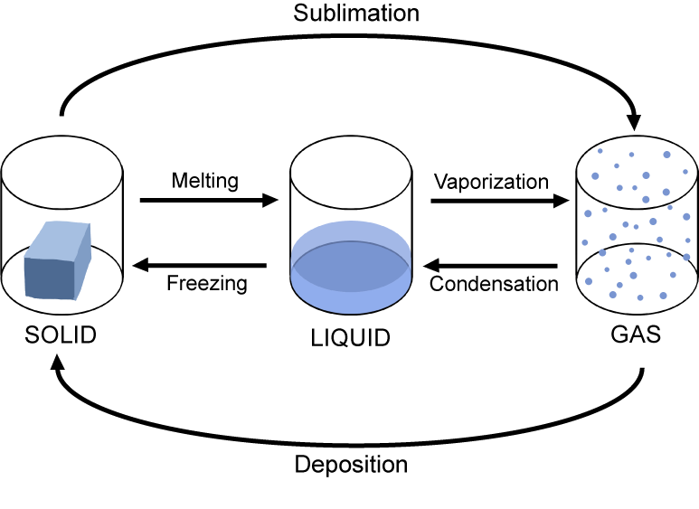

Slide 46


Condensation (to condense). Vapor → liquid

Slide 47
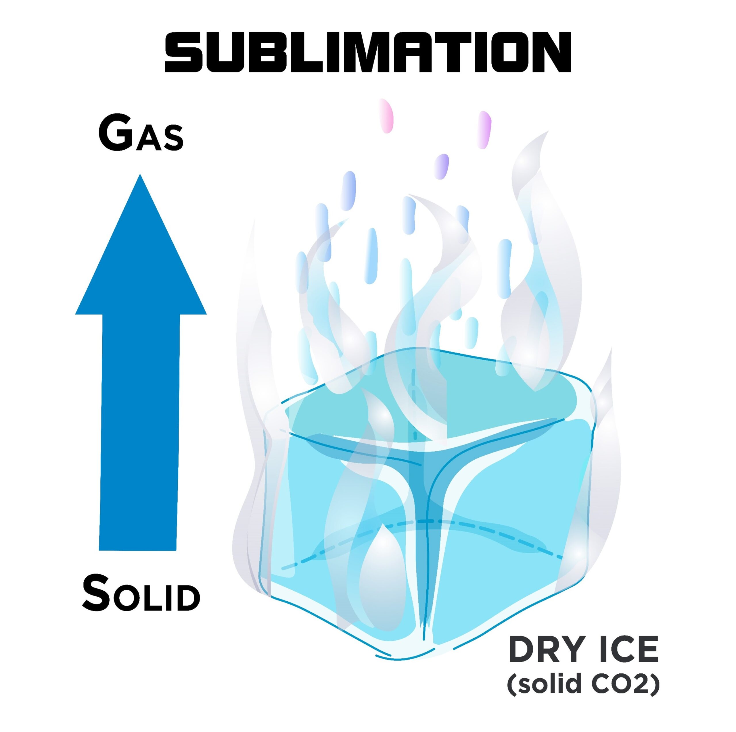
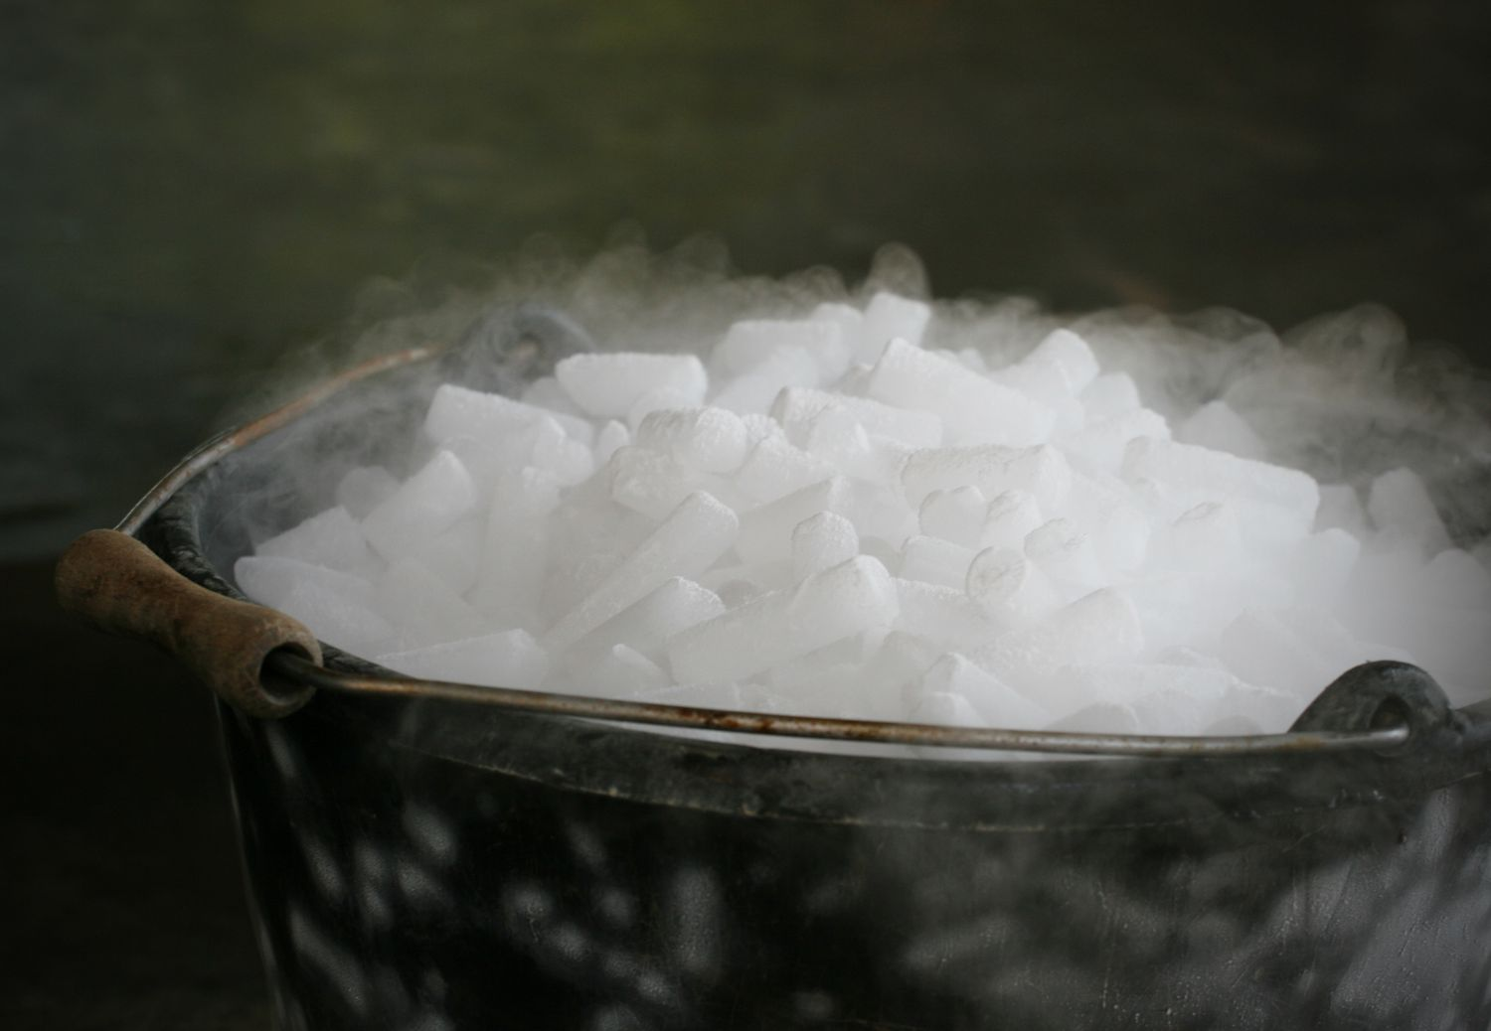
Sublimation: solid → gas

Slide 48
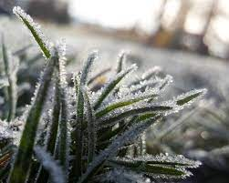
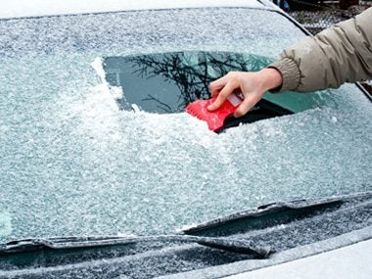
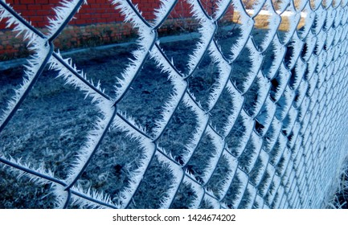
Deposition: Vapor → Solid
Frost on grass, windshield, fence

Slide 49
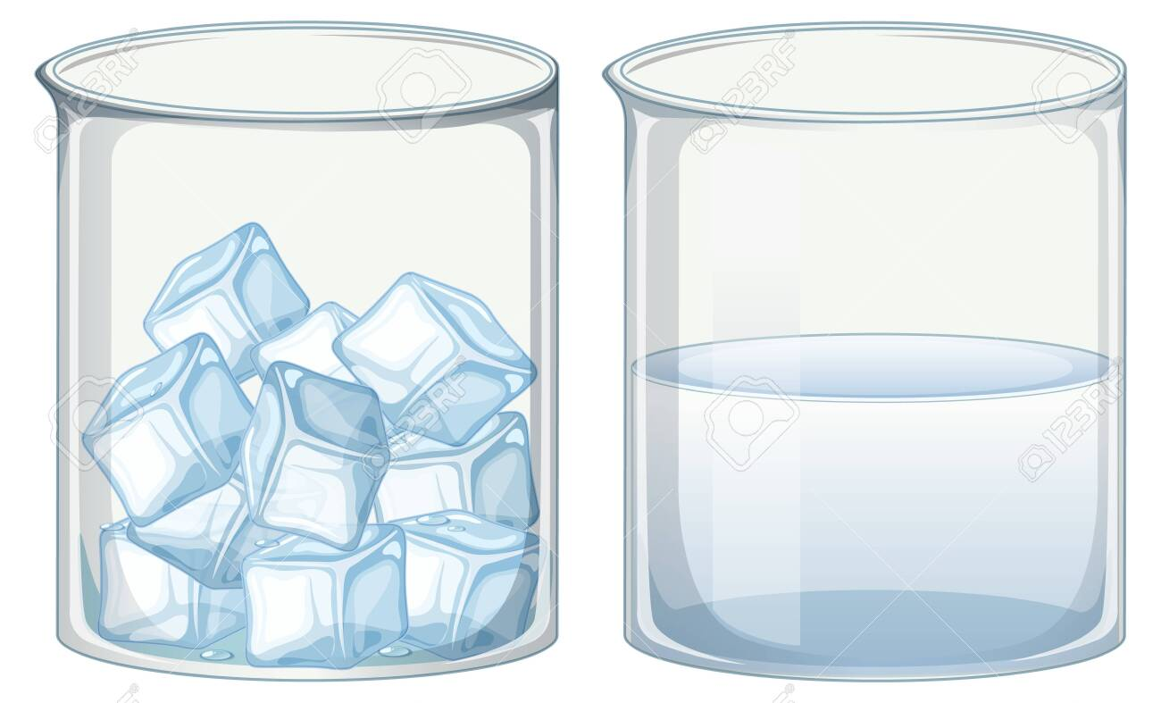
Matter changes state when energy (like heat) is added or removed:
To change solid → liquid, we add heat.
Notes:
Draw flame under ice, draw arrow from ice to water, label solid, liquid
https://www.youtube.com/watch?app=desktop&v=cX4X9-f3_OA

Slide 50
Matter changes state when energy/heat is added or removed:
To change from liquid → solid, we remove heat (cool the substance)

Slide 51
Check your understanding
What happens to the particles in matter when energy (heat) is ADDED?
Move ___________________
Attractive forces between particles _________________, allowing particles to ___________________
Spaces between particles get ___________________
Volume ____________________

Slide 52
Check your understanding
What happens to the particles in matter when energy (heat) is ADDED?
Move faster
Attractive forces between particles weaken
allowing particles to move farther apart
Spaces between particles get bigger
Volume increases

Slide 53
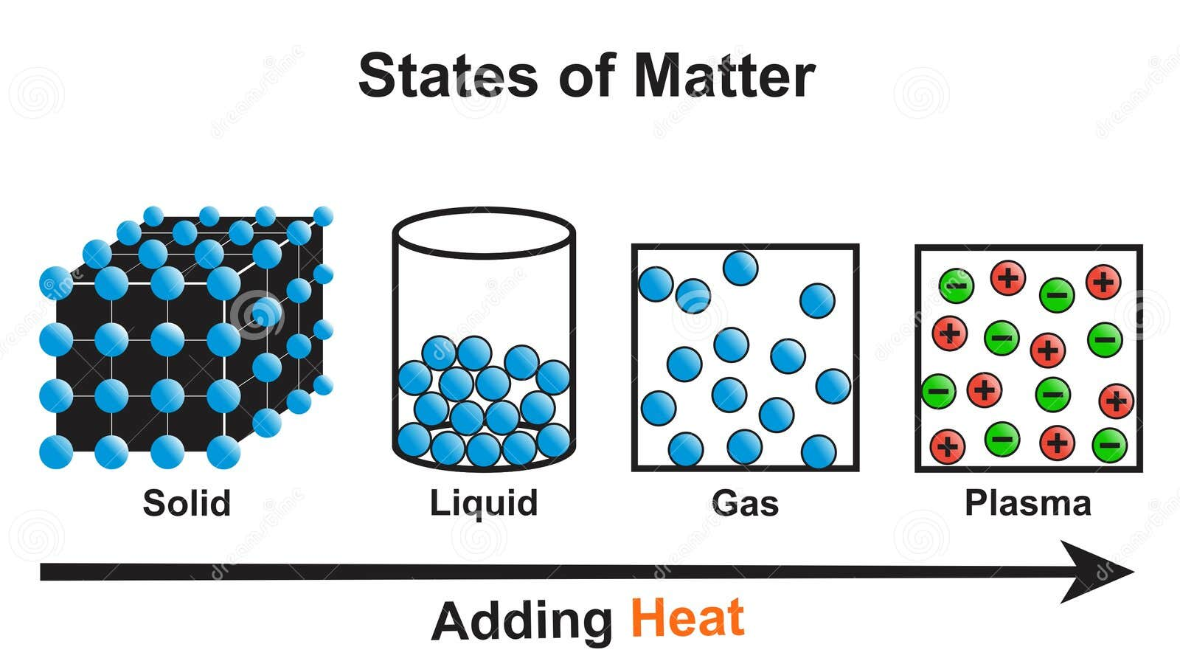

Slide 54
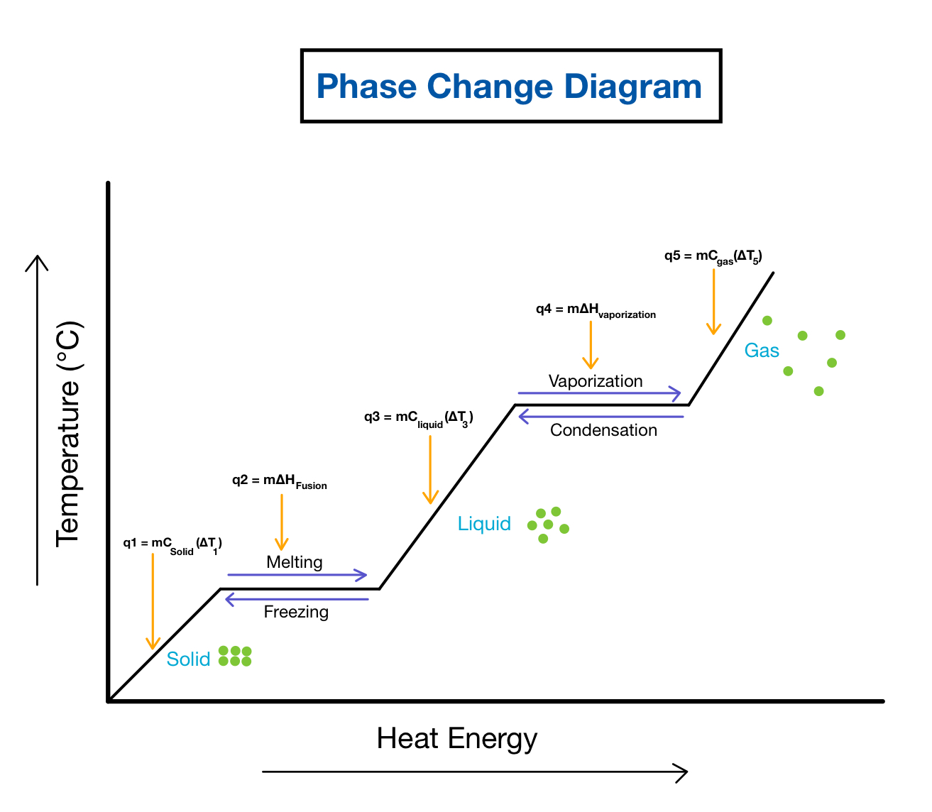

Slide 55
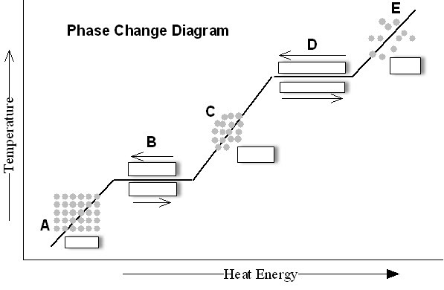
Check your understanding
Name the term for moving from A→C
E→ C
C → E
A → E

Slide 56
Practice
Change in state WB p81-82

Slide 57
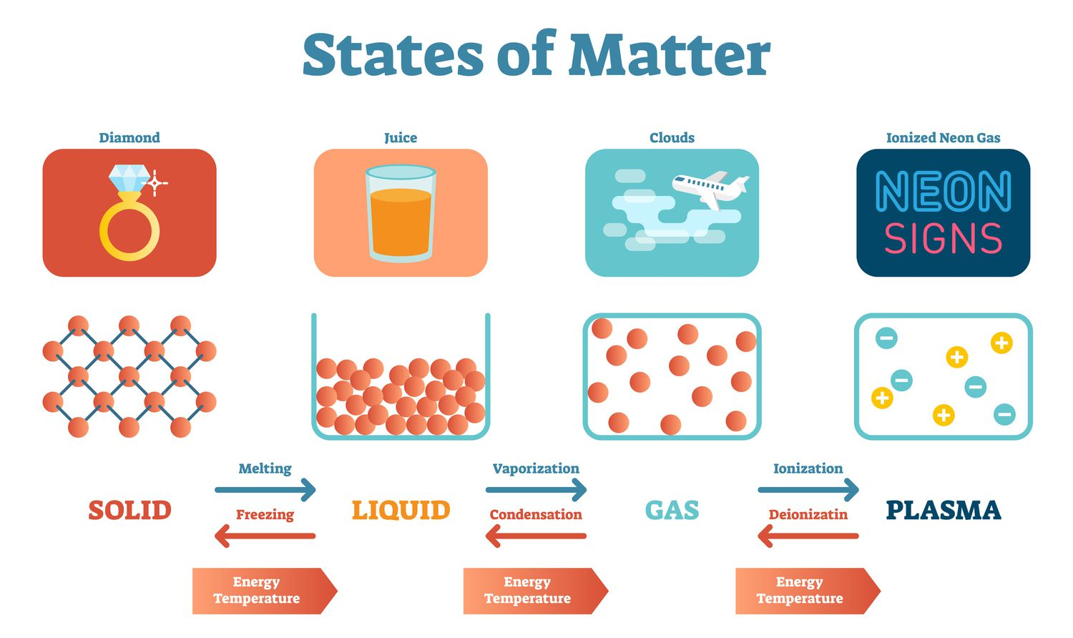
Matter exists in different states or phases:
Solid Liquid Gas Plasma

Slide 58
Topic 2.3: How can we describe and explain the states of matter?
The skier shown here is experiencing water in all of its forms:
  Drinkable liquid (water)
  Skiable solid (snow)
  Invisible gas that he breathes in an out (air)
Why does water in its different states (solid, liquid, gas) have such different properties?
Notes:
physical property:

Slide 60
Discussion Questions
In what ways does a model differ from a theory?
Summarize the kinetic molecular theory of matter.

