Slide 1
Measuring Matter
Mass and Volume

Slide 2
THE STUDY OF MATTER
CHEMISTRY is the study of matter, how it is organized and how it behaves

Slide 3
What is matter?
Matter is anything that has
MASS (amount of matter in a substance)
and
VOLUME (amount of space matter takes up)
What isn’t matter?

Slide 4
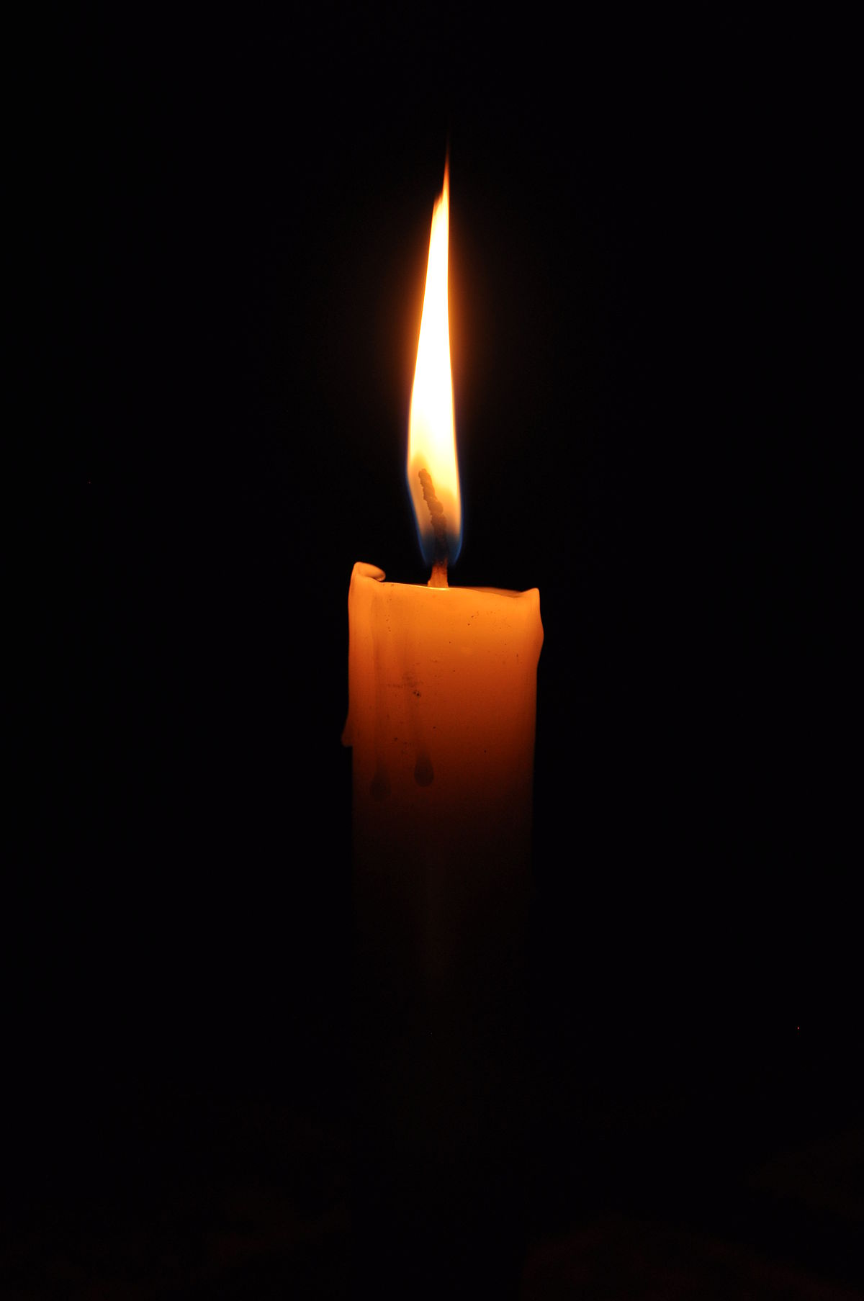
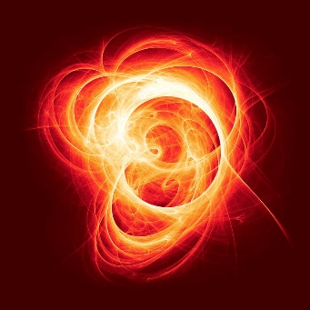
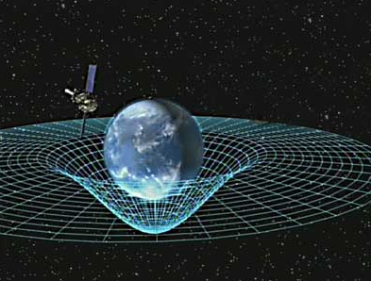
What ISN'T matter?
Energy (light, sound, heat)
Energy has no mass or volume

Slide 5
How can we Describe Matter?
Matter can be described by its Physical and Chemical Properties

Slide 6
MASS
Mass is the amount of matter a substance is made of.
Mass is measured in Units: grams (g) or kilograms (kg).
Mass is different than WEIGHT

Slide 7
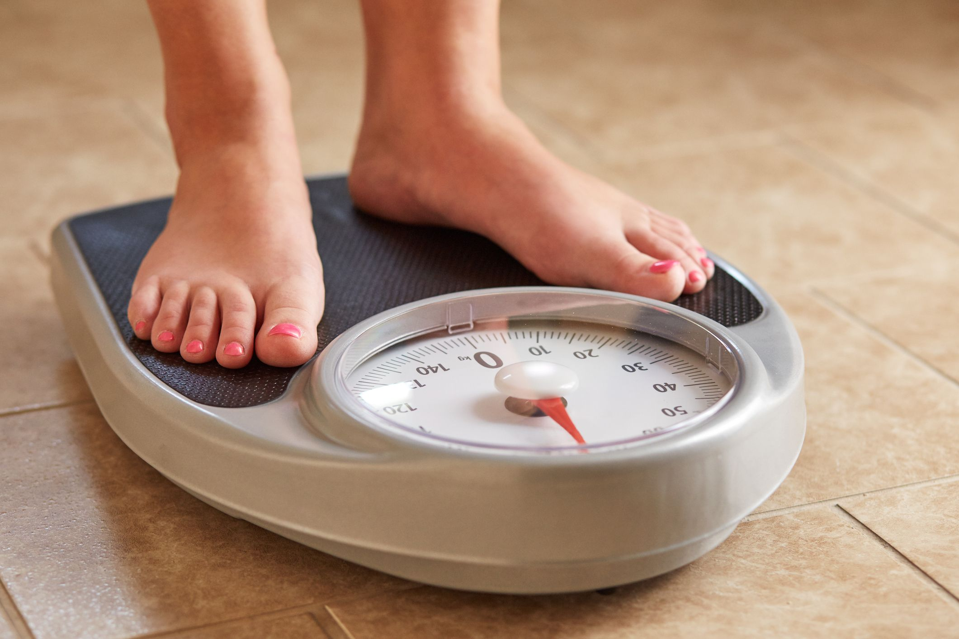
WEIGHT
Weight is the force of gravity pulling on an object
Weight is measured in NEWTONS (N)

Slide 8
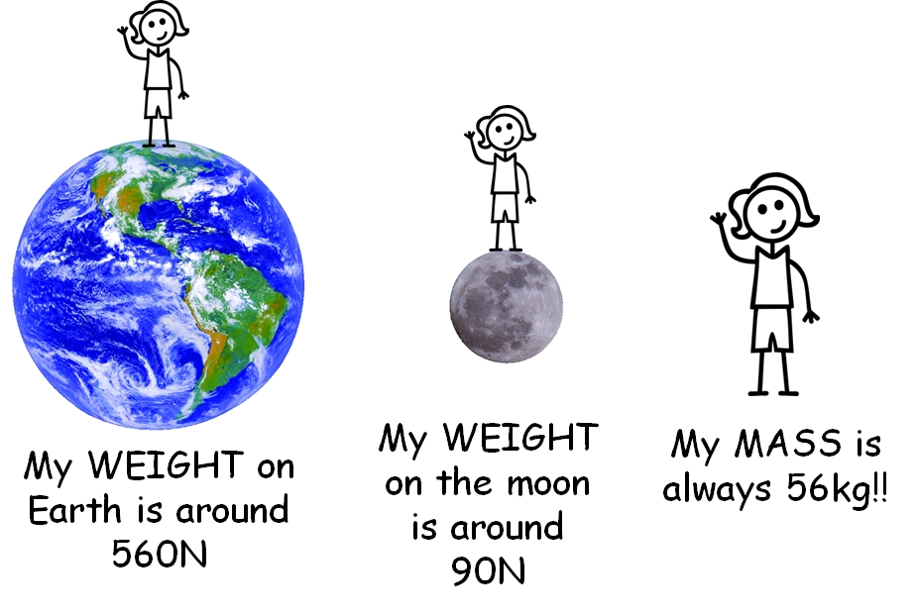
WEIGHT
Because weight depends on gravity, you would weigh LESS on the moon because the moon is smaller than Earth and has LESS gravity.

Slide 9
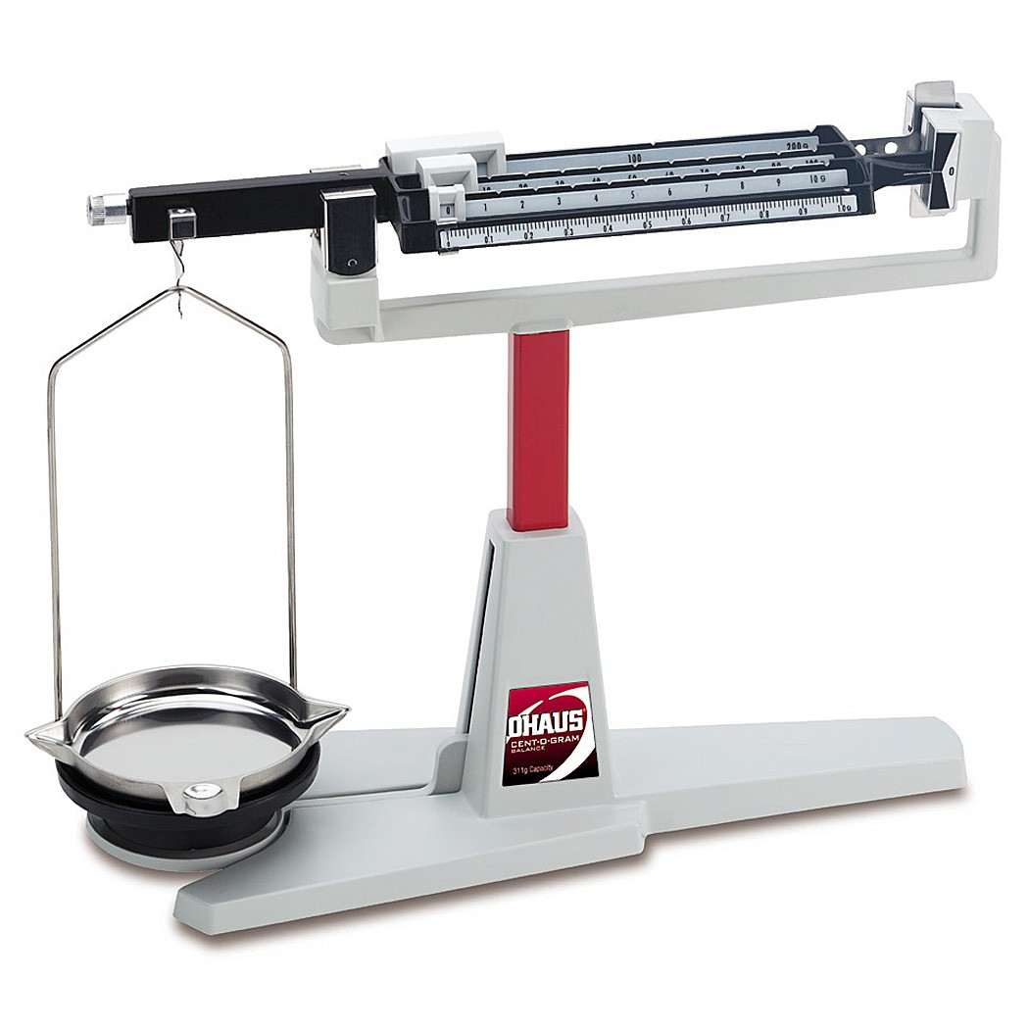
Equipment used to measure mass is called a Centigram or Triple Beam Balance

Slide 12
Using the Centigram
Place on a flat surface
Check if ZEROed. Adjust if necessary.
Place solid object on pan
Start with biggest rider: slide until bar touches bottom, then move back one notch
Then move next rider, etc
Never put wet objects directly on pan

Slide 13
MEASURING MASS :
When measuring mass of solids, it can be placed directly on the pan:

Slide 14
Reading Mass: What is the mass of the rock?

Slide 15
Reading the Mass

Slide 16
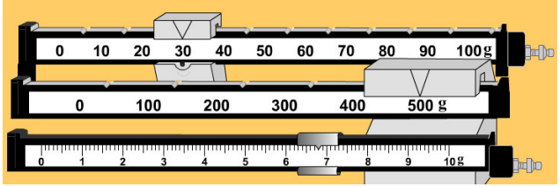
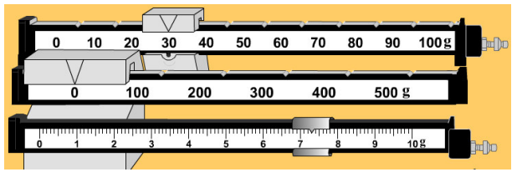
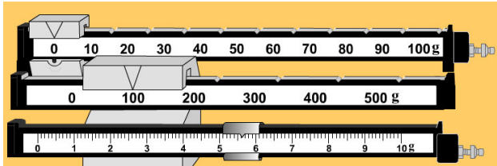
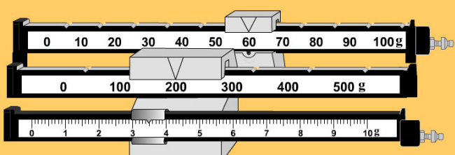

Slide 17
When measuring MASS OF LIQUIDS
Liquids need to be in a container
You will need to SUBTRACT the mass of the container

Slide 18
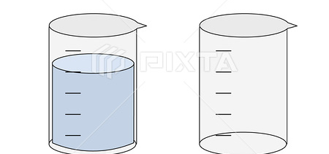
Example
A beaker full of liquid has a mass of 420 g
The beaker alone has a mass of 80 g
What is the mass of the liquid?

Slide 19
Example
A beaker full of liquid has a mass of 420 g
The beaker alone has a mass of 80 g
What is the mass of the liquid?
420g – 80 g = 340 g

Slide 20
Check your understanding
What is the Definition of Mass?
What Units are used when measuring mass?
What Equipment is used to measure mass?
Describe how is mass different than weight.
Which weighs more, a kilogram of feathers or a kilogram of lead?

Slide 21
Using a Centigram:
Carry with two hands, one stabilizing the pan
Place on flat surface
Zero using adjustment knob
Measure: Start with heaviest rider: slide until too heavy, then back one. Must be in groove.
Continue with next heaviest rider.

Slide 22
Practice
Reading Centigram
Handling Centigram
Mass Lab

Slide 23
Measuring Matter: Volume

Slide 24
VOLUME
Volume is the amount of SPACE an object takes up.
Volume is measured in:
milliliters (ml)
litres (L)
cubic centimeters (cm³)

Slide 25
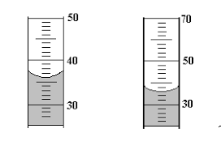
Volume of Liquids
Always use graduated cylinder

Slide 26
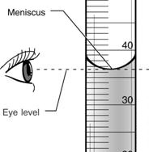
Volume of a LIQUID:
Must be on a FLAT SURFACE
Read at EYE LEVEL
Read from BOTTOM of meniscus

Slide 27
VOLUME
1 ml = 1 cm³

Slide 28
VOLUME OF RECTANGULAR OBJECT
VOLUME = LENGTH X WIDTH X HEIGHT

Slide 29
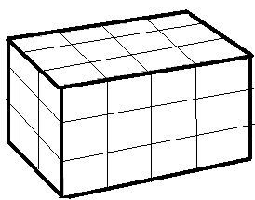
What is the volume of this block?

Slide 30
What is the volume of this block?
V = L x W x H
= 4 cm x 3 cm x 3 cm
= 36 cm³

Slide 31
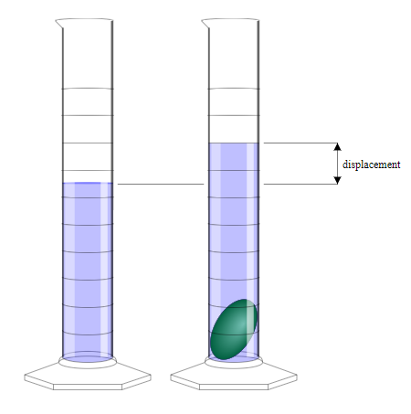
VOLUME OF IRREGULAR SHAPED OBJECT
Use DISPLACEMENT METHOD
Measure specific volume of water.
Measure volume of water with object submerged in it
Subtract volumes to find volume of object

Slide 32
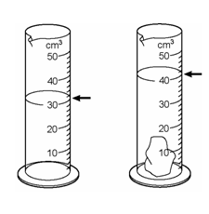
What is the VOLUME OF The OBJECT?

Slide 33
VOLUME OF IRREGULAR SHAPED OBJECT
40 ml – 30 ml = 10 ml

Slide 34
Practice
Volume Lab:
Measuring volume of liquids,
regular shaped objects,
irregular shaped object

Slide 35
Density

Slide 37
Density is a Physical Property of Matter
Density is the amount of MATTER in a certain VOLUME of a substance.
Is density a qualitative or quantitative property?
Density = Mass / volume
Units: g/ml or g/cm³

Slide 38
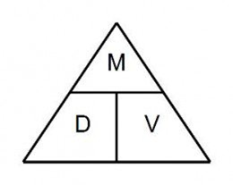
Calculating Density

Slide 39
Density Calculations
1. A substance has a mass of 0.56 grams and a volume of 3cm³. Calculate the density.

Slide 40
Density Calculations
A substance has a mass of 0.56 grams and a volume of 3cm³. Calculate the density.
Density = Mass / Volume
= 0.56 g / 3 cm³
= 0.187 g/cm³

Slide 41
Density Calculation
After each class, Ms. Wilson eats a chocolate bar that has a mass of 12.5 grams. She measures its volume to be 6cm³. Calculate the density of the chocolate bar.

Slide 42
Density Calculation
After each class, Ms. Wilson eats a chocolate bar that has a mass of 12.5 grams. She measures its volume to be 6cm³. Calculate the density of the chocolate bar.
Density = Mass / Volume
= 12.5g /6 cm³
= 2.08 g/cm³

Slide 43
Calculate
You find a piece of metal that has a mass of 29 grams and density of 13.2 g/ml. What would be the volume?

Slide 44
Calculate
You find a piece of metal that has a mass of 29 grams and density of 13.2 g/ml. What would be the volume?
Volume = Mass / Density
= 29 g / 13.2 g/mL
= 2.2 mL

Slide 45
Density Calculation
You place a piece of wood in a graduated cylinder. The level of the water in the cylinder moves from 98 mL to 125 mL.
If the piece of wood weights 72 grams, what is its density?
(you must first find the volume of the of the wood)

Slide 46
Density Calculation
You place a piece of wood in a graduated cylinder. The level of the water in the cylinder moves from 98 mL to 125 mL.
If the piece of wood weights 72 grams, what is its density?
(you must first find the volume of the of the wood)
Volume = 125mL – 98 mL
= 27 mL

Slide 47
Density Calculation
You place a piece of wood in a graduated cylinder. The level of the water in the cylinder moves from 98 mL to 125 mL.
If the piece of wood weights 72 grams, what is its density?
(you must first find the volume of the of the wood)
Density = Mass / Volume
= 72 g / 27 mL
= 2.67 g/mL

Slide 48
Why do we study Density?
Density is an intensive property, meaning that it depends only on the substance's composition and does not vary with size or amount.
Density allows us to determine what substances will float or sink when placed in a liquid.
Density can be used to determine the purity of a substance.
If we know a substance’s density, we can calculate mass or volume.

Slide 49
Why do some objects Sink or Float?
The density of water is 1 g/mL
If an object has a HIGHER density (is MORE dense) than water, it will sink. If an object is LESS dense that water, it will float.

Slide 50
Sink or Float?
Density can be used to determine whether a substance will sink or float in a liquid.
Coke Can POE

Slide 51
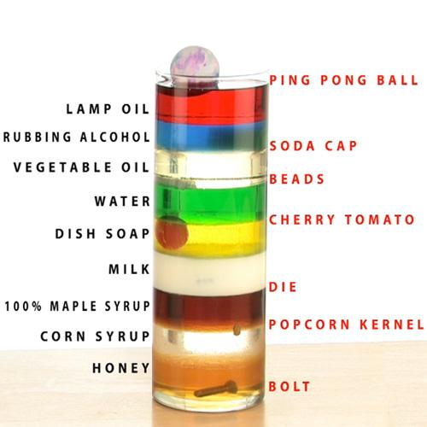
Sink or Float: Other Liquids
Different liquids have different densities.

Slide 52
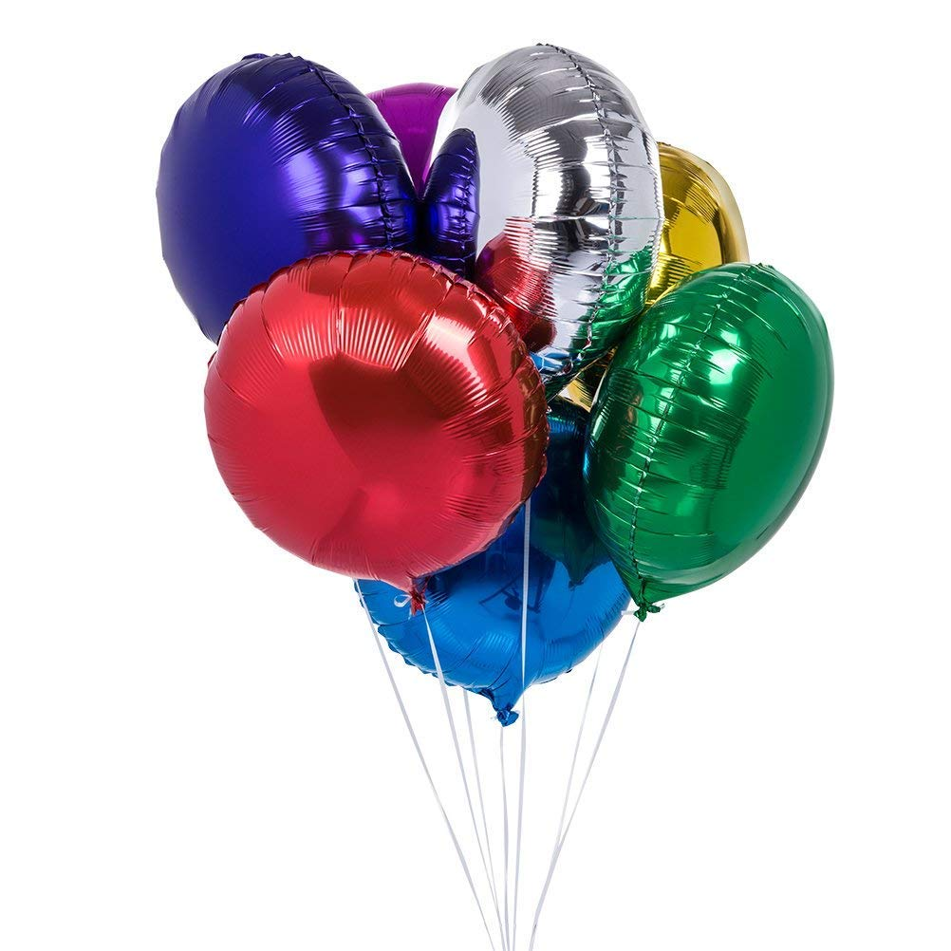
Different gases have different densities
Explain why birthday balloons float.
Balloon in CO₂ demo, 2 min
https://www.youtube.com/watch?v=DgVWbuFTd4c

Slide 53
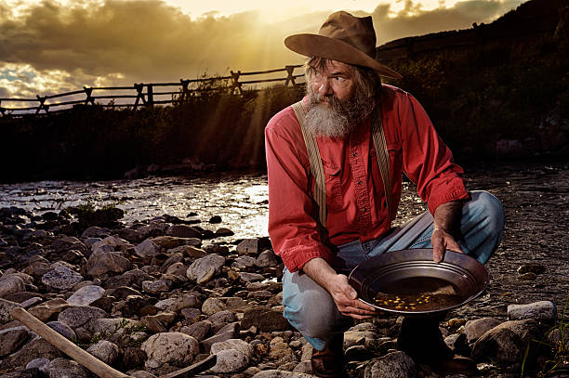
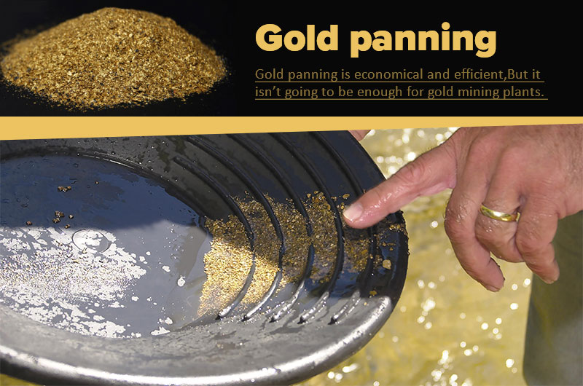
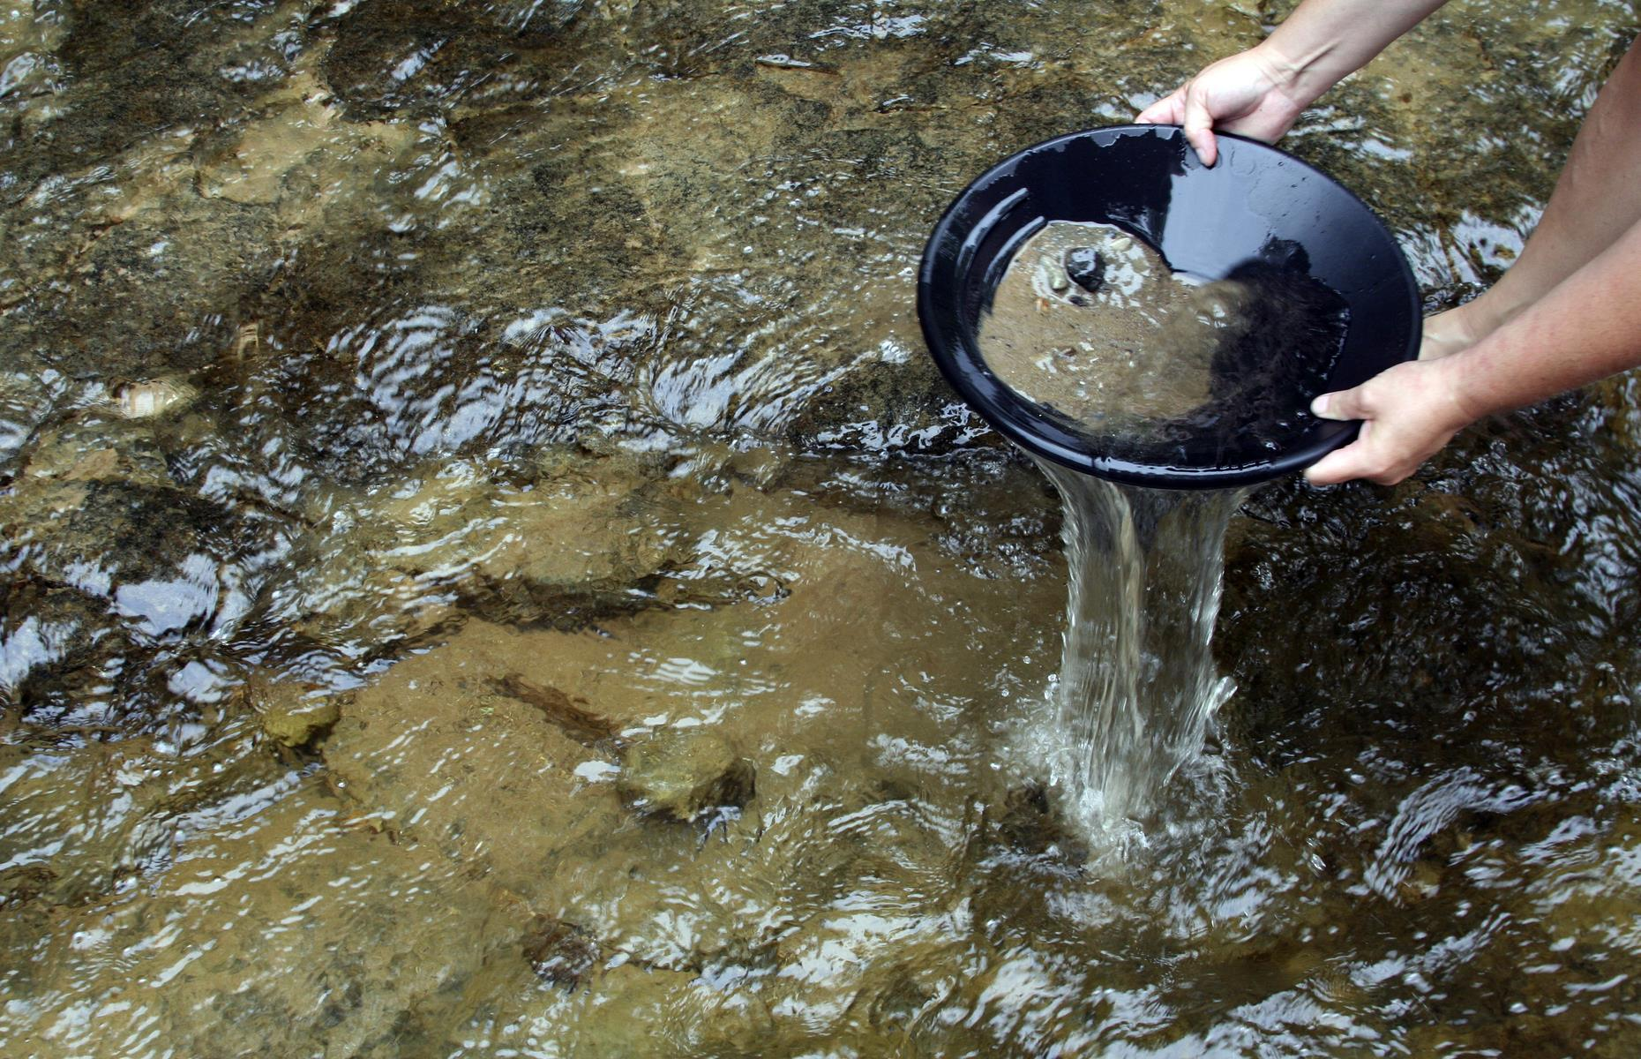
Density is everyday life
Density is the basis for gold mining,
Notes:
Earth is the densest planet in the solar system. The force by which a body draws objects toward its center is called gravity. Objects with a high density have a high gravitational pull, therefore Earth's gravitational pull is high.

Slide 54
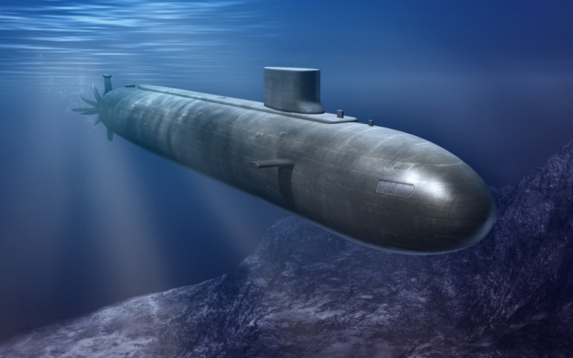
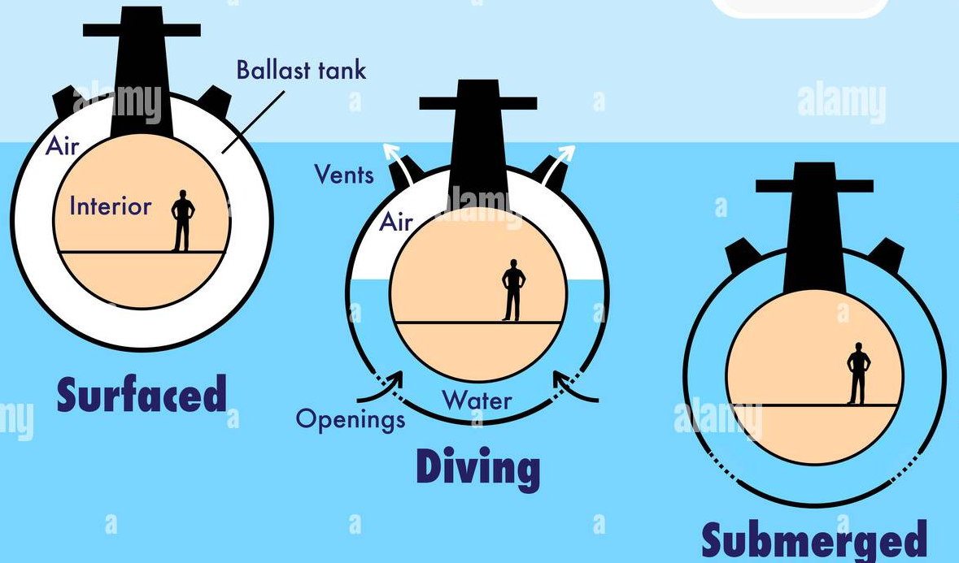
How do Submarines Float?
Submarines are ships made of steel.
Steel is more dense than water.
When the submarine contains a lot of air inside, the TOTAL density is less than water → float.
To sink (submerge), water is pumped into the ballast.

Slide 55
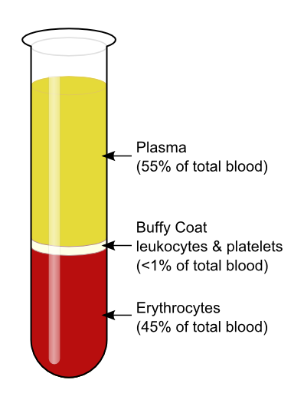
Density is the basis for blood separation
More dense red blood cells sink to bottom.
Less dense plasma (liquid) layers on top.
Notes:
Earth is the densest planet in the solar system. The force by which a body draws objects toward its center is called gravity. Objects with a high density have a high gravitational pull, therefore Earth's gravitational pull is high.

Slide 56
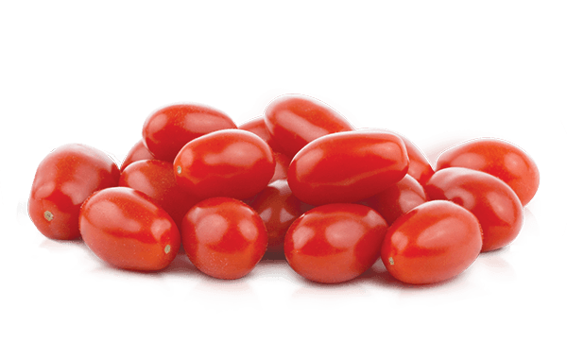
Tomato/Grape
Will a grape/tomato Sink or Float in water?
Can we change this without changing the tomato?

Slide 57
Challenge: Density Calculation
A graduated cylinder is filled with water to the 55 mL mark.
The mass of both the water and cylinder is 132 grams.
A piece of metal is placed in the water and the water rises to 105 mL.
The total mass of the cylinder, water, and metal is now 225 grams.
Calculate the density of the metal.

Slide 58
Summary
Density is the relationship between Mass and volume.
Different substances have different densities (unique to the substance)
Density can be used to determine whether a substance will sink or float.

Slide 59
Practice
Density Calculation Worksheet
Density Lab

Slide 60
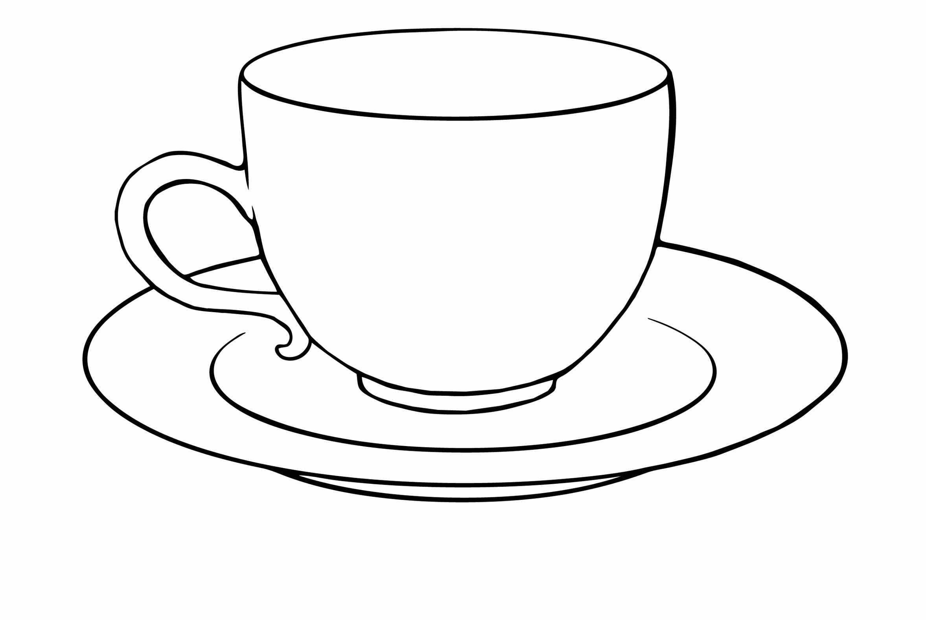
Which is more dense?

