Slide 1
Types of Charge
Static Charge is produced by electron transfer
Notes:
What is static charge? When materials rub together, you might see them cling to each other. Material that behave this way are said to carry an electrical charge. When a charge stays in place for some length of time, it si described as static electricity. Or static charge.
Why does rubbing make material charged?
Recall that all matter is made up of atoms. Most of the mass is in the nucleus. Nucleus contains p and n. p are +, e outside are -.
The overall charge of a material depends ont eh balance between the positive and negative charges in all the atoms of the material. A material may be neutral, positive, or neg.
When two materials are rubbed, elecrons fromt ehatoms of one material may move to the atoms of the other material. The movement of electrons from one atoms to another changes the charge on the atoms. Whena atom loses electrons, it is left with more protons tso its charge is positive. Whena an atom gains electrons, it has more electrons than protons, so neg.

Slide 2
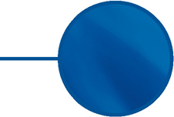
Static Electricity
CHAPTER
9
Key Ideas
Static electric charges can build up on objects.
Objects become charged by friction, conduction, and induction.
An electric force between static charges can either attract or repel the charges.
The discharge of static electricity in the form of lightning can be dangerous, but static electricity also has useful applications.

Slide 3
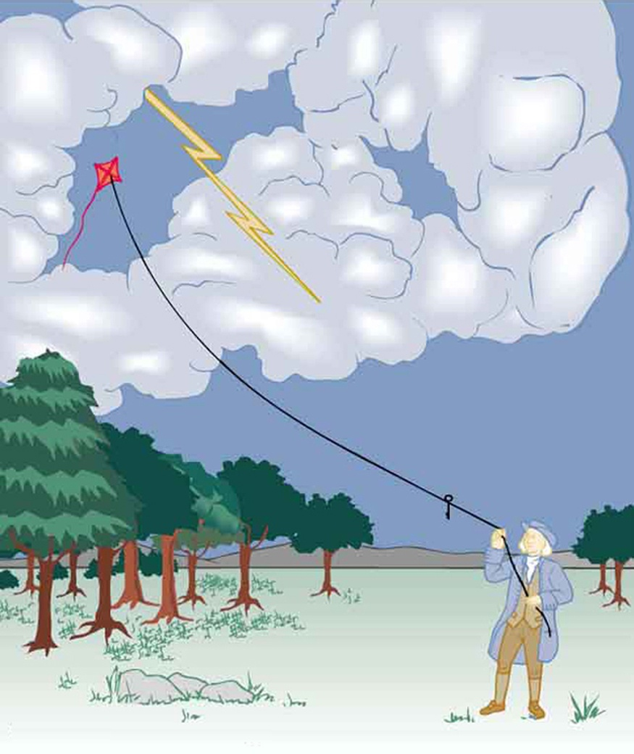
What is electricity?
Electricity (electrical energy) is the presence and flow of electric charge.
Using electricity we can transfer energy in ways that allow us to do simple chores.
Its best-known form is the flow of electrons through conductors such as copper wires.
History:
https://www.youtube.com/watch?v=g5mzFb2hhHY
Notes:
Extra https://www.youtube.com/watch?v=3QLnosS853Q

Slide 4
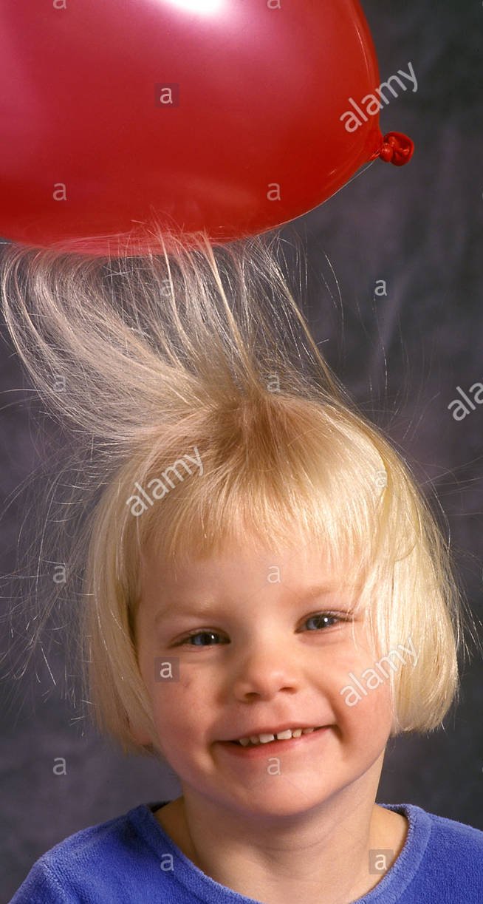
What is Static Electricity?
Static Electricity is a build up of static charge ( charge not moving)
The study of static electric charge is called electrostatics.
A charge is a build up of electrons.
https://www.youtube.com/watch?v=yc2-363MIQs&feature=emb_rel_pause
Notes:
When materials rub together, you might see them cling to each other.
Material that behave this way are said to carry an electrical charge.
Static charge cannot be seen but you can observe its affects with a pith ball.

Slide 5
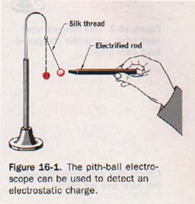
In class Activity: Pith Ball Electroscope, p275.
You can show different charges exist by rubbing plastic strips to give the strips a charge, and then watching the effect of the charged strip on a pith ball.
A pith ball is a very small, lightweight object that picks up electric charge quite well.
Acetate is a clear plastic. Vinyl is a type of coloured plastic that is used for raincoats, electrical tape, and vinyl siding.
Notes:
A pith ball is a very small, lightweight object that picks up electric charge quite well. A charged pith ball works well to show the Coulomb force between two charged objects. If a glass rod is rubbed with silk, the silk rubs some electrons off the rod. The rod thus becomes positively charged.
Touching the positively-charged rod to two pith ball gives the balls each a small positive charge. Since like charges repel, the pith balls repel one another.
If an ebonite rod is rubbed with fur, the rod rubs some electrons off the fur. The rod thus becomes negatively charged and attracts the positively-charged pith balls.

Slide 6
Think about the pith ball activity
How do you know the pith ball has a positive charge?
How would you test this?
If the acetate becomes positive after being rubbed with a paper towel, what does that mean about the movement of electrons between the paper towels and the acetate strip?
Draw a picture showing electron movement and charges on the objects.
Notes:
Answer: electrons move from acetate (leaving it more positive) to the paper towel (making it move negative)

Slide 7
How does charge build up?
Think of when you scrape your feet across the carpet and then you touch the door knob....

Slide 8
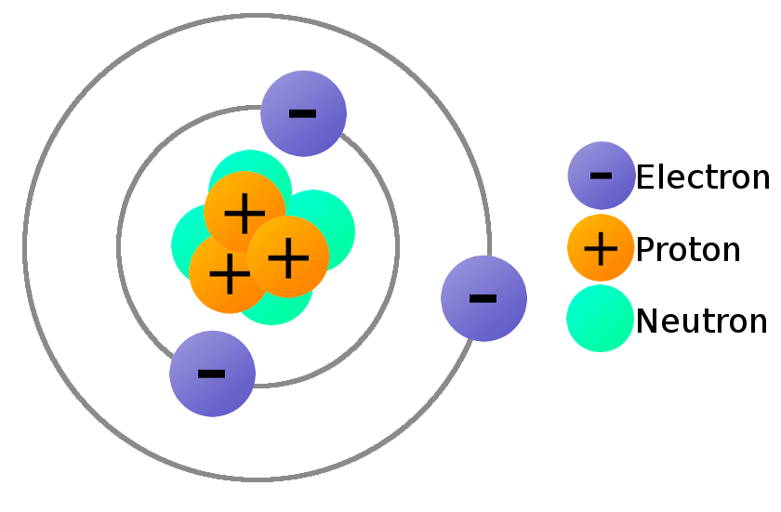
Charges on an atom…..Positive and Negative
Recall that all matter is made up of atoms.
All atoms are neutral (# protons = # electrons)
Protons and Neutrons exist tightly packed within the nucleus of an atom and are held firmly in place, so cannot be rubbed off.
But electrons can be rubbed off because they exist in the space around the nucleus and are not tightly bound to it.
Notes:
ONLY ELECTRONS CAN BE TRANSFERRED.

Slide 9
Types of Charges
A neutral object: positive = negative charges
A positive object: positive (protons) > negative. (lost electrons)
A negative object: negative charges > positive.
( gained electrons)

Slide 10
Can an object lose/gain protons?
Go back and check earlier slides if you are not sure.

Slide 11
What is the overall charge of each?

Slide 12
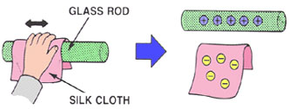
Charging an object
Objects get “charged” when electrons are transferred (rubbed off) from one object to another.
Notes:
Pith ball: What happens when you …
Acetate rubbed with paper towel (acetate gets positive, e rubbed off)
Pith ball charged (+) after touching paper towel.
Rub acetate (gets +). Repells pith ball because they are both positive.

Slide 13
PHET Simulation: John Travoltage
https://phet.colorado.edu/sims/html/john-travoltage/latest/john-travoltage_en.html

Slide 14
Law of Electrical Charge:
Like charges repel and unlike charges attract.
Charged objects can attract neutral objects.

Slide 15
Electrostatic Force (Attraction)
Force of Attraction depends on the distance and the amount of charge.
Strength of electric force increases with amount of charge and decreases with distance. (Coulomb’s Law)

Slide 16
Try this:
Balloon, Comb
Bits of tissue paper

Slide 17
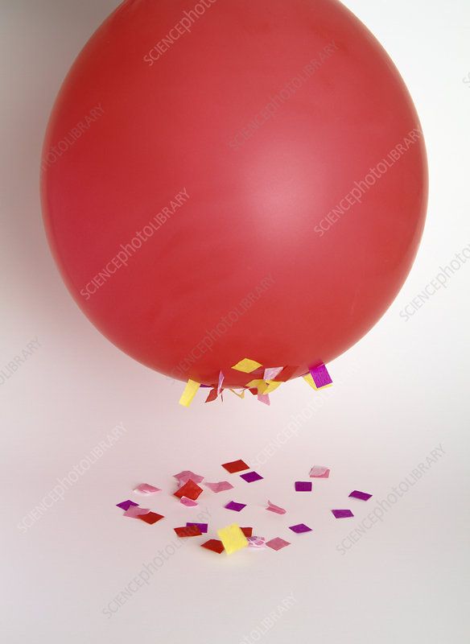
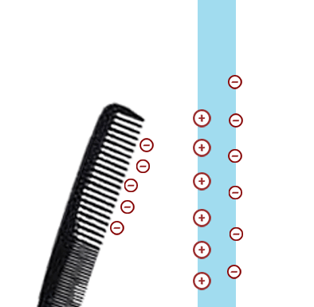
Explanation
Rubbing the balloon transfers electrons from your sweater to the balloon, making it negative.
The negative balloon attracts the positive charges in the bits of paper causing them to fly up and stick to the balloon.
Why do some fly off? Some negative charges are transferred to the bits of paper, charging them negative. The balloon is big and has a lot of negative charges still on it and remains negative. The balloons big negative charge repells the negative bits of paper causing them to fly off.
It helps if you draw this out on paper with negative and positive charges.

Slide 18
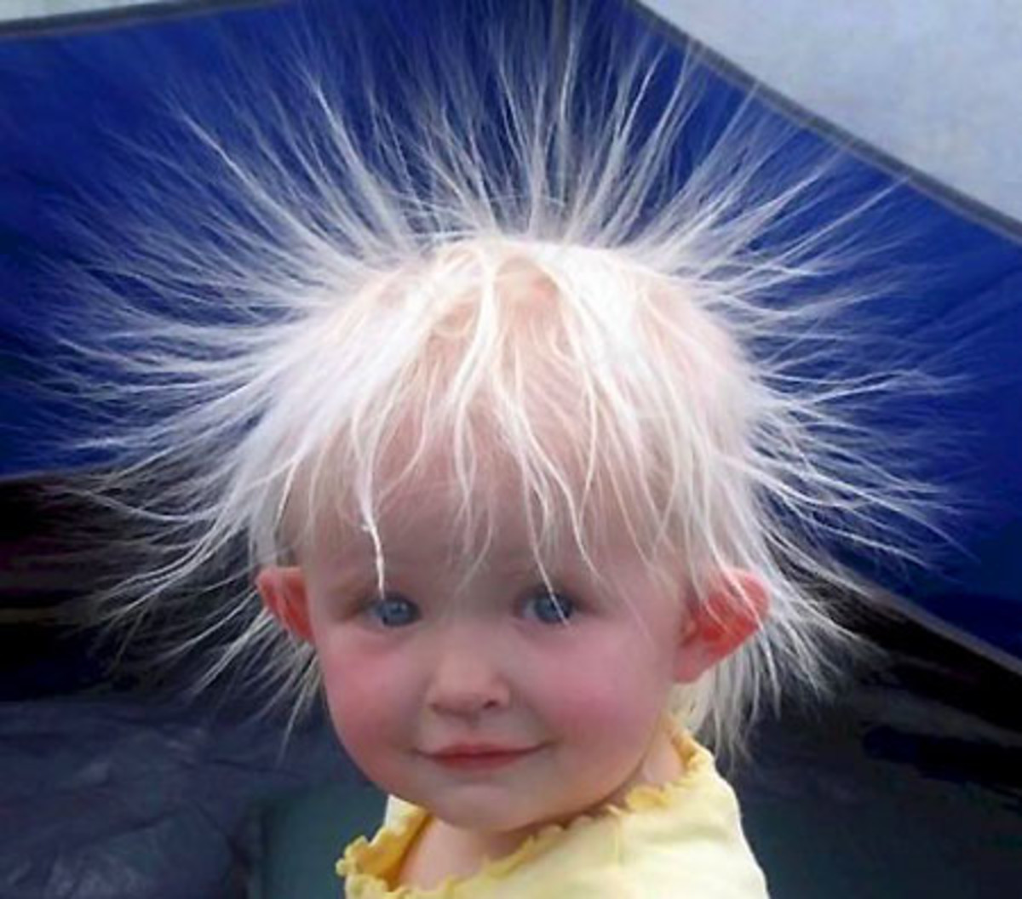
Same thing happens when combing your hair with plastic comb.
Combing dry hair transfers electrons from hair to comb.
Comb becomes negative, hair positive.
Each strand of hair is positively charged and will repel each other. They are so light, they will drift away from each other.

Slide 19
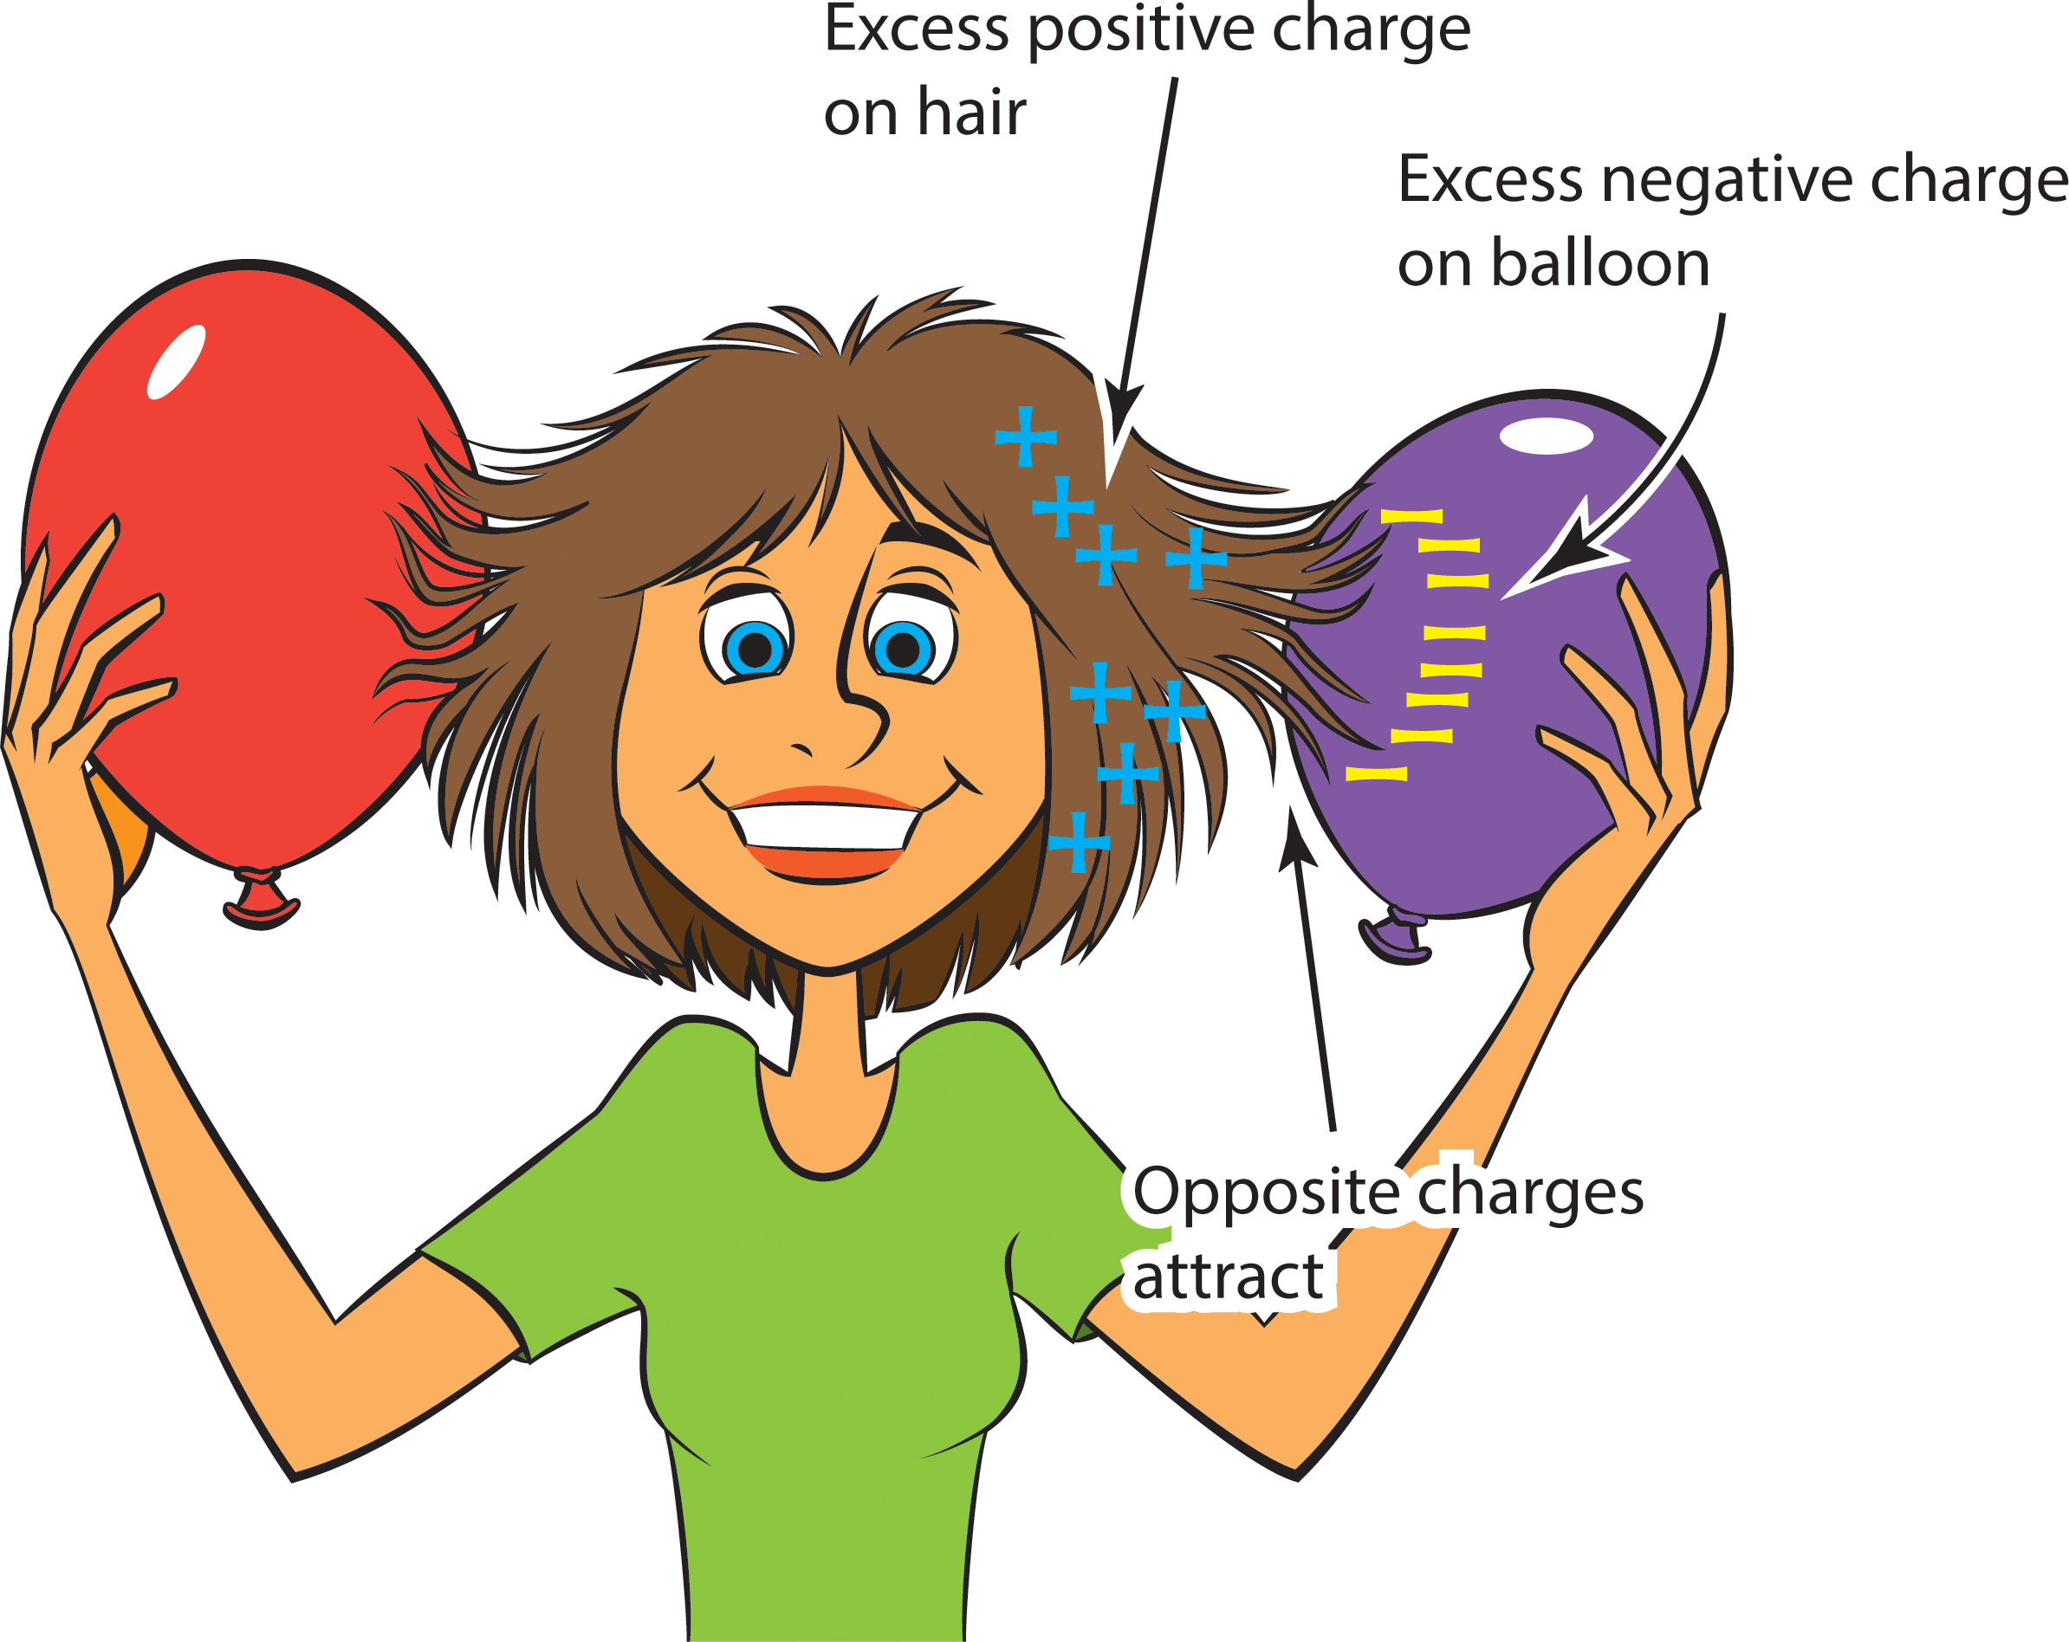

Slide 20
Try this
Charge an inflated balloon by rubbing it on your hair or sweater.
Can you make it stick to the wall?
Why does a charged balloon stick to a neutral wall?
Explain what’s happening to the charges?
PHET Simulation - https://phet.colorado.edu/sims/html/balloons-and-static-electricity/latest/balloons-and-static-electricity_en.html

Slide 21
Explanation
Rubbing the balloon on your sweater transferred electrons onto the balloon causing it to become more negative.
The wall is neutral (equal positive and negative charges)
The negative charges of the balloon attract the positive charges from the wall and repel the negative charges creating an induced separation of charge.
These forces of attraction are strong enough to hold the balloon to the wall.

Slide 22
Pith Ball Activity

Slide 23
Do you find some objects, when rubbed show a stronger attraction to various objects?
Some objects are more likely to lose or gain electrons than others.
Some materials let electrons move through them more easily than others.

Slide 24
9.2 Charging Objects
Friction, Conduction, and Induction
p279-281

Slide 25
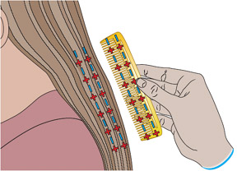
Charging by Friction: Rubbing two objects together
Remember: Charging an object can only occur by the transfer of electrons from one object to another.
Notes:
In this example, both hair and comb start neutral but after being rubbed together the comb is neg and hair positively charged.
When a charged object touches another object, electrons can be transferred between the objects. Electrons transfer from the object that has the more negative charge to the one that has the more positivecharge.

Slide 26
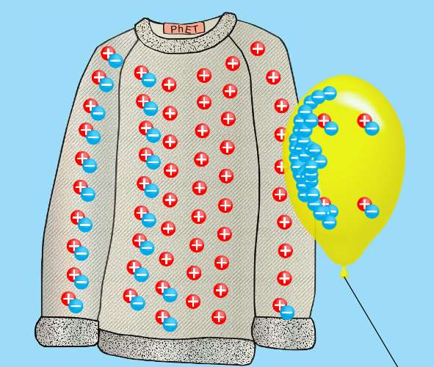
Example of Friction causing transfer of electrons between a balloon and sweater
Both items start relatively neutral
Latex has a higher affinity for electrons than the sweater
Rubbing allows electrons to be pulled off sweater to balloon,
Leaving both objects with an imbalance of charge:
Sweater “+” balloon “-”
Notes:
Rubber has a much greater attraction for electrons than animal fur/hair/sweater. As a result, the atoms of rubber pull electrons from the atoms of animal fur, leaving both objects with an imbalance of charge.

Slide 27
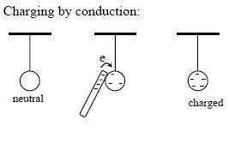
Charging By Conduction
When a charged object TOUCHES a neutral one.
Notes:
Eg. Walk across a carpet and get a spark by touching a metal doorknob, yu are transferrig someof your charge to the doorbkow by conduction.

Slide 28
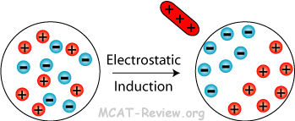
Charging by Induction
Occurs when objects are charged WITHOUT TOUCHING.
Eg. Build up of dust on TV or computer screen.
Notes:
When screen is turned on, it begins to buld up a charge. When a neutral dust particle coes near the screen, the screen induces an opposite charge onteh near side of the dust particle and a similar charge on the far side. The dust is attracted tot the screem.

Slide 29
Charging by Induction example.
Example: build up of dust on the computer screen:
When a computer is turned on, it begins to build up a charge
When a neutral dust particle come near the screen, the screen induces a opposite charge on the near side of the dust particle and a similar charge on the far side.
The dust is attracted to the screen

Slide 30
How do we know which object gets the electrons?

Slide 31
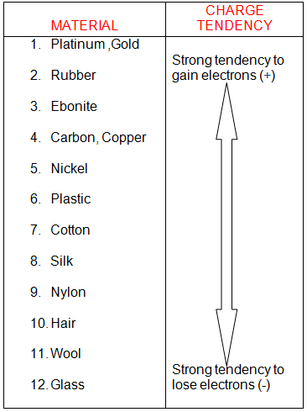
ELECTROSTATIC SERIES
List of materials in order of how easily they are to gain/lose electrons.
See p276 of text book

Slide 32
Electrostatic Series
What type of charge does rubber acquire when rubbed with a nylon cloth?
What type of charge does the nylon cloth acquire?
How does the size of the charge on the rubber compare to the size of the charge on the cloth?
What charge does the balloon get when rubbed on hair?

Slide 33
Insulators and Conductors
Insulators: Materials that do not let electrons move through them easily
Eg. glass, air, plastic, rubber, and wood
Conductors: Materials that do let electrons move through them easily
Eg. copper, aluminum, gold, and silver
Notes:
Grounding.

Slide 35
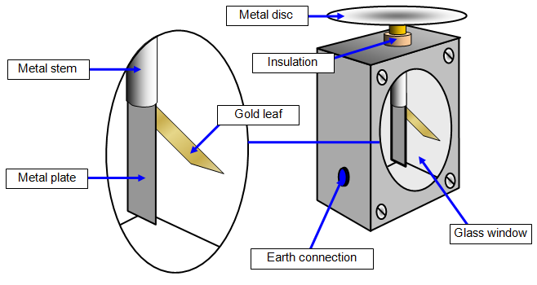
Electroscope - first electrical measuring instrument.
An electroscope is an instrument that detects static electricity by using thin metal or plastic leaves, which separate when charged.
Notes:
It is typically made with gold foil leaves hung from a (conducting) metal stem and is insulated from the room air in a glass-walled container.

Slide 36
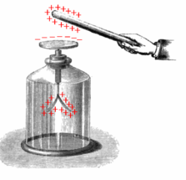
How it works
Electrical charges move to the metal ball/disk and down to the foil leaves, which then repel each other.
Since each leaf has the same charge (positive or negative), they repel each other.
Try this simulator:
https://simpop.org/electroscope/electroscope.htm
Explanation: https://www.youtube.com/watch?v=ectl3po7MuI
Notes:
Charging Electroscope by Induction: Touch the electroscope and bring a charged rod close.
If the charged rod is negative, electrons from the electroscope will flow onto your body. Now remove your hand and then move the charged rod away. The electroscope will be left with a deficit of electrons giving it a positive charge.

Slide 37
Electroscope

Slide 38
Induction
Positive rod brought NEAR top.
Electrons are attracted up to ball → leaves become positive.
Like charges repel → Leaves separate.
Notes:
A positively charged glass rod is brought near the tip of the electroscope, attracting electrons to the top and leaving a net positive charge on the leaves. Like charges in the light flexible gold leaves repel, separating them.
INDUCED SEPARATION OF CHARGE

Slide 39
Conduction
When the rod is TOUCHED to the ball, electrons are attracted and transferred, reducing the net charge on the glass rod but leaving the electroscope positively charged.
Notes:
A positively charged glass rod is brought near the tip of the electroscope, attracting electrons to the top and leaving a net positive charge on the leaves. Like charges in the light flexible gold leaves repel, separating them.
When the rod is touched against the ball, electrons are attracted and transferred, reducing the net charge on the glass rod but leaving the electroscope positively charged. (c) The excess charges are evenly distributed in the stem and leaves of the electroscope once the glass rod is removed.

Slide 40
When glass rod is removed, Excess charges evenly distribute in the stem and leaves of the electroscope.
Notes:
A positively charged glass rod is brought near the tip of the electroscope, attracting electrons to the top and leaving a net positive charge on the leaves. Like charges in the light flexible gold leaves repel, separating them.
When the rod is touched against the ball, electrons are attracted and transferred, reducing the net charge on the glass rod but leaving the electroscope positively charged. (c) The excess charges are evenly distributed in the stem and leaves of the electroscope once the glass rod is removed.

Slide 41
Grounding
Grounding: Removes excess charges by touching it (discharging) , making it neutral.
A grounded object is connected directly to Earth by a conductor.
An electroscope containing conducting metal but holds a static charge. Why?
Notes:
An electroscope containing conducting metal but holds a static charge because it is not in direct contat with its surroundinsg.

Slide 42
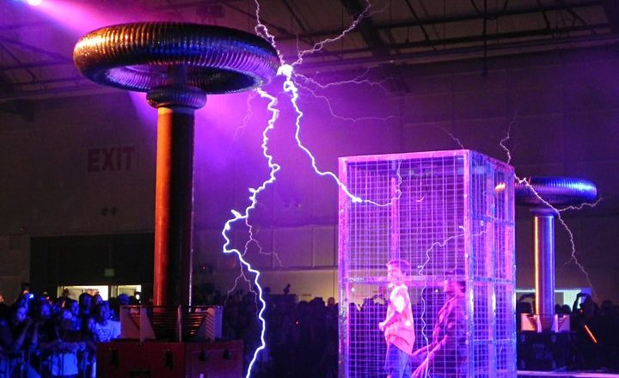
Isolating Charges: Faraday Cage
A Faraday Cage
a grounded metal screen surrounding a piece of equipment to exclude electrostatic influences.
Notes:
Car is the safest place in a lightning storm. Cell phones don’t work well in elevators. Car radio in tunnels.

Slide 44
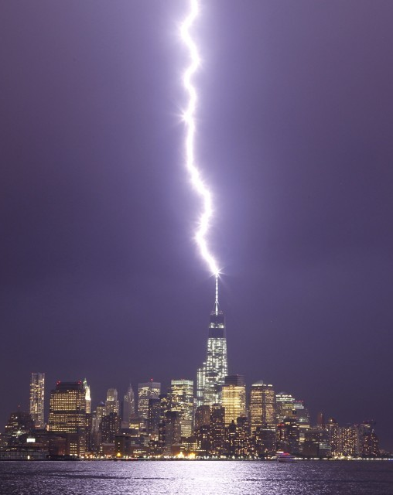
Attracting Charges: Lightning Rod
A Lightning Rod - Receives concentrated charges and conducts them safely to the ground (not through your building so your electronics don’t get fried).
Must be a conductor and usually pointed to receive a greater concentration of charge.
Notes:
What does it need to be made of?

Slide 45
Practice
Electroscope Activity, p294
Read pages 274-277
CYU p 278 #1,2,4,7,8, 9, 11, 13

Slide 46
EXTRAS

Slide 47
In class Activity: Attracting Neutral Objects p277
What happens when two neutral objects brought together?
What happens when charged object brought to neutral object?
Notes:
Charge one ruler by rubbing it. Bring it to the other…..

Slide 48
Induced Separation of Charge p277
When a positively charged object (like a ruler) is brought near a Neutral Object, the positive end of the ruler attracts electrons to that end, thus “charging the end” of the neutral object.
The electrons in the neutral object do not come off. Instead, the positive and negative charges in the molecules of the object stretch apart from each other. Creating an Induced Separation of Charge.
The neutral object is still overall neutral.
Notes:
Charged by induction

Slide 49
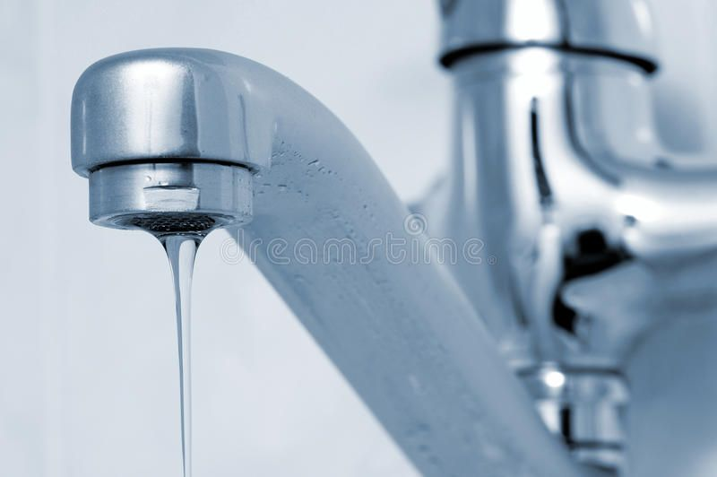
Try this:
Rub a balloon on clothes or hair
Bring near a narrow steady stream of water coming out of the tap.
What happens?

Slide 50
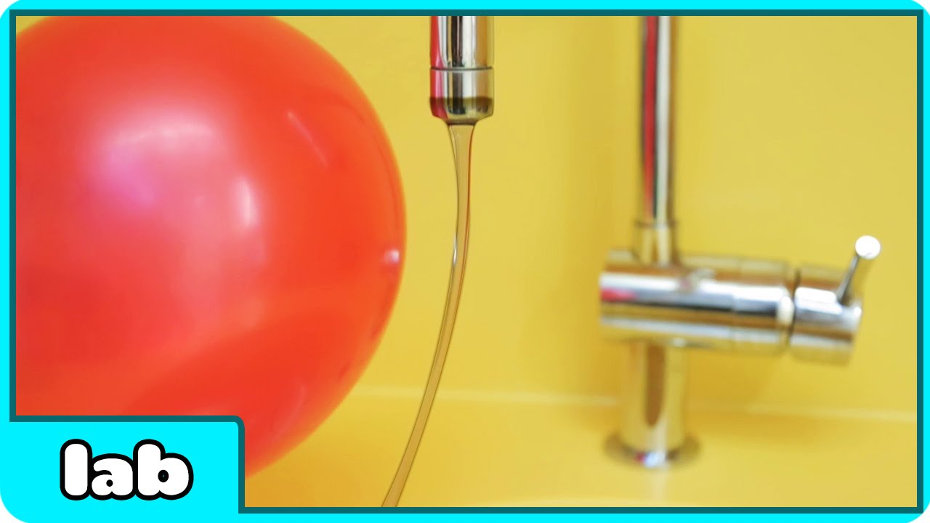
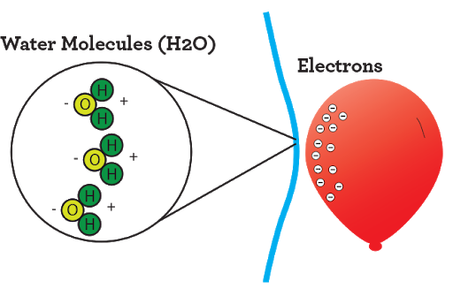
Rub a balloon and bring near water

Slide 51
Static Electricity Video
Bozeman https://www.youtube.com/watch?v=zHJkJGBdvwE
Ted Ed Electric Vocabulary
https://www.youtube.com/watch?v=MBRTR2dlwvA
Crash Course, first 5 min
https://www.youtube.com/watch?v=TFlVWf8JX4A
Ted Ed
https://www.youtube.com/watch?v=yc2-363MIQs
Extra:
https://www.youtube.com/watch?v=7MY7EqqFFe8

Slide 52
Activity 9A p292
When two objects are rubbed together, what charge does each material acquire?
Complete the chart on page 292.
Follow instructions
Answer: Analysis Questions a-d and Evaluation e-g in COMPLETE SENTENCES.
Notes:
You can make your own pith ball

Slide 53
Static Charge History…The Main Players
Read through Section 9.1 (p274-275 and 285-286).
How did each of the following contribute to information on static charge?
Benjamin Franklin
Charles de Coulomb
Robert Van de Graaf

Slide 54
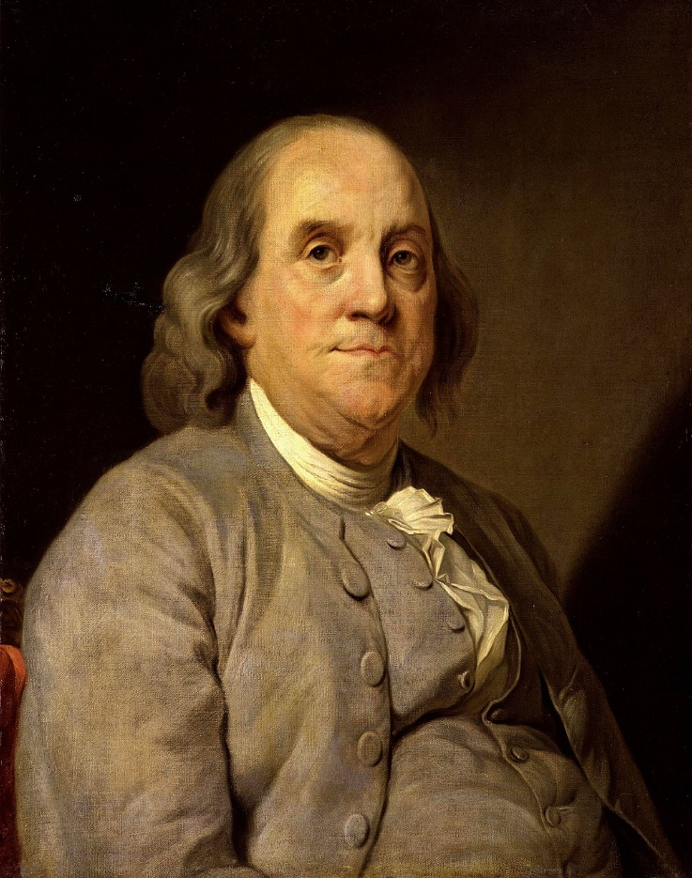
Benjamin Franklin
He believed electric charge was like a “fluid” → if an object had a “natural amount” of fluid it was neither attracted nor repelled by itself
Objects rubbed against each other gained or lost “fluid”
Notes:
Benjamin Franklin first shocked himself in 1746, while conducting experiments on electricity with found objects from around his house. Six years later and exactly 261 years ago today, the founding father flew a kite attached to a key and a silk ribbon in a thunderstorm and effectively trapped lightning in a jar.
a printer, writer, scientist, inventor, statesman, civic leader, and diplomat.
Inventions
lightning rod, bifocals, long arm and the Franklin stove.
Ancient Times
If you ask most people who discovered electricity, they’ll probably tell you Benjamin Franklin did.
This is because everyone has heard the story of Franklin flying his kite during a lightning storm.
This is NOT when electricity was discovered!
Sheldon Explains
An ancient Greek named Thales of Miletus noticed that if amber (hardened tree sap) was rubbed, it had the ability to pick up dust and leaves in about 700BC!
What he was seeing is what we now call “static electricity”
The ancient Greeks had no scientific explanation for this phenomenon.
What they did realize was that sometimes two objects would attract each other, sometimes they would repel.
This developed into the idea that there are two kinds of charge (we call them positive and negative today, which will be discussed shortly).
Like charges repel
Opposite charges attract.
This is usually called the Law of Charges.
The “Franklin” Era
Benjamin Franklin’s Experiments
Benjamin Franklin (1706-1790) did fly a kite on an overcast day (no actual lightning), but he wasn’t the first person to do it!
Several people had tried to do it before him to prove that lightning was electrical, but they’d all been killed.
Most people thought he was a nut to do it. In fact, he had his son set up most of the equipment while he stood back.
Franklin was able to prove that lightning was a discharge of static electricity (this does NOT mean he discovered electricity!!!)
Most of Franklin’s research actually focused on amber and glass rods…
It had been found that if a rubbed amber rod was suspended from a string, and another rubbed amber rod was brought near, the suspended one would move away.
If a suspended rubbed glass rod is brought near another rubbed glass rod, the suspended one would move away.
If a rubbed glass rod and amber rod were brought near to each other, they were attracted.
Therefore, the charge on the glass must be different from the charge on the amber!
Franklin decided to say that…
the glass rod had a positive charge
the amber rod (or the plastic ebonite used today) had a negative charge
Why did he choose to call glass positive and amber negative?

Slide 55
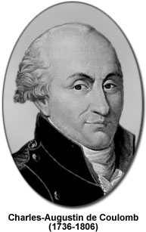
Charles de Coulomb
Coulomb’s Law: strength of electric force increases with increased electric charges and decreases with distance
Unit for size of electric charge is called the coulomb (C)

Slide 56
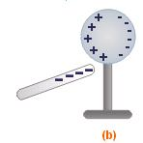
Demo: Charging by Induction.
Bring a negatively charged rod near – but not touching the sphere , the rod will repel the electrons in the sphere. The negative charges will move down the leaves and the leaves will repel each other.
The sphere is left with a temporary positive charge.
If the negative rod is removed, the electrons will move back to the sphere and the sphere will become neutral again.
Notes:
Example: dust build up on TV or computer screen

