Slide 1
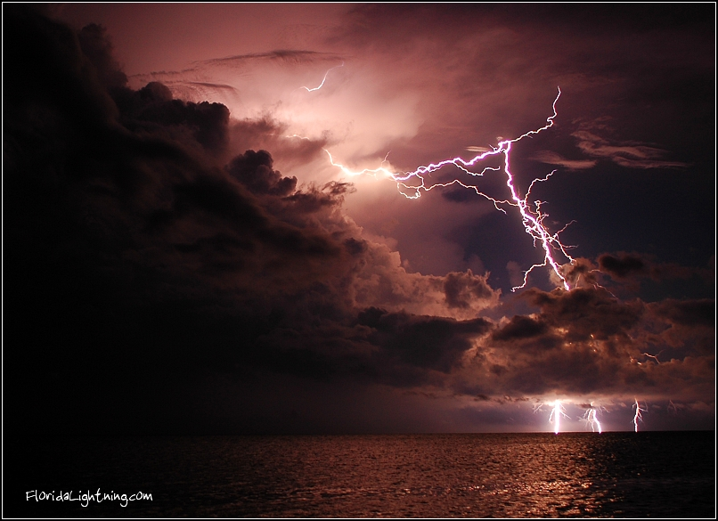
STATIC ELECTRICTY

Slide 2
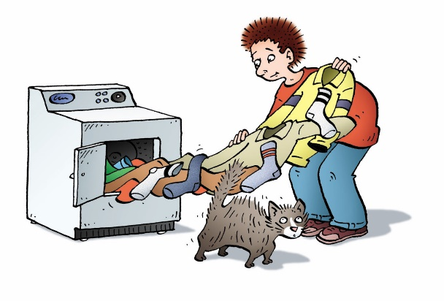

9.1 Types of Electric Charge
The effects of static electricity are all around you
  e.g. clothes from dryer, lightning, shocks from metal doors
A static charge is an electric charge that is stationary (not moving).
Eventually static charges are discharged, or lost, to other objects or to the air.
The study of static electric charge is called electrostatics.
We cannot see electric charge directly.
Instead, we observe its effects
  e.g. lightning is a discharge of static electricity

Slide 3
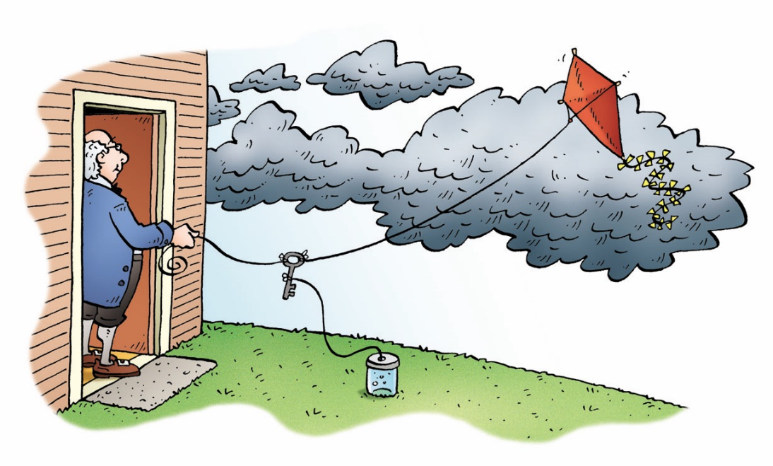
Types of Electric Charge
Benjamin Franklin showed that lightning is a form of electricity by flying a kite during a thunderstorm.
Because of experiments by Franklin and others, it was determined that there are two types of charges:
  positive and negative.
An object without any charge is neutral (0).

Slide 4
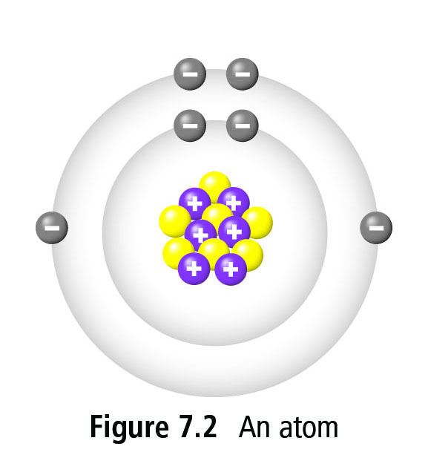
How does an object become charged?
Review parts of an atom

Slide 5
Atomic Structure and Electric Charge
Recall from chemistry that all matter is made up of tiny particles called atoms.
  Three smaller (subatomic) particles make up the atom: protons, neutrons and electrons.
Protons and neutrons are strongly attached to the nucleus but electrons are outside of the nucleus are can be easily added or removed.
Therefore, whether an object develops a negative or positive charge is due to whether it gains (-) or loses (+) electrons.

Slide 6
PHET Simulation: John Travoltage
https://phet.colorado.edu/sims/html/john-travoltage/latest/john-travoltage_en.html
Can this happen with other objects? Lets find out.
Materials: Plastic, Balloon, bits of paper, rice Krispies.

Slide 7
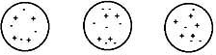
What is the overall charge of each?

Slide 8
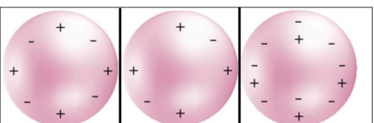
E.g. Positive Object
If an object is positive,
It has more _____________ than ____________ (electrons/protons)
Therefore it has ____________(lost/gained) some _______________(electrons/protons)

Slide 9
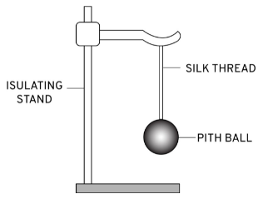
Pith Ball Activity/Demo
What happens when positively charged acetate strip brought near?
What happens when negatively charged vinyl strip brought near?
Notes:
What general rule could you come up with about what you learned about charges today?

Slide 10
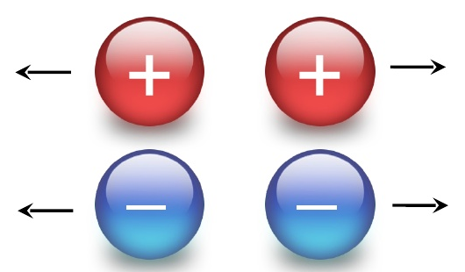
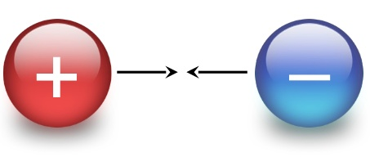
Law of Electrical Charge:
Like charges _______________
Unlike charges ______________
Charged objects can attract neutral objects.
Does it matter what charge?

Slide 11
Law of Electrical Charge:
Like charges repel
Unlike charges attract.
Charged objects can attract neutral objects.

Slide 12
Pith Ball Activity/Demo
What about distance?
Notes:
What general rule could you come up with about what you learned about charges today?

Slide 13
Electrostatic Force
Electrostatic Force is the force of attraction between two charged objects.
The force of the attraction depends on the distance between objects.
The strength of the electrostatic force increases with the amount of charge an object has but decreases the farther apart they are.
Notes:
The stronger the charge, the more attractive

Slide 14
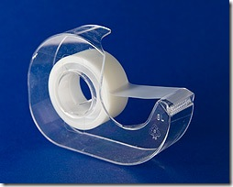
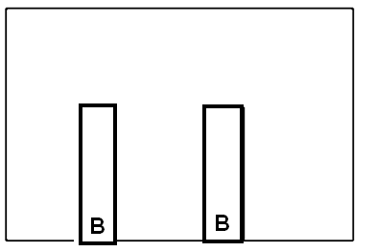
Exercise: Fun with Tape
Place 2 pieces of tape on your table and label the bottom ‘B’ for base

Slide 15
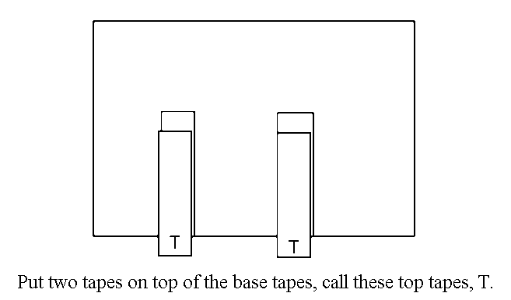

Slide 16
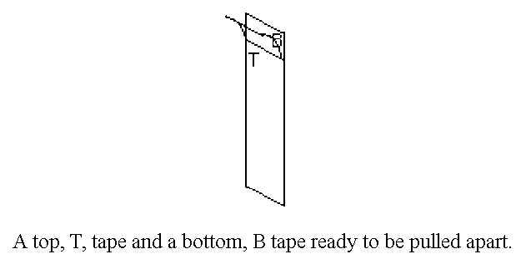

Slide 17
Static Electric Charge
An amber rod rubbed with wool or fur develops a negative charge
A plastic rod rubbed with cotton develops a positive charge
When objects are rubbed against each other, they can transfer charge from one to another
  only electrons move around – not protons
Some materials are more likely than others to give up electrons.
  Ex. When acetate (a type of plastic used in overhead transparencies) is rubbed with paper, the acetate develops a positive (+) charge and the paper develops a negative (-) charge.
  Example: if rubber was rubbed with silk...silk is more likely to lose electrons so it would become positively charged, giving electrons to the rubber and making it negatively charged.

Slide 18
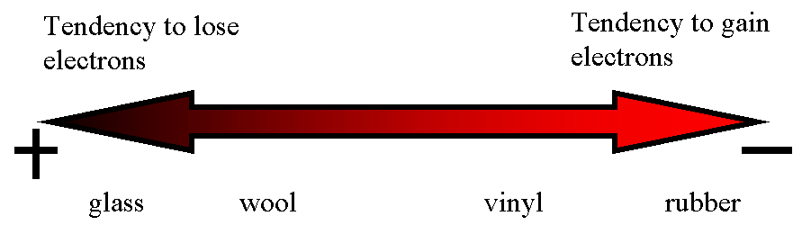
Pg. 276 Electrostatic series table
A list of materials in order of increasing attraction for electrons.
Movement of electrons

Slide 19
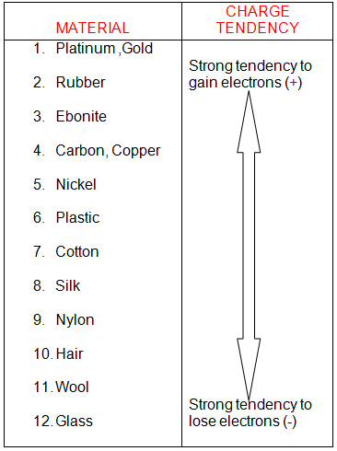
ELECTROSTATIC SERIES
List of materials in order of how easily they are to gain/lose electrons.
See p276 of text book

Slide 20
Electrostatic Series
What type of charge does rubber acquire when rubbed with a nylon cloth?
What type of charge does the nylon cloth acquire?
How does the size of the charge on the rubber compare to the size of the charge on the cloth?
What charge does the balloon get when rubbed on hair?

Slide 21
Insulators and Conductors
Insulators: Materials that do not let electrons move through them easily
  Eg. glass, air, plastic, rubber, and wood
Conductors: Materials that do let electrons move through them easily
  Eg. copper, aluminum, gold, and silver
Notes:
Grounding.

Slide 22
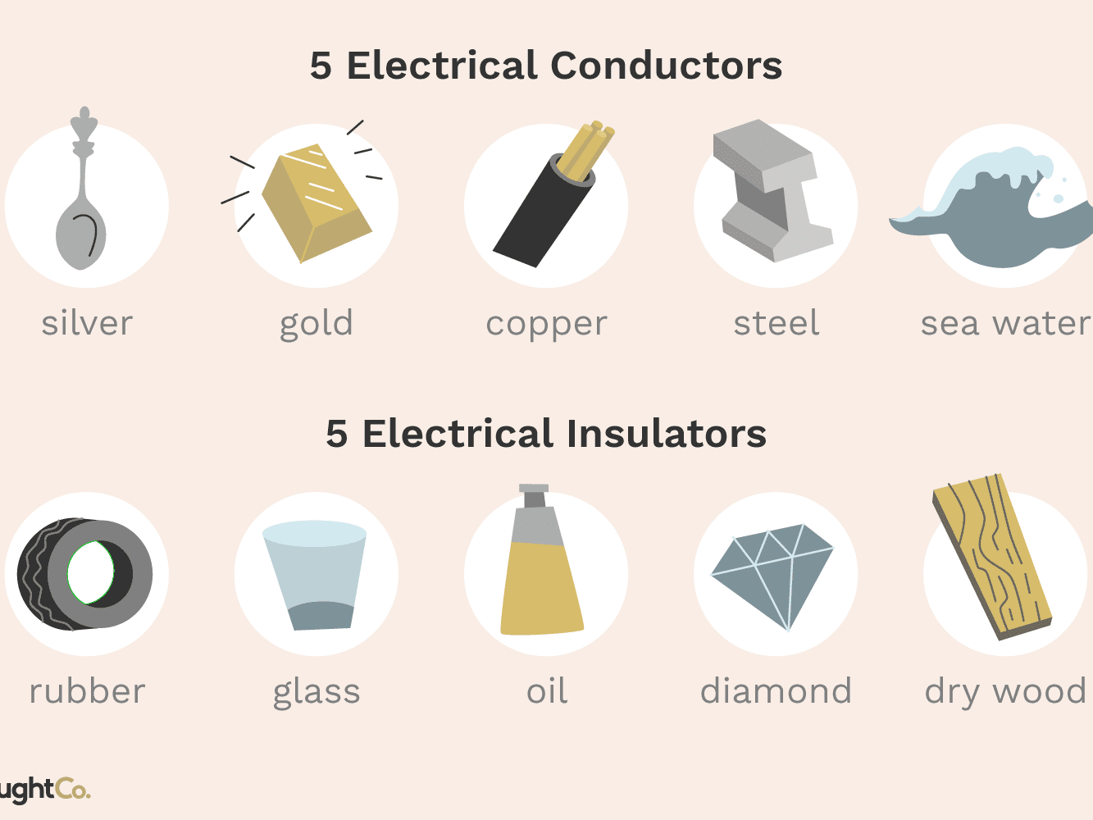

Slide 23
Practice
Read pages
Answer #

Slide 24
9.2 Friction, Conduction, and Induction
Three methods of charging:
Friction: occurs when two objects are rubbed together
  the objects will have opposite charges at the end
Conduction (contact): occurs when objects touch and an electric charge is transferred from one object to the other
  both objects will have the same charge at the end
Induction: results from charging without touching or making any direct contact
  creates areas of opposite charge on the objects

Slide 25
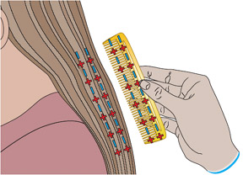
Charging by Friction
When 2 objects are rubbed together.
  Friction causes electric charges to be transferred from one object to another.
  the objects will have opposite charges at the end
Eg. Combing hair with plastic comb
Eg. Rubbing balloon on sweater
Eg. Electric charge built up on clothes as they tumble against each other in a dryer.
How will you know which item gets which charge?

Slide 26
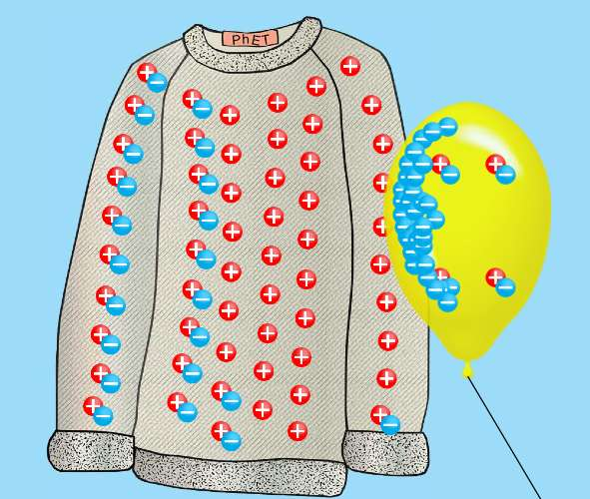
Eg. Rubbing balloon on sweater.
https://phet.colorado.edu/sims/html/balloons-and-static-electricity/latest/balloons-and-static-electricity_en.html
Both items start relatively neutral
Rubbing allows electrons to be pulled off sweater to balloon,
Leaving both objects with an imbalance of charge:
Sweater “+” balloon “-”
Notes:
Rubber has a much greater attraction for electrons than animal fur/hair/sweater. As a result, the atoms of rubber pull electrons from the atoms of animal fur, leaving both objects with an imbalance of charge.

Slide 27
Conduction
Occurs when objects touch.
electric charge is transferred from one object to the other.
  Ex. When you walk across a carpet and get a spark by touching a metal doorknob, you are transferring some of your charge to the doorknob.
  both objects will have the same charge at the end

Slide 28
Induction
When objects are charged without touching or making any direct contact
If a charged object is brought near a neutral object, we can induce a separation of charge in the neutral object because electrons move to get farther away from other electrons or closer to protons.
  Ex. Build-up of dust on a TV
  Screen creates areas of opposite
  charge on the objects

Slide 29
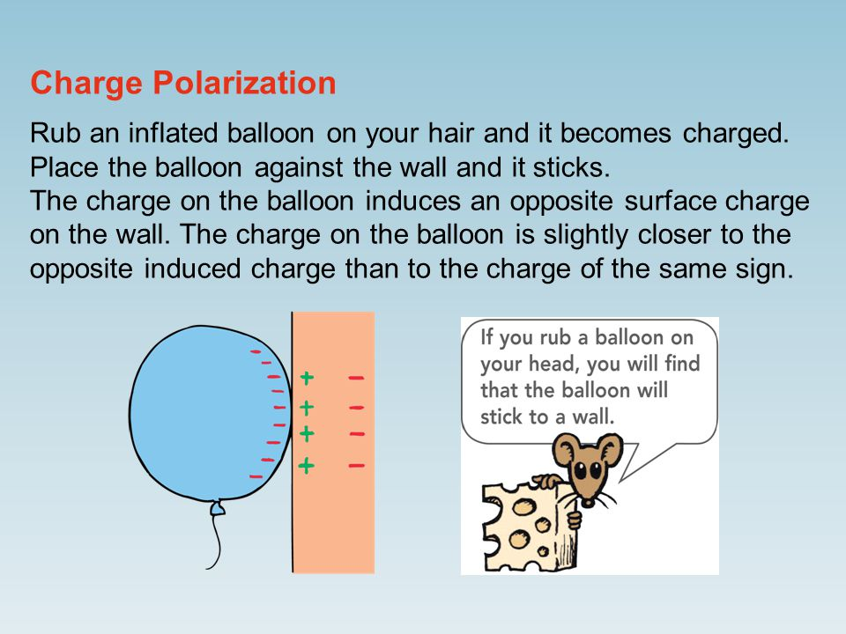
Induced Separation of Charge
When a charged object is brought near to a neutral object, the electrons in the neutral object shift so that the end of the neutral object is attracted to the charged object.
Although there is a slight shift of charges within the neutral object, it does not gain or lose electrons and is still neutral.
This charging effect is known as induced charge separation

Slide 30
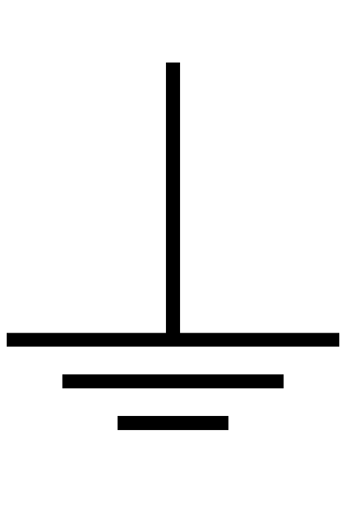
Removing a Charge: Grounding
Charged objects can be discharged by grounding. (Excess charges can be removed by touching it) making it neutral.
A grounded object is connected directly to Earth by a conductor.
An electroscope containing conducting metal but holds a static charge. Why?
Notes:
An electroscope containing conducting metal but holds a static charge because it is not in direct contat with its surroundinsg.

Slide 31
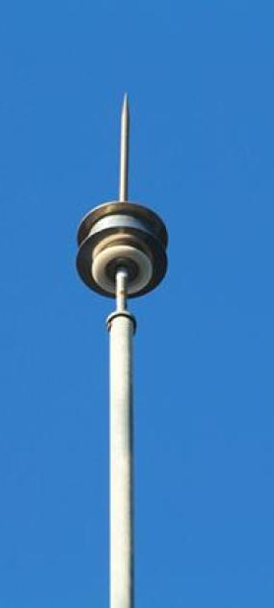
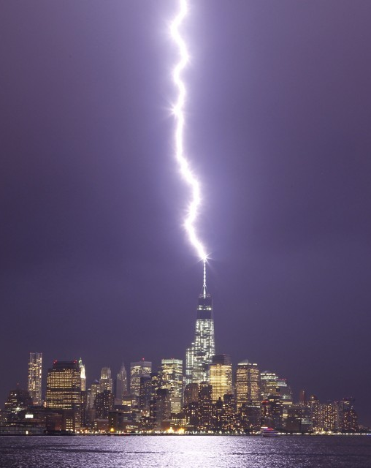
Attracting Charges: Lightning Rod
A lightning Rod is a conductor and usually pointed to receive a greater concentration of charge.
Conducts the charge safely down to the ground
(not through your building so your electronics don’t get fried).
Notes:
What does it need to be made of?

Slide 32
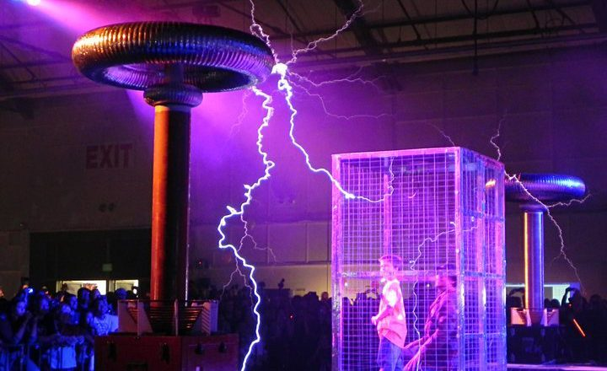
Blocking Charge: Faraday Cage
a grounded metal screen surrounding a piece of equipment that shields electrostatic influences.
Notes:
Car is the safest place in a lightning storm. Cell phones don’t work well in elevators. Car radio in tunnels.

Slide 33
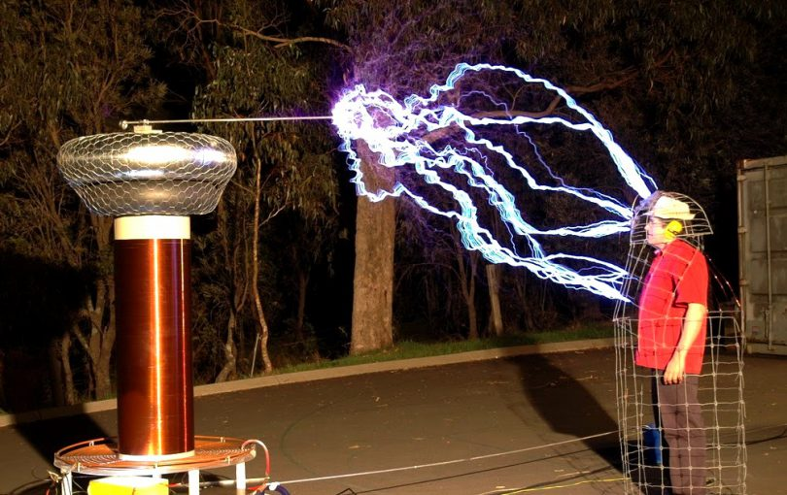

Slide 34
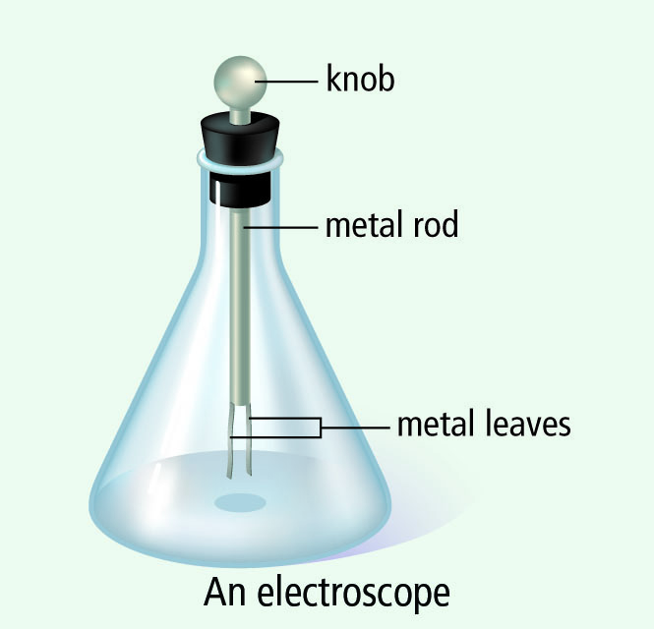
A Metal-Leaf Electroscope
Used to determine the presence of electric charges.
When a negatively charged strip is brought near the electroscope, it induces a separation of charge.
The ball on the top of the electroscope becomes positively charged and the two leaves become negatively charged.
Since the two leaves have the same charge, they repel each other and spread out.
When the charged object is removed, there is no longer and induced separation of charge and the leaves return to their original position.

Slide 35
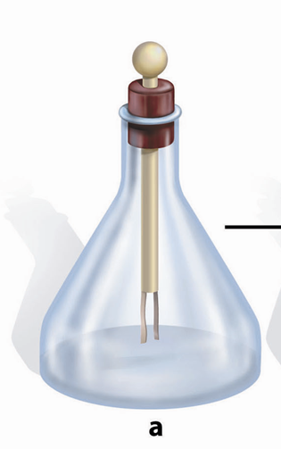

To ensure the electroscope is neutral, all excess charges need to be removed, or discharged, by grounding it.
An object is grounded if it is connected to Earth by a conductor.
If a conductor has a sharp point, that area receives a greater concentration of charge.
This is why lightning rods placed on the top of buildings have a pointed end.
A conductor goes from the rod to the ground which prevents the lightning from going through the building.

Slide 36
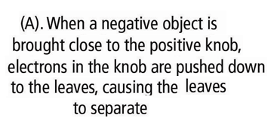
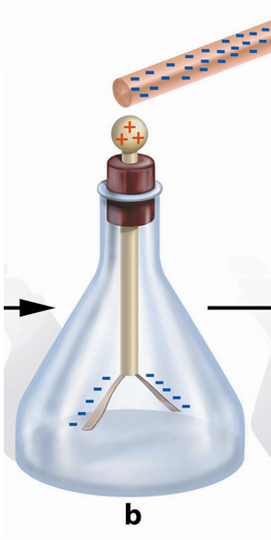
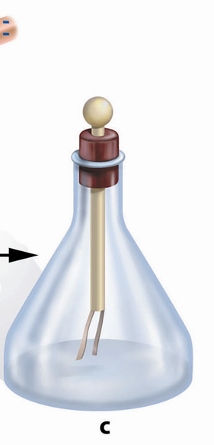
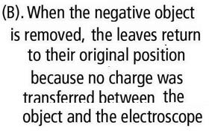


Slide 37
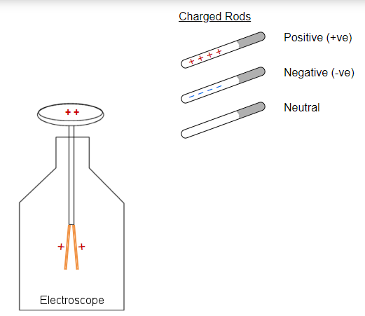
Electroscope simulation:
https://simpop.org/electroscope/electroscope.htm

Slide 38
Bozeman Science
Slow but good. This guy gives good explanation with diagram.
https://www.youtube.com/watch?v=dwJ-MM7yu4E

Slide 39
Homework
Answer questions a-j of Activity 9B In COMPLETE SENTENCES.
Read pages 281-283
Answer CYU p284 #2, 4, 5, 7, 8, 9
WB p

Slide 40
9.4 Electric Force

Slide 41
9.4 Electric Force
The Van de Graff generator is a device that separates large quantities of electric charge.
A charge (negative or positive) is transferred onto a moving belt at the base of the generator and is transferred off the belt onto the metal dome where they spread out across the outside surface.
Can produce very large electric charges which can be used to investigate electric forces.

Slide 42
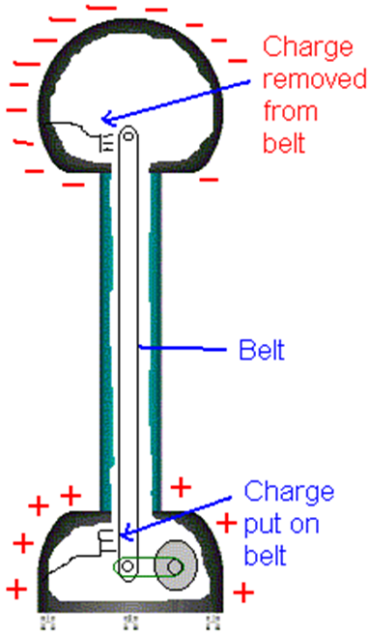
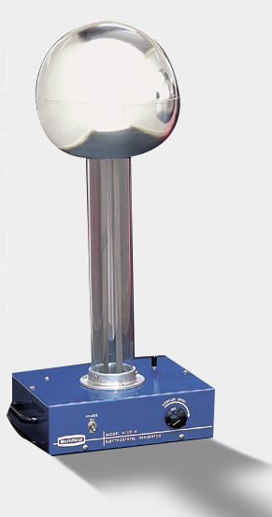
Van de Graff

Slide 43
The electric force (aka electrostatic force) is the force that exists between static charges.
It can either pull charges together (attraction) or push charges apart (repulsion)
The strength of the electric force increases with increasing electric charge and decreases with increasing distance (Coulomb’s Law)
The SI unit for size of the electric charge is called the Coulomb (C)
  Q: is the symbol for charge

Slide 44
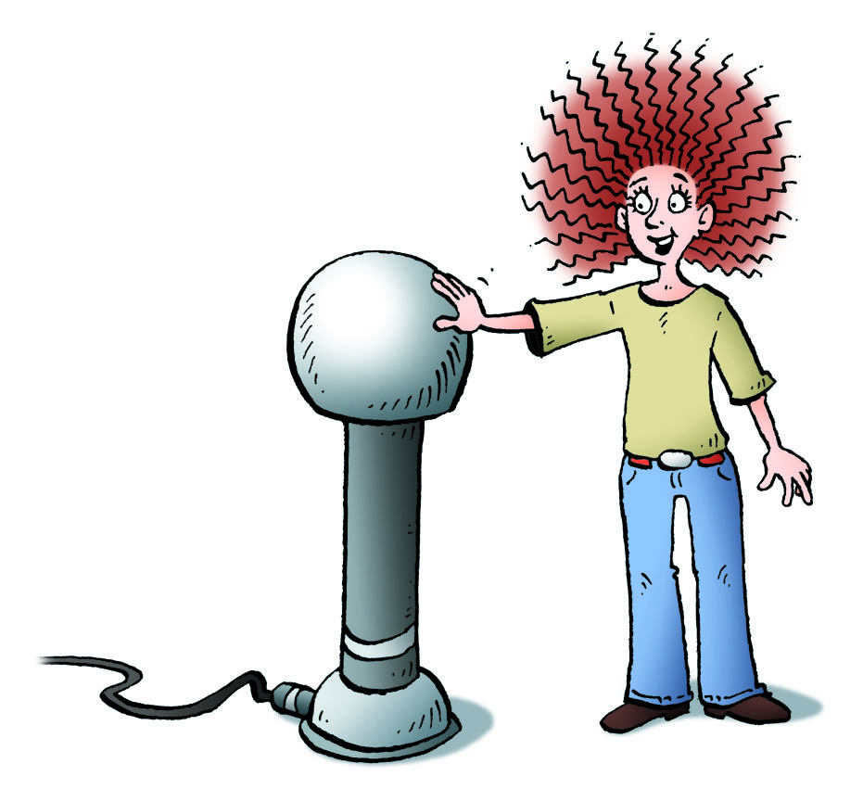
9.5 Applications of Static Electricity
There are several applications of static electricity such as
  Lightning
  laser printers
  fabric softener sheets and static cling
  electrostatic precipitators

Slide 45
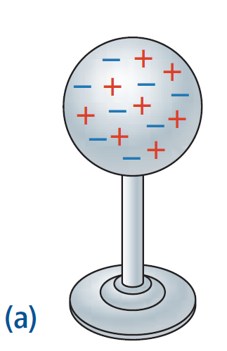
Charging by Conduction (contact)
A neutral metal sphere

Slide 46
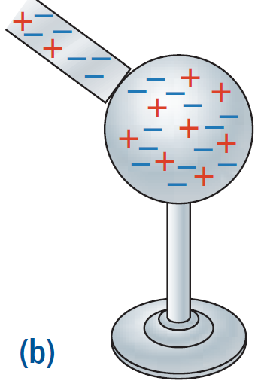
When a negatively charged bar contacts the sphere, some of the extra electrons move to the sphere, giving it a negative charge.

Slide 47
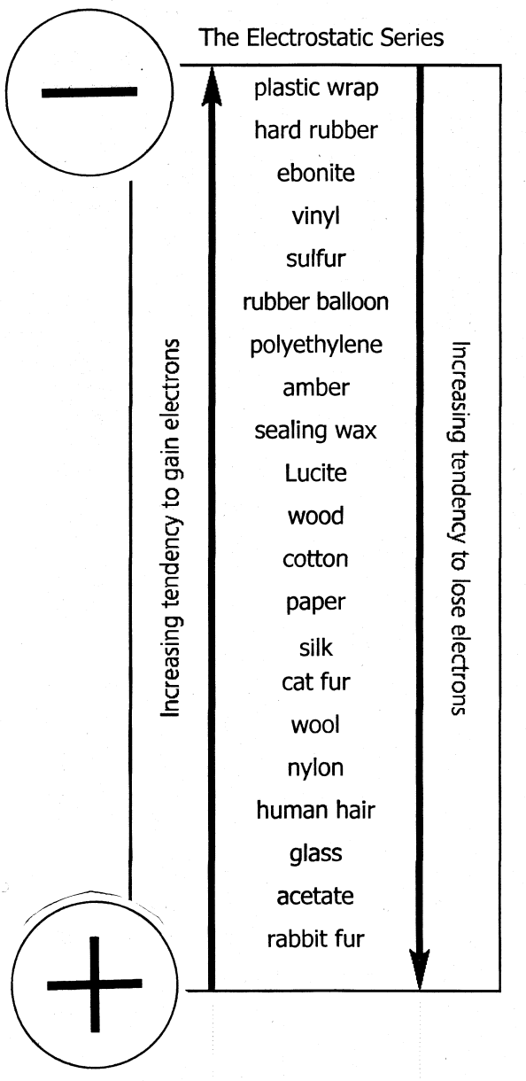
Attraction of Neutral Objects to Charged Objects
When a charged object is brought near to a neutral object, the electrons in the neutral object shift so that the end of the neutral object is attracted to the charged object.
Although there is a slight shift of charges within the neutral object, it does not gain or lose electrons and is still neutral.
This charging effect is known as induced charge separation.

Slide 48
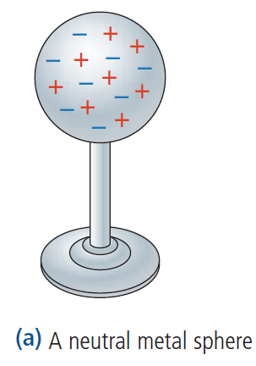
Charging by Induction
What happens when a negatively charged bar comes near the sphere?

Slide 49
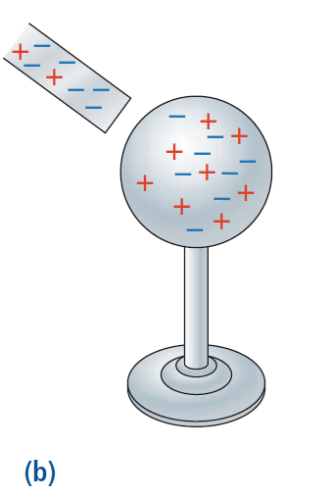
the charge on the bar causes, or induces, the electrons on the sphere to change their position.

Slide 50
9.3 Insulators and Conductors
Some materials are able to acquire electrical charges that stay on them for some time.
These materials are called insulators.
Insulators are substances in which the electrons are so tightly bound to the atoms making up the material that they are not free to move to a neighboring atom.
  E.g. plastic
Other materials, called conductors, allow electrons to flow freely from one atom to another E.g. metals
  See Table 1 (p. 282) for examples of insulators, conductors and semiconductors

