Slide 1
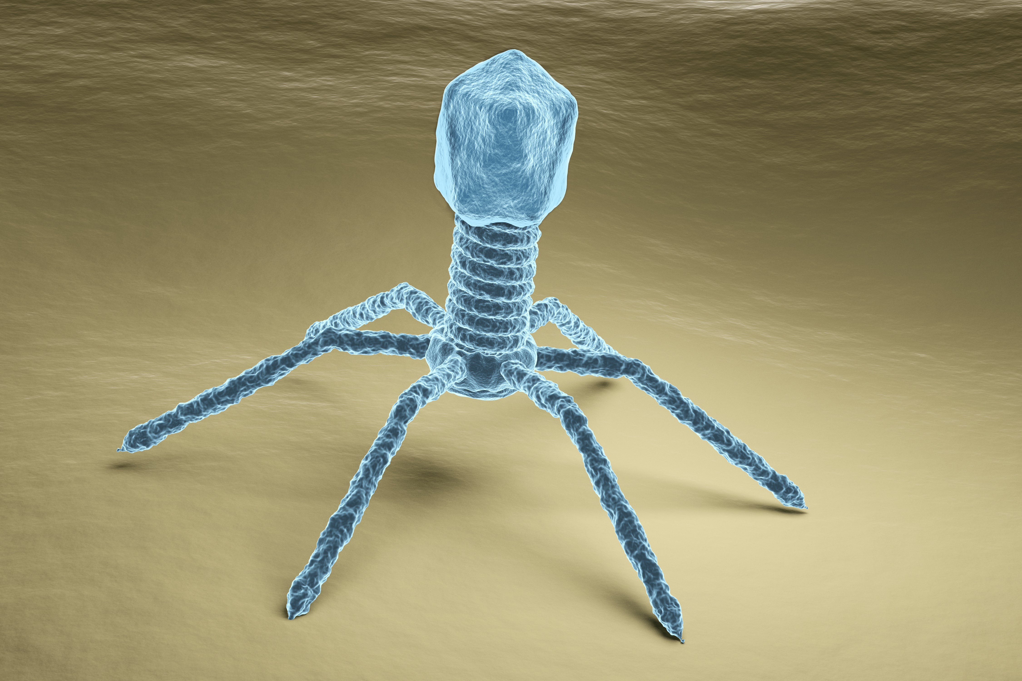
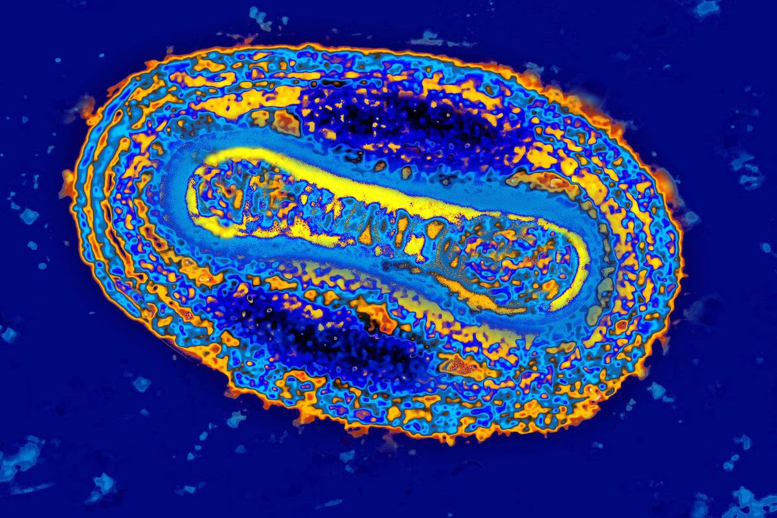
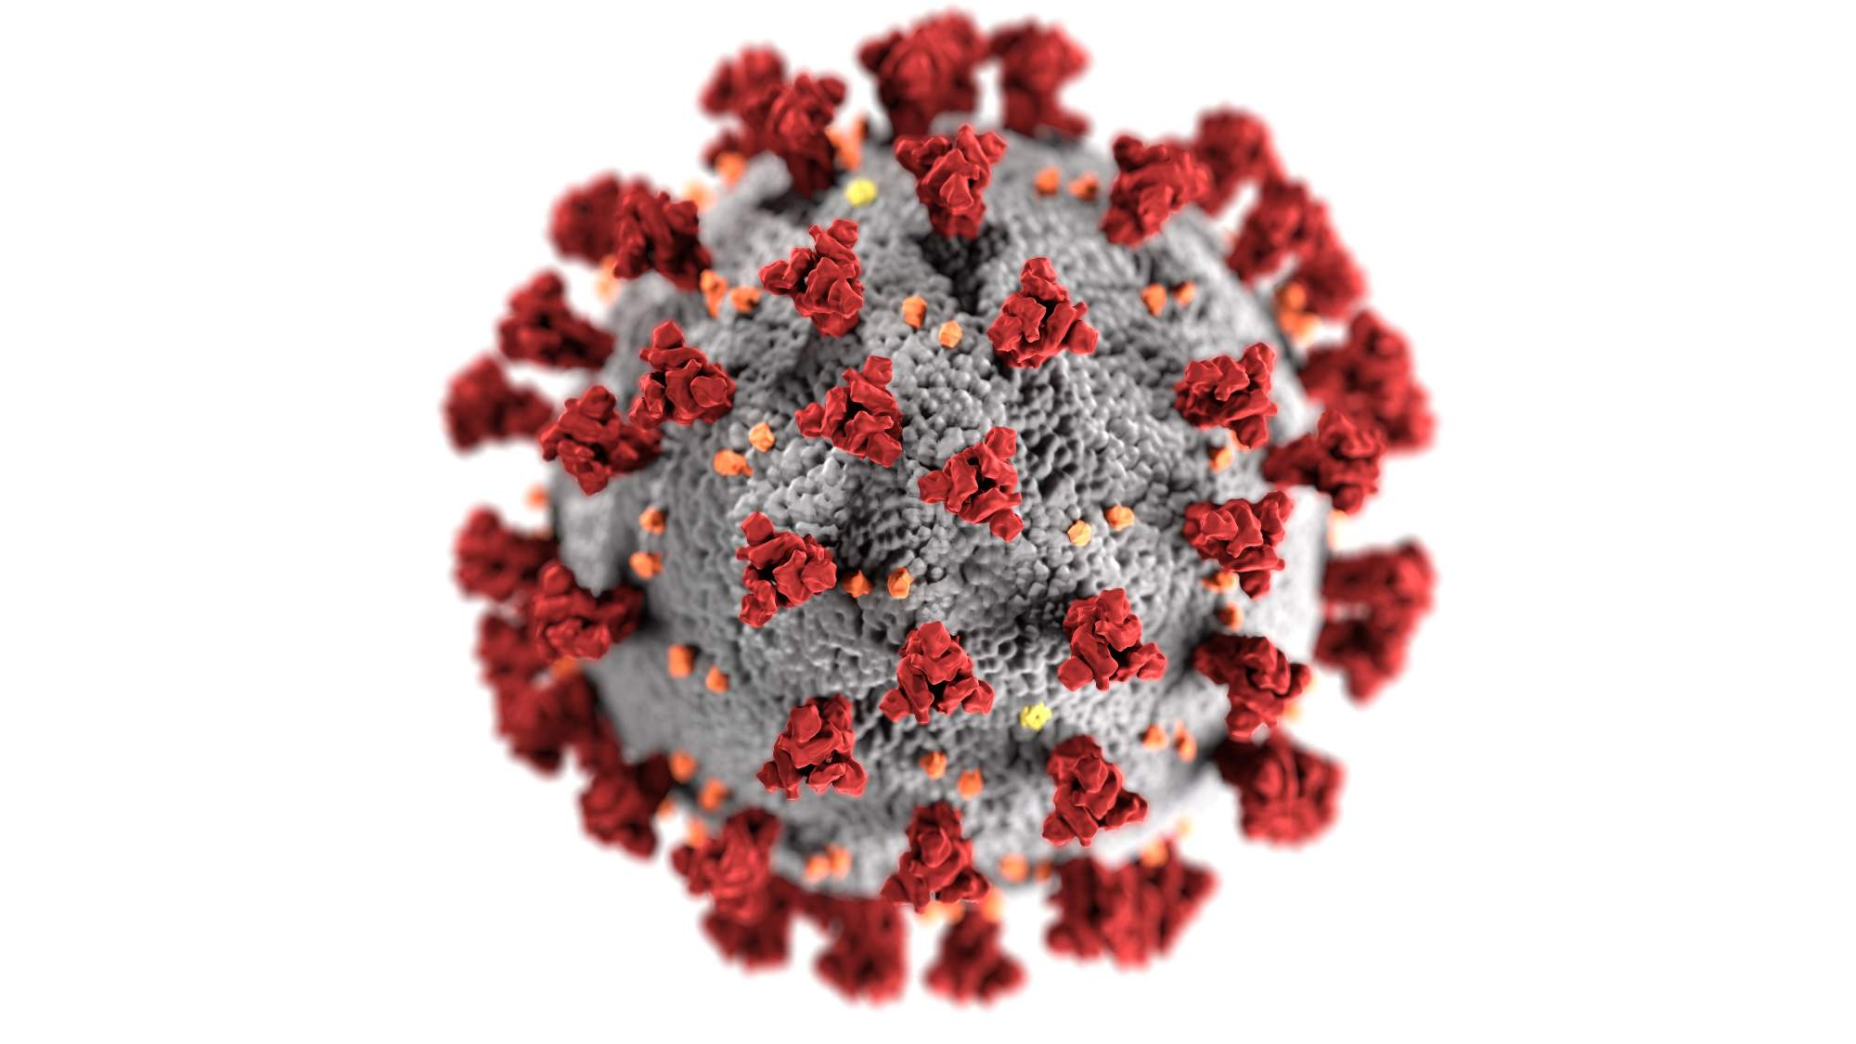
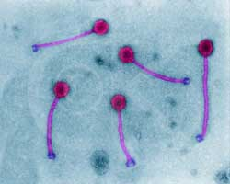
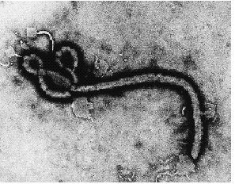
VIRUSES
Chapter 17, pages 355-360

Slide 2
Learning Goals
List evidence whether not viruses are living
Recognize viral size and structure
Define Specificity
List the steps of viral replication and explain what occurs at each step
Describe the lytic and lysogenic cycles of virus replication
Discuss the economic impact of plant and animal viruses
Notes:
Explain the transmission of plant and animal viruses
Discuss some of the diseases caused by plant and animal viruses

Slide 3
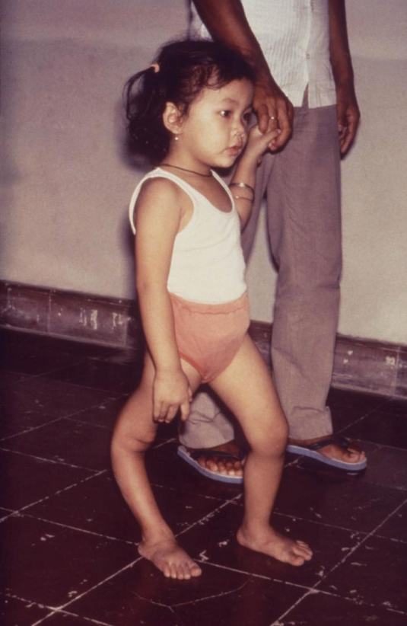
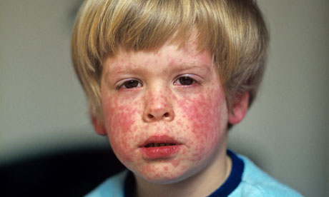
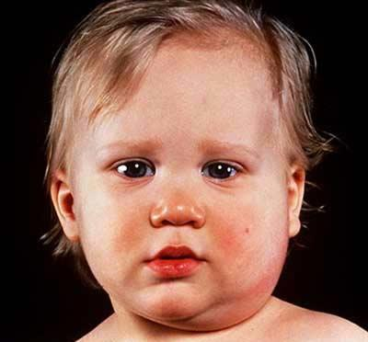
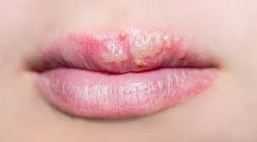
Why study viruses?
Viruses cause numerous diseases:
A.I.D.S., rabies, polio, mumps, warts, measles, common cold, cold sores (herpes simplex), various plants diseases, some cancers
Notes:
From latin word for poison.
All viruses are obligate pathogens as they are dependent on the cellular machinery of their host for their reproduction.
Obligate pathogens are found among bacteria, including the agents of tuberculosis and syphilis, as well as protozoans (such as those causing malaria) and macroparasites.

Slide 4
Are Viruses Alive?
What makes something a living thing?
Respond to a stimulus
Made out of cells
Require a constant energy supply
Growth
Potential for reproduction
Do viruses have these characteristics?

Slide 5
Viruses: Living or Non-living?
Living characteristics Non-living characteristics
Can evolve & mutate. Acellular
Contains nucleic acid and Does not respire
protein Does not grow
Can reproduce inside a living Does not respond to cell (needs a HOST) stimulus
Cannot replicate without a host.
https://scopeblog.stanford.edu/2020/04/02/whats-a-virus-anyway-part-1-the-bare-bones-basics/
Notes:
How many viruses can you name?

Slide 6
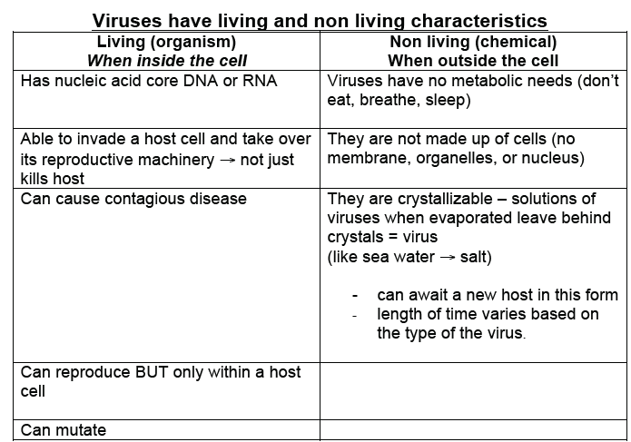
Notes:
Because viruses have characteristics like living and non- living things, they are considered
to be transitional between life and non- life.

Slide 7
What is a virus?
A virus is a noncellular infectious particle that can replicate only in a host cell.
Ameba Sisters, 7 min
https://www.youtube.com/watch?v=8FqlTslU22s
Notes:
Non-cellular particle made up of genetic material (DNA or RNA), surrounded by a protein coat (capsid) and in some cases, lipids.
Vary in size (10-400nm) & shape
Specific viruses affect specific organisms
Viruses can reproduce only by infecting living cells
Virus “injects” its nucleic acid into the cell & alters the normal functioning of the cell

Slide 8
Do all viruses cause disease?
Yes. All viruses are obligate pathogens (require a host to fulfill their life cycle) as they are dependent on the cellular machinery of their host for their reproduction.
A Pathogen is any bacterium, virus, protist, or other microorganism that can cause disease.

Slide 9
Virulence
Etymologically, the term came from Latin vīrulentus, meaning “full of poison”, “toxin”.
A related word, virulent, is a derived word that is used to denote a pathogen as extremely toxic
Virulence is the degree to which a pathogenic organism can cause disease.

Slide 10
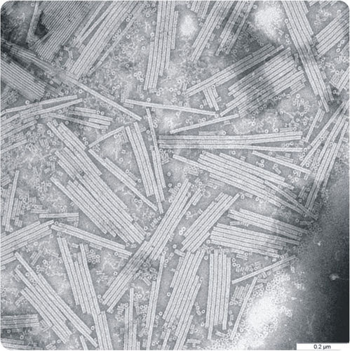
First virus to be discovered: Tobacco Mosaic Virus

Slide 11
How small are viruses? 10-400nm COVID ~ 100nm 1 mm = 10⁶nm
Notes:
Covid: around 100nm but: 20 nm - 500 nm.
the average pore diameter for the reusable mask, surgical mask and N95 mask are ~47, ~33 and ~30 µm, respectively.

Slide 12
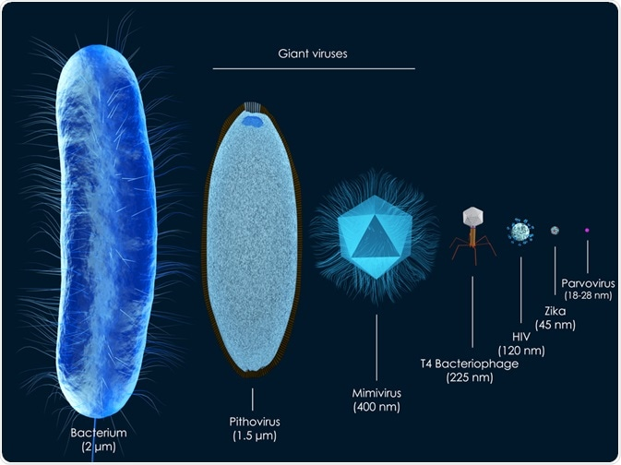
Notes:
Covid: around 100nm but: 20 nm to as large as 500 nm.

Slide 13
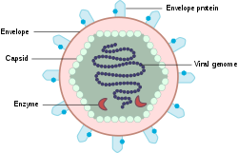
Viral Structure
Core containing nucleic acid- RNA or DNA (but never both)
Capsid (Protein Coat) – surrounds nucleic acid core
sometimes an outer envelope
Viruses may also contain additional proteins, such as enzymes.
Notes:
The capsid is made up of protein subunits called capsomeres.
Sometimes envelope: made of protein and phospholipid membranes derived from the host cell.

Slide 14
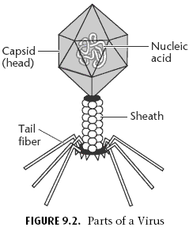
Fibrils (recognize target cells)
Enzyme site (“burns” hole in cell membrane/wall

Slide 15
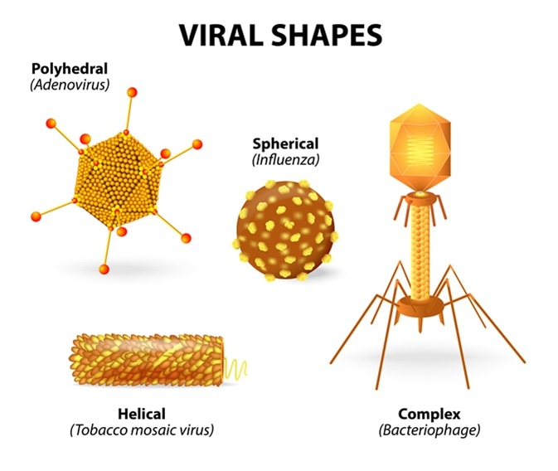
Virus shapes
helical – a hollow cylinder in the shape of a helix (coil)
polyhedral – a regular shape of many sides, usually an icosahedron (20 sides)
enveloped – a helical or polyhedral particle surrounded by an envelope
complex – a wide variety of other irregular shapes
Notes:
helical – a hollow cylinder in the shape of a helix (coil)
polyhedral – a regular shape of many sides, usually an icosahedron (20 sides)
enveloped – a helical or polyhedral particle surrounded by an envelope
complex – a wide variety of other irregular shapes

Slide 16
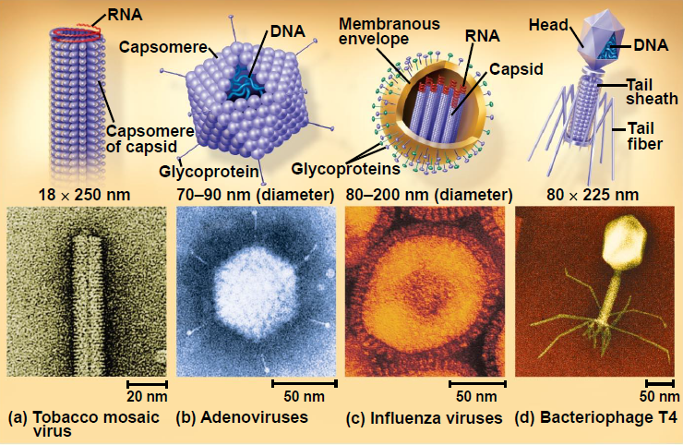

Slide 17
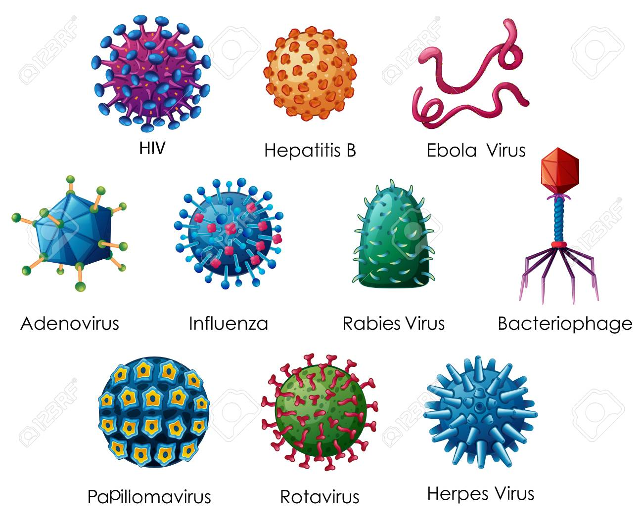
Notes:
Corona virus: common cold to more severe diseases such as Middle East Respiratory Syndrome (MERS) and Severe Acute Respiratory Syndrome (SARS).
Common cold - rhinovirus

Slide 18
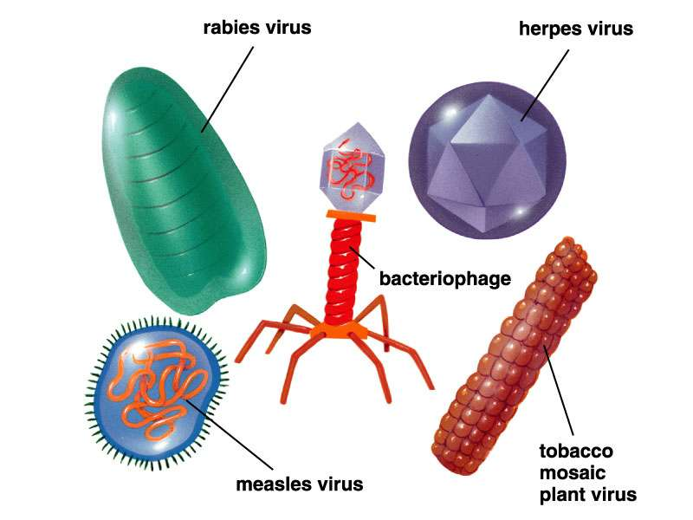
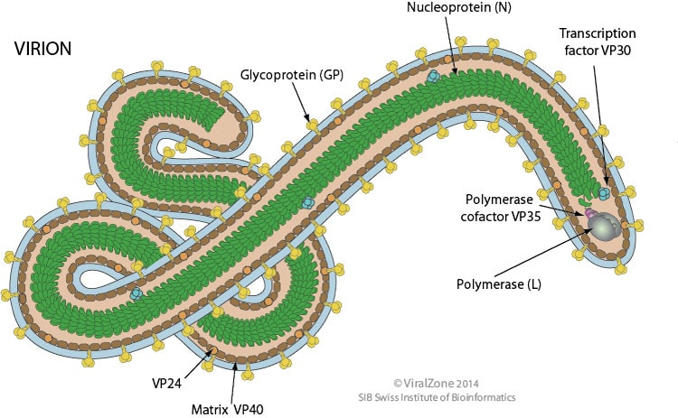
Notes:
Ebola – cylindrical or tubular

Slide 19
Bacteriophages
Also called phages
viruses that only infect bacteria
Most complex capsids among the viruses
Notes:
very specialised shape – like a little moon lander
Elongated capsid head
Protein tail attaches to tail and injects DNA

Slide 20
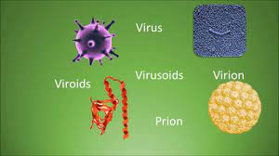
Others: Viroids, Prions, Virion, Virusiods
s
Notes:
The virion, that is the complete infectious virus particle, includes a genome comprising one or a few molecules of either DNA or RNA, surrounded by a morphologically defined protein coat, the capsid; the capsid and the enclosed nucleic acid together constitute the nucleocapsid.

Slide 21
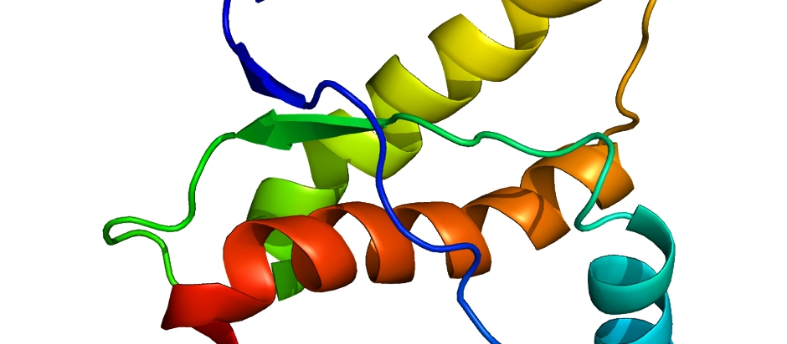
Other Non-Cellular Pathogens
Prions – type of protein that can cause disease in animals and humans by triggering normally healthy proteins in the brain to fold abnormally.
No genetic material.
Rare, fatal, degenerative brain disorders that are thought to occur worldwide in both humans and animals.
Eg. Mad Cow Disease and Creutzfeldt-Jakob Disease
http://highered.mcgraw-hill.com/olc/dl/120088/bio43.swf
Notes:
A prion is a type of protein that can trigger normal proteins in the brain to fold abnormally. Prion diseases can affect both humans and animals and are sometimes spread to humans by infected meat products.
Prions cause neurodegenerative disease by aggregating extracellularly within the central nervous system to form plaques known as amyloids, which disrupt the normal tissue structure. This disruption is characterized by "holes" in the tissue with resultant spongy architecture due to the vacuole formation in the neurons.
Prion diseases occur when normal prion protein, found on the surface of many cells, becomes abnormal and clump in the brain, causing brain damage. This abnormal accumulation of protein in the brain can cause memory impairment, personality changes, and difficulties with movement.

Slide 22
Other Non-Cellular Pathogens
Viroid - small, circular, single-stranded molecules of infectious RNA that cause several plant diseases
composed of single strand of RNA with no capsid.
http://highered.mcgraw-hill.com/olc/dl/120088/bio43.swf

Slide 23
Virion Vs Virus
Viruses are nucleoproteins. They are non-cellular structures with infectious genetic material.
Virions are capsid-encapsulated viruses with DNA or RNA molecules. It has both nucleic acid as well as protein layers.

Slide 24
Retrovirus
Virus that uses RNA
Makes a DNA copy to into the host cell
Eg. HIV

Slide 25
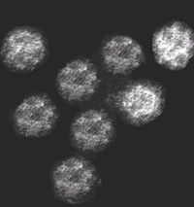
Specificity:
Viruses are host-specific - they only can attach to and infect cells of certain organisms.
The virus will attach to a specific receptor on the host cell via proteins on the capsid or envelope.
Each virus has a host range: a limited number of host cells that it can infect
Eg. Rotaviruses attack cells of the intestinal tract
Eg. Calici virus causes gastrointestinal infection
diarrhea, vomiting, fever. etc
Notes:
Viruses are host-specific because they only can attach to and infect cells of certain organisms. Cells that a virus may use to replicate are called permissive. The virus attacks the host cell by first attaching to a specific receptor site on the membrane of the host cell.

Slide 26
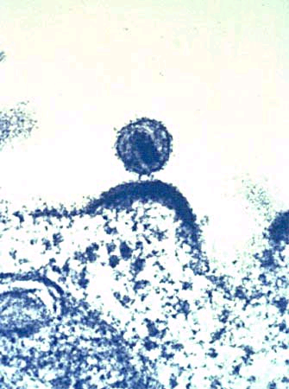
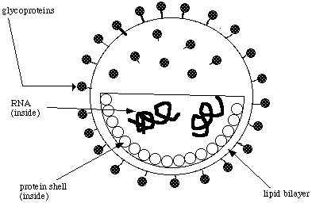
Eg. HIV- Human immunodeficiency virus
A retrovirus that attacks T-4 cells - a special type of white blood cell

Slide 27
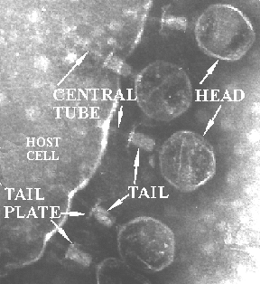
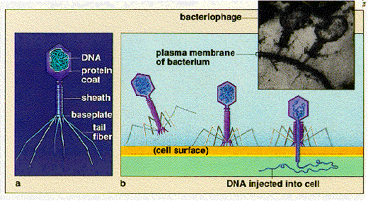
Eg. Bacteriophages attack bacteria

Slide 28
How did viruses come to be?

Slide 29
Escape hypothesis or Progressive Hypothesis
Viruses might have come from broken pieces of genetic material inside early cells.
These pieces were able to escape their original organism and infect another cell.
In this way, they evolved into viruses.
Modern-day retroviruses, like the Human Immunodeficiency Virus (HIV), work in much the same way.

Slide 31
Notes:
also called the Regressive Hypothesis.
Viruses might have come from more complex organisms.
This could have happened when two single-celled organisms formed a mutualistic or cooperative relationship.
At some point, this relationship would have become parasitic.
This happens when one organism starts to rely on the other organism to stay alive.
As the smaller organism became more and more dependent on the larger organism, it lost its protein-building structures. However, it could still replicate itself. This new organism would be able to infect new organisms. It is now a virus.

Slide 32
Reduction Hypothesis
also called the Regressive Hypothesis.
Viruses might have come from more complex organisms.
This could have happened when two single-celled organisms formed a mutualistic or cooperative relationship.
At some point, this relationship would have become parasitic.
This happens when one organism starts to rely on the other organism to stay alive.
As the smaller organism became more and more dependent on the larger organism, it lost its protein-building structures. However, it could still replicate itself. This new organism would be able to infect new organisms. It is now a virus.

Slide 33
Virus-first hypothesis
Viruses might have come from pieces of RNA that existed before the first cells.
They slowly became more complex.
Eventually they gained the ability to self-replicate and infect other cells.
Notes:
The sugar-phosphate “backbone” of RNA contains ribose instead of deoxyribose.
RNA has self-complementary sequences.
This allows parts of it to pair and fold with itself, like a protein.

Slide 34
Practice
Virus WS
10min: https://www.youtube.com/watch?v=wUgEhfo_qxU

Slide 35
Extra Slides Beyond Here

Slide 36
zoonotic
Viruses that infect animals only
Viruses that infect both humans and animals

Slide 37
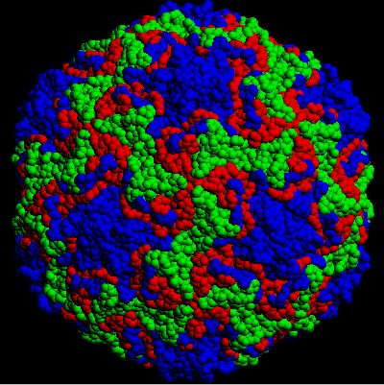
Rhinovirus – cold virus
Attacks cells in the nasal lining
Blue, red & green are interlocking proteins in the capsid

Slide 38
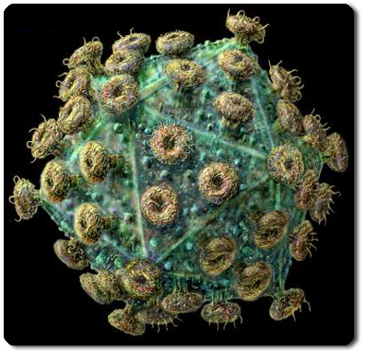
HIV- Human immunodeficiency virus

Slide 39
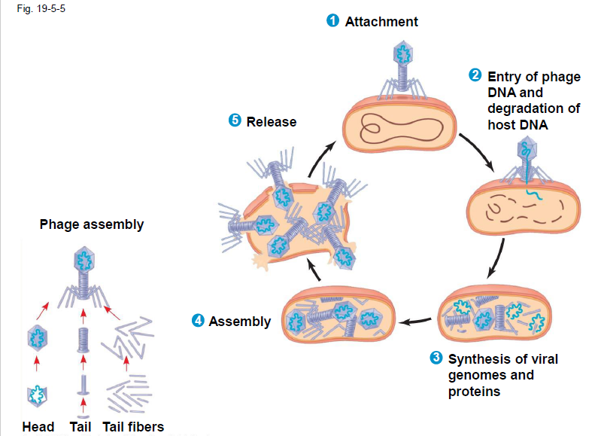

Slide 40
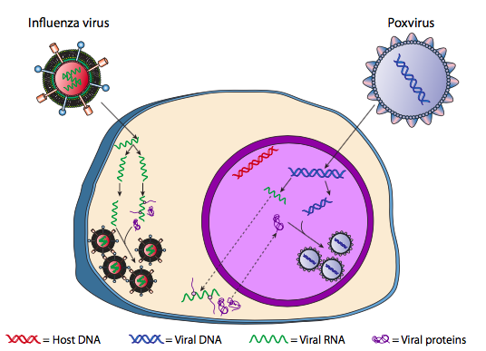
Lytic viruses in eukaryotes
an RNA virus (influenza) replicates completely in the cytoplasm, while the DNA virus (poxvirus) uses both cytoplasm and nucleus.
Notes:
In eukaryotes, the mechanism is slightly more complicated by the nucleus. The DNA is transported into the nucleus, where the transcription and replication take place. Although the viral mRNA is transported out to the cytoplasm for translation as expected, the resulting capsid proteins are then imported back into the nucleus, where the virion particles are assembled. Lytic plant and animal viruses with RNA genomes can bypass the nucleus altogether, and the genome replication, protein synthesis, and particle assembly all occur in the cytoplasm.

Slide 41
Lytic viruses in eukaryotes
an RNA virus (influenza) replicates completely in the cytoplasm, while the DNA virus (poxvirus) uses both cytoplasm and nucleus.
Notes:
In eukaryotes, the mechanism is slightly more complicated by the nucleus. The DNA is transported into the nucleus, where the transcription and replication take place. Although the viral mRNA is transported out to the cytoplasm for translation as expected, the resulting capsid proteins are then imported back into the nucleus, where the virion particles are assembled. Lytic plant and animal viruses with RNA genomes can bypass the nucleus altogether, and the genome replication, protein synthesis, and particle assembly all occur in the cytoplasm.

Slide 42
Virus Shapes
Helical - Rodlike (Tobacco Mosaic Virus)
Polyhedral - Many sides
Bacteriophage - viruses that infect bacteria. Sometimes referred to as a phage for short. Looks like a Lunar lander.

Slide 43
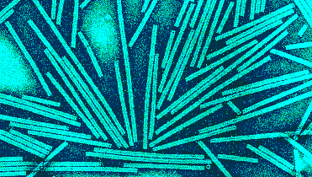
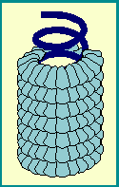
Helical Viruses

Slide 44
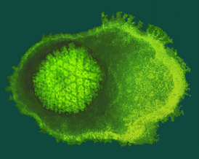
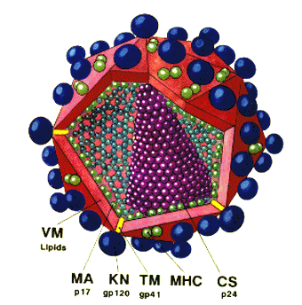
Polyhedral Viruses
Virus (capsid)
Envelope

Slide 45
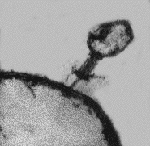
Bacteriophages
http://www.seyet.com/bacteriophage-t4

Slide 46
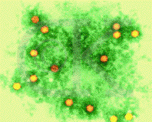
Polio Virus

Slide 47
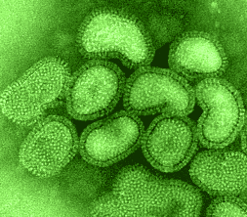
Influenza Virus

Slide 48
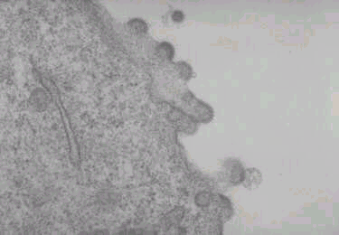
HIV bursting out of Human Blood Cell

Slide 49
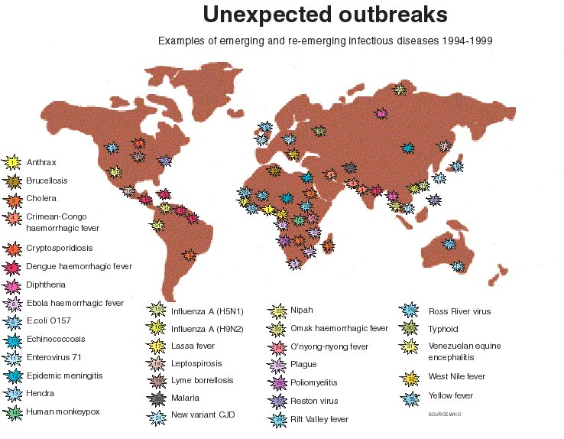
EMERGING VIRUS - a virus that evolves in a geographically isolated area and is pathogenic to humans.

