Slide 1
Safety in the Laboratory

Slide 2
Safety Video
https://www.youtube.com/watch?v=3ELbwzqyuhs
Amoeba Sisters
https://www.teachingexpertise.com/classroom-ideas/lab-safety-activities-for-middle-school/
https://www.youtube.com/watch?v=VXB1HWnjQBA

Slide 3
GENERAL RULES
Listen to and read all instructions. If you are still unsure what to do, ask the teacher.

Slide 4
GENERAL RULES
Tell teacher about allergies or anything else that could stop you from hearing, seeing, or doing the lab

Slide 5
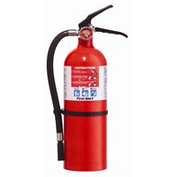
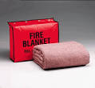
GENERAL RULES
Know where to find and how do use emergency equipment:
Eye wash station
Emergency shower
Fire extinguisher
Fire blanket
Fire alarm
Spill kit

Slide 6
Emergency Eye Wash Flush for 15 min

Slide 7
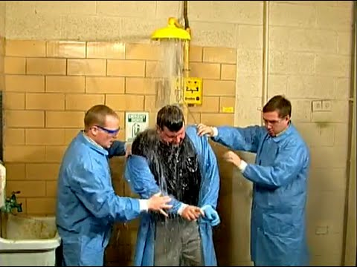
Safety Shower
Use if you spill a large amount of corrosive liquid on you or your clothes

Slide 8
Fire Extinguisher: PASS

Slide 9
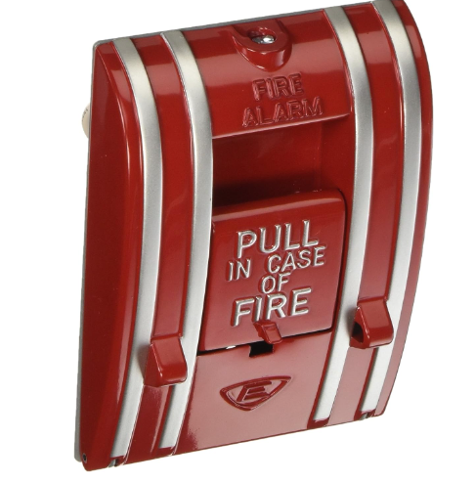
Fire Blanket, Fire Pull Station

Slide 10
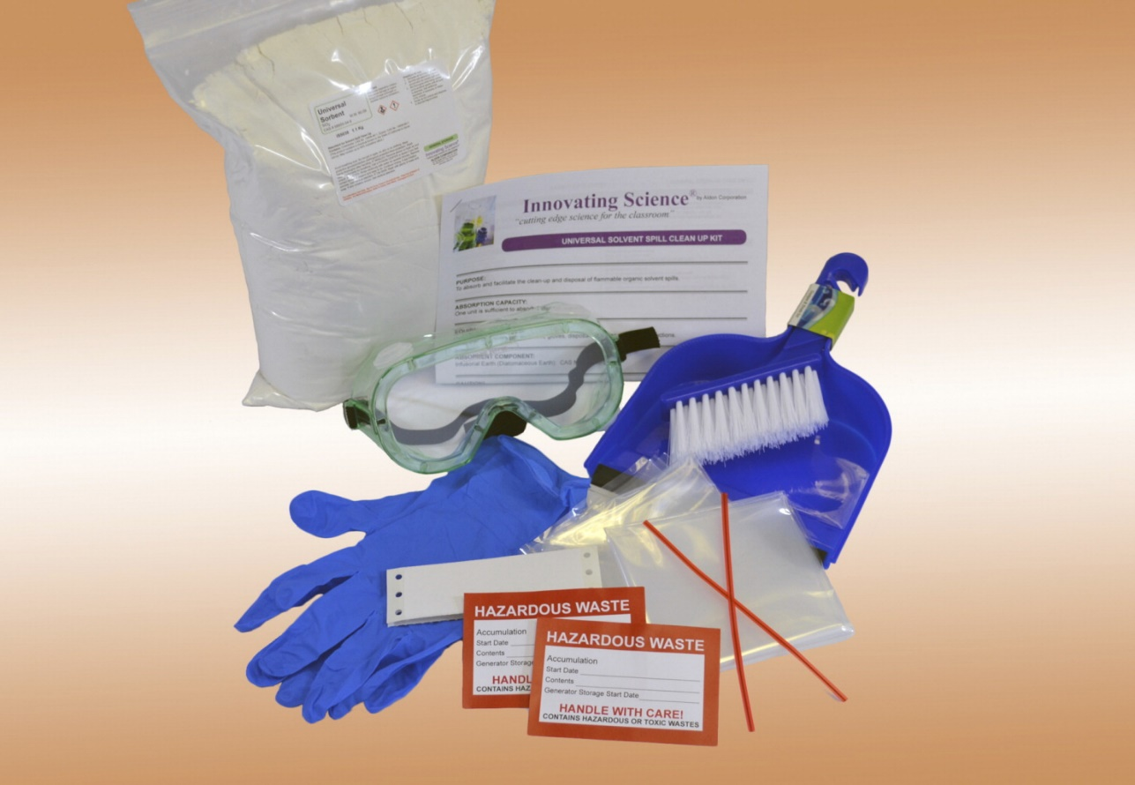
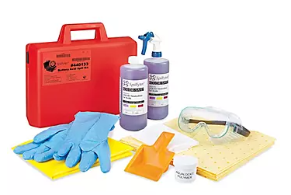
Spill kit
For large spills on floor.
Contains gloves and absorbent material to neutralize volumes of liquid acids or bases.

Slide 11
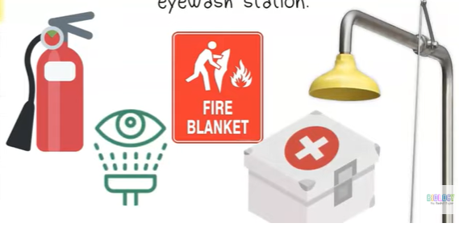
Video on how to use safety equipment, 3 min
https://www.youtube.com/watch?v=Y-dhcOqL5WA

Slide 12
GENERAL RULES
Report any accidents to teacher

Slide 13
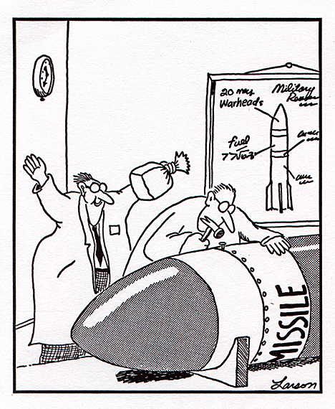
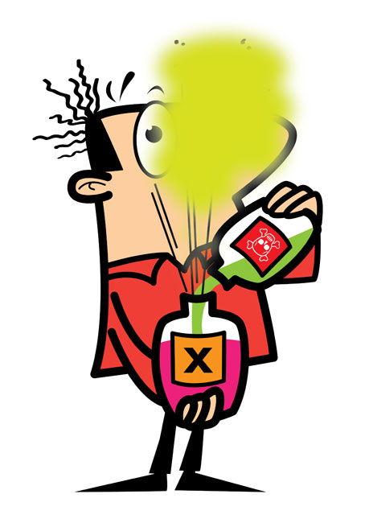
Behave Responsibly
No Horseplay
No unauthorized experiments - Do not use any equipment or mix chemicals without proper instruction

Slide 14
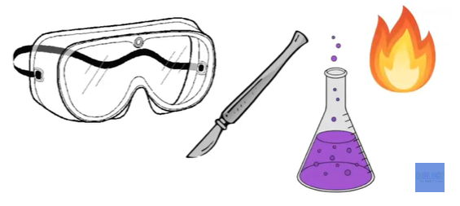
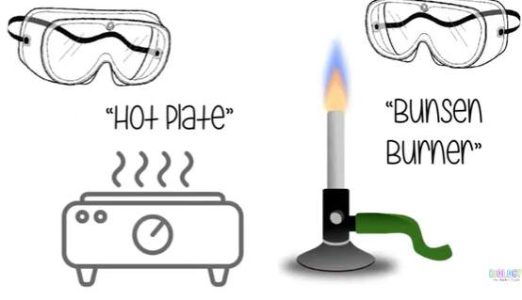
Behave Responsibly
Wear goggles when working with heat, chemicals, sharp objects

Slide 15
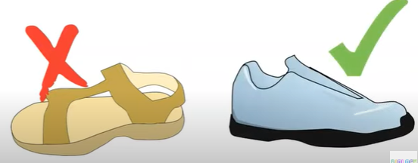
No open-toe shoes
Why not?

Slide 16
Tie back long hair, loose clothing, dangling jewelry.
Why?

Slide 17
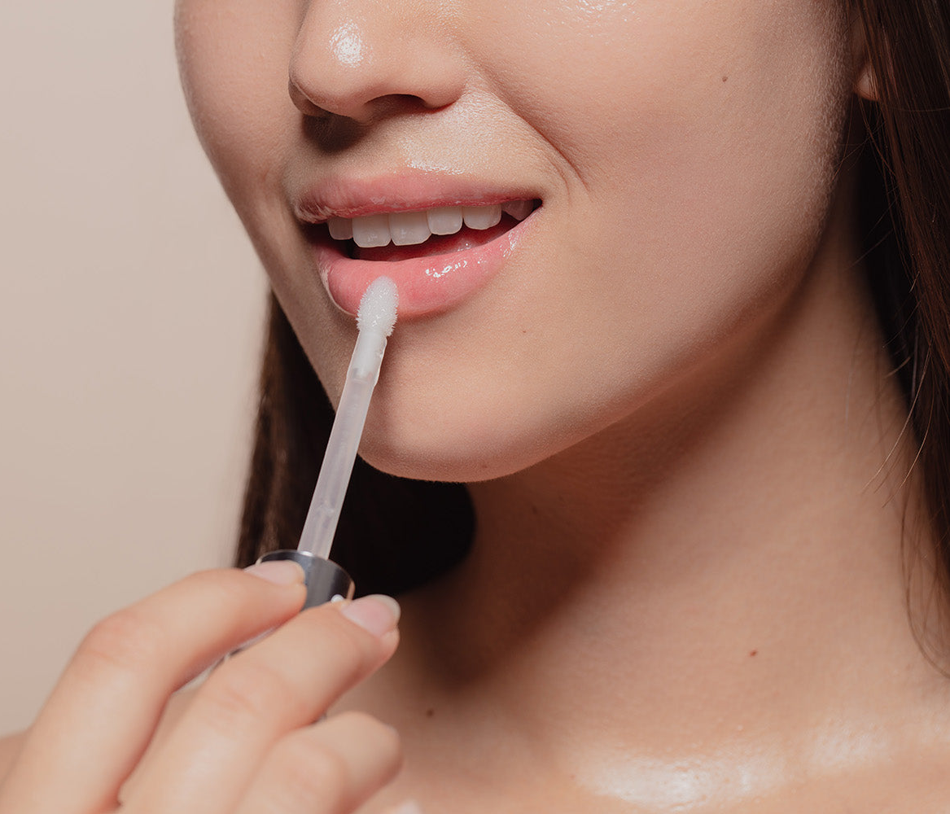
Do not chew gum, eat, drink, apply make up in the lab.
Do not taste or put anything in your mouth.
What is the reasoning?

Slide 18
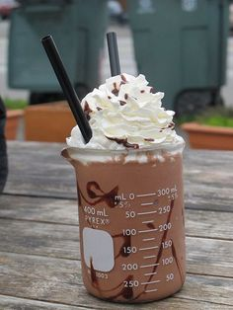
Behave Responsibly
Use equipment properly for intended purpose.
Tell teacher if you see something unsafe or equipment is broken

Slide 19
Working with Glass
Never use cracked or broken or glassware. Why not?
Notes:
Never pick up with your bare hands.
Never force glass tubing into a cork or stopper.

Slide 20
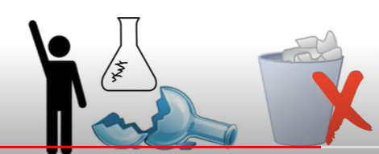
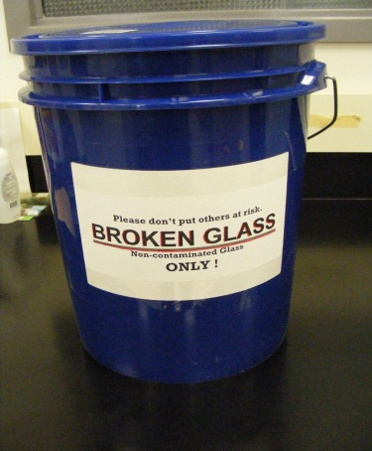
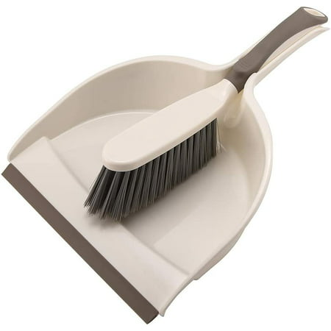
Clean up broken glassware:
Do not pick up broken glass with your hands.
SWEEP with paper towel or broom into dust pan and place in designated “broken glass” container.
Notes:
Never pick up with your bare hands.
Never force glass tubing into a cork or stopper.

Slide 21
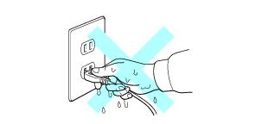
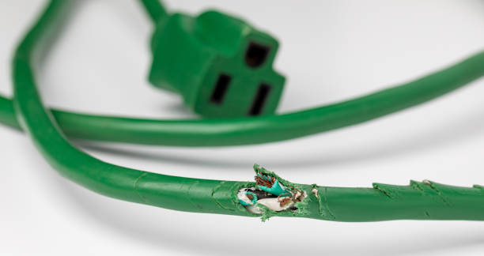
Electrical Safety:
Do not use equipment with frayed cords
Make sure hands are dry.
Pull the plug, not the cord when unplugging electrical equipment
Notes:
Why? Weak spot on the cord make break.

Slide 22
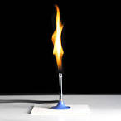
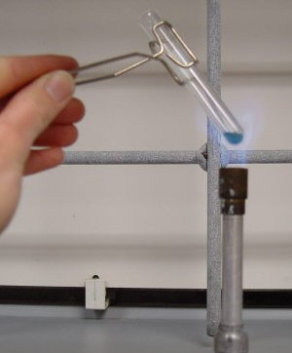
Working with Heat
NEVER leave a heating objects unattended
Do not heat closed containers.
Point open glassware away from you and partner.
Use correct clamp or tongs,
Do not reach over the flame.
Wea goggles.
If you burn yourself, immediately run cold water on the burn and tell teacher

Slide 23
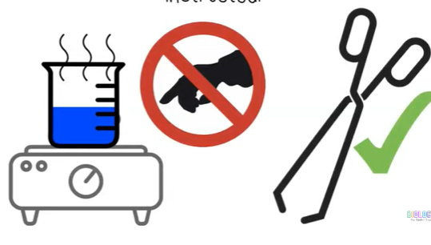
Working with heat
cc

Slide 24
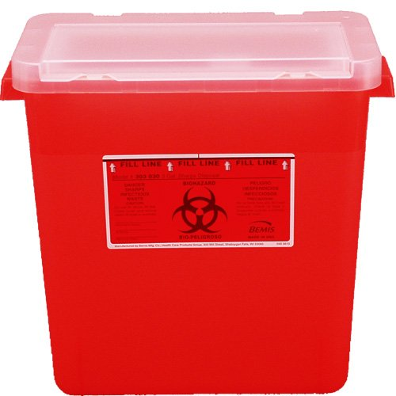
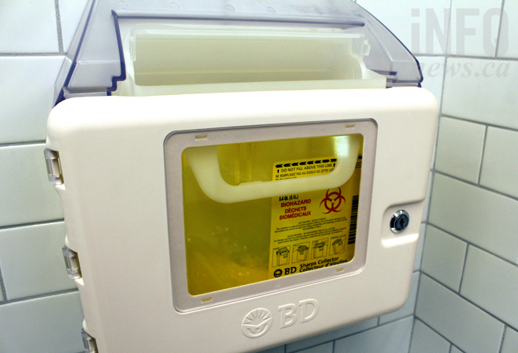
Sharps Safety:
Always cut away from you
Place used sharps in correct receptacle.

Slide 25
Chemical Safety
Treat all chemicals as if they were harmful

Slide 26
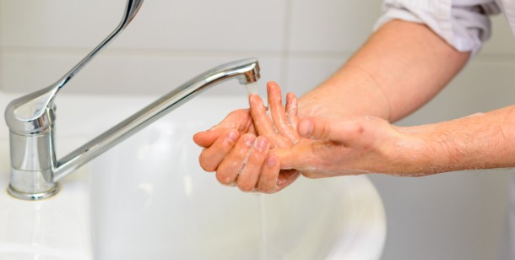
Chemical Safety
For small chemical spills on skin: Rinse with water

Slide 27
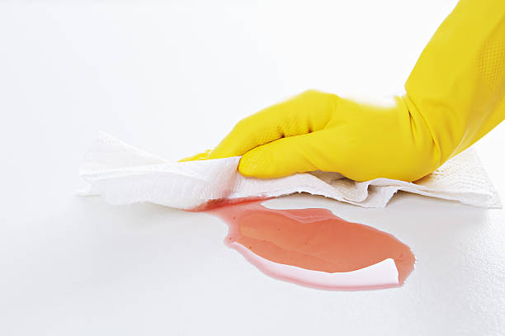
Chemical Safety
Small amount on bench: Wipe it up with paper towel.

Slide 28
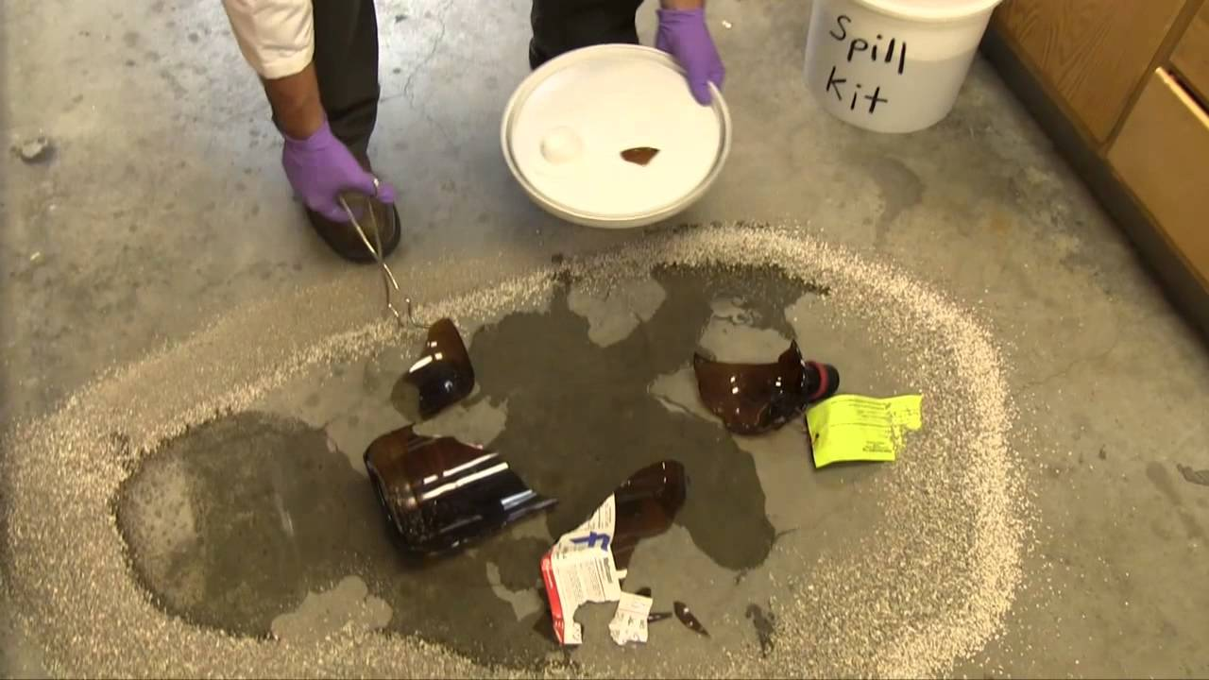
Chemical Safety
Large amount on floor: spill kit

Slide 29
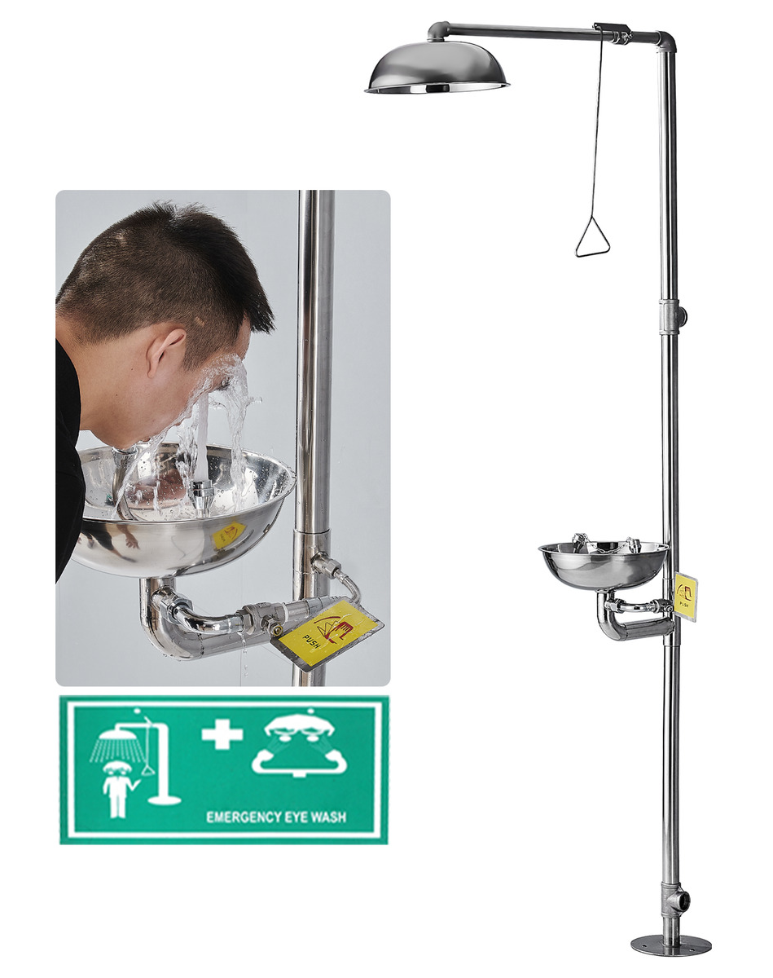
Chemical Safety
Any amount in eyes: Emergency Eye Wash
Large amount on clothes: Emergency Shower

Slide 30
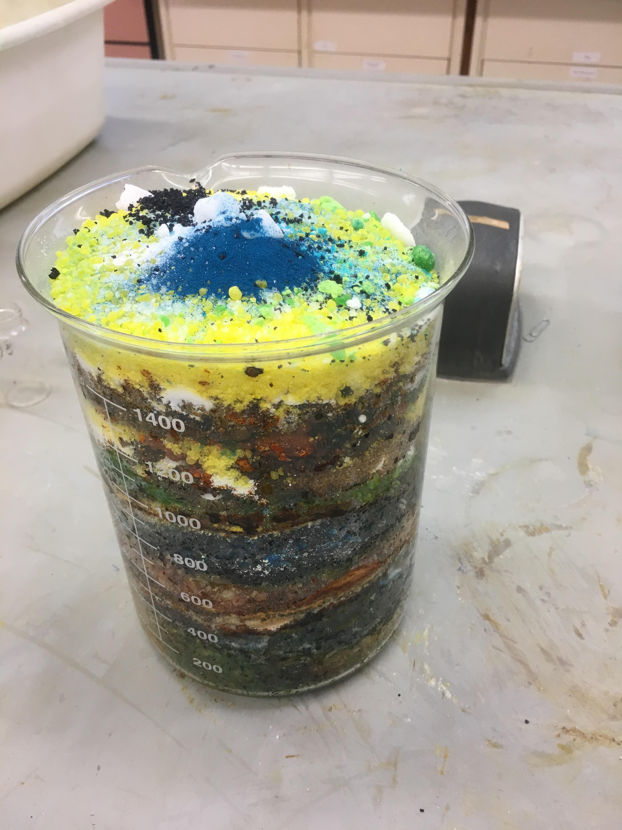
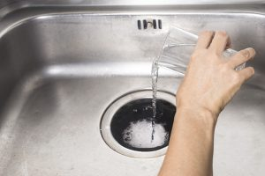
Chemical Disposal:
Check with teacher how to dispose of used chemicals:
Some→ Designated waste container
Some → drain

Slide 31
Detecting Odor: Waft

Slide 32
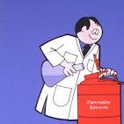
Clean up when finished
Clean glassware and place on drying rack.
Return other materials, equipment, waste to appropriate locations
Dispose of Chemicals properly
Wipe bench/counter.
Wash hands with soap and water.
Do not leave until your group has completely cleaned up.

Slide 34
Safety Video Rap
https://www.youtube.com/watch?v=xJG0ir9nDtc
ASAP Science https://www.youtube.com/watch?v=BRDApYgvDqQ

Slide 35
Chemical safety
Dispose of chemicals properly: some can go down drain, but some need to go in designated waste container. Check with teacher.
Do NOT put unused chemicals back into original stock container.
Notes:
Don’t mix chemicals if you are not supposed to

Slide 36
Practice
Safety Scenarios - in class
Safety Map – Hand in

