Slide 1
Safety in the Laboratory

Slide 2
Safety Video
https://www.youtube.com/watch?v=3ELbwzqyuhs

Slide 3
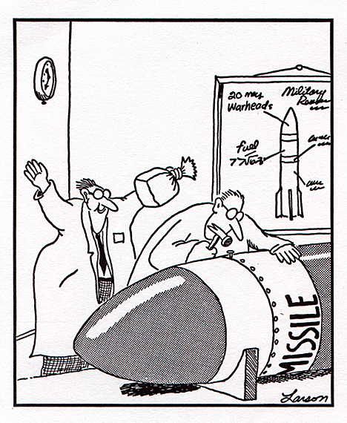
Behave Responsibly
No Horseplay
Arrive prepared
Be conscientious of your surroundings (equipment and partners)

Slide 4
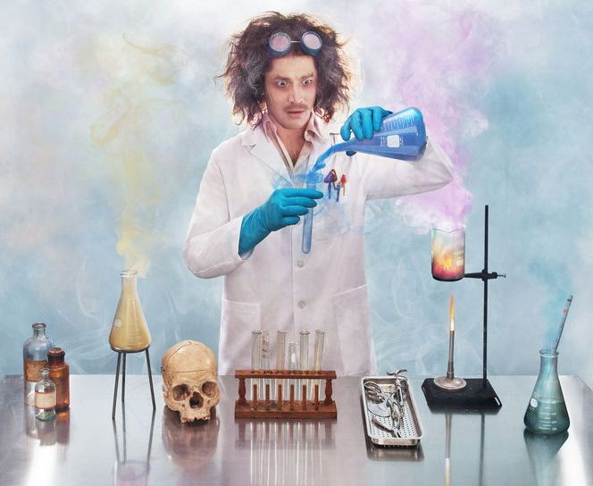
No unauthorized experiments
Do not use any equipment or instruments without proper instruction.
Follow all instructions given by the instructor including special direction for all individual experiments.
Notes:
If teacher asks class to stop, everyone must stop and what for further instructions.

Slide 5
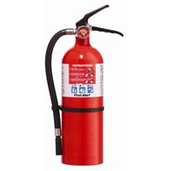
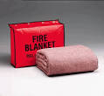
Know the location of all safety equipment and how to use it:
Fire pull station, fire blanket, fire extinguisher emergency shower, emergency eye wash.
Report accidents to your teacher

Slide 6
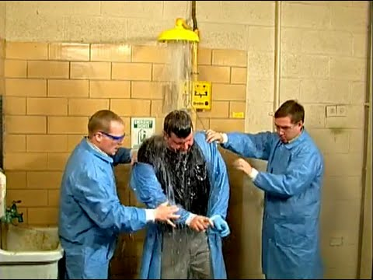
Safety Shower
Safety before modesty

Slide 7
Emergency Eye Wash – 15 min

Slide 8
Fire Extinguisher

Slide 9
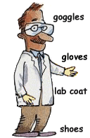
Wear protective equipment
safety goggles, gloves, lab coat to protect against burns and/or chemical spills.
Wear goggles when using liquids, powders, fire.
No open toe shoes
Inform the instructor of contact lenses.

Slide 10
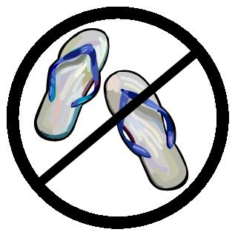
Dress appropriately:
tie back loose hair
No open toe shoes
Secure loose clothing or jewellery

Slide 11
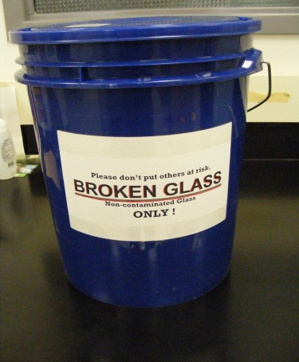
Glassware Safety:
Never use chipped, cracked or broken or glassware.
Never pick up broken glass with your bare hands.
Sweep broken glass in the “broken glass” container.
Never force glass tubing into a cork or stopper.

Slide 12
Electrical Safety:
Do not use electrical cords that are frayed.
Always pull on the plug, not the cord.
Notes:
Why? Weak spot on the cord make break.

Slide 13
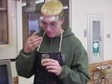
Chemical safety
Treat all chemicals as if they are harmful
Avoid inhaling fumes, tasting, touching, smelling any chemical unless specifically told to do so by the instructor.
Waft if you need to detect an odor.

Slide 14
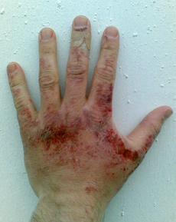
Chemical Safety
If chemical splashes on skin or clothing, rinse immediately with large quantities of water.
Used chemicals go into designated waste container.
When mixing water and acid, always pour acid into the water. Acid → Water.

Slide 15
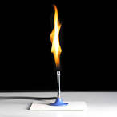
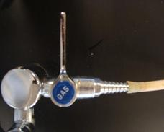
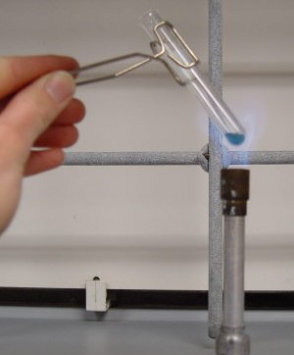
Fire Safety:
Never leave a Bunsen burner unattended. Turn off gas valves when not in use.
When heating, point open glassware away from yourself and partner. Use tongs.
Do not heat closed containers.
Arrange your work space so you do not have to reach over the flame.
Tie back long hair, loose clothing

Slide 16
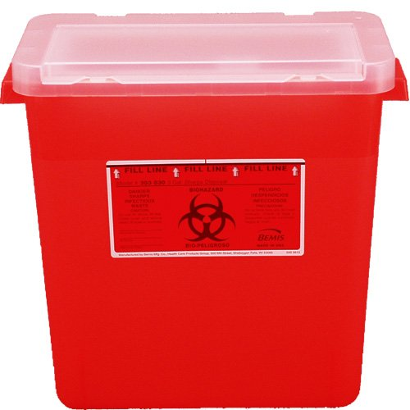
Sharps Safety:
Always cut away from you
Place used sharps in correct receptacle.

Slide 17
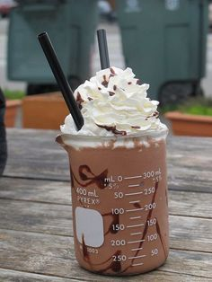
Food Safety
Do not eat, drink, smoke, chew gum or apply makeup in the lab.
Do not use any lab containers for food or drink.

Slide 18
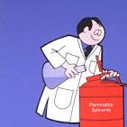
Clean Up When Finished:
Return all materials to their proper places.
Dispose of wastes properly.
Wipe bench.
Wash your hands with soap and water after working in the lab.

Slide 21
Safety Video Rap
https://www.youtube.com/watch?v=xJG0ir9nDtc
ASAP Science https://www.youtube.com/watch?v=BRDApYgvDqQ

Slide 22
Homework
Safety Poster

