Slide 1
Properties of Matter: Density

Slide 2
DENSITY
Density is another physical property of matter.
Density describes how TIGHTELY PACKED the particles are in a material.
It is the amount of MASS per unit of VOLUME.
It is measured in g/ml or g/cm³

Slide 3
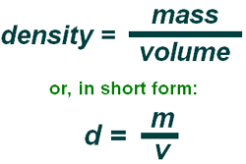
Density
Density Formula:

Slide 4
CALCULATING DENSITY
The mass of a rock is 75g and its volume is 3cm³. Determine the density of the rock.
Step 1: list the known and unknown quantities
Mass =
Volume =
Density =

Slide 5
CALCULATING DENSITY
2. A bottle of orange juice has a volume of 100ml and a mass of 250 grams. Calculate the density of the orange juice in g/ml.

Slide 6
CALCULATING DENSITY
3. A rock is dropped into a can of water and causes 25ml of water to be displaced. The mass of the rock is 150g. Calculate the density of the rock in g/cm3.

Slide 7
CALCULATING DENSITY
4. The dimensions of a rectangular block of wood are 5 cm for width, 10cm for length and 2 cm for height.
Find the volume of the block.
If the mass is 65g, what is the density of the block?
Will the block float or sink in water? Give a reason for your answer.

Slide 8
Practice: Density Calculations WS

Slide 9
Density and state of matter
Most substances are MORE dense in their SOLID form than in their liquid state.

Slide 10
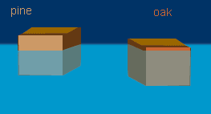
DENSITY
Density can be used to Predict whether an object will SINK or FLOAT in a fluid.

Slide 11
Sink or float
An object that is LESS dense than its surroundings will FLOAT.
An object that is MORE dense than its surroundings will SINK.

Slide 12
Compare densities

Slide 13
Demos. Use CER to explain
Grape/tomato in water
Coke cans in water
Oil and water
Salt (coloured) then water
Notes:
Blue salt water, pour clear water on top

Slide 14
Will a grape sink or float in water?
Claim: The grape will __________ in water
Evidence: __________________________
Reasoning: The grape’s density is ______________ than the density of water (1 g/ml)
Can we change the outcome?
Notes:
Can we change the outcome?

Slide 15
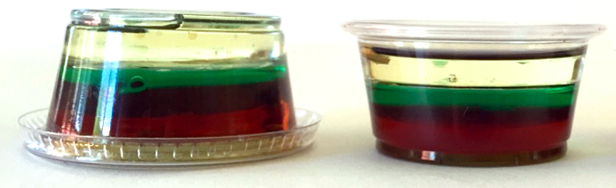
Fluids have different densities
Fluids that do not mix will form layers based on density.
More dense substances will be at the bottom.

Slide 16
Demo
Oil and water POE
Salt (coloured) then water
Notes:
Blue salt water, pour clear water on top

Slide 17
Density and Temperature
Knowing this, how do you think temperature and density are related?
Can you think of an exception?

Slide 19
Density and Temperature
Use KMT, temperature and density to explain how a lava lamp works.

Slide 20
Density and Temperature
Use KMT, temperature and density to explain how a lava lamp works.
Heat from the light bulb gives the particles in the red glob more energy.
The particles start moving farther away from each other, becoming less dense that the surrounding water.
When a substance is less dense than its surroundings, it floats.

Slide 21
LAVA LAMP
As the glob rises, it gets farther away from the heat and starts to cool.
The particles slow down and move closer together, becoming more dense
Glob sinks.

Slide 22
Who Cares? When will I need this? It is important to know the density of a substance ….
In construction materials: When building a bridge, engineers need to consider the density of the different materials to ensure the structure can support the weight and withstand external forces.

Slide 23
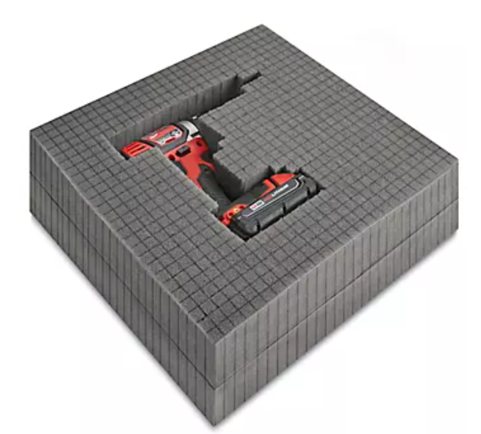
Who Cares? When will I need this? It is important to know the density of a substance ….
Packaging: Density is crucial in packaging materials. Companies need to choose materials with appropriate densities to protect fragile items during transportation. E.g. foam packaging materials with low density can absorb shocks and protect delicate electronics

Slide 24
Who Cares? When will I need this? It is important to know the density of a substance ….
Fluid mechanics: in designing pipelines, pumps, and hydraulic systems. Understanding the density of fluids helps engineers determine the flow rate, pressure, and efficiency of these systems.

Slide 25
Who Cares? When will I need this? It is important to know the density of a substance ….
Environmental Science: Density is used to study and monitor environmental changes.
E.g. Scientists measure the density of water quality, identify pollution sources, and study the effects of climate change on aquatic ecosystems.

Slide 26
Who Cares? When will I need this? It is important to know the density of a substance ….
Aviation and aerospace: Pilots and engineers need to consider air density when calculating aircraft performance, such a s lift, drag, and fuel consumption. Density also affects the design and performance of rockets and spacecraft.

Slide 27
Engineering, physics, chemistry environmental science, etc

