Slide 1
Human Reproduction
Chapter 4
Pages 108-119

Slide 2
Humans have both Primary and Secondary Sexual Characteristics
Primary Sex characteristics:
present at birth.
Necessary for reproduction
Eg. Penis, testes, E.g. Vaginal, ovaries,

Slide 3
Secondary sex characteristics:
Occur later in life during puberty
NOT directly involved in reproduction
help distinguish “male” from “female” for mating purposes
Notes:
For

Slide 4
Puberty
Puberty is the maturation into an adult body capable of sexual reproduction.

Slide 5
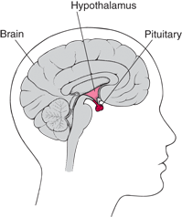
What initiates Puberty?
Hypothalamus in brain secretes gonadotropin-releasing hormone (GnRH).
GnRH stimulates pituitary gland.
Pituitary gland releases: Follicle Stimulating Hormone (FSH) and Luteinizing Hormone (LH).

Slide 6
Puberty in those with testes
Pituitary gland in the brain releases hormones that stimulate the testes to produce sex hormone testosterone.
Average onset; around 12 yr, Until around 18

Slide 7
Puberty in those with ovaries
Pituitary gland in the brain stimulates ovaries to produce hormones:
progesterone and estrogen
Average onset: Around 11 yr

Slide 8
Secondary Sexual Characteristics for those with testes
growth spurt;
hair on face, under arm, and pubic region
Voice deepens ,
Broader shoulders

Slide 9
Puberty in those with ovaries
Growth spurt Organs involve: ovaries,
underarm and pubic hair external genitalia
Widening of hips
Breast development

Slide 10
Transgender
Transgender is an umbrella term for persons whose gender identity, gender expression, or behavior does not conform to that typically associated with the sex to which they were assigned at birth.
Notes:
What about transgender athletes

Slide 11
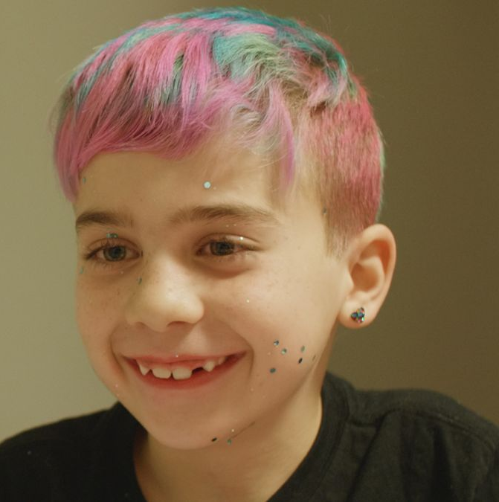
Intersex
People who are intersex have genitals, chromosomes or reproductive organs that don't fit into a male/female sex binary.
Their genitals might not match their reproductive organs, or they may have traits of both.
Being intersex may be evident at birth, childhood, later in adulthood or never.
Notes:
Or a person may be born with genitals that seem to be in-between the usual male and female types—for example, a girl may be born with a noticeably large clitoris, or lacking a vaginal opening, or a boy may be born with a notably small penis, or with a scrotum that is divided so that it has formed more like labia.

Slide 12
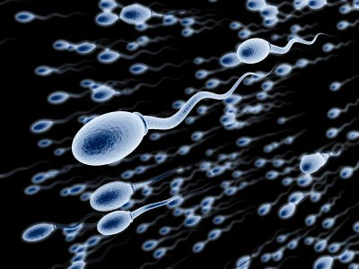
Reproductive System for those with testes
The whole purpose of the male reproductive system is to produce sperm AND to deliver sperm to egg.

Slide 13
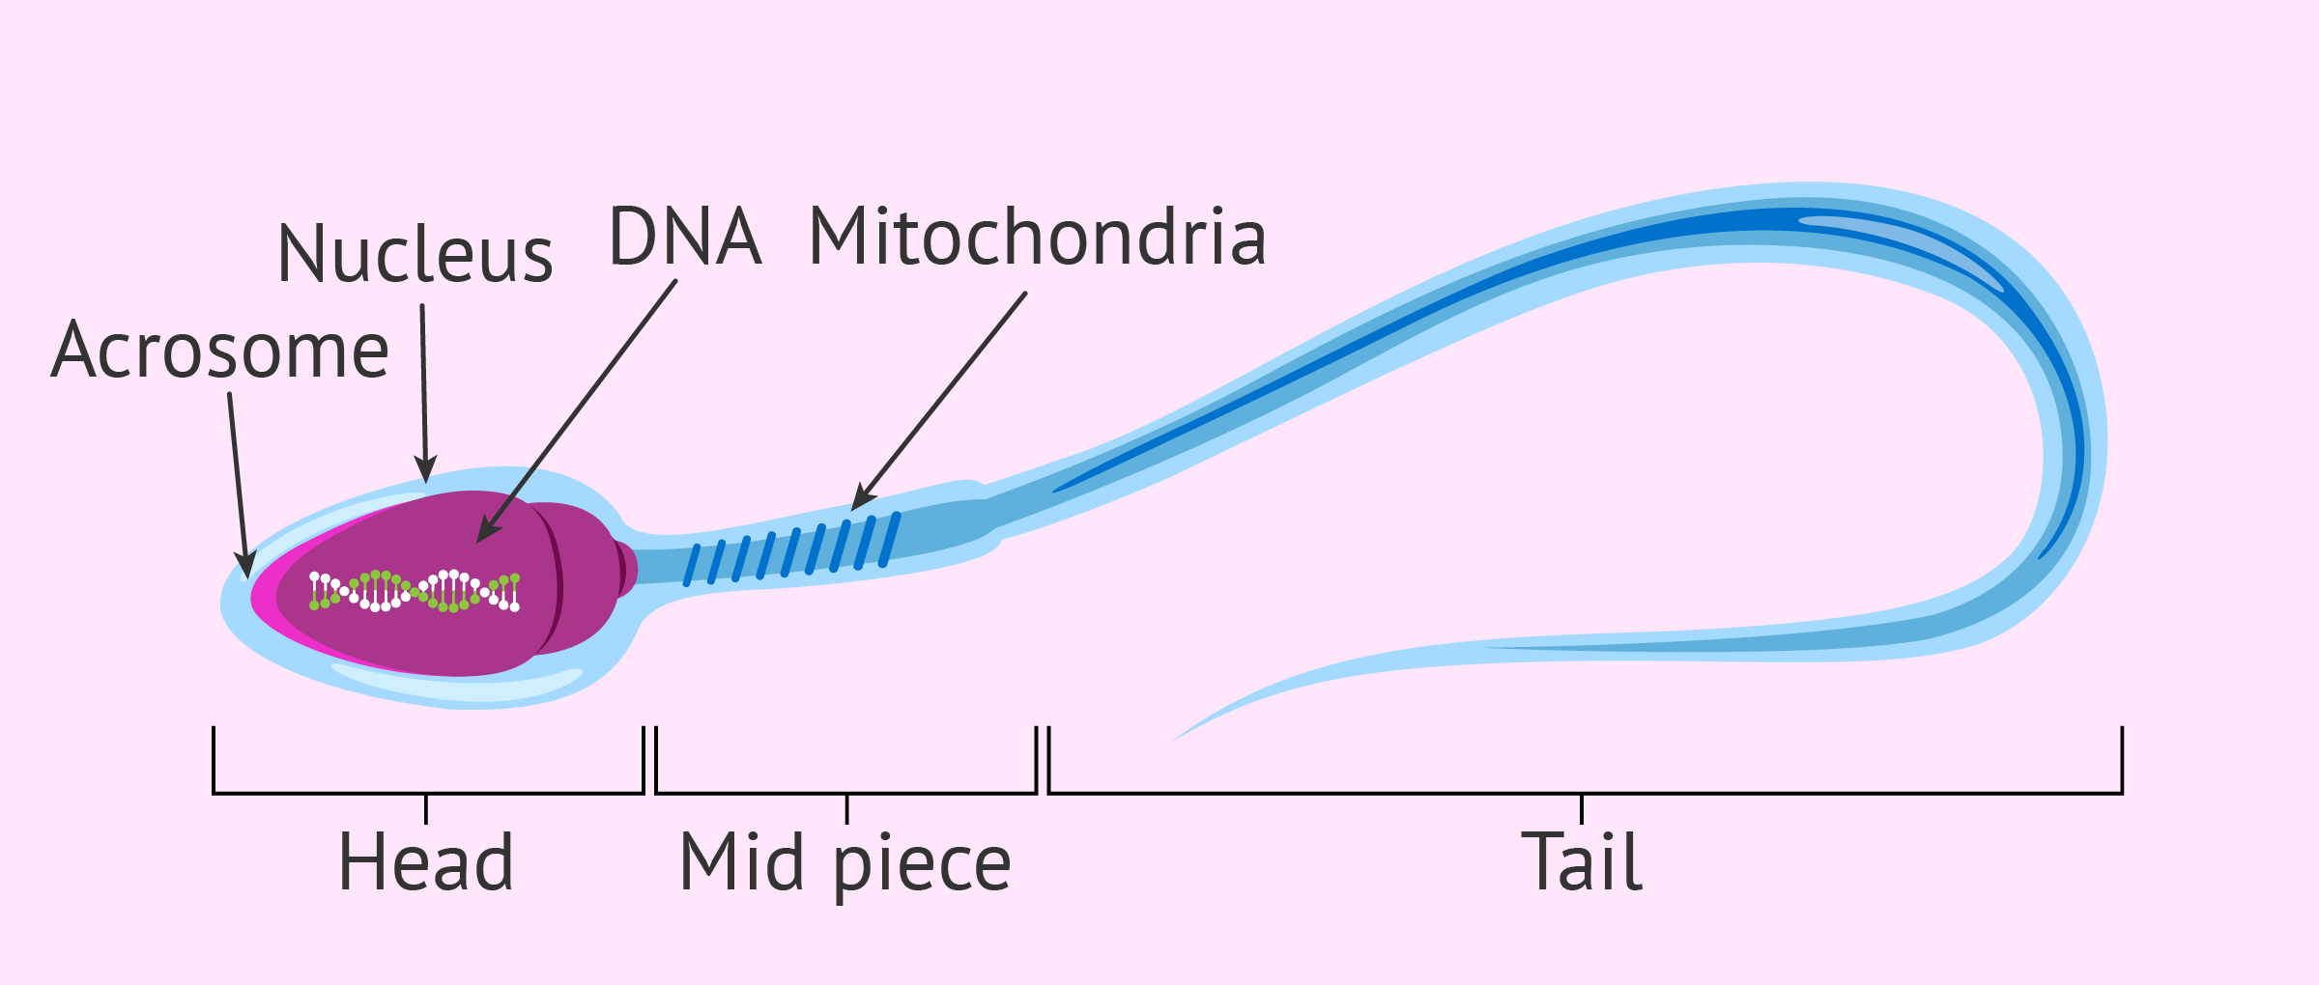
Structure of Human Sperm Cell
Notes:
Head – contains haploid nucleus, acrosome – contains enzymes
Middle piece – mitochondria ( )
Tail – is a flagellum (for locomotion)
List the functions of each section of sperm

Slide 14
How is structure related to function?

Slide 15
Sperm are MUCH smaller than egg

Slide 17
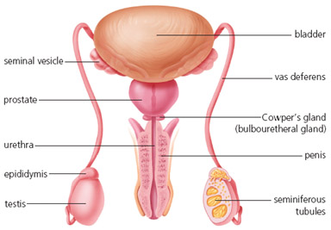
Two TESTES – Or testicles (two outside body)
Produce sperm and testosterone
SCROTUM – sac containing testes
SEMINIFEROUS TUBULES –
coiled tubes in testes
Where diploid cells undergo meiosis →haploid sperm
EPIDIDYMIS – where mature sperm are stored.
Notes:
Testicle derives from the Latin word testis, meaning 'witness'. In pre-biblical times men sometimes placed their hand on another man's testicles when swearing an oath, because the testicles gave witness to a man's virility.

Slide 18
Male Reproductive Structures
VAS DEFERENS – tube carries sperm to urethra
URETHRA – tube leading to outside of body
located in the penis
PENIS – specialized organ to enter female during sexual intercourse
Notes:
What connects ---- to urethra

Slide 19
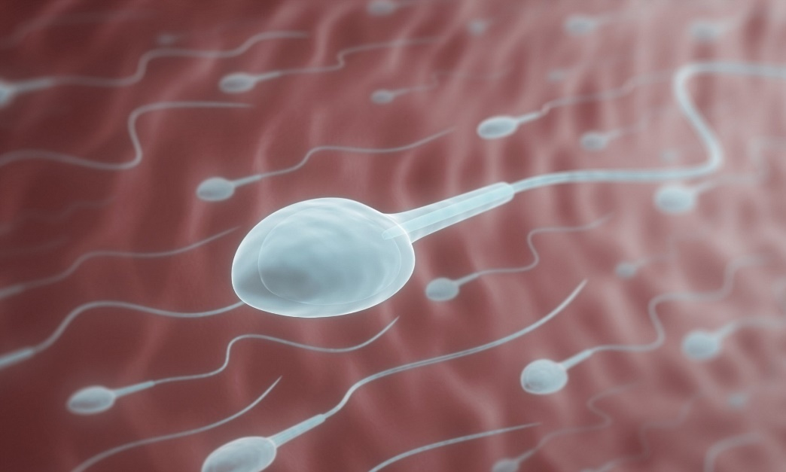
ACCESSORY GLANDS:
ACCESSORY GLANDS secrete seminal fluid which supplies sugar for energy and fluid in which to swim.
SPERM + SEMINAL FLUID = SEMEN
Seminal vesicles
prostate gland
Cowper’s gland (Bulbourethral gland)

Slide 20
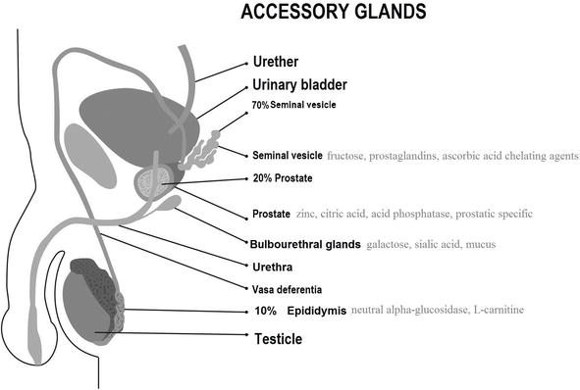
DID YOU KNOW?
Sperm don’t actually travel through the accessory glands.
The glands secrete fluid through ducts that connect to the vas deferens.
Sperm don’t travel through bladder either

Slide 21
Common Cancers
Testicular Cancer - An estimated 1,200 Canadians will be diagnosed with testicular cancer in 2022. An estimated 35 will die from the disease. CHECK THEM REGULARLY!
Prostate cancer
67 Canadians will be diagnosed with prostate cancer every day.
4,600 Canadians will die from prostate cancer (10% of all cancer deaths in men in 2022).
13 Canadian will die from prostate cancer every day.
Guess how this is checked.
Notes:
Check prostate at 50

Slide 22
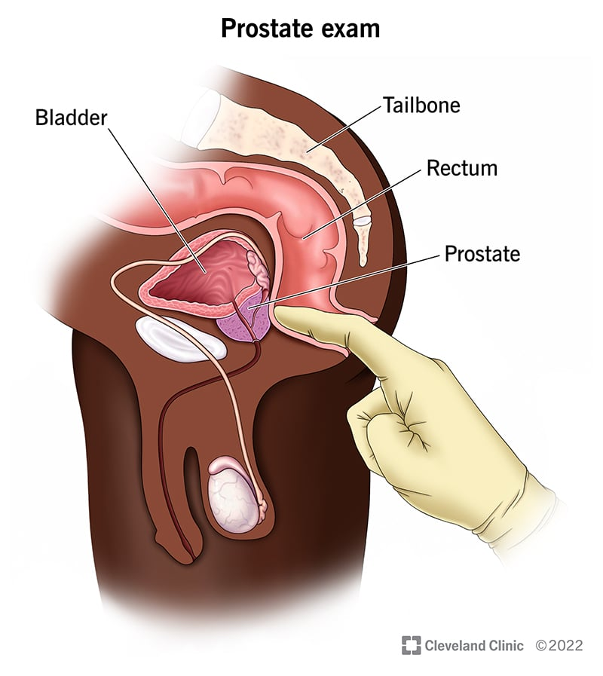
D-R Exam

Slide 23
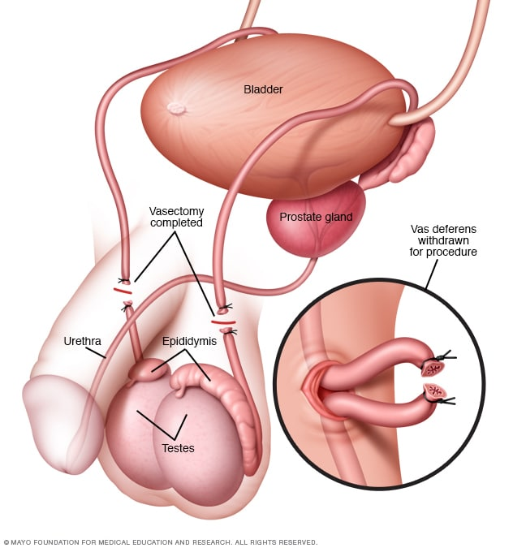
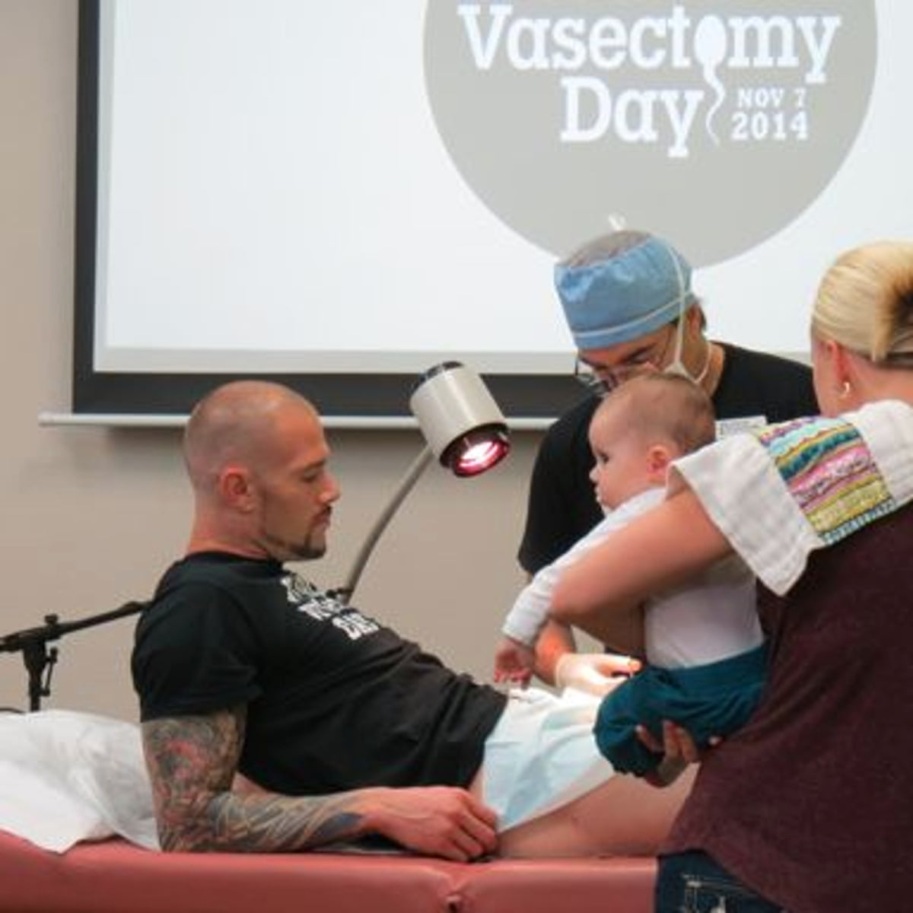
Vasectomy
Vas deferens are cut.
Why?

Slide 24
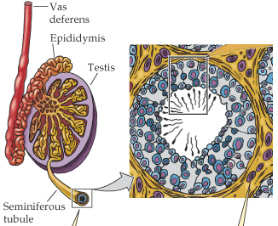
Sperm Production and Development
Sperm begin as diploid cells that undergo mitosis to increase in number
Gradually pushed closer to center
Undergo meiosis → haploid
Sperm finish maturing in epididymis, ~ 74 days
200-300 million sperm produced each day
Notes:
Why so many?

Slide 25
Check your Understanding
HW: Read pages 108-110
Answer CYU p111
What is the purpose of the male reproductive system?
Identify each part and its function/contribution.
Discuss how a sperm cell structure is suited to its function, Know the path sperm takes from where it is produced, stored and leaves the body.
What structure does the sperm NOT pass through?

Slide 26
Reproductive System for those with testes

Slide 27
Notes:
What is the purpose of …
How does function relate to form?

