Slide 1
Reproductive System for those with ovaries
Pages 112-115

Slide 2
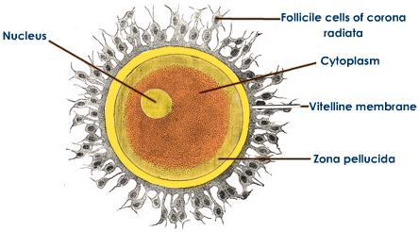
Reproductive System for those with ovaries
sex cell is an egg cell or ovum.
The whole purpose of this reproductive system is to nurture the fertilized egg from conception to birth.

Slide 3
Secondary Sex Characteristics
Growth spurt
breast development, widening of hips, underarm and pubic hair.
Puberty begins around 10-12 years

Slide 5
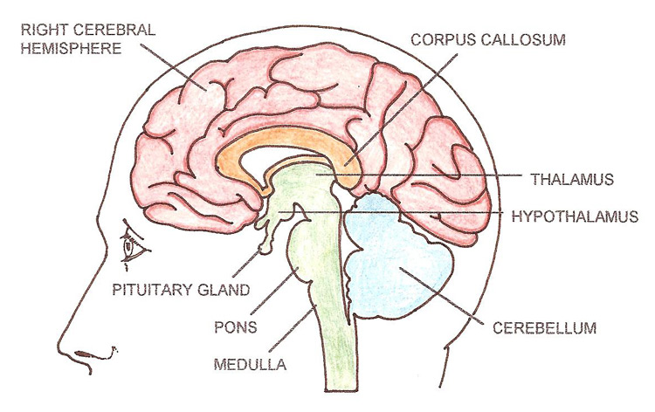
What triggers puberty?
The trigger for puberty in both boys and girls is the production of 'gonadotrophin releasing hormone' (GnRH) from a part of the brain called the hypothalamus.
This hormone stimulates the pituitary gland to release two hormones, Follicle Stimulating Hormone (FSH) and Luteinizing Hormone (LH).
These hormones stimulate the gonads (ovaries and testes) to produce their sex hormones (estrogen and testosterone).

Slide 6
Female Sex Hormones
Ovaries produce estrogen and progesterone and some male hormones (androgens).
In female puberty, estrogen triggers physical changes including maturation of the breasts, ovaries, uterus, and vagina.
Progesterone is a crucial part of the menstrual cycle and maintenance of pregnancy. After you ovulate each month, progesterone helps thicken the lining of the uterus to prepare for a fertilized egg.

Slide 7
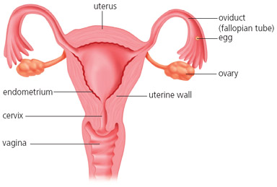
Structures of Female Reproductive System
OVARIES – produce eggs and female sex hormones estrogen, and progesterone.
OVIDUCT (fallopian tube) – conveys egg from ovary to uterus.
UTERUS (womb) – organ that receives embryo if egg is fertilised
ENDOMETRIUM – lining of uterus
CERVIX – muscular opening between the uterus and vagina
VAGINA – receives penis and sperm and is birth canal

Slide 9
Add this to your diagram
Frimbriae – finger-like projections that waft egg from ovary into oviduct

Slide 10
Female Reproductive System

Slide 11
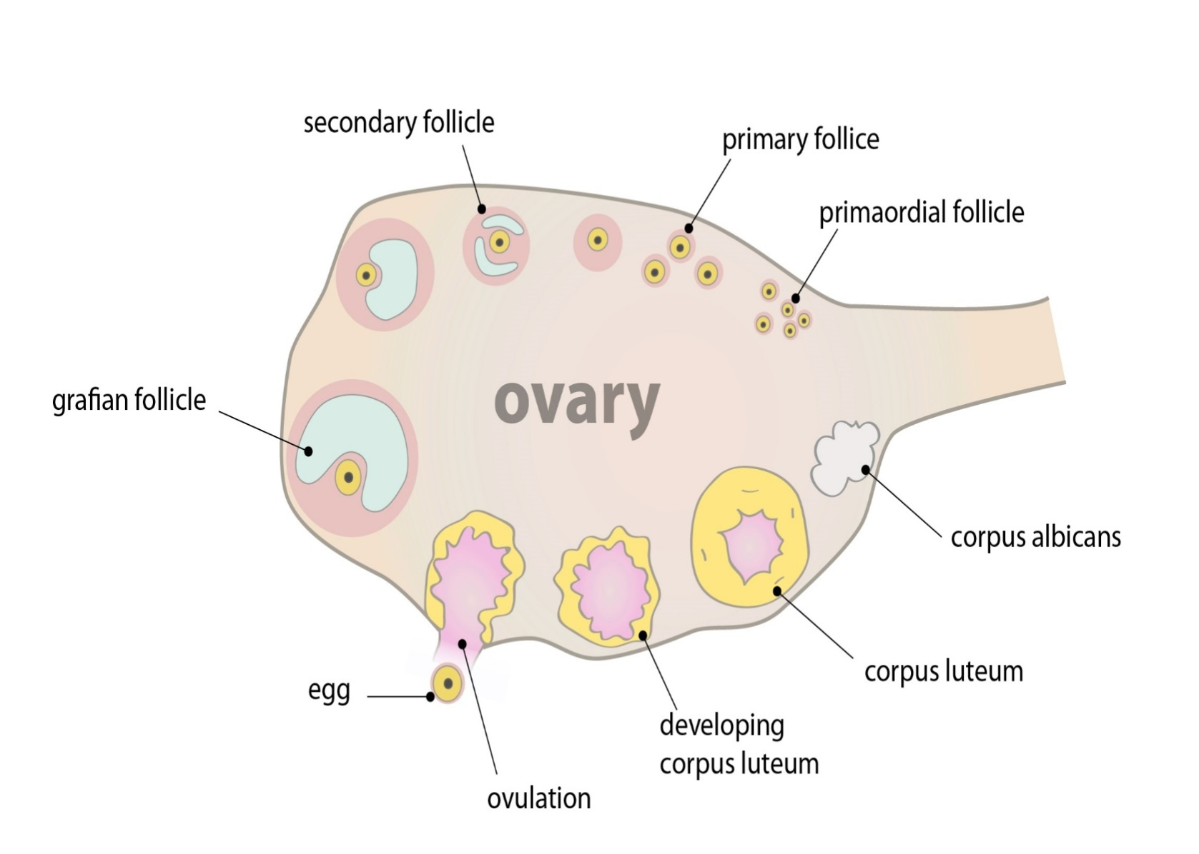
Egg Production and Development
A person is born with ALL the eggs – up to 2 million
one released each month.
Each egg is produced and matures in a follicle within ovary.
Follicle protects and nourishes developing egg.
Notes:
Born with 2 million , many degenerate, leaving about 400,000 at puberty.

Slide 12
Egg Production and Development
When mature, egg is released in a process called ovulation .
Notes:
Born with 2 million , many degenerate, leaving about 400,000 at puberty.

Slide 13
Corpus Luteum
The mature ovum is released from the ovary, resulting in the corpus luteum.
produces the hormone progesterone that makes your to promote the preparation of the endometrium for implantation.
A new corpus luteum forms each time you ovulate and breaks down once you no longer need it to make progesterone.

Slide 15
Egg Calculation
Not all the eggs are released.
How many eggs will an average female release in her life time?
Consider that she starts releasing eggs at puberty (menarche) up to menopause (around 50yr).

Slide 16
Egg Calculation
1 egg/month x 12months/year x (50-12)
1 x 12 x 38yr
Approximately 456 eggs

Slide 17
Egg Calculation
Approximately how many eggs have been released in a woman who is 40 yr and has given birth to 4 children? Assuming menstruation begins at age 12.
Consider that pregnancy lasts 10 months.
Notes:
No more than 400. 396

Slide 18
Egg Calculation
Approximately how many eggs have been released in a woman how is 40 yr and has given birth to 4 children? Assuming periods begins at age 12.
Answer is Variable:
40-12 = 28 years = 336 months (eggs)
4 children: 10 x 4 = 40 months (eggs)
336 – 40 = 296 eggs
In reality menstruation doesn’t begin immediately after pregnancy but is delayed around 1-4 + months.
Notes:
No more than 400. 396

Slide 19
Egg Calculation
What event would reduce the number of eggs released from puberty to menopause?

Slide 20
Egg Calculation
What event would reduce the number of eggs released from puberty to menopause?
Many things:
Trauma that damages ovaries,
Ovarian cancer,
medications,
loss of too much body fat (marathon runners temporarily stop menstruating)

Slide 21
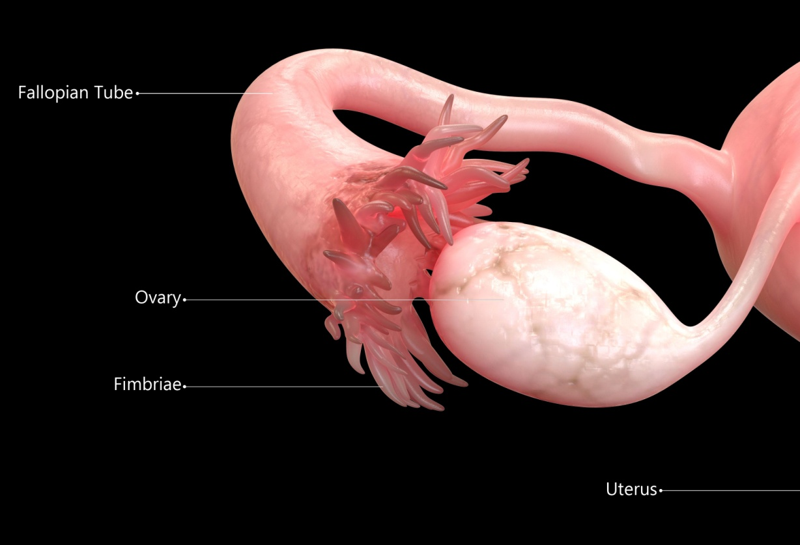
Menstrual Cycle
After ovulation, ovum (egg) is wafted into fallopian tube by finger-like projections called fimbriae .

Slide 22
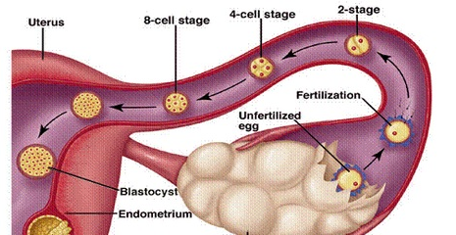
Path of the Egg
Egg moves along oviduct via peristalsis (wave-like muscular contractions), and cilia (microscopic hairs) toward uterus.
Corpus ….. secretes
Endometrium of uterus thickens in preparation to receive the egg

Slide 23
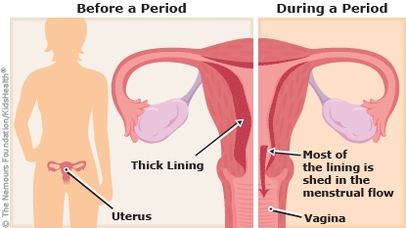
Menstrual Cycle
Egg released once a month
Governed by hormones
if egg NOT fertilised → menstruation - endometrium layer is shed

Slide 24
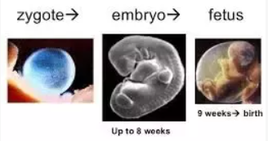
Pregnancy
If egg is FERTILIZED , egg becomes a zygote which begins dividing as it travels along oviduct.
About 1 week after fertilization, zygote has become an embryo and reaches the uterus where it implants into endometrium.
Fertilized egg --> zygote --> 5-6 days, implants --> 2 weeks embryo--> Fetus (9 weeks)

Slide 25
Menstrual Cycle
Menstruation occurs about once a month from puberty until menopause, except during pregnancy.
Menopause – 40-50 years old
Several follicles develop during cycle but usually only one reaches maturity.
Sometimes both ovaries release an egg resulting in twins if both fertilized.

Slide 26
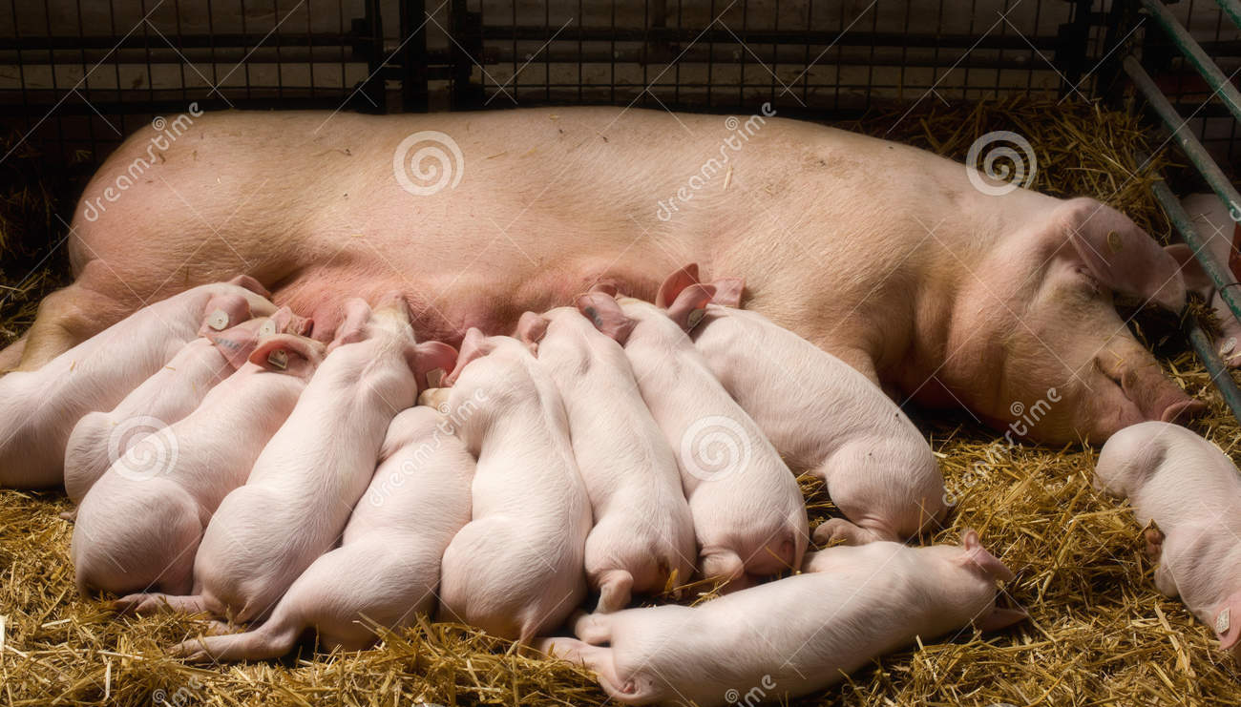
Accessary Glands
Mammary glands - Number of glands relates to number of offspring produced in a pregnancy.
Notes:
During pregnancy, high levels of estrogen and progesterone stimulate milk glands
After birth, prolactin causes milk production, progesterone decreases

Slide 27
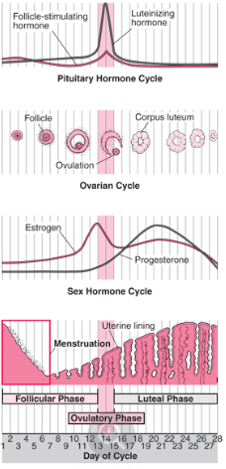

Slide 29
Here’s a good resource for more info on female reproductive system and menstruation if you want more info.
https://www.merckmanuals.com/home/women-s-health-issues/biology-of-the-female-reproductive-system/puberty-in-girls

Slide 30
Three main tissue layers form

Slide 31
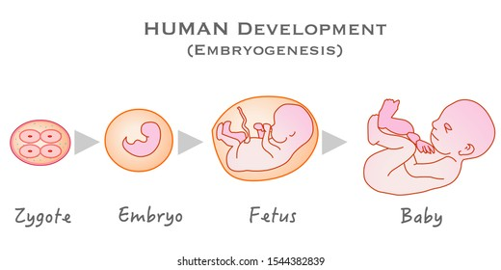

Slide 32
How many sperm can fertilize the egg?

Slide 33
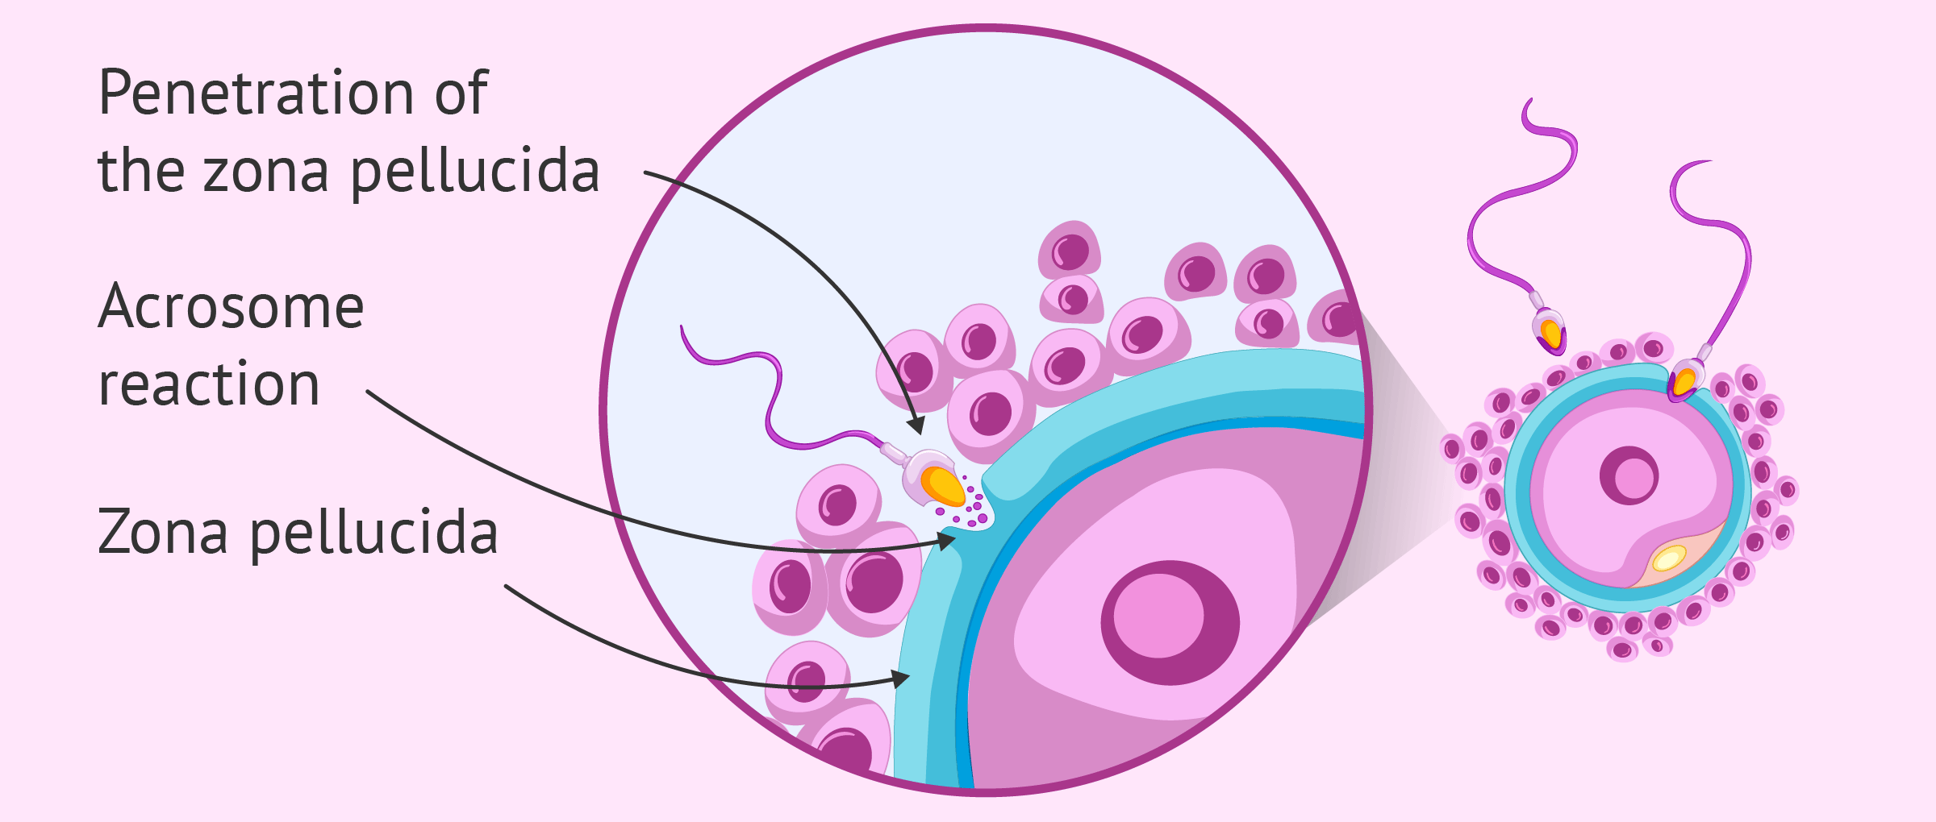
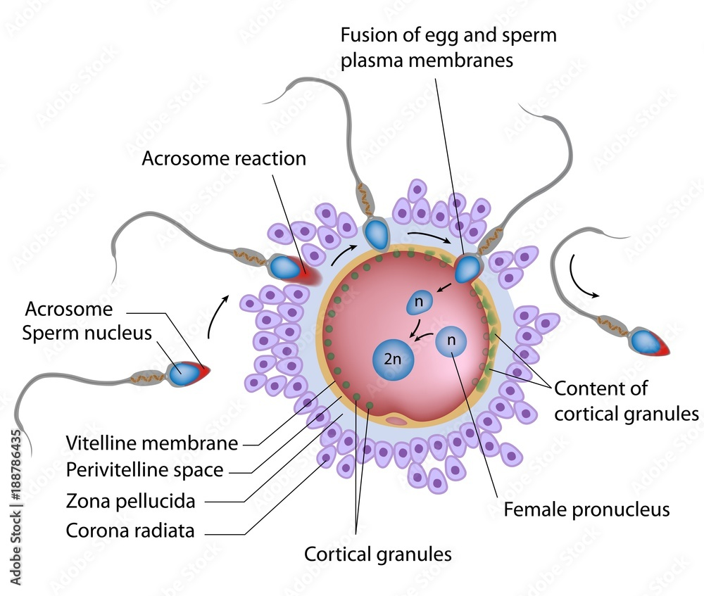
How many sperm can fertilize the egg?
Usually just one
Notes:
this 'double fertilization' is thought to happen in about 1% of human conceptions. An embryo created this way doesn't usually survive, but a few cases are known to have made it — these children are chimaeras of cells with X and Y chromosomes.

Slide 34
Why only one sperm enters egg?
Once ONE sperm enters, the egg creates a force field preventing other sperm from entering.
6min
https://www.youtube.com/watch?v=_5OvgQW6FG4

Slide 35
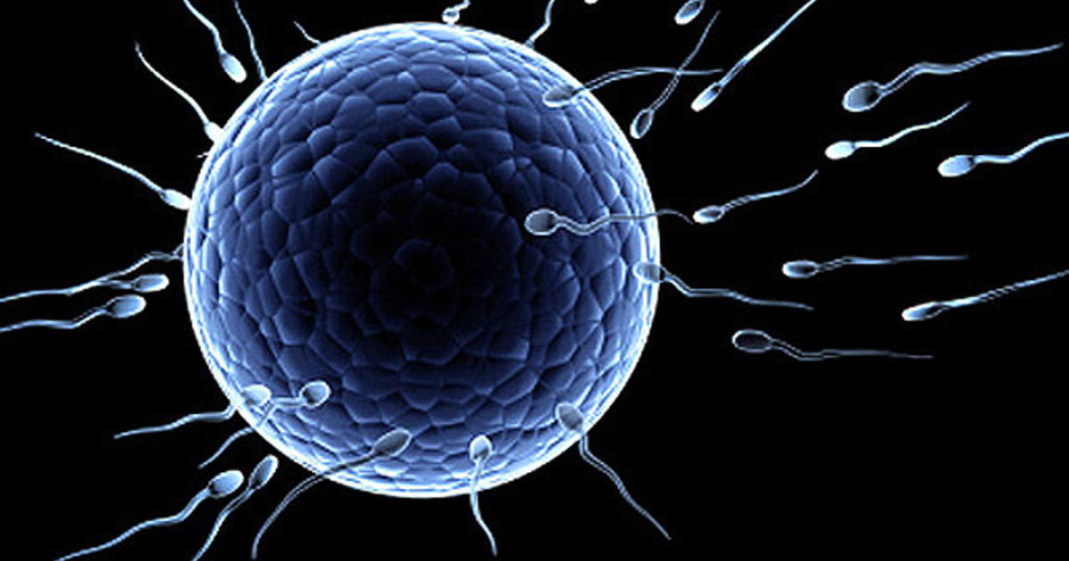
Egg Production and Development
Egg is larger than sperm because it contains many nutrients that will be used in cell division once fertilized.
Notes:
Born with 2 million , many degenerate, leaving about 400,000 at puberty.
Spike (increase) in estrogen signals release of egg.

Slide 36
How long will an unfertilized egg last?

Slide 37
How long will an unfertilized egg last?
About 24hr
What happens after it gets fertilized?
Fertilized egg continues down the oviduct, dividing by mitosis, until it implants into uterus

Slide 38
How you get pregnant,2min:
https://www.plannedparenthood.org/learn/pregnancy/how-pregnancy-happens
How sperm meets egg: https://www.youtube.com/watch?v=vFfqLs94iHc

Slide 39
What is an ectopic pregnancy?
Occurs when a fertilized egg implants and grows OUTSIDE the main cavity of the uterus.
Usually in a fallopian tube.
AKA tubal pregnancy.
Accompanied by a lot of pain

Slide 40
Ectopic Fetus will not survive
A fetus in an ectopic pregnancy sometimes survives for several weeks.
However, because tissues outside the uterus cannot provide the necessary blood supply and support, ultimately the fetus does not survive.

Slide 41
Why does female stop releasing eggs?
It happens because female sex hormone levels naturally go down as you get older.
Your ovaries eventually stop releasing eggs, so you'll no longer have periods or be able to get pregnant.
Most women go through menopause in their 40s or 50s. But that can vary widely.

Slide 42
Homework
Read pages 112 – 115
Answer CYU p 116 #1-12
Project: Journey
The Great Sperm Race: https://www.youtube.com/watch?v=gAnMymnJiLM

Slide 43
Extra slides beyond here

Slide 44
Menstrual Cycle - female reproductive cycle
Ovulation - Mature egg is released from ovary
Empty follicle becomes a corpus luteum which then produces estrogen and progesterone.
Progesterone signals endometrium to thicken

Slide 45
Menstruation p114
Flow phase – endometrium is shed (Menstruation)
Follicular phase - If not zygote implants, a new follicle start to develop , follicles produce estrogen, endometrium re-forms.
Ovulation- egg released
Luteal phase – empty follicle develops into corpus luteum; Corpus Luteum releases estrogen and progesterone, stimulating endometrium to thicken in preparation for possible fertilized egg.

Slide 46
Menstrual Cycle:
2min video: https://www.youtube.com/watch?v=vXrQ_FhZmos
The menstrual cycle begins with menstrual bleeding (menstruation), which marks the first day of the follicular phase.
https://www.merckmanuals.com/en-ca/home/women-s-health-issues/biology-of-the-female-reproductive-system/menstrual-cycle

Slide 47
Menstrual Cycle: In depth
Ted Ed, 4min: https://www.youtube.com/watch?v=ayzN5f3qN8g
When the follicular phase begins, levels of estrogen and progesterone are low. As a result, the top layers of the thickened lining of the uterus (endometrium) break down and are shed, and menstrual bleeding occurs. About this time, the follicle-stimulating hormone level increases slightly, stimulating the development of several follicles in the ovaries. Each follicle contains an egg. Later in this phase, as the follicle-stimulating hormone level decreases, only one follicle continues to develop. This follicle produces estrogen.

Slide 48
Ovulatory Phase
The ovulatory phase begins with a surge in luteinizing hormone and follicle-stimulating hormone levels. Luteinizing hormone stimulates egg release (ovulation), which usually occurs 16 to 32 hours after the surge begins. The estrogen level peaks during the surge, and the progesterone level starts to increase.

Slide 49
Luteal Phase
During the luteal phase, luteinizing hormone and follicle-stimulating hormone levels decrease. The ruptured follicle closes after releasing the egg and forms a corpus luteum, which produces progesterone. During most of this phase, the estrogen level is high.Progesterone and estrogen cause the lining of the uterus to thicken more, to prepare for possible fertilization. If the egg is not fertilized, the corpus luteum degenerates and no longer produces progesterone, the estrogen level decreases, the top layers of the lining break down and are shed, and menstrual bleeding occurs (the start of a new menstrual cycle).

Slide 50
