Slide 1
Reproductive Technologies
Overcoming barriers to reproduction

Slide 2
What is Reproductive Technology?
Methods to assist couples to get pregnant or treat fertility problems.

Slide 3
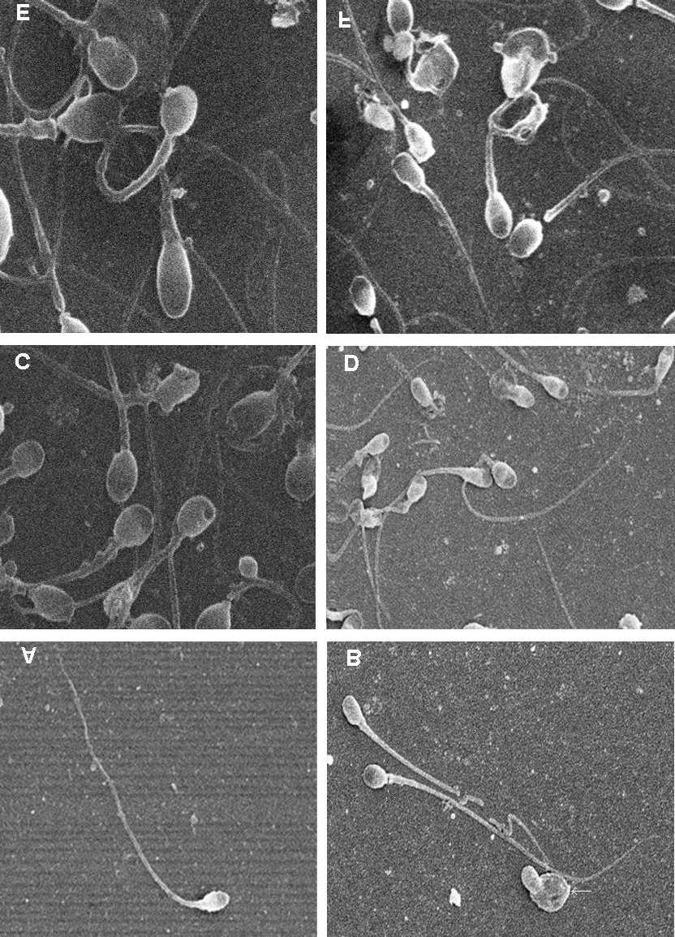
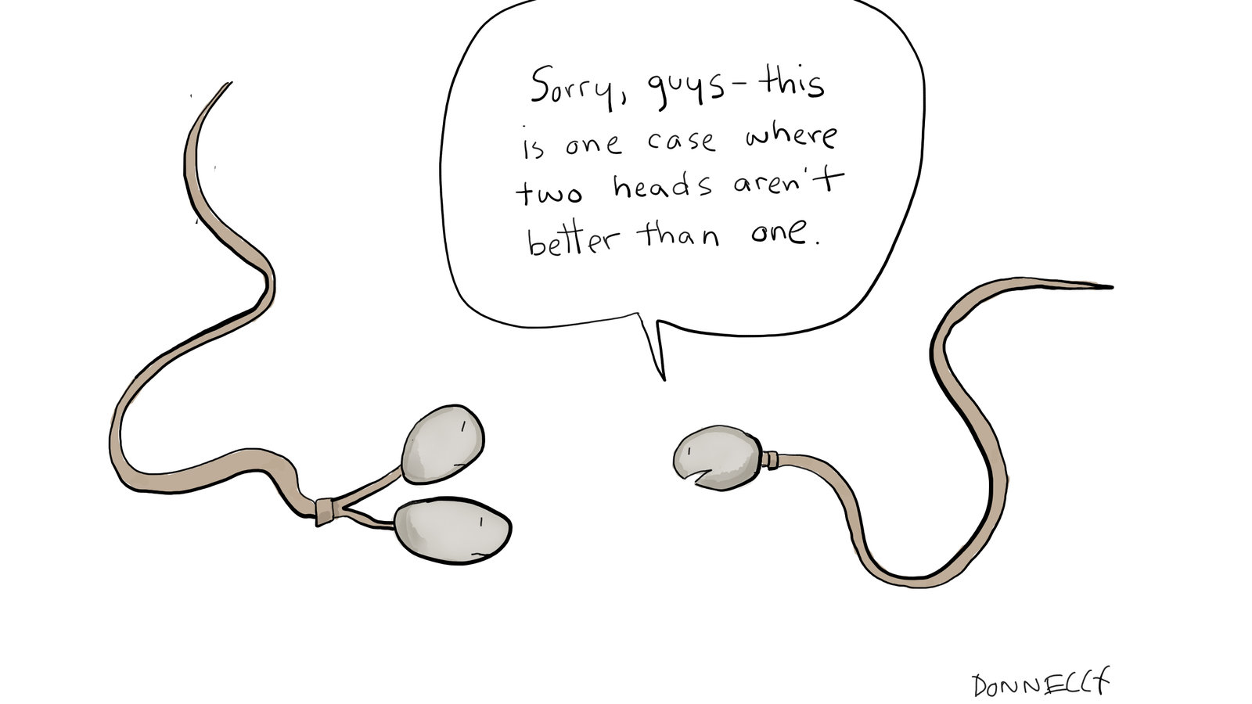
Why use reproductive technology?
Infertility/Low fertility in Males:
Not enough sperm, low motility, deformed sperm

Slide 4
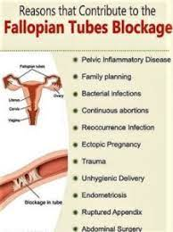
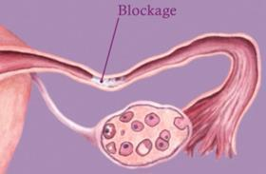
Why use reproductive technology?
Females may have blocked oviduct, ovaries not functioning properly, irregular hormone levels.

Slide 5
What techniques are used?

Slide 6
Fertility Drugs
Fertility Drugs stimulate production of hormones that affect the action of female’s follicles
Induce more eggs to mature and be released to increase chance of conception
Fertility drugs are often used in conjunction with the following techniques as well

Slide 7
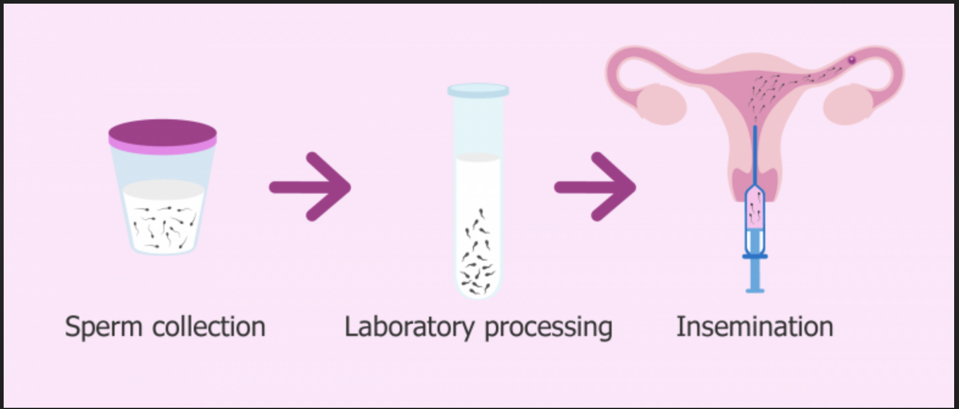
Artificial Insemination
Sperm collected and injected into vagina
Used with low sperm count.
Also done with animals
Notes:
Also done with animals

Slide 8
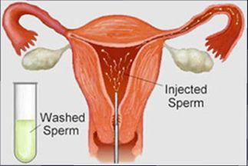
Intrauterine Insemination
sperm collected from male and placed directly into uterus, rather than vagina.
Notes:
Because sperm are injected higher up in the uterus, less will die (as they would in the vagina).

Slide 9
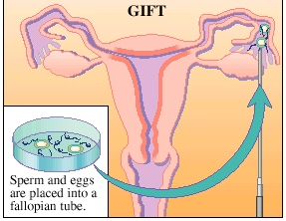
Gamete Intrafallopian Transfer (GIFT)
Female’s eggs are removed from ovary and reinserted into the oviduct along with sperm to allow fertilization.

Slide 10
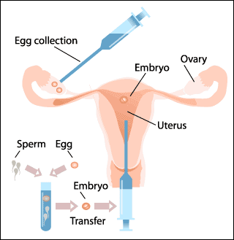
In Vitro Fertilization (IVF)
Means fertilization takes place outside the female’s body in a petri dish
“test-tube babies”
Follicles containing immature eggs are removed from ovaries
When mature, eggs are mixed with sperm
Embryos inserted into uterus

Slide 11
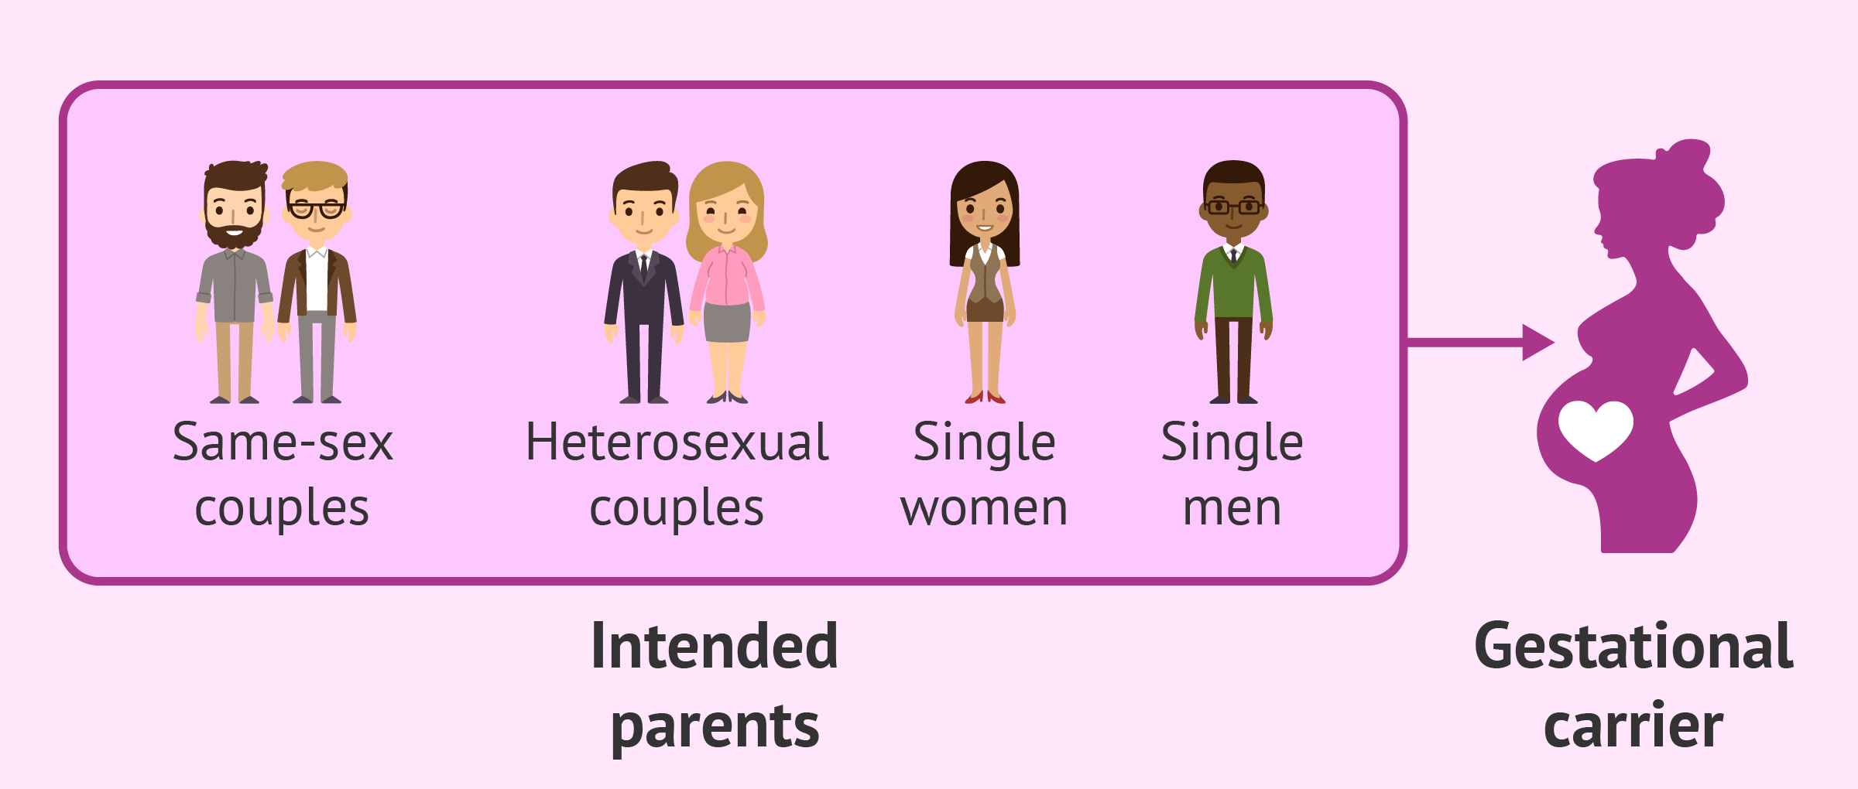
Surrogate Mother
Another woman who has agreed to accept an embryo and carry the baby to term.
Usually done when a woman’s uterus cannot accept an embryo or with same sex male couples.
Whenever possible the couple’s gametes are used

Slide 12
Ethics? Baby Farming

Slide 13
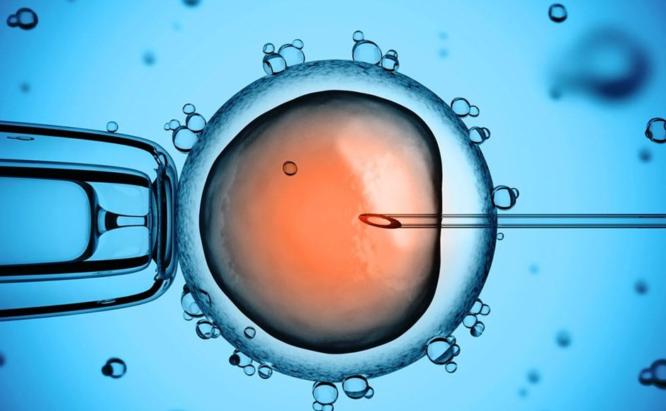
Intracytoplasmic Sperm Injection (ICSI)
Single sperm is injected directly into egg
Used when IVF was unsuccessful, sperm count very low, sperm structurally impaired

Slide 14
How NOT to get pregnant

Slide 15
Abstinence
Just say NO
100 % effective
Consent is like a cup of tea:
https://www.youtube.com/watch?v=fGoWLWS4-kU
Notes:
Kissing
Masturbating
Fondling
Rubbing
Acting out sexual fantasies
Using sex toys
Oral sex
Anal sex

Slide 16
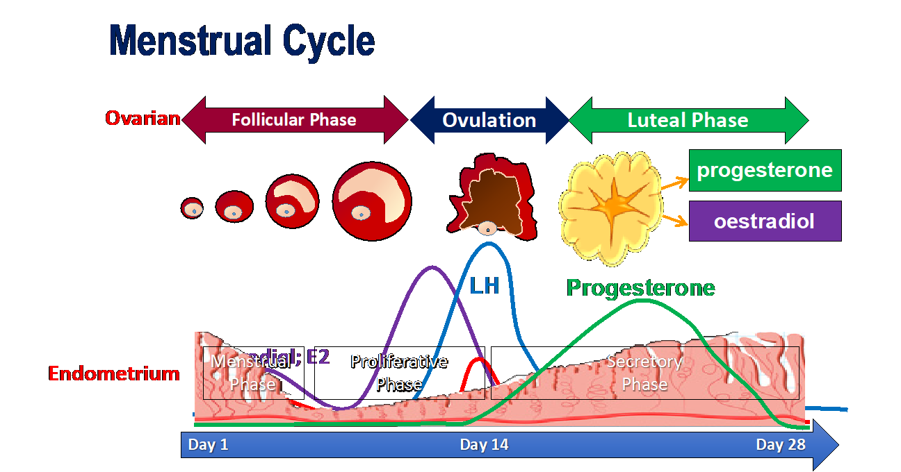
Rhythm Method: 80% Effective

Slide 17
Barrier Methods…

Slide 18
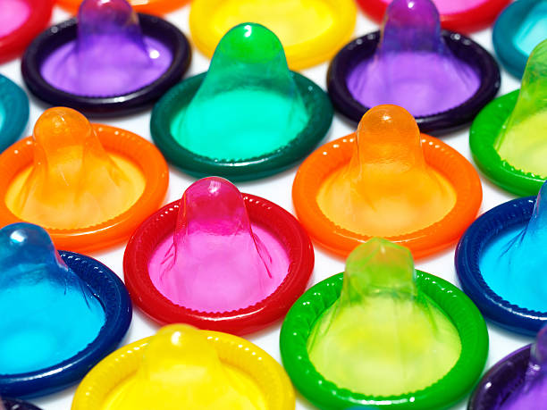
Condoms
98% Effective when used correctly
Sheath worn over penis
BEST protection against STIs

Slide 19
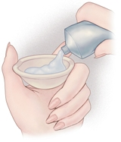
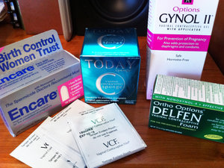
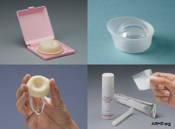
Spermicidal Chemicals
72% effective (should use with other barriers such as diaphragm, cervical cap, or condom)
Spermicide kills sperm, preventing fertilization.
Does not protect against STD’s

Slide 20
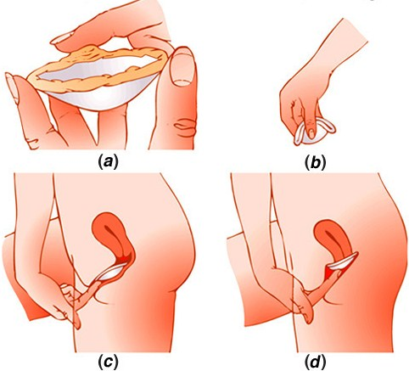
Diaphragms and Cervical Caps
86-94 % effective
Cap worn over cervix holds spermicide in place over the opening to the uterus.
After intercourse, it should be left in place for 6-8 hours.
Does not protect against STIs

Slide 21
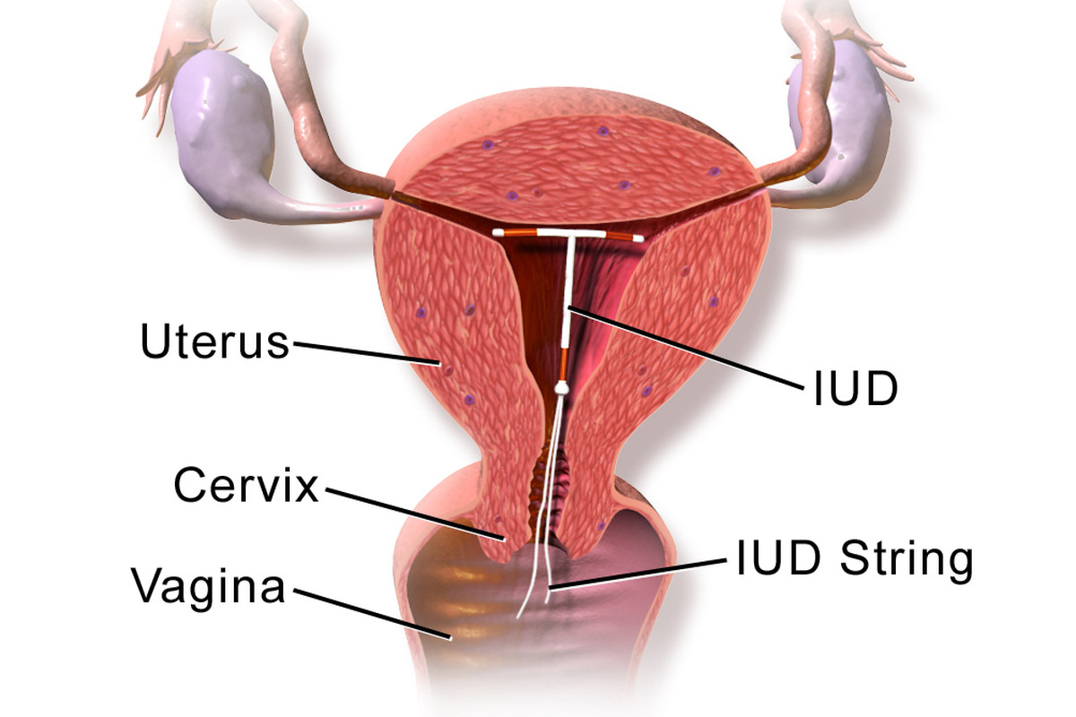
Intrauterine Device (IUD)
More than 99% effective
Does not prevent STD’s
copper triggers your immune system to prevent pregnancy.
Works for up to 10 years;
'Fit and forget' contraception

Slide 22
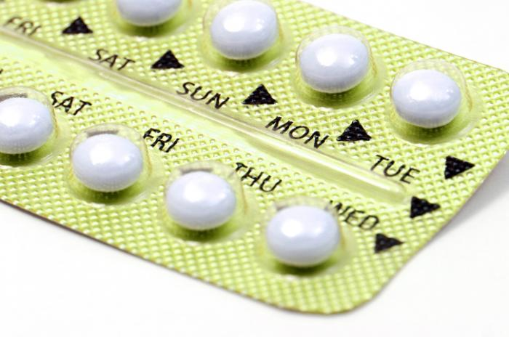
Oral Contraceptives: The Pill
98% effective
Releases hormones to prevent ovulation
Must be taken everyday or not effective for that month
https://www.youtube.com/watch?v=Gu11uty__OY

Slide 23
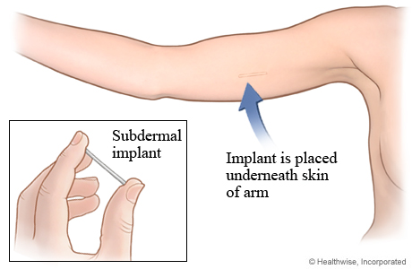
Implants
Time release hormones prevent ovulation
Lasts up to 4 years
No STI protection
Notes:
tiny, thin rod about the size of a matchstick. The implant releases hormones into your body that prevent you from getting pregnant. A nurse or doctor inserts the implant into your arm and that’s it — you’re protected from pregnancy for up to 4 years. It’s get-it-and-forget-it birth control.

Slide 24
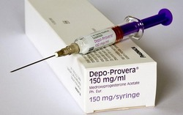
Contraceptive Injections
about 99% effective,
One shot of hormones
lasts in the body about 3 months
same effect as the pill.
No STI protection

Slide 25
Contraceptive Patch
Same as pill but in a patch
Wear for 3 weeks, off for one week to menstruate
No STI protection

Slide 26
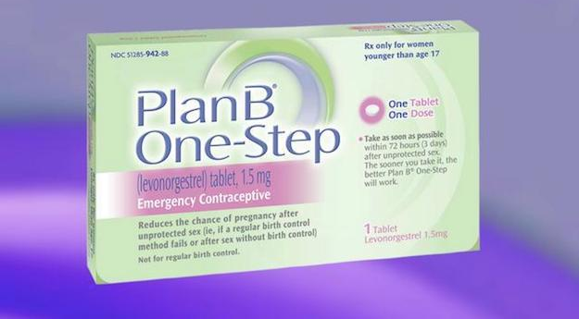
Emergency Contraceptives
Stops you from getting pregnant if you had unprotected sex
“Morning After Pill”
Must be taken within 24hr → 95% effective,
The longer you wait, the less effective (only 50% effective after 3 days)

Slide 27
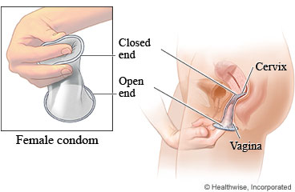
Female condom
Worn inside vagina

Slide 28
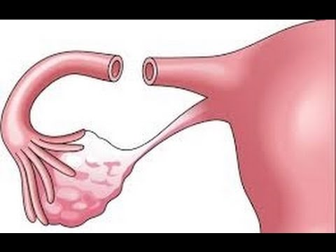
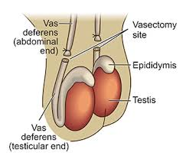
Sterilization
Tubal litigation (“Tubes tied”) Vasectomy

Slide 29
Abortion
Medical Abortion (Abortion Pill): can be taken up to 70 days (10 weeks) after the first day of your last period.
Surgical Abortion: D&C, More than 71 days, vacuum aspirations until about 14 weeks,
Dilation and curettage (D&C) refers to the dilation (widening/opening) of the cervix and surgical removal of part of the lining of the uterus and/or contents of the uterus by scraping and scooping (curettage).

