Slide 1
EMS
Electromagnetic Spectrum

Slide 2
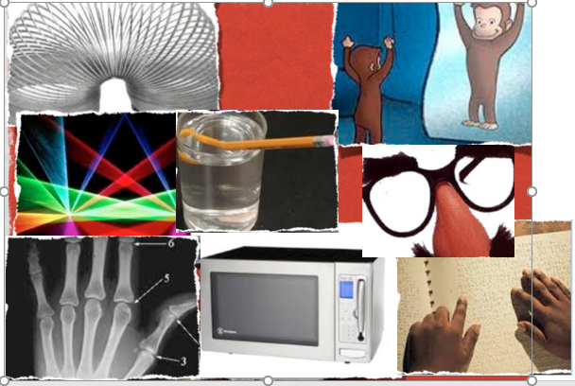
What do these have in common?
Notes:
What do x-rays, sun tanning, the warmth from a candle, TVs, and radios all have in common?

Slide 3
They are all forms of Radiation
Notes:
What do x-rays, sun tanning, the warmth from a candle, TVs, and radios all have in common?

Slide 4
Seven Types of Electromagnetic Radiation:
Radio Waves
Microwaves
Infrared radiation
Visible light
Ultraviolet radiation
X-rays
Gamma rays

Slide 5
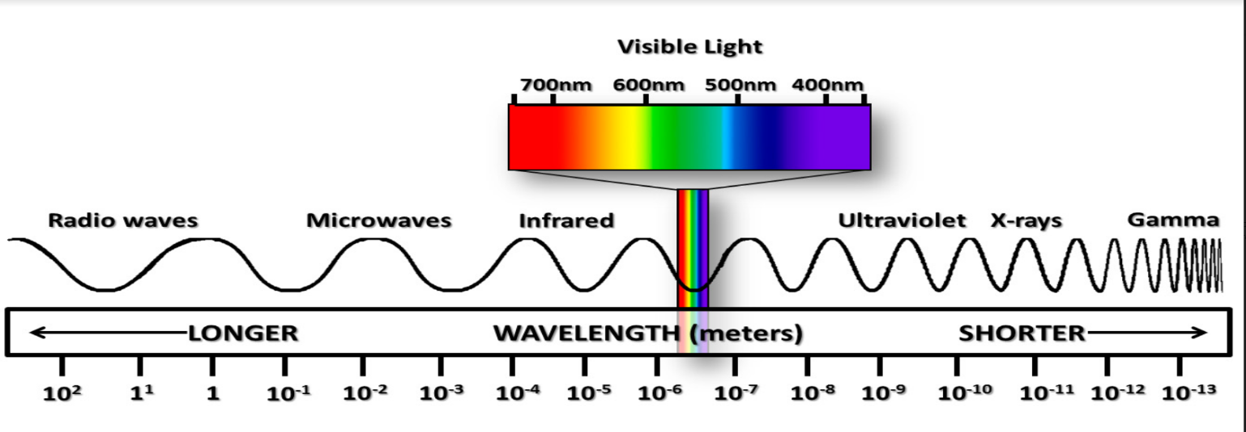
Electromagnetic Spectrum:
5min Video https://science.nasa.gov/ems/01_intro
Notes:
To describe the electromagnetic spectrum, we need to understand properties of waves.
What patterns/trends do you notice?
Which wavelength is the longest? Shortest
Which do you think would carry more energy?

Slide 6
Sound travels in waves. Is it part of EMS?
No. Sound requires a medium (such as air or water) through which to move.
Electromagnetic waves can radiate through the vacuum of space.
Notes:
Humans can hear only a certain spectrum of frequencies and anything below or above that spectrum will be inaudible to our ears.
Sound serves as an illustration that human senses are very limited.
Some animals (bats, dolphins, elephants, and whales, for instance) are able to hear frequencies that are much lower or higher than what our ears are capable of hearing – to us, those sounds would translate to total silence.

Slide 7
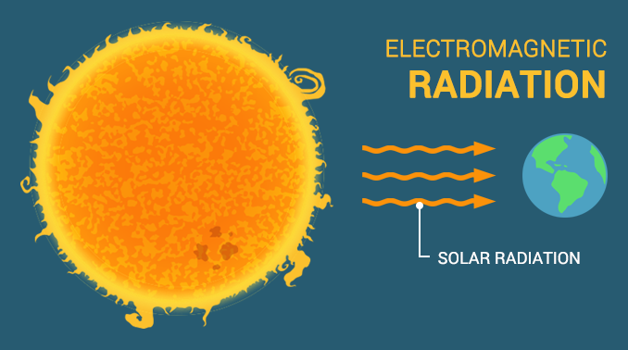
Where does EMR come from?
The Sun gives off ALL types of electromagnetic radiation.

Slide 8
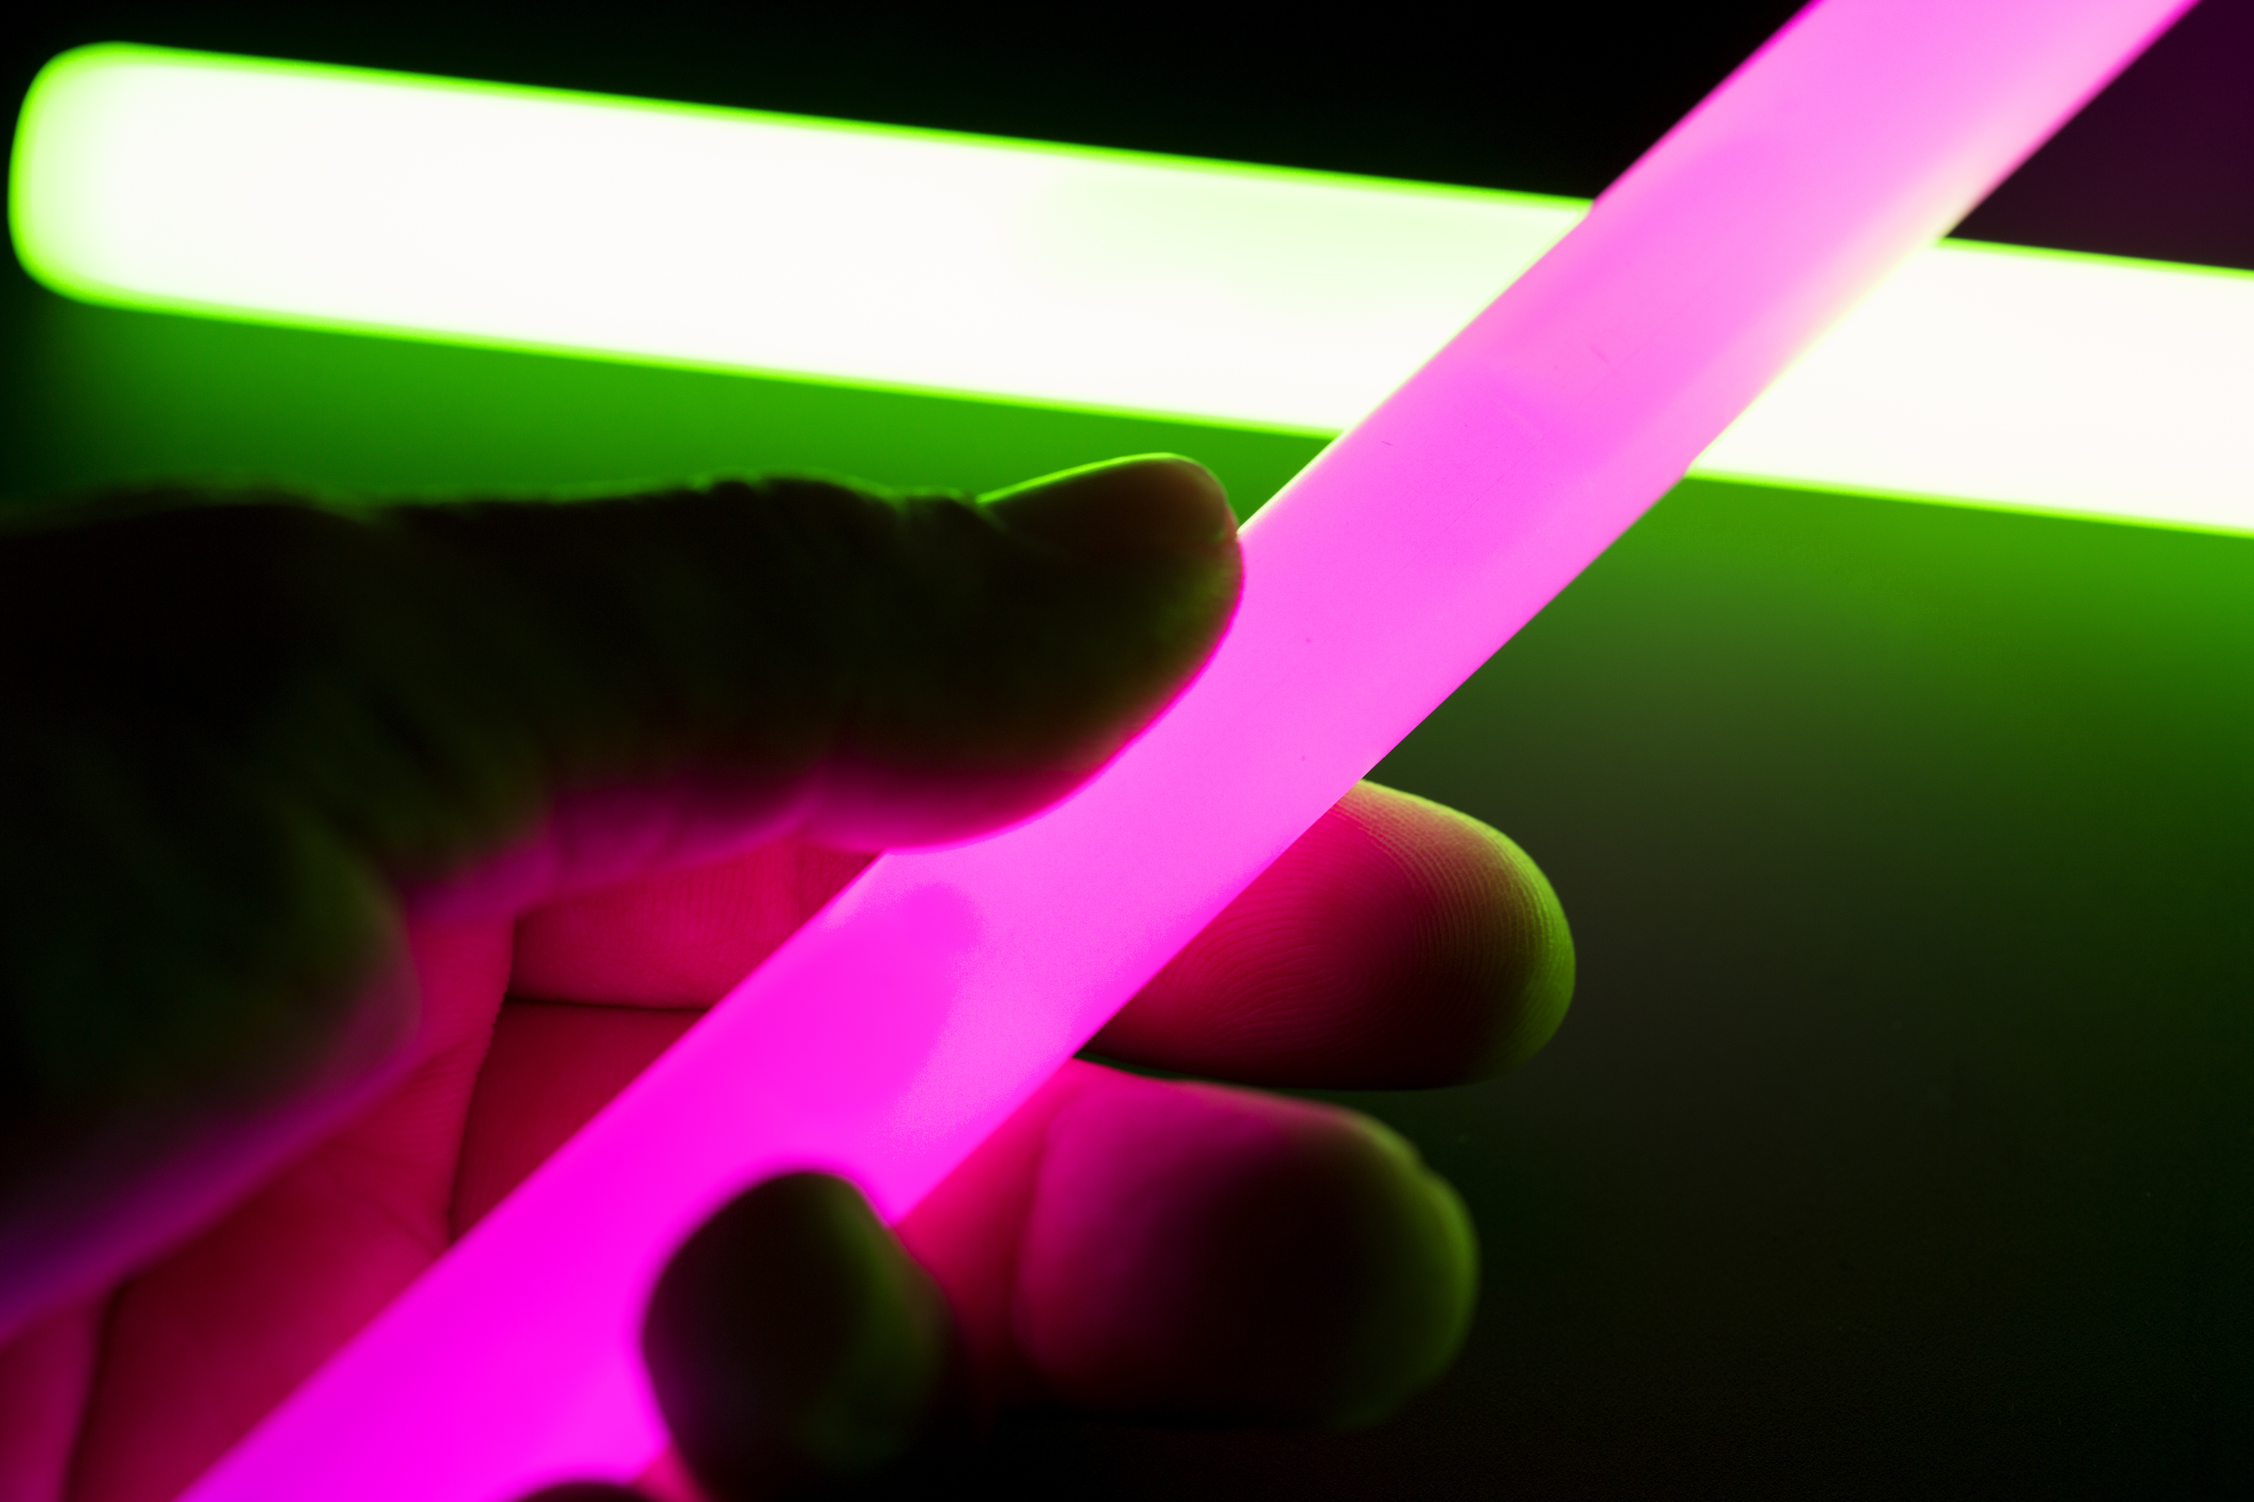
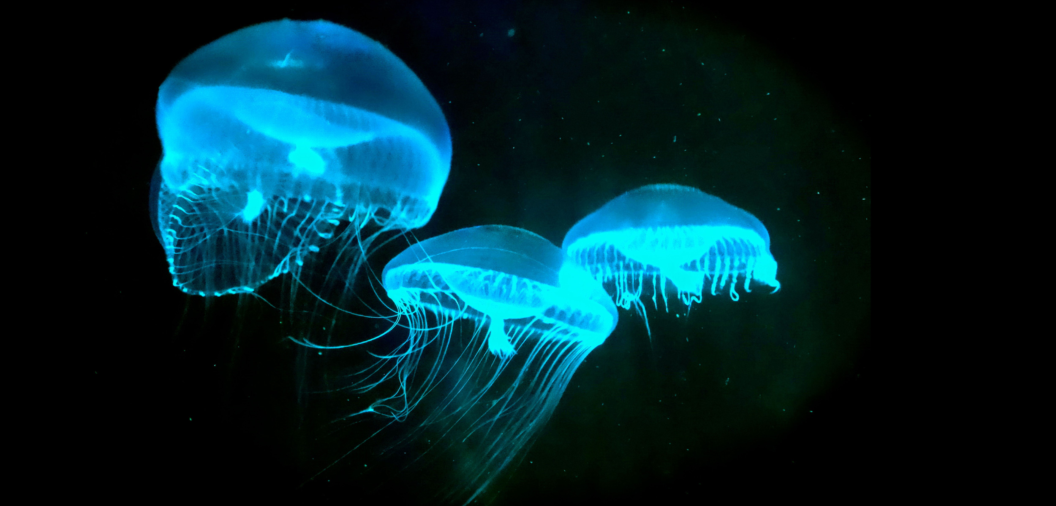
Where does EMR come from?
Chemical reactions in living things can give off visible light
chemiluminescence: The creation of light using chemical reactions instead of heat.
bioluminescence: A special kind of chemiluminescence that occurs in some living organisms, like fireflies.
phosphorescence: A process in which energy stored in a substance is released very slowly and continuously in the form of light.
Notes:
chemiluminescence: The creation of light using chemical reactions instead of heat. bioluminescence: A special kind of chemiluminescence that occurs in some living organisms, like fireflies. phosporescence: A process in which energy stored in a substance is released very slowly and continuously in the form of light.

Slide 9
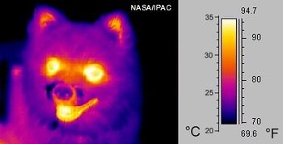
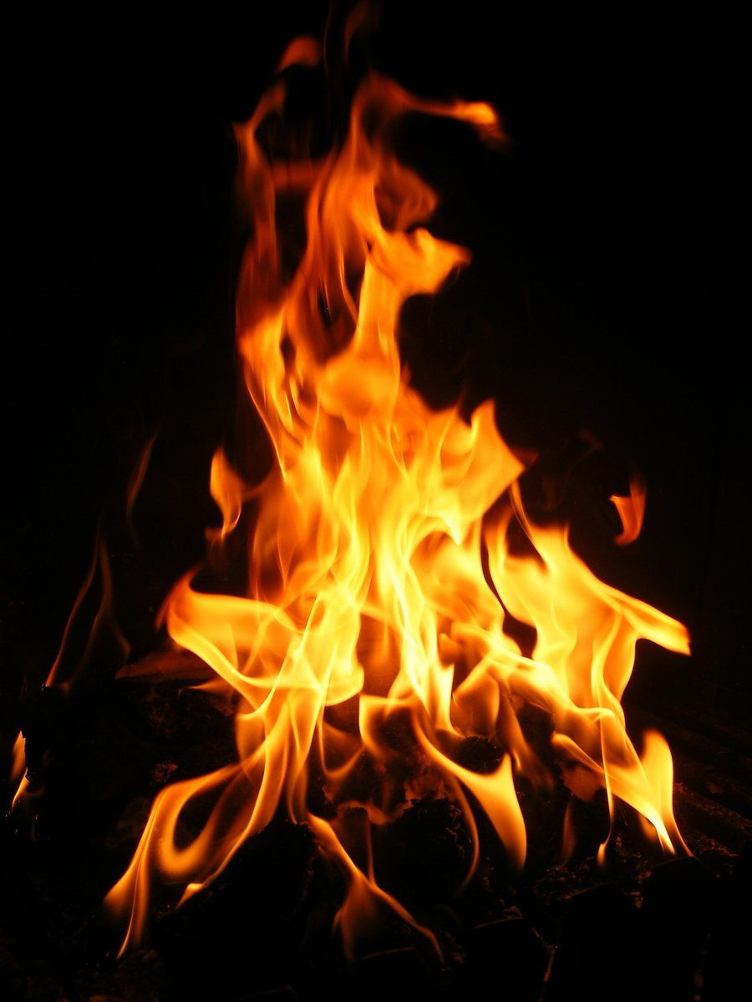
Where does EMR come from?
All objects give off infrared radiation.
We sense infrared radiation as heat.
If objects are very hot, they give off visible light too.

Slide 10
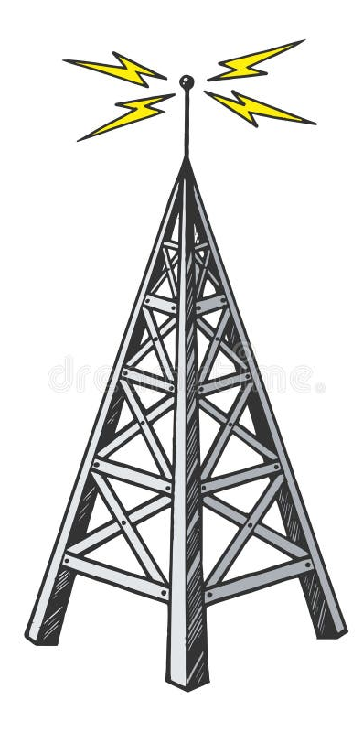
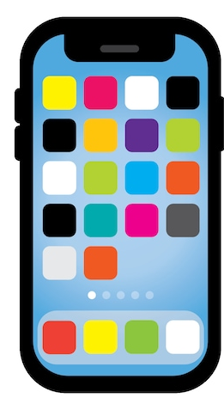
Where does EMR come from?
Cell phones are a source of microwaves.
Commercial radio stations send out radio waves signals.

Slide 11
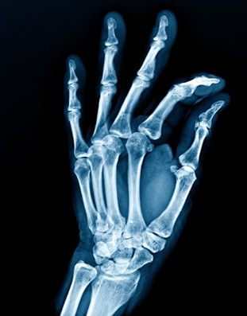
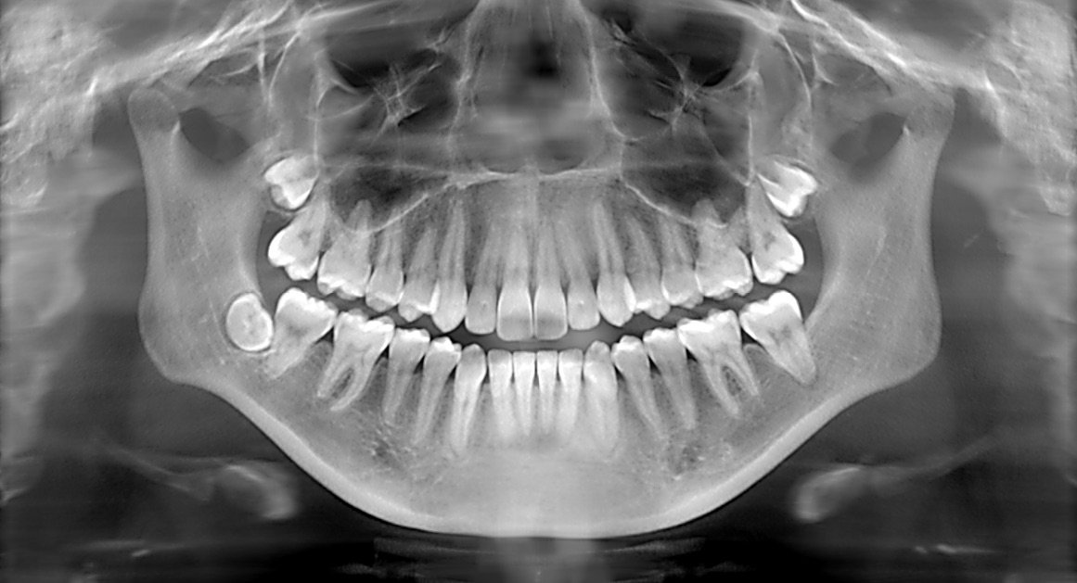
Where does EMR come from?
X-rays are produced by a change in the speed over very fast-moving electrons in an X-ray tube.
Radioisotopes are atoms with unstable nuclei that can give off gamma rays.
E.g. Iodine-131 is a radioisotope that gives off gamma rays.

Slide 12
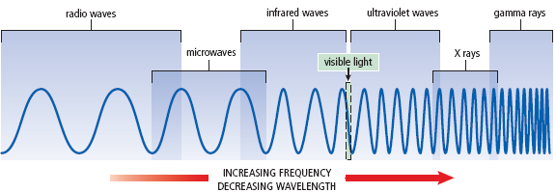
What patterns/trends do you notice?
Which wavelength is the longest? Shortest
Which do you think would carry more energy?
See pages 152 - 154
Notes:
Which one has the longest wavelength? Shortest?
Radio waves can be kilometers long, gamma wavelength smaller than an atom.

Slide 13
Helpful, Harmful, both?
Some forms of EMR, like X-ray and gamma rays, are IONIZING radiation.
This means they can remove electrons from atoms of materials such as air, water, and living tissue.
they can pass through materials and can damage our DNA.

Slide 14
Who Cares? There are many uses of EMR
Solve crimes
Medical imaging
Treat cancer
Communications
Information gathering - to study the universe.
Interpret the weather

Slide 15
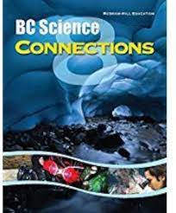
Assignment
Read pages 186-201 of BC Connections 8 Textbook
Complete the summary Worksheet,
Hand in
Due….
Then, selection ONE form of EMR ….
Notes:
Answer Questions #1,3-7 on p199
WB p102, 104

Slide 16
Radio Waves
MRI scan of the brain
Longest wavelength and lowest energy and frequency.
Broadcasting radio and TV signals, Bluetooth, baby monitors
Commercial radio stations send signals that radio receivers convert into sound.
MRI (magnetic resonance imaging) technology uses radio waves (along with magnets) to see inside our body.

Slide 17
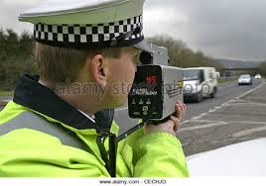
Microwaves are a type of radio wave
Microwaves have the shortest wavelength and highest frequency of all the radio waves.
Used in microwave ovens and telecommunications (carry talk or text info from phone to cell phone tower)
Radar uses short wavelength microwaves.
  Radar is used in: tracking the motion of objects, weather forecasting, and taking images of the Earth’s surface.
A radar image of the Earth’s surface
See pages 155 - 156

Slide 18
Infrared Waves
Infrared cameras record differences in temperature.
EMR that has a wavelength longer than red light but shorter than that of radio waves.
Infrared radiation is also referred to as heat. (used in heat lamps)
Infrared waves are used in: remote controls, infrared cameras, and CD-ROM readers.
LANDSAT is a satellite that measures visible light and infrared radiation coming from Earth’s land surface to map it. (helps with monitoring loss of rain forests to finding near-shore shipwrecks.
See page 157

Slide 19
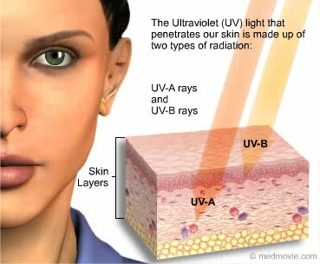
High Energy Radiation
Radiation with shorter wavelengths than visible light on the EMS have higher energy and therefore more penetrating power.
Prolonged exposure can cause damage to our cells.

Slide 20
Ultraviolet Waves
Wearing sunglasses and sunscreen help protect you against harmful UV radiation.
Wavelengths shorter than visible light have more energy than visible light.
Ultraviolet waves (UV) are shorter than that of violet light, which is the shortest wavelength of light in the visible part of the electromagnetic spectrum therefore UV is just beyond the visible region of the spectrum.
much more energy than visible light.
UV waves striking your skin allows your body to make Vitamin D.
Overexposure to UV can cause sunburns and possible skin cancer.
Used to kill bacteria in food, water, medical tools.
See pages 158 - 159
Notes:
Why do sunglasses have special lenses to block UV?
Good/bad

Slide 21
Types of UV light
UVC Light - short wavelengths, blocked by the ozone layer, and don’t reach the Earth’s surface. This is great news because these rays can do the most damage to us. However, they are often used for medical purposes, because in smaller and controlled amounts, they’re able to kill germs, help heal wounds and even treat some skin conditions such as psoriasis or vitiligo.
UVB Light – can cause sunburns and skin cancer. can reflect on water and snow, causing damage to your skin even during cold months when the sun is scarce.
UVA Light - longest wavelength in the UV category, 95% of the light that reaches the Earth’s surface. able to infiltrate the deeper layers of the skin, causing wrinkles. The response of the skin to these rays is to tan –considered to be perfectly safe in smaller amounts.
Black Light - type of UV-A light. Invented by a chemist and a physicist William H. Byler in 1935.

Slide 22
Black Light is a type of UV light
Blacklight is low-power UV-A and is not a hazard to skin or eyes and can be viewed without protection.

Slide 23
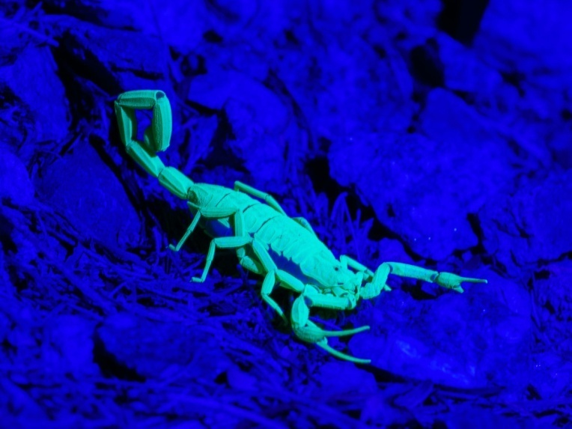
Black Light
makes white and fluorescent objects shine in the dark.
This is because all of these objects contain – phosphor.
The phosphor absorbs the energy and re-emits it as visible light, and when put under a black light, it will absorb the UVA rays and re-emit them as the light that can be perceived by the human eye.
The phosphor can be found in many natural elements such as teeth, fingernails, and scorpions but it’s often found in laundry detergents, in order to make your clothes look extra white.
The fluorescent light you often see in clubs are in fact nothing more than black lights that are coated with phosphor glass covering.

Slide 24
Uses of Black Light
Art inspection –Newer paints tend to emanate a subtle sparkle or sheen, while old paint doesn’t. This way it’s really easy to determine whether a painting is forged.
Currency fraud – Most banknotes nowadays have phosphor elements infused in them so as to avoid money forgery. There are small blacklight lamps behind every bank counter that are able to detect fake currency within seconds. Notice the white streak in the banknote below – it’s only visible under blacklight.
Detecting Bacteria – There are some microorganisms that are fluorescent under UV light. This is the common case of Salmonella and Shigella, and detecting them is especially important in the food industry.
Psoriasis – Much like the UVC light, a black light can also be used in the treatment of skin diseases. When exposed to it, the skin produces increased amounts of vitamin D, which in turn helps regenerate the skin.

Slide 25
Greenhouse Effect
Energy from the sun radiates down through the atmosphere.
Some is absorbed and re-radiated back but the wavelength has changed (longer) and can not penetrate the atmosphere (or car window).

Slide 26
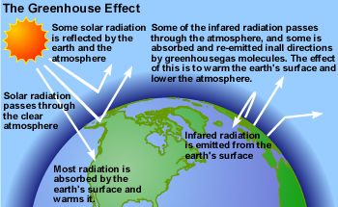

Slide 27
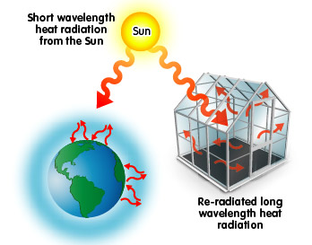
Green house Effect

Slide 28
X rays
X rays have a much shorter wavelength and higher energy and frequency than ultraviolet waves.
X rays are commonly used to photograph teeth and bones.
X rays are also used to detect small cracks in metals and also to photograph the inside of machines.
Too many X-rays may lead to cancer
See pages 159 - 160

Slide 29
Gamma Rays
Gamma rays can be used to kill cancer cells.
shortest wavelength, and highest energy.
Most damaging.
Gamma rays can be emitted from some radioactive isotopes or result from nuclear reactions.
Gamma rays can be used in radiation therapy to kill cancer cells. (yet too much can also cause cancer)
See page 160

Slide 30
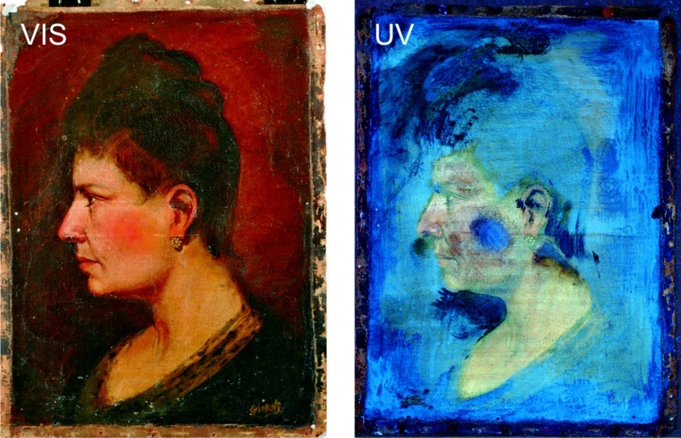
Using EMR in
Fighting Crime
Investigators use X-ray, infrared, and ultraviolet radiation to uncover art forgeries.
The radiation can help show an artists unique brushstrokes, identify pigments and varnishes, and uncover other paintings an artist has painted over.

Slide 31
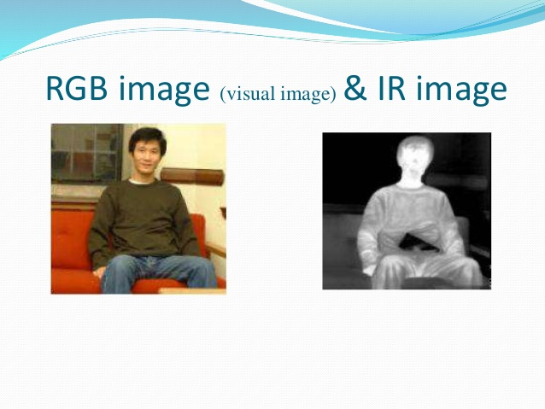
Using EMR in
Fighting Crime
Infrared photography creates images by sensing temperature differences. Often used to find hidden evidence, such as weapon and other objects placed within walls.

Slide 32
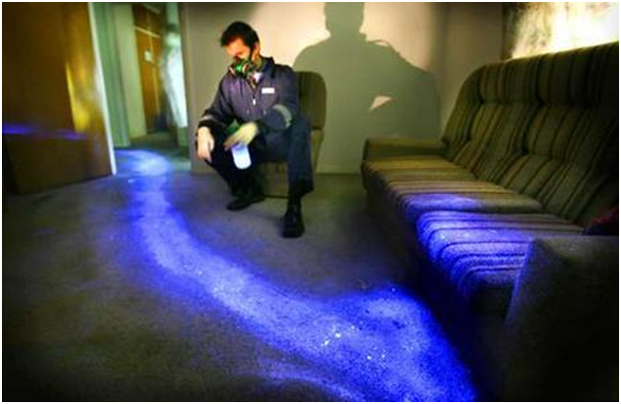
Using EMR in Fighting Crime
Forensic investigators use luminol to detect trace amounts of blood at crime scenes, as it reacts with the iron in hemoglobin.
When luminol is sprayed evenly across an area, trace amounts of an activating oxidant make the luminol emit a blue glow that can be seen in a darkened room.
Notes:
Beneath a black light, blood turns black, unless sprayed with luminol which gives it a blue-glow. Saliva, semen and urine also glow when hit with a black light. Most biological fluids contain fluorescent molecules to help them glow.

Slide 33
That’s just weird
A diary from a senior member of MI6 tells that the British Secret service used semen as invisible ink in First World War because it didn’t react to iodine vapour – the substance that gave away other invisible inks.

Slide 34
Check your Understanding
Name TWO forms of EMR that have shorter wavelengths than visible light.
Name Two forms of EMR that have longer wavelengths than visible light.
Which form of EMR has the LONGEST wavelength?
Which form of EMR has the highest energy?
Which EMR is the most damaging?
Other than cooking food, what else are microwaves used for?

Slide 35
Check your Understanding
Name the types of radiation given off by:
  A halogen light bulb
  The Sun
  Iodine -131
  You
Identify three sources of EMR you interactes with this week.

Slide 36
Practice with EMS WS

Slide 37
Homework
Song
https://www.youtube.com/watch?v=CK1Uowu9mQk
Work book p64-66
Make your own Glow in the dark slime
pbslearningmedia.org/resource/nvgs-sci-glowslime/wgbh-nova-gross-science-how-to-make-glow-in-the-dark-slime/

Slide 38
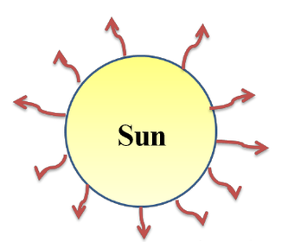
What is Light?
Light is a form of radiant energy we can see.
Radiant energy is energy transferred by electromagnetic radiation, such as light, X-rays, gamma rays, and thermal radiation, which may be described in terms of either discrete packets of energy, called photons, or continuous electromagnetic waves.
Other sources of energy give off waves of energy we cannot see.
Visible light (light that we see) is a tiny portion of a much larger spectrum of radiation called the electromagnetic spectrum.

Slide 39
Visible Light is a type of Electromagnetic Radiation.
Electromagnetic Spectrum 2min
https://www.youtube.com/watch?v=m4t7gTmBK3g
Electromagnetic radiation (EMR) is waves of energy with vibrating electrical and magnetic fields.
The electromagnetic spectrum (EMS) is the range of frequencies (the spectrum) of electromagnetic radiation and their respective wavelengths.

