Slide 1
The Immune System
How the Body Protects Itself

Slide 2
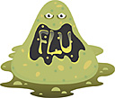
INFECTION
INFECTION is the invasion (entering) and growth of a foreign substance (microorganisms) in the body:
Can be bacteria, viruses, fungi, or other microorganisms.
Ted Ed Germ Theory: https://www.youtube.com/watch?v=N9LC-3ZKiok

Slide 3
Foreign Substances: Things that invade your body
1. Antigens:
Any substance your body does not recognize
Causes a reaction
Can be living or non-living
Eg. Splinters, metals, pathogens
2. Pathogens
Any substance that causes disease
Eg. Bacteria, viruses, cancerous cells, germs
Notes:
An infection can cause fever and other health problems, depending on where it occurs in the body

Slide 4
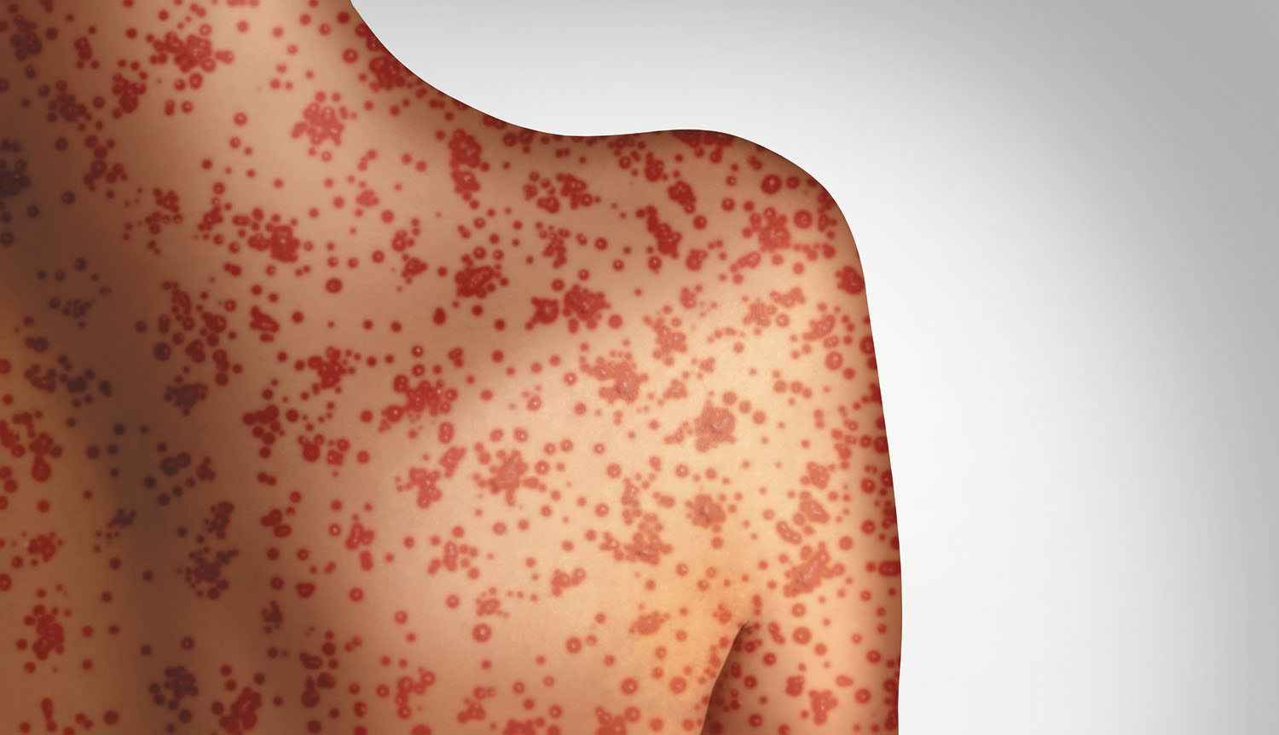
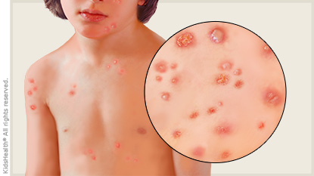
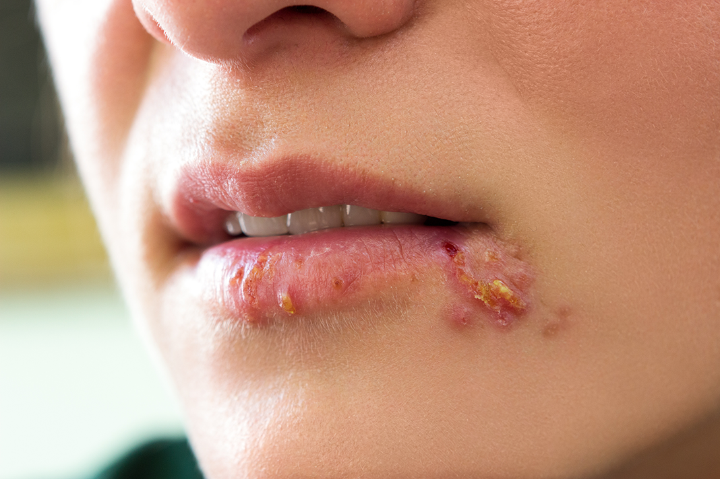
Viruses:
the common cold,
measles,
chicken pox,
genital herpes, and
influenza.
AIDS, SARS, COVID-19

Slide 5
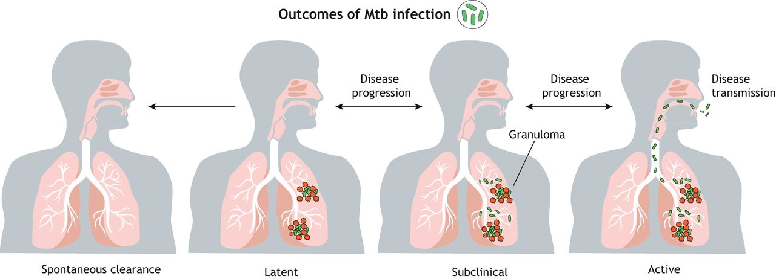
Bacteria
Whooping cough | Bordatella pertussis
Bubonic plague | Yersinia pestis
TB (Tuberculosis) | Mycobacterium tuberculosis
https://www.youtube.com/watch?v=31tnXPlhA7w
Notes:
Worldwide, there are an estimated 24.1 million cases of pertussis and about 160,700 deaths per year, according to a recent publication modeling these data. In 2012, the most recent peak year, CDC reported 48,277 cases of pertussis in the United States, but many more go undiagnosed and unreported.
uberculosis (TB) is an infectious disease usually caused by Mycobacterium tuberculosis (MTB) bacteria. Tuberculosis generally affects the lungs, but can also affect other parts of the body. Most infections show no symptoms, in which case it is known as latent tuberculosis.

Slide 6
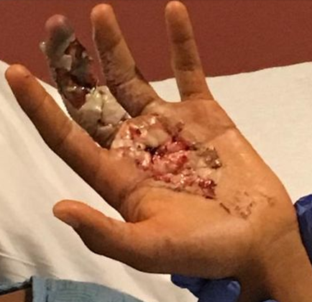
Necrotizing fasciitis -Flesh Eating Disease
Caused by bacteria group A streptococcus.
found on the skin or in the nose and throat of healthy people.
these bacteria make toxins that destroy body tissue directly.
The bacteria also cause the body's immune system to destroy its own tissue while fighting the infection.
spread by contact with saliva or mucus from the mouth, nose or throat of an infected person
Notes:
Many people carry these bacteria but don¡¦t get sick.
These bacteria can also cause strep throat, scarlet fever, skin infections and rheumatic fever.
It is not fully understood why group A streptococcus bacteria sometimes cause necrotizing fasciitis

Slide 7
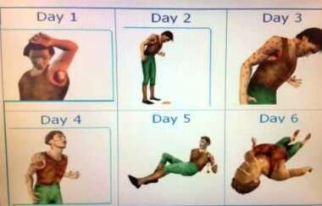
Bubonic plague (Black Death) - caused by Bacteria: Yersinia pestis
headaches, vomiting, swollen and painful lymph nodes (buboes)

Slide 8
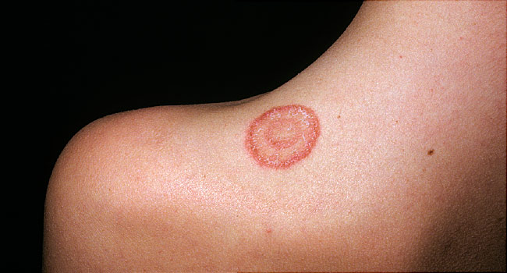
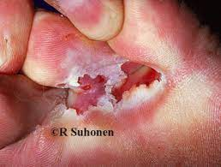
Fungi
Ringworm
Athlete's Foot
Vaginal yeast infection
Notes:
cand

Slide 9
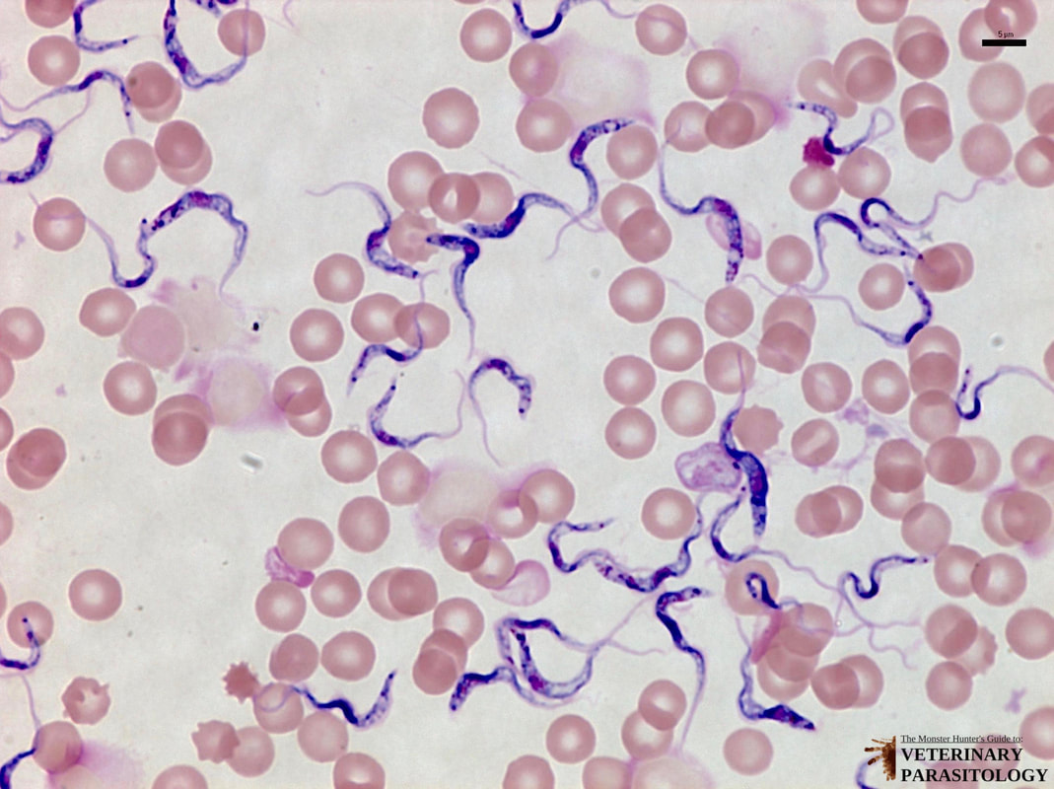
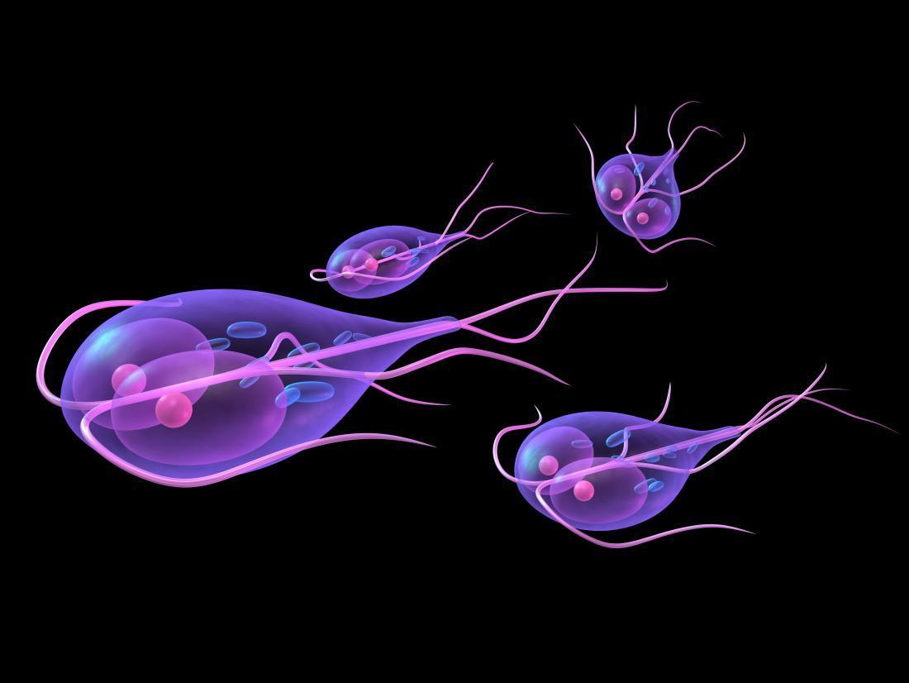
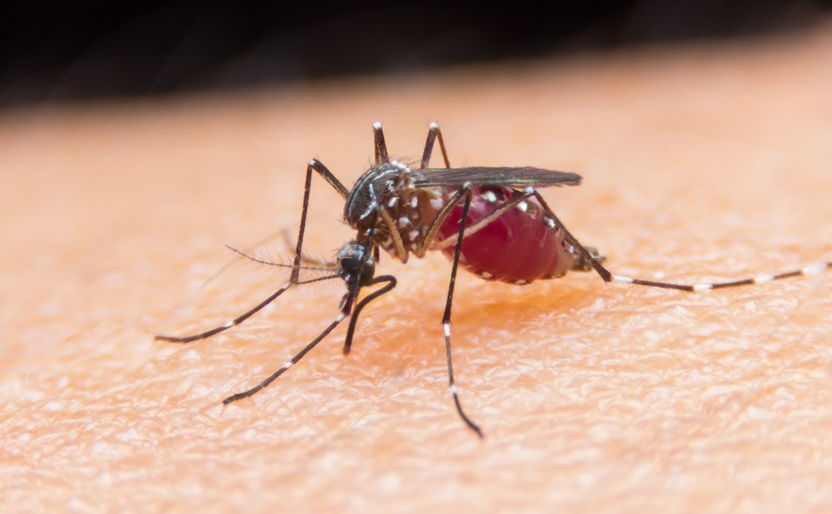
Protists (mostly protozoa)
Trypanosoma protozoa causes sleeping sickness
Giardia protozoa cause giardiasis
Plasmodium protozoa cause malaria.
Notes:
Trichinosis is a food-borne disease caused by a microscopic parasite called Trichinella. People can get this disease by eating raw or undercooked meat from animals infected with the parasite. Often these infected meats come from wild game, such as bear, or pork products.

Slide 10
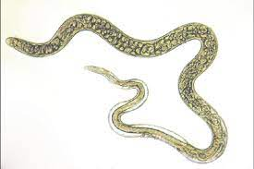
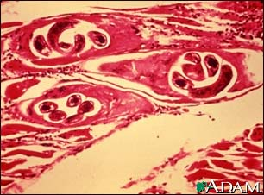
Trichinella parasite in pork
s

Slide 11
How does the Body Protect itself?
Our immune system is the system in an organism that prevents and fights infections of pathogens.
The Immune System offers 3 lines of Defense

Slide 12
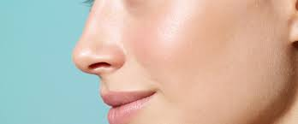
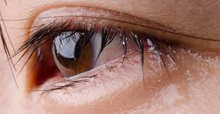
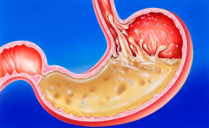
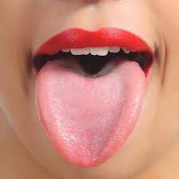
The First Line of Defense
Works to keep pathogens out of the body.
It is the Skin and Linings of all internal body systems.

Slide 13
Skin
Physical barrier
Sweat and oils are slightly acidic.

Slide 14
Stomach
Strong acid kills many pathogens.
Vomiting removes them.

Slide 15
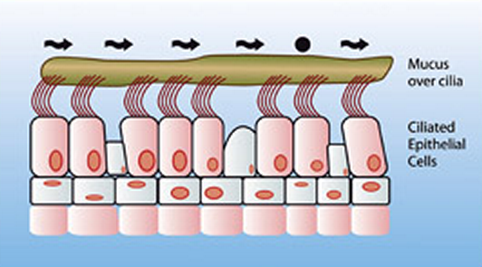
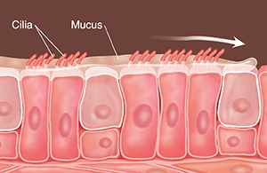
Hair, mucus, cilia (microscopic hair)
Trap or prevent some pathogens from entering respiratory system.

Slide 16
How do pathogens enter the body?
In infectious diseases, pathogens are transmitted in 4 different ways.

Slide 17
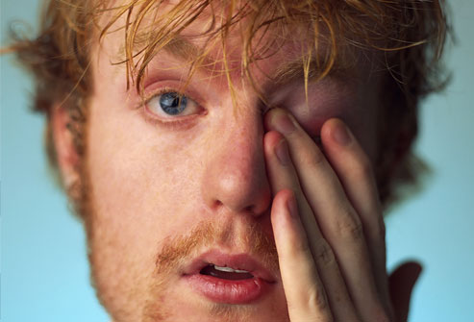
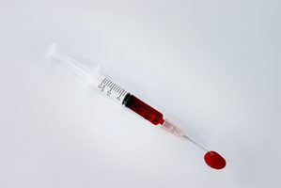
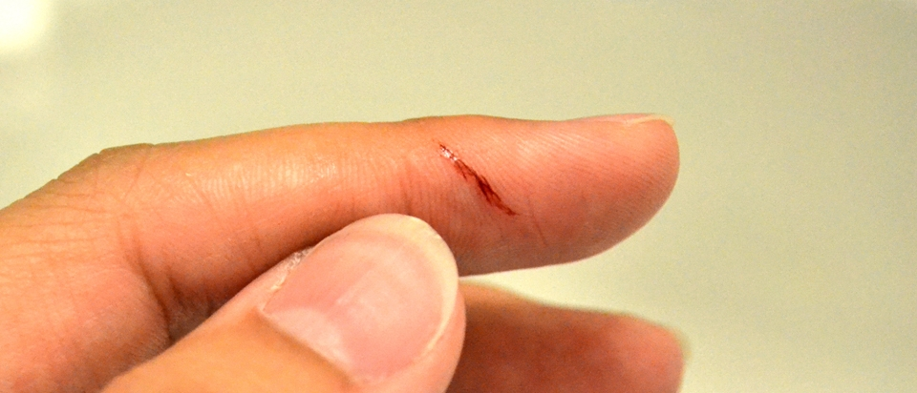
1. Direct Contact
Pathogens can enter the body through:
eyes, mouth, nose, breaks in skin, and needle punctures.
Eg. Shaking hands
Eg. Sharing Body fluids
Eg. Cuts, Scratches
Notes:
Eg. Sexually transmitted diseases, hepatitis, and HIV/AIDS can be transmitted through: Kissing, touching, sexual intercourse

Slide 18
How not to get sick:
Don’t share body fluids!
Don’t rub your face (especially your eyes) after shaking hands with a sick person.
Don’t have unprotected sexual intercourse
Don’t inject anything unless prescribed by a doctor
Keep wounds covered

Slide 19
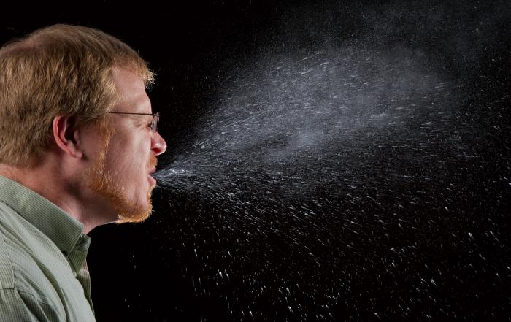
2. Indirect contact (Inhalation)
Being within 2 m of a sneeze.
Eg. the common cold and tuberculosis are spread in this way.
COUGH INTO YOUR SLEEVE!
Stay home when you are sick

Slide 20
R value

Slide 21
3. By Ingestion (through the mouth)
Consuming contaminated food or water
Improperly cooked food may contain Salmonella or E. coli.
Wash hands, cutting board, utensils after cutting raw meat, after using the washroom
Cook your food well, drink only water that is purified by filtering, chemicals, or boiling.

Slide 22
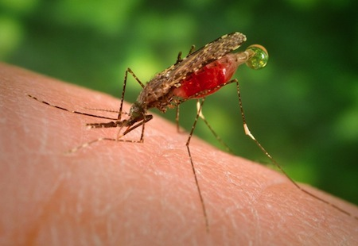
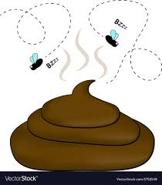
4. By Vectors
Vectors are organisms that transmit (spread) pathogens and parasites from one infected person (or animal) to another.
usually bites
Eg. mosquitoes (malaria and Zika)
Eg. houseflies (dysentery).
Eg. Bites from an animal with rabies virus
Eg. Fleas carried the bacteria that caused the Black Death
Notes:
Dysentery is an inflammatory disease of the intestine, especially of the colon, which always results in severe diarrhea and abdominal pains.
shivering and chills, followed by a high fever, followed by sweating and a return to normal temperature. Malaria signs and symptoms typically begin within a few weeks after being bitten by an infected mosquito.

Slide 23
Zika

Slide 24
Rabies

Slide 25
Discussion
Where are some of the places in your school that may have the most germs?
What other common places may have a lot of germs?
What is the most common way to be infected with germs?
Are you more likely to catch them from another person who is already infected?
What are some common diseases/germs we can catch from other people?

Slide 26
Practice
1. Watch: The Sneeze:
https://www.youtube.com/watch?v=yToii3-p-NI
2. Spread your germs activity
Read p100-102, and notes to answer WS

Slide 27
Extra Slides beyond here

Slide 28
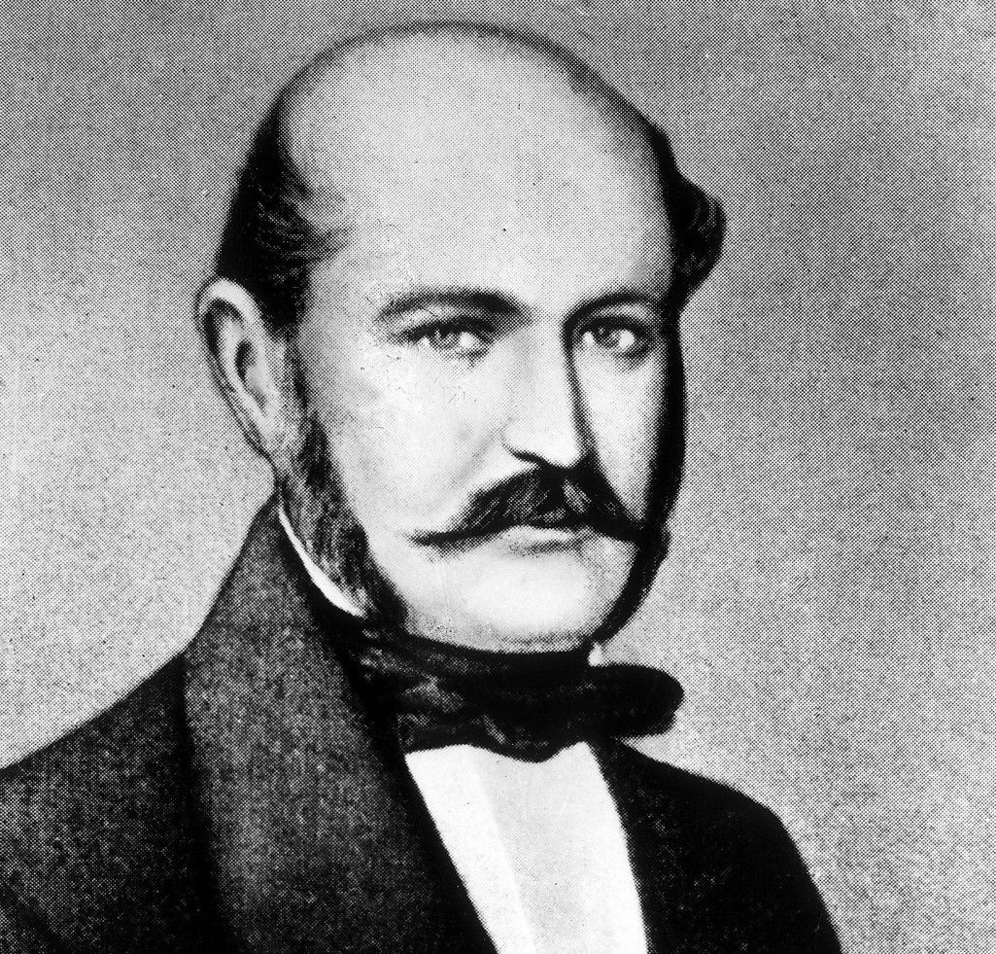
Ignaz Semmelweis: Hand Washing 1847
Ignaz Semmelweis, the doctor who discovered the disease-fighting power of hand-washing in 1847
young Hungarian physician and scientist did an important observational study at Vienna General Hospital
know known as an early pioneer of antiseptic procedures.
Described as the "saviour of mothers", he discovered that the incidence of puerperal fever could be drastically cut by the use of hand disinfection in obstetrical clinics

Slide 29
The leading cause of maternal mortality in Europe at that time was puerperal fever – an infection, now known to be caused by the streptococcus bacterium, that killed postpartum women.
Prior to 1823, about 1 in 100 women died in childbirth at the Vienna Hospital. But after a policy change mandated that medical students and obstetricians perform autopsies in addition to their other duties, the mortality rate for new mothers suddenly jumped to 7.5%. What was going on?
Notes:
Eventually, the Vienna Hospital opened a second obstetrics division, to be staffed entirely by midwives. The older, First Division, to which Semmelweis was assigned, was staffed only by physicians and medical students. Rather quickly it became apparent that the mortality rate in the first division was much higher than the second.
Semmelweis set out to investigate. He examined all the similarities and differences of the two divisions. The only significant difference was that male doctors and medical students delivered in the first division and female midwives in the second.
Remember that at this time, the general belief was that bad odors – miasma – transmitted disease. It would be two more decades at least before germ theory – the idea that microbes cause disease – gained traction.
Semmelweis cracked the puerperal fever mystery after the death of his friend and colleague, pathologist Jakob Kolletschka. Kolletschka died after receiving a scalpel wound while performing an autopsy on a woman who’d died of puerperal fever. His autopsy revealed massive infection from puerperal fever.
No midwives ever participated in autopsies or dissections. Students and physicians regularly went between autopsies and deliveries, rarely washing their hands in between. Gloves were not commonly used in hospitals or surgeries until late in the 19th century.
Realizing that chloride solution rid objects of their odors, Semmelweis mandated hand-washing across his department. Starting in May 1847, anyone entering the First Division had to wash their hands in a bowl of chloride solution. The incidence of puerperal fever and death subsequently dropped precipitously by the end of the year.
Unfortunately, as in the case of his contemporary John Snow, who discovered that cholera was transmitted by water and not miasma, Semmelweis’ work was not readily accepted by all. The obstetrical chief, perhaps feeling upstaged by the discovery, refused to reappoint Semmelweis to the obstetrics clinic.
Semmelweis’ refusal to publish his work may have also contributed to his downfall. With little recognition during his lifetime, he eventually died from injuries sustained in a Viennese insane asylum.

Slide 30
Ritual hand-washing appears to have come with public health implications. During the Black Death of the 14th century, for instance, the Jews of Europe had a distinctly lower rate of death than others. Researchers believe that hand-washing prescribed by their religion probably served as protection during the epidemic.

Slide 31
Germ Theory
Germ Theory is the idea that microorganisms known as pathogens or "germs" can lead to disease.
These small organisms, too small to see without magnification, invade humans, other animals, and other living hosts.

Slide 32
Louis Pasteur proves germ theory 1861
Louis Pasteur opposed the accepted theory of “spontaneous generation”.
between the years 1860 and 1864 conducted experiments .
He discovered the pathology of the puerperal fever and the pyogenic vibrio in the blood, and suggested using boric acid to kill these microorganisms before and after confinement.
In 1861, Pasteur published his germ theory which proved that bacteria caused diseases. This idea was taken up by Robert Koch in Germany, who began to isolate the specific bacteria that caused particular diseases, such as TB and cholera.
Building on Pasteur's work on germ theory, Koch used experiments to prove that the bacterium Bacillus anthracis was the cause of anthrax - the bacterium could be observed in the tissue of anthrax victims. He extracted this bacterium from a sheep which had died of anthrax, grew it and injected a mouse with it.
Notes:
He was not the first to propose that diseases were caused by microscopic organisms, but the view was controversial in the 19th century, and opposed the accepted theory of “spontaneous generation”
The more formal experiments on the relationship between germ and disease were conducted by Louis Pasteur between the years 1860 and 1864. He discovered the pathology of the puerperal fever and the pyogenic vibrio in the blood, and suggested using boric acid to kill these microorganisms before and after confinement.
In 1861, Pasteur published his germ theory which proved that bacteria caused diseases. This idea was taken up by Robert Koch in Germany, who began to isolate the specific bacteria that caused particular diseases, such as TB and cholera.
Building on Pasteur's work on germ theory, Koch used experiments to prove that the bacterium Bacillus anthracis was the cause of anthrax - the bacterium could be observed in the tissue of anthrax victims. He extracted this bacterium from a sheep which had died of anthrax, grew it and injected a mouse with it.

Slide 34
Organs of the Immune System

Slide 35
Do some reading to find the role these play in our immune system

Slide 37
How do pathogens enter the body?
Getting through the first line of defence
Ted Ed
https://www.youtube.com/watch?v=yxonJTWhBJQ

Slide 39
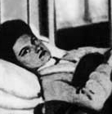
Mary Mallon
(September 23, 1869 – November 11, 1938), also known as Typhoid Mary, was an Irish cook. She was the first person in the United States identified as an asymptomatic carrier of the pathogen associated with typhoid fever. She was presumed to have infected 51 people, three of whom died, over the course of her career as a cook.^{[1]} She was twice forcibly isolated by public health authorities and died after a total of nearly three decades in isolation

Slide 40
How does your immune system work?
Immune system: Innate and Adaptive, 5min
https://www.youtube.com/watch?v=PzunOgYHeyg

