Slide 1
ELEMENTS: building blocks of matter

Slide 2
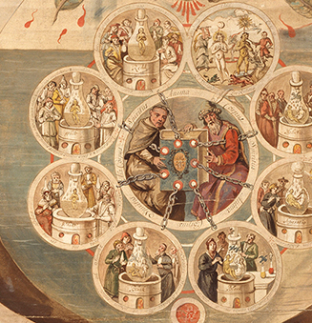
The History of Chemistry
Alchemy - medieval precursor to chemistry based on the idea of transforming of matter, particularly in converting metals into gold.

Slide 3
The History of Chemistry
Years ago, scientists believed all matter was made up of these “four elements”:
Fire
Earth
Air
Water
Notes:
Alchemists believed what the Greeks had, that all substances in the world were composed of:

Slide 4
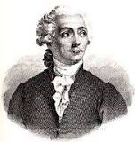
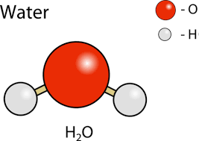
Antoine Lavoisier – the father of chemistry
June 1783, Antoine Lavoisier SPLIT (separate) water into hydrogen and oxygen, proving water was NOT an element but a compound.
Notes:
He discovered that WATER was a COMPOUND of hydrogen and oxygen

Slide 5
AntoineLavoisier – the father of chemistry
In 1777, he was the first to prove that sulfur was an element, not a compound.
He wrote a list of elements, and helped reform the naming of chemicals
In 1778, he named oxygen.
In 1783 he named hydrogen.
Also helped create the metric system

Slide 6
Beginnings of Modern Chemistry
Chemists began to test substances to see if they could be broken down into something smaller.
If it could NOT be broken down → they found a new ELEMENT

Slide 7
Review:
An element is a pure substance that cannot be broken down into simpler components.
There are more than 115 different elements
Around 92 occur in nature, while the remainder are “synthetic” (man-made) elements created in laboratories.

Slide 8
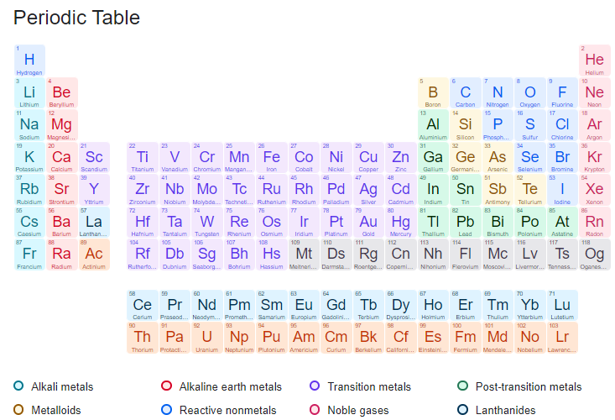

Slide 9
How do we NAME elements?
Elements are named based on:
1. Most have Latin origins: plumbum
Mercury – hydragyrum "liquid silver"
2. Some names are based on element’s special properties
Eg. “light giving” (phosphorous)
Eg “water forming” (hydrogen)
3. To honour scientists (einsteinium)
4. After Countries (germanium) or cities (berkelium)
Notes:
Mercury gets is name from the planet Mercury which was named after the swift messenger of the Roman gods, Mercury. It was given this name because it flowed swiftly in its liquid form. The symbol Hg comes from the Latin word "hydragyrum" meaning "liquid silver."

Slide 10
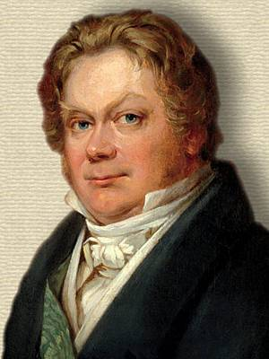
Chemical Symbols for Elements
Swedish chemist Jons Jakob Berzelius suggested symbolic system to describe all the elements using the letter of either their common name or Latin name.
Each element has an International symbol consisting of one or two letters..

Slide 11
Writing Symbols for Elements
Each element has an International symbol consisting of one or two letters..
First letter is always capitalized. Usually first letter of their common or Latin name:
Carbon = C
Hydrogen = H
Boron = B

Slide 12
Symbols for Elements
If there is a second letter, it is never capitalized
Helium = He
Calcium = Ca
Lithium = Li

Slide 13
Periodic Table of Elements

Slide 14
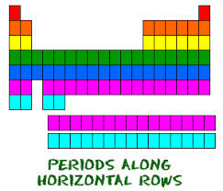
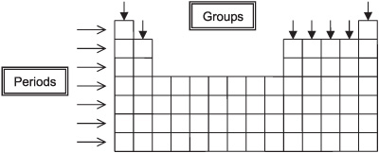
How are elements organized (arranged)?
Elements are organized on the periodic table in horizontal rows called PERIODS.

Slide 15
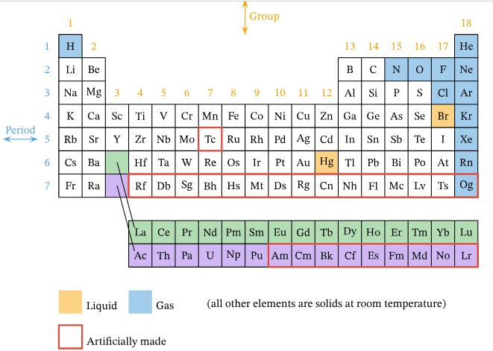
Vertical Columns of Periodic Table
Elements are organized on the Periodic Table in vertical columns called GROUPs or FAMILIES.

Slide 16
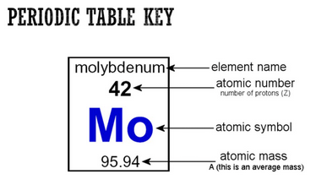

Slide 17
Elements on the Periodic Table
Atomic number - unique to that element, NEVER changes). Molybdenum is the 42nd element on the Periodic Table.
Atomic mass – mass of an atom in atomic mass units

Slide 18
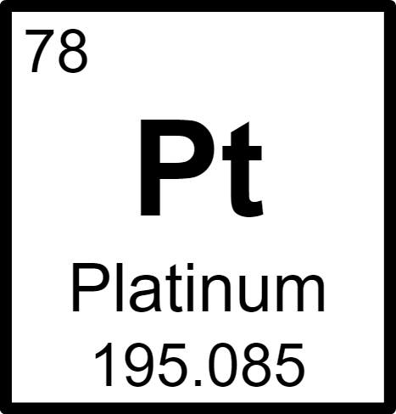
Find Platinum on Periodic Table
What is the number of the element before platinum?
What is the number of the element after platinum?
Elements are organized along rows according to their atomic number

Slide 19
Practice
Colour your Periodic Table
Periodic Table Scavenger Hunt WS
Vocab: Element, Group, row, Period, column
Atomic number, atomic mass

Slide 27
Mercury
Aluminum and mercury
https://www.youtube.com/watch?v=IrdYueB9pY4
Could put these in compounds/reactions
Mercury and penny
Extra: Periodic Table
https://www.youtube.com/watch?v=O-48znAg7VE

