Slide 1
How does light behave?

Slide 2
What is light?
Light is a form of energy that we can see
What are some sources of light? https://www.youtube.com/watch?v=BUYeQa_-ojk
Notes:
Extra: 6 min Intro to Light Video Ted Ed:
https://www.youtube.com/watch?v=O0PawPSdk28

Slide 3
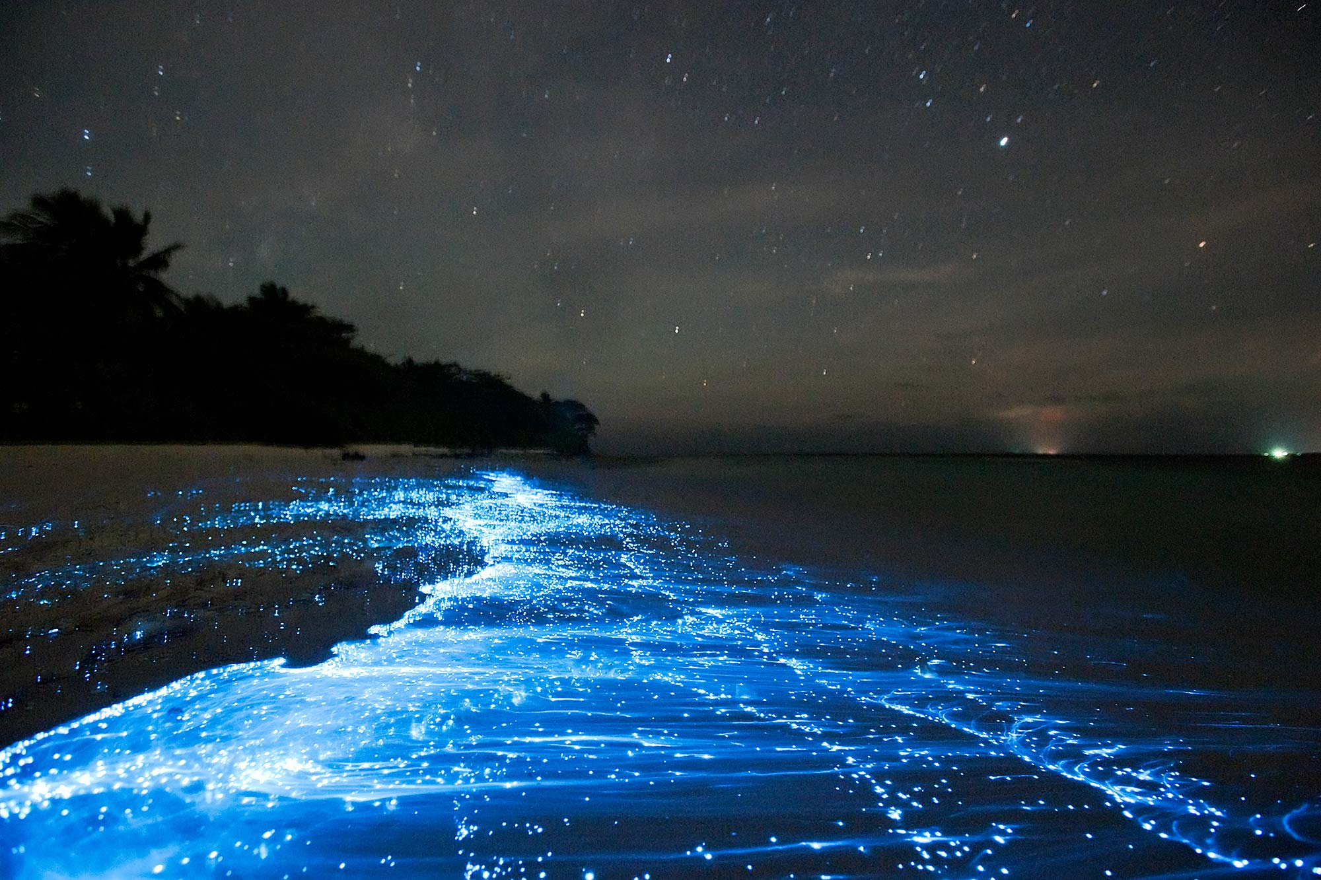
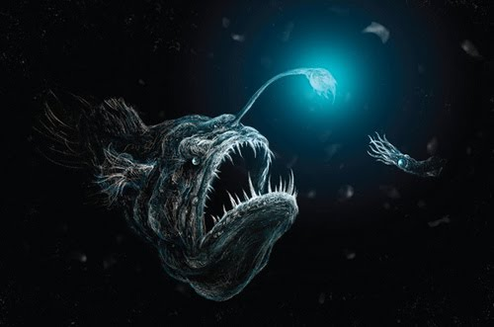
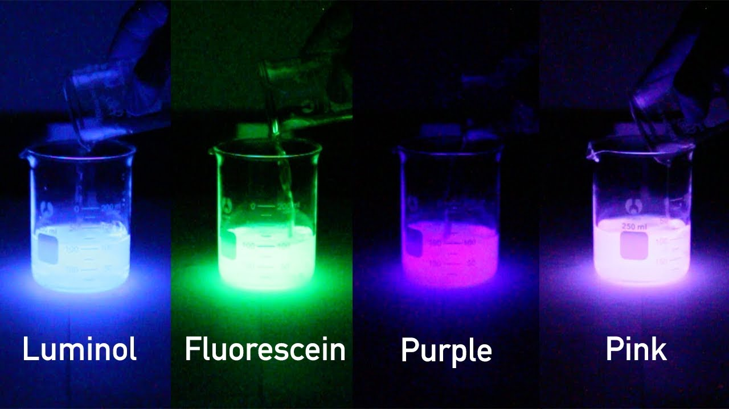

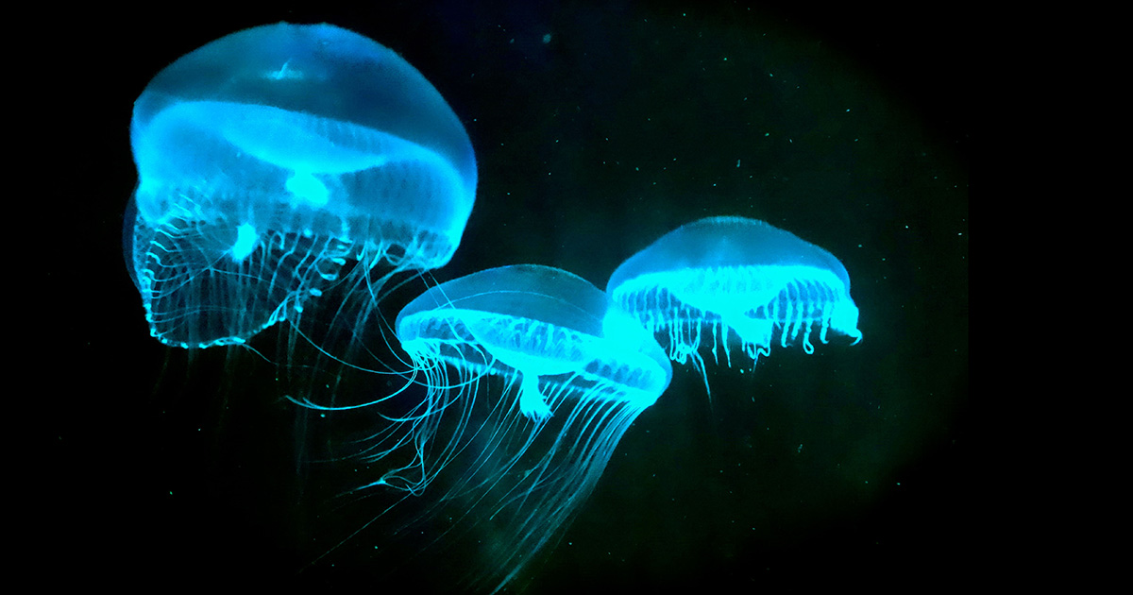
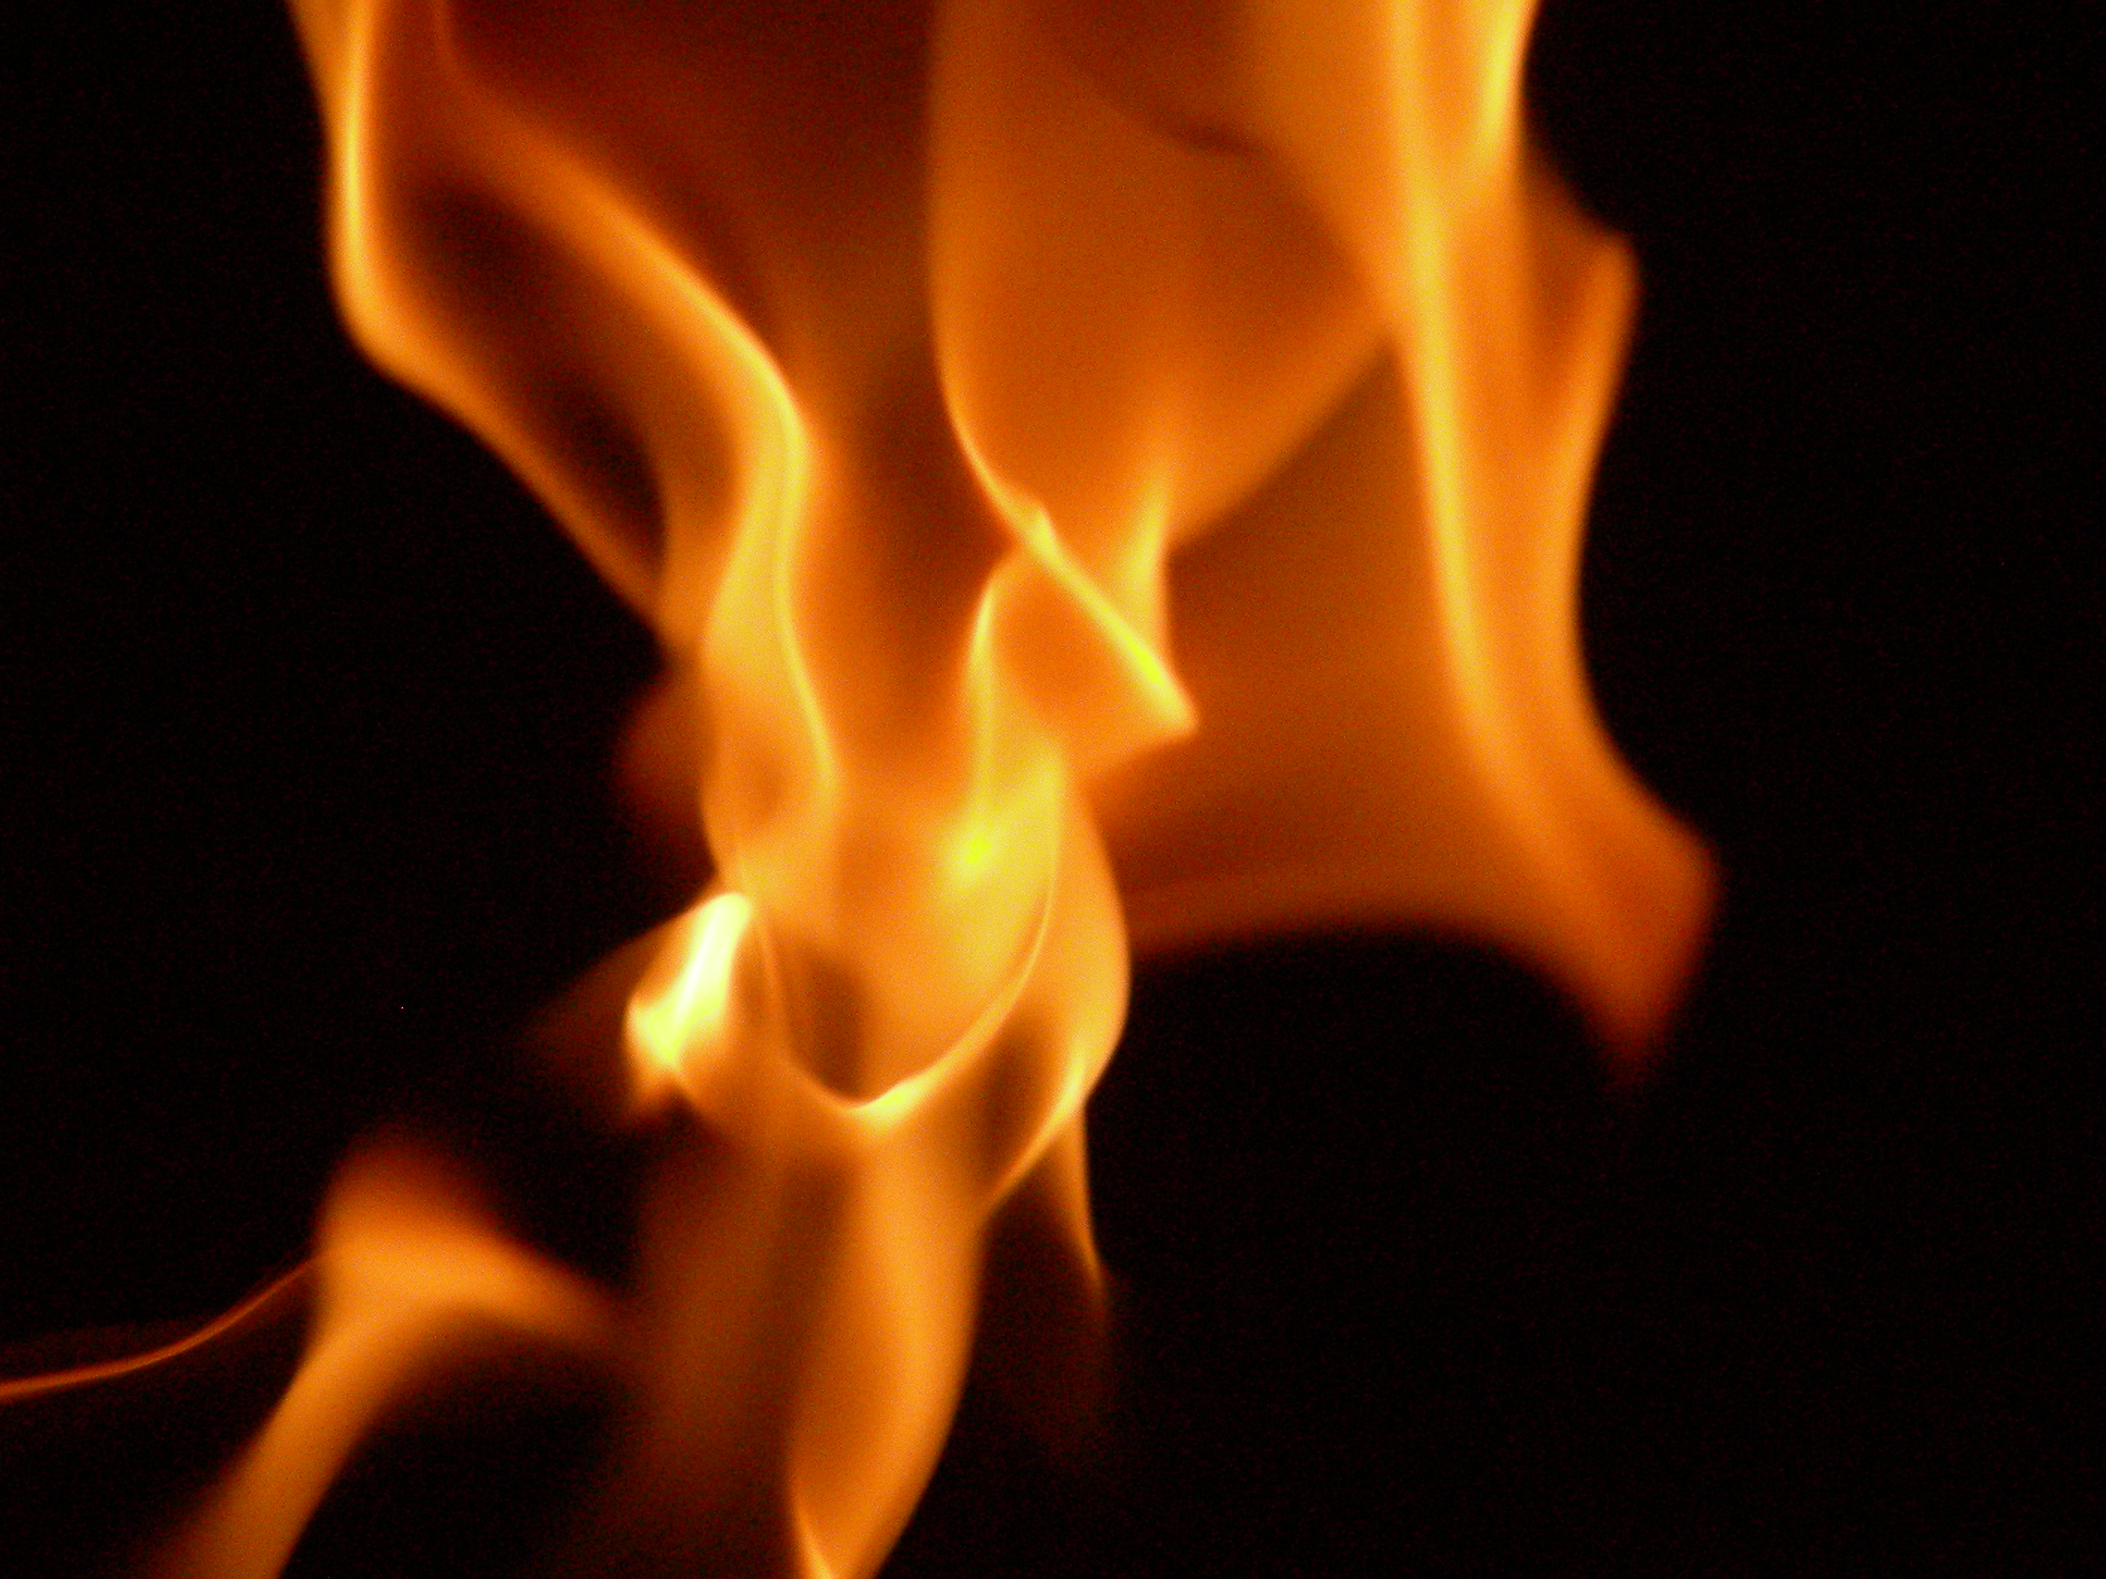
Notes:
Anglerfish have a lighted, dangling lure that looks like a fat, juicy worm. The anglerfish entices prey close with the glowing lure, then pounces. The anglerfish's glow comes from luminous bacteria that live in its lure. In some anglerfish species, the male is much smaller than the female

Slide 4
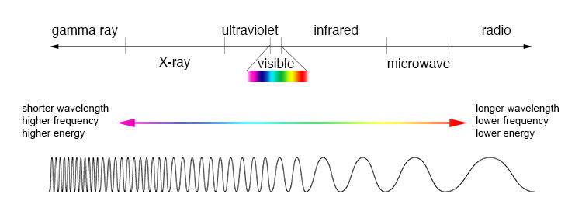
What is light? Why is it important?
Light is a form of energy that we can see.
Visible Light is a type of electromagnetic radiation (within the electromagnetic spectrum of other forms of radiation).

Slide 5
Why it is important?
We can see and hear the world around us because of the energy carried by waves.
Waves with different properties can be used in different ways
Electromagnetic waves can be used to make different kinds of images in the world around us.

Slide 6
UNDERSTANDING HOW LIGHT TRAVELS
A model is a way of representing something to understand it better and to make predictions.
The WAVE model of explains that light has wave-like properties.
Notes:
Light transfers energy from one place to another (such as from the Sun to the Earth).

Slide 7
Other Models of Light
The Ray Model – Light travels in straight lines
Particle Model of Light – light behaves like a particle

Slide 8

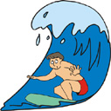
What is a Wave?
A WAVE is a movement of ENERGY through matter or space.
Examples of waves include: water waves, sound waves, and microwaves.
See page 134
Notes:
Energy is the capacity to apply a force over a distance.
A force is a push or a pull on an object.

Slide 9
Waves Travel through different mediums
The matter that waves travel through is called a medium (can be solid, liquid, gas)
Some waves such as light waves, can travel through space where there is no medium.
See page 137

Slide 10
Think, Pair, Share Activity
Think about different types of Waves you have seen in your life time.
2) Discuss with a partner
3) Share to class

Slide 11
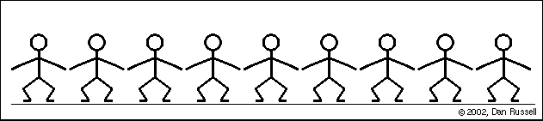
Waves
Water Waves
Radio Waves
Human Waves!!?

Slide 12
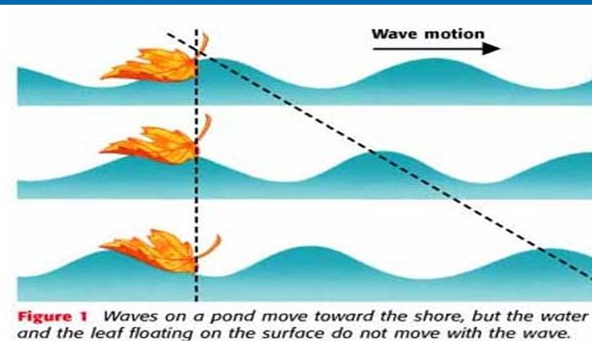
Water Waves move Energy, Not Water
A water wave does not carry water along with it.
Only the energy carried by the water wave moves forward.
Only the energy in the waves moves forward toward the shore.

Slide 13
Types of Waves

Slide 14


TRANSVERSE WAVES
Movement: Up and down. Particles to vibrate perpendicular to the direction of its motion.
E.g. Water waves
Direction of wave propagation:
Diagram:
.

Slide 15
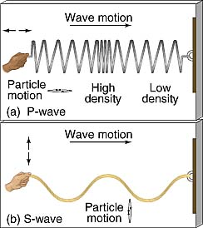
Transverse Waves
Transverse Wave
  oscillations are perpendicular
  to the direction of Motion

Slide 16
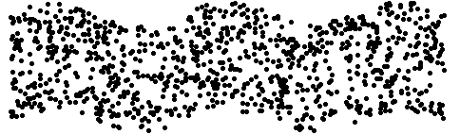
TRAVERSE WAVE MOTION
Direction of wave

Slide 17
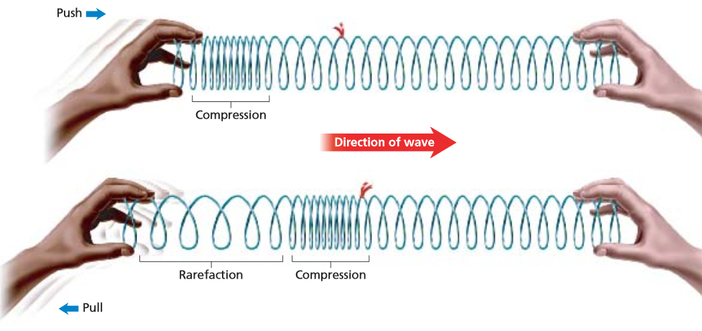
LONGITUDINAL (or Compression Waves)
Movement: Wave travels parallel to the particle motion (Same Direction)
E.g. Sound Waves (and Primary Waves from Earthquakes)
Direction:
alternating compressions and rarefactions in a medium.
Notes:
Sound waves traveling in air compress and expand the air in bands

Slide 18
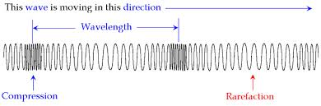
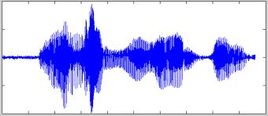
LONGITUDINAL (or Compression Waves)
Notes:
Sound waves traveling in air compress and expand the air in bands

Slide 19

LONGITUDINAL WAVE MOTION
Direction of wave

Slide 20
Types of Waves
Longitudinal wave oscillations are in the direction of motion (parallel to the motion)

Slide 21
Features of a Wave
Crest: the highest point on a wave.
Trough: the lowest point on a wave.
Rest Position: midline between crest and trough
Wavelength: the distance, in meters, for one complete cycle of the wave Crest to crest or trough to trough.
Amplitude: the height of a wave crest or depth of a trough, as measured from rest position
Identify each of the lettered parts of the wave.
See pages 135 - 136

Slide 22
Components of a Light Wave: Label your diagram
Notes:
p136

Slide 23

Frequency
Frequency is number of repetitions in given amount of time.
Wave Frequency is the number of waves that pass a given point in one second.
Wave Frequency is measured in hertz (Hz).
Write down this Formula:
Notes:
This is called an Inverse Relationship
named after the German physicist who first confirmed the existence of electromagnetic waves, Heinrich Hertz.

Slide 24
What is the Frequency of each waveform?

Slide 25
Calculate Frequency:
a) A hummingbird flaps its wings 120 times in 3 seconds.
b) A DVD spins 35 times in 7 seconds.

Slide 26
Calculating Frequency
a) A hummingbird flaps its wings 120 times in 3 seconds.
Frequency = cycles/sec = 120/3 = 40 Hz
b) A DVD spins 35 times in 7 seconds.
Frequency = cycles/sec = 35/7 = 5 Hz
Take the Section 4.1 Quiz
See page 138

Slide 27
Calculating Frequency
Merry-go-round: 12 revolutions every 2 minutes

Slide 28
Check your understanding
Figure 1 Figure 2 Figure 3 Figure 4
Which one has the greatest amplitude?
Which one has the highest frequency?
Which one has the longest wavelength?
Notes:
Greatest amplitude = Figure 4
Highest frequency = Figure 3
Longest wavelength = Figure 1

Slide 29
Frequency and Wavelength
Wavelength:
Frequency:
What do you notice? What is the relationship between wavelength and frequency?

Slide 30
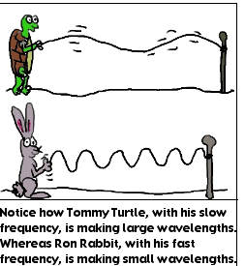
Frequency and Wavelength
,
This is called an Inverse Relationship
When one value increases as the other decreases,
Notes:
As a wavelength increases in size, its frequency and energy (E) decrease.

Slide 31
Summary
Waves transfer energy through matter or space.
Amplitude is the height of a waves crest or depth of a wave trough, as measured from its rest position.
A wavelength is the distance over which the wave repeats.
As the wavelength decrease, the frequency increases.
Waves can differ in how much energy they carry and in how fast they travel.

Slide 32
Practice
Waves WS

Slide 33
Extra Slides beyond here

Slide 34
Light waves are more complicated than water waves.
This is because light waves have electrical and magnetic properties

Slide 35
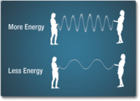
How is Energy related to Frequency?
It takes more energy, to produce more waves (higher-frequency wave has more energy) of same amplitude.
High Frequency = Higher energy. (Direct Relationship)
What high energy EMR do we know of?

Slide 36
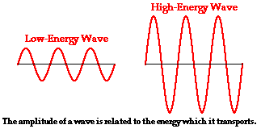
How is Energy related to Amplitude?
A high energy wave is characterized by a high amplitude
Notes:
Of same wavelength

Slide 37
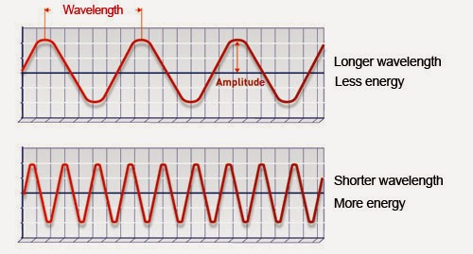
How is Energy related to Wavelength?
Notes:
Both waves MUST have same amplitude to compare.

Slide 38
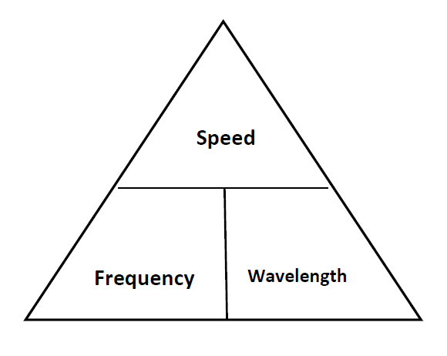
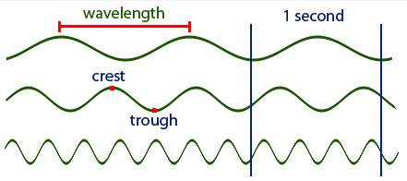
Extension: Calculating speed of waves
Wave speed is the distance a wave travels in a given amount of time, such as the number of meters it travels per second.
Wave speed is related to wavelength and wave frequency by the equation: Speed = Wavelength x Frequency.

Slide 39
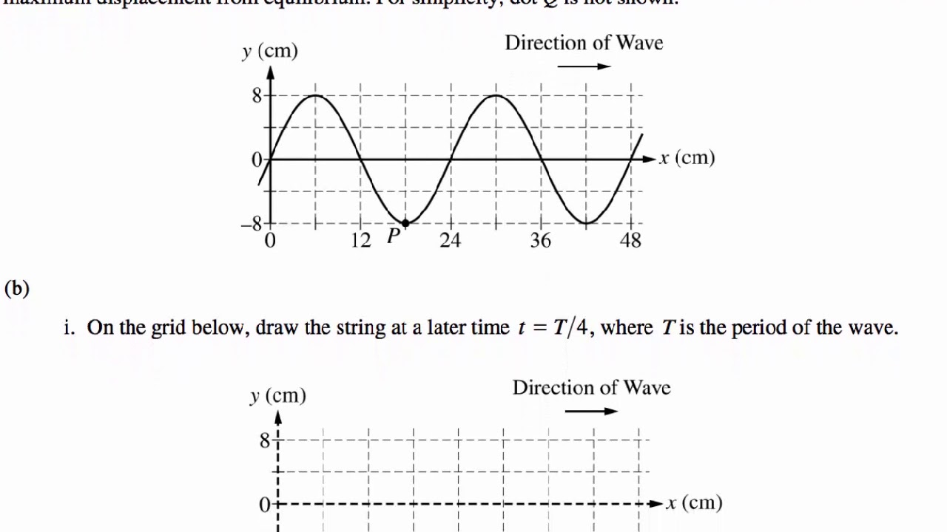
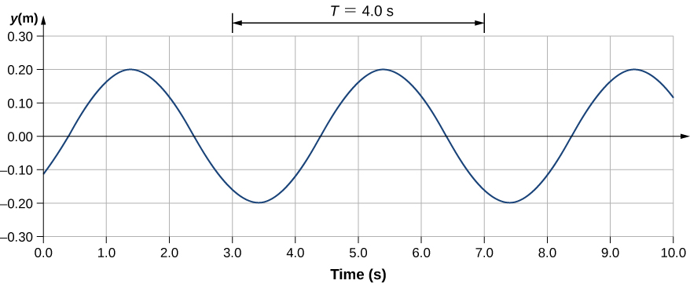
A wave train a group of waves of equal or similar wavelengths traveling in the same direction.
Assume this wave train is 4 seconds long.
How many waves in this wave train?
What is the length of one wave?
How many waves per second? ( frequency)
What is the speed of one wave?

Slide 40
A wave train a group of waves of equal or similar wavelengths traveling in the same direction.
Assume this wave train is 4 seconds long.
How many waves in this wave train? 2 waves
What is the length of one wave? 24 cm
How many waves per second? (frequency) 2 waves/4 seconds = 0.5Hz
What is the speed of one wave? Speed = 24 cm/wave x 0.5 waves / sec = 12 cm/sec

Slide 41
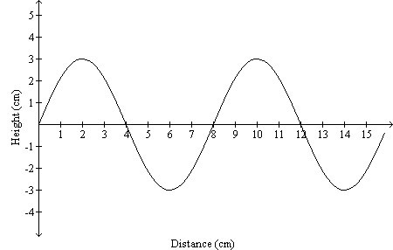
CYU
A wave train a group of waves of equal or similar wavelengths traveling in the same direction.
How many waves in this wave train?
What is the amplitude?
What is the wavelength?
If the entire distance takes 1 sec,
What is the frequency?
What is the speed of wave?

Slide 42
Amplitude is determined by energy
A wave with more energy has greater amplitude.
Imagine dropping a small pebble into a pond of still water. Tiny ripples will move out from the disturbance in concentric circles. The ripples are low-amplitude waves with very little energy.
ow imagine throwing a big boulder into the pond. Very large waves will be generated by the disturbance. These waves are high-amplitude waves and have a great deal of energy.

Slide 43
Wave amplitude is the maximum distance the particles of the medium move from their resting positions when a wave passes through.
Wave amplitude of a transverse wave is the difference in height between a crest and the resting position. Wave amplitude of a longitudinal wave is the distance between particles of the medium where it is compressed by the wave.
Wave amplitude is determined by the energy of the disturbance that causes the wave. A wave caused by a disturbance with more energy has greater amplitude.

Slide 44
Practice
Wave WS in class
Slinky Activity 4-4 p140
HW: Read pages 134-137
HW: Answer CYU p143 #1-8 → Hand in Wed

Slide 45
Bill Nye: Waves
https://www.youtube.com/watch?v=R89dJP5v1Tg
What is light?
In a nutshell, 4.38min
https://www.youtube.com/watch?v=IXxZRZxafEQ
EMS video 5 min
https://www.youtube.com/watch?v=cfXzwh3KadE

Slide 46
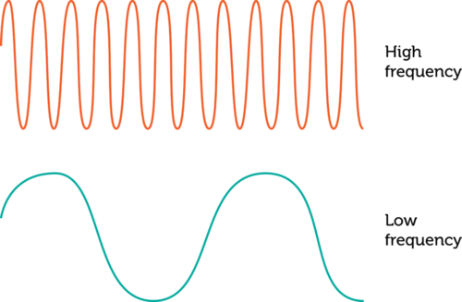
Frequency
Infer how wave frequency is related to wavelength.

Slide 47
Frequency
A: Waves with a higher frequency have crests that are closer together, so higher frequency waves have shorter wavelengths.

Slide 48
This guy explains using simulation
https://www.youtube.com/watch?v=KWzyQKcJBYg
https://www.youtube.com/watch?v=4yfXp1jNBn8

Slide 49
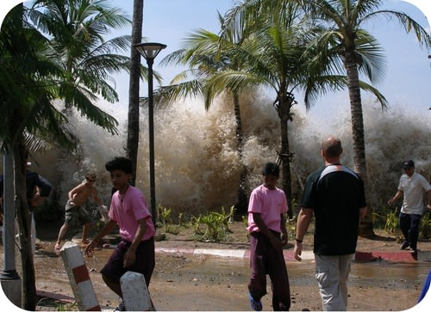
Introduction
Tsunamis are large ocean waves caused by earthquakes.
The height of the wave is one way of measuring the size of the wave.

Slide 50
Watching Water Waves Activity p134
Pie pan, beaker, water
1. In what direction did the waves travel when you tapped the water lightly with the pencil
2. How did the spacing of the water waves change when the rate of the tapping increased.
Empty water and return beakers and pie pans back to bins.

Slide 51
Increased frequency: Decreased Frequency:
shorter wavelength Longer wavelength
This is called an Inverse Relationship

Slide 52
Frequency
What happens when
See page 136
Notes:
This is called an Inverse Relationship
named after the German physicist who first confirmed the existence of electromagnetic waves, Heinrich Hertz.

Slide 53
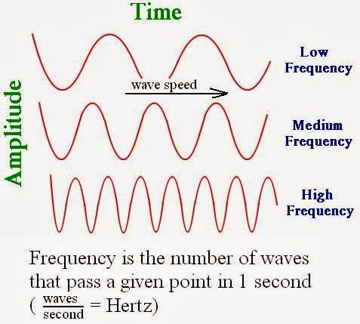
Are amplitude and frequency related? Not necessarily:
These waves have the same amplitude but different(increasing) frequencies

Slide 54

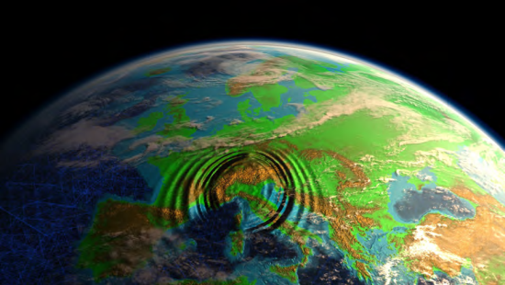
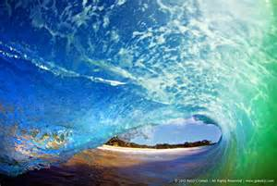
2. Mechanical Waves
Mechanical Waves are waves that transfer energy through a medium.
Created when a source of energy causes a vibration to travel through a medium.

Slide 55

Answer the following multiple choice questions.
Which of the following energy does NOT travel as a wave?
  Sound
  Light
  Earthquakes
  Wind

Slide 56

The answers are ...
Which of the following does NOT travel as a wave?
  Sound
  Light
  Earthquakes
  Wind

Slide 57
Answer the following multiple choice questions.
How are sound and light waves different?
  Sound has a wavelength, light does not
  Sound can be measured, light cannot
  Light travels through space, sound cannot
  Light travels more slowly than sound

Slide 58
The answers are ...
How are sound and light waves different?
  Sound has a wavelength, light does not
  Sound can be measured, light cannot
  Light travels through space, sound cannot
  Light travels more slowly than sound

Slide 59
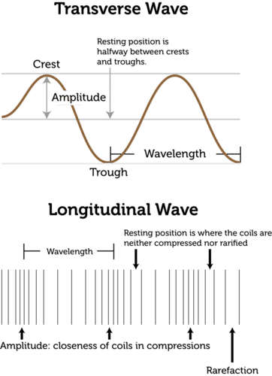
Two Types of Waves that travel through a medium:
  TRANSVERSE WAVE – matter in the medium moves perpendicular (up and down) to direction of the wave.
  All types of electromagnetic radiation, including visible light, are transverse waves.
See page 137

Slide 60
Longitudinal or Compression Waves
  A Longitudinal or Compression wave – matter in the medium moves parallel (side to side) to direction of the wave.
  Amplitude measures how compressed the particles in the medium are when wave passes through. The more compacted they are, the greater the amplitude)
  Eg. sound waves (vibrations in pressure, and seismic P-waves (created by earthquakes and explosions).
See page 137
Notes:
Rarefaction is the reduction of an item's density, the opposite of compression. Like compression, which can travel in waves (sound waves, for instance), rarefaction waves also exist in nature. A common rarefaction wave is the area of low relative pressure following a shock wave

Slide 61
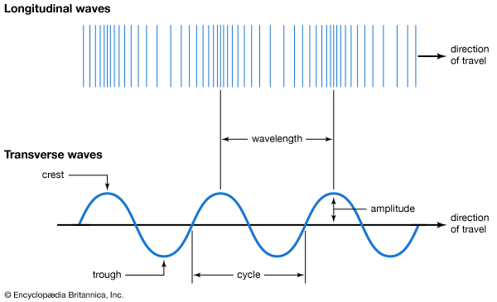

Slide 62
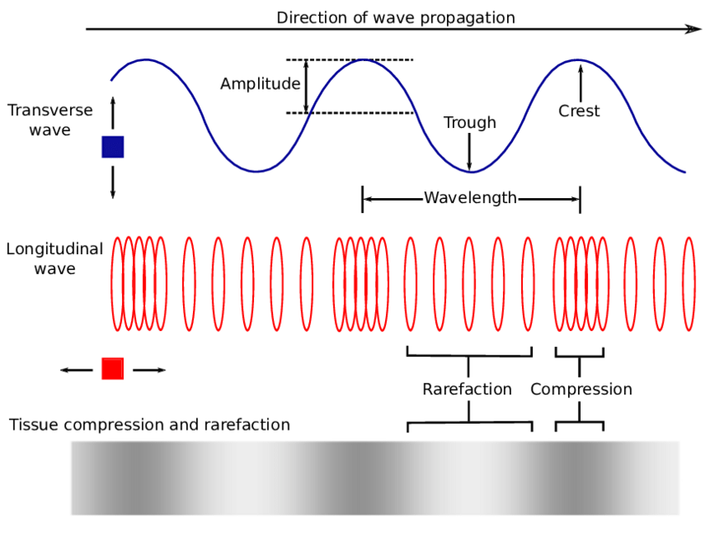

Slide 63
