Slide 1
Respiratory System
Essential Questions:
How do we breathe?
What makes smoking so bad?
Why do we need oxygen?

Slide 2
UNIT B
Chapter 11: Respiratory System
Section 11.1
The respiratory system works with the circulatory system in the following 4 areas of homeostatic functions:
Breathing: exchange of air in and out of lungs.
External respiration: exchange of gases (oxygen and carbon dioxide) between the air and blood
Internal respiration: exchange of gases between the blood and tissue fluid
Cellular respiration: production of ATP in cells.
TO PREVIOUS SLIDE
Notes:
Cellular respiration uses the oxygen and produces the CO2 that makes gas exchange with the environment necessary. Without a continuous supply of ATP, the cells cease to function.

Slide 3
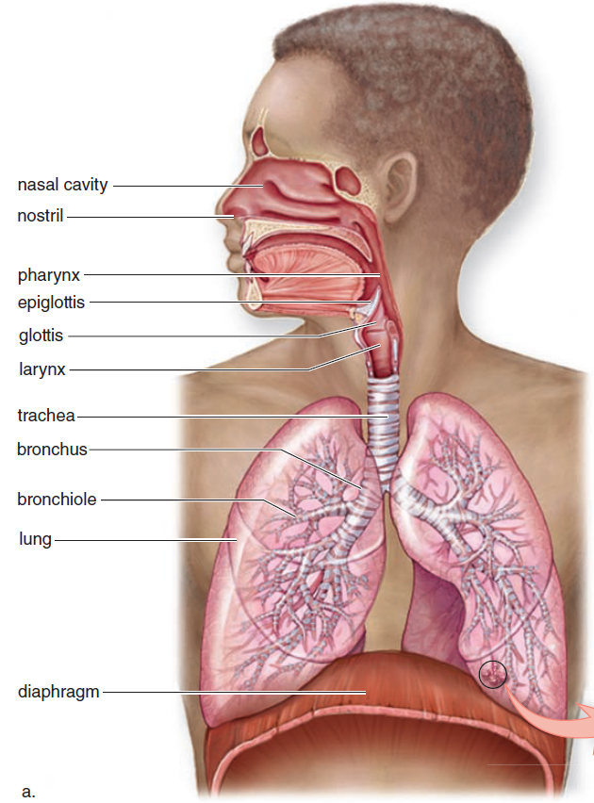
The Respiratory System
UNIT B
Chapter 11: Respiratory System
Section 11.1
Ventilation (breathing) includes:
inspiration (inhalation) and
expiration (exhalation).
TO PREVIOUS SLIDE
Notes:
The main function of the respiratory system is to allow oxygen from the air to enter the blood and carbon dioxide from the blood to exit into the air.
respiratory system: a type of organ system consisting of the lungs and tubes that take air to and from them; brings oxygen into the body and removes carbon dioxide, restoring pH
Ventilation, another term for breathing, includes both
Inspriation: breathing in
Expiration: breathing out
Air is conducted toward or away from the lungs by a series of cavities, tubes, and openings.

Slide 4
Respiratory System: Structure
There are 3 major parts of the respiratory system:
the airway
the lungs and
the muscles of respiration.

Slide 5
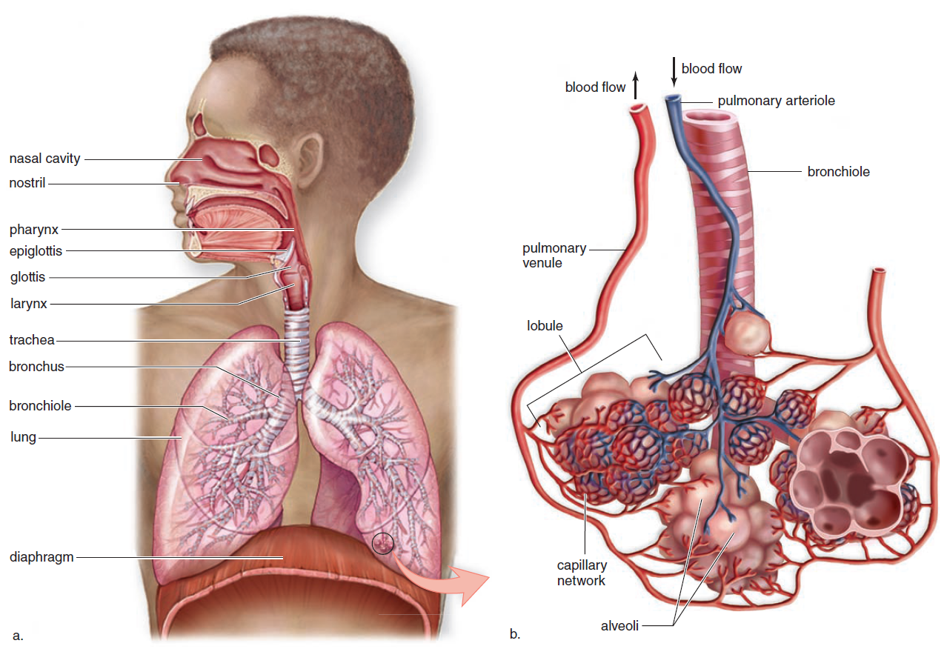
UNIT B
Chapter 11: Respiratory System
Section 11.1
TO PREVIOUS SLIDE
Notes:
The respiratory tract - extends from the nose to the lungs, which are composed of air sacs called alveoli
b. Gas exchange occurs between air in the alveoli and blood within a capillary network that surrounds the alveoli. Notice that the pulmonary arteriole is coloured blue—it carries O₂-poor blood away from the heart to the alveoli. Then carbon dioxide leaves the blood, and oxygen enters the blood. The pulmonary venule is coloured red—it carries O₂-rich blood from the alveoli toward the heart.

Slide 6
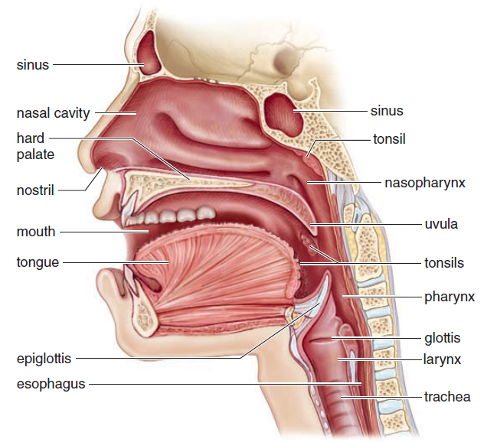
The Nose
UNIT B
Chapter 11: Respiratory System
Section 11.1
Air enters nasal passages
Hairs and Cilia trap dust and debris
Air is warmed and moistened
TO PREVIOUS SLIDE
Notes:
The nose is the only external portion of the respiratory system.
Air enters the nose through the nostrils
Air is moistened and warmed in two nasal cavities that are lined with mucous membranes
Nasal cavities are separated from the mouth by the palate, which is composed of the hard palate and soft palate
Nose contains two nasal cavities-narrow canals separated from each other by a septum of bone and cartilage.
Special ciliated cell in the narrow upper recesses of the nasal cavities act as receptors. Nerves from cells to brain where impulses generated by odor receptors are interpreted as smell.
Tear (lacrimal) glands drain into nasal cavities by tear ducts – crying gives runny nose.
Nasal cavities also communicate with the cranial sinuses, air-filled mucosa-lined spaces in the skull. If inflamn due to cold or allergy blocks ducts leading from sinuses, mucus accumulates →sinus headache.
Nasal cavities empty into nasopharynx to middle ears.

Slide 7
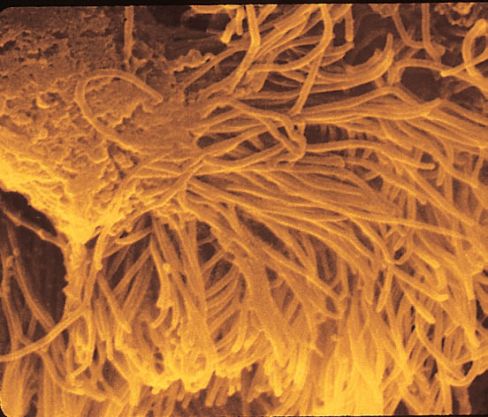
UNIT B
Chapter 11: Respiratory System
Section 11.1
Ciliated Cells
TO PREVIOUS SLIDE
Notes:
Figure 11.2 Ciliated Cells. These cells line the interior of the nasal passages and upper respiratory tract..
Air entering airway is cleansed, warmed and moistened.
Cleansing done by coarse hairs, cilia and mucus in nostrils,, and cilia alone in other airways. Hairs and cilia act as screening devices.
Trachea: cilia beat upward → pharynx to be swallowed or coughed out.
Warmed: heat givenoff by the blood vessels lying close to the surface of the airway lining. Shape of noses.
Moistened by wet surface of passages.

Slide 8
The Pharynx: “throat”
UNIT B
Chapter 11: Respiratory System
Section 11.1
Contains lymphatic tissues called tonsils that contain lymphocytes that protect against pathogens
Allows for the passage of air and food
TO PREVIOUS SLIDE
Notes:
pharynx: a funnel-shaped passageway that connects the nasal and oral cavities to the larynx
3 parts: nasopharynx – where nasal cavities open above soft palate
Oropharynx – where oral cavity opens
Laryngopharynx – opens into larynx.
Tonsils form a protective ring at the junction of oral cavity and pharynx. – protects against foreign inhaled antigens.
Pharynx receives air and food.

Slide 9
The Larynx: Voice Box
UNIT B
Chapter 11: Respiratory System
Section 11.1
cartilaginous structure between the pharynx and the trachea
Adam’s Apple
voice box since it contains the vocal cords.
TO PREVIOUS SLIDE
Notes:
larynx: a. Adam’s Apple
vocal cords: mucosal folds supported by elastic ligaments, housed within the larynx
glottis: the slit between the vocal cords
epiglottis: a flap of tissue that prevents food from passing into the larynx
Connects the pharynx to the trachea
Composed of cartilage and dense connective tissue
Allows for the passage of air (the glottis allows air into the larynx)
A flap of tissue above the larynx, the epiglottis, prevents passage of food into lower respiratory tract

Slide 10
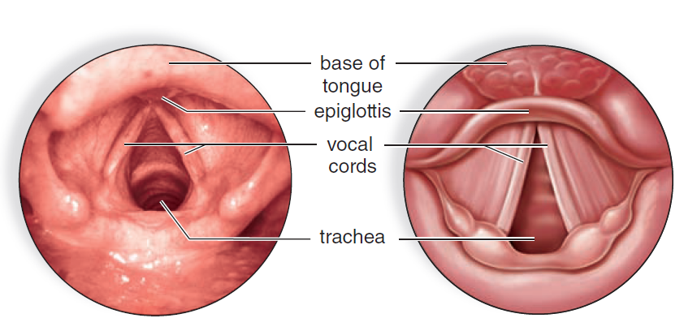
UNIT B
Chapter 11: Respiratory System
Section 11.1
Figure 11.4 Placement of the vocal cords. Viewed from above, the vocal cords stretch across the glottis, the opening to the trachea. When air is expelled through the glottis, the vocal cords vibrate, producing sound. The glottis is narrow when we make a high-pitched sound, and it widens as the pitch deepens.
TO PREVIOUS SLIDE
Notes:
https://www.youtube.com/watch?v=v9Wdf-RwLcs
Puberty: growth of larynx and vocal cords is more rapid in malescasuing more prominent Adam’s apple and deeper voice. . Voice breaks due to lack of control of longer vocal cords.
Pitch of voice regulated by changing tension of chords. Wider glottis – lower pitch. Loudness – amplitude of vibrations.

Slide 11
The Trachea: Windpipe
UNIT B
Chapter 11: Respiratory System
Section 11.1
Connects larynx with bronchi
cartilaginous rings
passage of air to bronchi
Lined with:
goblet cells and ciliated cells
tracheostomy
TO PREVIOUS SLIDE
Notes:
windpipe
tube connecting the larynx to the primary bronchi,
C- shaped Cartilaginous rings. Opens to esophagus expand when eatingConnects larynx with bronchi
Held open with C-shaped cartilaginous rings
Allows for the passage of air to bronchi
Lined with:
Ciliated mucous membranes contains goblet cells (produce mucus) and ciliated cells (sweep mucus and debris toward the pharynx)

Slide 12
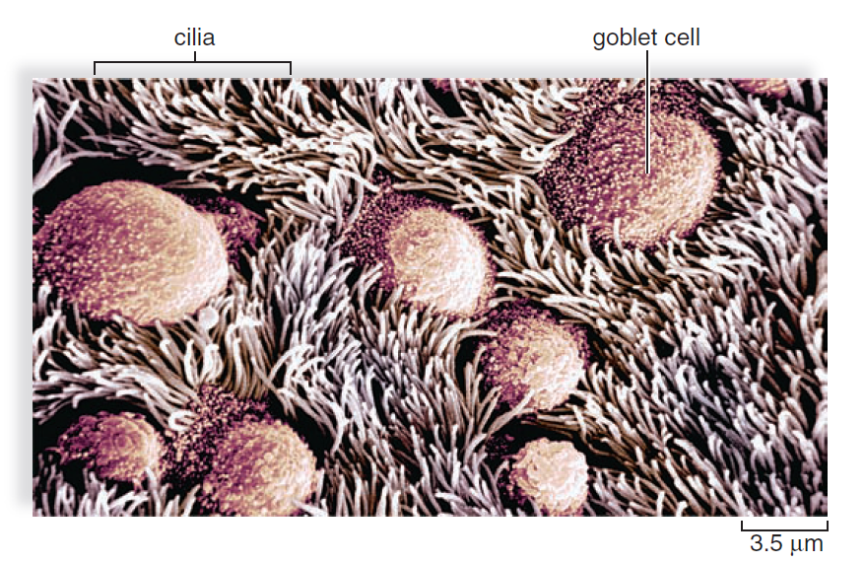
UNIT B
Chapter 11: Respiratory System
Section 11.1
TO PREVIOUS SLIDE
Notes:
Figure 11.5 The surface of the trachea. A scanning electron micrograph shows that the surface of the mucous membrane lining the trachea consists of goblet cells and ciliated cells. The cilia sweep mucus and the debris embedded in it toward the pharynx, where they are swallowed or expectorated.
Smoking causes the cilia to disappear, allowing debris to enter the bronchi and lungs.

Slide 13
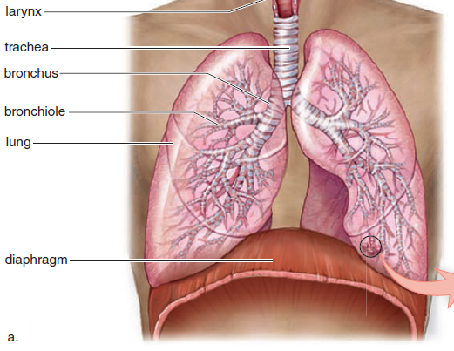
The Bronchial Tree
UNIT B
Chapter 11: Respiratory System
Section 11.1
The trachea divides into the bronchi
branch into
secondary bronchi
that lead to bronchioles
Each bronchiole leads to
alveoli (air sacs)
TO PREVIOUS SLIDE
Notes:
The bronchi branch into secondary bronchi that lead to bronchioles→ continue to branch and walls Get thinner and diameter smaller
Each bronchiole leads to thin-walled air sacs called alveoli (site of gas exchange between air and blood)
The components of the bronchial tree beyond the primary bronchi make up the lungs
bronchi: (sing., bronchus) branch of the trachea that leads to the lungs
bronchioles: small tubes that conduct air from the bronchi to the alveoli
alveoli: (sing., alveolus) the air sacs or air pockets in the lungs. About 300 million alveoli/lung for a total of 150m2 of area (40x area of skin). Alveoli surrounded by capillaries. Gas exchange. Surfactant prevents collapsing when air leaves.

Slide 14
Cigarettes
Notes:
Cigarette smoke contains over 4,000 chemicals, including 43 known cancer-causing (carcinogenic) compounds and 400 other toxins. These include nicotine, tar, and carbon monoxide, as well as formaldehyde, ammonia, hydrogen cyanide, arsenic, and DDT. Nicotine is highly addictive.

Slide 15
Effects of Smoking on Respiratory System:
Air Passages: damages the ciliated cells → unable to sweep debris out → more prone to infections.
Alveoli: walls break down and join together, forming larger air spaces than normal →reducing efficiency of gas exchange
→ may lead to emphysema
3. Hemoglobin: Carbon monoxide binds to hemoglobin with higher affinity than oxygen → reducing O2 transport throughout body. Increases the risk of coronary heart disease and strokes.
Notes:
Nicotine
Nicotine is the addictive substance in tobacco. It reaches the brain within 20 seconds and creates a dependency so that smokers become addicted. Smokers can suffer from withdrawal symptoms if they try to give up cigarettes.
Carbon monoxide
Carbon monoxide combines with the haemoglobin in red blood cells and so reduces the ability of the blood to carry oxygen. This puts extra strain on the circulatory system, and can cause an increased risk of heart disease and strokes.
Smoking during pregnancy is very dangerous. It reduces the amount of oxygen available to the growing fetus, which leads to an increased risk of low birth weights of babies.
Tars
Carcinogens are substances that cause cancer. Tobacco smoke contains many carcinogens, including tar. Smoking increases the risk of lung cancer, and cancer of the mouth, throat and oesophagus.
The images below compare a healthy lung and a smoker's lung. You can see the deposits of tar and particulates (particles) in the smoker's lung.

Slide 16
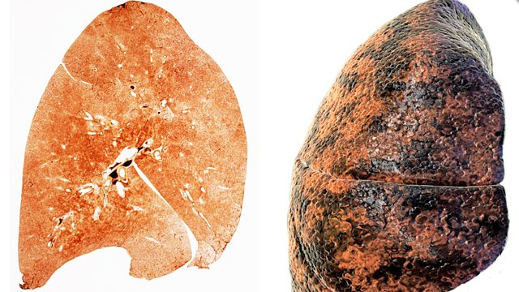
Lung cancer
Tobacco smoke contains many carcinogens, including tar. Smoking increases the risk of lung cancer, and cancer of the mouth, throat and esophagus.

Slide 18
Throat Cancer

Slide 19
Diaphragm
A muscle at the base of the
lungs involved in inspiration
and expiration

Slide 20
The Lungs
UNIT B
Chapter 11: Respiratory System
Section 11.1
The lungs contain: alveoli, airways, and blood vessels.
TO PREVIOUS SLIDE
Notes:
lungs: paired, cone-shaped respiratory organs that occupy the thoracic cavity
Each lung is covered with a thin membrane called a pleura
Secretes fluid so that it can slide freely against the pleura of the chest wall and diaphragm during inspiration and expiration
diaphragm: a dome-shaped muscle that separates the thoracic cavity from the abdominal cavity
R lung 3 lobes, L lung 2
Lobe divided into lobules, each of which has a bronchiole serving many alveoli.
Lungs would float.

Slide 21
The Lungs
UNIT B
Chapter 11: Respiratory System
Section 11.1
Air enters the lungs via bronchial tree → alveoli
Gas exchange between air in alveoli and blood in capillaries
Lungs covered with a pulmonary pleural membrane - thin membrane, secretes fluid for lubrication
Visceral pleura – covers lungs
Parietal pleura - lines chest wall
Pleural cavity - thin fluid-filled space between the two pulmonary pleurae of each lung
TO PREVIOUS SLIDE
Notes:
A pleura is a serous membrane which folds back onto itself to form a two-layered membranous pleural sac. It is extremely difficult to save a premature baby at 4 or 5 months of pregnancy because physicians say there is a "wall" that prevents survival much earlier than six months. The premature alveoli do not develop surfactant to prevent their collapsing shut.

Slide 22
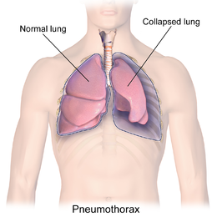
Collapsed Lung
When air enters the pleural space between the wall of the chest cavity and the lung.
Caused by an injury to the chest wall or a hole in the lung.
Total collapse called pneumothorax
Notes:
What would cause this ?
Due to injury to the chest wall or a hole in the lung. Emphesyma.

Slide 23
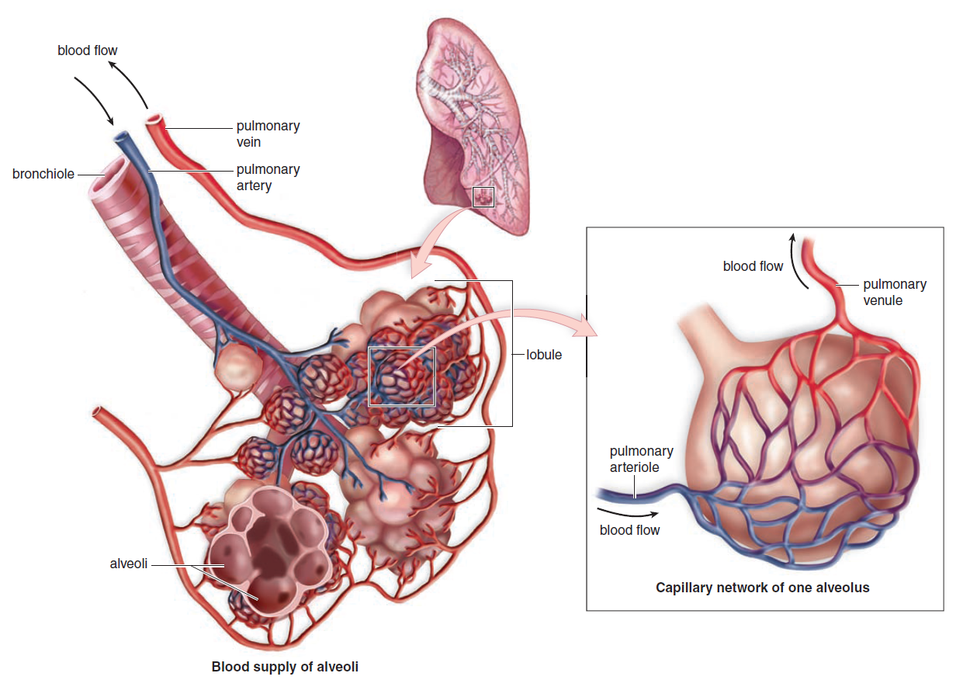
UNIT B
Chapter 11: Respiratory System
Section 11.1
Figure 11.6 Gas exchange in the lungs. The lungs consist of portions of the bronchial tree leading to the alveoli. Each alveolus is surrounded by an extensive capillary network. Notice that the pulmonary artery and arteriole carry O₂-poor blood (coloured blue) and the pulmonary vein and venule carry O₂-rich blood (coloured red).
TO PREVIOUS SLIDE

Slide 24
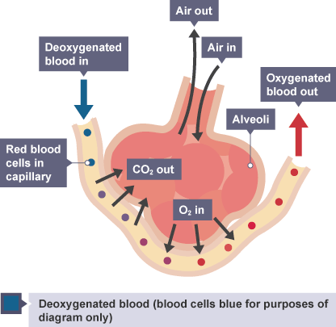
Alveoli – structure
thin walls (just one cell thick)
large surface area
moist surface
Covered in surfactant
Surrounded by many
blood capillaries
Notes:
Structure suited to function

Slide 25
Alveoli
Alveoli are covered with pulmonary surfactant,
film of lipoprotein that prevents the alveoli from closing so that inhaled air can enter.
lowers surface tension →increasing lung compliance (ability to expand) allowing the lung to inflate much more easily, thereby reducing the work of breathing.
Notes:
About 300 million alveoli/lung for a total of 150m2 of area (40x area of skin). Alveoli surrounded by capillaries. Gas exchange. Surfactant prevents collapsing when air leaves.
Surfactant also

Slide 26
UNIT B
Chapter 11: Respiratory System
Section 11.1
TO PREVIOUS SLIDE

Slide 27
UNIT B
Chapter 11: Respiratory System
Section 11.1
TO PREVIOUS SLIDE

Slide 28
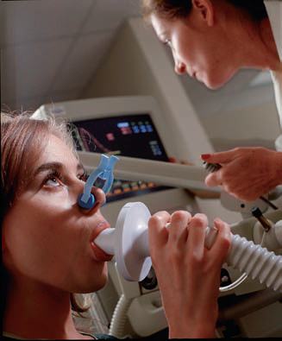
Mechanism of Breathing
UNIT B
Chapter 11: Respiratory System
Section 11.2
A spirometer - records volume of air inhaled and exhaled.
TO PREVIOUS SLIDE
Notes:
A free flow of air is vitally important during ventilation (breathing).
A spirometer is a device used to record the volume of air inhaled and exhaled with each breath.

Slide 29
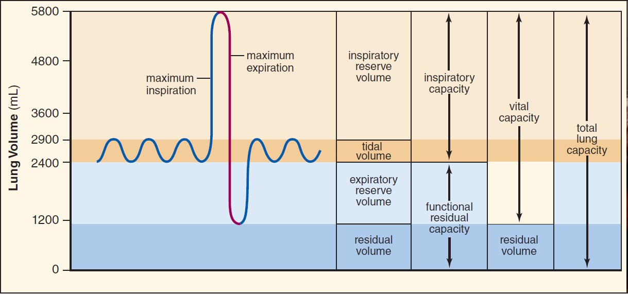
UNIT B
Chapter 11: Respiratory System
Section 11.2
TO PREVIOUS SLIDE
Notes:
Vital Capacity: Measuring ventilation:
A spirometer measures the air inhaled and exhaled with each breath. During inspiration, pen moves up. During expiration, the pen moves down.
At rest, only small amount of air moves in and out.
Tidal Volume - normal volume of air displaced between normal inhalation and exhalation when extra effort is not applied. In a healthy, young human adult, tidal volume is approximately 500 mL per inspiration or 7 mL/kg of body mass
Vital Capacity – Maximum you can breathe in. deep breathing, called vital cap bc life depends on breathing and the more air you can move the better off you are.
Vital Capacity:
Inspiratory Reserve Volume (Forced Inspiration):
Increase inspiration by expanding chest (and therefore lungs)
Expiratory Reserve Volume:
Increase expiration by contracting abdomen
Vital Capacity = tidal + inspiratory reserve + expiratory reserve
21. A short while after a person has died, a "gasp" of air may occur as the lungs collapse. This flow would represent the residual volume.

Slide 30
Respiratory Volumes
Tidal Volume:
normal volume
Vital Capacity:
Maximum amount
Inspiratory Reserve Volume (Forced Inspiration):
Increase inspiration by expanding chest (and therefore lungs)
Expiratory Reserve Volume:
Increase expiration by contracting abdomen
Vital Capacity = tidal + inspiratory reserve + expiratory reserve
Notes:
At rest, only small amount of air moves in and out.
Tidal Volume - normal volume of air displaced between normal inhalation and exhalation when extra effort is not applied. In a healthy, young human adult, tidal volume is approximately 500 mL per inspiration or 7 mL/kg of body mass
Vital Capacity – deep breathing, called vital cap bc life depends on breathing and the more air you can move the better off you are.

Slide 31
Other Volumes not used in Gas Exchange
Dead-Space Air
Residual Volume
Notes:
Not all air reaches lungs. Air in nasal cavities, trachea, bronchi, bronchioles – no air exchange occurs here.
Hyperventilate
Residual Air- some remains in lungs – don’t completely collapse. No longer useful for gas exchange. some lung diseases can cause build up of Resid Vol due to difficulty emptying lungs completely → reducing vital capacity.

Slide 32
UNIT B
Chapter 11: Respiratory System
Section 11.2
Respiratory volumes depend on various factors.
Age (decreasing after age 30)
Gender (10-20% lower in women)
Physical activity (20-30% higher in conditioned athletes)
Respiratory disorders
Some disorders decrease vital capacity or can increase residual volumes because the individual has difficulty emptying the lungs
TO PREVIOUS SLIDE
Notes:
Respiratory volumes depend on various factors.
Age (decreasing after age 30)
Gender (10-20% lower in women)
Physical activity (20-30% higher in conditioned athletes)
Respiratory disorders
Some disorders decrease vital capacity or can increase residual volumes because the individual has difficulty emptying the lungs

Slide 33
If a person was born and grew up at a higher altitude in the Andes mountain, what consequences would we expect?
A. larger vital capacity from larger chest volume
B. ability to breathe slower at sea level than natives of sea level areas
C. greater endurance in marathon sports conducted at sea level
D. more hemoglobin
E. All of the choices would be likely.
Notes:
e

