Slide 1
Kingdoms

Slide 2
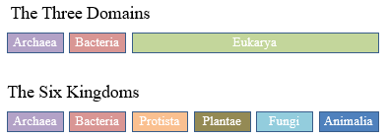
Three-Domain System:
a DOMAIN is a Super kingdom that shows extremely ancient lineages
based on modern DNA evidence.
Notes:
Traditional Five Kingdom System: Places all prokaryotes (organisms without nuclear membranes) in a single Kingdom Monera, and puts multicellular life into three branches: plants, fungi, animals. Protista is a group for others that don’t fit anywhere else.

Slide 3
Evolution of Classification Systems
Linnaeus’ original system was based on 2 main Kingdoms: Animalia and Plantae
Your textbook lists 5 kingdoms
We now have:
3 Domains
6 Kingdoms
Notes:
This is due to the development of microscopes and other tools and the ability to analyze genetic material.
Kingdom Monera in your text book is now divided into Eubacteria and Archaebacteria)

Slide 4
Defining Features of Domains and Kingdoms
Domain Archeabacteria – Unicellular, Prokaryotic cell, No peptidoglycan (sugar) in cell wall
Domain Eubacteria – Unicellular, Prokaryotic cell, Peptidoglycan in cell wall
Domain Eukarya – Eukaryotic cells

Slide 5
How are organisms organized?
Organisms are placed into domains and kingdoms based on their:
cell type (eukaryotic vs prokaryotic)
number of cells in their bodies (multicellular vs uni)
ability to make food (heterotroph vs autotrophic)

Slide 6
Classification Kingdoms and Domains
The Three Domains
Archaea
Bacteria
Eukarya
The Six Kingdoms
Archaea
Bacteria
Protista
Plantae
Fungi
Animalia

Slide 7
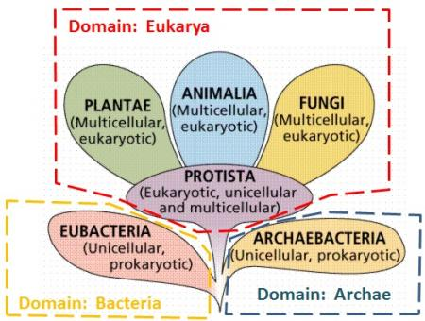
Notes:
Why do we show them like a tree?

Slide 8
Caution
Your textbook has only 5 kingdoms,
Monerans are the largest and oldest group of organisms on Earth. We know them better as bacteria.
In 1983, The Kingdom Monera was found to be too broad and has been split into two kingdoms called Archaea and Bacteria because some bacteria are chemically different.

Slide 9
Why the new classification?
A new discovery in 1983 led to the reclassification. Scientists took a water sample from a thermal vent deep in the Pacific Ocean.
Hot gases and molten rock poured out of the Earth's interior.
They found archaebacteria (ahr kee back TIER ee uh) in the water samples where no life was thought to exist.
The word archaebacteria means "ancient bacteria."
Scientists think that modern-day archaebacteria were similar to Earth's early life forms, existing on Earth billions of years before the dinosaurs lived

Slide 10
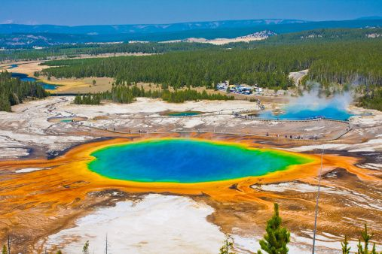
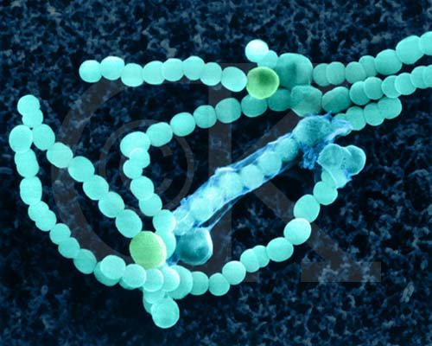
Archaea
Primitive
Unicellular
Prokaryotic
Ancient bacteria, often extreme environments, often anaerobic
Heterotrophic only (no autotrophs) obligate anaerobes living in environments low in oxygen (e.g., water, soil).
Notes:
Archaea are obligate anaerobes living in environments low in oxygen (e.g., water, soil).

Slide 12
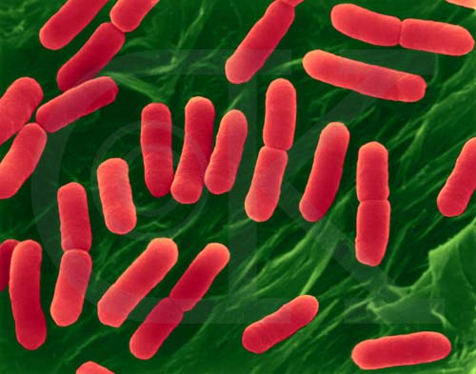
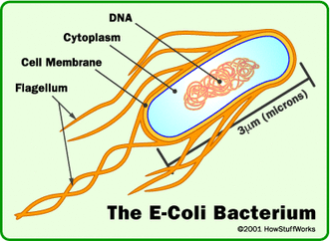
Eubacteria
Unicellular
Prokaryotic
Can be heterotrophic, autotrophic, or saprotrophic

Slide 13
Check your understanding
What 4 Kingdoms fit into Domain Eukarya?

Slide 14
Assignment
Make an infographic of the 3 domains and 6 kingdoms.
Give general defining descriptions of each
Give 2-3 examples of each
Include one named image of an organism from each kingdom

Slide 15
Extra Slides Beyond here

Slide 17
Characteristics of the 6 Kingdoms
Kingdom Archeabacteria – Unicellular, Prokaryotic cell, No peptidoglycan (sugar) in cell wall (Is a domain and a kingdom!)
Kingdom Eubacteria – Unicellular, Prokaryotic cell, Peptidoglycan in cell wall (Is a domain and a kingdom!)
Kingdom Protista – Eukaryotic organisms that can be unicellular or multicellular. Can be animal-like, plant-like, or fungi-like
Kingdom Plantae –Eukaryotic, photosynthetic autotrophs (make their own energy) , multicellular.
Kingdom Animalia – Eukaryotic, heterotrophs (must consumer energy), multicellular
Kingdom Fungi – Eukaryotic, saprotrophic decomposers (eat dead matter outside their body), multicellular.

Slide 19
Terms
Autotroph – an organism that makes its own energy
Heterotroph – An organism that gets its energy by “eating”
Prokaryotic Cells – Simple cells with no nucleus and no organelles (bacteria)
Eukaryotic Cells – Larger cells with a nucleus and organelles such as mitochondria (animals, plants, fungi protists)
Notes:
Note: We will learn about each Kingdom in more detail and define words like autotroph, heterotroph, eukaryotic, and prokaryotic in more detail as we move through the course. But just a quick breakdown:

Slide 20
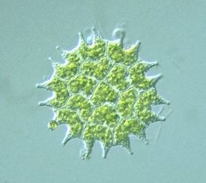
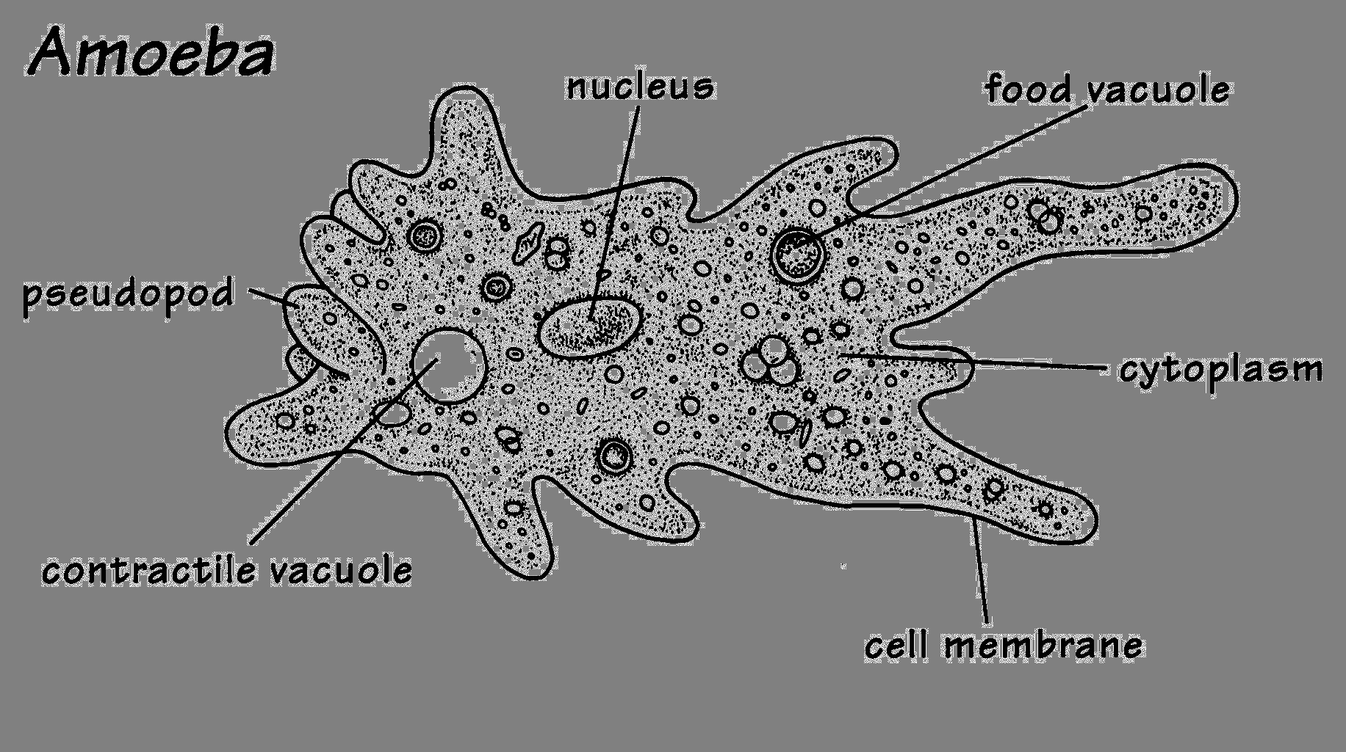
Protista
Unicellular & multicellular
Eukaryotic
Animal-like, plant-like, fungi-like
Heterotrophic, autotrophic, saprotrophic

Slide 21
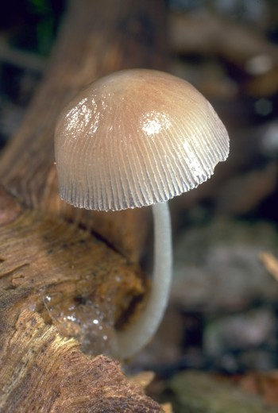
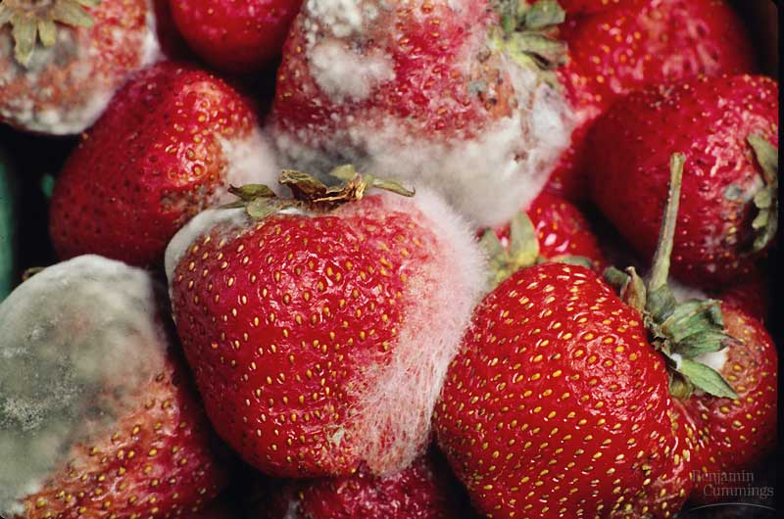
Fungi
multicellular & eukaryotic
Cell wall made of chitin (animal material)
saprotrophic

Slide 22
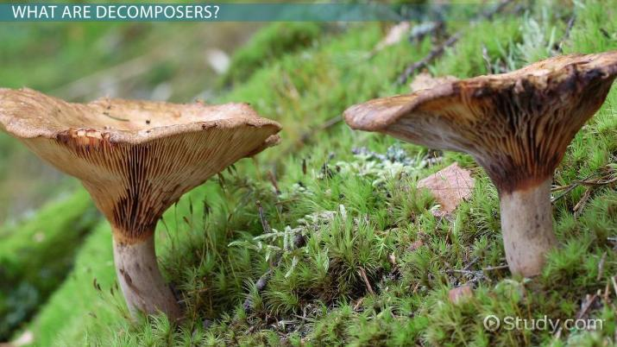
Saprotrophs
Also called saprophyte or saprobe
Organism that feeds on nonliving organic matter known as detritus at a microscopic level.
The etymology of the word saprotroph comes from the Greek saprós (“rotten, putrid”) and trophē (“nourishment”).

Slide 23
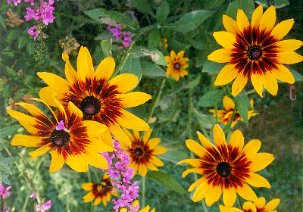
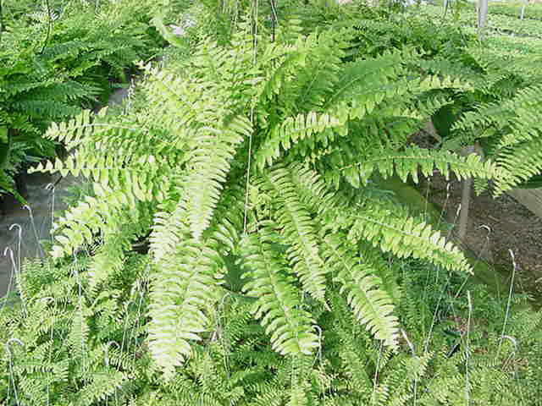
Plantae
multicellular & eukaryotic
Cell wall made of cellulose
Autotrophic

Slide 24
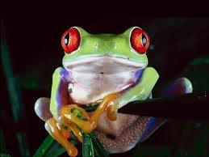
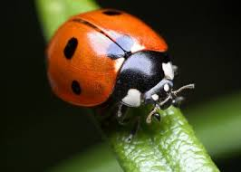
Animalia
multicellular & eukaryotic
Heterotrophic
No wall cell (only cell membrane)

Slide 25
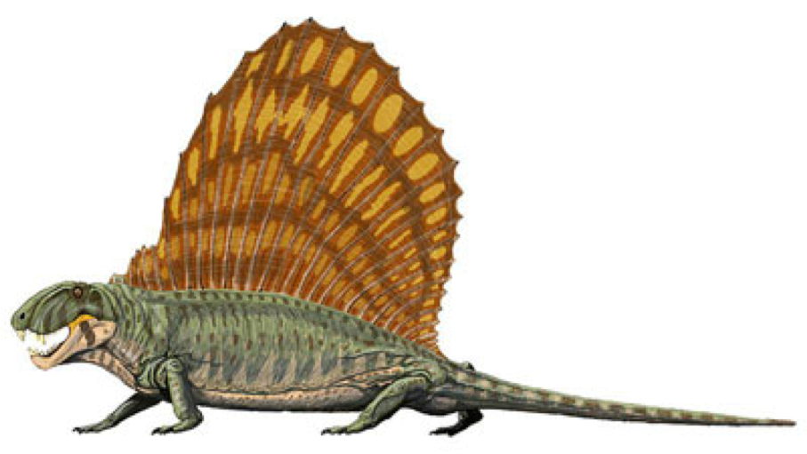
Fun Fact
Dimetrodon is a protomammal constantly confused for a dinosaur and classified incorrectly as a reptile! You can even buy dinosaur toys and candy that includes Dimetrodon!
https://youtu.be/-tdVPiyVDsQ

Slide 26
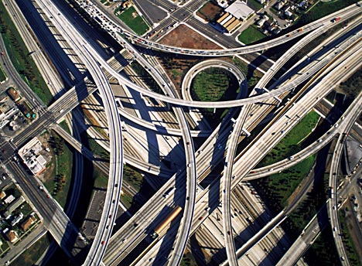
What factors contribute to how organisms are classified?
Evolutionary connections
Homologous structures
Embryonic development

Slide 27
Basis for Classification
Evolutionary connections
Homologous structures
Embryonic development

Slide 28
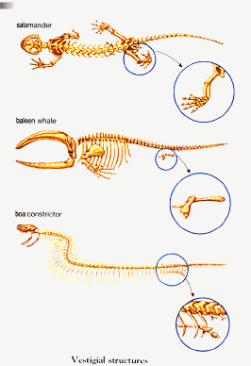
Examples of Vestigial Structures

