Slide 1
Electrical Circuits, chapter 10
How do charges flow through the components of a circuit?
Notes:
Recall static electricity is a build up of charge until discharge like a spark jumping from hand to metal doorknob or lightning. Current electricity is electic charges flowing ina circuit througha conductors in a controlled way.
Static electricity involves charges that build up and stay in the same place on a an object. How could you store the charges to use later?

Slide 2
Intro to Current Electricity, 5min
https://www.youtube.com/watch?v=kYwNj9uauJ4

Slide 3
Vocabulary for Chapter 10
Current electricity, joule, electric cell, battery, load, circuit, ampere, electron flow, direct current, alternating current, series and parallel circuits, electric potential difference, voltage, volt, voltmeter, cells, resistor, ohm, Ohm’s law,

Slide 4
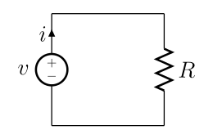
What is current electricity?
An electric current is a flow of electric charge (electrons) through a conductor (wire).
Notes:
It can also be carried by ions in an electrolyte, or by both ions and electrons such as in an ionised gas (plasma).
Malcolm and Angus Young developed the idea for the band's name after their sister, Margaret Young, saw the initials "AC/DC" on a sewing machine. "AC/DC" is an abbreviation meaning "alternating current/direct current" electricity.
As slang for "bisexual," c.1940; the notion is of working both ways.

Slide 6
Parts of an Electric Circuit
Energy source – battery or wall outlet, energy measured in joules (J)
Conductor – wire to conduct electrons
Load – device that converts electrical energy into other forms of energy such as light or sound. Eg. Lightbulbs, speakers, heaters, motors.
Switch – a device for making and breaking the connection in an electric circuit (controls flow of electrons).
Complete circuit: electrons flow freely whole circuit
Incomplete circuit: no electrons flow due to break in circuit (switch is off)

Slide 7
Copy the Symbols
Notes:
Cell: 2 parallel lines, shorter line is the negative terminal
Some circucuits require >1 cell.

Slide 8
Copy the Symbols
Notes:
Cell: 2 parallel lines, shorter line is the negative terminal
Some circucuits require >1 cell.

Slide 9
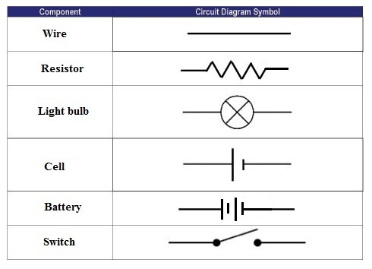
Copy the Symbols
Notes:
Cell: 2 parallel lines, shorter line is the negative terminal
Some circucuits require >1 cell.

Slide 11
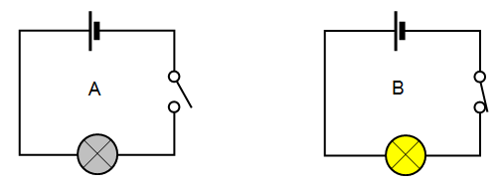
Switch closes the circuit

Slide 12
Simple Circuit Diagram
Notes:
electrons flow out of the negative terminal, through the circuit and into the positive terminal of the source
Posiitve is the long side

Slide 13
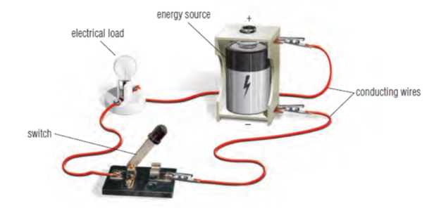
Draw the circuit diagram for this set up

Slide 14
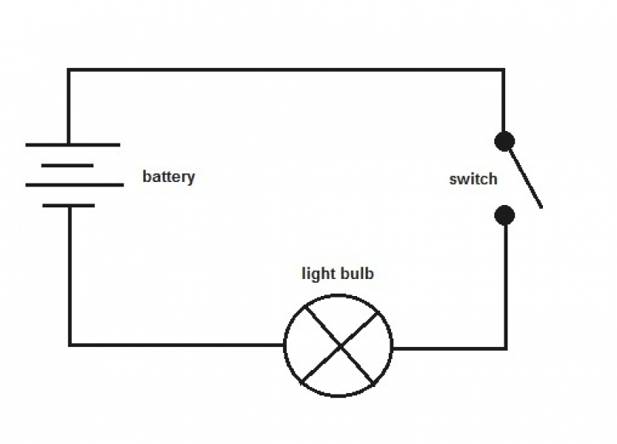
Circuit Diagram
Notes:
When switch is closed, electrons will flow and the light turns on. In this diagram, e flow counterclockwise direction from negative terminal though bulb, to positive terminal.

Slide 15
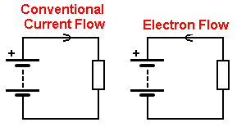
Direction of Current (p306)
Conventional Current:
We used to think the positive charges were moving → negative terminal
Electron Flow: But it is the electrons that are moving from negative → positive terminal (this is correct way)
Notes:
Initially it was thought that positive charges were moving so movement was always described as from positive to neg terminal.

Slide 16
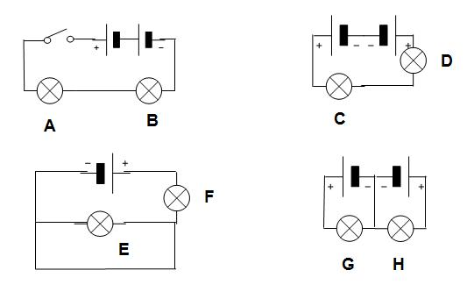
Circuit Diagrams: What’s the same? Different?
Notes:
When switch is closed, electrons will flow and the light turns on. In this diagram, e flow counterclockwise direction from negative terminal though bulb, to positive terminal.

Slide 17
Two Types of Circuits:

Slide 18
Circuits in Series
Components are connected in a single loop.
Current flows through all devices
Current is the same at all points.
Eg. Computers, radios, TV’s, rockets
Voltage is shared between components
If you add electric loads, each on get less electric pressure (light bulbs will dim as more are added)

Slide 19
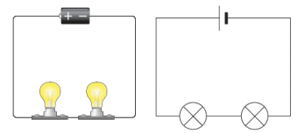
Circuits in Series
If you follow the circuit diagram from one side of the cell to the other, you should pass through all the different components, one after the other, without any branches.

Slide 20
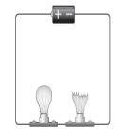
Circuits in Series
If you put more lamps into a series circuit, the lamps will be dimmer than before.
If a lamp breaks or a component is disconnected, the circuit is broken and all the components stop working.
Series circuits are useful if you want a warning that one of the components in the circuit has failed. They also use less wiring than parallel circuits.

Slide 21
Draw an example of a circuit in series that includes:
One battery
One open switch
Two lamps

Slide 22
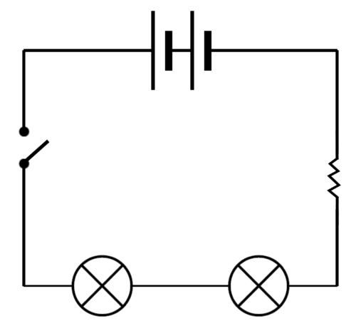
Draw an example of a circuit in series that includes:
One battery
One open switch
Two lamps

Slide 23
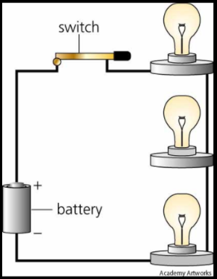
Circuit in Series

Slide 24
Parallel Circuits
Two or more paths for electrons (current) to flow.
Current is shared between the branches (splits up).
Only some of the current goes through each device.
Used in homes.
To find total current you must add up the current flowing through each device.
Notes:
Voltage loss is the same across all components
If circuit is broken, the current may pass through other pathways and other devices continue to work
None of the current goes through more than one device.

Slide 25
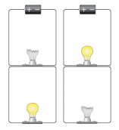
Parallel Circuits
If a lamp breaks or a component is disconnected from one parallel wire, the components on different branches keep working.
And, unlike a series circuit, the lamps stay bright if you add more lamps in parallel.

Slide 26
Draw a circuit with two lamps in parallel

Slide 27
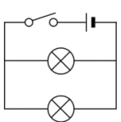
Draw a circuit with two lamps in parallel

Slide 28
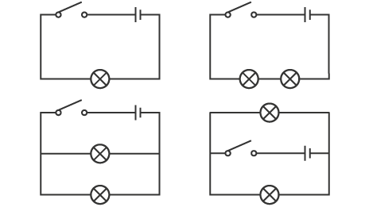
Which circuits are in series and which are in parallel?

Slide 29
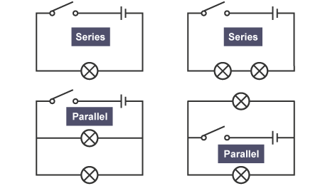

Slide 30
Practice
Circuit Diagram Worksheet
CYU p 305
#1, 2, 4, 5, 6, 7,
(10, 11, 13, 14, 15)
Notes:
Make a battery out of pennies, cardboard, tin foil, vinegar, wire, light

Slide 31
Extras

Slide 32
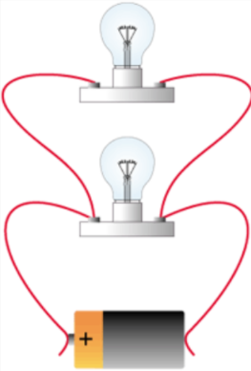
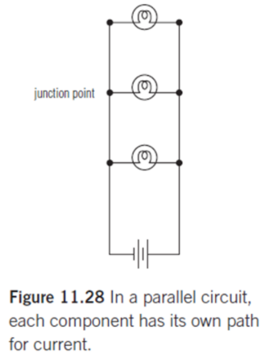
Circuit in Parallel

Slide 33
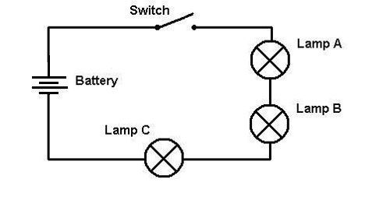
Draw example of Series Circuit

Slide 34
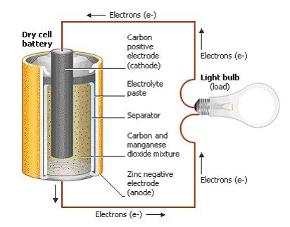

Slide 35
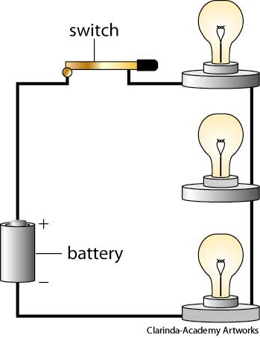
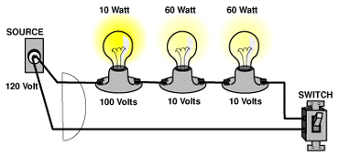
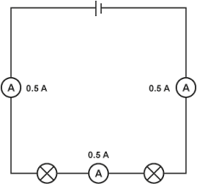
Series

