Slide 1
KMT and STATES of MATTER

Slide 2
Matter exists in different states or phases

Slide 3
Review State of Matter
Solid Liquid Gas/Vapor Plasma

Slide 4
Matter changes state when energy/heat is added or removed:
To change solid → liquid, we add heat
To change from liquid → solid, we remove heat (cool the substance)

Slide 5
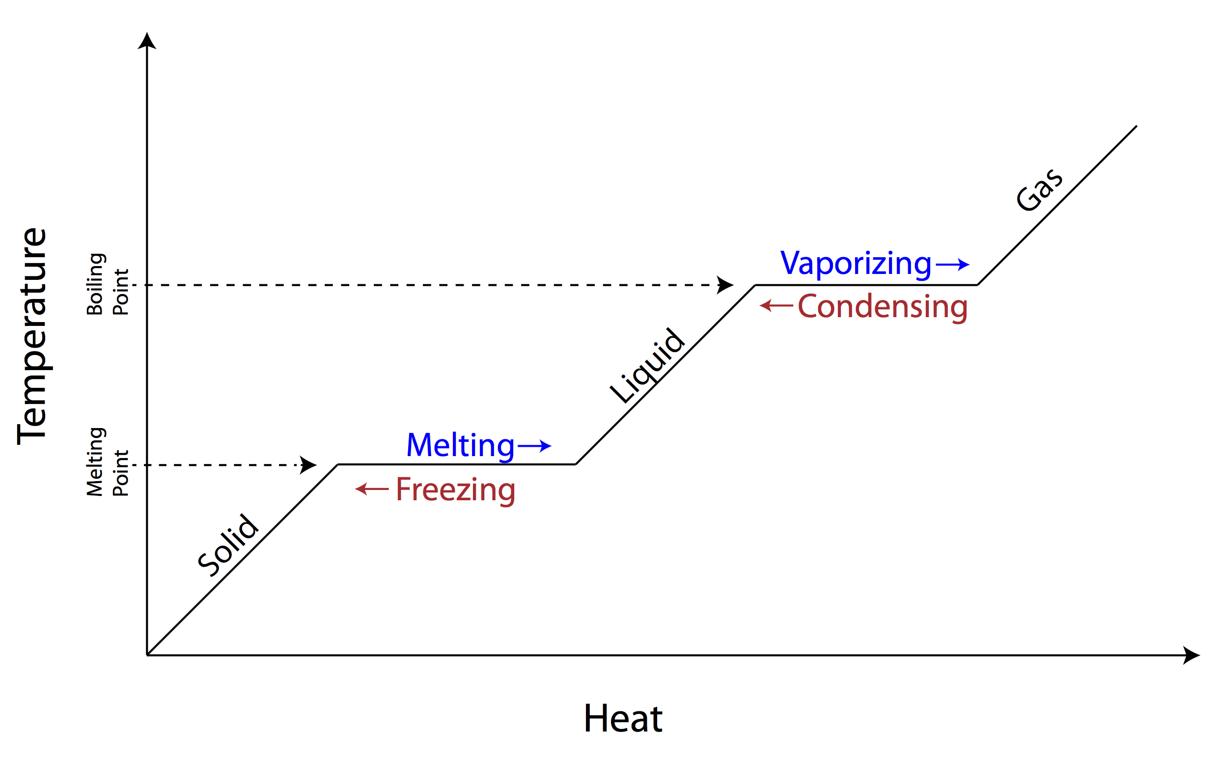

Slide 6
Change of State or Phase Change

Slide 7
Kinetic Molecular Theory of Matter (KMT):
1. All matter is made up of very small particles.
2. There are spaces between the particles.
3. The particles are in constant motion.
4. Energy makes particles move. The more energy the particles have, the faster they move.
Notes:
2. Different substances have different particles.
5. The attraction between particles decreases with an increase in distance.

Slide 8
Use KMT to describe the three states of matter in terms of particle movement, energy, and spacing
Solid Liquid Gas

Slide 9
Matter exists in THREE States (or Phases)
 | Solid | Liquid | Gas
Particle Movement | Barely moving, Can only vibrate in place | particles can slide past each other | Fast, in all directions
Spaces between particles | Very small | small | Large
Energy of particles | Lowest | more than solids, less than those in gas | Particles have more energy than particles in liquids and solids
Solid Liquid Gas

Slide 10
DIFFERENCE BETWEEN HEAT AND TEMPERATURE
Heat is a form of energy
Temperature is a measure of how hot or cold something is.

Slide 11
Heat and Temperature
These both may be at the same temperature but there is more heat in the bathtub

Slide 12
Practice
Vocabulary
WS
Know the terms for when matter changes state/phases
Use KMT to describe the three main states of matter.
Know when heat is added or removed for each change of state

Slide 14
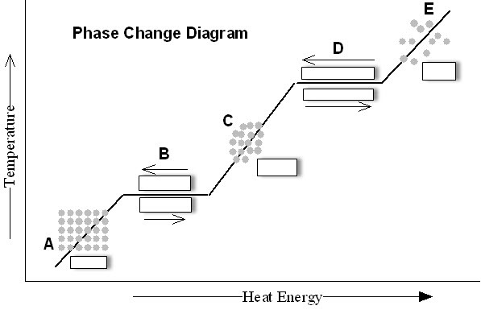

Slide 15
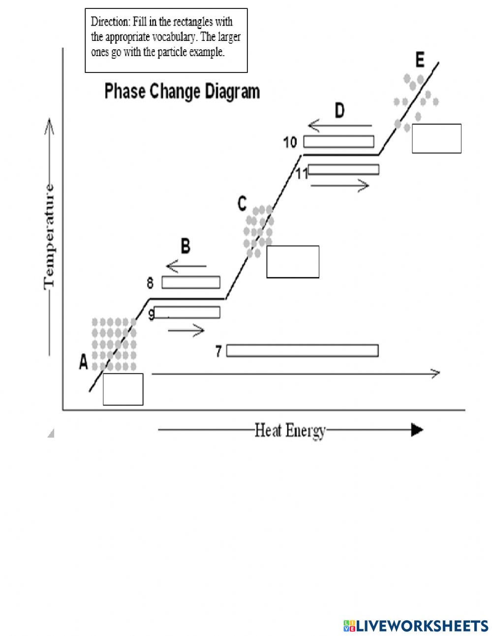
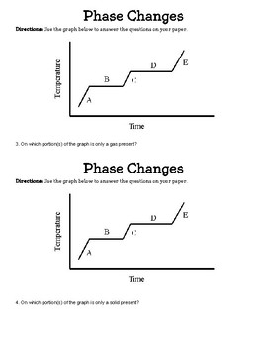

Slide 16
Label your diagram

Slide 17
