Slide 1
Properties of Matter
How and why do we study Matter?

Slide 2
Learning goal:
To DESCRIBE and EXPLAIN matter based on its PROPERTIES and INTERACTIONS

Slide 3
How can we Describe Matter?
Matter can be described by its Physical and Chemical Properties

Slide 4
What is a property?
Property: a characteristic of a substance that can be observed. (you can see)
Properties can be used to describe a substance’s appearance or behaviour.
(how it looks or behaves) Can be either physical or chemical

Slide 5
PHYSICAL PROPERTIES OF MATTER
Can be measured or observed without changing matter to a different substance.
Properties you can see, hear, smell, or feel.
Qualitative properties –described using words
Quantitative properties - measured
Notes:
Describe properties of a strawberry
Qualitative properties – Descriptions:
Eg. Flavor, colour, texture, hardness, sound, phase
Quantitative properties – Can be measured.
Eg. mass, volume, melting point, solubility, boiling point.

Slide 6
Physical Properties
Colour - red, blue,….
Odour - putrid, burnt, spicy,…
TASTE - sweet, salty, sour, bitter
Notes:
Lustre: (how shiny a solid is) - shiny, dull, metallic, pearly
Clarity - Transparent (clear), cloudy, opaque, translucent

Slide 7
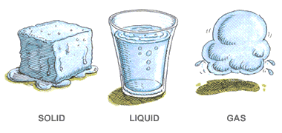
State: solid, liquid, gas

Slide 8
Texture – (how it feels) coarse, smooth, fine, gritty, rough, slippery, sticky, feathery, bumpy, fluffy, …

Slide 9
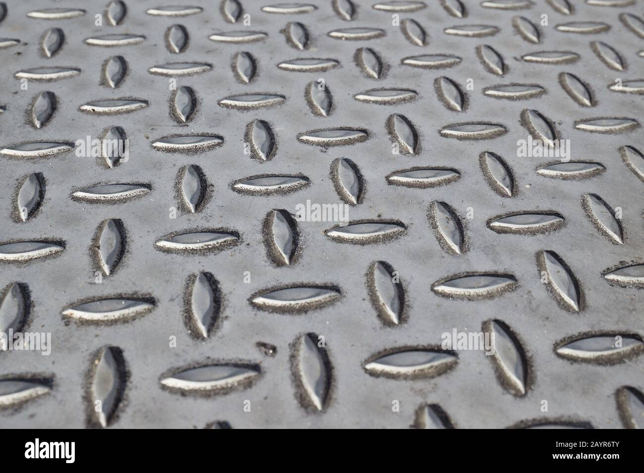
Bumpy

Slide 10
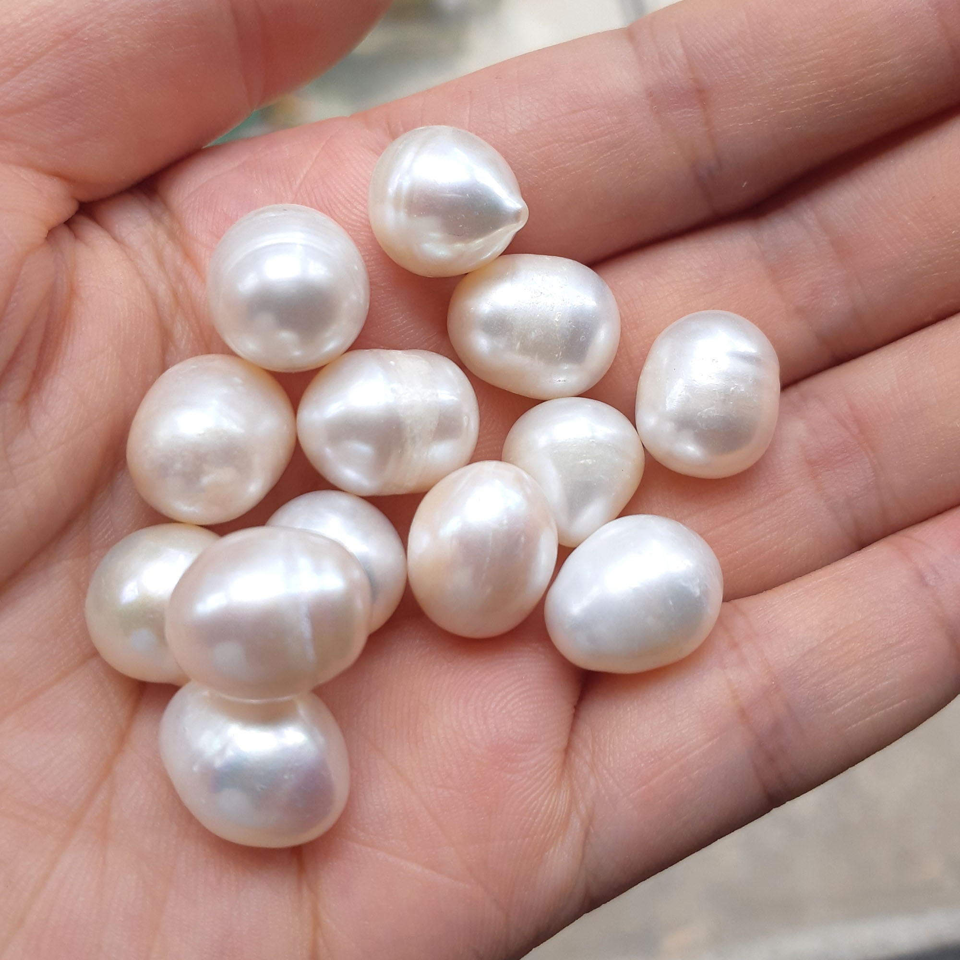
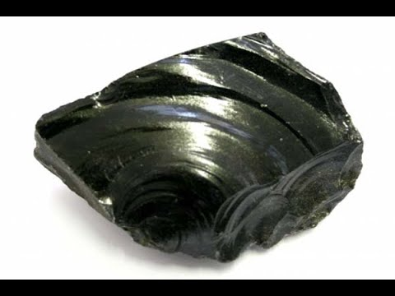
Luster - (how shiny a solid is) - shiny, dull, metallic, pearly, glassy, etc
Notes:
jewelery

Slide 11
CLARITY - Transparent (clear), cloudy, opaque, translucent

Slide 12
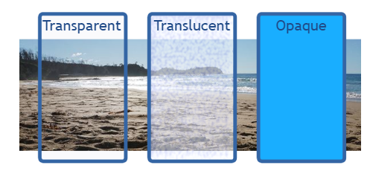
CLARITY - Transparent (clear), cloudy, opaque, translucent

Slide 13
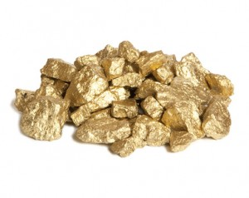
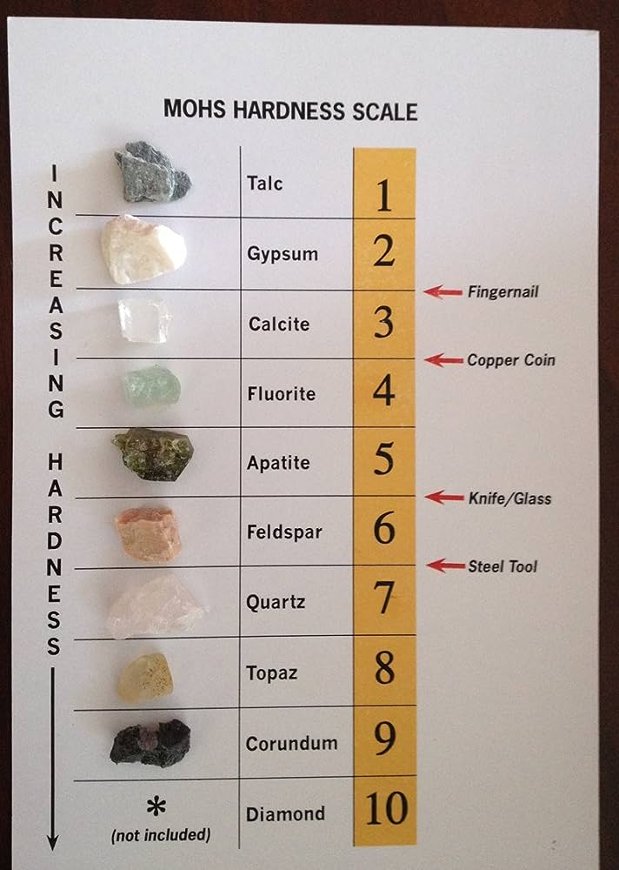
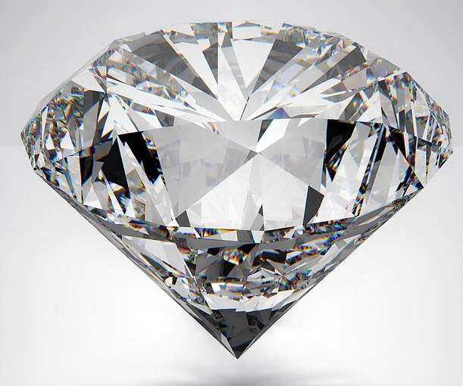
Hardness: resistance to being scratched or dented

Slide 14
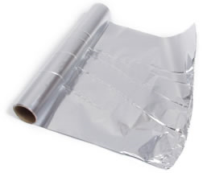
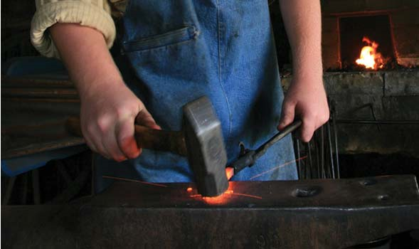
Malleability (Malleable)
Substance’s ability to be shaped/ pressed, bent into a thin sheet (or different shapes)
Notes:
MALLEABILITY: ability to be pressed or bent into different shapes

Slide 15
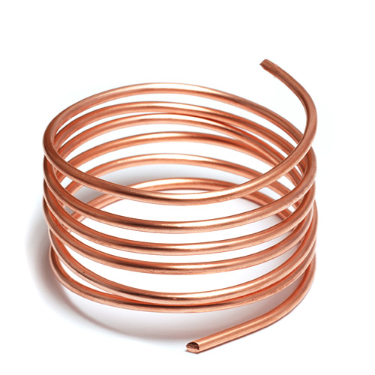
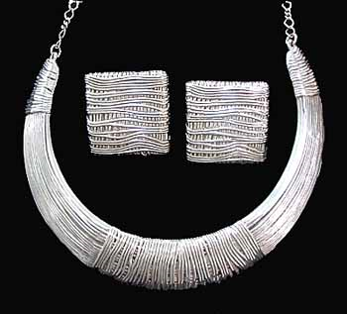
Ductility
Substance’s ability to be stretched into a wire.
Notes:
Single ounce (28g, equal weight to about 2 Tablespoons of sugar) can be stretch into a gold thread 8 km long

Slide 16
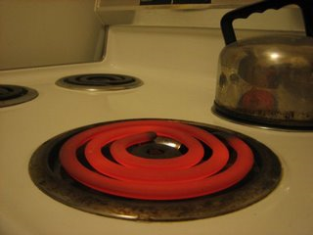
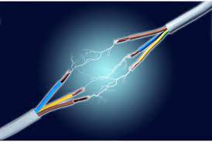
Conductivity – ability to CONDUCT Heat or Electricity
Notes:
Metals are good conductors

Slide 17
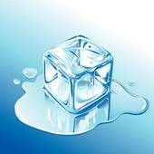
Melting Point - the temperature at which a substance changes from a solid to a liquid

Slide 18
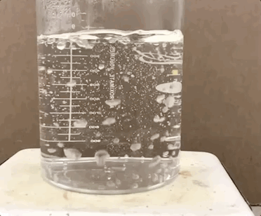
Boiling Point - the temperature at which a substance changes from a liquid to gas.

Slide 19
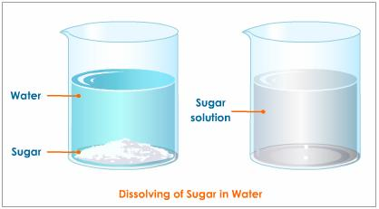
Solubility – substance’s ability to dissolve into another substance

Slide 20
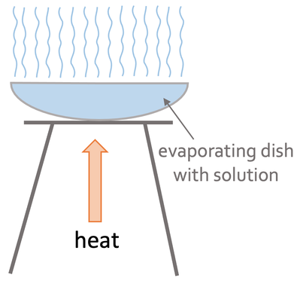
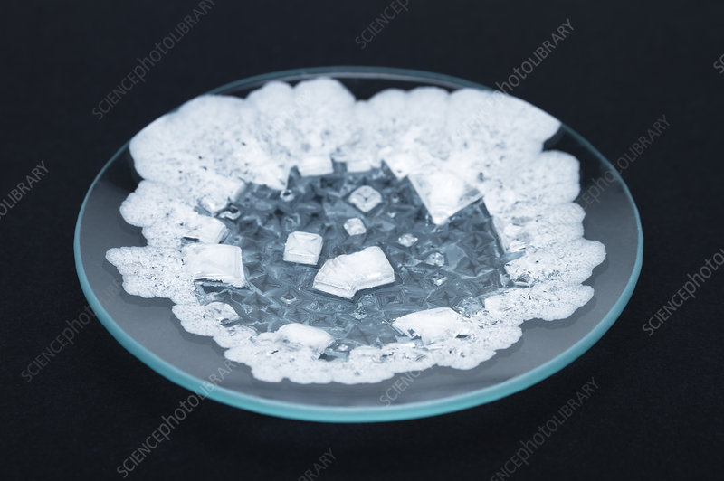
s

Slide 21
Soluble vs INSOLUBLE
If a substance is INSOLUBLE, it will NOT dissolve in the other substance.
Sugar will dissolve in water. It is soluble in water
Sand will NOT dissolve in water. Sand is in INSOLUBLe in water.

Slide 22
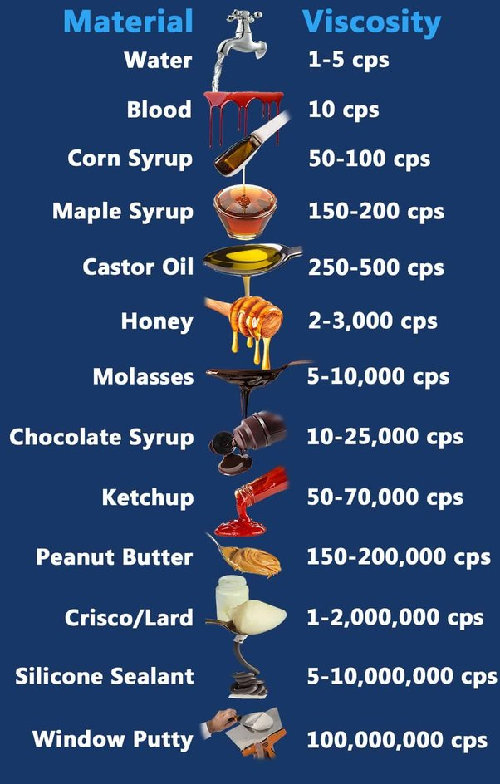
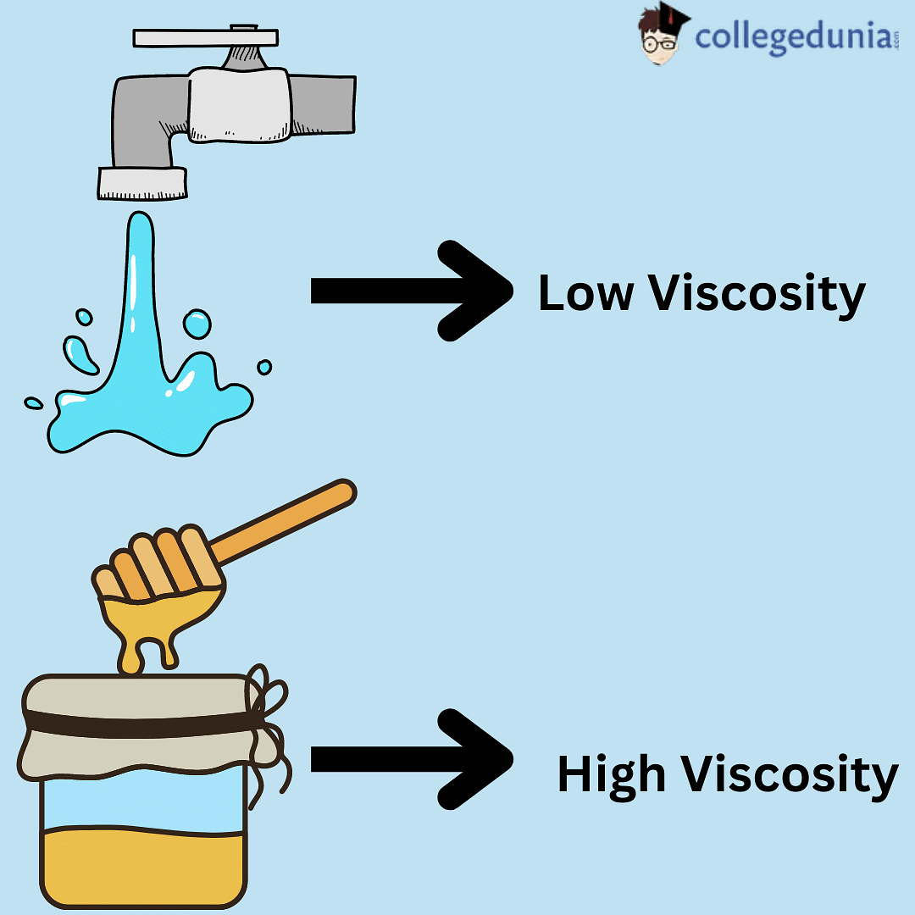
Viscosity – a substance’s resistance to flow. The more Viscous a substance is, the slower it pours.

Slide 23
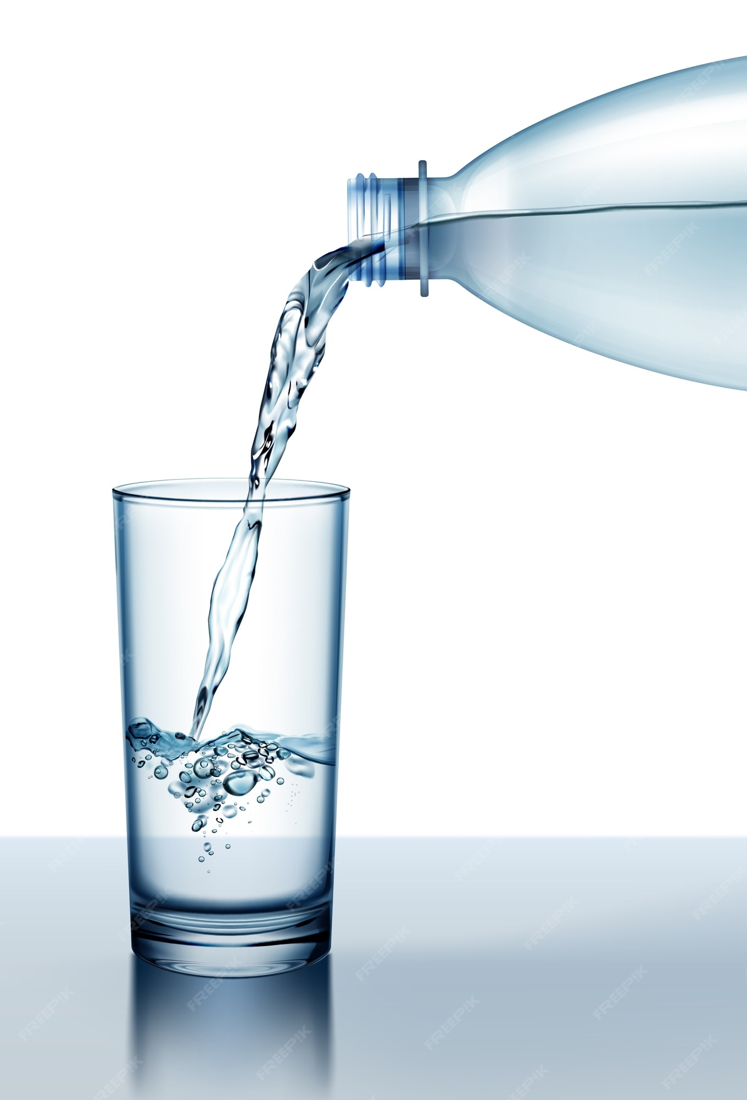
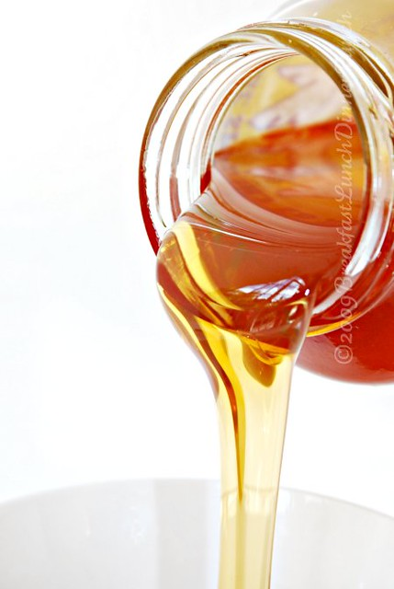
Viscosity
Honey is more viscous than water

Slide 24
Mass, Volume, Density are Physical properties

Slide 25
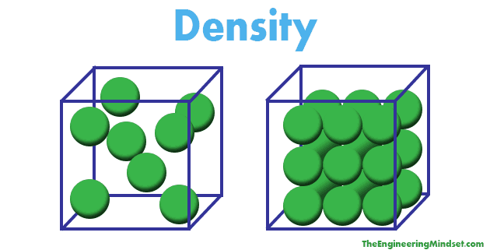
Density: how tightly packed the particles are

Slide 26
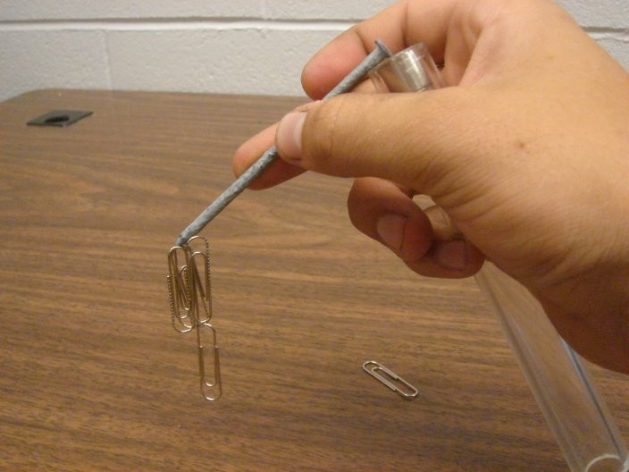
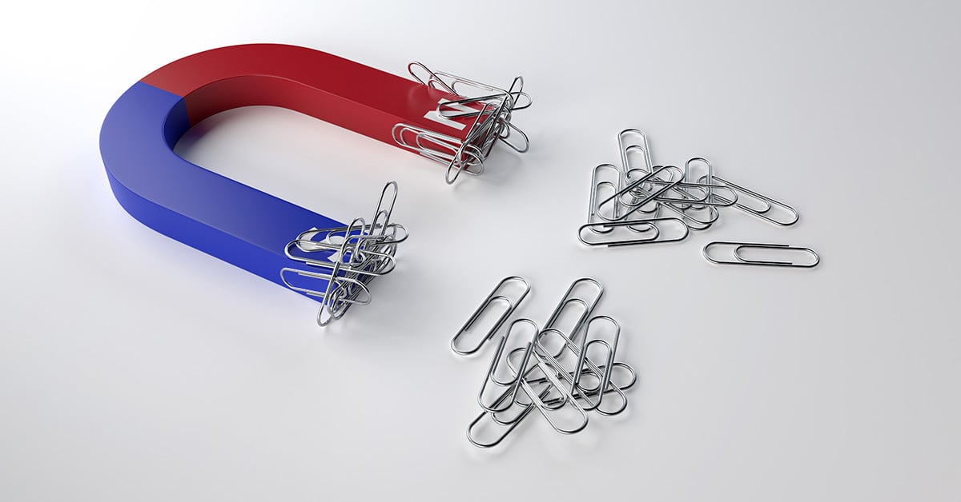
Magnetism
Iron is magnetic
Aluminum is not

Slide 27
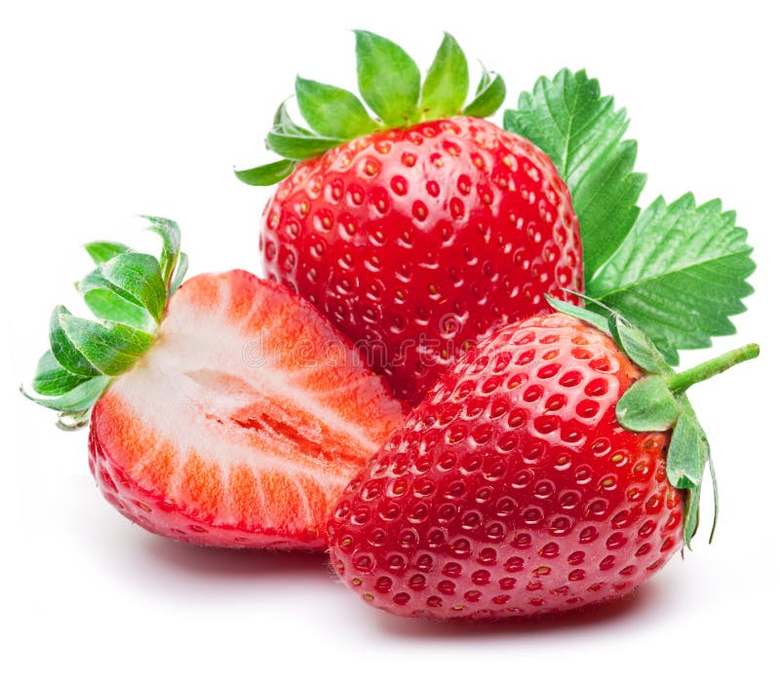
How many can you use to describe a strawberry?
Notes:
How many
Colour -
Odour -
Texture -
Lustre:
Clarity -
TASTE can you use?

Slide 28
PROPERTIES OF MATTER can be Qualitative or Quantitative
Qualitative properties – Description using words
Eg. Flavor, colour, texture, hardness, sound, phase
Eg. the strawberry is red, sweet, soft
Quantitative properties – description using numbers
Eg. mass, volume, melting point, solubility, boiling point.
Eg. the strawberry has a mass of 23g, a volume of 2.5 ml, and density of 9.3 g/ml
Notes:
Describe properties of a strawberry

Slide 29
Practice Calculating Density

Slide 30
Practice Calculating Density
A substance weighs 0.56 grams. It has a volume of 3cm³. Calculate the density.
2. You place a piece of wood in a graduated cylinder. The level of the water in the cylinder moves from 98 mL to 125 mL.
What is the volume of the piece of wood?
b) If the piece of wood weights 72 grams, what is its density?
3. A sample of pure copper has a volume of 3.75 cm3 . If the density of pure copper is 8.96 g/cm3 , calculate its mass .
4. A graduated cylinder is filled with water to the 55 mL mark. The graduated cylinder with water weights 132 grams. A piece of metal is placed in the water. The water rises to the 105 mL mar. When you re-weigh the cylinder, it now weighs 225 grams. Calculate the density of the metal.
Notes:
Practice: Read p157-163 Probe 9 Textbook, Answer #1-4, 7-10 p164

Slide 31
Chemical Properties of Matter
A Chemical property is a characteristic that can only be observed when matter reacts to another substance and transforms (changes or turns into) into a different type of matter.
Notes:
This occurs when a substance REACTS with another substance.

Slide 32
Chemical Properties of Matter
Example: To see if something is flammable, you must burn it. Then the substance is changed.
Is paper flammable?

Slide 33
Chemical Properties of Matter
Is Paper flammable?
Yes, we can see it burn and the paper has changed from White → black

Slide 34
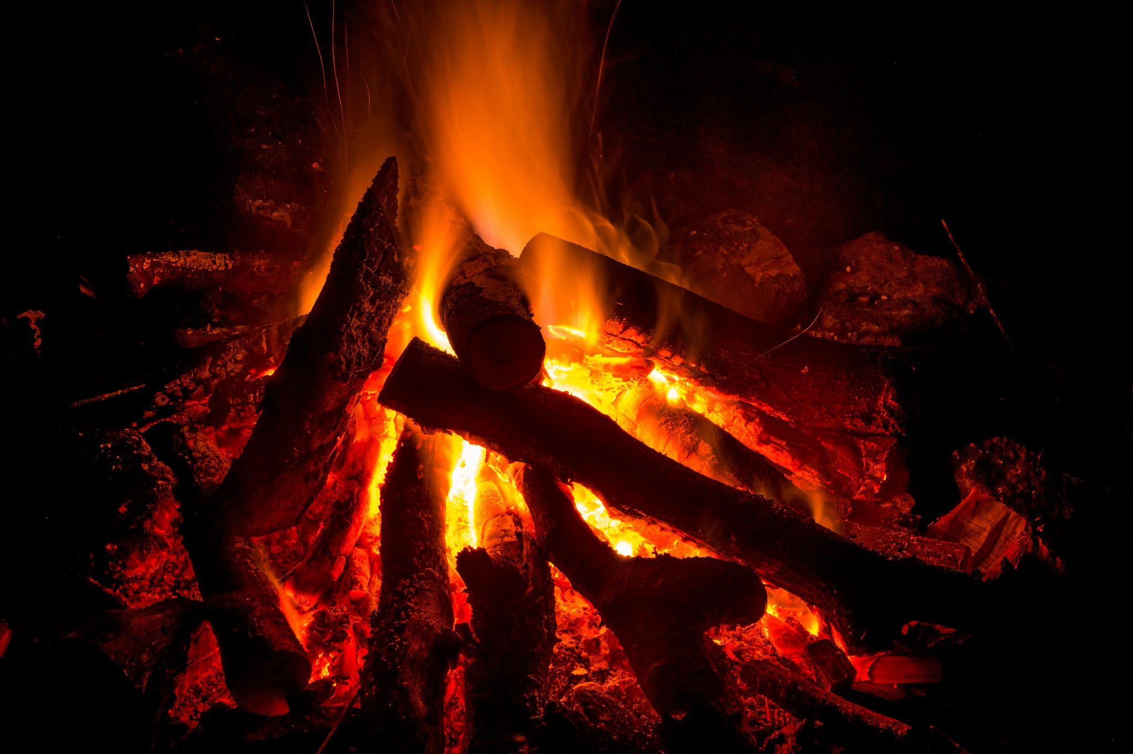
Chemical Properties of Matter
Flammability - ability to burn.
As matter burns, it reacts quickly with oxygen and transforms into various substances.
E.g. wood is flammable

Slide 35
Chemical Properties of Matter
Reactivity – ability to combine chemically with another substance.
Certain materials are highly reactive, whereas others are extremely inactive.

Slide 36
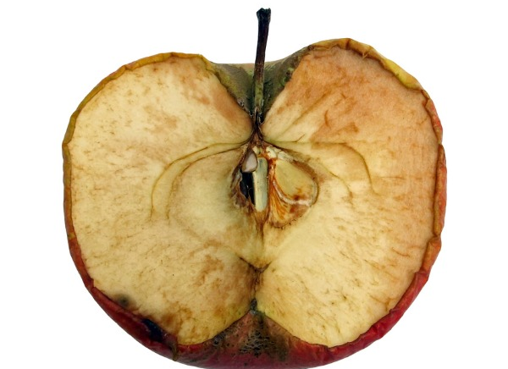
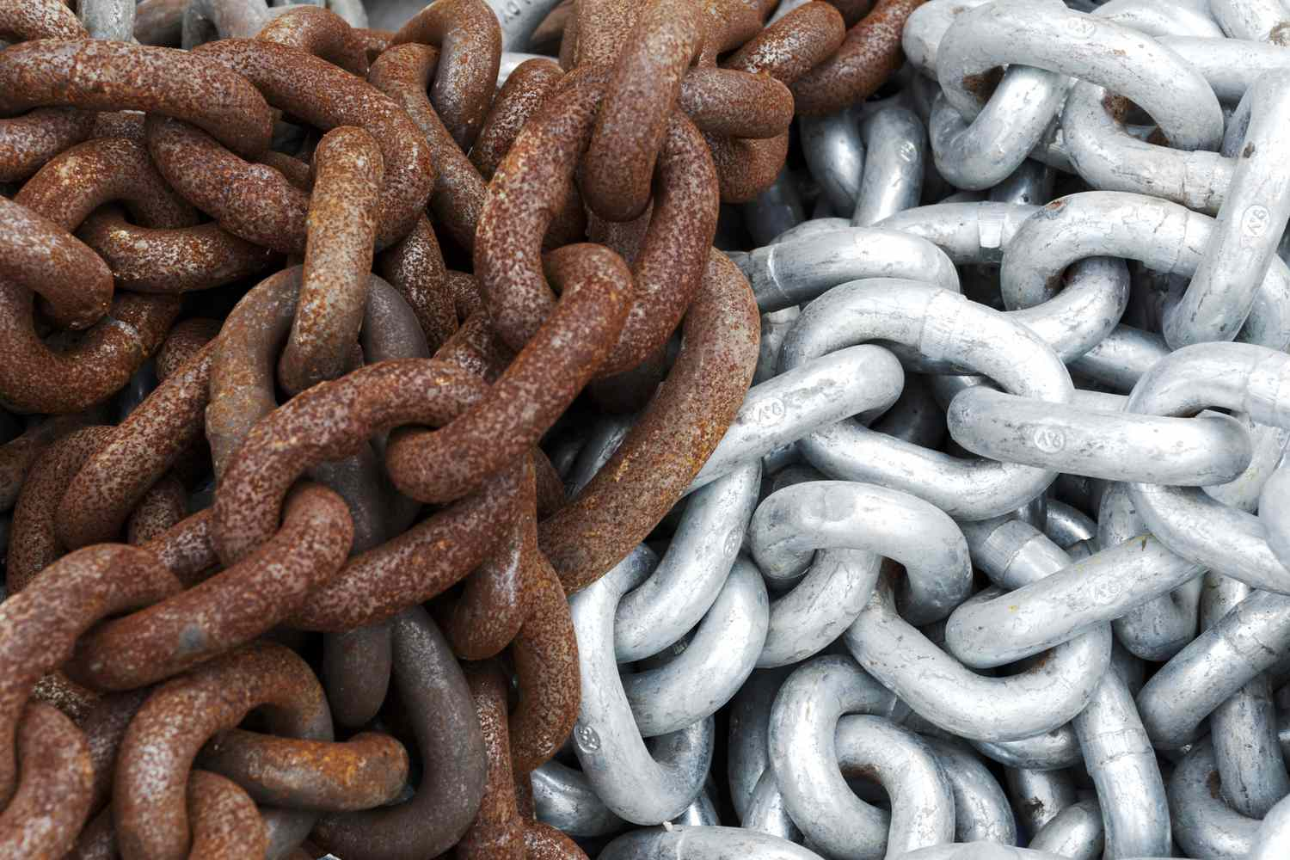
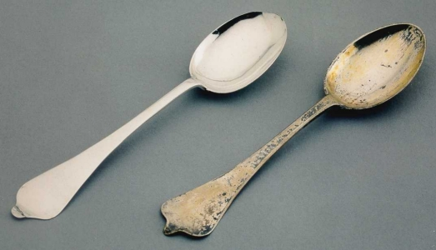
Reactivity
Reactivity to oxygen
Oxidation – slow reaction with oxygen
Apples brown when cut
Iron rusts (oxidizes) but aluminum does not
Silverware tarnishes.
Notes:
Iron rusts, aluminum does not.

Slide 37
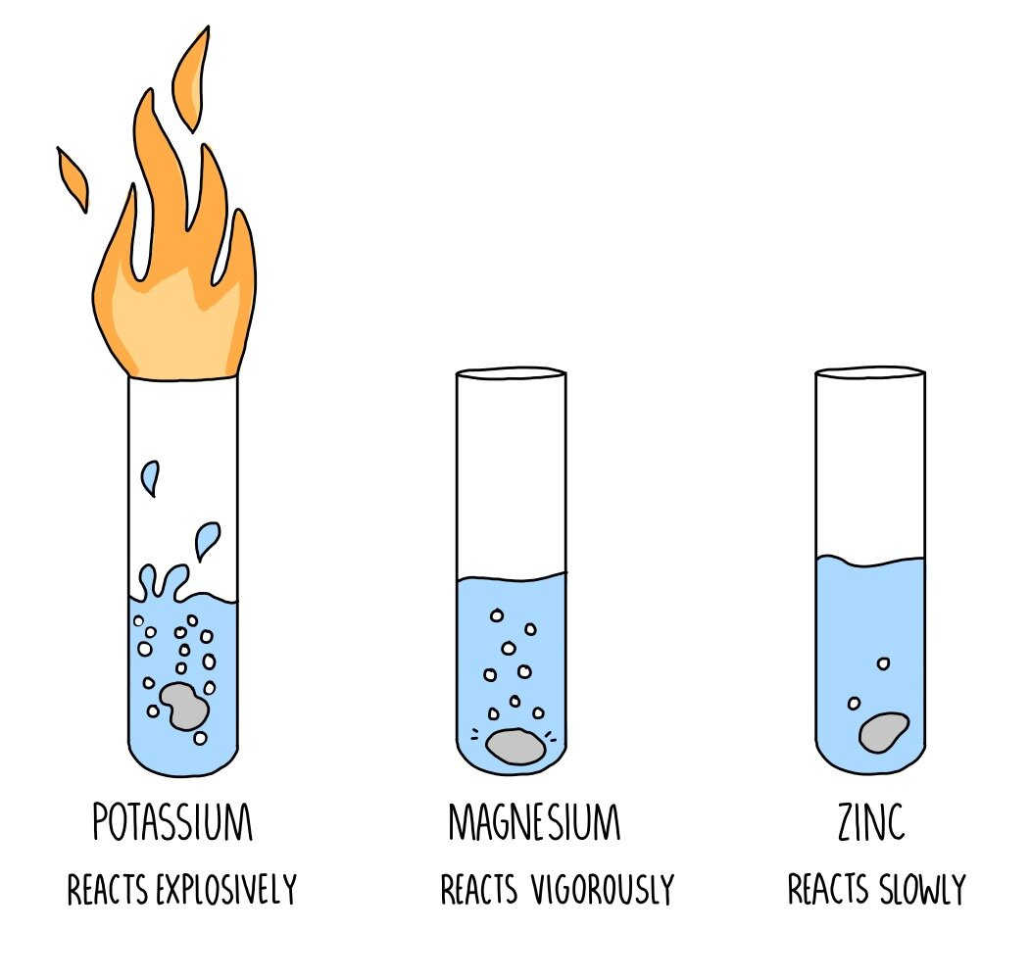
Reactivity
Reactivity to acid
Some metals will FIZZ in acid. Some will not.
Glass does not react with acid.
Notes:
Iron rusts, aluminum does not.

Slide 38
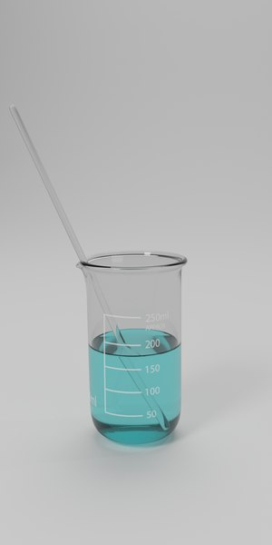
Glass is unreactive
x

Slide 39
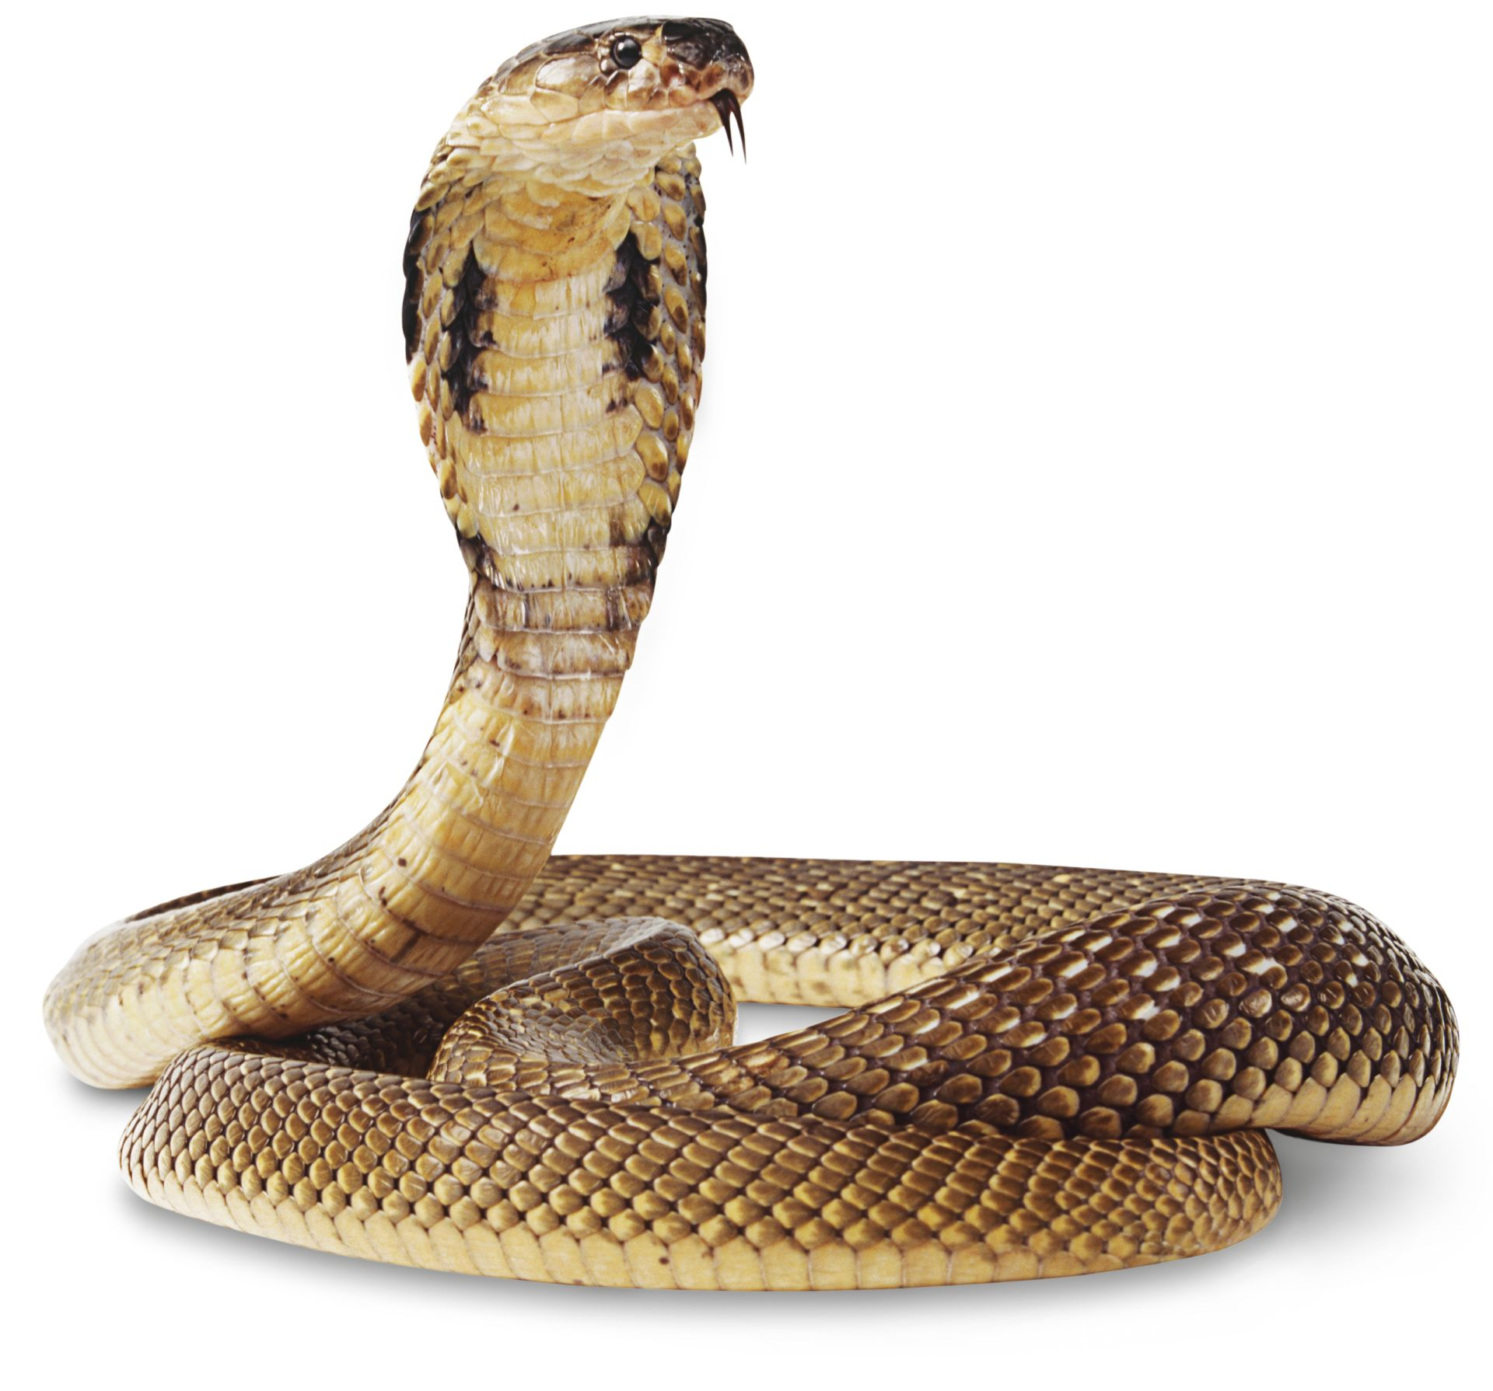
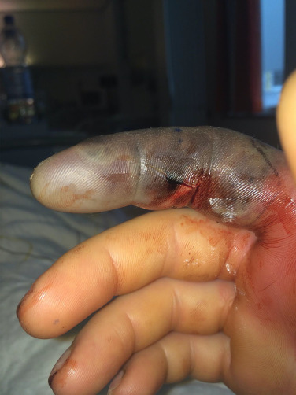
Chemical Properties of Matter
Toxicity- ability of a substance to harm an organism.

Slide 40
Practice
Properties of Matter WS
Properties of Matter Lab

Slide 41
Practice
Properties of matter worksheet
vocabulary
Video: Examples of Physical and Chemical Properties https://www.youtube.com/watch?v=oF0lN0jZYx0
Properties Song!:
https://www.youtube.com/watch?v=uJOGy0dgmUU

Slide 42
Density Calculations
1. A substance weighs 0.56 grams. It has a volume of 3cm³. Calculate the density.

Slide 43
Density Calculations
1. A substance weighs 0.56 grams. It has a volume of 3cm³. Calculate the density.

Slide 44
Density Calculation
2. After each class, Ms. Wilson eats a chocolate bar that weighs 12.5 grams. She measures its volume to be 6cm³. Calculate the density of the chocolate bar.

Slide 45
Density Calculation
2. After each class, Ms. Wilson eats a chocolate bar that weighs 12.5 grams. She measures its volume to be 6cm³. Calculate the density of the chocolate bar.

Slide 46
Density Calculation
3. You place a piece of wood in a graduated cylinder. The level of the water in the cylinder moves from 98 mL to 125 mL.
a) What is the volume of the piece of wood?

Slide 47
Density Calculation
3. You place a piece of wood in a graduated cylinder. The level of the water in the cylinder moves from 98 mL to 125 mL.
a) What is the volume of the piece of wood?

Slide 48
Density Calculation
b) If the piece of wood weights 72 grams, what is its density?

Slide 49
Density Calculation
b) If the piece of wood weights 72 grams, what is its density?

Slide 50
Density Calculation
4. A graduated cylinder is filled with water to the 55 mL mark. The graduated cylinder with water weights 132 grams. A piece of metal is placed in the water. The water rises to the 105 mL mar. When you re-weigh the cylinder, it now weighs 225 grams. Calculate the density of the metal.

Slide 51
Density Calculation
5. A graduated cylinder is filled with water to the 55 mL mark. The graduated cylinder with water weights 132 grams. A piece of metal is placed in the water. The water rises to the 105 mL mar. When you re-weigh the cylinder, it now weighs 225 grams. Calculate the density of the metal.

Slide 52
Density Calculation
5. A graduated cylinder is filled with water to the 55 mL mark. The graduated cylinder with water weights 132 grams. A piece of metal is placed in the water. The water rises to the 105 mL mar. When you re-weigh the cylinder, it now weighs 225 grams. Calculate the density of the metal.

Slide 53
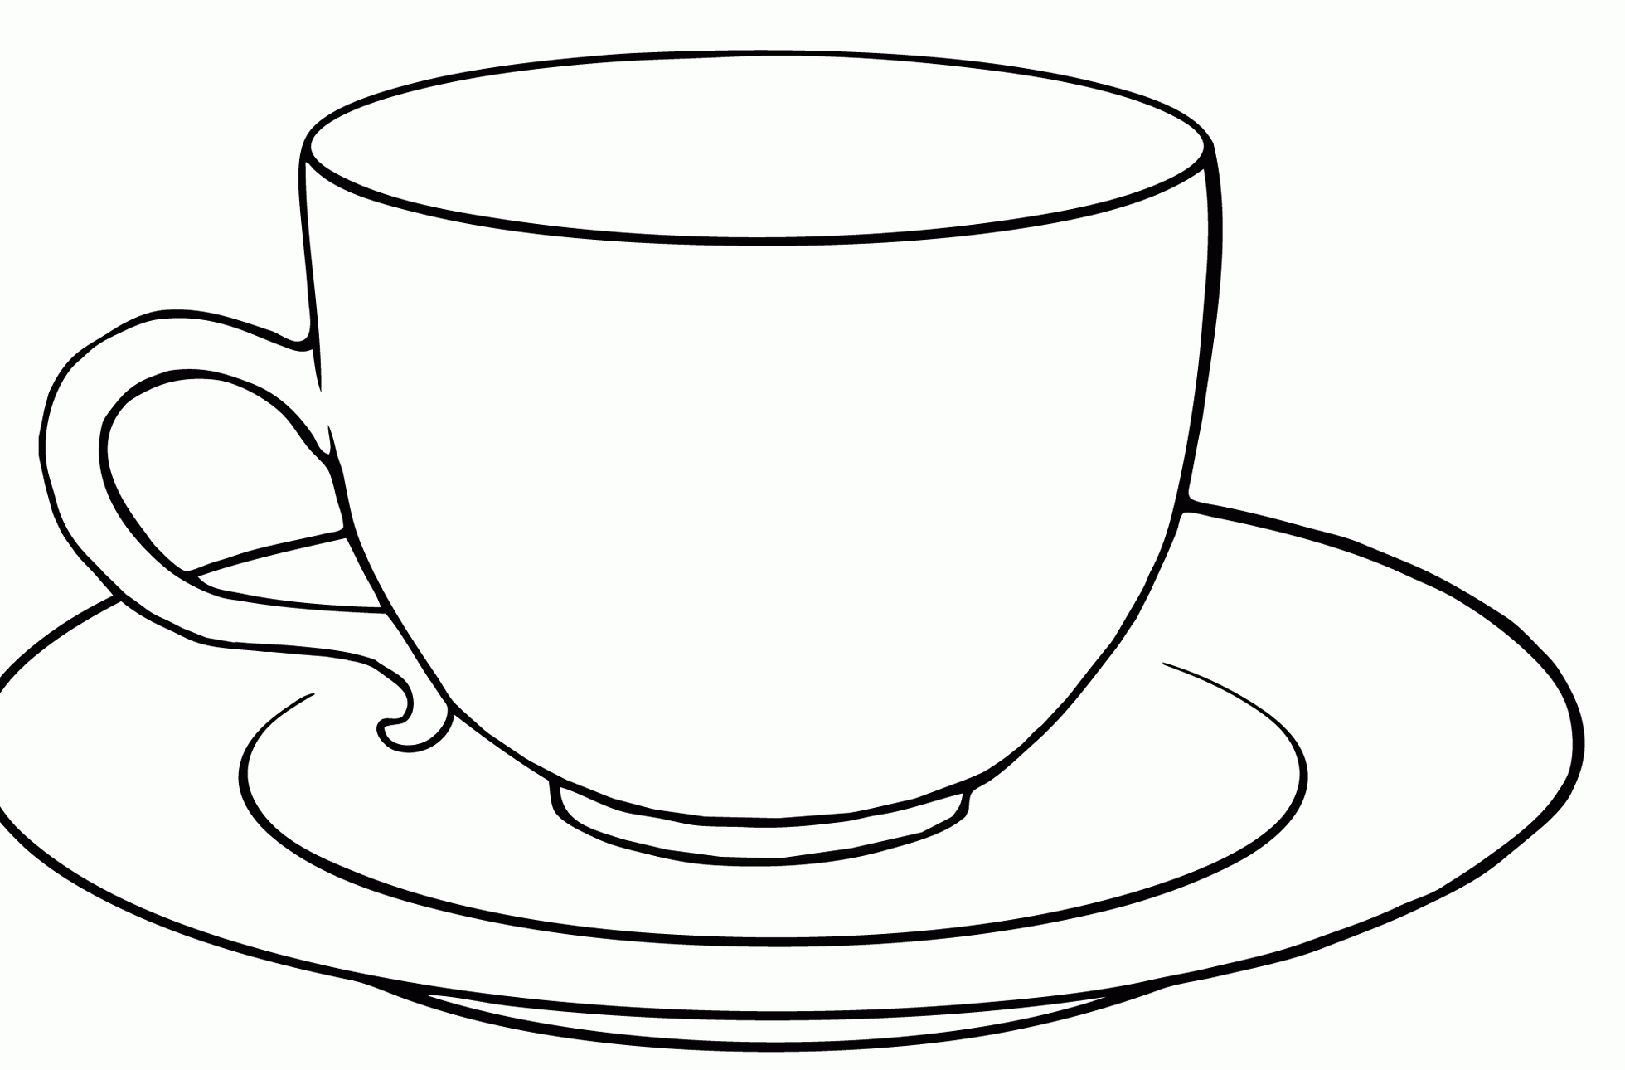
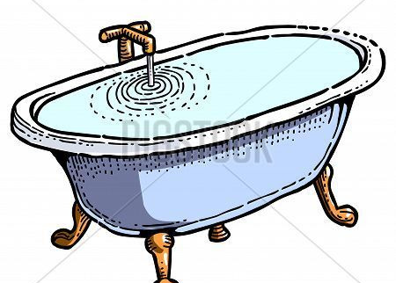
Density Calculation
5. How does the density of a 250ml cup of water compare to the density of a bathtub containing 55 litres of water?

