Slide 1
PHYLUM TRACHEOPHYTA
First Vascular Plants
Section 21-3, P 455 - 459

Slide 3
Phylum Tracheophyta: True Land Plants
Tracheophytes have evolved to free their dependence on wet environments
The are the First Vascular Plants. Meaning they have vascular tissue (xylem and phloem)
Tracheophytes = “tube plants.”
Notes:
Vascular plants are known as tracheophytes, which literally means “tube plants.”

Slide 4
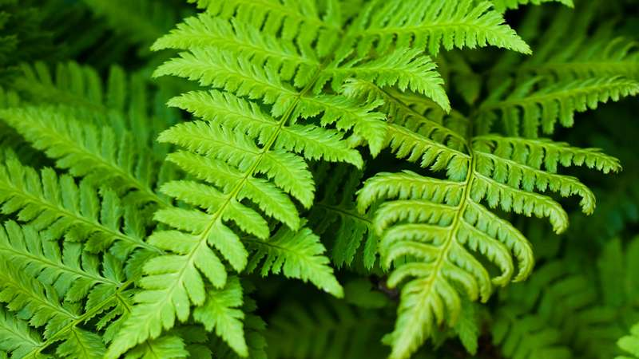
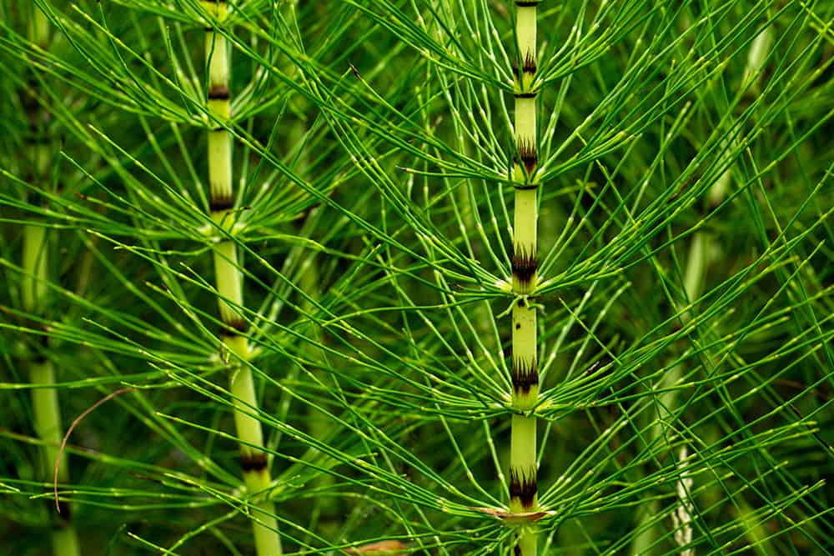
Ferns, Club Mosses and Horsetails

Slide 5
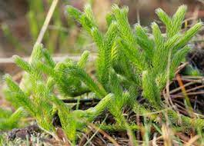
Club Mosses and Horsetails
Club Mosses (lycophytes) and Horsetails (sphenophytes) are the only living descendants of ancient land plants
Some ancient ones grew up to 40 m
But species living today are tiny
eg. Lycopodium, 9 cm tall
Notes:
Looks like tiny pine tree

Slide 6
Horsetails
Only living species is Equisetum,
Up 1 m tall
Nicknamed “Scouring Rush” Stems contain crystals of silica and were used as an abrasive to scrub pots and pans.

Slide 7
General Characteristics
Vascular Tissue (xylem and Phloem)
Therefore True roots, leaves, stems
Alternation of generations

Slide 8
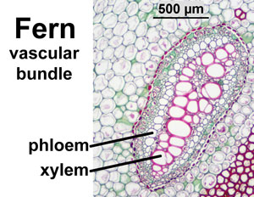
Vascular Tissue
Specialized tissues that transport water and products of photosynthesis throughout plant:
Xylem – moves water and minerals up from roots to all parts of plant.
Phloem – transports nutrients and products of photosynthesis throughout plant.

Slide 10
Advantage
Because water and nutrients can be distributed and transported to all areas of the plant, they don’t have to stay small.
Can grow bigger. As big as a tree.

Slide 11
General Characteristics of Ferns
Ferns have True Roots, Stems, Leaves

Slide 12
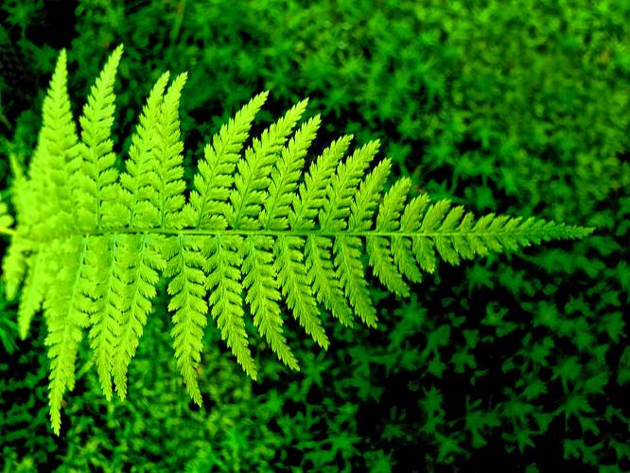
True Leaves
True leaves – photosynthetic, contain vascular bundles called veins.
Leaves = Fronds
Leaves usually have waxy covering (cuticle) to protect against water loss.

Slide 13
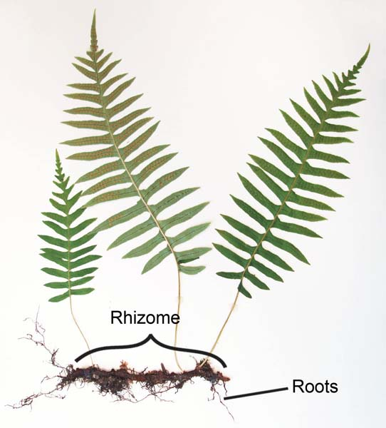
Rhizomes
Creeping underground stems = Rhizomes
But also has TRUE ROOTS

Slide 14
Rhizomes
Rhizomes are thin, modified stems running underground horizontally
They strike new roots out of their nodes, down into the soil. They also shoot new stems up to the surface out of their nodes.
help to stabilize the soil.
Ferns help aid in erosion control and soil stabilization.
If a rhizome is separated each piece may be able to give rise to a new plant. The plant uses the rhizome to store starches, proteins, and other nutrients. These nutrients become useful for the plant when new shoots must be formed or when the plant dies back for the winter.

Slide 15
Rhizoids vs Rhizomes
Rhizoids are thin hair-like structures that help bryophytes to anchor plant onto a surface and absorb nutrients and water.
Rhizomes are modified stems that store food.
Rhizomes can give rise to new shoots and roots.
Rhizoids function as roots of higher plants while rhizomes function as stems of higher plants.

Slide 16
Habitat
Rain forests
Moist or Wet tropical areas

Slide 17
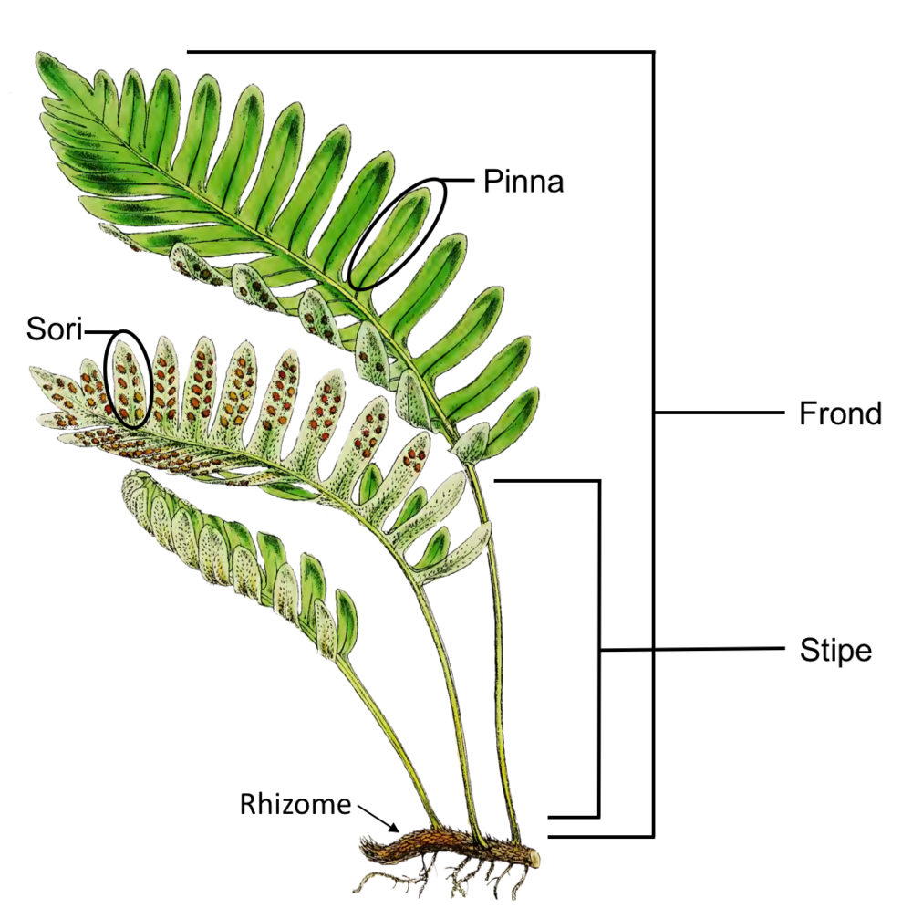
d

Slide 18
Reproduction
Still depends on standing water for sperm to swim to eggs
Alternation of Generation
Dominant phase: 2n sporophyte

Slide 19
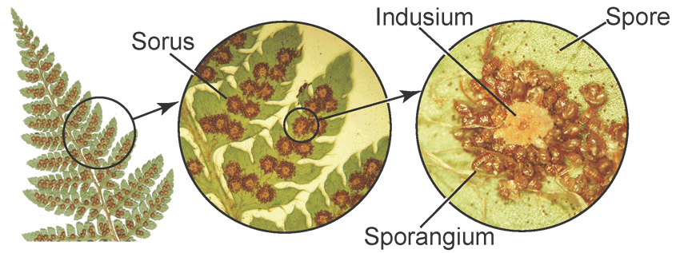
Reproductive Structures
Sporophyte plant has reproductive structures on underside of fronds called sporangia (like mosses) that produce haploid spores (by meisosis)
Sporangia are grouped into clusters called sori (s. sorus)
Notes:
Each sporangium is a capsule that contains spores.
They are usually aggregated into clusters called sori.
The position and arrangement of the sporangia are very important for the identification of ferns.
Fronds that have sporangia on their underside are fertile, and those that don't are sterile.

Slide 21
Spores → germinate → gametophyte
Released spores germinate, develop into n gametophytes.
Gametophyte develops rhizoids, then flattens out into heart-shaped prothallium.
Very small, less than 1 cm across, 1 cell thick
No vascular tissue
Notes:
It is a green, photosynthetic structure that is one cell thick, usually heart or kidney shaped, 3–10 mm long and 2–8 mm broad. It is very difficult to find in the bush as it is so tiny.

Slide 22
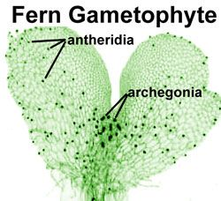
Prothallium contains antheridia and archegonia.
It is a green, photosynthetic structure that is one cell thick, usually heart or kidney shaped, 3–10 mm long and 2–8 mm broad. It is very difficult to find in the bush as it is so tiny.

Slide 23
Fertilization: Sperm + Egg → Zyote (2n)
When ground and prothalia are covered in water,
Sperm swim to archegonia
Zygote (2n) forms

Slide 24
Sporophyte
Zygote immediately grows into a sporophyte, which puts out fronds and rhizomes.
Gametophyte withers away.
Sporophyte can live for many years.

Slide 25
Summary Adaptations to Land
Sporophyte dominant phase
Vascular tissue
Fronds – big blades allow for more light capture
Fronds have cuticle – reduce water loss
Rhizomes to anchor
Notes:
Some similarities to higher plants

Slide 27
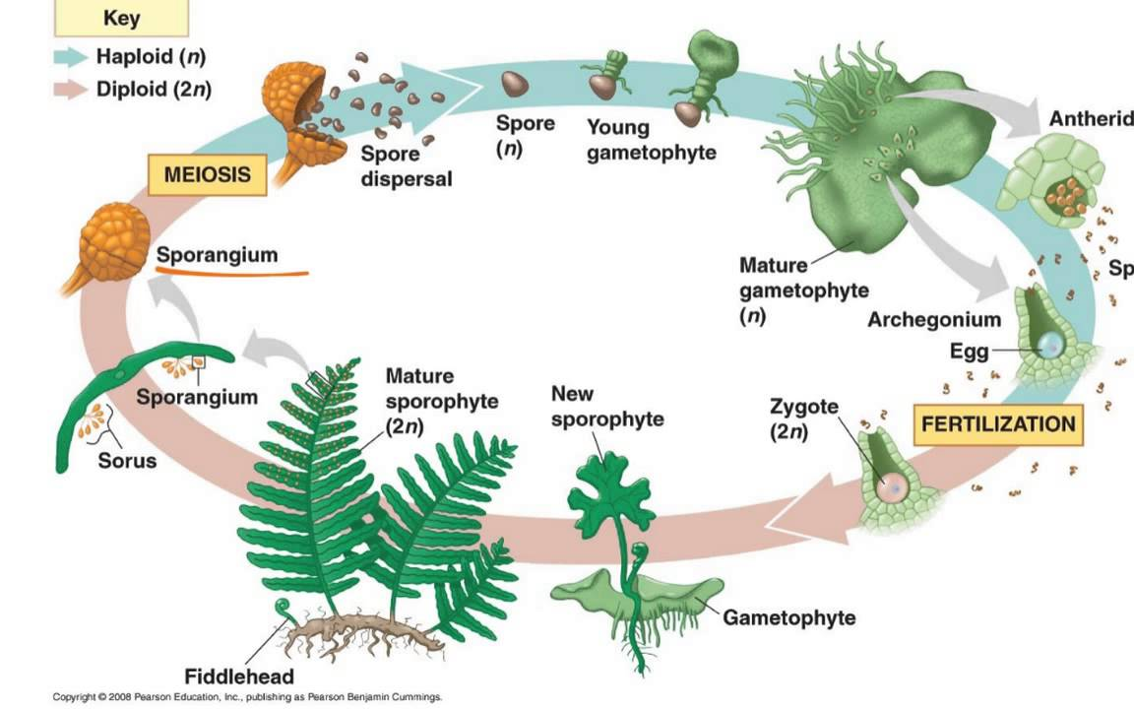
Fern Life Cycle

Slide 29
Similarities/Differences to Mosses:
Still dependent on water for reproduction
Also has archegonia and antheridia – help prevent gametes from drying out
Different: Fern gametophyte lacks vascular tissue, is small, short lived, only exists in moist environment.
Fern sporophyte is dominant phase. Moss sporophyte totally dependent (parasitic) on gametophyte
Notes:
Gametophyte lacks vascular tissue, is small, short lived, only exists in moist environment.

Slide 31
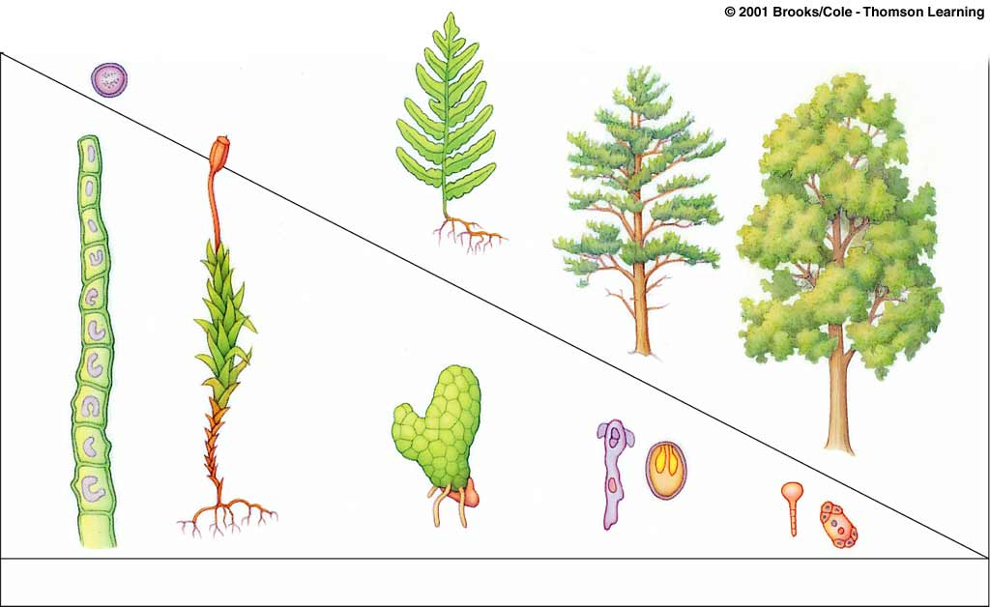
Evolutionary Trend
Label gametophyte and sporophyte phases. What is the general trend of the phases as plants become advanced?
zygote
SPOROPHYTE (2n)
GAMETOPHYTE (n)
Relative size
Life span
GREEN ALGAE
BRYOPHYTE
FERN
GYMNOSPERM
ANGIOSPERM
Notes:
General Trend = Gametophyte decreases in size, duration, and prominence relative to sporophyte

Slide 32
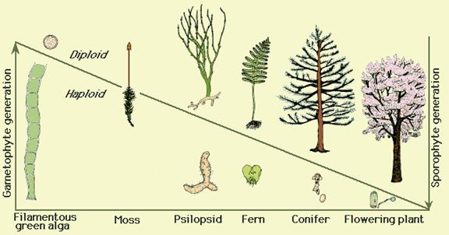

Slide 33
General Trend = Gametophyte decreases in size, duration, and prominence relative to sporophyte
Algae = some have no sporophyte or only the zygote
Mosses = gametophyte is green leafy and sporophyte is small and short lived
Ferns = sporophyte is the fronds of the ferns, gametophyte is smaller yet independent
Seeded plants = male and female gametophytes are microscopic and produce gametes to form sporophyte embryo
Recall: evolution occurs because of advantageous traits being selected therefore what is the advantage of diploid sporophyte dominance?

Slide 34
How do we use ferns?
Ferns are not of major economic importance, but some are used for
Food (fiddleheads)
Medicine (Maidenhair smoked for asthma. Maidenhair Speenwort (Asplenium tricomanes) used for coughs. Rattlesnake Fern (Botrychium virginianum) used as a cough medicine for tuberculosis. Bracken Fern used for tuberculosis, infections, and chest pain
Biofertilizer,
Ornamental plants for gardens
Bio remediation - They have been the subject of research for their ability to remove some chemical pollutants from the atmosphere and soil.
Notes:
provide a source of food or medicine for animals, including people.
ceremonial and spiritual use or importance.
colonize disturbed sites as one stage in succession.
filter toxins, such as heavy metals, from environments and thus provide a bioindicator for the health of an ecosystem.

Slide 35
Fiddleheads – food (Ostrich Fern)
Notes:
iddleheads are the curled, edible shoots of the ostrich fern and are considered a seasonal delicacy in many parts of Canada. Every year, thousands of Canadians get food poisoning. Fiddleheads can cause food poisoning if they have not been stored, prepared or cooked properly.

Slide 36
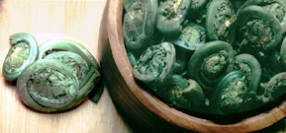
HOW DO WE USE FERNS?
Trim the base of your ferns, leaving only a tiny tail beyond the circumference of each Fiddlehead. Rub off any remaining furry brown covering. Rinse under running water. Drop ferns into a large pot of boiling salted water. Boil for about 5 minutes or until tender. If undercooked, you will miss the full, rich flavor. Drain well and serve piping hot with melted butter.
Notes:
Because Fiddlehead ferns are delicious, with a remarkable wild flavor . The flavor? It has been described as similar to green beans with a hint of artichoke. But descriptions do not begin to capture the flavor. You must try them to know the wonderful flavor and delightful crunch of Fiddleheads.
Ferns should be picked early in the morning when they are still very young and fresh. The "crosier" should be tightly curled, and should snap off crisply. They must be washed carefully and rubbed to remove the paper-y brown skin on the outside. Avoid yellow or "floppy" ferns. Trim the base leaving a tiny tail.
Exercise caution if you decide to harvest Fiddleheads yourself. There are many varieties of ferns, and only the Ostrich Fern is recommended for consumption.
The flavor of fiddleheads goes well with cheeses, tomato sauce and oriental cuisine. Excellent with Hollandaise sauce.
Fiddleheads are excellent marinated in vinegar and oil or as a crunchy pickle. Fiddleheads can be used in similar ways to any firm green vegetable such as Asparagus or Broccoli florets.
Do not overcook.
Fiddlehead ferns are a good source of vitamins A and C. Fiddleheads should not be served raw as they have a slight bitterness until cooked and may cause stomach upset if eaten raw in quantity. Health Canada advises that fresh fiddleheads must be properly cooked before being consumed.

Slide 37
Practice
Read pages 455 -459
Answer Fern WS

Slide 38
EXTRAS

Slide 40
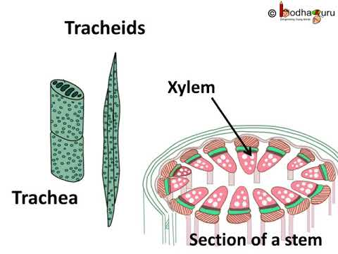
Tracheid Cells in Xylem Tissue
Tracheid cells carry water from roots to leaves
Tracheid cells have thick, strong cells walls that strengthen stems and help plants stand up against the pull of gravity.
Tracheophytes are so named because all plants in this phylum have tracheids.
Notes:
Most important cell type in xylem.
Tracheid have thick, strong cells walls that strengthen stems and help plants stand up against the pull of gravity.
All plants in phylum Tracheophyta have teacheids

Slide 41
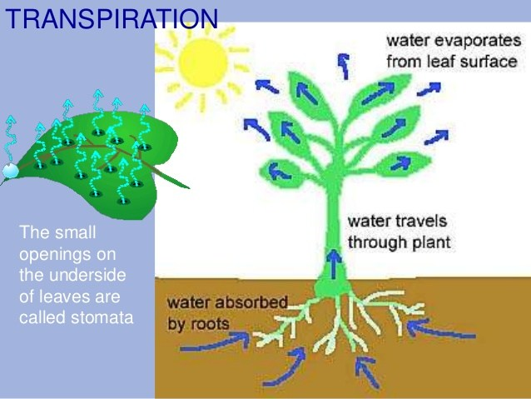
Transpiration
Transpiration is the movement of water from root to tip of plant
Occurs due to cohesive nature of water
Evaporation causes water to constantly leave the leaves of all plants

Slide 42
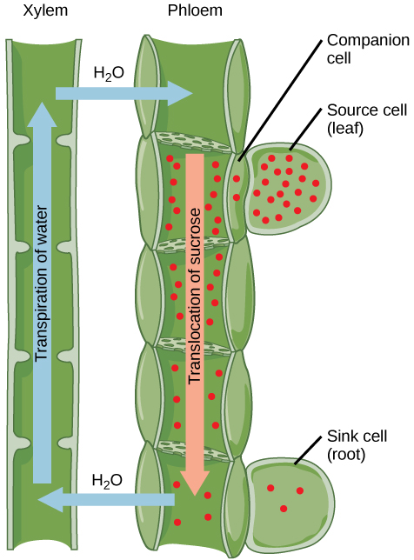
Sink cell is a root
Source cell is a leaf
Translocation is the movement of sugar in plants
Transpiration is the movement of water in plants

Slide 45
True Roots have a Vascular Cylinder

Slide 46
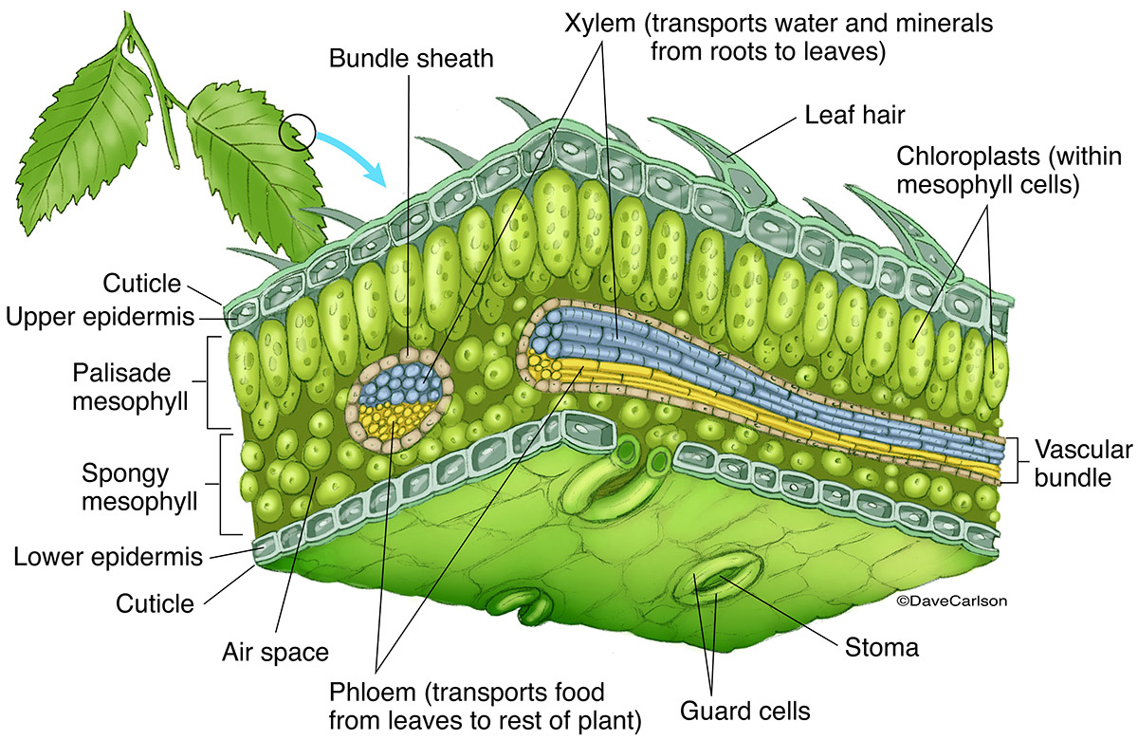
Leaf Cross Section

