Slide 1
CHEMICAL REACTIONS

Slide 2
What is a CHEMICAL REACTION?
A chemical change means a chemical reaction took place
A chemical reaction has taken place when a substance reacts with another substance to form a NEW substance with NEW properties
Describing Chemical Reactions:
https://www.youtube.com/watch?v=izZHp7pdxjU

Slide 3
Chemical Reaction
The Law of Conservation of Mass states that mass is neither created nor destroyed in chemical reactions. Mass of reactants = Mass of products
Atoms within the reactants REARRANGE to form a new substance.
Reactants --------------→ Products
Notes:
dates from Antoine Lavoisier's 1789

Slide 4
Notes:
Synthesis or combination reactions
Decomposition or analysis reactions
Single replacement, single displacement, or substitution reactions
Double replacement, double displacement, or metathesis reactions

Slide 5
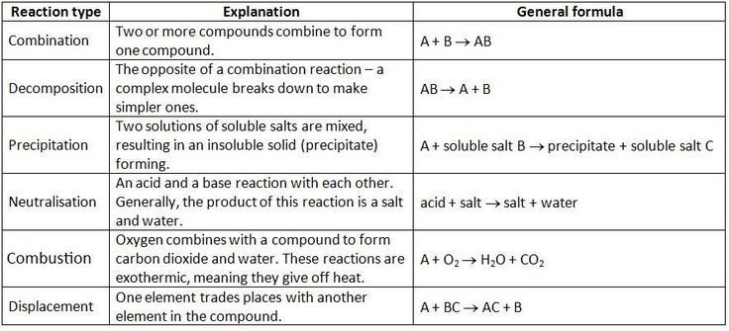
Types of Chemical Reactions

Slide 6
Name the type of Chemical Reaction
8 Fe + S₈ → 8 FeS
2 H₂O → 2 H₂ + O₂
Zn + 2 HCl → ZnCl₂ + H₂

Slide 7
Name the type of Chemical Reaction
8 Fe + S₈ → 8 FeS Synthesis
2 H₂O → 2 H₂ + O_{2 Decomposition}
Zn + 2 HCl → ZnCl₂ + H_{2 Double Replacement}

Slide 8
Examples of chemical reactions in everyday life
photosynthesis,
rust,
baking,
digestion,
combustion,
chemical batteries,
fermentation,
washing with soap and water.

Slide 9
Assignment: Design an Experiment
Plan and Conduct: an experiment to test the effectiveness of baking soda and different types and concentrations of vinegar in producing CO₂.
What risks are associated with gas production in an enclosed space?
Evaluate your model.
Notes:
What risks are associated with gas production in an enclosed space?
Evaluate your model.

Slide 10
Assignment: Research a Chemical Reaction

Slide 11
.
Coke and mentos
Invisible ink
Elephant toothpaste
Steel wool and 9V battery
Milk to plastic
Vinegar and baking soda
Notes:
What risks are associated with gas production in an enclosed space?
Evaluate your model.

