Slide 1
HOW ARE ELEMENTS CLASSIFIED?

Slide 2
Learning Goals
I can identify metals on the periodic table
I can identify non-metals on the periodic table
I can describe properties of metals and non-metal

Slide 3
How are Elements classified?
Elements are classified by their properties (chemical and physical). They can be classified as either:
Metals
Non-metals
Metalloids

Slide 4
Notes:
Which group is the biggest? Therefore most elements are metals.

Slide 5
Notes:
First 18 elements make up most of earth

Slide 6
Hydrogen is NOT a metal

Slide 7
Metals

Slide 8
Physical Properties of Metals
Metals are solid at room temperature (except mercury)
Metals are good conductors of heat and electricity.
Metals have metallic luster (shiny)
Metals are Malleable – can be flattened into thin sheets
Metals are Ductile – can be stretched into a wire
Metals have high density (are heavy for their size)
Metals have high tensile strength (can hold a load)
Metals have high melting and boiling points.
Notes:
Most elements are metals

Slide 9
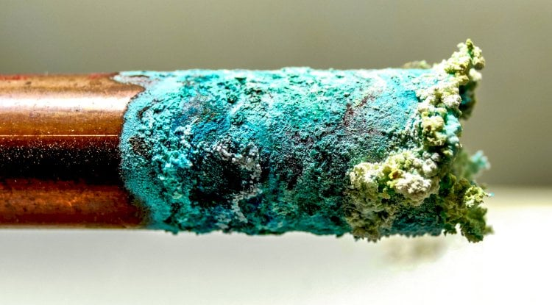
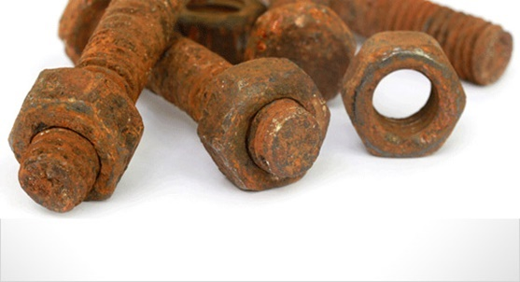
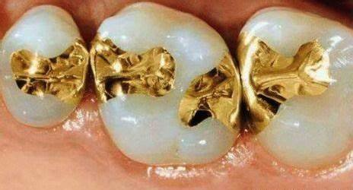
CHEMICAL PROPERTIES of Metals
Some MAY react with water, resulting in corrosion
E.g. Iron, copper, lead, zinc
However,
Gold and Platinum do NOT corrode easily:

Slide 10
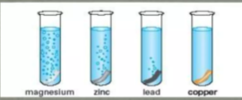
CHEMICAL PROPERTIES of Metals
Some may react with acid
E.g. Magnesium
NOT copper

Slide 11
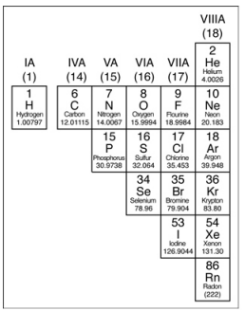
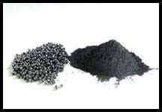
Non metals
Notes:
selenium

Slide 12
Non-Metals
Poor (not good) conductors of electricity or heat.
Not malleable or ductile.
Lower densities than metals.
Lower melting and boiling points than metals.
The one exception to this is carbon.
Low luster (dull, not shiny)
Solid non-metals are brittle and break easily
Many are gas at room temp (hydrogen, oxygen, nitrogen)

Slide 13
Metalloids or Semi-Metals

Slide 14
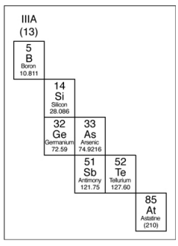
Metalloids or Semi-metals
Have some qualities of both metals and non-metals.
Often look like metals but behave like nonmetals.
They are solid at room temperature
Can be either shiny or dull.
Can conduct heat and electricity better than non-metals but not as well as metals.
Brittle (break easily) Not very ductile or malleable.
Examples include: silicon, boron, arsenic.
Notes:
Some are called semiconductors. – conductors under special conditions.
Silicon is the 2nd most abundant element in Earth’s crust (after oxygen)
car grease, cookware, satellite parts, contact lenses, film props and prosthetics

Slide 15
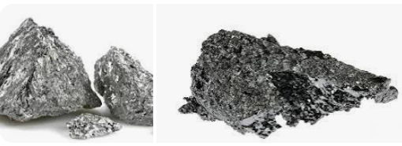
Unique to Metalloids
most useful property of metalloids: they are semiconductors .
Important in electronics.
act as both metals and nonmetals under different conditions.

Slide 16
Other uses of Metalloids
Metalloids are semiconductors - important in electronics
Antimony is used as a flame retardant in plastics and other materials.
Boron is used as a bonding agent in magnets and other chemical substances

Slide 17
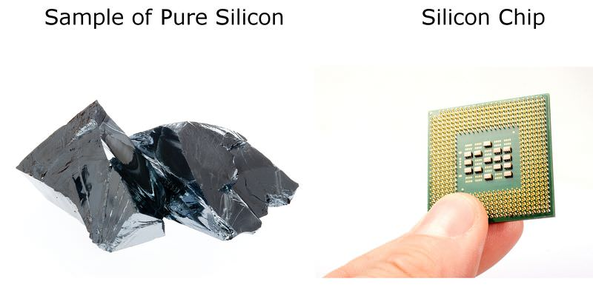
Semiconductor
Silicon is one of the most important materials used to make electronics such as computers and mobile phones
A semiconductor substance lies between the conductor and insulator.
It controls the flow of electric current in electronic equipment.
https://www.youtube.com/watch?v=aKPmQTj9BzA

Slide 18
Hydrogen: NOT a METAL!
Usually placed on the left side of PT, but is a non-metal.
Can either lose or gain an electron
Often called a proton
Smallest and lightest element,
Colourless, odorless, tasteless, highly flammable gas
Most abundant (plentiful) element on Earth (Makes up over 90 % of the atoms in the universe).
Notes:
On Earth, most hydrogen is found combined with water.

Slide 19
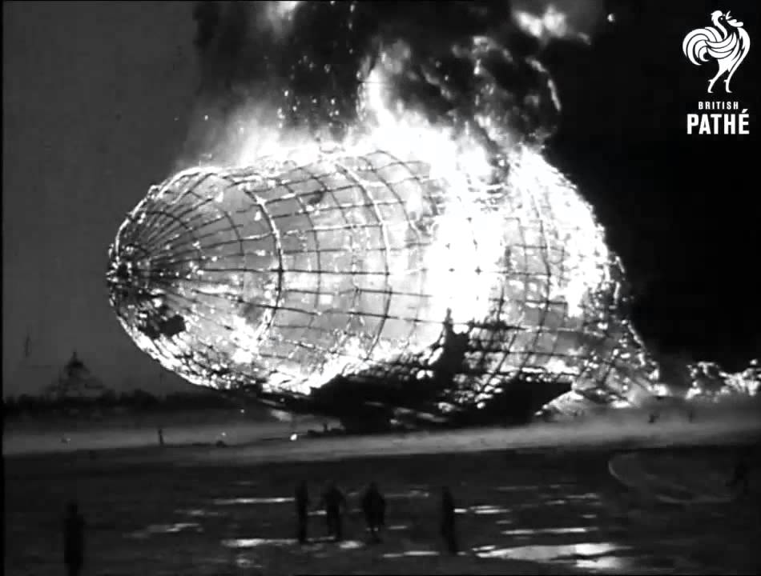
Hindenburg Disaster
The Hindenburg disaster was an airship accident that occurred on May 6, 1937, in Manchester Township, New Jersey, US.
The Hindenburg had been designed to use the inert gas helium, but Germany was unable to acquire the quantities needed to operate a fleet of airships.
Hindenburg disaster was caused by an electrostatic discharge (i.e., a spark) that ignited leaking hydrogen.
of the 97 passengers and crew on board, 62 survived.

Slide 20
Check your Understanding
Where on the periodic table can you find metals? Non-metals? Metalloids?
How do metals and non-metals differ in their properties?
What are some properties of metals that make them good for electrical wiring?

Slide 21
Practice:
Colour in your periodic table
Metals, nonmetals Worksheet –> Go over in class

Slide 23
Notes:
Fe male

