Slide 1
Classifying Matter

Slide 2
CLASSIFIYING MATTER: Create a concept map
Mixtures
Pure Substances
Homogeneous
Heterogeneous
Compounds
- Suspensions
- tiny particles
of one substance are held within
Another
-E.g. __________
Elements
Solutions
looks like one
substance
-Homogeneous
E.g. ______
made of 2 or more
elements
can be broken
down chemically
- E.g. ________
simplest form
cannot be broken
down
- E.g. ________
- Mechanical
Mixtures
- individual substances
are visible
- E.g. ____________

Slide 3
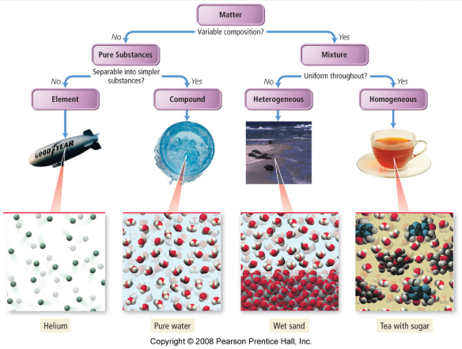

Slide 4
Classifying Matter According to its Composition
Pure Substance – composed of one type of atom or molecule – Own set of physical and chemical properties
Mixtures – composed of two or more different types of atoms or molecules, chemically bound together in variable proportions – Physical and chemical properties vary with the proportions of the components of the mixture.

Slide 5
Pure substance or mixture?
a) gold
b) air
c) chunky peanut butter
d) sugar completely dissolved in water
e) ice

Slide 6
Classifying Matter

Slide 7
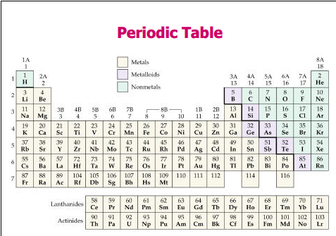
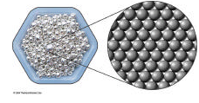
Pure Substances: Elements
Elements can not be broken down into simpler substances, i.e. silver (Ag)
Anything on the Periodic Table of Elements

Slide 8
Pure Substances: Compounds
Compounds – substance composed of two or more elements, chemically bound together in fixed proportions, i.e. H₂O & CO₂
Matter
Pure Substances
Mixtures
Elements
Compounds

Slide 9
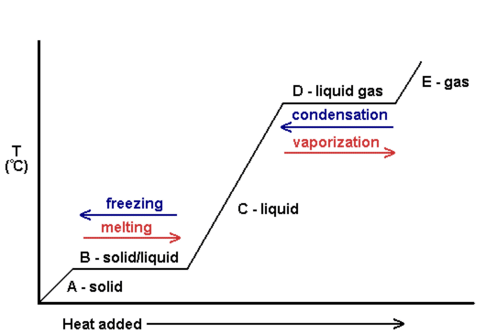
Pure Substances each have their own consistent Heating curves
Notes:
Note - Pure substances have a constant boling, freezing and melting points

Slide 10
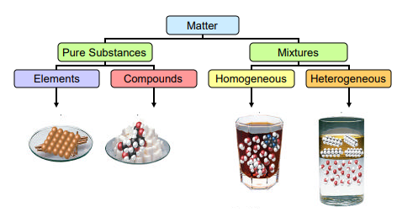
Mixtures: Homogeneous and Heterogeneous

Slide 11
Homogeneous Mixtures: Solutions and Alloys
Uniform composition: Two separate samples would yield the same ratio of components.
Same properties throughout.
Eg. salt water, apple juice, paint.

Slide 12
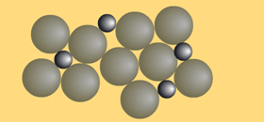
Homogeneous Mixtures: Alloys
An alloy is a homogeneous mixture of two elements, with one being a metal (solid).
Atomic arrangement in alloys are very irregular and different in sizes, making it harder for its layers to slide over each other.
Advantage: Alloy tend to have better qualities than the original.
Eg. Gold jewellry- usually a mix of gold, silver and other metals.
Eg. Stainless steel is a mixture of Iron, Chromium and Nickel.
Eg. Amalgam is a type of alloy often by dentists to fill cavities in teeth.
Eg Brass is also an alloy, with copper and zinc as its main metals
Notes:
Atomic arrangement in alloys are very irregular and different in sizes, making it harder for its layers to slide over each other. Stainless steel behaves in a similar way. It is also a mixture of Iron, Chromium and Nickel. These metals mix up perfectly to become alloys too.
Why are metals mixed into alloys? The advantage of this mixture is that, the alloy tends to have better qualities than the original. For example, an alloy of gold would have better properties in terms of its strength and lustre that the unmixed gold. Common types of alloys. Amalgam is one common alloy. It is used often by dentists to fill cavities in teeth. The main metal in amalgam is mercury. Brass is also an alloy, with copper and zinc as its main metals. Brass is usually used for door hinges and electrical plugs.

Slide 13
Homogeneous
Heterogeneous

Slide 14
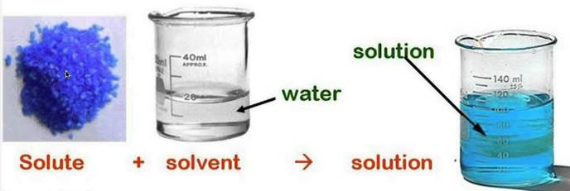
Homogeneous mixtures: Solutions
Can be dilute, concentrated, or saturated.
Involve a solute and a solvent.
A material is said to be soluble if it dissolves completely in a solvent.
Solutions are NOT always liquid.
Notes:
A solution is a homogeneous mixture involving a solute (substance that gets dissolved ) and a solvent (liquid in which the solute dissolves).
The solute (may be liquid or solid) is broken down completely into individual ions or molecules in a way that can no longer be seen as a separate entity. A material is said to be soluble if it dissolves completely in a solvent. For example: If you dissolve salt (solute) in water (solvent), the salt is broken down into Sodium and Chlorine ions within the solvent. This mixture will look and taste the same everywhere in the cup, and would have salt and water in the same proportions.

Slide 15
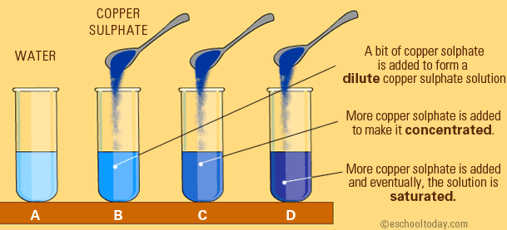
Copper sulfate is added to water. What happens when more of the solute is added?

Slide 16
What is a saturated solution?
If you keep adding a solute to a solvent, it gets concentrated.
If you keep adding, eventually, no more solute can be dissolved with the temperature remaining constant.
Then, the solution is said to be saturated.

Slide 17
How can you identify a solution from other mixtures?
1. No particles will be visible. 2. It will have a clear look. 3. Nothing will settle at the bottom. 4. It cannot be filtered.

Slide 18
Heterogeneous Mixtures
Composition is not uniform. Two separate samples would yield varying amounts of the components.
Each component has different properties.
Eg: sulphur and lead mixed together with a stirring rod, or different coloured marbles in a bag.
Mechanical Mixtures, Suspensions, Emulsions, Colloids

Slide 19
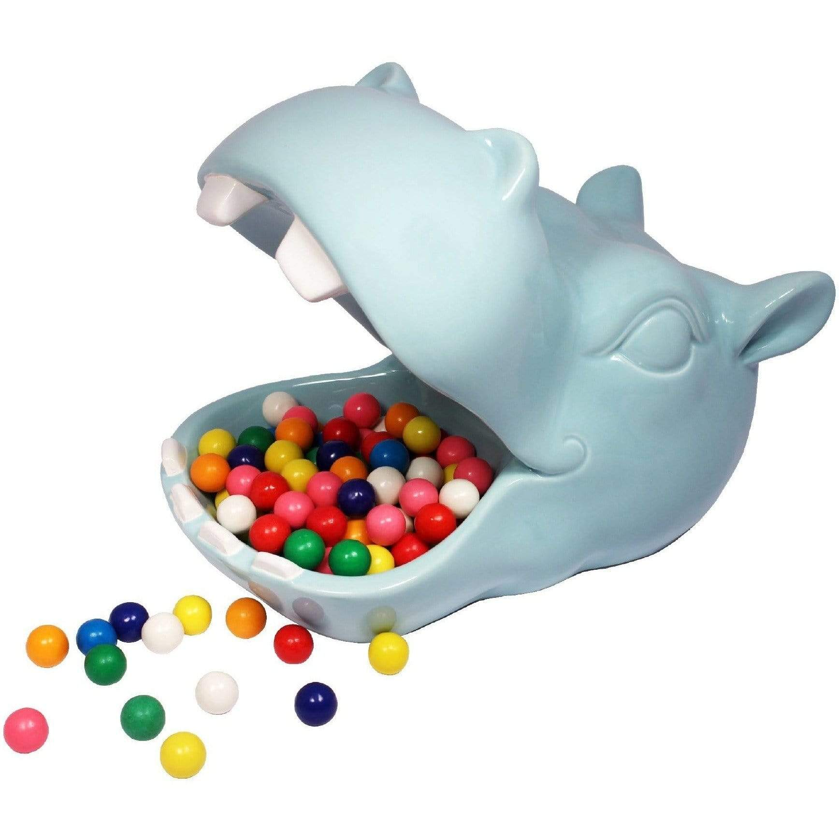
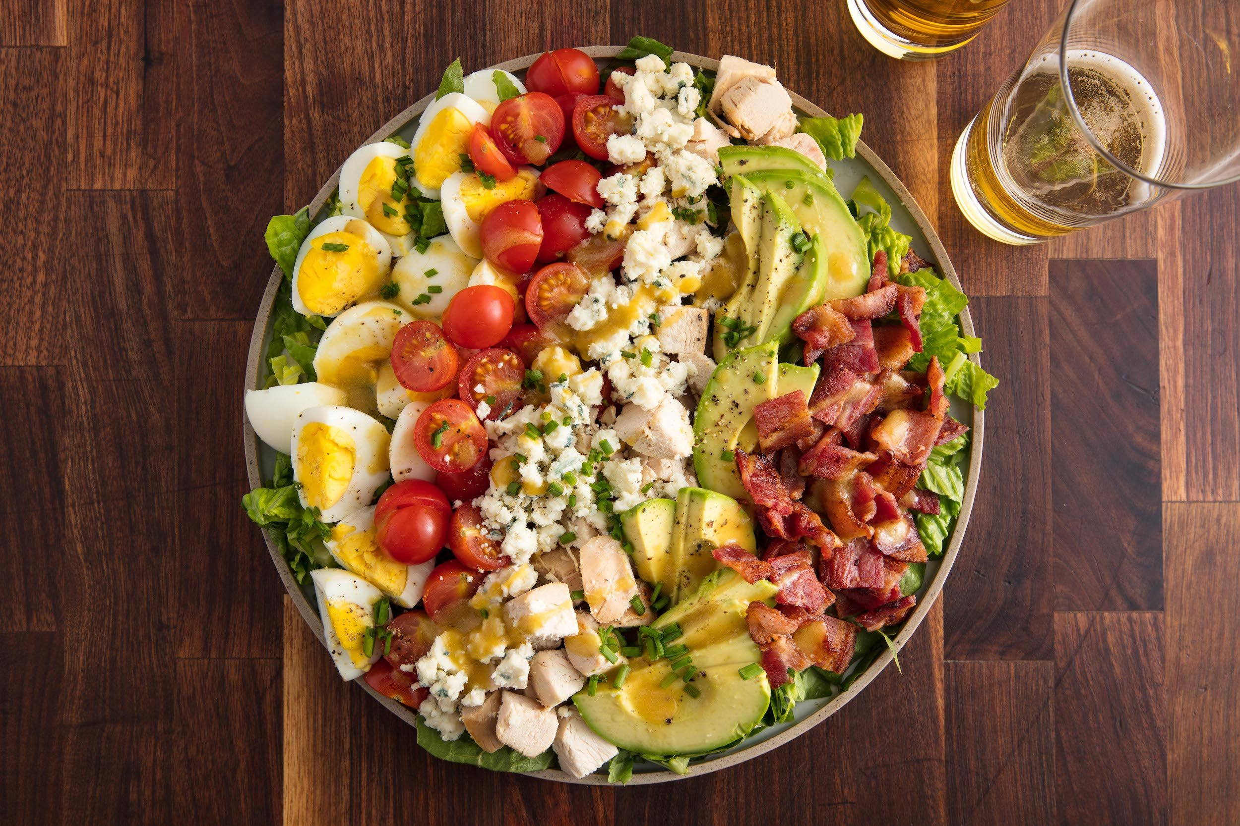
Mechanical Mixtures
a mixture whose components are separable by mechanical means as distinguished from a chemical compound.
Eg. Cereal and Milk
Eg. Pizza
Eg. Granola
Eg. Vegetable soup

Slide 20
Heterogeneous Mixture: Suspensions
Two phases. Particles may settle out. Can be filtered
Looks cloudy
Eg. sand and water, pollutants in atmosphere such as dust particles, soot, clouds.
Notes:
Suspensions often involve 2 phases of matter, because after the solids are mixed with the solvent (liquid) stay the same. Some good characteristics of suspensions are: 1. It is cloudy (not as clear as a solution). 2. It can be filtered. 3. The larger particles settle at the bottom. 4. It is a mixture of two phases.
Note that suspensions can also involve tiny liquid particles in a gas, or tiny solid particle in a gas. Examples include particulate matter in the atmosphere. Pollutants such as dust particles, soot, salt or cloud droplets in the atmosphere are all suspensions.

Slide 21
Heterogeneous Mixture: Emulsions
Uniform mix of two or more immiscible liquids (those that do not dissolve well into each other). in which one ends up as very tiny droplets inside the other.
Eg. Oil and water: even with shaking they do not dissolve in each other, but appear as bits and pools in the main liquid.
Emulsions are colloidal systems too.
Eg. ice cream, salad dressings and paints.
Notes:
Emulsions are more viscous than the oil or water that they hold. Examples of emulsions are ice cream, salad dressings and paints.
'Because a large number of emulsions contain water as one of the two phases, emulsions are classified into two categories: 1) Oil-in-water and 2) Water-in-oil. Oil-in-water emulsions consist a dispersed phase of oil droplets in a water medium. Water-in-oil emulsions consist of a dispersed phase of oil in a water medium. One can distinguish between an emulsion types based on the volume fraction of the two phases.'

Slide 23
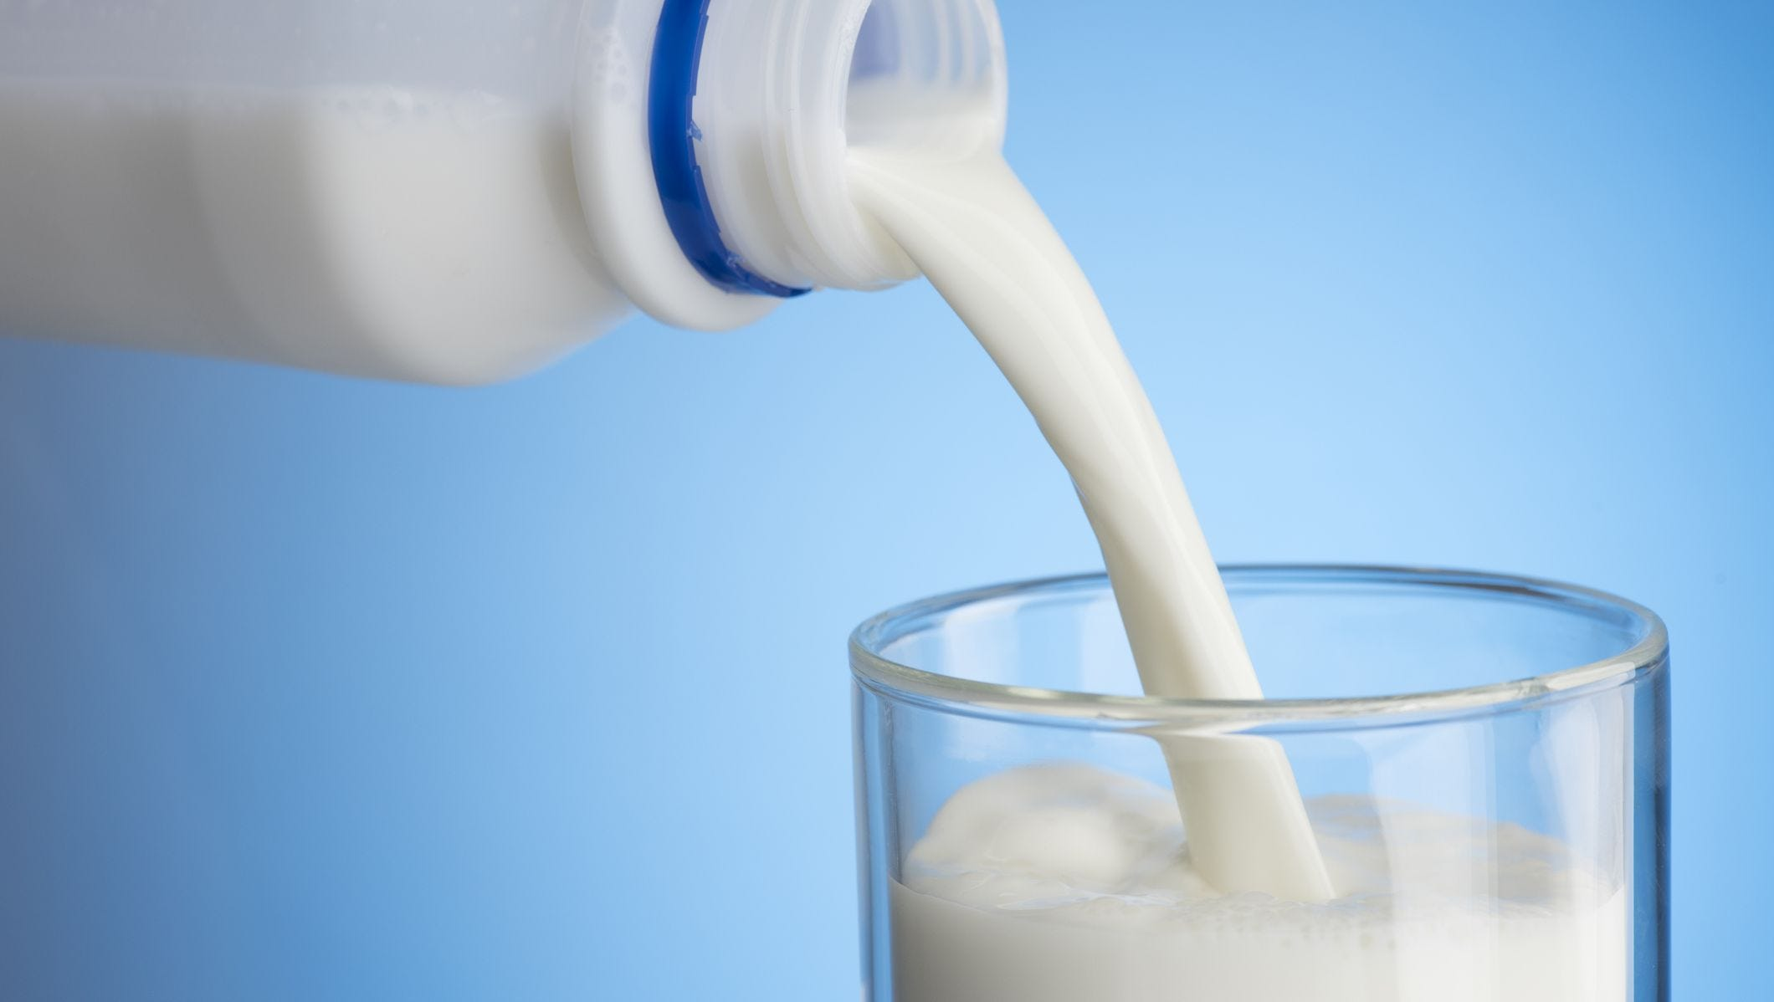
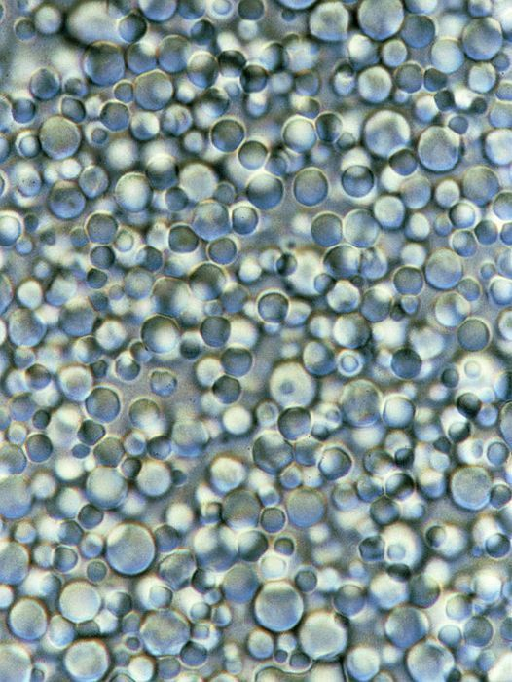
Colloids
May look homogenous but the solute is not completely dissolved, and the particles are big enough, making the entire mixture cloudy.
Eg. Milk, Mayonnaise, Butter, and Egg Whites. What is the difference between a colloid and an emulsion? With colloids, components tend not to settle out and involves the uniform dispersion of fine solid particles in a liquid medium. Emulsion is usually two liquids.
Milk under microscope
Notes:
Eg. Mayonnaise is a mixture of egg yolk, vinegar and lemon juice. It is whisked smoothly to a degree that it feels so smooth, but under a microscope, the solute is not completely dissolved.

Slide 24
Classify the following as either: mechanical mixture, suspension, solution, element or compound
a) Lead i) pepsi
b) Water j) neon
c) Coffee k) carbon dioxide
d) Salad dressing l) milk
e) Sand m) pizza
f) Air n) orange juice
g) Salt
h) cereal

Slide 25
Practice
Read Hebden WB p50-52
Try Hebden WB Exercises p52
Matter Ws

Slide 26
All Mixtures can be separated
Usually bases on each components different physical properties:
Filtration is bases on different particle sizes.
Distillation is based on different boiling points.

Slide 27
Can pure substances be separated?
Not by physical means, only by using energy
Based on chemical properties.
New elements would be formed
Eg. Water can be separated into oxygen gas and hydrogen gas by electrolysis.

Slide 28
Check your Understanding
Classify each of the following as a physical or chemical change.
a) grape juice turns to wine
b) wood burns to ashes
c) a broken leg heals itself
d) grass grows
e) an infant gains 10 pounds
f) a rock is crushed to powder
g) baking soda fizzes in vinegar
h) vinegar and oil separate into two layers
i) helium balloon decreases in size

