Slide 1
Elements: the building blocks of matter. NAMING AND CLASSIFYING

Slide 2
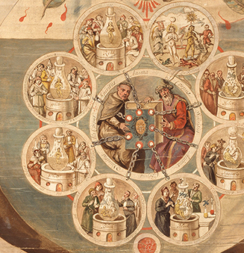
The History of Chemistry
Alchemy - medieval precursor to chemistry based on the idea of transforming of matter, particularly in converting metals into gold.

Slide 3
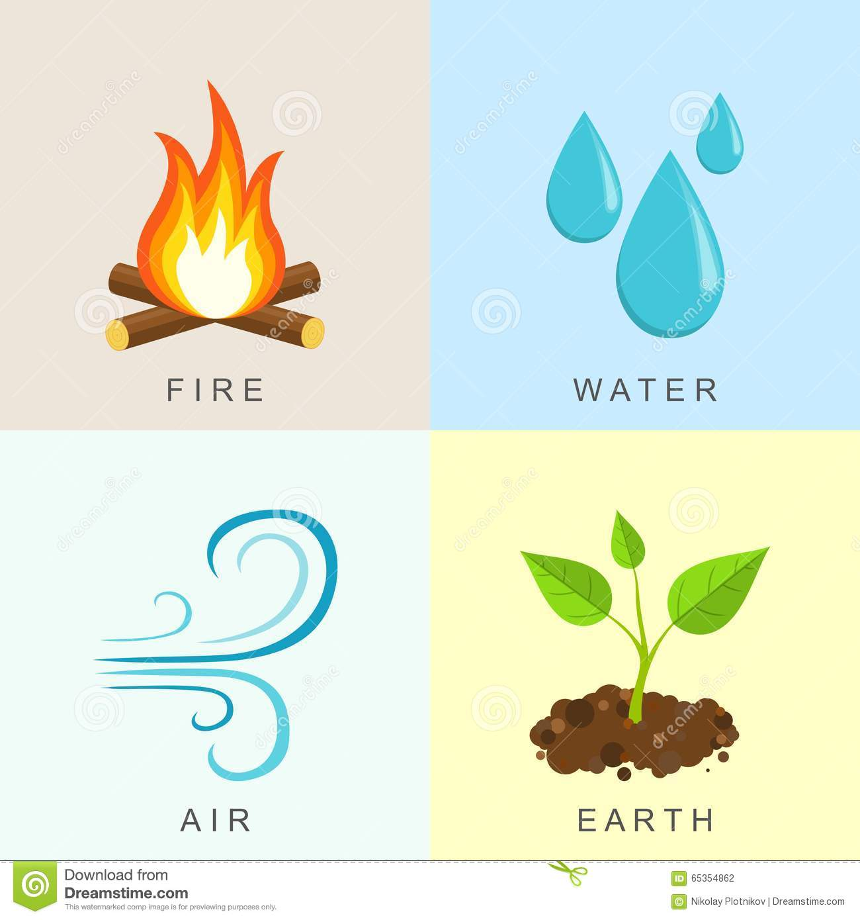
The History of Chemistry
Alchemists believed what the Greeks had, that all substances in the world were composed of:
Fire
Earth
Air
Water
https://www.youtube.com/watch?v=O-48znAg7VE

Slide 4
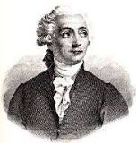
AntoineLavoisier – the father of chemistry
Scientists believed water was an element.
Lavoisier discovered that water was a compound made of hydrogen and oxygen.
In 1777, he was the first to establish that sulfur was an element, not a compound.
He wrote the first extensive list of elements, and helped to reform chemical nomenclature.
In 1778, he named oxygen.
In 1783 he named hydrogen.
Also helped construct the metric system

Slide 5
Beginnings of Modern Chemistry
Early chemists began to recognize the existence of two types of pure substances:
Compounds and elements
And began to test many substances to see if they could be broken down.
If it could not be broken down → they found a new element

Slide 6
How are elements named?
Based on their special properties
Eg. “light giving” (phosphorous)
Eg “water forming” (hydrogen)
2. To honour scientists (einsteinium)
3. After Countries (germanium), cities (berkelium)
4. Most have Latin origins: plumbum
Mercury – hydragyrum "liquid silver"
Notes:
Mercury gets is name from the planet Mercury which was named after the swift messenger of the Roman gods, Mercury. It was given this name because it flowed swiftly in its liquid form. The symbol Hg comes from the Latin word "hydragyrum" meaning "liquid silver."

Slide 7
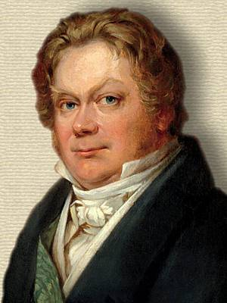
Symbols
Swedish chemist Jons Jakob Berzelius suggested symbolic system to describe all the elements using the letter of either their common name or Latin name.

Slide 8
Symbols
Each element begins with one capital letter for it’s symbol.
Usually first letter of their common or Latin name:
Carbon = C
Hydrogen = H
Boron = B

Slide 9
Symbols
If there is a second letter, it is lower case :
Helium = He
Calcium = Ca
Lithium = Li

Slide 10
Homework
Use pages 20-21 of WB to answer p22-23
And ptable.com interactive WS
Element Song ASAP Science:
https://www.youtube.com/watch?v=rz4Dd1I_fX0

Slide 17
Mercury
Aluminum and mercury
https://www.youtube.com/watch?v=IrdYueB9pY4
Could put these in compounds/reactions
Mercury and penny

