Slide 1
How does the Body Protect Itself?
The immune System: Three Lines of Defense

Slide 2
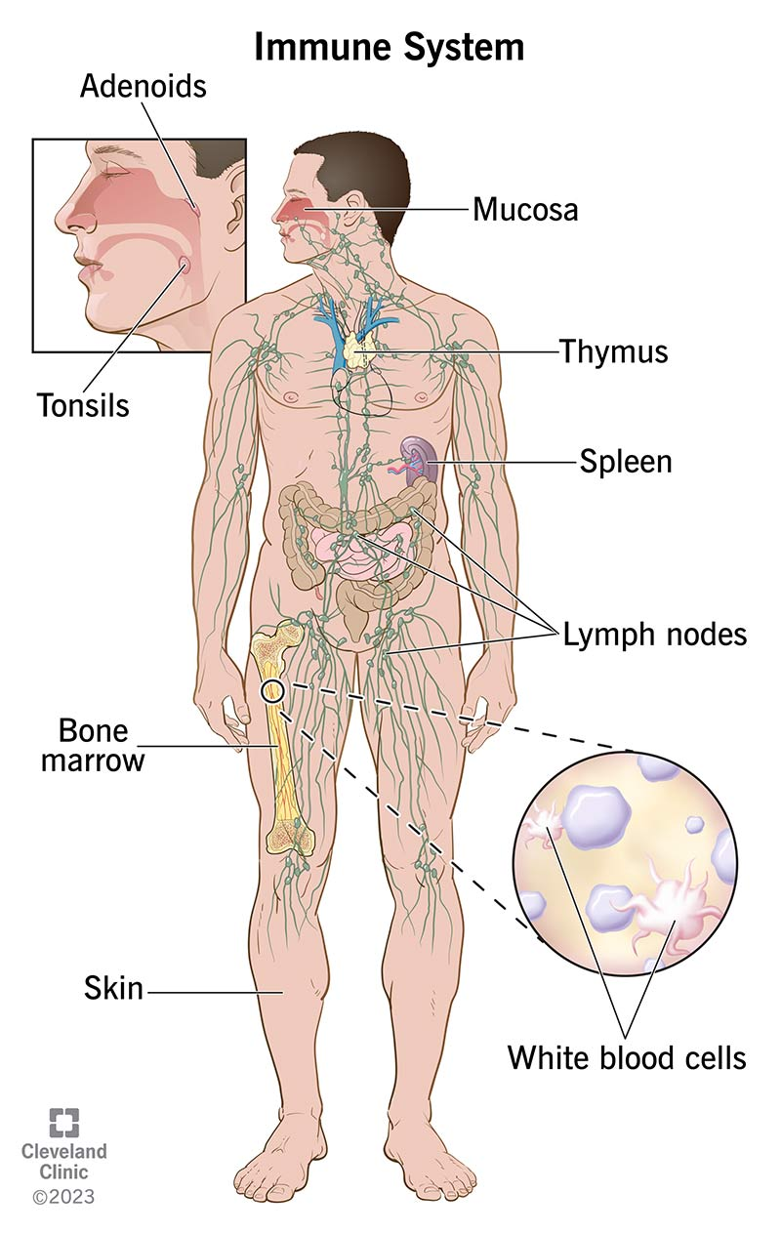
Immune System
Our Immune System works to PROTECT and FIGHT infection from foreign substances.

Slide 3
How does your immune system work?
Amoeba Sisters Immune System: https://www.youtube.com/watch?v=fSEFXl2XQpc
Immune system: Innate and Adaptive, 5min
https://www.youtube.com/watch?v=PzunOgYHeyg
Ted ed video, 5min
https://ed.ted.com/lessons/how-does-the-immune-system-work-emma-bryce

Slide 4
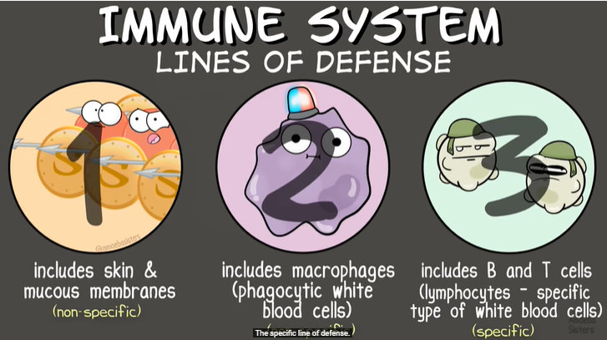

Slide 5
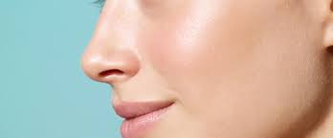
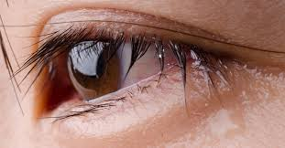
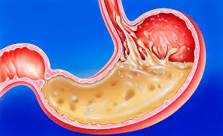
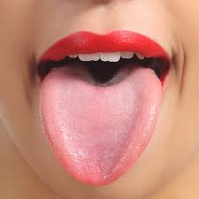
Recall: The First Line of Defense:
  Works to keep pathogens out of the body.
  Structures and Secretions in linings of all internal body systems.

Slide 6
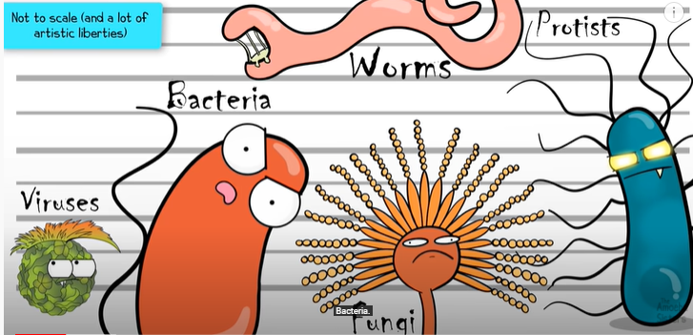
Pathogens
Bacteria
Viruses

Slide 7
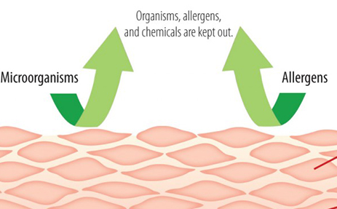
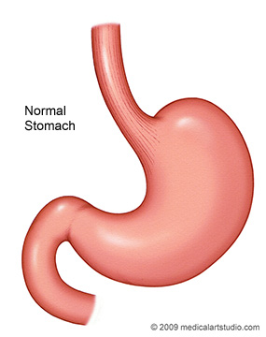
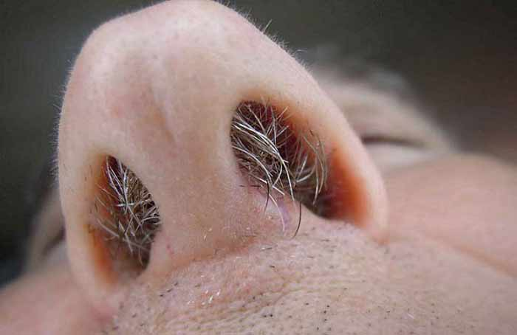
Recall: First line of Defense
Physical Barriers:
skin
mucus
cilia (microscopic hairs) in your nose and throat prevent pathogens from entering your respiratory system.
Chemical Barriers (Secretions) :
Gastric juices in your stomach can destroy some pathogens.
sweat and oils on are slightly acidic.
tears
See page 102
Notes:
that stops most pathogens from entering the body.
The skin is waterproof so you can wash

Slide 8
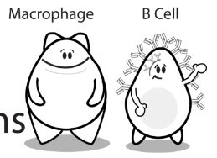
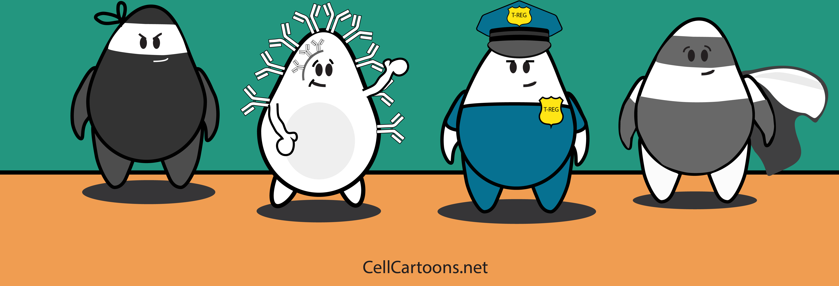
2nd and 3rd Lines of Defense involves other white blood cells

Slide 9
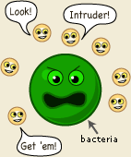
Recall: INFECTION is when a foreign substance (antigen) gets past the First Line of Defense and invades the body and causes an immune response.
  An Antigen is any foreign particle that causes an immune response.
  E.g. pollen, bacteria, parasitic worms, and viruses
  (Pathogen – antigen that causes disease)
  An IMMUNE RESPONSE when the body recognizes it as not belonging and will mount an attack.
  2nd and 3rd Lines of Defense become activated.
Notes:
Pathology – study of disease

Slide 10
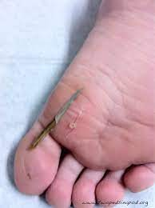
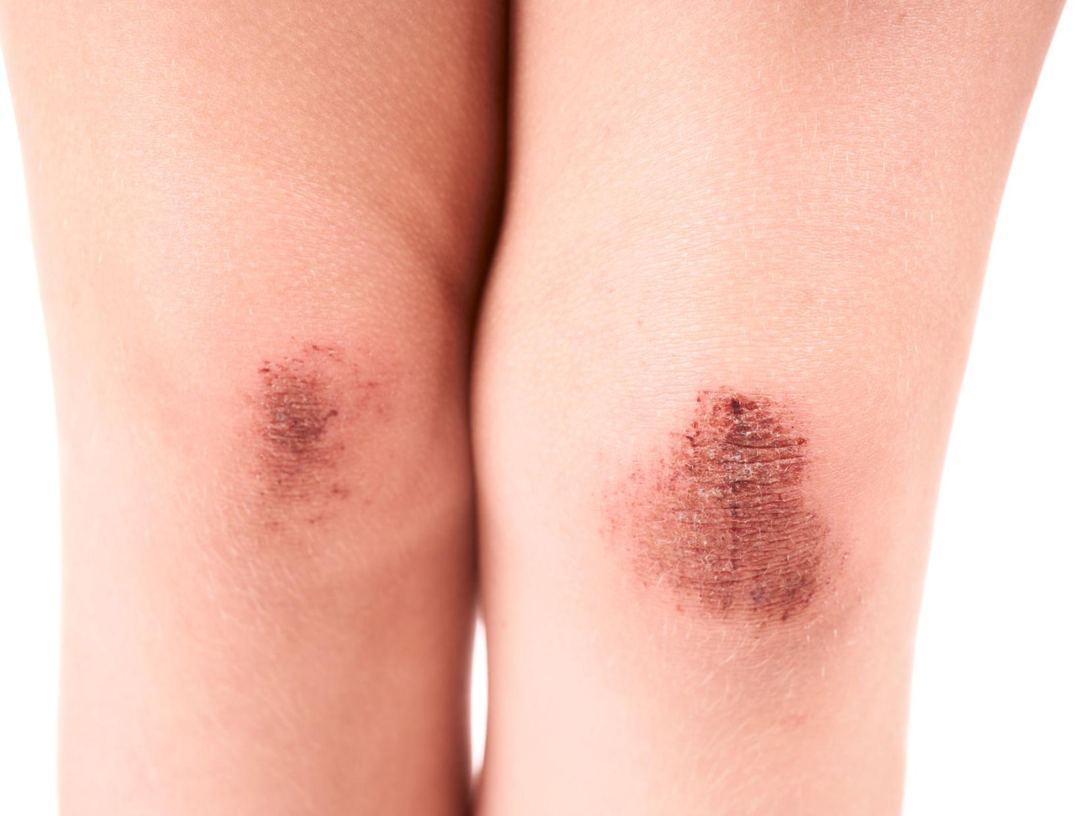
Infection : when pathogens get through the First Line of Defense?
When an antigen or pathogen enters the body, the Second line of Defence becomes activated
This is your Innate = inborn, natural Immune system

Slide 11
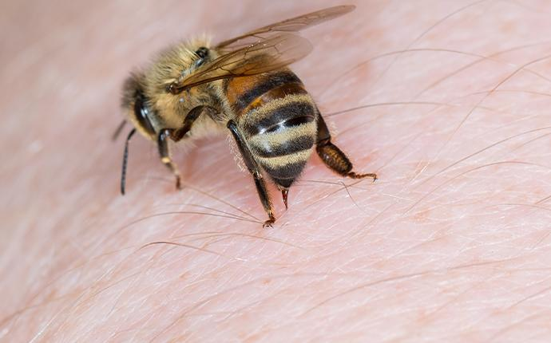
Second line of Defense
Is an Innate Immune Response – something you are born with.
The response is quick, (hours) and Nonspecific (same for any pathogen).
See page 102

Slide 12
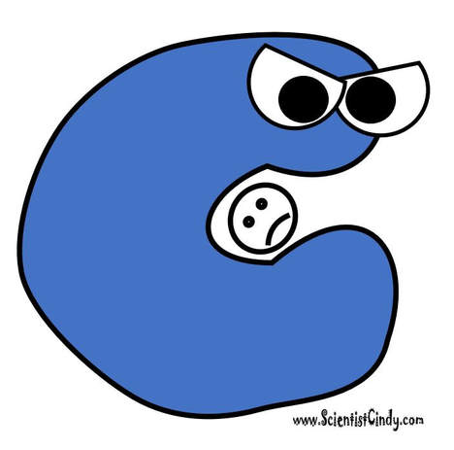
Second line of Defense
2nd line of Defense involves a special type of White Blood Cell called Phagocytes which engulf (surround) and kill pathogens in a process called phagocytosis.
See page 102

Slide 13
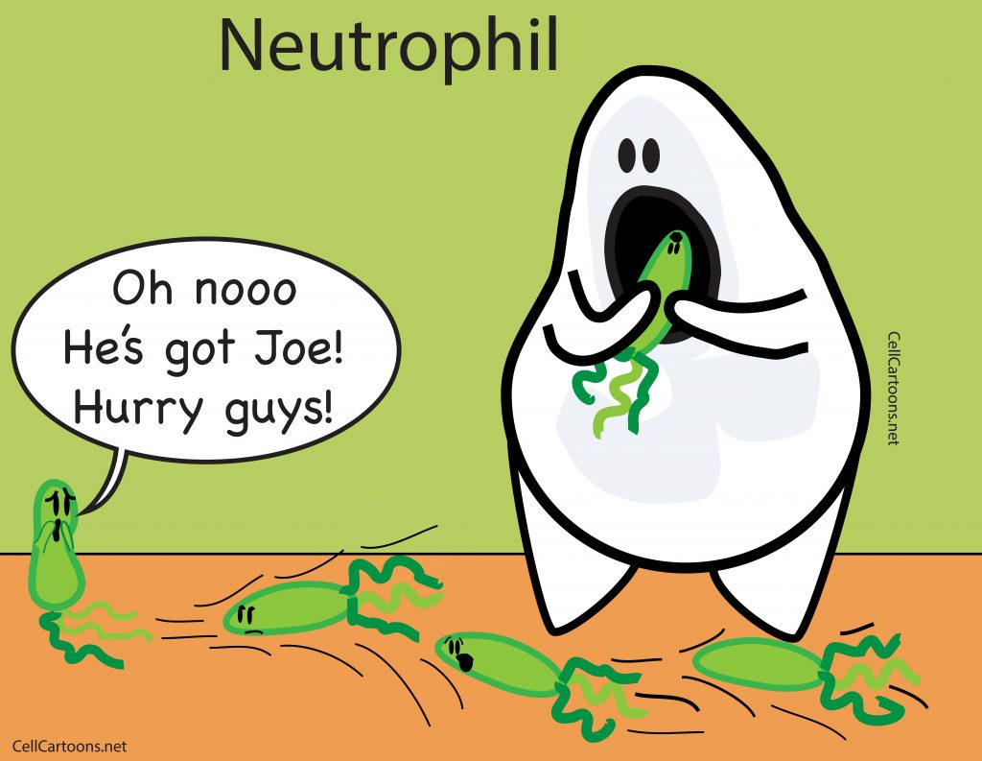
Phagocytes are white blood cells that engulf pathogens

Slide 14
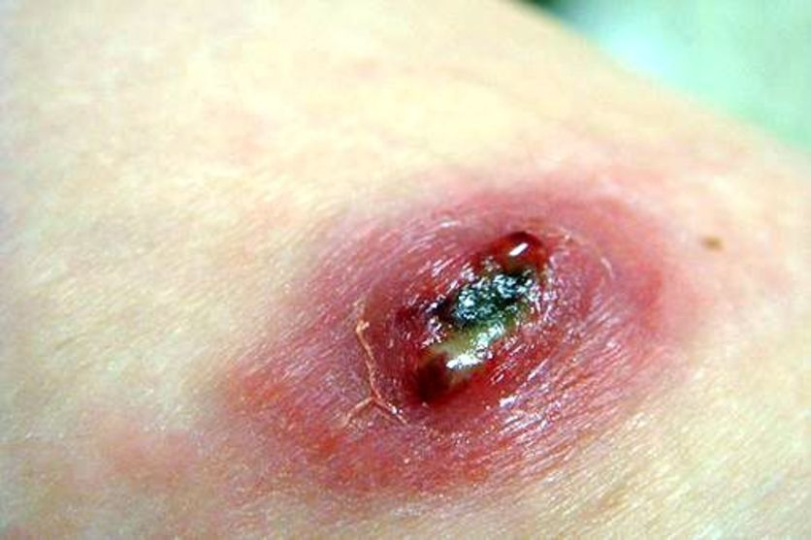
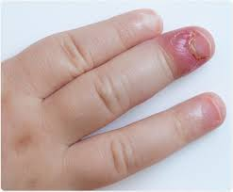
Second line of Defense
Your body reacts with INFLAMMATION

Slide 15
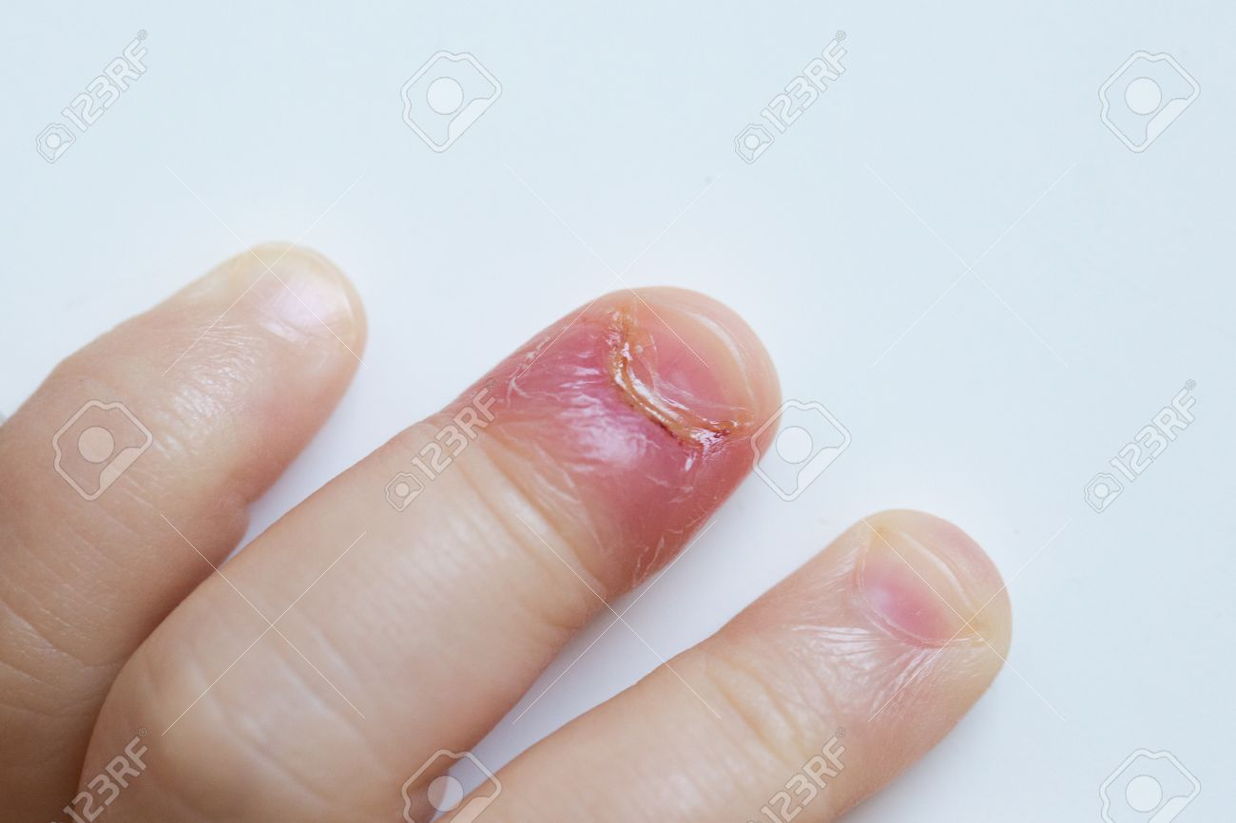
Inflammation:
  Pain,
  redness,
  swelling,
  Heat
  Why does it swell?
See page 103
Notes:
Fluid flowing in creates swelling
https://www.youtube.com/watch?v=X-ubCIcAh4M

Slide 16
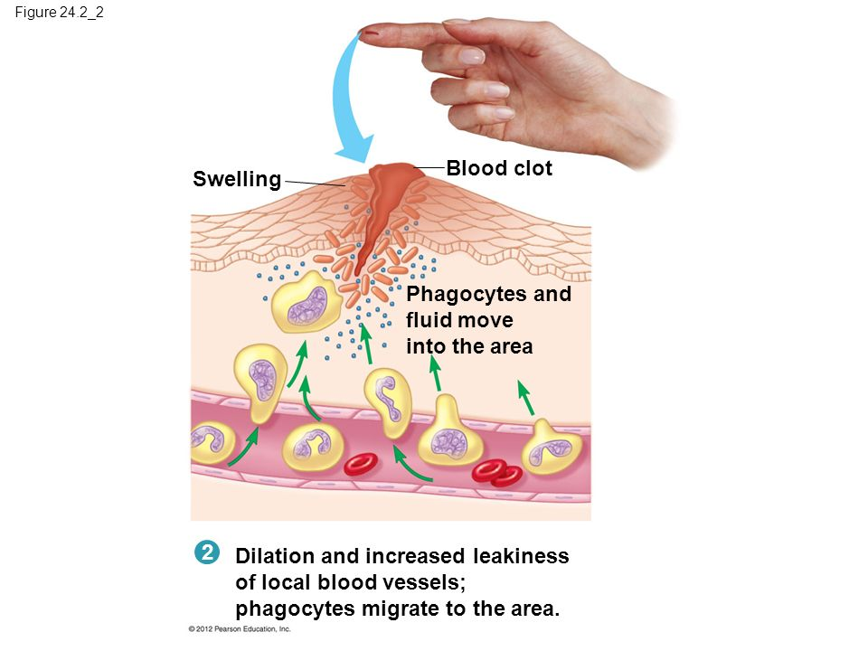
Mast cells secrete a chemical called histamine, that causes blood vessels to dilate (expand) and become “leaky”.
This allows more fluid and therefore more cells to get to the infected area.
Creates Swelling

Slide 17
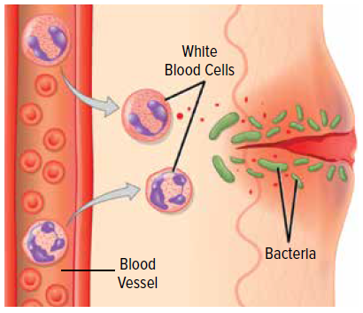
Inflammation
  Your bodies response to an antigen
  The affected area becomes
  red, swollen, warm, painful
  White blood cells move to the area and kill the pathogens

Slide 18
What’s the point?

Slide 19
What’s the point?
Inflammation hurts.
This tells us we have encountered something bad and should do something about it.
→ learn to stay away from poison ivy, bee hives, thorny bushes, fire

Slide 20
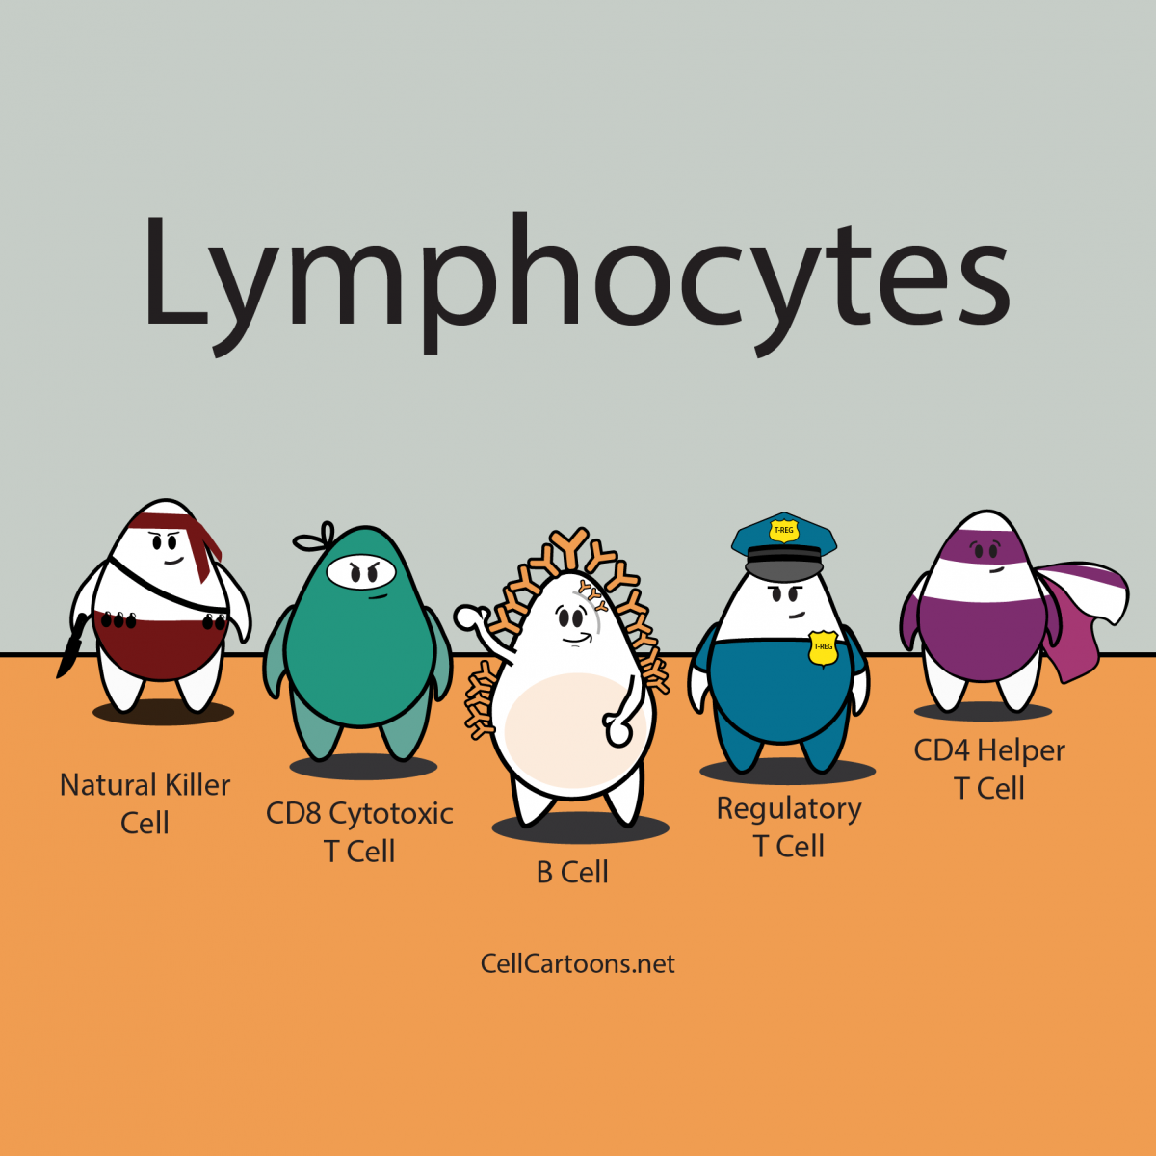
The Third Line of Defense
When a pathogen enters the body, it’s time to activate the 3rd line of defense:
This is a targeted attack
Uses more White Blood Cells:
Notes:
Uses Specialized White Blood Cells (Lymphocytes)
And proteins called antibodies

Slide 21
Third Line of Defense
Is an Acquired Immune Response because you acquire it after an infection has occurred.
It is a highly specific attack on a specific pathogen or antigen.
Involves White blood cells like T-cells and B-cells and special proteins called antibodies
Chicken Pox
See page 104 - 105

Slide 22
Third Line of Defense
Slower – because it takes time to activate and grow more of these cells
Gives us active immunity.
  This means your body remembers how to fight a pathogen that has infected it before.
  This is why you get diseases such as chicken pox only once
Chicken Pox
See page 104 - 105

Slide 23
How does it work?
It starts when
A pathogen enters the body.

Slide 24
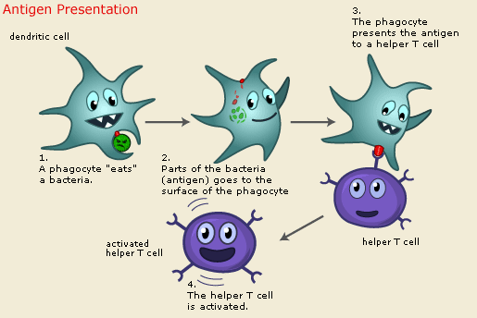
A Phagocyte recognizes the pathogen as foreign (not belonging), engulfs it, and breaks it down.
Phagocyte is a type of Macrophage.
Notes:
Recognize antigens or pathogens on the surface of macrophages and stimulate B cells and Killer T cells.
Recognize antigens or pathogens on the surface of macrophages and stimulate B cells and Killer T cells.

Slide 25
The Phagocyte then presents a piece of the antigen on its surface as a signal.
Notes:
Recognize antigens or pathogens on the surface of macrophages and stimulate B cells and Killer T cells.
Recognize antigens or pathogens on the surface of macrophages and stimulate B cells and Killer T cells.

Slide 26
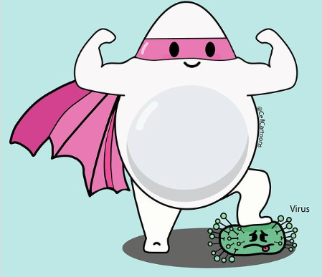
This “antigen presentation” signal activates other cells like T Helper Cells

Slide 27
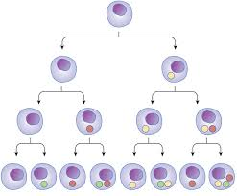
T Helper Cells
Once activated T helper cells will:
divide to make clones (copies) of themselves,
Notes:
Recognize antigens or pathogens on the surface of macrophages and stimulate B cells and Killer T cells.
Recognize antigens or pathogens on the surface of macrophages and stimulate B cells and Killer T cells.

Slide 28
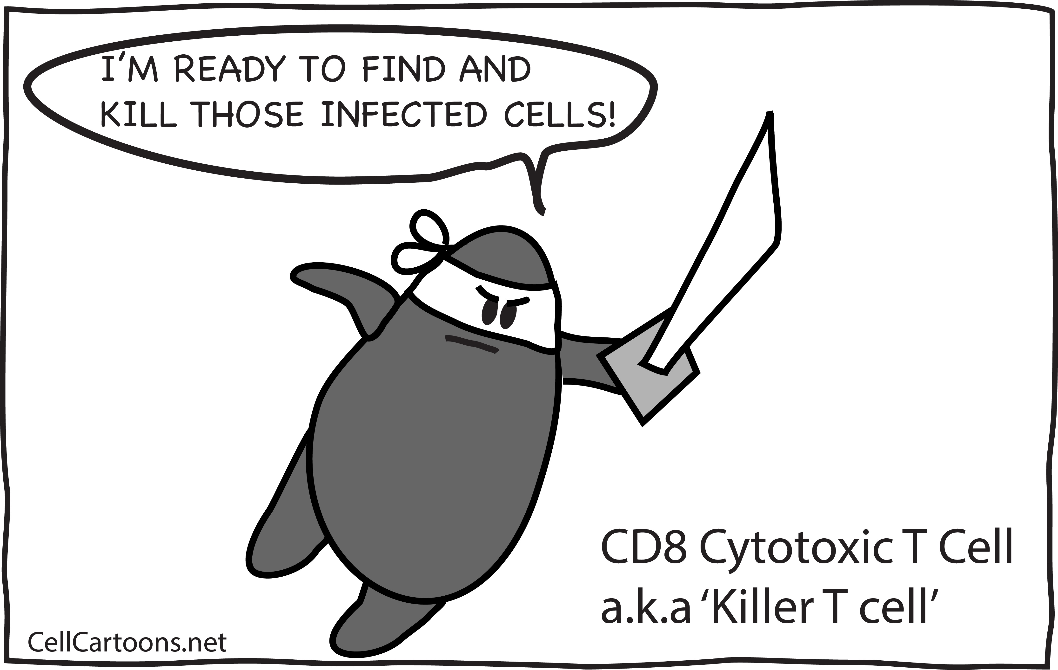
T Helper Cells
Once activated T helper cells will:
divide to make clones (copies) of themselves,
Help activate cytotoxic T cells and B cells.
Notes:
Recognize antigens or pathogens on the surface of macrophages and stimulate B cells and Killer T cells.
Recognize antigens or pathogens on the surface of macrophages and stimulate B cells and Killer T cells.

Slide 29
Cytotoxic T cells
can recognize the signal and kill the infected cells.
Also kill cancer cells

Slide 30

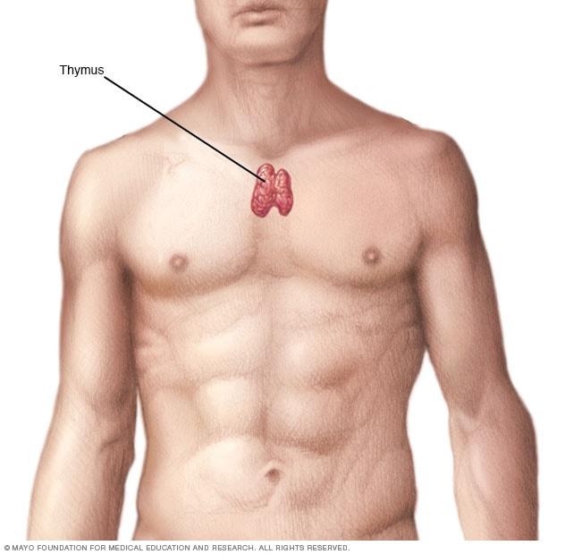
T Cells
T cells are named after the organ they develop in, the thymus.

Slide 31
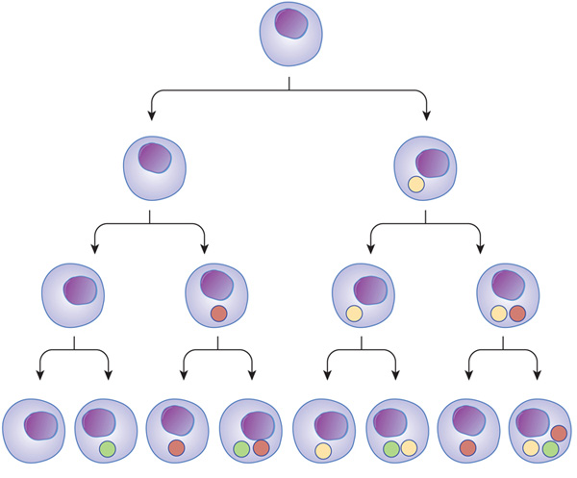
B cells
Activated B cells will:
divide to make more copies of themselves:

Slide 32
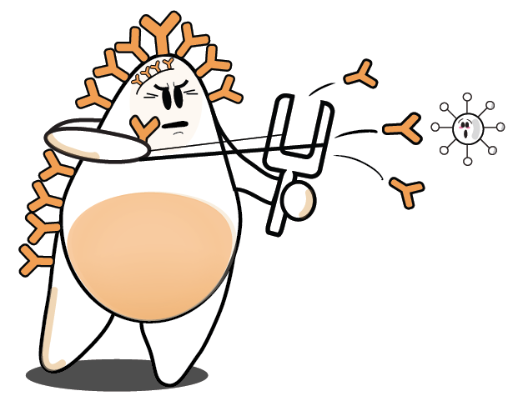
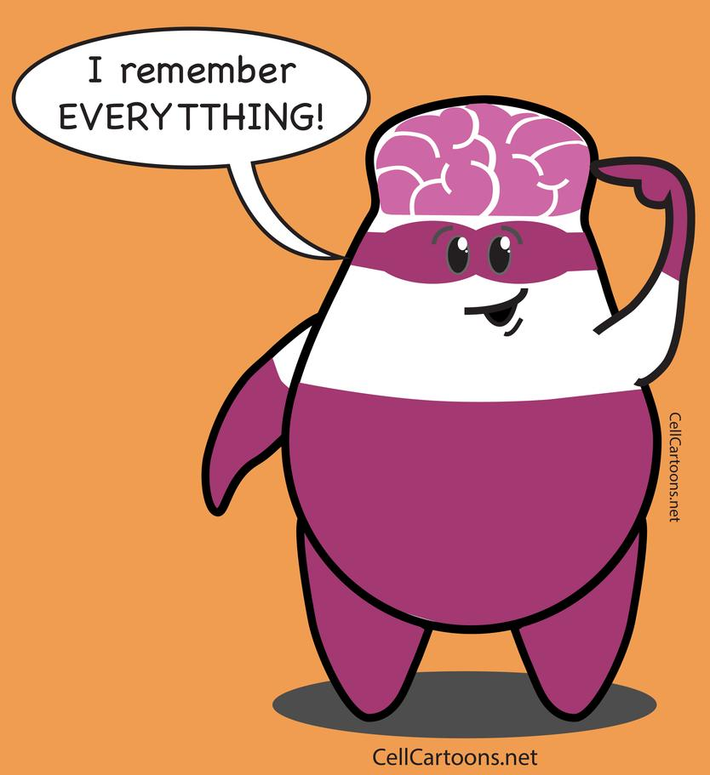
B cells
Activated B cells will:
divide to make more copies of themselves:
  Some become plasma cells that will produce antibodies.
  Some will become memory cells

Slide 33
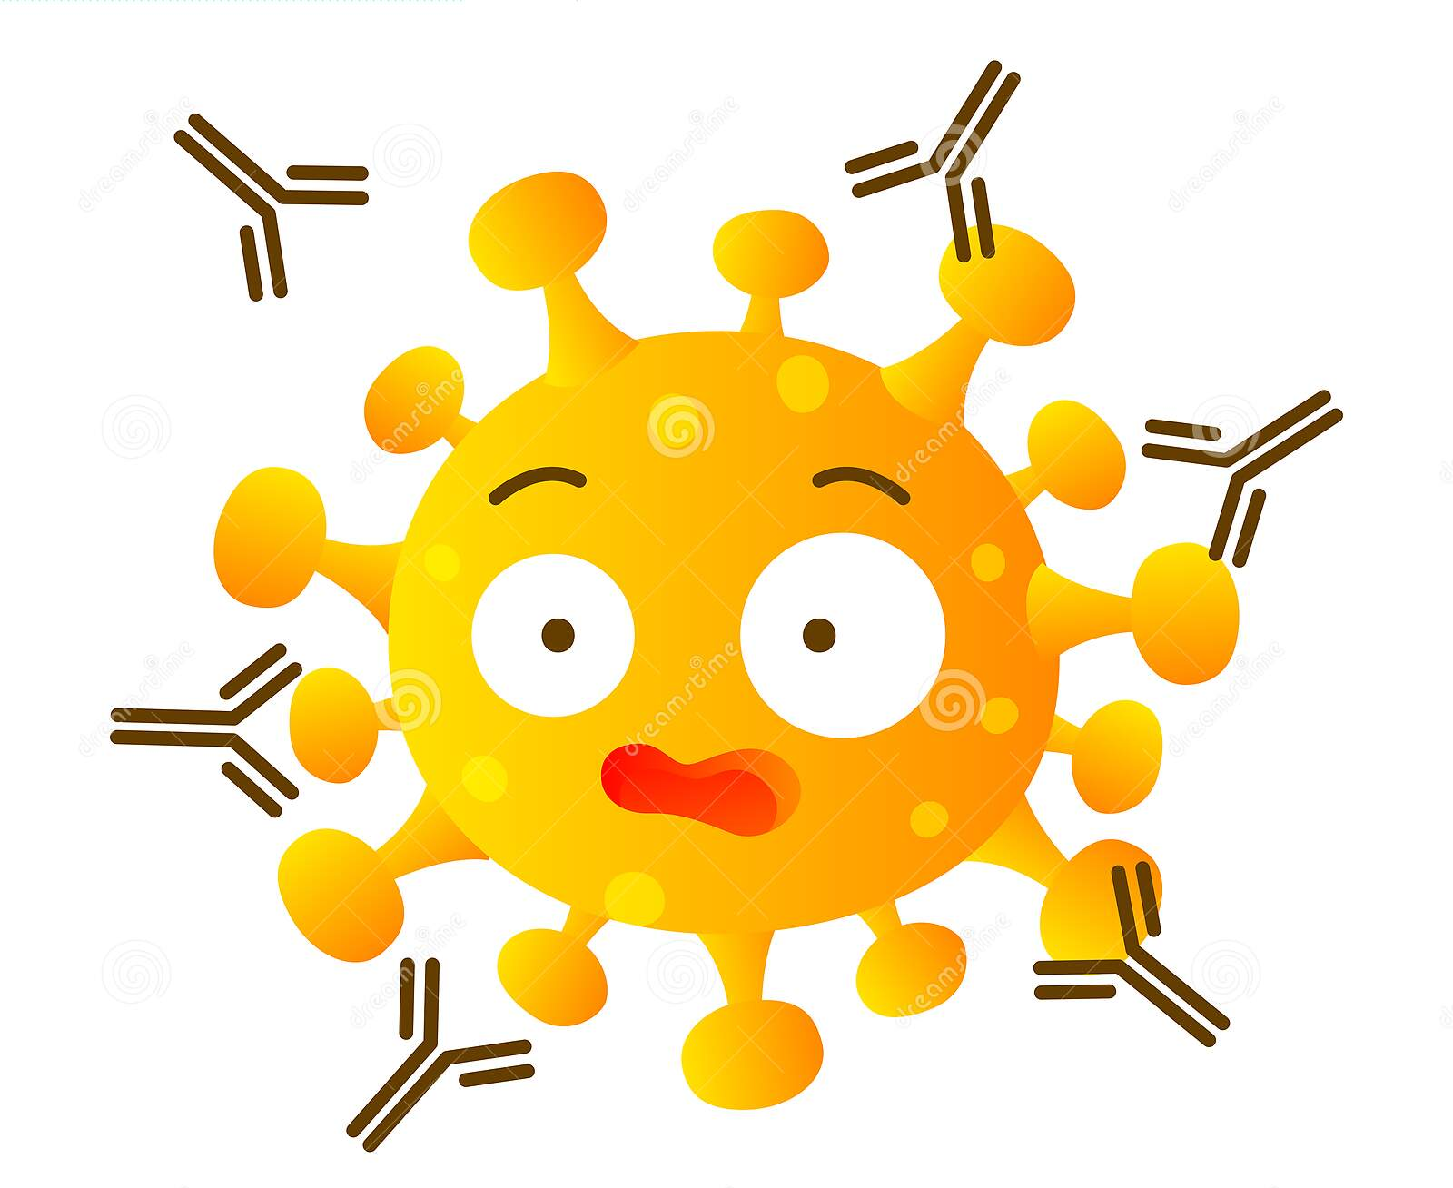
What are Antibodies?
Antibodies are Y shaped proteins that bind to the antigen to neutralize them (make them harmless) or mark them for destruction by other white blood cells.
each antibody is specific to the invading antigen (like a lock and key)
This can take time – this is why you can be sick for days/weeks.

Slide 34
Aside: Antigen
An “antigen” is any foreign particle that causes an immune response.
The term "antigen" comes from ANTI-body GENerating substances.
Antigens could be markers on the pathogen

Slide 35
Types of Memory Cells
Memory cells can last for years in the body and keep
a memory of that specific antigen so they can respond quick if you same pathogen invades the body again.
Memory B → activate plasma B cells →antibodies
Memory T → activate cytotoxic T cells → kill infected cells

Slide 36
Natural Killer Cells
Natural Killer Cells destroy antigens, pathogens or infected cells.
can work independently to directly Do not need activation to recognize infected or damaged cells and kill them
Part of innate immune response.
Kill cancer cells
https://www.youtube.com/watch?v=ntk8XsxVDi0
Notes:
Cytotoxic T-cells attack viruses when activated by an antigen.
Natural killer cells don't need activation to attack harmful cells. Cytotoxic T-cells are part of your adaptive immune response. Natural killer cells are part of your innate immune response.

Slide 37
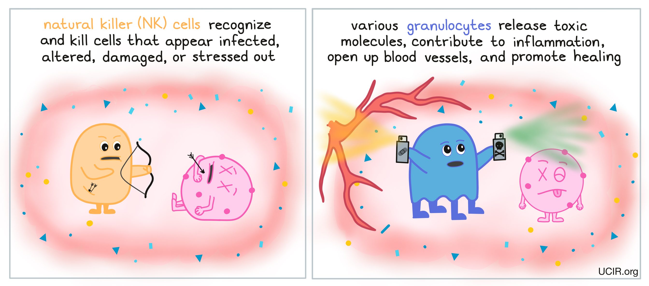

Slide 38
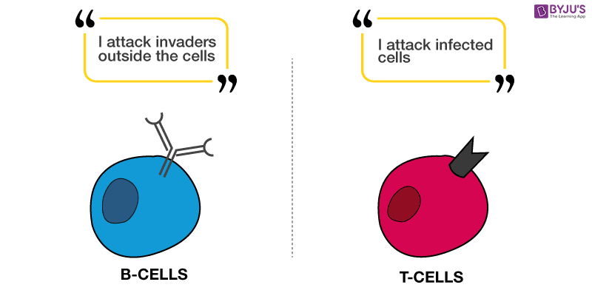

Slide 39
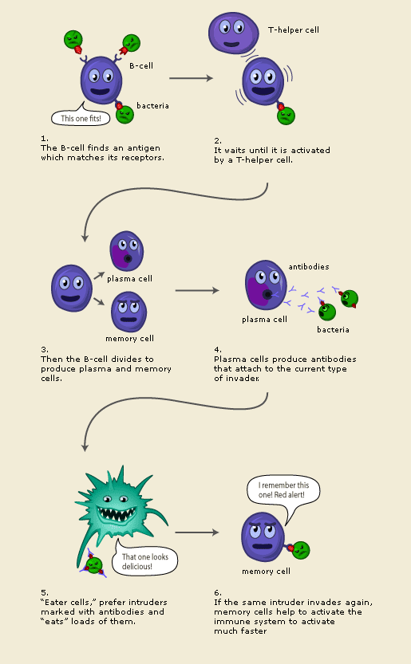
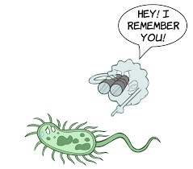
Immunity
Because they are clones of the first activated B cells, they have “memory” of that particular pathogen and will immediately recognize it to mount a fast attack, quickly neutralizing it before it take hold.
This is how we become immune to certain diseases like chicken pox.

Slide 40
Check your Understanding
How many White blood cells can you name?
What is their role in our immune system?
Compare and Contrast the 2nd Line of Defense with the 3rd Line of Defense
What’s the difference between the role of a B cell to that of a T cell?

Slide 41
Homework
Immune System Assignment 2023
Read Pages 100-106
Answer #6-17 p109 – hand in by Friday
Connections Textbook: Read pages 48 -49, Answer questions #1-2, page 49
BC Science 8 Textbook: Reading Check #1-6 pg 106

Slide 42
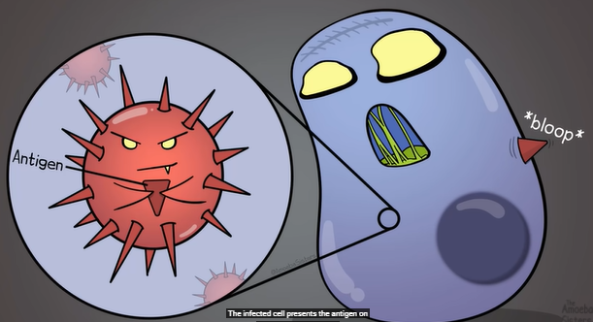
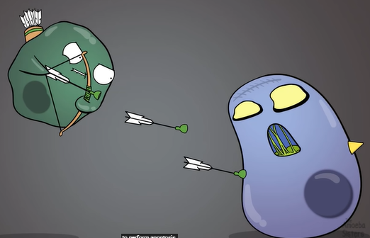
Cytotoxic T cells can recognize the signal and kill the infected cells.

Slide 43
The Body Story: The Flu
https://www.youtube.com/watch?v=D2Uuc76DvlI
24 min
Allergic Response: The body story. Body snatchers.
48 min

Slide 44
Videos
Ted ed three lines of defence https://youtu.be/oqGuJhOeMek
Immune system explained Kurzgesagt Part I bacteria https://www.youtube.com/watch?v=zQGOcOUBi6s
Immune system KidsHealth
https://www.youtube.com/watch?v=WJEc2GDEfz8
KidsHealth How Immune system works
https://www.youtube.com/watch?v=24IYt5Z3eC4&t=316s
Sneeze: https://www.youtube.com/watch?v=yToii3-p-NI
Ted ed How are germs spread goldilocks http://ed.ted.com/lessons/how-do-germs-spread-and-why-do-they-make-us-sick-yannay-khaikin-and-nicole-mideo
Reading Check #1-6 pg 106
https://www.youtube.com/watch?v=Non4MkYQpYA
Ted Ed Cell vs Virus https://www.youtube.com/watch?v=oqGuJhOeMek&feature=youtu.be

Slide 45
