Slide 1
WIND and PRESSURE

Slide 2
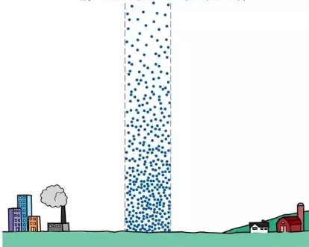
Atmospheric Pressure
= Weight of air pressing down on an area.

Slide 3
Air Pressure changes with altitude
Air pressure decreases with altitude.
At higher elevations, there are fewer air molecules compared to closer to the ground.
The thinner air exerts less pressure than air at a lower altitude
Notes:
Barometer reading drops about 1 cm for every 123 meter within the first few km of atmosphere.
Then pressure changes more slowly as air thins rapidly.
Half the weight of the atmosphere is within 5.5 km of surface of Earth.

Slide 4
Why is it colder the higher you go?
Less air particles, less collisions, less heat generated.

Slide 5
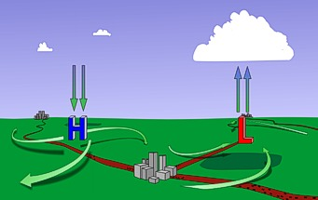
WIND
WIND is the movement of air from an area of higher pressure to an area of lower pressure.
Notes:
WIND is caused by ____________________________ of the atmosphere.

Slide 6
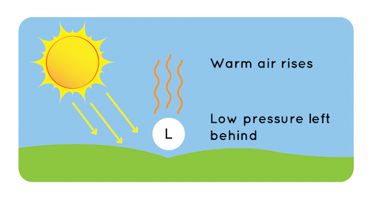
What causes a difference in pressure?
Difference in pressure is caused by Uneven heating from the sun:

Slide 7
Review KMT (Kinetic Molecular Theory)
All matter is made up of particles
These particles are constantly moving
Energy makes these particles move.

Slide 8
KMT explains air movement
When air heats up, the air particles move faster and farther apart.
This causes warm air to expand and rise.
In colder air, the particles move slower and are closer together, which makes the air sink.

Slide 9
Notes:
When air heats up, the air particles move faster and farther apart.
This causes warm air to expand and rise.
In colder air, the particles move slower and are closer together, which makes the air sink.

Slide 10
When heat from the sun reflects off the Earth’s surface, it warms the air above it.
When a mass of air rises, it leaves an area of of lower pressure.

Slide 11
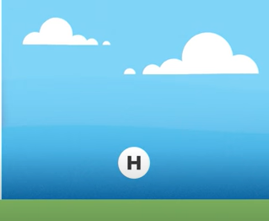
In contrast, areas of higher pressure occur where the cooler air is located.

Slide 12
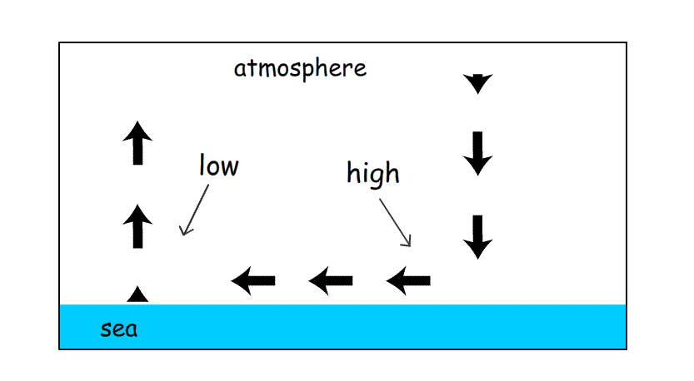
Difference in pressure
When there is a difference in air pressure between two areas, air will move from high pressure to low pressure, to equalize the pressure.

Slide 13
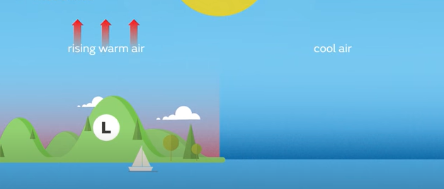
Sea Breeze
On sunny days, land warms up quicker than the sea.
This creates a temperature contrast and, as the land heats up, it warms and expands the air above it.
As the warm air expands, an area of low pressure is created over land.

Slide 14
Sea Breeze
Leaving relatively higher pressure over the water.
This pressure differences causes air to move from the sea to the land to equalize the pressure difference.
The rush of air inland is called a Sea Breeze
https://www.youtube.com/watch?v=edsNPCwU9lo

Slide 15
Night time: Land Breeze
At night: The land cools more quickly than the ocean, cooling the air above it.
The warmer air above the water continues to rise, and cooler air from over the land replaces it, creating a Land Breeze.

Slide 16
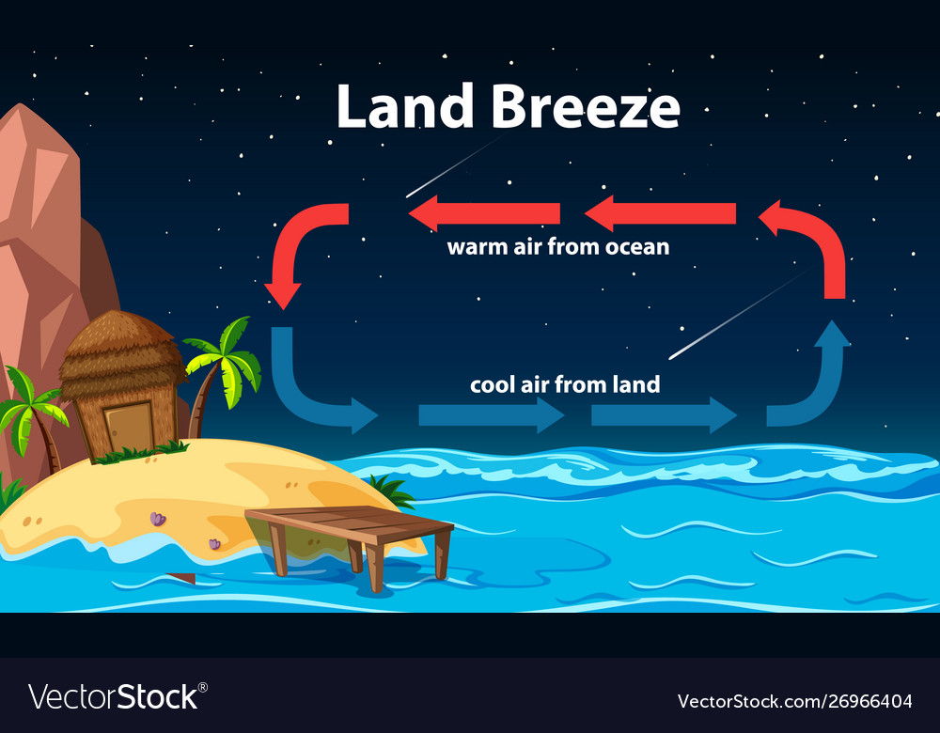
Land Breeze
The opposite is true at night.

Slide 17
What’s this got to do with WEATHER?
When air rises, it expands because there is less atmospheric pressure the higher you go.
Because air particles are farther apart, there are less collisions to generate energy and therefore it is cooler.
When water molecules in the air (water vapor) cool, they condense.
Condensation → clouds or precipitation (rain, snow, etc)
Notes:
Aerosol

Slide 18
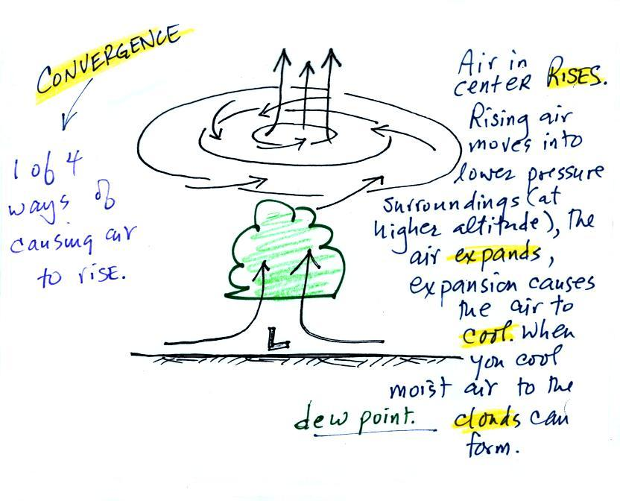
Low Pressure System Weather
Low pressure systems are associated with bad weather:

Slide 19
High pressure system associated with FAIR weather:
Air sinks,
Spreads out,
Preventing clouds from forming

Slide 20
Extra Slides beyond here

Slide 21
Isobars
Isobars are lines showing areas of equal air pressure on a map.

Slide 22
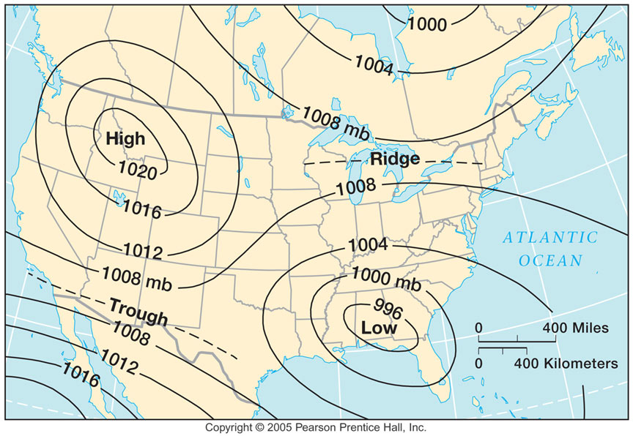
Pressure Gradient
Pressure Gradient is the rate of change (gradient) of atmospheric (barometric) pressure
Depends on temperature and density of the air mass.

Slide 23
What is the pressure gradient on this map?

Slide 24
What is the pressure gradient on this map?
The pressure gradient is
4 millibars.
(1020 – 1016) = 4

Slide 25
Isobars indicate pressure systems (weather).
low pressure system (L)
Isobars decreasing inward Air moves toward the center.
Associated with bad weather. This can include heavy precipitation (i.e. rain and snow), strong winds, and low visibility.
Winds spin counterclockwise
Notes:
Winds spin counterclockwise and spiral inward around low pressure centers

Slide 26
Cyclones
A LARGE air mass inward spiraling winds around a zone of low pressure is called a cyclone.
Can bring: heavy rain, strong wind, storms, tornadoes.

Slide 27
Why do low pressure systems indicate bad weather?
Air converging towards the centre has only one place to go: up .
So the air rises.
Rising air expands (because it is moving into lower pressure surroundings at higher altitude),
The expansion causes it to cool.
If the air is moist and it is cooled enough (to or below the dew point temperature) clouds will form and may then begin to rain or snow.

Slide 28
High Pressure System
A high pressure system (H) is a whirling mass of cool, dry air that generally brings fair weather, sunny skies, and light winds.
In Northern Hemisphere, Winds spiral out in a clockwise rotation.

Slide 29
Anticyclones
a large weather system with air slowly circulating around a high pressure center (H) is an anticyclone.
Associated with calm, fine weather.

Slide 30
High pressure centers - Winds spin clockwise (counterclockwise in the southern hemisphere) and spiral outward The outward motion is called divergence. Air sinks in the center of surface high pressure to replace the diverging air. The sinking air is compressed and warms. This keeps clouds from forming so clear skies are normally found with high pressure (clear skies but not necessarily warm weather, strong surface high pressure often forms when the air is very cold).

Slide 31
What's the difference between cyclone and hurricane or typhoon?
the location where the storm occurs.
same weather phenomenon;
“typhoon” occur in Northwest Pacific
“hurricanes” occur in the Atlantic and Northeast Pacific
“cyclones” occur in the South Pacific and Indian Ocean

Slide 32
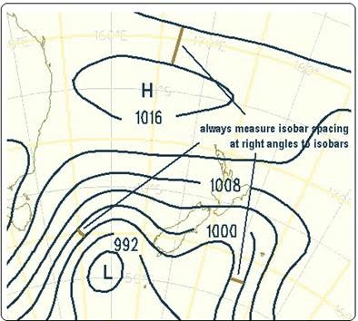
Where are the areas of high and low pressures?
Is A an area of high pressure or Low?
B?
A
B

Slide 33
Wind
Wind is the movement of air from higher pressure to lower pressure.
The pressure pattern determines the wind direction and wind speed.
The closer the isobars, the higher the gradient (difference in pressure) the stronger the wind.

Slide 34
From what direction would the wind be blowing at point C?
C

Slide 35
From what direction would the wind be blowing at point C?
From North West
C

Slide 36
Where would winds be strong?
Weak?
C

Slide 37
Where would winds be strong? Between C and L
Weak? Around H
C

Slide 38
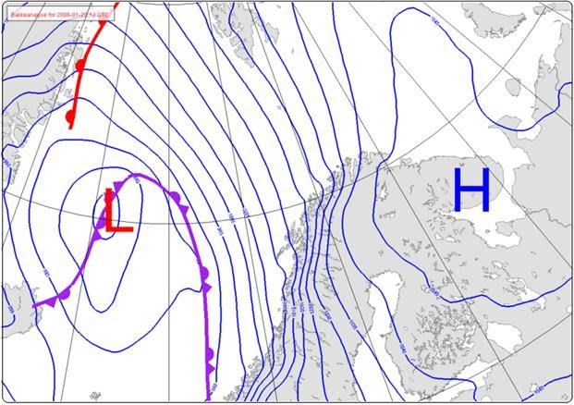
Where is the wind strongest?

Slide 39
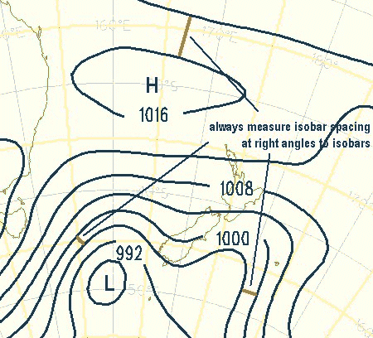
Direction?

Slide 40
Summary
Isobars indicate pressure.
The closer the isobars, the stronger the wind.
Wind moves from High → Low pressure.
Lower pressure system (L) can be called cyclones, wind spins inward, associate with bad weather (because air rises, cools, condenses).
High pressure systems (H) indicate fair weather, called anitcyclones, wind spirals outward.

Slide 41
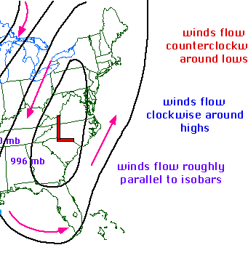
Wind Direction and Isobars
Winds flow roughly parallel to the isobars.

Slide 42
Extra Slides beyond here

Slide 43
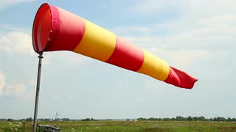
Measuring Wind
Weather Vanes and wind socks – measure wind direction
Wind direction is reported as the direction from which the wind blows, not the direction toward which the wind moves.
A north wind blows from the north toward the south.

Slide 44
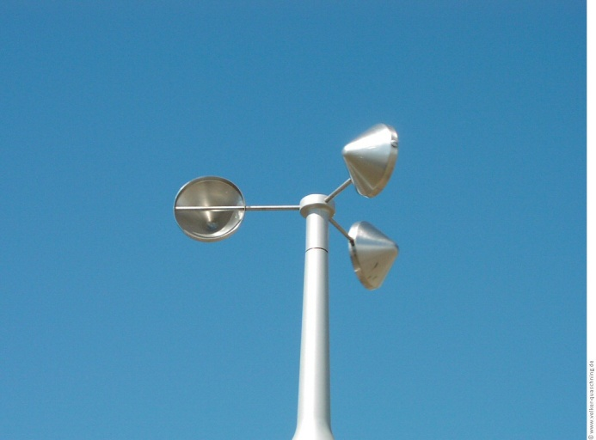
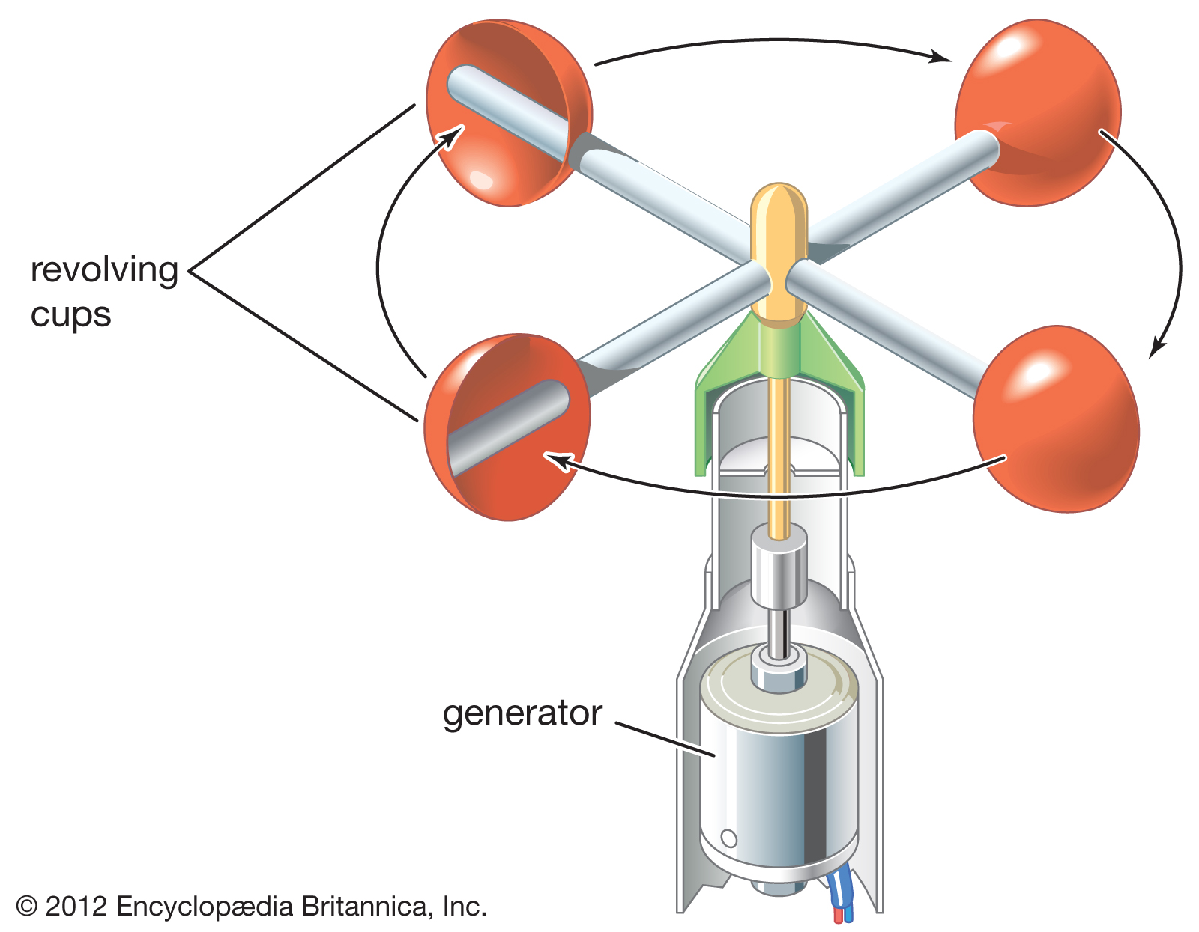
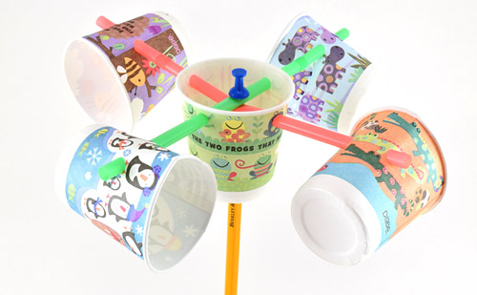
Anemometer – measures wind speed
As the wind blows, the cups rotate, making the rod spin. The stronger the wind blows, the faster the rod spins.
The anemometer counts the number of rotations, or turns, which is used to calculate wind speed

Slide 45
Weather Station Symbols
Weather stations use symbols as short hand to indicate weather.
Wind barbs on the symbol indicate wind speed and direction.
Wind barbs point in the direction "from" which the wind is blowing.
Wind speed is measured in “knots” (nautical mile/hour).
1 Knot = 1.9 Kilometers Per Hour KM/HR

Slide 46
Which way is the wind blowing? What is the speed?

Slide 47
Wind Speed
Short barb = 5 knots,
Long barb = 10 knots.
Pennants = 50 knots.
No barb = winds are calm.

Slide 48
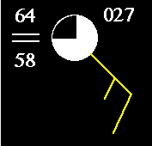
Wind Barbs
What direction is the wind coming FROM?

Slide 49
Wind Barbs
wind is coming FROM the South East.

Slide 50
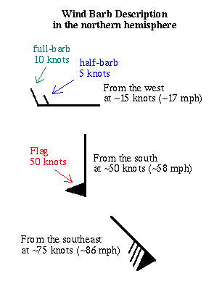
c

Slide 51
How fast?

Slide 52
How fast?

Slide 53
Weather Station Symbols

Slide 54
Precipitation

