Slide 1
Cell Size
Why are cells so small?

Slide 2
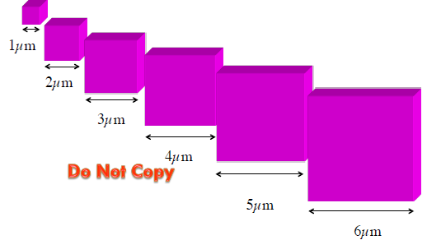
What happens to volume when cells get bigger?

Slide 3
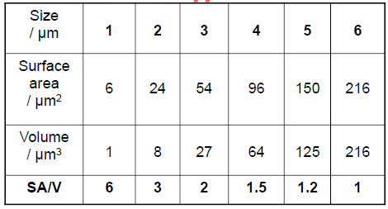
How are surface area and volume affected by growth?

Slide 4
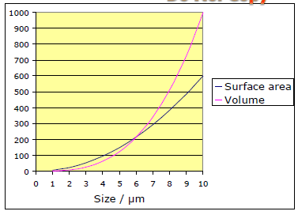
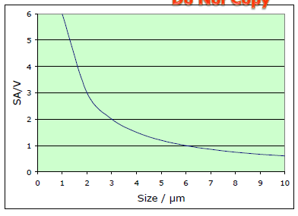
Comparing Surface Area and Volume changes
Both SA and Volume increase,
but at different rates
Surface Area: Volume Ratio decreases

Slide 5
Problem:
Bigger cells have a greater metabolism than smaller cells
BUT bigger cells have a proportionally less surface for exchange.
How to increase surface area with increasing size?

Slide 6
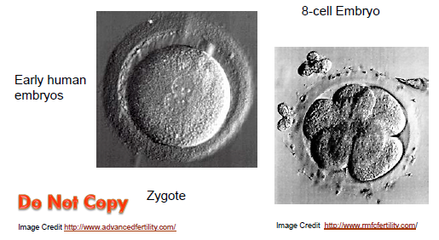
Divide

Slide 7
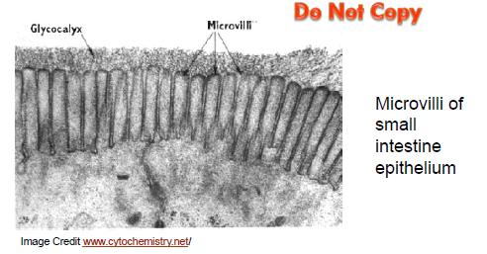
Extensions

Slide 8
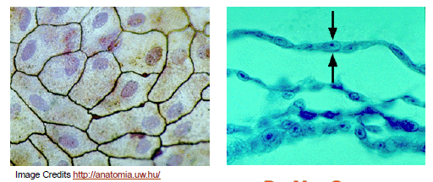
Flatten to thin film

Slide 9
Multicellular organisms show the same adaptations

Slide 10
How do cells get around the limits of the surface to volume ratio?
1. Divide.
2. Get long and thin rather than round and fat:
e.g. nerve cells
3. Folds in the cell membrane: e.g. microvilli of intestinal epithelial cells
4. Slow down metabolism: e.g. unfertilized chicken eggs

Slide 11
Cell Lab

