Slide 1
Bacteria:
Kingdom Eubacteria
Structure, Reproduction, Classification

Slide 2
3 Domains
Archaea – Ancient bacteria, extremophiles
Eubacteria – True bacteria, found everywhere
Eukarya – Fungi, protists, plants, animals
Ameoba Sisters, 7:30 min
https://www.youtube.com/watch?v=ORB866QSGv8
https://www.youtube.com/watch?v=EWjYS-DNIiQ
Crash course: https://www.youtube.com/watch?v=vAR47-g6tlA

Slide 3
Archaebacteria – slightly different than bacteria
Extremophiles – can live in extreme environments
Methanogens live in oxygen-free environments (ex. thick mud & animal digestive tracts)
Halophiles live in salty environments
Thermophiles live in hot environments (ex. hot springs)
Notes:
DNA shows a closer evolutionary relationship to eukaryotes

Slide 4
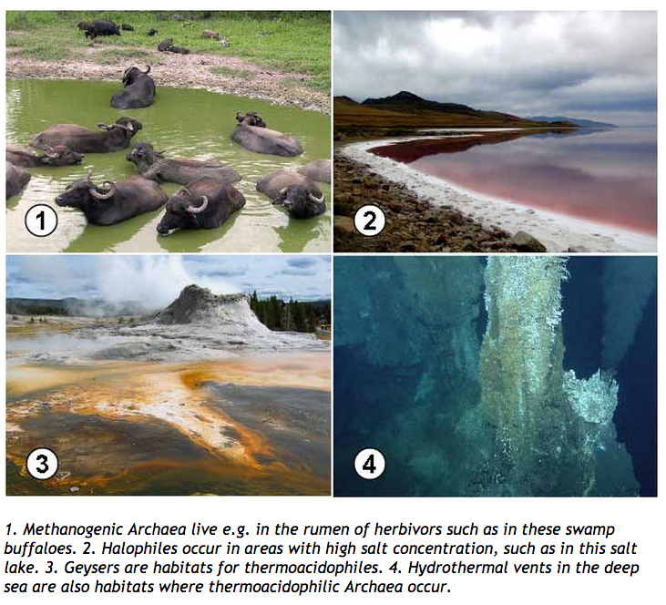

Slide 5
Eubacteria
Archaebacteria
Peptidoglycan in cell walls
Cannot survive in extreme environments
Bacteria & cyanobacteria
Prokaryotic
No nucleus
Single-celled
Ribosomes
No membrane-bound organelles
No peptidoglycan in cell walls
Live in extreme environments
Thermophiles, halophiles, methanogens

Slide 6
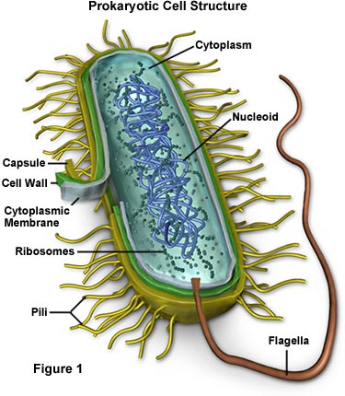
Eubacteria: True bacteria
All Bacteria are Prokaryotic Cells
No nucleus
DNA a singular chromosome loop
Plasmid
No organelles bound in membranes
Not many organelles, some ribosomes
Cell membrane
Cell wall composed of complex carbohydrates
Divide by binary fission (not mitosis)
Some have flagella for movement
Some photosynthetic
    in fresh and salt water
    on land
    in the human body

Slide 7
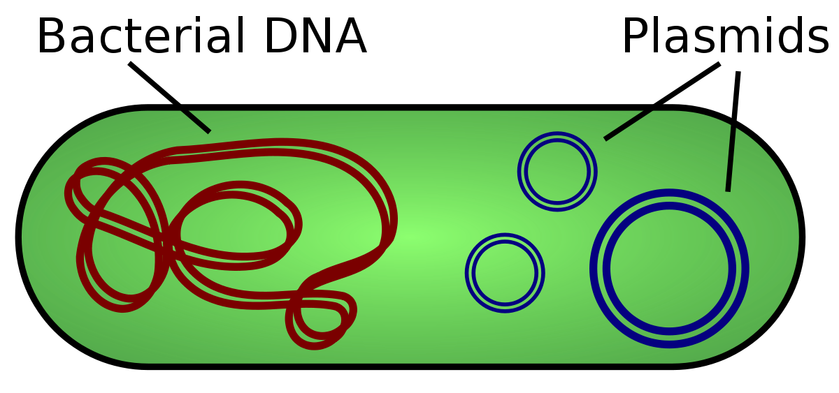
All bacteria have plasmids
Plasmids are a small, circular, double-stranded DNA molecule, which is naturally found in all Bacterial cells.
Separate from chromosomal DNA
Can replicate independently.
Notes:
Does not code for any genes that aid in cell replication
Do not transcribe/translate their DNA into protein
Plasmid 101 https://youtu.be/SdqJFA6mOkI

Slide 8
Plasmids
Often contains genes useful for antibiotic resistance.
Does not code for any genes that aid in cell replication
Do not transcribe/translate their DNA into protein
Plasmid 101 https://youtu.be/SdqJFA6mOkI
Stable. Easy to manipulate and use as delivery vectors

Slide 9
Capsule
Some bacteria have a capsule.
It is a polysaccharide layer that lies OUTSIDE the cell wall.
Protects bacteria from toxic compounds and desiccation and allowing them to adhere to surfaces and to escape the immune system of the host
can be the cause of various diseases

Slide 10
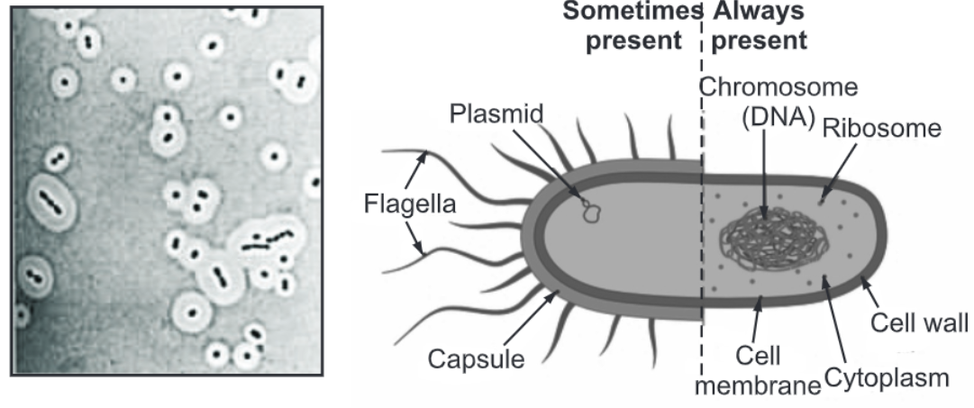

Slide 12
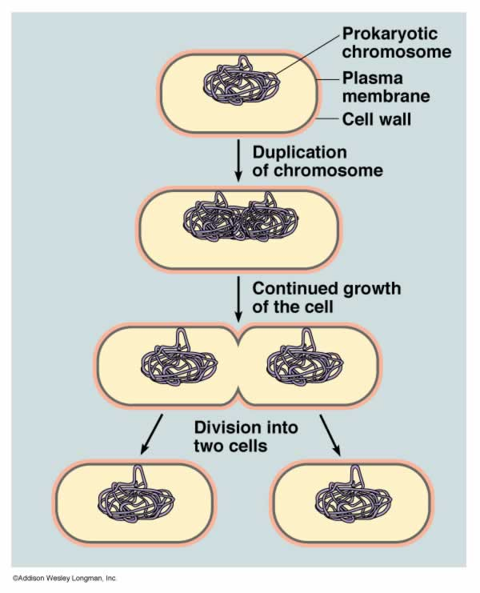
Reproduction
Asexual
    Binary Fission- cell pinches into 2 equal parts
    Not the same as mitosis.

Slide 13

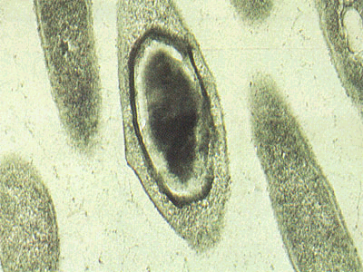
Reproduction
Asexual
    Some have endospores
    Thick-walled membrane around chromosomes that can withstand harsh conditions created during times of stress.

Slide 14
Endospore
Endospores can remain dormant for many years.
They will ‘germinate’ when conditions are more favorable.

Slide 15
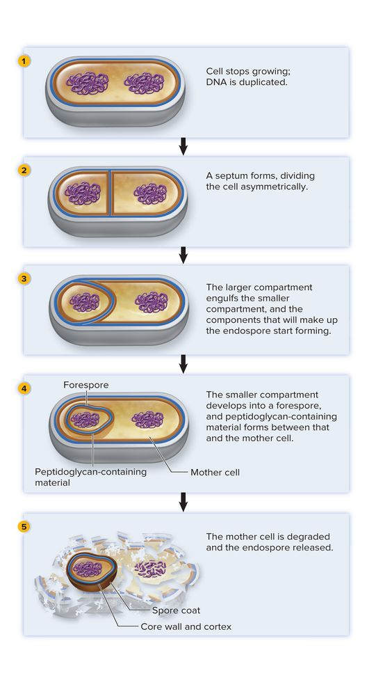

Slide 16
Endospores
Endospores will remain dormant under harsh conditions such as depletion of nutrients, high temperature, or drought.
Endospores can only be destroyed with an autoclave (pressure cooker like apparatus that uses high temperature and pressure).

Slide 17
Reproduction
Sexual (Sort Of)
    Conjugation - 2 organisms exchange genetic info→ spreads antibiotic resistance

Slide 18
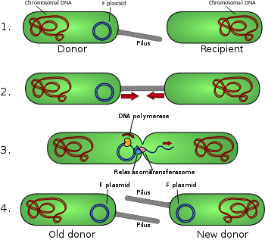
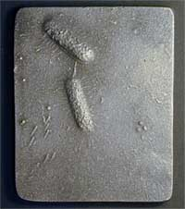
Conjugation
Notes:
Notice the line in between

Slide 19
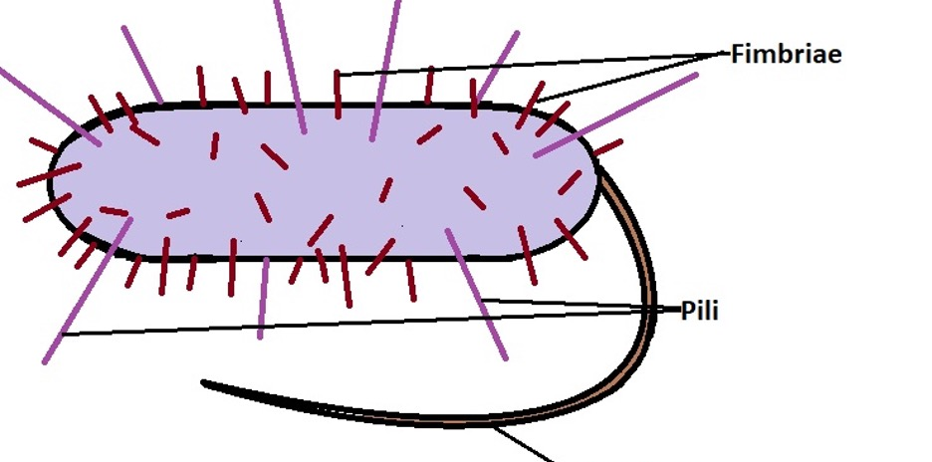
Pili
Spike-like extensions that allow for bacteria to stick to surfaces (skin).
Eg. bacteria that stick to the inside of your throat causing you to have strep throat.
Also allows for bacteria to stick together during conjugation (process in which bacteria exchange genetic material with one another).
http://www.learner.org/channel/courses/biology/glossary/conjugation.html

Slide 20
Reproduction
Sexual (Sort Of)
    Conjugation - 2 organisms exchange genetic info→ spreads antibiotic resistance
    2. Bacterial Transformation - the process by which bacterial cells take up naked DNA molecules

Slide 21
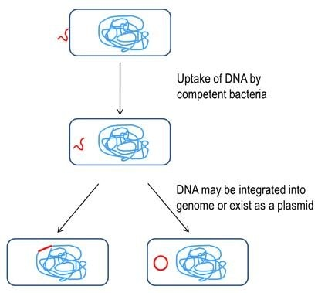
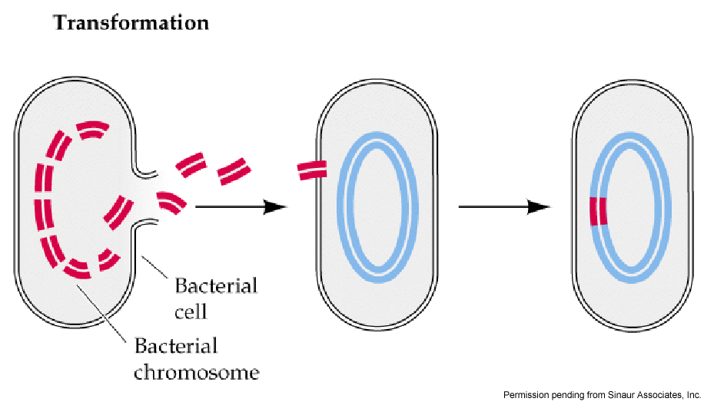
Transformation
Bacterial transformation is a process of horizontal gene transfer by which some bacteria take up foreign genetic material (naked DNA) from the environment.
Notes:
It was first reported in Streptococcus pneumoniae by Griffith in 1928. DNA as the transforming principle was demonstrated by Avery et al in 1944.

Slide 22
Notes:
It was first reported in Streptococcus pneumoniae by Griffith in 1928. DNA as the transforming principle was demonstrated by Avery et al in 1944.

Slide 23
Identifying Bacteria
Shape
Cell Wall
Movement
How they obtain their energy

Slide 24
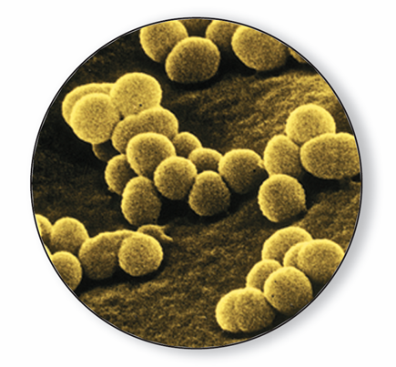
Bacteria can be classified by their SHAPE
  Rod-shaped: Bacilli
  Spherical: Cocci
  Spiral & corkscrew-shaped: Spirilla
Notes:
Prokaryotes can be identified by their shapes. Photo Credit: ©David Scharf/Peter Arnold, Inc.

Slide 25
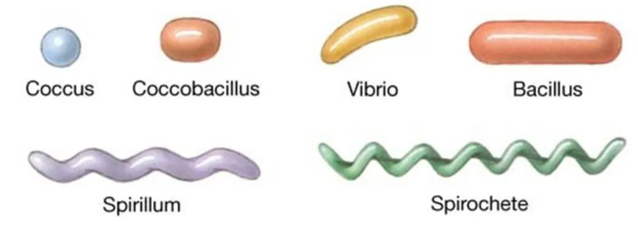

Slide 26
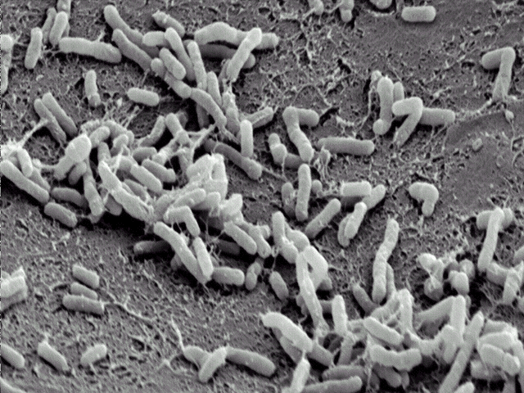
Bacillus

Slide 27
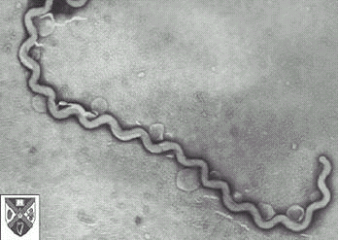
Spirillum

Slide 28

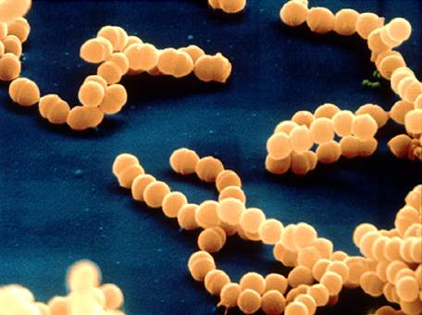
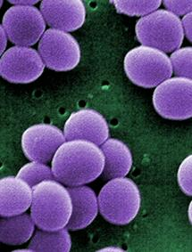
Arrangement or Grouping
Paired = diplo
Filamentous (chains) = strepto
Colonial (grape-like clusters) = staphylo

Slide 29
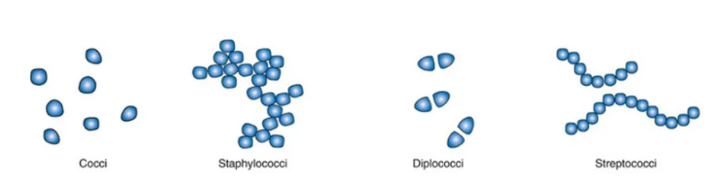
Name these

Slide 30
Name these

Slide 31
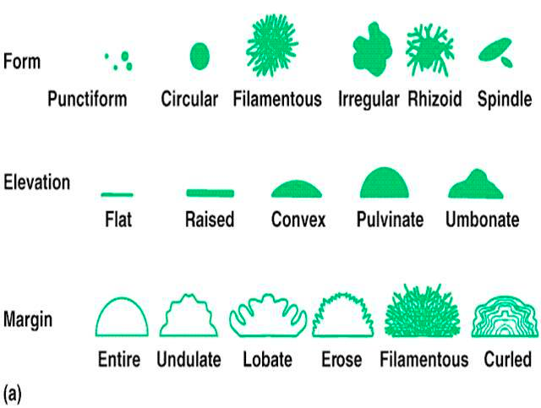
Colonies look different too

Slide 32
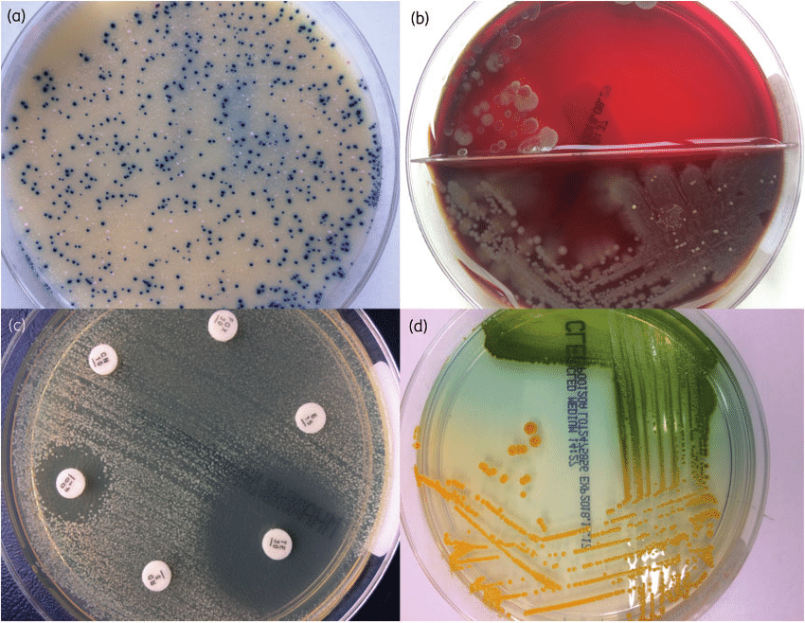
Colonies on a plate

Slide 33
Cell Wall and Gram Staining
Depending on the type of bacteria certain chemical dyes (stains) will adhere to the cell wall while other stains will not.
Useful in identifying types of pathogenic bacteria.
Helps us to determine what antibiotic to use in treating a bacterial infection.

Slide 34
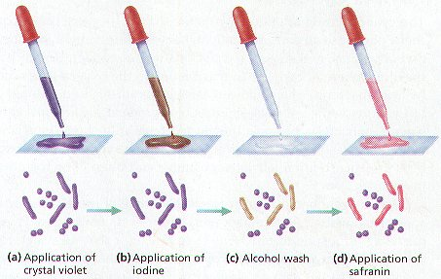
Gram Staining

Slide 35
Identifying Bacteria: Gram Stain
    All bacteria will either stain:
    Gram-positive bacteria have thick cell walls with large amounts of peptidoglycan.
    Gram-negative bacteria have thinner cell walls inside an outer lipid layer.
    extra outer membrane

Slide 36
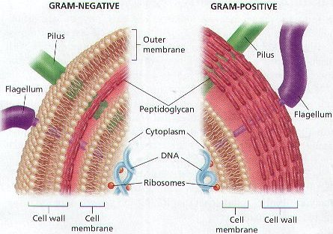
• Gram-Negative: PINK Gram-Positive: PURPLE
Notes:
Depending on the structure of their CELL WALLS, THE BACTERIA ABSORB EITHER THE PURPLE DYE OR THE PINK DYE

Slide 37
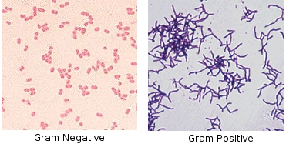

Slide 38
Bacterial Respiration
Obligate aerobe- must live in the presence of oxygen. Dies if no oxygen present.
b) Obligate anaerobe- must live in the absence of oxygen. Dies if oxygen is present.
c) Facultative anaerobe- can live in the presence or absence of oxygen.

Slide 39
How do bacteria get their energy?
AUTOTROPHS
Phototrophic autotrophs - trap sun’s energy
Eg. cyanobacteria
Chemotrophic autotrophs – use inorganic molecules such as hydrogen sulfide, nitrites, sulfur and iron.
Eg Nitrosomonas uses ammonia and oxygen
HETEROTROPHS – take in organic molecules, break them down and absorb them.
Chemotrophic heterotrophic – most
Photosynthetic heterotrophs – use sunlight for energy but also need organic compounds for nutrition.

Slide 40
Respiration and Fermentation
  Obligate Anaerobes - must have oxygen. Eg. Humans
  Obligate Anaerobes - live without oxygen (can’t live in presence of oxygen or will die)
  Eg. Clostridium botulinum – found in soil, produces toxins causing botulism
  Facultative anaerobes - can survive with or without oxygen. ex. Yeast
Notes:
Clostridium botulinum – found in soil, produces toxins causing botulism ( rare form of food poisoning) that can interfer with nerve activity and cause paralysis.
Can of food is perfect place – no oxygen, lots of food.
Can be found any where

Slide 41
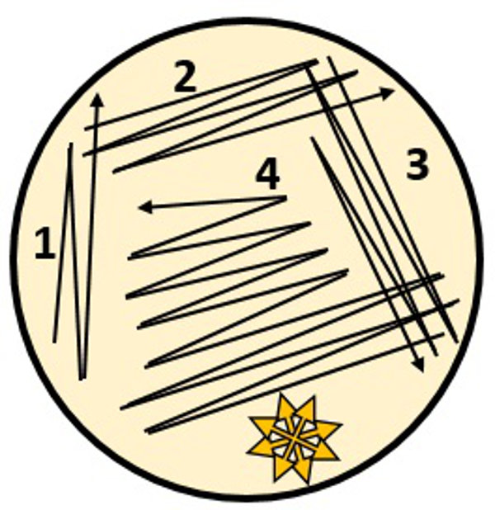
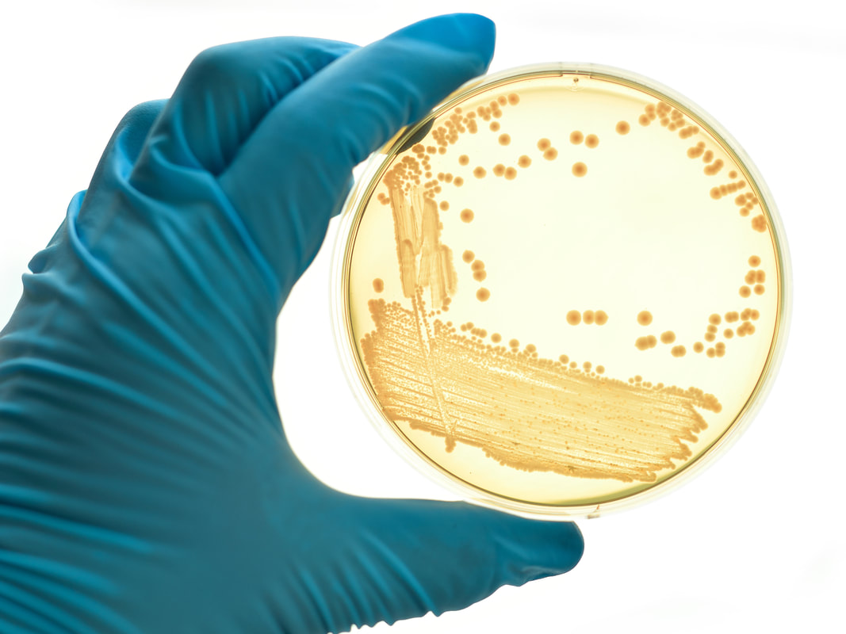
Streak Plate

Slide 42
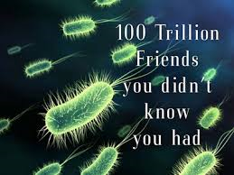
Importance of Bacteria p 370
Ecological Role:
    Some are producers which make oxygen
    Some are decomposers that break down the nutrients in dead matter.
    Some perform nitrogen fixation (convert nitrogen from the air into a form plants can use )

Slide 43
Importance of Bacteria
2. Human uses:
    foods and beverages
    Sewage treatment
    Cleaning up oil spills
    synthesis of drugs and chemicals via genetic engineering
    Gut bacteria: production of vitamins in human intestines

Slide 44
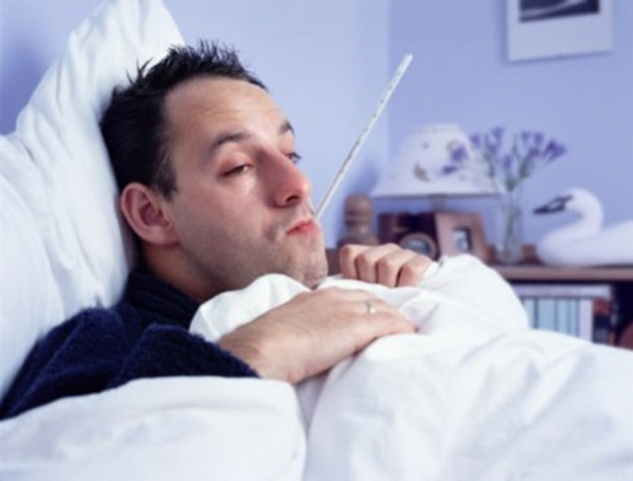
3. Pathogenic bacteria (parasites)
Either cause damage directly to cells/tissues (bacterial pneumonia) or
produce toxins (tetanus)

Slide 45
Bacteria Cause Disease two ways
Some bacteria damage the cells and tissues of th infected organism directly by breaking down the cells for food.
Other bacteria release toxins (poisons) that travel throughout the body interfering with the normal activity of the host.
Eg. Botulism (Clostridium botulinum), C. difficile.

Slide 46
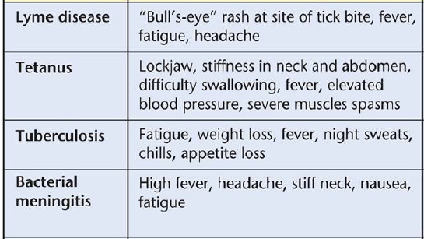

Slide 47
Practice
Bacteria Worksheet

Slide 48
Extra Slides Beyond here

Slide 49
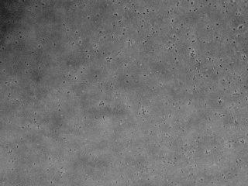
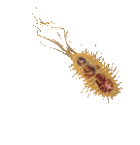
Mobility
Some have one or more flagella
Some lash, snake or spiral forward
Some glide on a layer of slime-like material

