Slide 1
CHARACTERISTICS OF LIFE
CH2 - P. 27-31
CH5 - P. 87-102

Slide 2
What do you remember from Grade 8?
All living things share certain characteristics ….

Slide 3
All living things….
Made of cells
Grow and develop
Reproduce
Take in nutrients, Produce Waste,
Use energy
Respond to environment

Slide 4
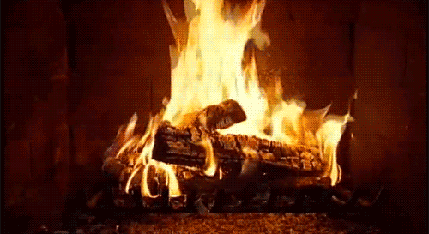
Is this fire alive?
Does it move?
Does it produce more fire? (grow)
Does it need oxygen? (take in nutrients)

Slide 5
1. LEVELS OF ORGANIZATION (MADE OF CELLS)
Cell = smallest unit of a living organism
atoms → molecules (2 or more atoms held together by chemical bond) →macromolecules (proteins, carbohydrates, fats, DNA) → organelles (structures within cells that carry out specific function for the cell.
Cells → tissues → organs→ organ systems→ organism
Notes:
Living things have multiple levels of organization. Their molecules are organized into one or more cells. A cell is the basic unit of the structure and function of living things. Cells are the building blocks of living organisms. An average adult human being, for example, consists of trillions of cells. Living things may appear very different from one another on the outside, but their cells are very similar. Compare the human cells and onion cells in the figure below. What similarities do you see?

Slide 6
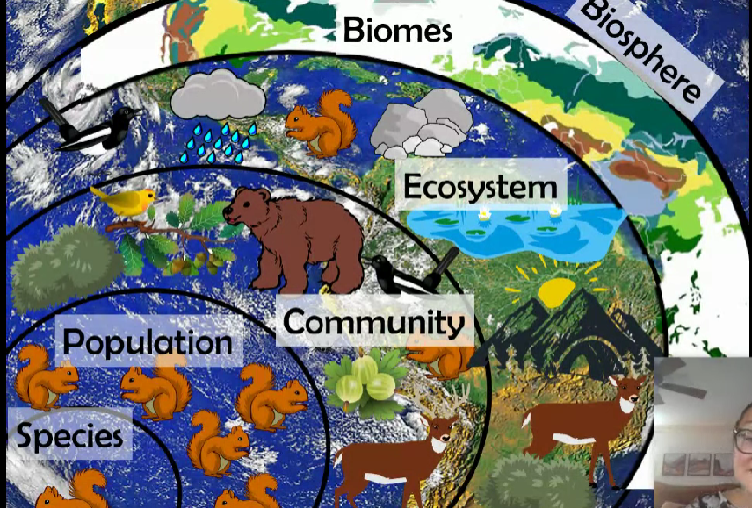
1. LEVELS OF ORGANIZATION
Species → population → community → ecosystem → biome → Biosphere.
All individuals of a species within a specific area are collectively called a population. E.g. all pine trees in a forest
Community – sum of all populations in an area. E.g. all trees, flowers, insects, etc
Ecosystem – all living (biotic factors) and non-living (abiotic factors) e.g trees, soil, rain water, nitrogen
Biome – characterized by abiotic factors
Biosphere – collection of all ecosystems

Slide 7
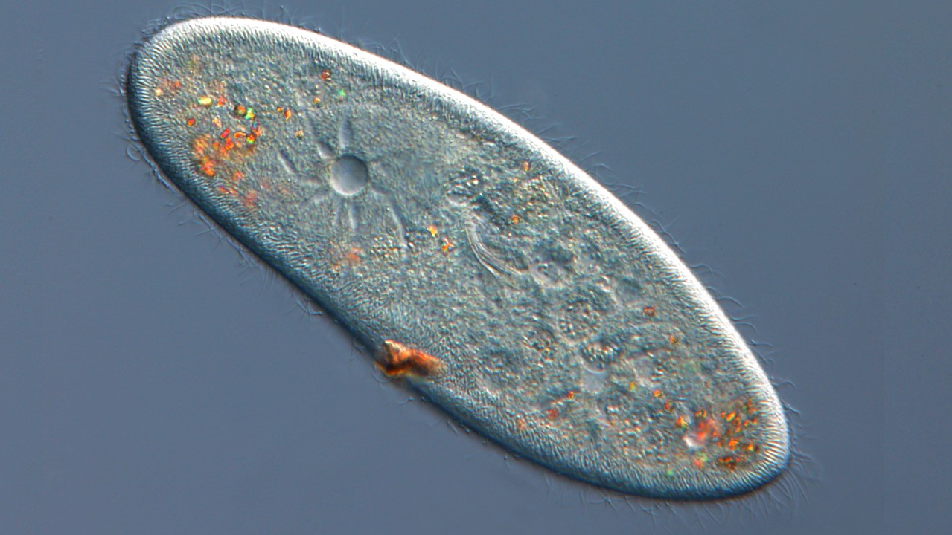
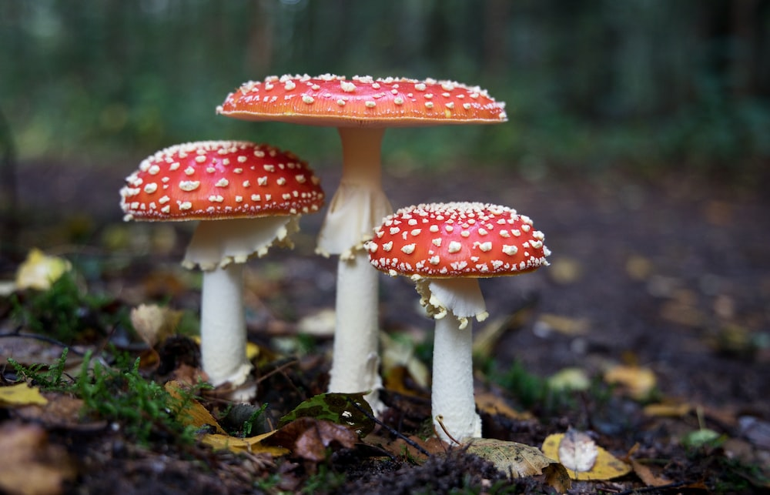
Types of Cells
Prokaryotes – single celled or colonial organisms that do not have membrane- bound nuclei or organelles
Eukaryotes – larger, more complex, have membrane bound organelles.
Organisms can be:
Unicellular (amoeba, yeast, paramecium, bacteria)
Multicellular (plants, animals, insects, mushrooms)
Notes:
multicellular (plants, animals, mushrooms, insects) form tissues, which in turn create organs (body structures with distinct function). Organs work together to form organ systems (e.g. heart and vessels make circulatory system)

Slide 8
Check your understanding

Slide 9
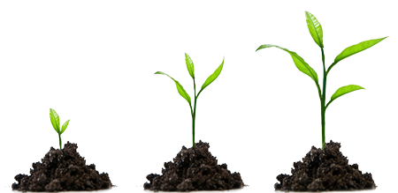
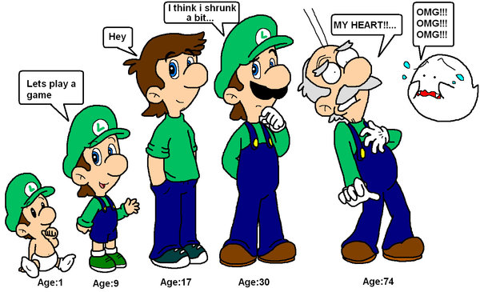
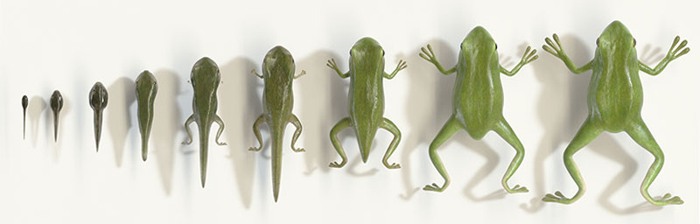
2. GROWTH AND DEVELOPMENT
Increase in size (unicellular) and number of cells (multicellular)
Growth may be different in different locations
Individuals change as development proceeds throughout life

Slide 10
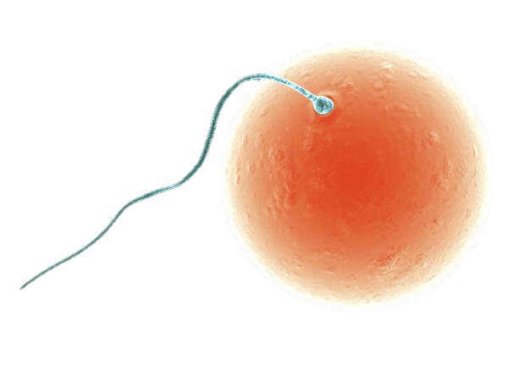
3. REPRODUCTION
Asexual Reproduction:
Binary Fission: Bacteria divide in two equal halves
Budding – yeast
Sexual Reproduction:
Multicellular organisms often form gametes that fuse to form zygote → new individual
Notes:
Fragmentation, parthenogenesis, spores

Slide 11
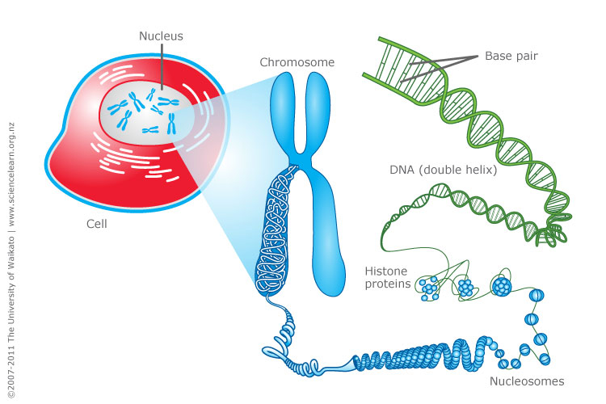
CONTAIN GENETIC INFORMATION (DNA)
Living things grow and develop according to a genetic “plan‟ encoded in their DNA. Copying of genetic information allows for passing on of traits to offspring.
DNA (deoxyribonucleic acid)
Genes – regions of DNA on chromosomes that determine characteristics of cells and organism
Heredity: DNA is passed on to the next generation (characteristics of one generation are passed on to the next)

Slide 12
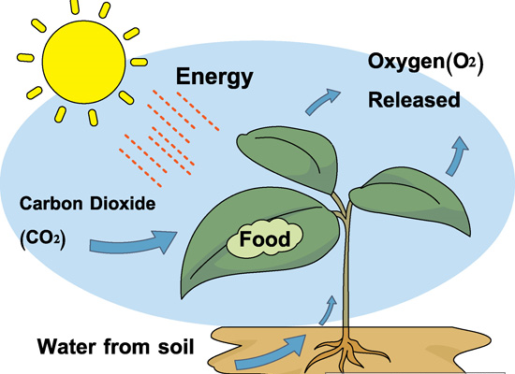
4. TAKE IN nutrients
Consumers – Animals Producers – Plants
Nutrients can be: Food, Water, Oxygen, Carbon Dioxide

Slide 13
5. PRODUCE METABOLIC Waste
Must get rid of waste so that cells are not poisoned.
Nitrogenous wastes - Urine in mammals
Solid wastes - Feces
Gaseous wastes - Carbon dioxide in animals and oxygen in plants

Slide 14
6. Use ENERGY
Use a source of energy for metabolic activities.
Producers (plants) get energy from sun and covert it into chemical energy in food (photosynthesis)
Consumers use chemical energy from food they eat (cellular respiration)

Slide 15
METABOLISM AND USE OF ENERGY.
METABOLISM refers to the sum of all chemical reactions that enable an organism to maintain itself, grow and reproduce. In order for these reactions to occur, they require a constant input of matter and energy
Anabolism: synthesis (building) of complex substances from simpler ones
E.g. Photosynthesis in plants makes sugar
Catabolism: breakdown of complex substances to simpler ones
E.g. digestion in animals
Metabolism: sum of anabolism and catabolism
Notes:
Consumers get energy from food they eat
Plants get their energy from sun

Slide 16
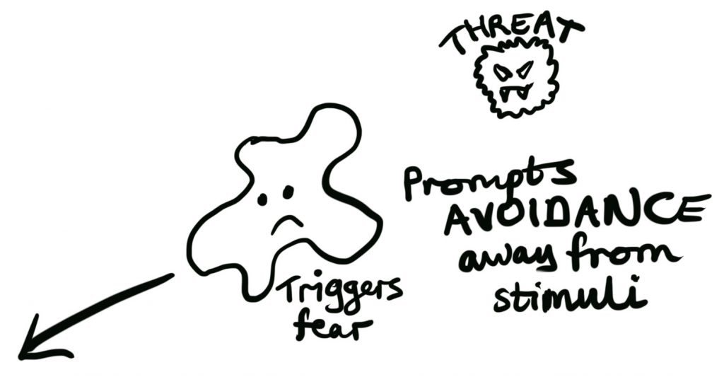
7. RESPONSE TO STIMULI/ENVIRONMENT
Stimulus → Response
E.g. Chemotaxis: Bacteria can move toward or away from chemicals
Movement toward a stimulus is considered a positive response
Movement away from a stimulus is considered a negative response
Notes:
E.g. Chemotaxis: Bacteria can move toward or away from chemicals
Movement toward a stimulus is considered a positive response
Movement away from a stimulus is considered a negative response
May be simple response such as opening or closing pore
Eg. sponge
May have complex system of detecting of stimuli and responding to them
In order to function properly, cells need to have appropriate conditions such as proper temperature, pH, and appropriate concentration of diverse chemicals. These conditions may, however, change from one moment to the next. Organisms are able to maintain internal conditions within a narrow range almost constantly, despite environmental changes, through homeostasis (literally, “steady state”)—the ability of an organism to maintain constant internal conditions. For example, an organism needs to regulate body temperature through a process known as thermoregulation. Organisms that live in cold climates, such as the polar bear (Figure 4), have body structures that help them withstand low temperatures and conserve body heat. Structures that aid in this type of insulation include fur, feathers, blubber, and fat. In hot climates, organisms have methods (such as perspiration in humans or panting in dogs) that help them to shed excess body heat.

Slide 17
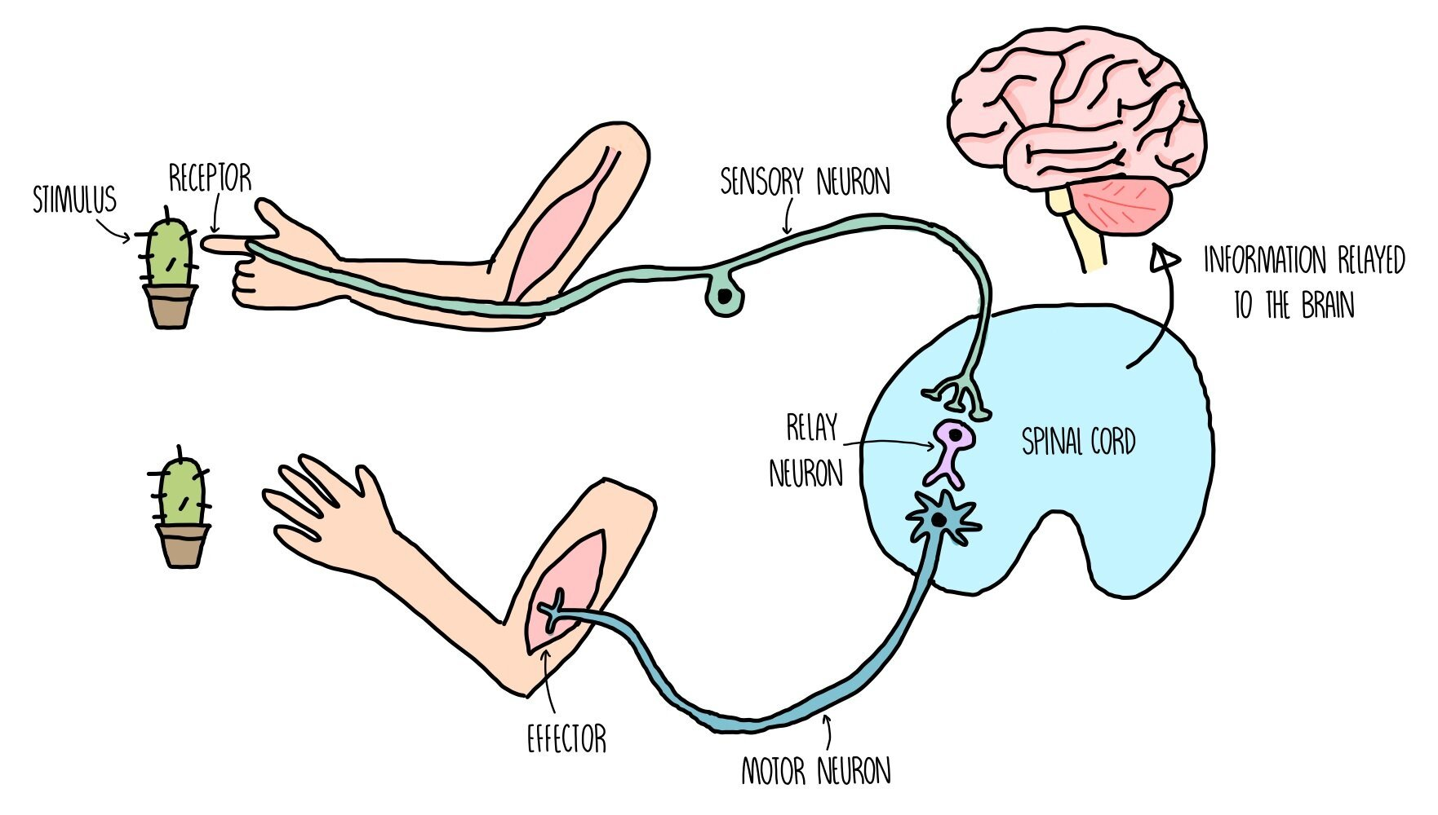
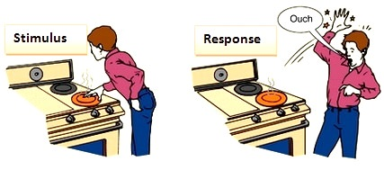

Slide 18
Respond to Stimulus
Stimulus: Response:
See a bear → Run
Light through a far → Plant bends toward light
window
Feel hot → Sweat, pant, move

Slide 19
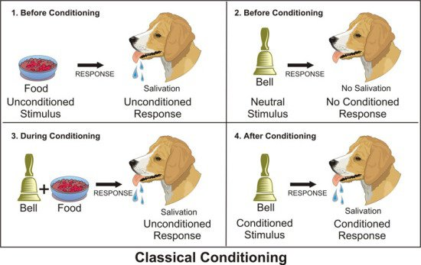
E.g. Response to stimulus (Pavlov’s Dog)

Slide 20
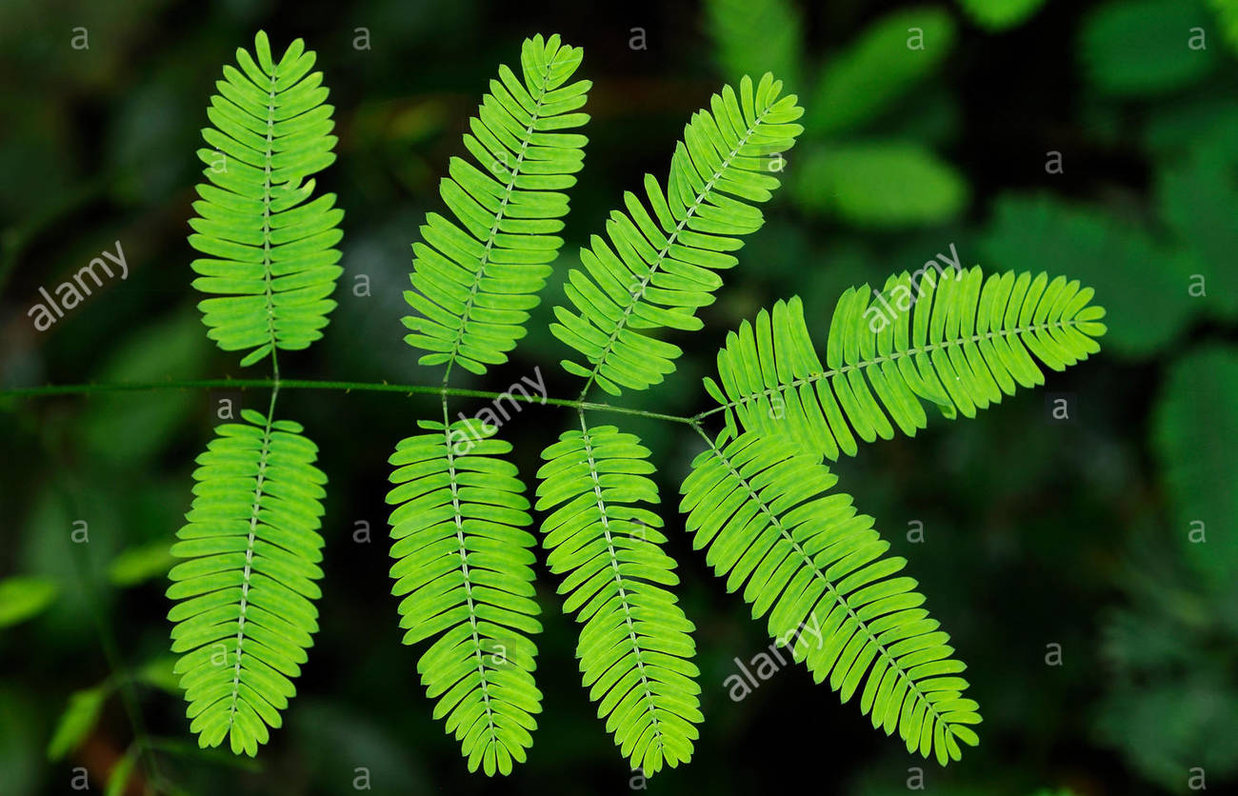
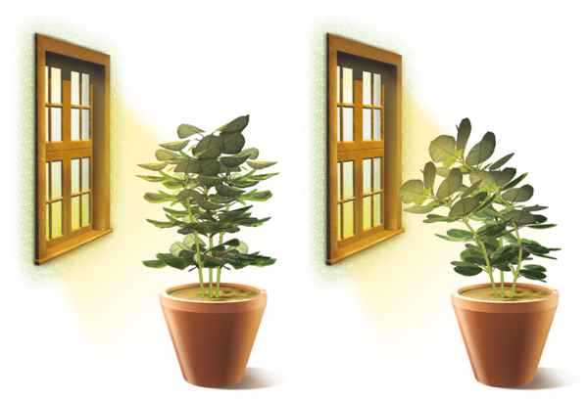
Do plants respond to stimuli?
https://www.youtube.com/watch?v=zHe7y8cy-7Y
Mimosa (Sensitive Plant) https://www.youtube.com/watch?v=DF-b6TsO1DM

Slide 21
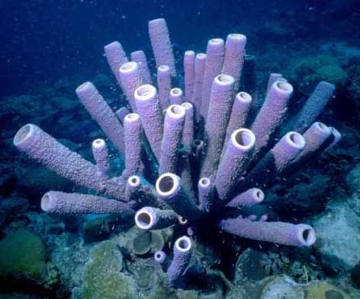
Respond to Stimuli with Movement
MOTILE organisms can MOVE: Cells move, crawl, swim
Cells have internal movement (transport within the cells)
SESSILE Organisms stay in one place (barnacles, oysters, anemones, plants

Slide 22
Homeostasis
Internal environment is maintained through homeostasis (internal conditions kept at a “Steady State” )
Most organisms maintain a narrow range of internal conditions: (Bio 12)
temperature (thermoregulation) feather, fur, blubber, help keep organism warm in cold climates. perspiration, panting help shed excess heat
pH, chemical concentration
Eg. opening or closing pore Eg. stomata

Slide 23
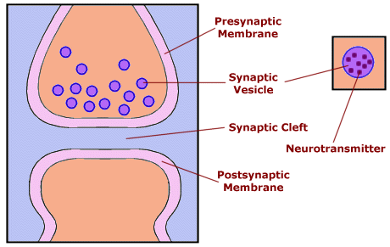
Intracellular Communication (between cells)
Cells “talk” to each other through cell signaling via special molecules (hormones, neurotransmitters)

Slide 24
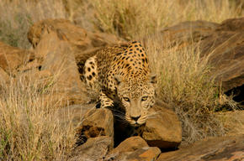
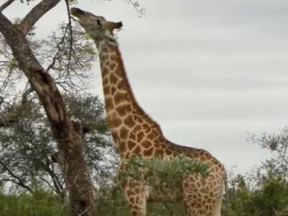
8. EVOLUTION – CHANGE OVER TIME (ADJUST AND ADAPT)
Evolution explains the unity and diversity of life.
Unity: Living systems change through time and share common ancestry.
Diversity: Evolution has produced diverse living systems on earth.
Adaptations allow organism to survive in a particular environment.
What is the adaptation here?

Slide 25
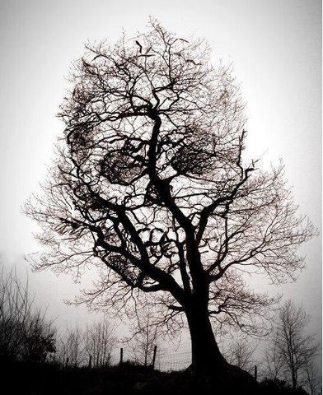
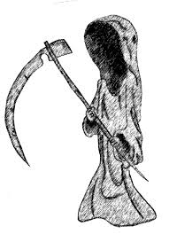
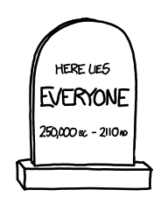
9. Living things have a life span
i.e. death occurs after life

Slide 26
Which of the following statements is false?
Tissues exist within organs, which exist within organ systems.
Communities exist within populations, which exist within ecosystems.
Organelles exist within cells, which exist within tissues.
Communities exist within ecosystems, which exist in the biosphere.

Slide 27
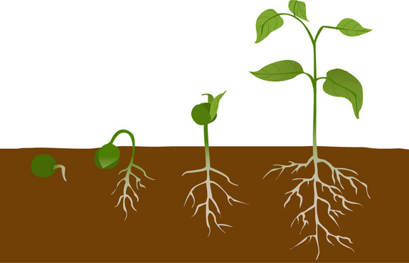
Check your understanding
The picture shows the different stages in the life of a pea plant.
Which characteristic of living things is being shown here?

Slide 28
Are viruses alive?
Virus – discuss yes points and no points
No cells
Evolve over time
Has genetic material - where did it come from? All living things have DNA. Was it a living thing that has evolved, morphed into something streamlined down to the bare necessities.
What other char (other than cells) that make it sound living

Slide 29
Practice
Practice: Characteristics of Living Things WS
Apply: Isopod Lab
Demonstrate your Understanding: Be able to identify these characteristics on a test and give an example of each

Slide 30
Learning Goals
Describe the characteristics of living things p. 27-31
Explain the role of homeostasis p. 31
Compare and contrast a prokaryotic cell with a eukaryotic cell p. 92
Compare plant and animal cells p. 87-98
State the roles of the cell’s organelles p. 89-97
Describe the relationship of the cell membrane and the cell wall to osmosis p. 97, 100-102
Compare sexual and asexual reproduction and the benefits of each p. 28

Slide 31
Cell Theory
Wacky History of the cell. 6 min
https://www.youtube.com/watch?v=4OpBylwH9DU
1. All living things are composed of one or more cells
2. The cell is the basic unit of life
3. All cells arise from pre-existing cells

Slide 32
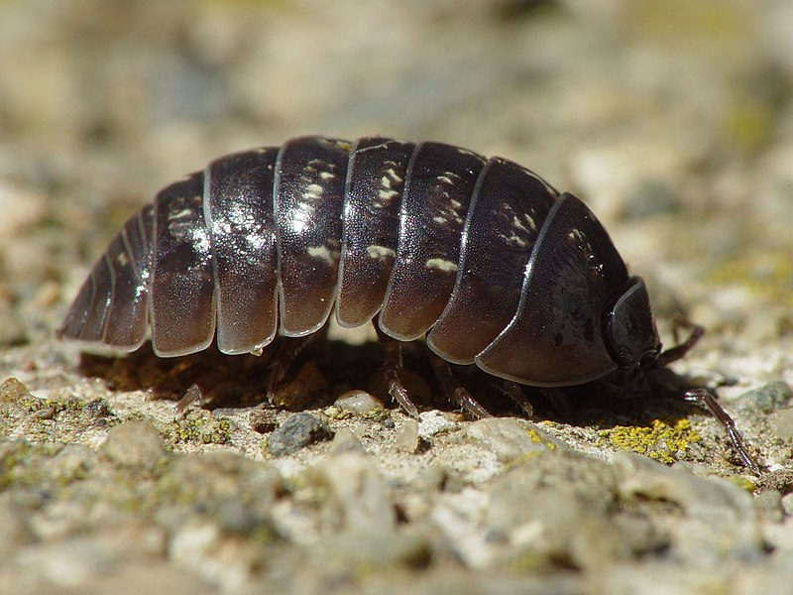
Isopods
Order Isopoda includes shrimp, crabs, lobsters and krill.
Found in oceans, fresh water, land.
All breathe with gills.
Most Common is the
terrestrial woodlouse
They eat detritus on
the forest floor.

Slide 33
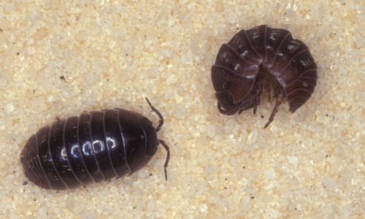
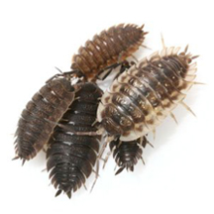
Woodlice
Pill Bug
Smoother
More grey
Can roll into a ball
Sow Bug
Flatter
More brown
Less smooth
Can’t roll into tight ball, will just try to evade

Slide 34
Practice: SECTION 2-1 - SECTION REVIEW
Define the five characteristics of living things and give an example of evidence for each.
2. Compare and contrast sexual and asexual reproduction. What are the positives and negatives of both?
3. Define Metabolism in terms of catabolism and anabolism.
4. Think of a non-living thing that satisfies each of the 5 characteristics of life. Does any non-living thing have all the characteristics of life?
Review Prefix meaning p32

