Slide 1
How are the Elements Organized?
Periodic Table of Elements

Slide 2
How are the Elements Organized?
By mid-1800s, scientists has identified nearly 60 elements.
They needed a classification system that would organized their observations.
They started grouping elements into “families” based on similar properties.
Notes:
Mendeleev was a Russian teacher and chemist, youngest of 17 children

Slide 3
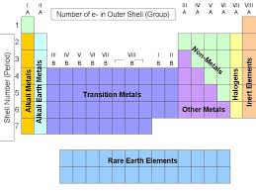
Patterns of the Periodic Table
Metals on the left
Non-metals on the right
Metalloids (boron, silicon) - zigzag staircase
Chemical Families

Slide 4
Elements are Grouped into FAMILIES
Recall:
A chemical FAMILY or GROUP is a vertical column
Elements in the same family share similar PROPERTIES.

Slide 5
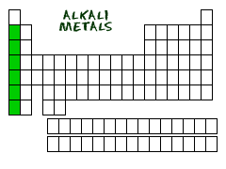

Slide 6
Alkali Metals (First column Group 1)
Does NOT include Hydrogen
Properties: shiny, soft (malleable), low densities.
Malleable, some soft enough can be cut with a knife,
ALL react vigorously with oxygen and water. (therefore not found freely in nature)
Notes:
Hydrogen is a very special element of the periodic table and doesn't belong to any family. While hydrogen sits in Group I, it is NOT an alkali metal.
They all have one electrons in their outer shell. That's one electron away from being happy (full shells). When you are that close to having a full shell, you want to bond with other elements and lose that electron. An increased desire to bond means you are more reactive. In fact, when you put some of these pure elements in water (H₂O), they can cause huge explosions.
The reactivity of the alkali metals increases down the group
Flame tests can be used to identify alkali metals

Slide 7
Alkali Metals need to be kept under oil
Notes:
Need to be kept under

Slide 8
Alkali Metals
The reactivity of the alkali metals increases down the group
https://www.youtube.com/watch?v=uixxJtJPVXk

Slide 9
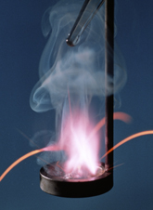
Alkali Metals
Flame tests are used to identify alkali metals
Flame colour | Ion present
red | lithium
orange | sodium
lilac | potassium
Notes:
Potassium reacts with a lilac flame

Slide 10
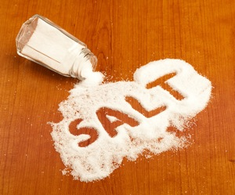
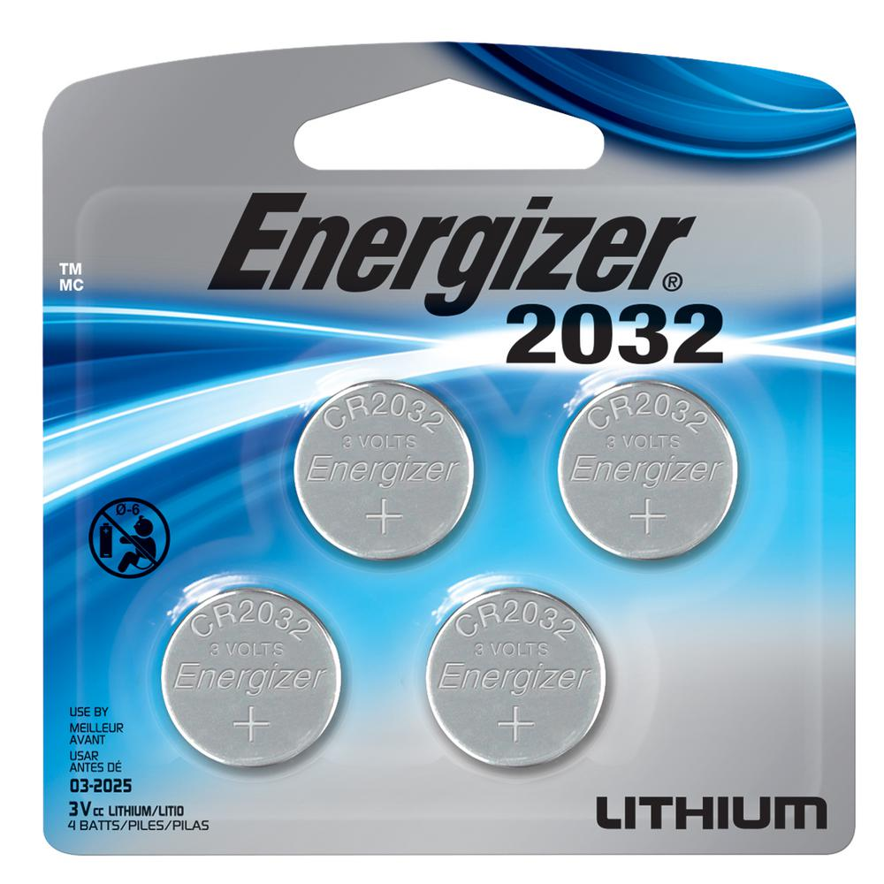
Uses of Alkali Metals
Sodium is used to make other compounds
Eg. NaCL
Lithium is used to make batteries
Potassium is a main component in fertilizer

Slide 11
Interesting Facts
Because they are so reactive with air and water, they are generally stored in oil.
Cesium and rubidium are used to make atomic clocks.
They like to form salts by combining with halogens.
The name "alkali" is derived from the Arabic word for "ashes."
Different alkali metals burn with different colored flames including sodium (orange yellow), lithium (red), potassium (lilac), rubidium (red), and cesium (blue or violet).
All alkali metals have odd atomic numbers. They are considered to be more similar to each other than any other group in the periodic table

Slide 13
Hydrogen – Family of One
Most common element in the universe
Very reactive (readily binds to another element) – rarely found in its free state.
Smallest element
Used as fuel
Bubbled through oil to make hydrogenated oils (trans fats)
Can behave as either a highly reactive metal or highly reactive non-metal.
Has only one electron – can be either lost or gained.

Slide 14
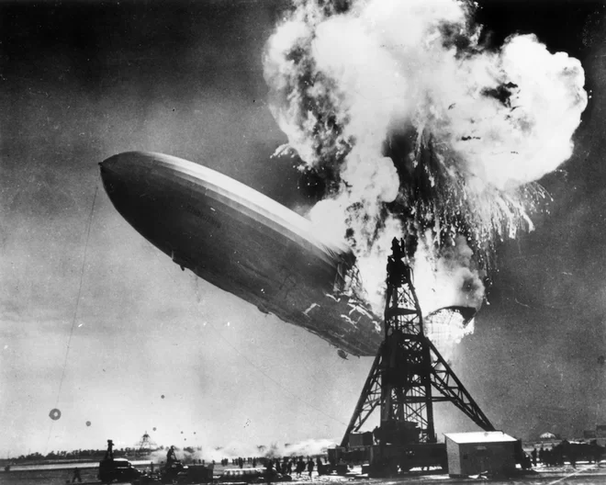
Hindenburg Disaster
May 6, 1937, German passenger airship LZ 129 Hindenburg caught fire and was destroyed during its attempt to dock
The airship was designed to be filled with helium gas but because of U.S. export restriction on helium, it was filled with hydrogen.
Hydrogen is extremely flammable, and the official cause of the fire was due to a "discharge of atmospheric electricity" near a gas leak on the ship's surface.
Notes:
On board were 97 people; there were 36 fatalities.
https://www.youtube.com/watch?v=CgWHbpMVQ1U

Slide 15
Interesting Facts about Hydrogen
Scientists estimate that Hydrogen makes up over 90 percent of all the atoms in the universe.
It is the only element that can exist without neutrons.
Hydrogen becomes a liquid at very low temperature and high pressure.
Under extremely high pressure it can become a liquid metal. It is thought that metallic hydrogen exists at the cores of gas giant planets like Jupiter.
Because it is so light, it was once used in lighter-than-air-balloons. However, it became too dangerous because of its highly flammable nature. Hydrogen gas can be produced in a lab by combining a dilute acid with a metal.

Slide 16
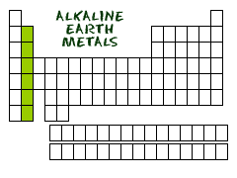

Slide 17
Alkaline Earth Metals - Group 2
Second most reactive family
They are silvery, shiny, and relatively soft metals.
Only found in compounds and minerals, not in their pure elemental forms.
They react with halogens to form compounds called halides.
All except beryllium react strongly with water.
Notes:
As you get to the bottom of the list, you will find the radioactiveradium. While radium is not found around your house anymore, it used to be an ingredient in glow-in-the-dark paints. It was originally mixed with zinc sulfide (ZnS). The other elements are found in many items, including fireworks, batteries, flashbulbs, and special alloys. The lighter alkaline earth metals, such as magnesium and calcium, are very important in animal and plant physiology. You all know that calcium helps build your bones. Magnesium can be found in chlorophyll molecules.

Slide 18
Alkali Earth Metals

Slide 19
Uses of Alkali Earth Metals
Calcium is often found as part of calcium carbonate (chalk or limestone). Limestone is used as a building material.
Magnesium produces brilliant flame -was used to produce the brilliant flash powder in old cameras and in fireworks. Reacts to Carbon dioxide so a fire extinguisher will not work on this flame.
Magnesium often used with aluminum to increase strength but maintain low density.
Magnesium has the highest strength-to-weight ratio of any metal.
Anything with Beryllium in it is TOXIC

Slide 20
Interesting Facts
They burn with various colored flames as follows: beryllium (white), magnesium (bright white), calcium (red), strontium (crimson), barium (green), and radium (red).
They are called alkaline because they form solutions with a pH greater than 7, making them bases or "alkaline."
Radium is formed from the decay of uranium. It is very radioactive and is dangerous to handle.
Calcium and magnesium are important for animal and plant life. Calcium plays an important role in helping us to build strong bones and magnesium is used to help regulate the body's temperature.
Radium was discovered by scientists Marie and Pierre Curie.

Slide 21
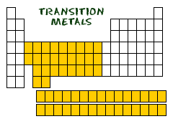

Slide 23
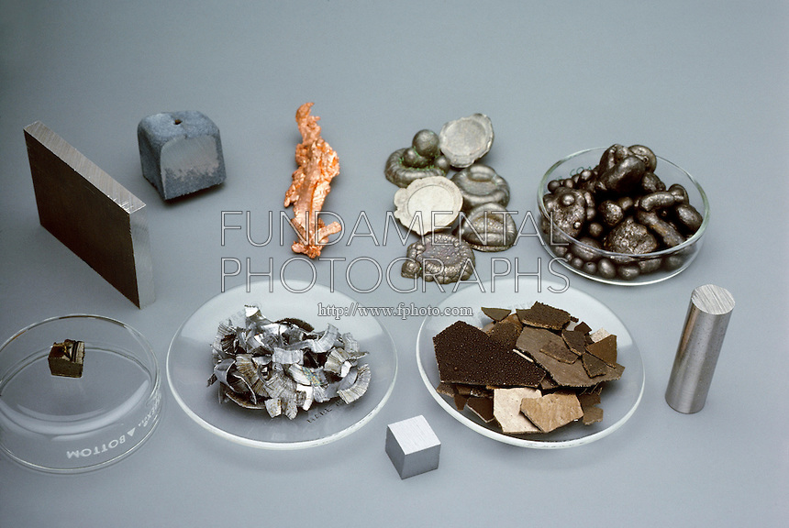
Transition Metals
Shiny,
High Densities
High melting and boiling points
Good Conductors of Heat and electricity
Eg. Gold, silver, platinum
Used for coins, electric and heat applications, structural materials.
Notes:
able to put more than eight electrons in the shell that is one in from the outermost shell.
Transition metals can use the two outermost shells/orbitals to bond with other elements. It's a chemical trait that allows them to bond with many elements in a variety of shapes.

Slide 24
Interesting Facts
Iron, cobalt, and nickel are the only three elements that produce a magnetic field.
The transition metal group is called the "d-block" of the periodic table.
Because of the their unique qualities, transition metals are often used in industry as catalysts for various reactions.

Slide 25
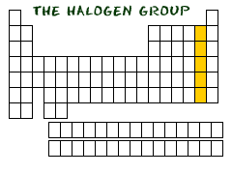
Notes:
What chlorine does is it corrodes moist surfaces (like the inside of your lungs) by getting into the water and forming acids. If your lungs are dissolving from the chlorine, you won't be able to breathe, and that's how it will kill you.

Slide 26
Halogens - Group 17
All very reactive non-metals (Therefore not found freely in nature)
All toxic (harmful) in their elemental (pure) form.
All have bright colors as gases: chlorine is yellow, bromine is orange, and iodine is purple.
Can be liquid (bromine), solid (iodine), gas (fluorine and chlorine) at room temperature.
Often form compounds with alkali metals.
typically found in minerals or salts
Notes:
fluorine and chlorine are gases, bromine is a liquid, and iodine and astatine are solids at RT
Greek words meaning “forming salts.”
Fluorine most reactive.
halogens are often used to kill harmful microorganisms. For example, the halogen chlorine is used to prevent the growth of algae in swimming pools and to purify drinking water. Solutions containing iodine are often used in hospitals and in doctors’ offices to kill germs on skin.

Slide 27
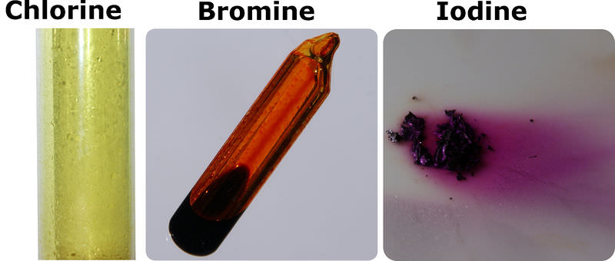
Halogens have bright coloured gases
cc

Slide 29
Uses of Halogens
Chlorine and bromine are used as disinfectants for drinking water, swimming pools, fresh wounds, spas, dishes, and surfaces.
They kill bacteria and other potentially harmful microorganisms through a process known as sterilization.
Iodine in alcohol used as disinfectant to treat cuts.
Chlorine also used in plastics (PVC)

Slide 31
Halogens

Slide 32
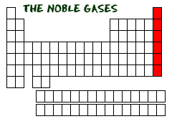

Slide 33
Noble Gases - Last column: Group 18
Colorless, odorless gases.
Inert (unreactive – do not bind to other elements)
Their melting and boiling points are close together giving them a very narrow liquid range.
Helium and Neon never form compounds, others form with great difficulty
Notes:
Last to be discovered: Because most elements were discovered through their reactivity with other elements, typically with oxygen, it was difficult for scientists to work with a substance that seemed to have little or no chemical properties based upon the lack of reactivity.
Most noble gases are found in the atmosphere in small amounts. Argon gas makes up about one percent of the atmosphere. Passing an electric current through a glass tube filled with a noble gas can produce a colorful light, as in the photograph to the right. Argon gas also is placed in tungsten filament light bulbs, because it will not react with the hot filament.
Neon is used in advertising signs.
Argon is used in light bulbs.
Helium is used in balloons and to cool things.
Xenon is used in headlights for new cars.
atomic numbers increase, the elements become rarer.

Slide 34
Noble Gas
Neon in signs
Notes:
Neon is used in advertising signs.
Argon is used in light bulbs.
Helium is used in balloons and to cool things.
Xenon is used in headlights for new cars.

Slide 35
Noble Gases

Slide 36
Noble Gas
Argon in light bulbs
Notes:
Because argon doesn’t react with the tungsten filament in the bulb

Slide 37
Noble Gas
Xenon in head lamps of new cars

Slide 38
Noble Gas
Xenon is being investigated further as a possible replacement for nitrous oxide as an anesthetic.

Slide 39
Noble Gas
Xenon as a satellite propellant.

Slide 40
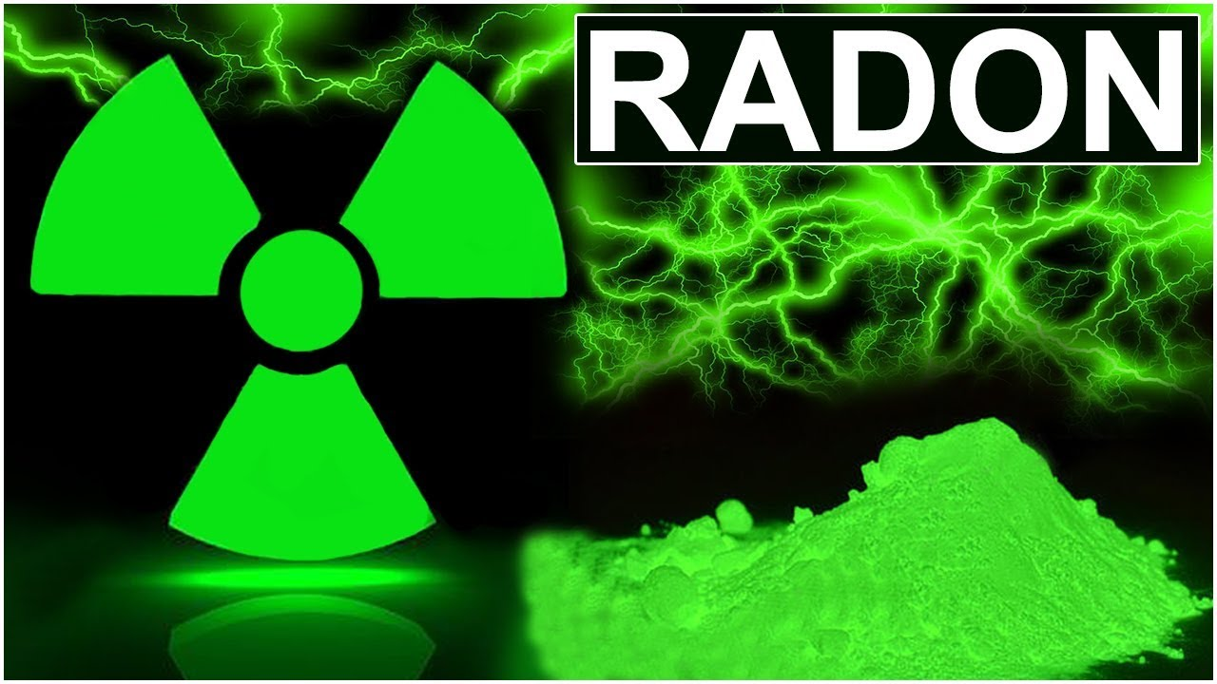
Noble Gas
Radon in cancer therapy.

Slide 41
Noble Gas
Krypton is used in some types of photographic flashes used in high speed photography.
Some fluorescent light bulbs are filled with a mixture of krypton and argon gases.

Slide 42
Interesting Facts
Krypton gets its name from the Greek word "kryptos" meaning "the hidden one."
Many of the noble gases were either discovered or isolated by Scottish chemist Sir William Ramsay.
Helium has the lowest melting and boiling points of any substance.
Noble gases are often used to create a safe or inert atmosphere due to their stable nature.
Xenon gets its name from the Greek word "xenos" which means "stranger or foreigner."

Slide 43
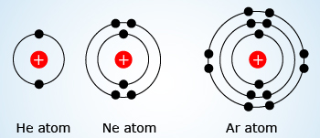
Helium- Another special case
different from all of the other elements because it is very stable with only two electrons in its valence shell.
But still grouped with the noble gases (8 valence e’s).
The noble gases and helium are all "happy," because their valence shell is full.
Notes:
Hydrogen can have the electron traits of two groups: one and seven. For chemists, hydrogen is sometimes missing an electron like the members of group IA, and sometimes has an extra one as in group VIIA. When you study acids and bases you will regularly work with hydrogen cations (H⁺). A hydride is a hydrogen anion and has an extra electron (H⁻).

Slide 44
Practice
Chemical Family WS
Read pages 248 – 253 of text book
Answer CYU p254 #2-9, 16
Periodic Table Interactive
Intro to Element Research Project
ASAP Science: Periodic Table Song
https://www.youtube.com/watch?v=rz4Dd1I_fX0

Slide 45
Nobel Gas
Extra Video
https://www.youtube.com/watch?v=qNaBMvJXdJ4

