Slide 1
Microscopes

Slide 2
History of the microscope
Sci Show
https://www.youtube.com/watch?v=Ue-86MDmjns
Notes:
5 min

Slide 3
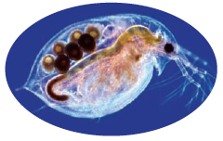
Observing Very Small Living Things
The microscope is used by scientists to observe very small unicellular and multicellular living things.
There are many different types of microscopes.
  magnifying lenses
  compound light microscopes
  electron microscopes
  scanning electron microscopes (SEM)
Water flea (Daphnia)
See page 11

Slide 4
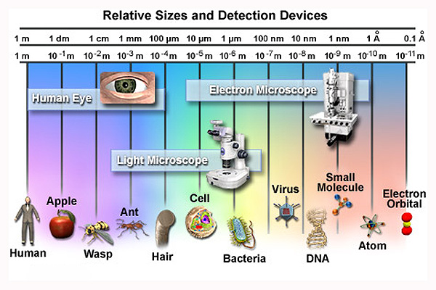

Slide 5
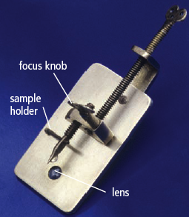
Hans and Zacharias Janssen invented first Microscope 1590s
In 1590’s First light microscope invented by Hans and Zacharias Janssen, a father-son team of spectacle makers who put several lenses in a tube and made a very important discovery.
Notes:
The microscope is used by scientists to observe very small unicellular and multicellular living things.
Early microscopes were built in the late 1600’s.
The history of the microscope begins with Zacharias Jansen's invention of the first light microscope in the 1590's. Anton van Leeuwenhoek later made significant improvements to the compound microscope.

Slide 6
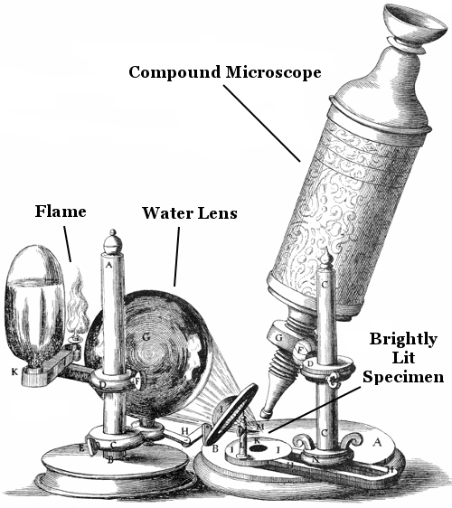
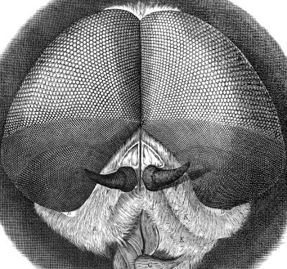
Robert Hooke -early microscope pioneer
1665 Hooke built a compound microscope with a new, screw-operated focusing mechanism he had designed. Previously, people needed to move the specimen to get it in focus.
Added a light source.
First to discover microscope fungi.
Looked at sections of cork – called them "cells".
At the time, Hooke's microscope was one of the best ever produced.

Slide 7
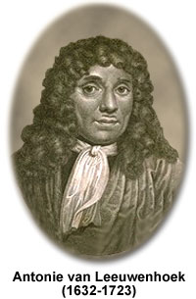
Anton van Leeuwenhoek, 1666
In 1666 he made his own microscope and improved it. Credited with inventing first practical microscope.
It was hand held, single lens
It could magnify up to 250x.
discovered "protozoa" -single-celled organisms he called "animalcules".
First to observe red blood cells, muscle fibers, and sperm.
known as "the Father of Microbiology"

Slide 8
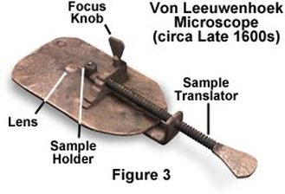
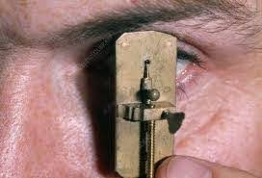
It was quite small

Slide 9
Microscopes
Notes:
Wacky History of the Cell video

Slide 10
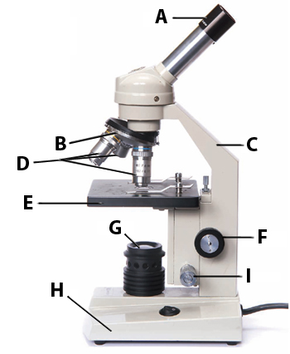
Compound Light Microscope
Two sets of lenses to magnify an image,
(One in eye piece, one in each objective)
Total magnification: 400 - 600x
The image you observe is magnified and inverted (upside down) and backwards (reversed).
Do you know all the compound microscope parts?
See pages 12-13

Slide 11
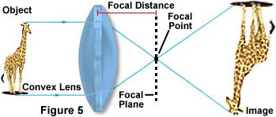
The image you observe is magnified and inverted (upside down) and backwards.

Slide 12
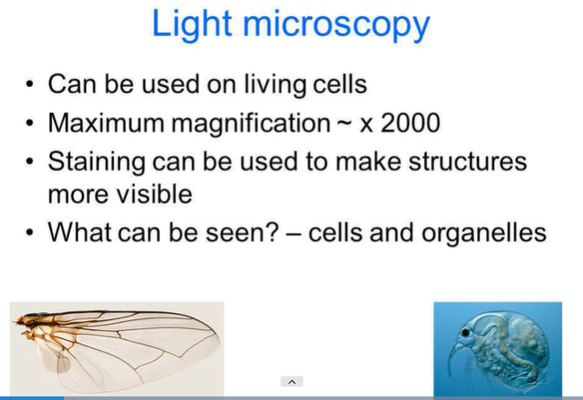

Slide 13
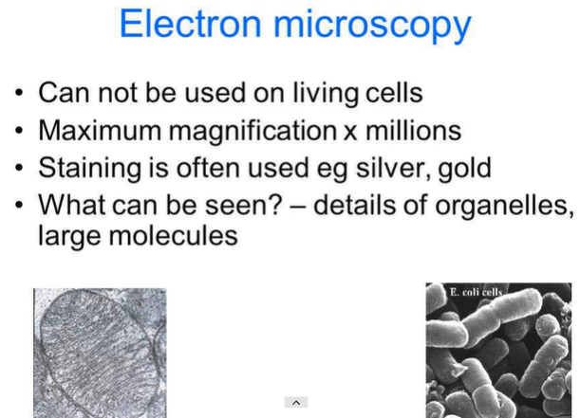
Electron Microscope
uses beams of electrons instead of rays of visible light
Magnification up to 10,000,000 x
Cannot be used on living cells
Staining is often silver or gold
What can be seen? Details of organelles, large molecules
Notes:
to form highly magnified images of tiny areas materials or biological specimens.
Much higher magnifications and has a greater resolving power than a light microscope, allowing it to see much smaller objects in finer detail.

Slide 14
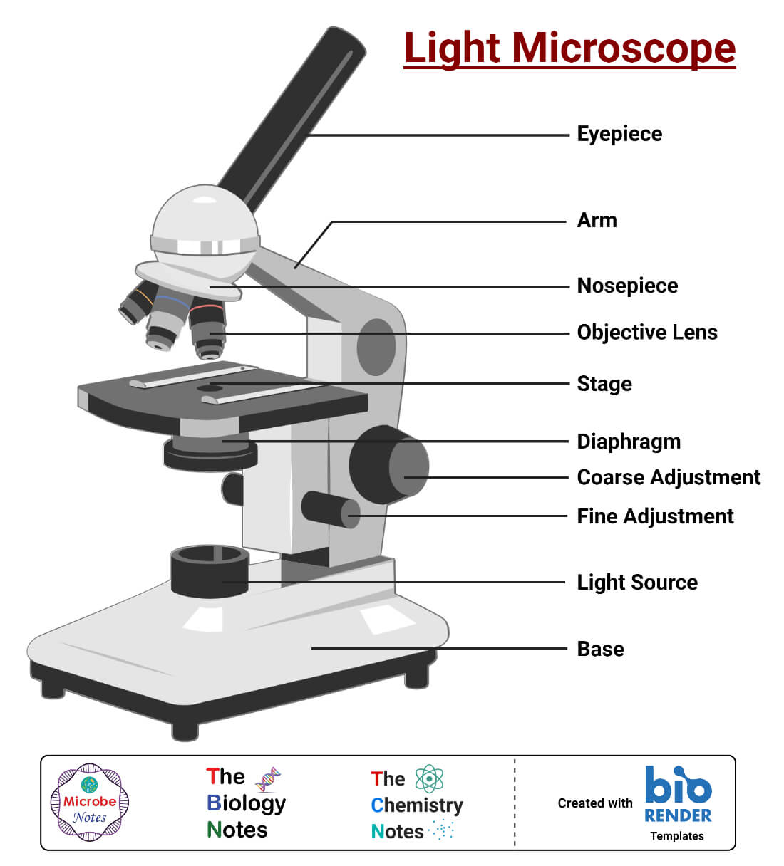
Know the parts and functions

Slide 16
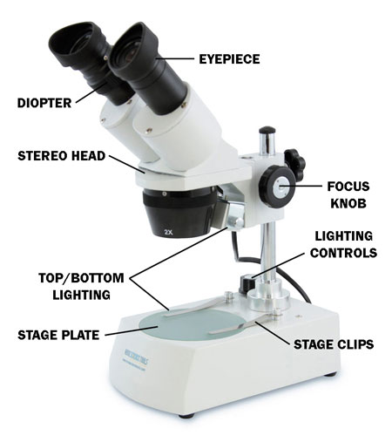
Dissecting Microscope

Slide 17
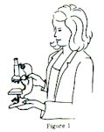
Proper Handling of a Microscope
1. Always use 2 hands:
  One hand around the arm,
  one hand supporting the base

Slide 18
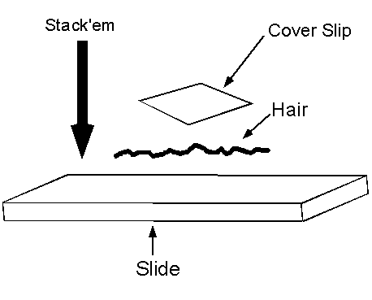
Never put a specimen directly on the stage
If viewing your OWN specimen, use a plane Microscope SLIDE and a COVERSLIP.

Slide 19
Using a light microscope
1. Place specimen on glass slide, cover with coverslip.
2. Always start with the lowest power objective.
3. Use coarse adjustment knob to find and focus your specimen.
4. Move to higher power. Only use fine focus knob when using highest power objective.
5. Adjust the light using the diaphragm
Notes:
Use lowest objective first:
Find your object, get it into focus without cracking slid

Slide 20
Why do we need to start with the lowest objective first?

Slide 21
Why do we need to start with the lowest objective first?
The lowest object makes it is easier to locate the specimen on the slide than if you start with a higher power objective.
Cover and return to cart when finished.

Slide 22
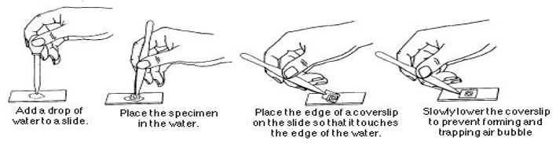
Preparing a Wet Mount Slide

Slide 23
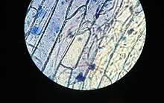
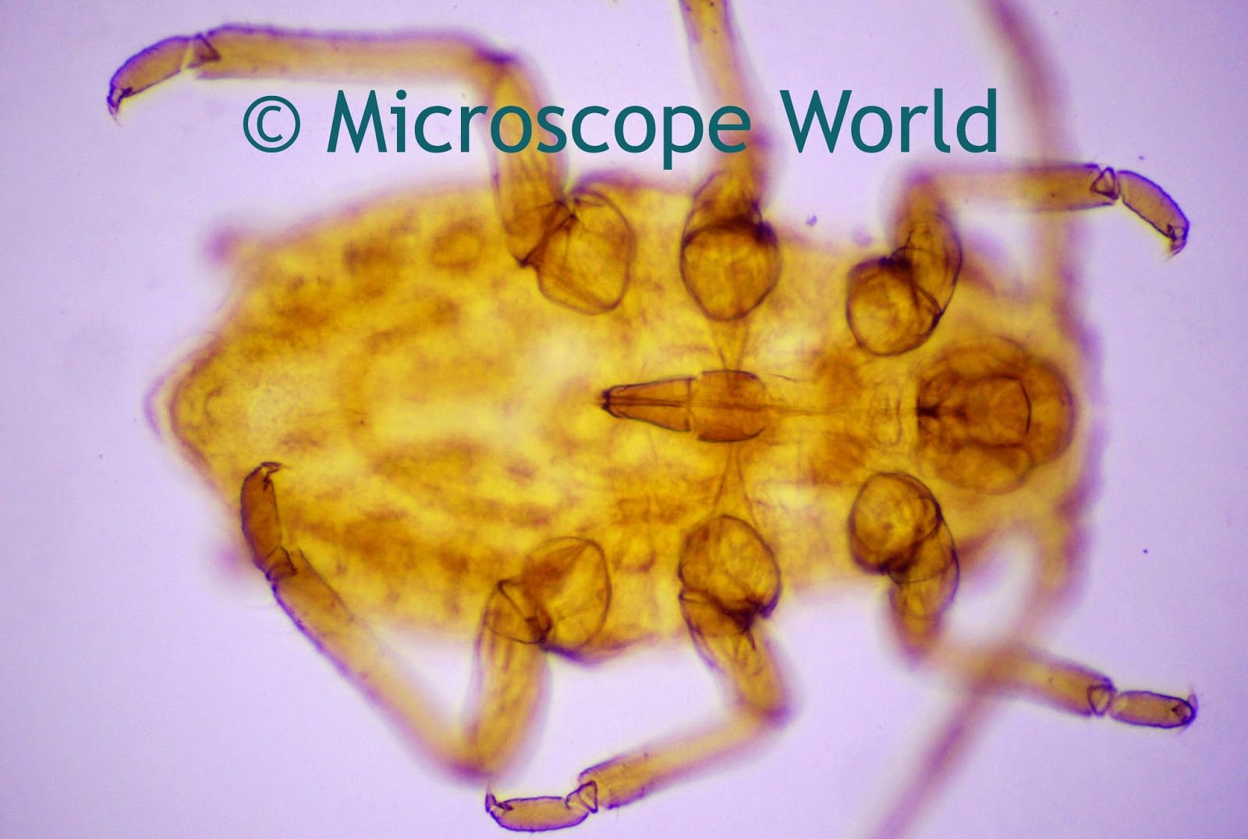
Why Wet Mount?
Uses a drop of water between the slide and coverslip
Prevents the specimens from drying out.
Enables viewing of microscopic aquatic organisms in their “natural” environment.
Notes:
Wet mounts are used to view microscopic organisms that grow in pond water or other liquid media, especially when studying their movement and behaviour.

Slide 24
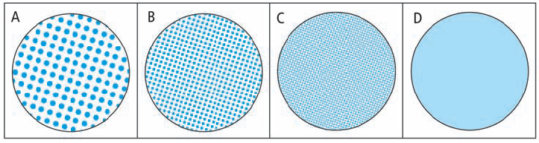
Resolving Power
Resolving power is the ability to distinguish between very small objects that are very close together.
The human eye has a certain resolving power.
You can see the individual dots in diagrams A, B and C.
The human eye does not have the resolving power to see the dots in diagram D.
Can you think of ways to increase resolving power?
Notes:
Magnification is the ability to make small objects seem larger, such as making a microscopic organism visible. Resolution is the ability to distinguish two objects from each other. Light microscopy has limits to both its resolution and itsmagnification.

Slide 25
Magnification. Most Microscopes:
Low power = 4x objective
Med power = 10x objective
High power = 40x objective
Eye piece is usually 10x
Total Magnification = Eyepiece X objective used
What is the total magnification when using the medium objective?
Notes:
Example: High Power = 40 x 10 = 400 x

Slide 26
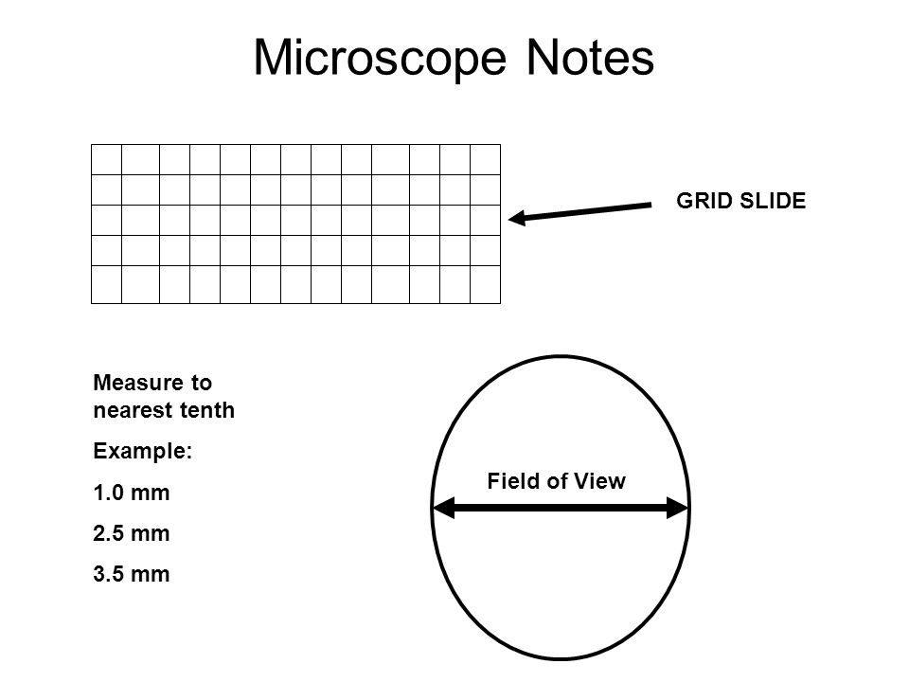
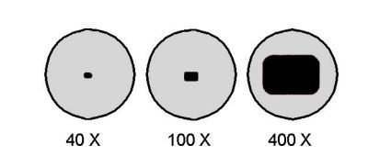
Field of View (FOV)
Microscope Field of View (FOV) is the maximum area visible, usually quoted as a diameter measurement.
What happens to FOV as magnification increases?

Slide 27
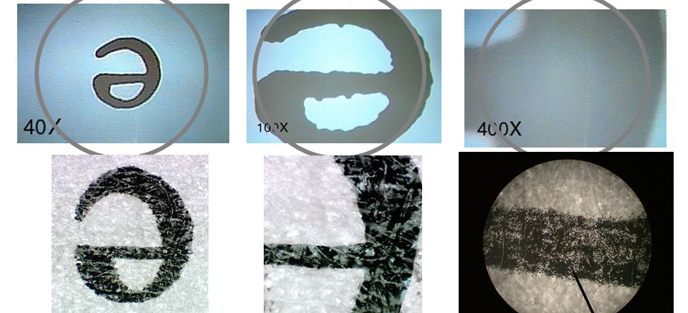
What happens to FOV as you switch to higher Magnification? What type of relationship is this?
Notes:
As the power gets greater, the image gets larger but the field of view gets smaller.

Slide 28
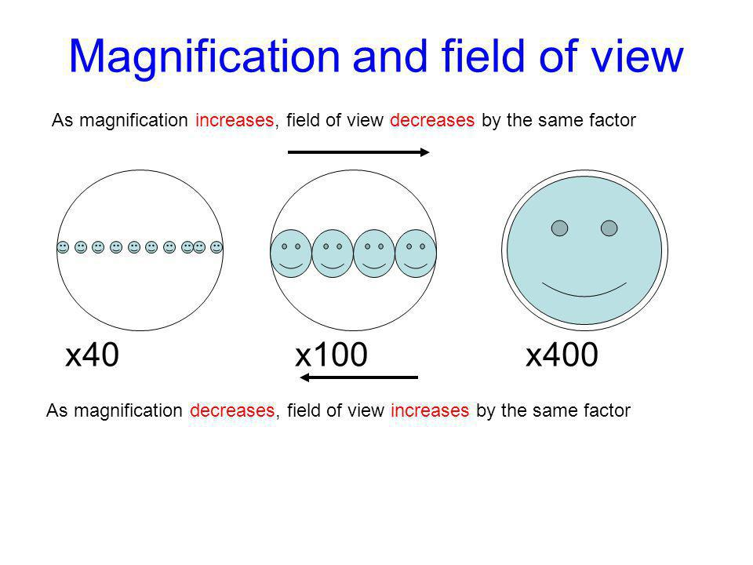

Slide 29
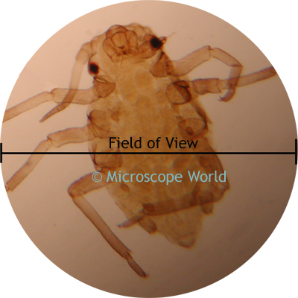
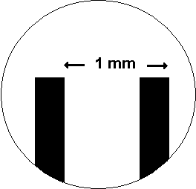
Measuring Field of View (FOV)
You can determine field of view by placing a clear metric ruler on the stage and counting the millimeters from one side to the other.
What is the FOV in the image?

Slide 30
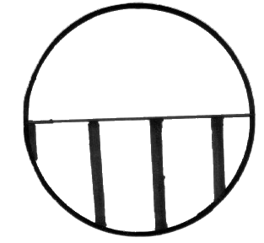
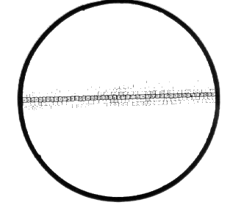
Exercise #2: Calculating Field of View
Ruler under scanning power
Filament of spirolina under scanning power

Slide 31
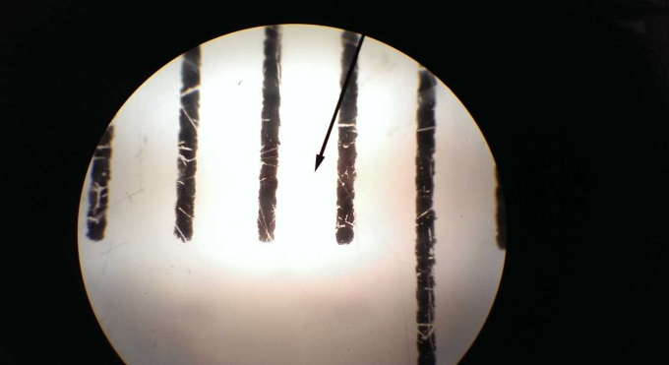

Calculating Field of View
Scanning power
10 x ocular
4 x objective
total magnification = 40X
What happens at high and oil immersion?
Low power
10 x ocular
10 x objective
total magnification = 100X

Slide 32
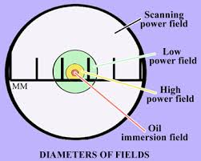
You will sometimes see “medium power”. We are not using that, (but be aware it is another naming method).
Medium is low in our naming.
Scanning
Low
High
Oil immersion

Slide 33
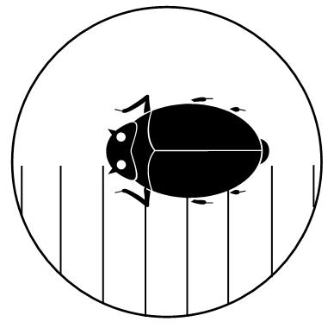
Use FOV to determine approximate size of an object:
If each line represents 1 mm, how big is the bug?
Notes:
For the diagram on the right, If each line represents 1 mm, how big is the bug?

Slide 34
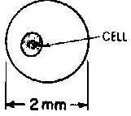
If the Field of View is 2mm, how big is the cell?

Slide 35
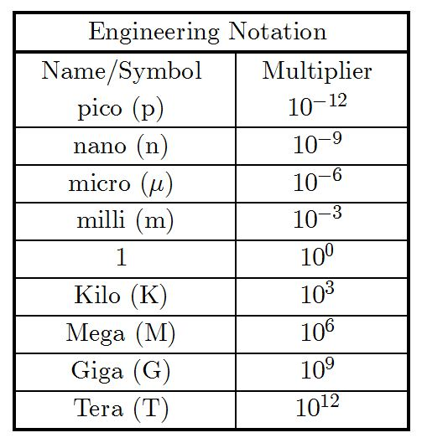
Changing Units To Micrometers
5 mm = ___________µm
4 cm = ____________µm
0.2 mm = __________µm

Slide 36
Use FOV to Estimate Size of Specimen
Size of object = diameter of FOV
            # of objects that can fit across

Slide 37
Metric Conversion

Slide 38
One micrometer (um) is 1/1000 of a millimeter
1 mm = 1000 um
Convert:
2 mm = _______________um
200um = ______________ mm
1.5 cm = ______________ um

Slide 39
One micrometer (um) is 1/1000 of a millimeter
1 mm = 1000 um
Convert:
2 mm = ______2000 um
200um = _____0.2 mm
1.5 cm = ______1500um

Slide 40
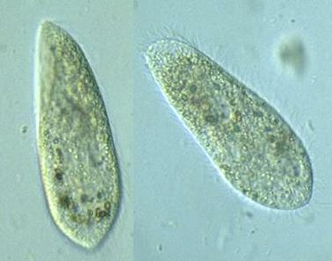
When looking at pond water you see a paramecium that covers 1/6 of the FOV in low power (4mm).
How big is the paramecium?

Slide 41
When looking at pond water you see a paramecium that covers 1/6 of the FOV in low power (4 mm).
Specimen size = FOV / how many fit
= 4 mm/ 6 cells across
Paramecium is 0.67 mm

Slide 42

Estimating Magnification from a drawing
Drawings will be MUCH larger than the actual specimen.
You may need to indicate how much larger than life your drawing is.
Must be in same units so they can cancel
Notes:
Must use same units!

Slide 43
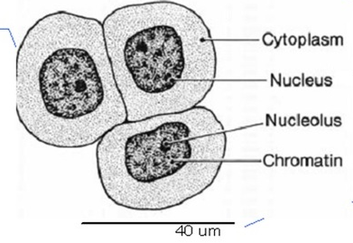
If the drawing of one cell is 47.5 cm in length, what is the magnification?
(Don’t forget to convert to same units. )

Slide 44
If the drawing of one cell is 47.5 mm in length, what is the magnification?
(Don’t forget to convert to same units. )
Magnification = Drawing / Actual
= 47500 mm / 40 um

Slide 45
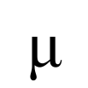
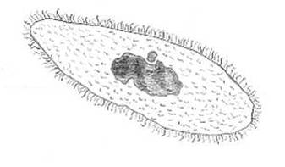
A student drew a diagram of a paramecium, below. An actual paramecium is 180 m.
What is the magnification of student's diagram?
7.2 cm

Slide 46
Magnification = Drawing / Actual
= 7.2 cm / 0.018 cm
= 400x
7.2 cm

Slide 47
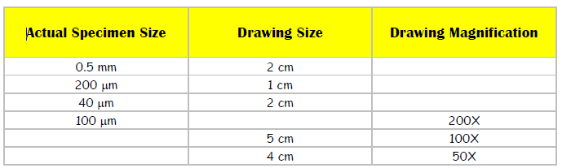
Practice

Slide 48
A student, observing a micro-organism under a magnification of 40X, calculates that it is about 100um long.
a) If she then draws the micro-organism 2 cm long, what is the magnification of her drawing?
b) If her partner draws the micro-organism at a magnification of 1000X, how long will the drawing be?

Slide 49
A student, observing a micro-organism under a magnification of 40X, calculates that it is about 100um long.
a) If she then draws the micro-organism 2 cm long, what is the magnification of her drawing?
D = 2cm = 20000um M = 200x
A = 100 um
b) If her partner draws the micro-organism at a magnification of 1000X, how long will the drawing be?
A = 100 um D = MxA = 100 000 um = 10 cm
M = 1000x

Slide 50
Practice Calculations
Microscope WS

Slide 51
Most microscopes:
Objective Total Mag Approx FOV
4x | 40x | 4.0 mm
10x | 100x | 2.0 mm (1.78)
40x | 400x | 0.4 mm (0.45)
100x | 1000x | 0.2 mm (0.178)

Slide 52
Extra slides beyond here

Slide 53
Actual Specimen size from Drawing and Mag
Specimen = Size of drawing
Magnification
Notes:
Must use same units!

Slide 54
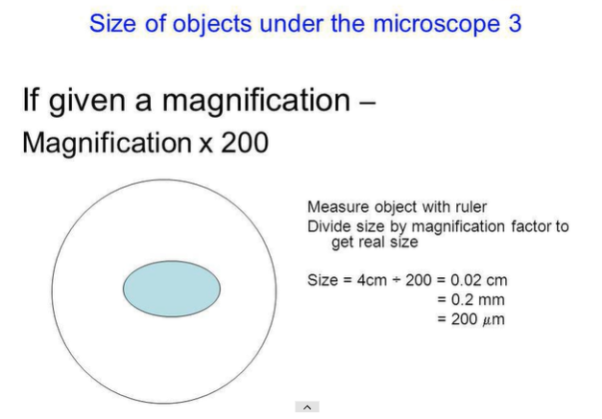
Actual Size of Specimen, from Drawing and Mag

Slide 55
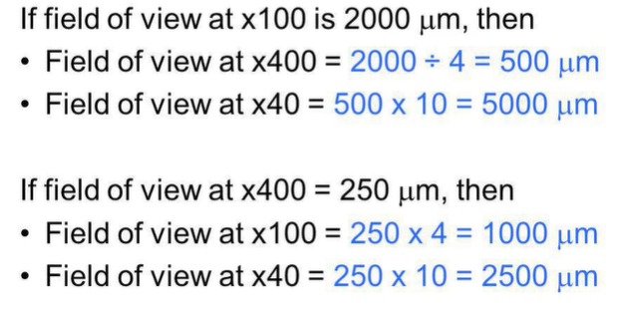
Field of View at Different Magnifications

Slide 56
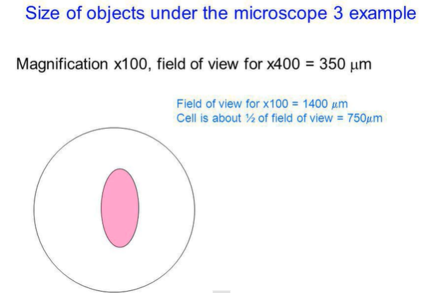
Calculating Actual Specimen Size from
Mag and FOV

Slide 57
Specimen is about half FOV, so about 800um

Slide 58
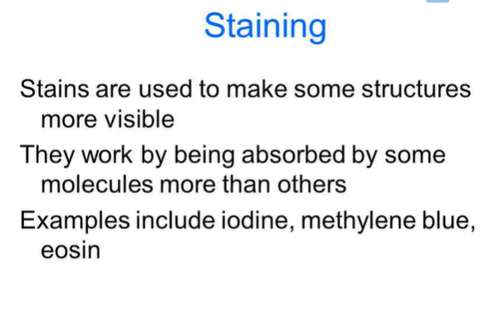

Slide 59
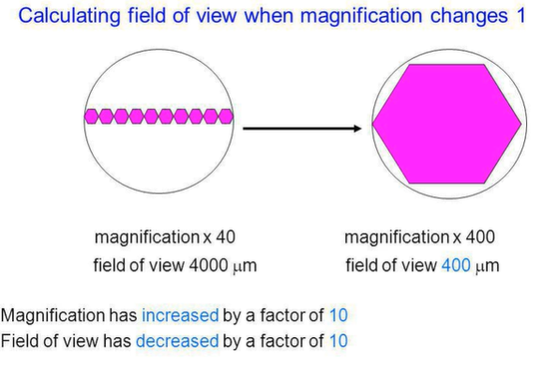

Slide 60
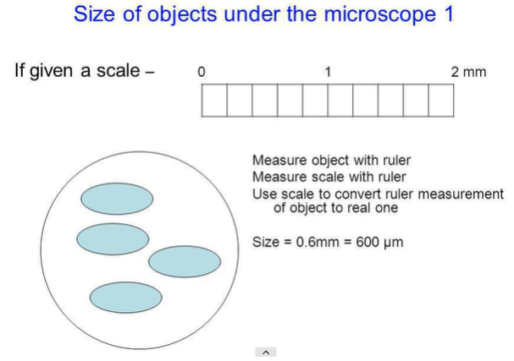

Slide 61
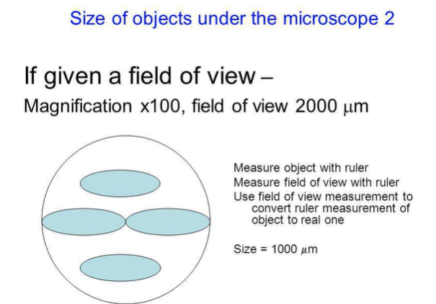

Slide 62
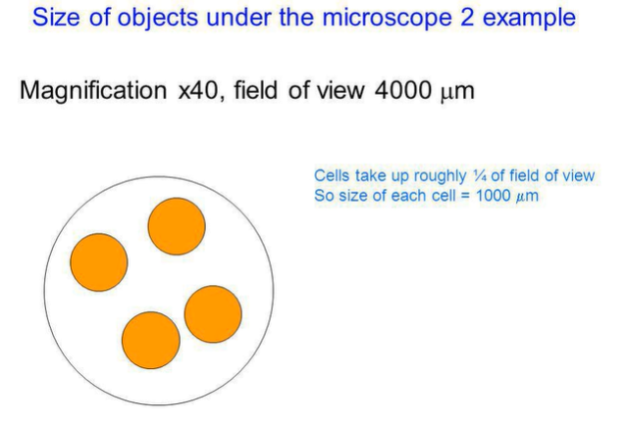

Slide 63
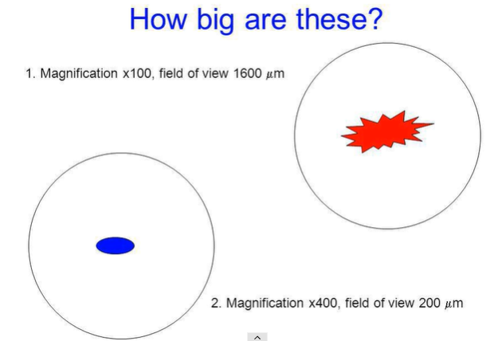

Slide 64
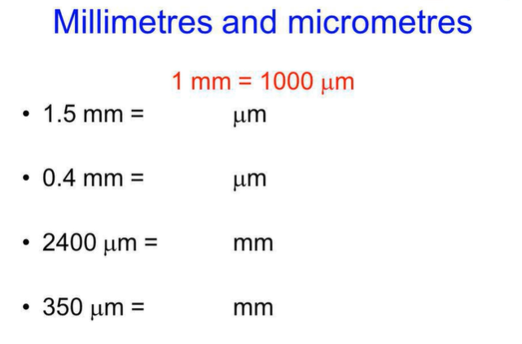

Slide 65
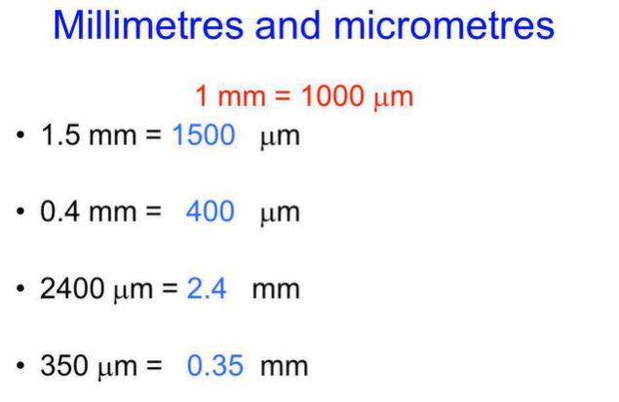

Slide 66
Calculating Field of View
Scanning power
10 x ocular
4 x objective
total magnification = 40X
What happens at high and oil immersion?
Low power
10 x ocular
10 x objective
total magnification = 100X

Slide 67
You will sometimes see “medium power”. We are not using that, (but be aware it is another naming method).
Medium is low in our naming.
Scanning
Low
High
Oil immersion

Slide 68
Calculate Actual Size of a Specimen
Actual Size = Image size (with ruler) ÷ Magnification.

Slide 69
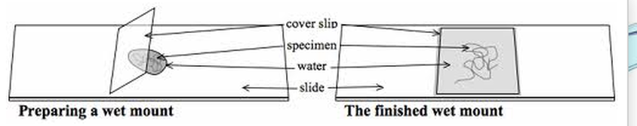
Exercise #3: Prepare a Wet Mount

Slide 70
Example
A student draws a leaf and labels it ½ X. What does this label mean?

Slide 71
Example
A student draws a leaf and labels it ½ X. What does this label mean?
Drawing is half the size of the actual leaf.
(Actual leaf is twice as big as drawing)

