Slide 1
Intro to Organelles
https://www.youtube.com/watch?v=I0vji1C9Evs&feature=youtu.be
Notes:
approximately 30,000 skin cells die every minute;
a skin cell lives for approximately 2 to 3 weeks).

Slide 2
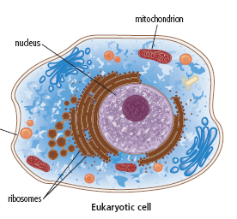
Cells can be classified into TWO MAIN GROUPS:
Prokaryotic Cells Eukaryotic Cells (Prokaryotes) (Eukaryotes)
Video Amoeba Sisters Prokaryotes and Eukaryotes
https://www.youtube.com/watch?v=Pxujitlv8wc

Slide 3
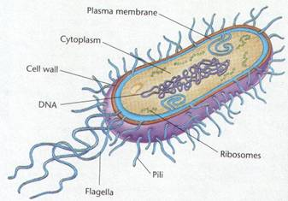
Prokaryotic Cells (Primitive)
Have no nucleus
Much smaller than eukarotes
Less complex: have fewer internal structures
Internal structures are not surround by membranes
All are Unicellular organisms,
All have cell wall
Eg. All bacteria are prokaryotes ( E. coli)

Slide 4
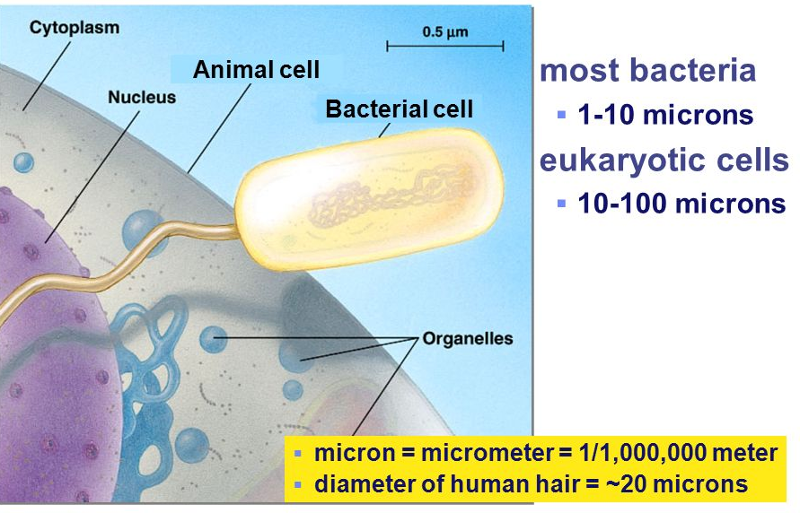
Prokaryotes are much smaller than Eukaryotes

Slide 5
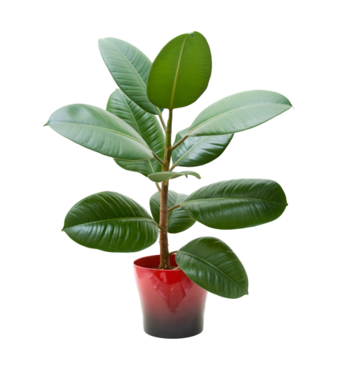
Eukaryotic Cells
All have a nucleus,
Organelles (Internal structures) surrounded by membranes
Are larger and more complex than prokaryotic cells
Can be either Unicellular (amoebas, paramecium, yeast ) or multicellular (any cell from a plant or animal)

Slide 6
Practice
Venn diagram Prok vs Euk

Slide 7
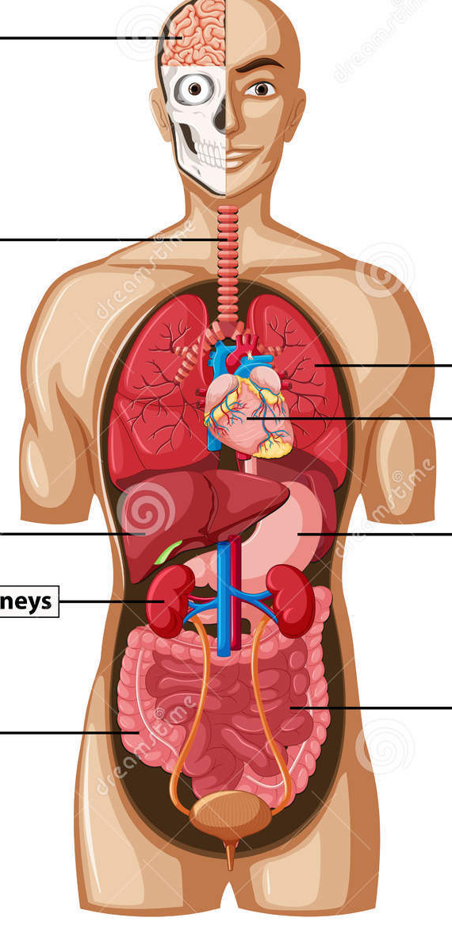
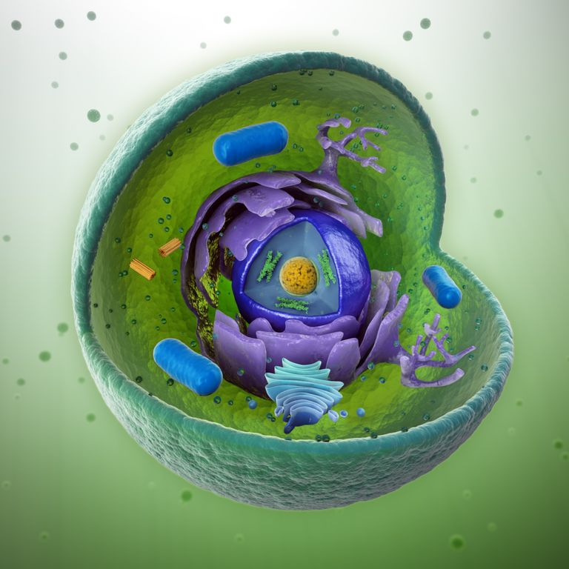
Cell Structure
Like organs working together to body to function, cells made up of small, specialized structures called organelles
Notes:
Organelles take up bout 5-30 % of the cell. The rest of the cell consists of water.

Slide 8
Cell Structure
Different types of cells have different types of organelles, but some organelles can be found in all cells.
Cell structure animation
https://www.youtube.com/watch?v=URUJD5NEXC8
Amoeba sisters: https://www.youtube.com/watch?v=8IlzKri08kk

Slide 9
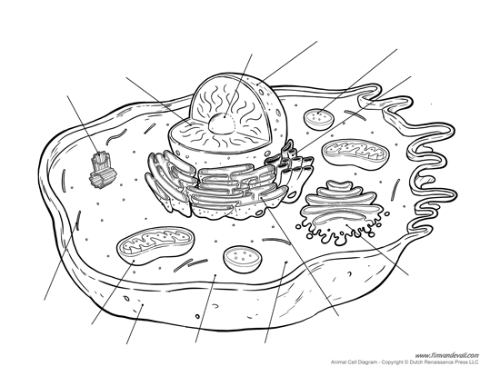

Slide 10
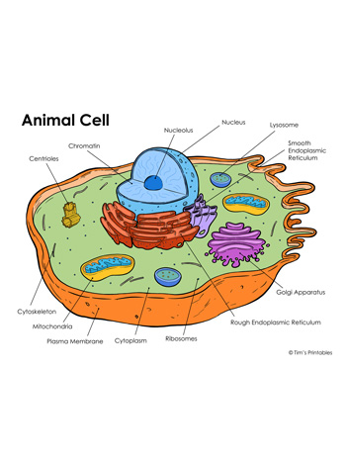

Slide 11
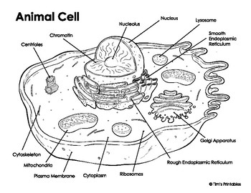

Slide 12
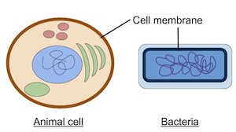
Cell Membrane = Gate Keeper
The cell membrane surrounds the cell.
Cell Membrane is Selectively Permeable.
Regulates movement of particles in and out of the cell.
ALL cells have a cell membrane
See page 25

Slide 13
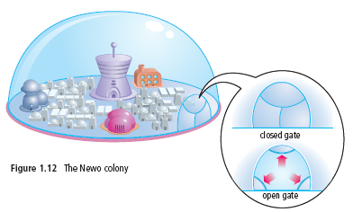
Cell Membrane = Gate Keeper
In the Newo colony the cell membrane would be like the protection dome, controlling movement of materials in and out of the colony through the entry and exit gate.
See page 25

Slide 14
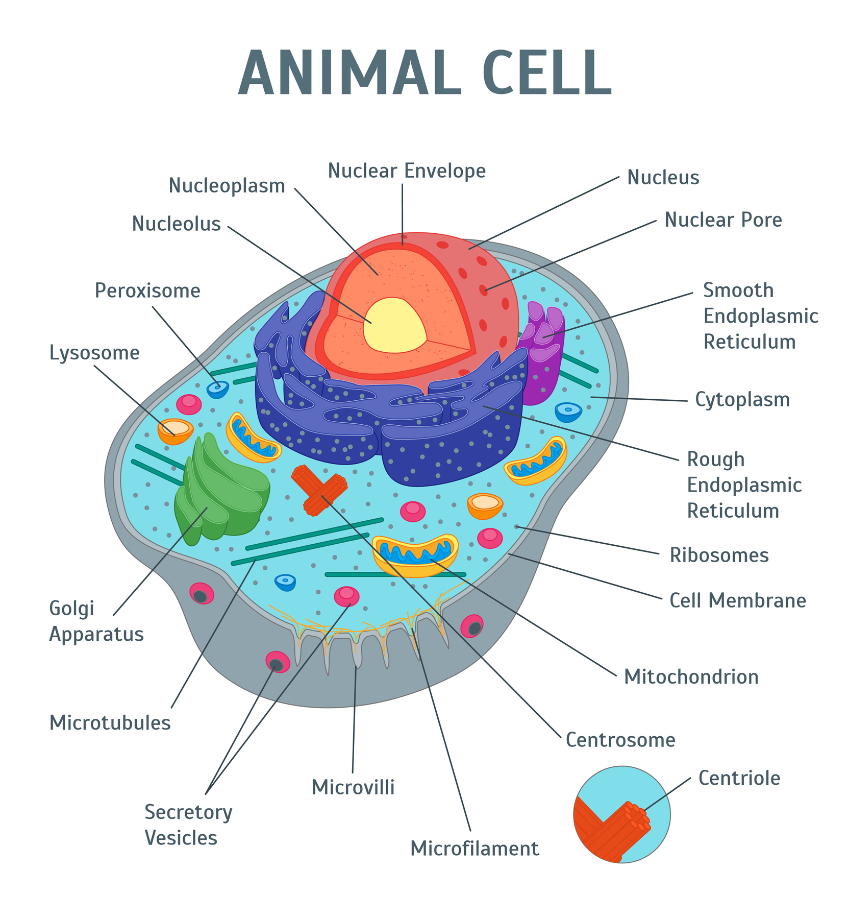
Cytoplasm = Environment
Cytoplasm, the jelly-like substance within the cell, contains organelles, water, and other life supporting materials.
Notes:
The liquid in which the NEWO colony lives

Slide 15
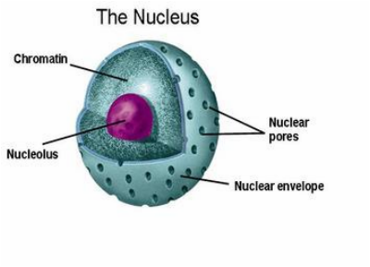
Nucleus = Control Center
  Controls all activities within the cell.
  Surrounded by nuclear envelope
  Nuclear envelope has small holes called nuclear pores

Slide 16
Nucleus = Control Center
  Largest Organelle
  Controls all activities within the cell.
  Contains our genetic material (DNA)
Notes:
Surrounded by a membrane called the nuclear envelope
Nuclear envelope has small holes called nuclear pores
Inside the nucleus is a fluid called nucleoplasm

Slide 17
Nucleus = Control Center
  Surrounded by a membrane called the nuclear envelope
  Nuclear envelope has small holes called nuclear pores
  Inside the nucleus is a fluid called nucleoplasm
Notes:
Surrounded by a membrane called the nuclear envelope
Nuclear envelope has small holes called nuclear pores
Inside the nucleus is a fluid called nucleoplasm

Slide 18
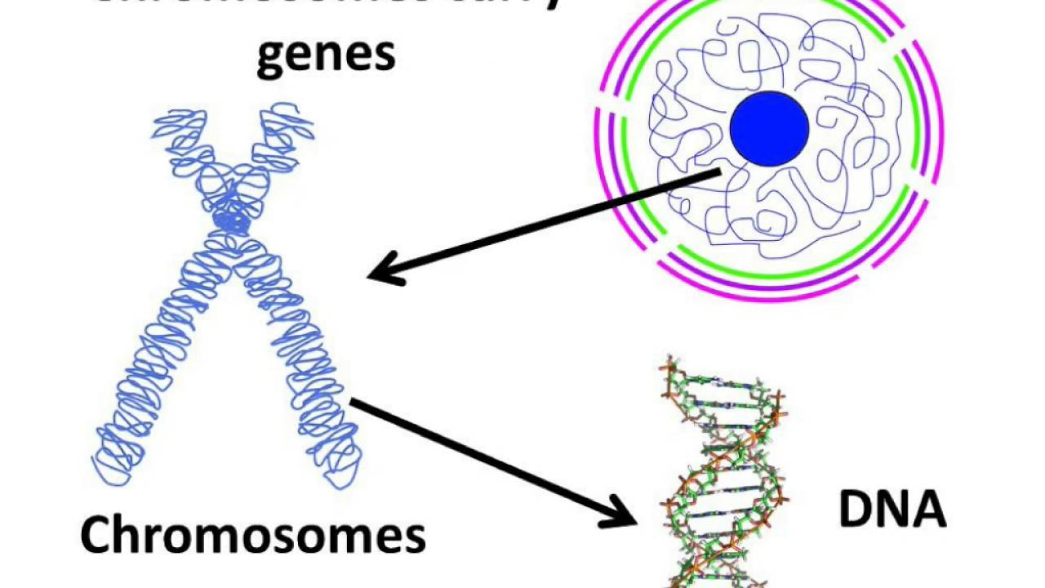
Inside the Nucleus: Chromatin
  DNA is our genetic material that contains the instructions for the development and function of living things

Slide 19
Inside the Nucleus: Chromatin
  Nucleus contains chromatin: thin strands of DNA and protein that condense into chromosomes during cell division.

Slide 20
Chromosomes
Rod-shaped bodies in the nucleus visible during cell division
Contains our genetic material (DNA)
Each eukaryotic cell has a characteristic number of chromosomes.
Human body cells have 46 chromosomes (23 pairs)

Slide 21
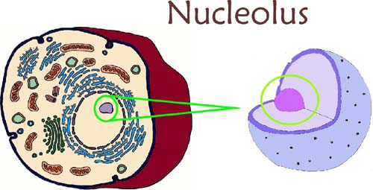
Nucleolus
Nucleus also contains a nucleolus
Dark region in the nucleoplasm
This is where ribosomes are assembled.
Ribosomes produce proteins for the cell.
Some nuclei may contain one or more nucleoli

Slide 22
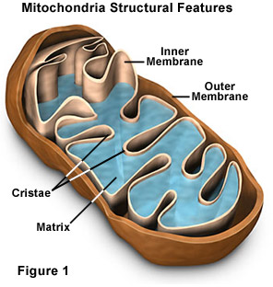
Mitochondria = Power House of the Cell
Produce energy for the cell.

Slide 23
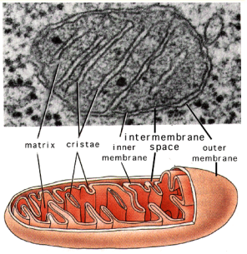
Mitochondrion

Slide 24
Mitochondria use the process Cellular respiration to convert energy from the food we eat to a usable form the cell can use (in form of ATP):

Slide 25
Cellular Respiration: Label your diagram
Food + Oxygen ---→ Carbon + Water + Energy
(glucose) Dioxide

Slide 26
Ameoba Sisters Video on Cellular Respiration
https://www.youtube.com/watch?v=4Eo7JtRA7lg

Slide 27
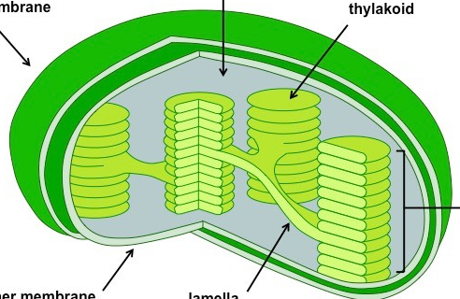
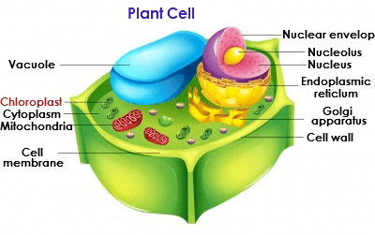
Chloroplast = food Maker

Slide 28
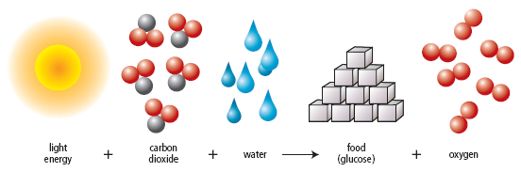
Chloroplast = Food Maker
  Takes energy from the sun to make food for the cell in a process called photosynthesis.

Slide 29
Cyanobacteria
See Ted Ed video
How chloroplasts came to be

Slide 30
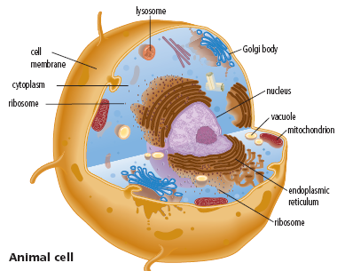
Organelles for Assembly, Transport, and Storage:
Ribosomes
Endoplasmic Reticulum
Golgi Apparatus
Lysosomes
Vacuoles

Slide 32
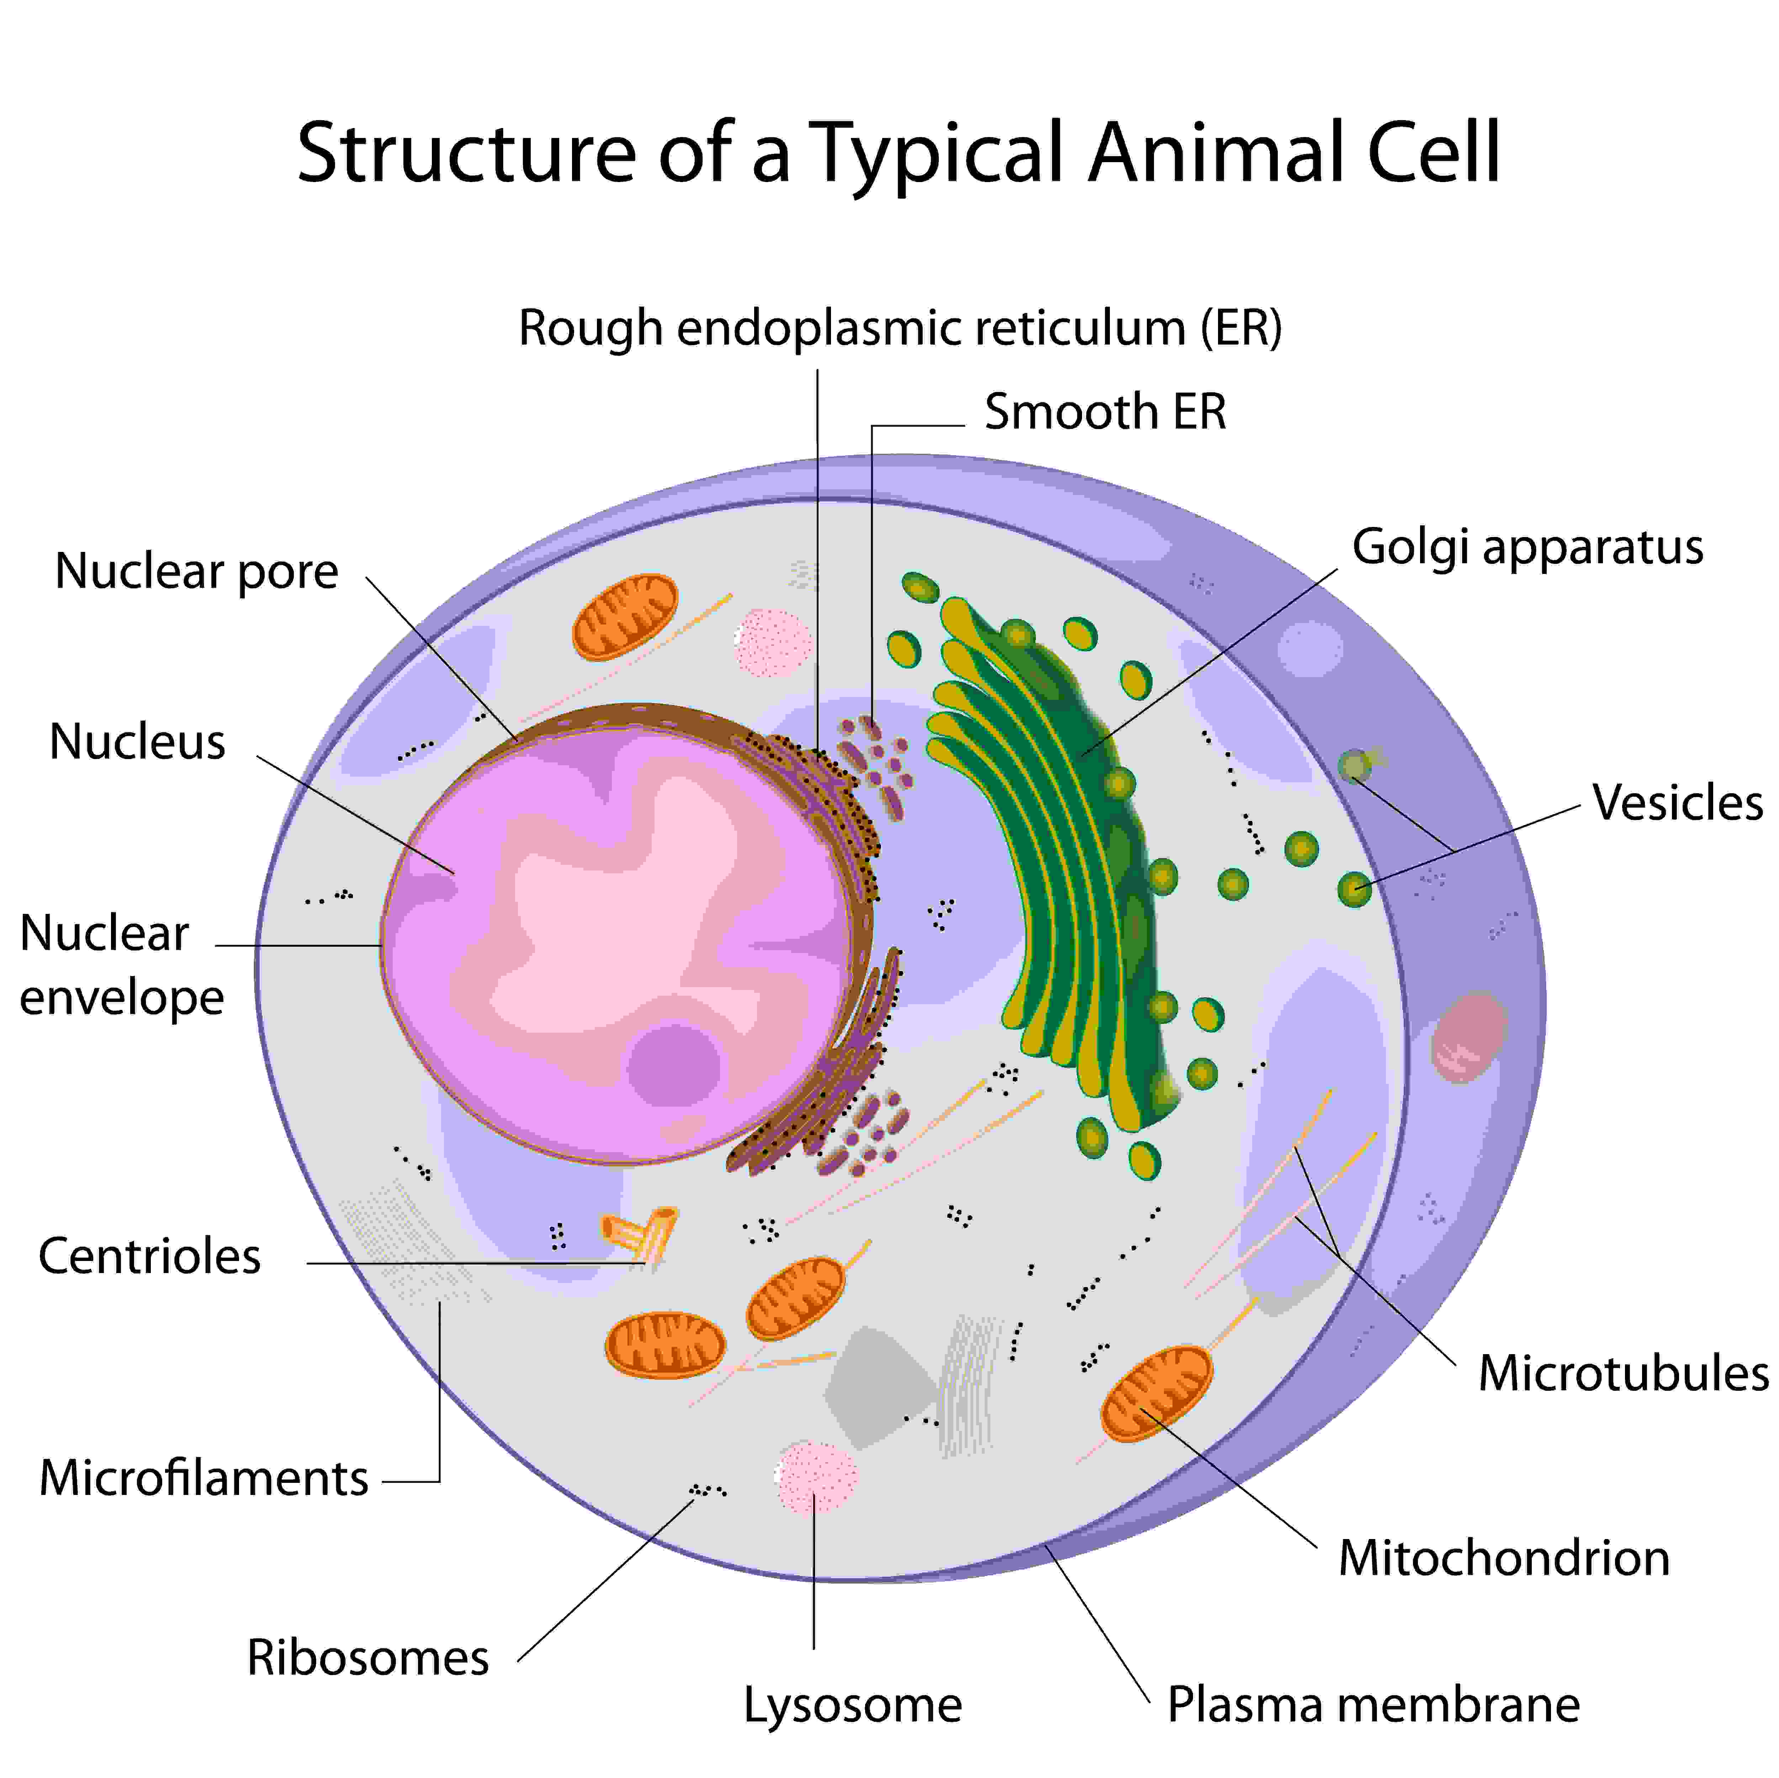

Slide 33
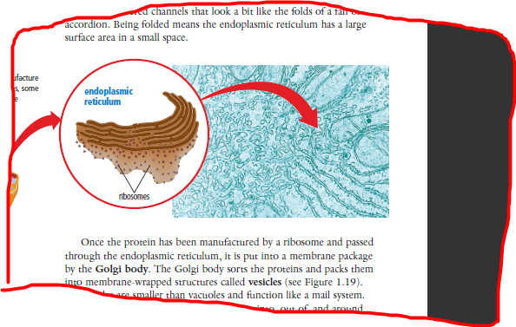
Endoplasmic Reticulum (ER) = transport
Network of membrane-covered channels that transport materials throughout the cell.
Smooth ER and Rough ER
Notes:
Rough ER is found throughout the cell but the density is higher near the nucleus and the Golgi apparatus. Ribosomes on the rough endoplasmic reticulum are called 'membrane bound' and are responsible for the assembly of many proteins. This process is called translation.

Slide 34
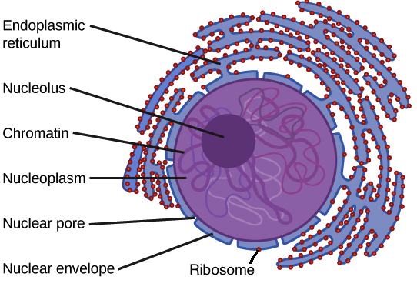
Rough Endoplasmic Reticulum (Rough ER)
Involved in production (synthesis), folding, export of proteins.
It is called ‘rough’ because it is studded with ribosomes
Rough ER is found throughout the cell but mostly near the nucleus and the Golgi apparatus.
Package proteins in vesicles which go to the Golgi Apparatus
Notes:
Protein molecules are synthesized and collected in the cisternal space/lumen. When enough proteins have been synthesized, they collect and are pinched off in vesicles. The vesicles often move to the Golgi apparatus for additional protein packaging and distribution.
It is made up of cisternae, tubules and vesicles. The cisternae are made up of flattened membrane disks, which are involved in the modification of proteins.

Slide 35
Rough Endoplasmic Reticulum (Rough ER)
Rough ER is found throughout the cell but mostly near the nucleus and the Golgi apparatus.
Package proteins in vesicles which go to the Golgi Apparatus
Notes:
Protein molecules are synthesized and collected in the cisternal space/lumen. When enough proteins have been synthesized, they collect and are pinched off in vesicles. The vesicles often move to the Golgi apparatus for additional protein packaging and distribution.
It is made up of cisternae, tubules and vesicles. The cisternae are made up of flattened membrane disks, which are involved in the modification of proteins.

Slide 36
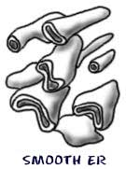
Smooth Endoplasmic Recticulum (SER)
Produces and exports lipids (fats), steroid hormones, and detoxification of harmful byproducts.
More tubular in appearance
No ribosomes – appears smooth
Cells in your body that release oils also have more SER than most cells.
Notes:
produce and export lipids and protein and function for detoxification, while RER produces, secrete and export proteins and few hormones.

Slide 37
Ribosomes = Production of Building Blocks
Ribosomes make proteins that are essential for all life
Ribosomes may be free in the cytoplasm are attached to the RER
Notes:
The floating ribosomes synthesize proteins that are used by the inside of the cell, whereas the bound ribosomes synthesize proteins that will be used both by the inside of the cell and for export to the outer region of the cel

Slide 38
Ribosomes = Production of Building Blocks
The proteins made by ribosomes are then passed into the RER for modification and transport.
Notes:
The floating ribosomes synthesize proteins that are used by the inside of the cell, whereas the bound ribosomes synthesize proteins that will be used both by the inside of the cell and for export to the outer region of the cel

Slide 39
Golgi Apparatus (Post Office)

Slide 40
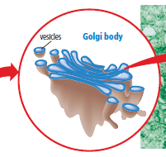
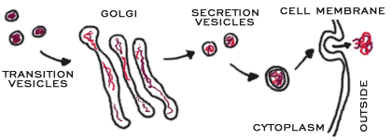
Golgi Body = Post Office
Piles of flattened sacs, layered one above the other and connected to each other.
Sorts and Repackages proteins
One side receives protein-filled vesicles from the ER which are then transformed into more complex proteins, sorted and then repackaged into vesicles to be moved within the cell or to the outside.
bleb
Notes:
They are also sorted depending on their final destinations, such as plasma membrane, lysosome, etc. and then sent their way
The multiple sacs of the Golgi serve as different chambers for chemical reactions

Slide 41
Golgi Body = Post Office
Notes:
They are also sorted depending on their final destinations, such as plasma membrane, lysosome, etc. and then sent their way
The multiple sacs of the Golgi serve as different chambers for chemical reactions

Slide 42
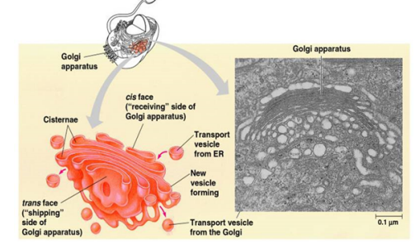

Slide 43
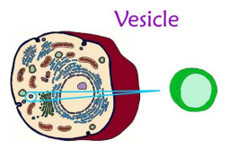
Vesicles = transport units
Small membrane-wrapped packages that carry proteins, nutrients and water around the cell.
Can be made by the Golgi Apparatus or from an in-folding of the cell membrane.

Slide 44
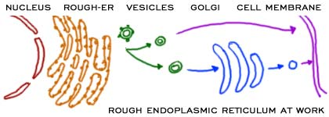
Organelles work together

Slide 45
Notes:
They are also sorted depending on their final destinations, such as plasma membrane, lysosome, etc. and then sent their way
The multiple sacs of the Golgi serve as different chambers for chemical reactions

Slide 46
What would happen to cells without the endoplasmic reticulum?
Without the RER the cell is not able to synthesis new plasma membrane proteins, lysosomal enzymes, proteins for the Golgi apparatus and proteins for extracellular secretion.

Slide 47
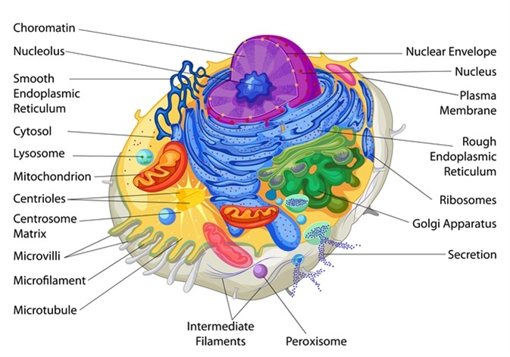

Slide 48
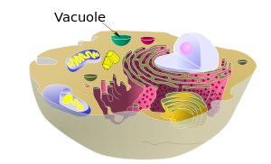
Vacuoles = Storage
    temporary storage compartments that store nutrients or waste.

Slide 49
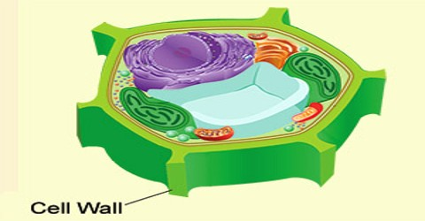
Vacuoles
Plant cells have a large central vacuole for storing water.

Slide 50
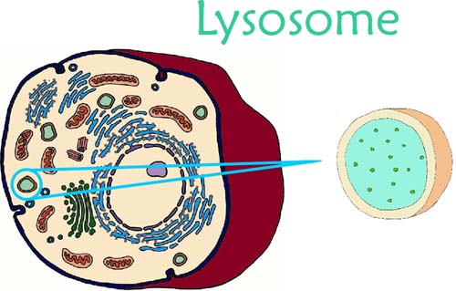
Lysosomes = Garbage Disposal
Specialized vesicles that contain enzymes that digest (break down) food particles, cellular waste, and worn-out organelles.
Notes:
Several inherited diseases affect lysosomal metabolism. • These individuals lack a functioning version of a normal hydrolytic enzyme. • These diseases include Pompe's disease in the liver and Tay-Sachs disease in the brain

Slide 51
  Cell Wall = Structure and Support
A tough, rigid structure surrounding the cell membrane
Protects and supports the cell and give the cell shape
Found in cells of plants, fungi, bacteria, algae.

Slide 52
Cytoskeleton
Tiny tube-like structures in the cytoplasm that provide support and maintain shape, anchor the organelles, and allow them to move when appropriate.
Made of microtubules.

Slide 53
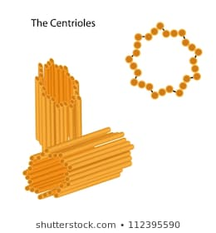
Centrioles
Cylindrical organelles occurring in pairs (centrosome)
involved in cell division.
Only found in animal cells.

Slide 54
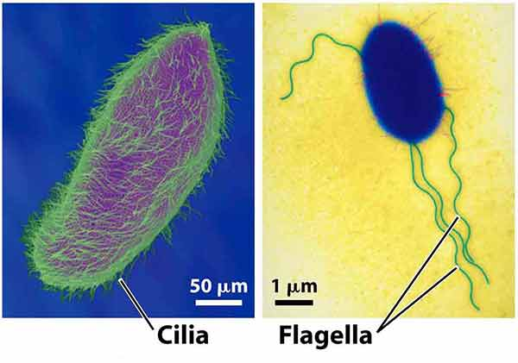
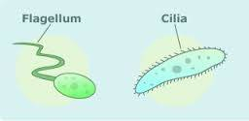
Cilia and Flagella
Short, Numerous hair like structures used
for movement by many unicellular organisms.
Made of microtubules.

Slide 55
Flagella
Like cilia but longer
Also for movement

Slide 56
Practice
Cell WB p10-12

Slide 57
Compare Plants and Animals
Do you think plant cells have all the same organelles as animals?

Slide 58
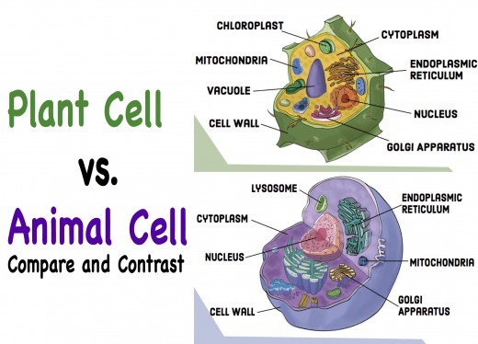

Slide 59
Plants and Animals
Do you think plant cells have all the same organelles as animals?
What could be different?

Slide 60
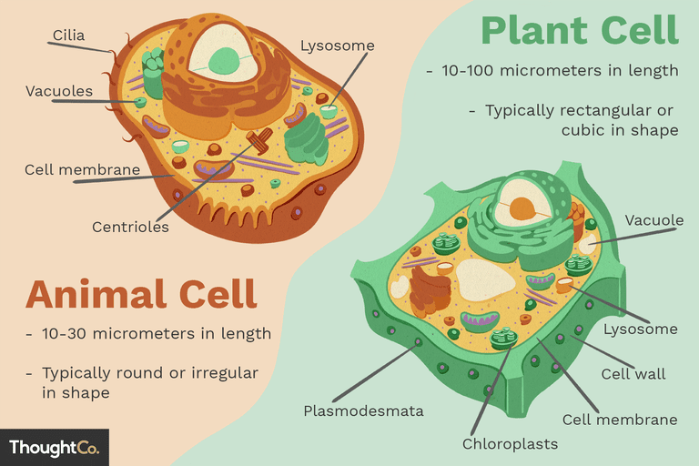
Difference between Animal and Plant Cells

Slide 61
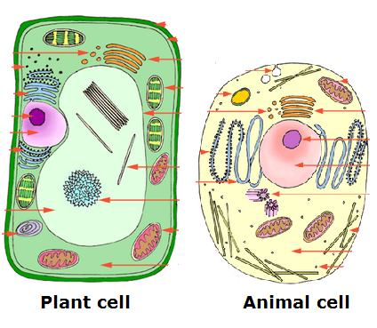

Slide 62
Size: Plant cells can sometimes be bigger.
Animal Cells
Plant Cells
10-30 um in length
10-100um in length

Slide 63
Shape:
Plant cells are often square or rectangular
Animal cells are more rounded

Slide 64
  Plant Cells have a Cell Wall
Cell Wall is a tough, rigid structure that surrounds the cell membrane
Protects and supports the cell and give the cell shape

Slide 65
Centrioles
Plant cells have no centrioles

Slide 66
Plant cells have large central vacuole
For storing water

Slide 67
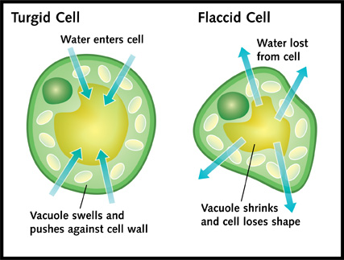

Slide 68
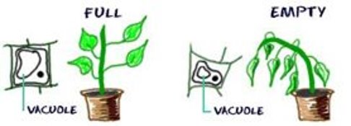
Notes:
Plants can’t move to get water, need to store it when it comes.

Slide 69
Plant cells have chloroplasts
Animal Cells

Slide 70
Amoeba Sisters video on Photosynthesis
https://www.youtube.com/watch?v=uixA8ZXx0KU

Slide 71
Organelles summary
Cell organelles animation
https://www.youtube.com/watch?v=URUJD5NEXC8
Organelles Amoeba sisters
https://www.youtube.com/watch?v=8IlzKri08kk

Slide 72
Check your understanding
A cell that produces a lot of proteins might have more of which organelle(s)?
A cell whose job is about secretion might have more of which organelle(s)?
Cells that require a lot of energy might have more of which organelle?
Compare photosynthesis and cellular respiration
Compare plant and animal cells.
Notes:
Cells that require lots of proteins may have more ribosomes and ER.
Cells that secrete a lot may have more Golgi bodies
Cells that require a lot of energy may have more mitochondria.

Slide 73
Practice
Discuss the difference between prokaryotic and eukaryotic cells.
Identify 3 differences between plant and animal cells.
Label the diagrams and state the function of each organelle:

Slide 74
Assignment: 3D model of a cell
Using recycled materials from around the home, create a 3 dimensional model of a plant or animal cell. Must include:
Title (plant or animal), your names, block
Include all parts listed
All parts must be labeled or use a legend
Brief description of function of each organelle
Each type of organelle must look different from the others

Slide 75
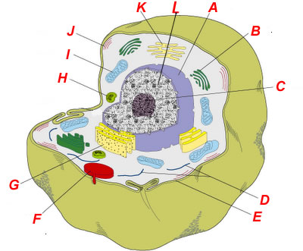

Slide 76
Cellular respiration
Both plants and animals
Doesn’t require sunlight

Slide 77
Difference between Bacteria and Virus
Amoeba Sisters
https://www.youtube.com/watch?v=kxM_9DL2GYw

Slide 80
Newo Colony Activity
An analogy is a way to understand new ideas by making a comparison.
A factory can be used as an analogy for the cell.
How is the Newo colony similar to a factory?
See pages 22 - 24

