Slide 1
Biomes can be divided into Ecosystems

Slide 2
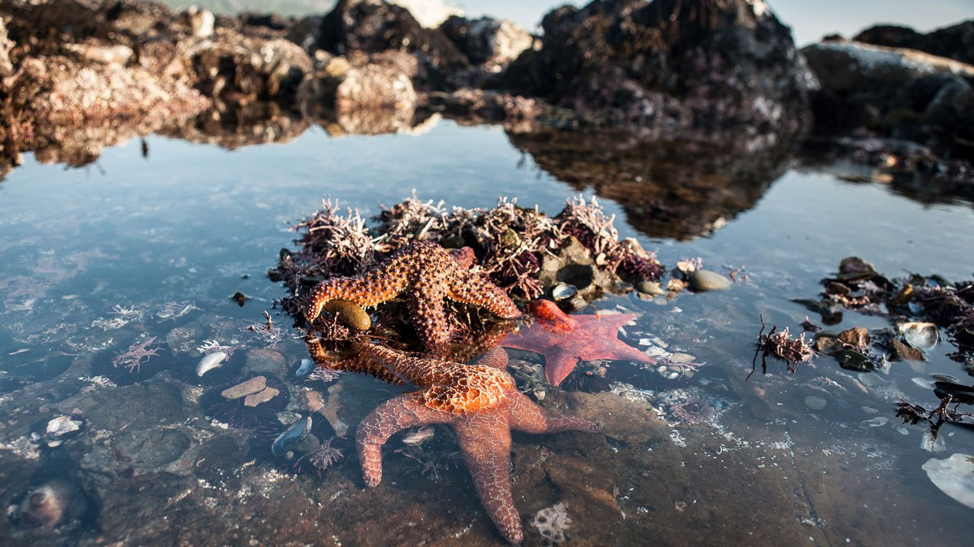
What is an ecosystem?
An ecosystem has abiotic components (such as oxygen, water, nutrients, light and soil) that interact with biotic components such as plants, animals and microorganisms.
Biomes may contain many ecosystems
Ecosystems may cover many hectares of land, or be very small such as a tide pool or a rotting log.

Slide 3
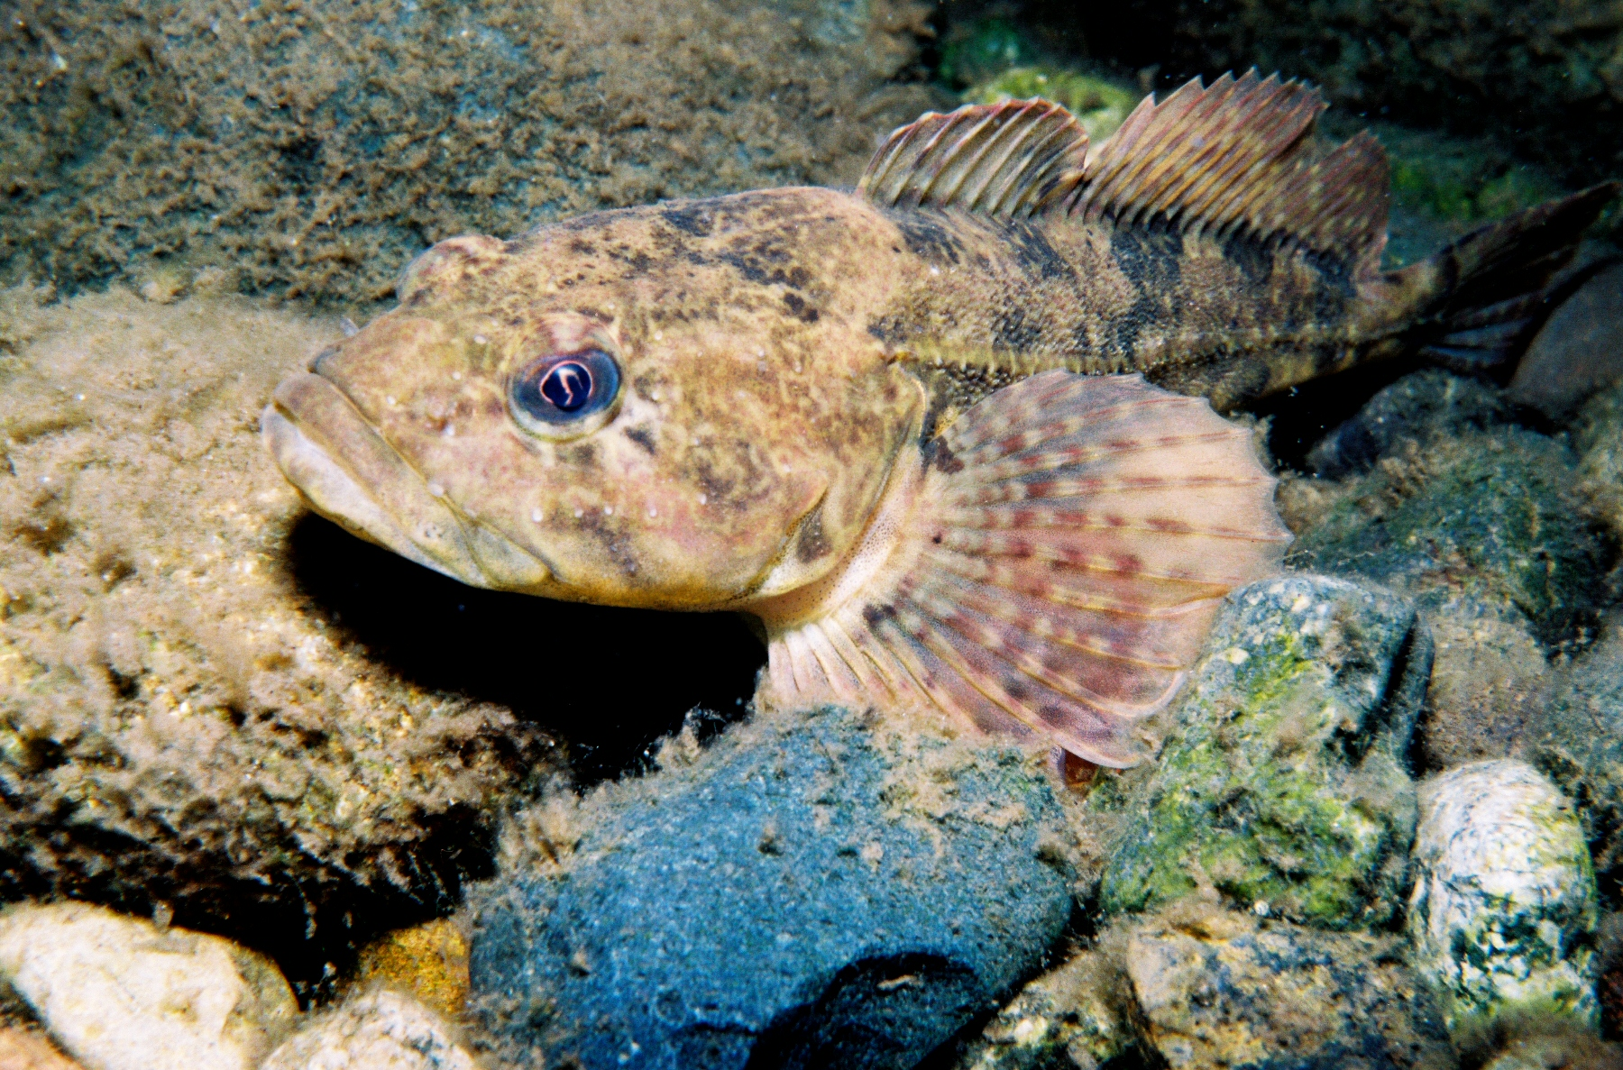
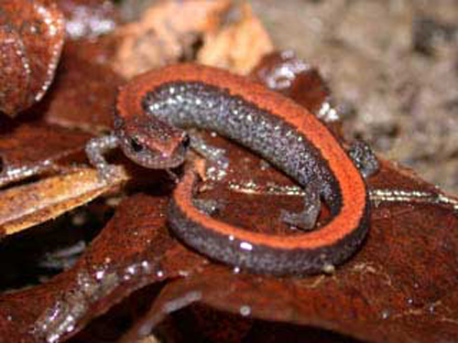
Ecosystems can be divided into Habitats
Habitat is the place in which an organism lives
Eg Sculpin fish lives between the rocks at the bottom of a tidepool
Salamander makes its nest in the decaying wood of a fallen tree

Slide 4
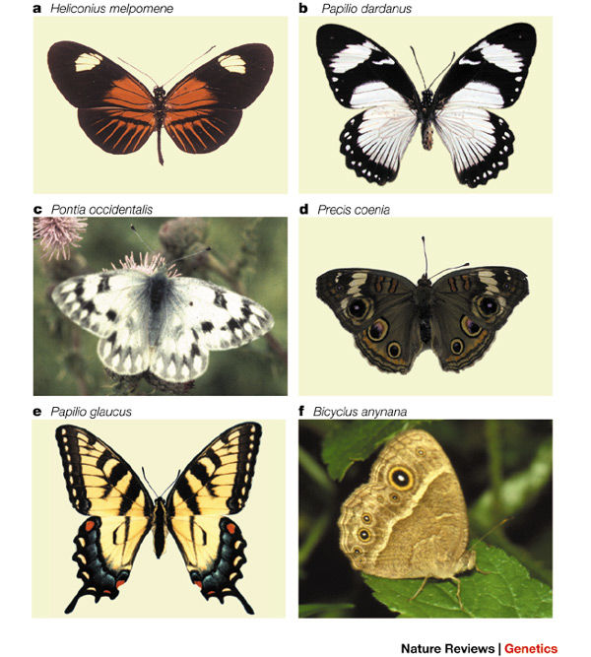
Species
A species is a group of closely related organism that can reproduce with one another.
Eg Swallowtail species of butterfly will not breed with Monarch species of butterfly

Slide 5
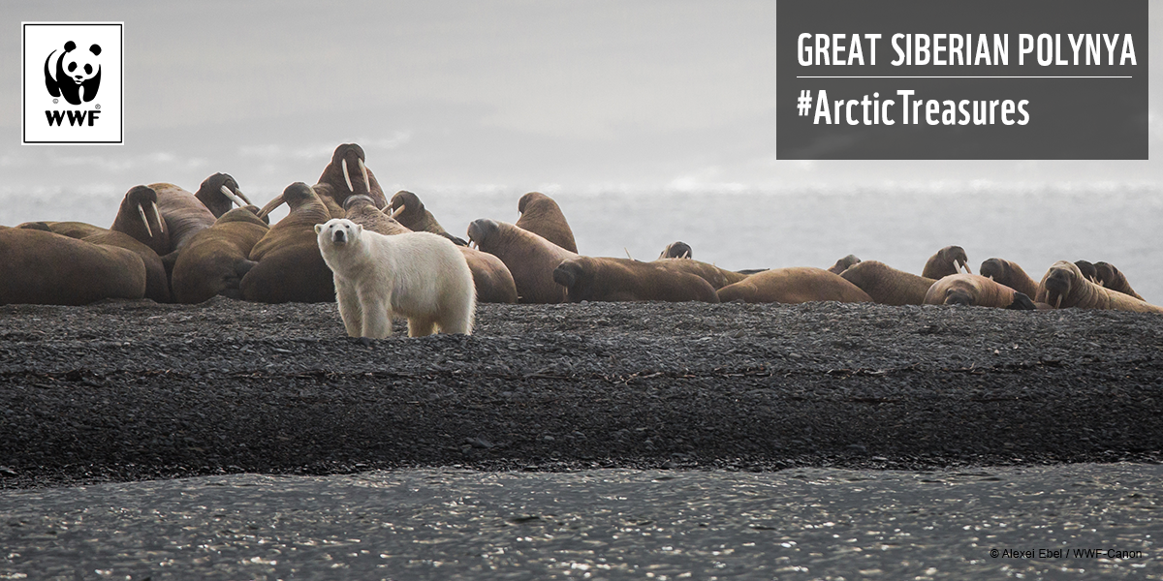
Populations
A population refers to all the members of a particular species within an ecosystem.
Eg. Polar bear population on Greenland
Different populations within ecosystems interact with each other.
Notes:
They also eat many other kinds of benthic invertebrates including worms, gastropods, cephalopods, crustaceans, sea cucumbers, and other soft-bodied animals. Walruses may occasionally prey on fishes such as polar cod.

Slide 6
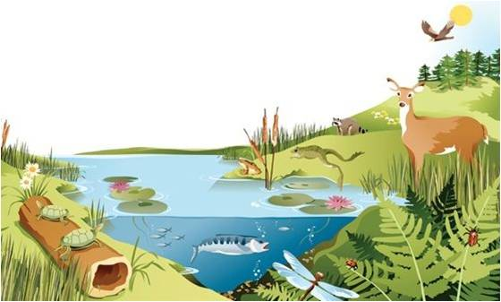
Community
A community is all the populations of the different species that interact in a specific area or ecosystem

Slide 10
How are abiotic factors important in ecosystems?

Slide 11
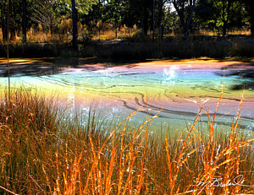
Oxygen
Plants and animals cannot survive without oxygen.
In wetlands, water plants such as certain types of grass and algae produce oxygen, which is used by other organism that live in water. If the plant life in a wetland is damage because of pollution, you may see fish gulping for air.

Slide 12
Water
Cells of most living things contain between 50 -90% water.
ALL organisms require water to survive.
You can go longer without food than you can without water.
Water also carries nutrients from one place to another in ecosystems.
Notes:
Ecosystems vary in the amount of light they recieve

Slide 13
Nutrients
Nutrients such as nitrogen and phosphorous are chemicals that are required for plant and animal growth.

Slide 14
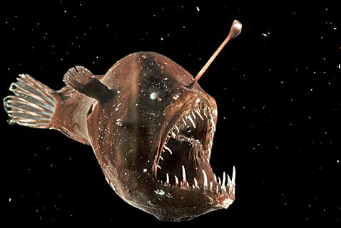
Light
Light is required for photosynthesis, a chemical reaction that converts solar energy into chemical energy used by plants.
The amount of light varies in each ecosystem:
Marine ecosystems, the amount of light decreases in deeper water, so fewer plants can grow.
In the forest canopy, much more light is available for photosynthesis.

Slide 16
Soil
Soil provides nutrients for plants and supports many species of small organism.
- A square meter of soil may contain as many a 1000 different species of invertebrates (animals with no backbone).
- Several thousand species of bacteria can be found in one gram of soil.
Soil anchors plant in one place and absorbs and hold water, making it available for both plants and animals.
How can living organisms affect the soil?

Slide 17
Can Living Organisms (Biotic Components) Affect Non-living (Abiotic Components)?

Slide 18
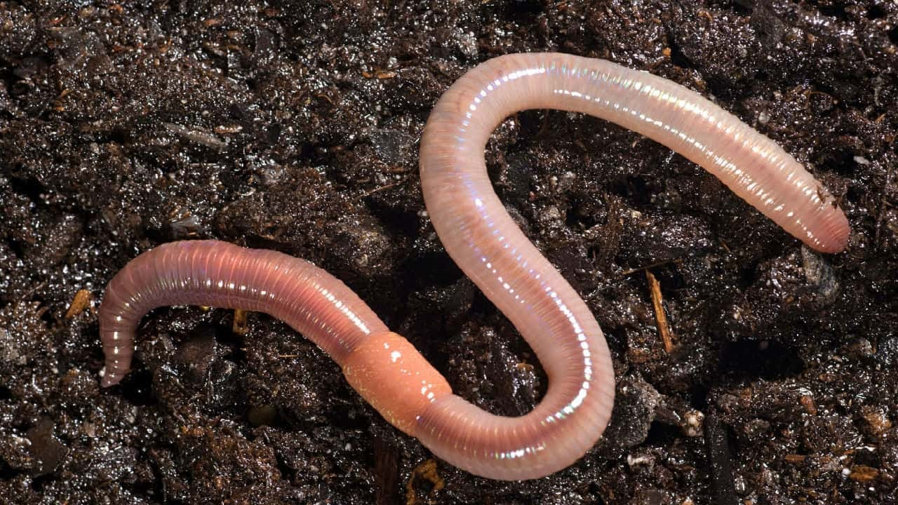
Living organisms affect the Soil
Earthworms loosen the soil by tunnelling though soil, allowing water and nutrients move more easily though soil; they also enrich the soil with their castings.
Some bacteria break down pollutants.
Decomposers breakdown dead plants and animals, returning their nutrients to the soil.

Slide 19
Check your Understanding
What is an ecosystem?
What is a habitat?
What are three abiotic components of an ecosystem necessary for supporting life?
Explain how soil is important to ecosytems.
What is a species?
What is a population?
What is a community?
How can biotic factors affect abiotic factors with an ecosystem.

Slide 20
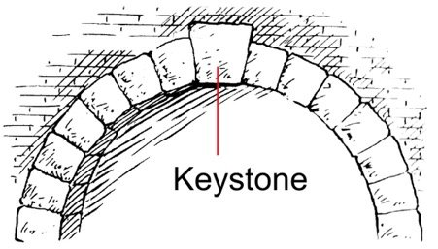
Keystone Species
A keystone species is an organism that helps define an entire ecosystem.
Without its keystone species, the ecosystem can change dramatically.
Eg. Sea otter
Notes:
Crabs, snails, clams, and shrimp are also found in kelp forests. Sea otters play a very important role in keeping kelp forest ecosystems healthy. The sea otter is an example of an important keystone species (a species that, if removed, has a great effect on other species in its food web

Slide 21
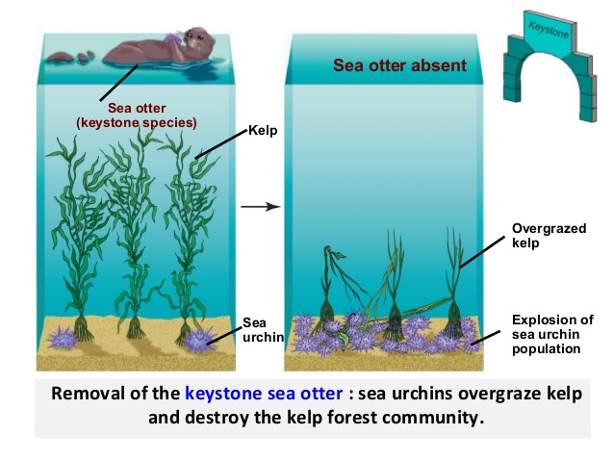
Keystone Species
Sea otters
Notes:
When sea otters were removed from some areas, the sea urchins and other herbivores quickly managed to severely reduce the kelp, allowing barnacles and mussels to flourish at the cost of other species. An example of a keystone speciesfound throughout Canada is the beaver.

Slide 23
Grey Wolf of Yellowstone Park

Slide 24
How can the addition or removal of one species have an impact on other species or even abiotic factors?
Ted Ed:
https://ed.ted.com/on/wM14ZLAs#discussion

