Slide 1
Factors Affecting the Immune System

Slide 2
When is someone more susceptible to infection?

Slide 3
When is someone more susceptible to infection?
If you are tired and feeling "run down“ you may be more susceptible to getting sick because you are less likely to be able to fit off infection.
When you engage in risky behaviour
If you are old: Elderly population may weakened immune system
Some people are Immunocompromised
Some people have a Genetic predisposition to certain disorders

Slide 4
How else can we prevent getting sick?

Slide 5
Prevention goes a looooong way
WASH HANDS OFTEN!
Don't touch your face
Don't engage in risky behaviour...
You may have natural Immunity:
If you have been Exposed before
If you have a genetic protection
Notes:
Being within 2m of a sneeze.
Sharing fluids

Slide 6
What do we take when we are sick?

Slide 7
Antibiotics
Antibiotics are substances that can either kill or prevent bacteria from growing by disrupting their cell wall.
We take antibiotics after we know what infection we have.
Usually taken in pill form
Penicillin was the first antibiotic developed
Tetracyclin,….

Slide 8
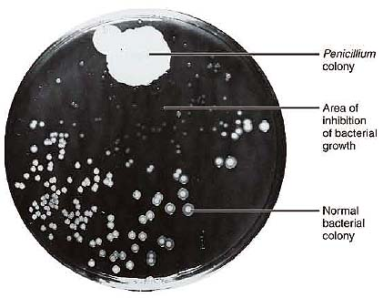
Penicillin is an antibiotic that came from mold
By accident in 1928, a British scientist named Alexander Fleming returned to his laboratory from holiday to find several petri dishes with Staphylococcus aureus bacteria still on his bench.
One dish also had a large patch of mould growing on it. No bacteria were growing around the mould.
Derivatives: erythromycin, amoxicillin and tetracycline
https://www.youtube.com/watch?v=0ZWjzcsTd5M

Slide 9
Why should we be cautious about taking antibiotics?

Slide 10
Why should we be cautious about taking antibiotics? Not all bugs need drugs.
Antibiotics only work against bacterial infections, NOT viruses or other microbes.
Sometimes the body can take care of itself
Antibiotics may kill good bacteria in our bodies
Some bacteria can develop a RESISTANCE to antibiotics

Slide 11
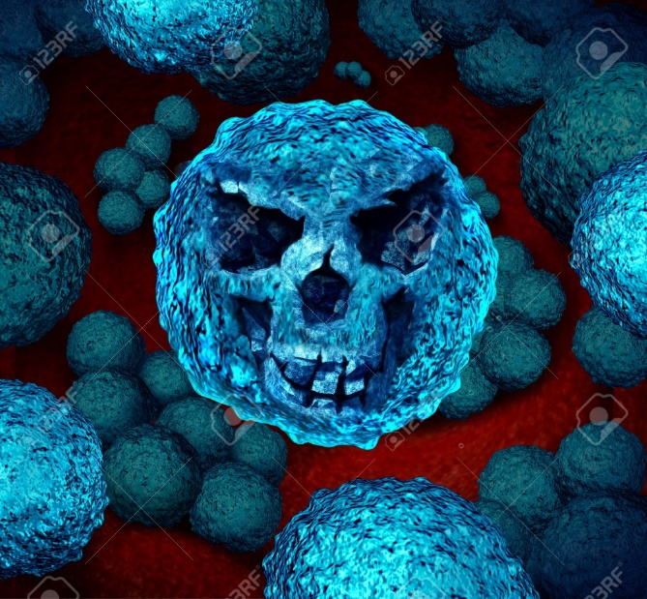
“Super bugs” are bacteria that have become resistant to several types of antibiotics
Eg MRSA (Methicillin-resistant Staphylococcus aureus ).
Some disease such as tuberculosis, pneumonia and meningitis are now more difficult to treat as a result of antibiotic-resistant bacteria
Ted Ed 4.5 min optional
https://www.youtube.com/watch?v=znnp-Ivj2ek
Antibody Apocalypse https://www.youtube.com/watch?v=xZbcwi7SfZE

Slide 12
What can we take to prevent use from getting sick?

Slide 13
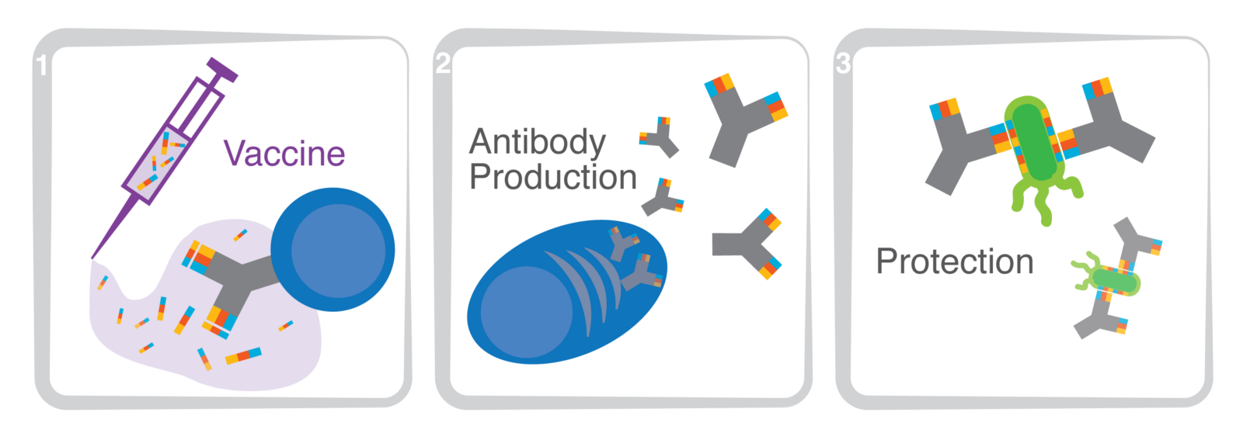
What are vaccines? How do they work?
Vaccines are injections of a weakened, killed, or piece of pathogen given to people to stimulate your body to create antibodies against that particular disease (usually a virus).
Notes:
Antibodies stick to the virus or bacteria and mark it for destruction

Slide 14
Types of Vaccines
Live attenuated (weakened) eg. MMR, Flu
Killed (inactivated) eg. Polio, Hepatitis A
Part of the pathogen eg. DTaP (D, T)
Toxin produced by the pathogen eg. “P” part of DTaP, Hepatitis B,
Mimics of the pathogen
types of vaccines, 2min https://www.youtube.com/watch?v=Zcftgu1Dwk4

Slide 15
Concerns and Misinformation about vaccines
So many vaccines may overwhelm baby’s immune system
Child’s immune system is too immature – better to wait
Vaccines contain toxins, such as mercury, aluminum, formaldehyde, and antifreeze
Vaccines don’t really work anyway (Flu)
Vaccines are a way for pharmaceutical companies to make money
Side effects are worse than the actual disease
Forcing vaccination is a violation of rights
Autism
Notes:
https://www.parents.com/health/vaccines/controversy/8-reasons-parents-dont-vaccinate-and-why-they-should/

Slide 16
4 Corners: Should it be mandatory for everyone to get vaccinated?
If these diseases are so rarely deadly, what’s the point?
Strongly Agree Agree
Disagree Strongly Disagree

Slide 17
Vaccines give immunity
Vaccines give you immunity, preventing you from getting that particular disease:
If a vaccinated person is exposed to that same pathogen, the immune system remembers it and immediately begins to defend the body against it.
Sometimes booster shots are required to increase the antibody production and extend the immune system’s memory for that antigen.
Notes:
Antibodies stick to the virus or bacteria and mark it for destruction

Slide 18
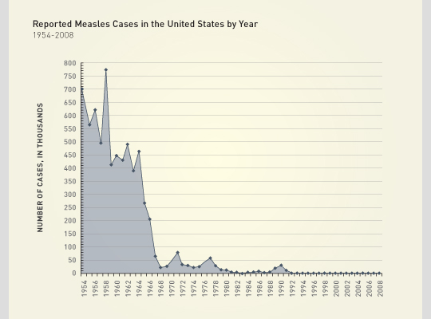
Vaccines can help stop the spread of disease.
E.g. Live measles vaccine was given in Canada in 1963, and by the early 1970s.
Why the blips?
Notes:
Why the blips? Virus always around. Sometimes we stop vaccinating.
Small pox has been a devastating disease. But after worldwide vaccination, it was declared eradicated in 1980.

Slide 19
Why Vaccinate?
Vaccines create “Herd Immunity” - a form of indirect protection: when a large percentage of a population is immune to an infection, this provide protection for individuals who are not or cannot get vaccinated:
Babies who are too young
Immunocompromised individuals
People allergic to components of the vaccine
Cultural or religious reasons
Why vaccines work- herd immunity (7:22): https://www.youtube.com/watch?v=3aNhzLUL2ys
ASAP Science debunks anti-vaxxers, (7min)
https://www.youtube.com/watch?v=b03U6BYF9L0

Slide 20
FAQ: Why don’t we just make vaccines for everything?

Slide 21
Why don’t we just make vaccines for everything?
Some viruses mutate
Eg. common cold
Eg. the flu

Slide 22
FAQ: Why take all these vaccines separately?
Why not combine them all into one?

Slide 23
FAQ: Why take all these vaccines separately?
Why not combine them all into one?
This would overwhelm our immune system

Slide 24
Check your understanding
What are the various type of vaccines?
How do vaccines work?
How are they different that antibiotics?
How do they affect the general population?

Slide 25
How did Vaccines originate?

Slide 26
Small Pox
One of the deadliest and most contagious diseases known to humankind.
Smallpox killed over half a billion people in the 20th century alone — three times the number of deaths from all of the century's wars combined.
It began with flu-like symptoms, progressing to an horrendous rash consisting of deep sores, filled with fluid that would blister, ooze, crust and scab over, leaving permanent scars on those lucky enough to survive.
1/3 of the survivors went blind.
.
Notes:
Smallpox is thought to arrive here from Asia through major trade routes, like the Silk Road. Crusades further contribute to the spread of smallpox in Europe with the European Christians moving to and from the Middle East during the next two centuries.
The last known natural case was in Somalia in 1977. In 1980 WHO declared smallpox eradicated

Slide 27
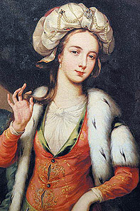
Story of Lady Montagu:
How One Daring Woman Introduced the Idea of Smallpox variolation to England.
Notes:
in April 1721, a smallpox epidemic was raging in England.
Mary’s beloved only brother had died from the smallpox. When she also fell ill, only two years after her brother’s death, she narrowly escaped with her own life. Her skin now bore the tell-tale scars left by the disease. Her eyes suffered too. She could never look at bright light again. She also lost all her eyelashes
After her own battle with smallpox, Mary went to live in Constantinople in Turkey with her husband. Daughter born there

Slide 28
Small Pox
April 1721, a smallpox epidemic was raging in England.
Mary’s only brother had died from the smallpox.
2 years later, she also fell ill but survived. Her skin was scarred She could never look at bright light again. She also lost all her eyelashes.
Later, Mary went to live in Constantinople in Turkey with her husband.

Slide 29
Lady Mary had witnessed the Turks employing a technique known as ‘engraftment’ against smallpox.
A small sample of pus from open wounds would be taken from someone who had the disease, and the pus mixed into their bloodstreams.

Slide 30
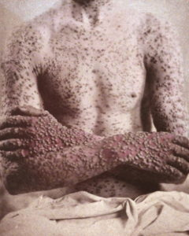
As a result of inoculation, smallpox was far less virulent in Turkey than it was back in England.
She had her older son inoculated before returning to England. Did not inoculate her daughter yet as she was just a baby.
Notes:
Mary was the first Western woman to be invited to dine alone with the wives of senior Turkish officials.
Her hostesses there assured her that inoculation was totally safe.

Slide 31
After many more dying in England due to smallpox, Mary decided to speak up about the inoculation procedure.....
1721. Had her own daughter inoculated in front of many who ran a temperature and a few harmless spots.

Slide 32
How we beat smallpox
Ted Ed 4.5 min
https://youtu.be/yqUFy-t4MlQ
Notes:
"The technique was introduced to England in 1721 by Lady Mary Wortley Montagu and she called it inoculation, or engrafting which is how she had heard it described in Turkey. Later it came to be known as variolation and was widely practised in Britain until replaced by Jenner's vaccine inoculation," Gower said.
In rural parts of Britain, there was a tradition that those who had contracted cowpox would also be safe from smallpox. Cowpox is a disease usually affecting cattle, but it could also be passed to people in close contact with animals, causing mild symptoms.
Jenner decided to apply scientific tests to the country legend and began collecting evidence of people who had contracted cowpox and then been exposed to smallpox without becoming infected.
https://www.nzherald.co.nz/lifestyle/smallpox-and-the-photos-anti-vaxxers-dont-want-you-to-see/24MJGHWAIJRJYD6LIPQ6ZTBKHI/

Slide 33
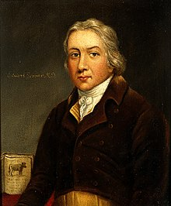
Edward Jenner developed the first vaccine
80 years later Edward Jenner realized that a milkmaid infected with cowpox would not subsequently get smallpox.
Ted Ed on Variolation
https://www.youtube.com/watch?v=yqUFy-t4MlQ

Slide 34
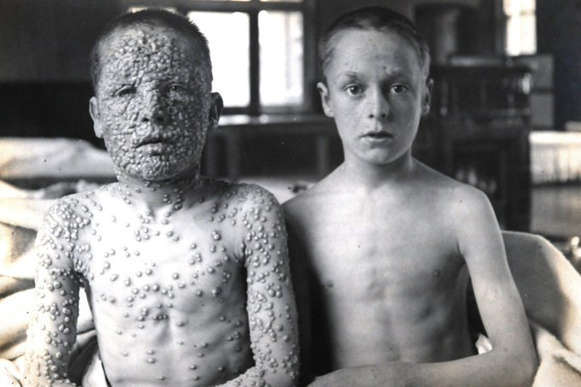
Both boys were exposed to smallpox, but only the boy on the right had previously been vaccinated.
1901
Notes:
Both boys were exposed to smallpox, but only the boy on the right had previously been vaccinated. The photograph, taken by a doctor working in Leicester, was first published in 1901

Slide 36
Why Vaccinate?
What are the pros and cons of getting vaccinated?
Why vaccines work- herd immunity (7:22): https://www.youtube.com/watch?v=3aNhzLUL2ys
How vaccines work controversy https://www.youtube.com/watch?v=Y6E5Euli2Fc

Slide 37
What can we do if we do get sick?

Slide 38
Should we treat livestock with Antibiotics?
Antibody Apocalypse:
https://www.youtube.com/watch?v=xZbcwi7SfZE

Slide 39
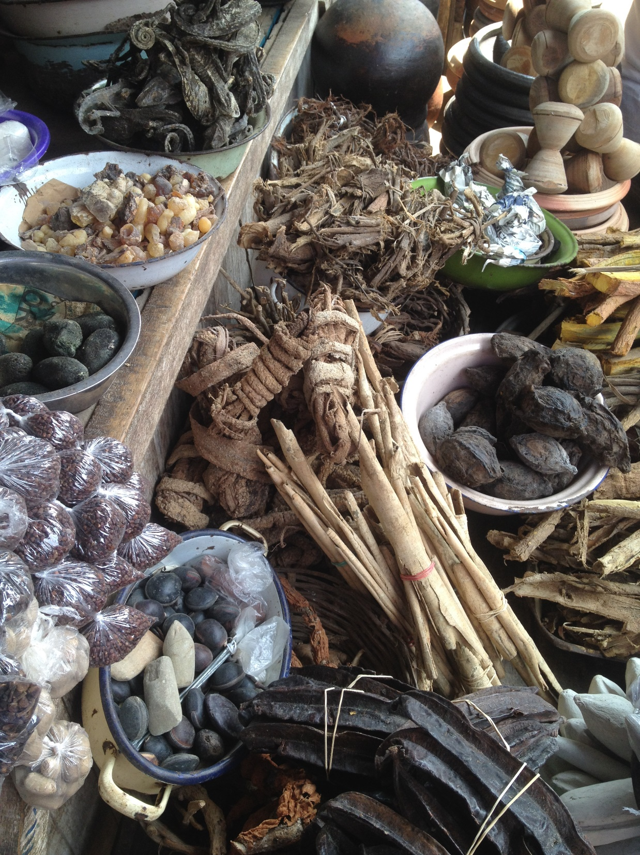
Traditional Knowledge
Knowledge and practices of indigenous and local communities around the world.
Developed from experience gained over the centuries and adapted to the local culture and environment.
Often transmitted orally from generation to generation.

Slide 40
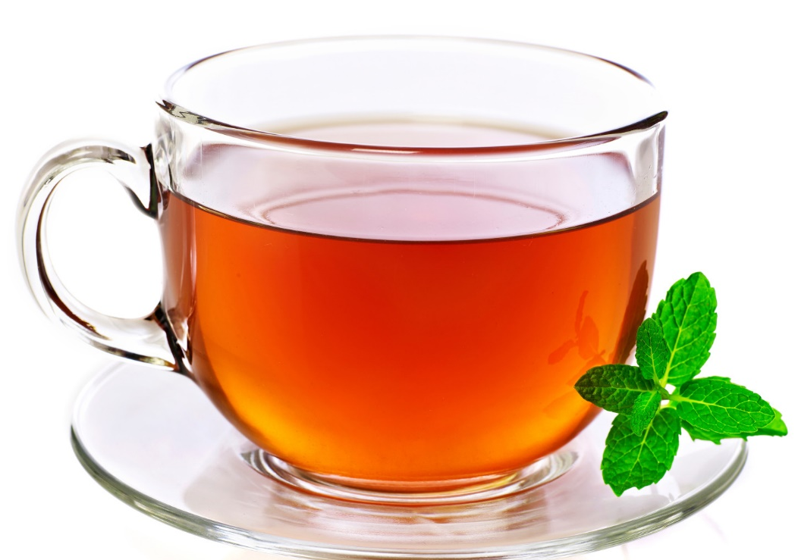
Traditional Knowledge
Home Remedies
What home remedies have you used?

Slide 42
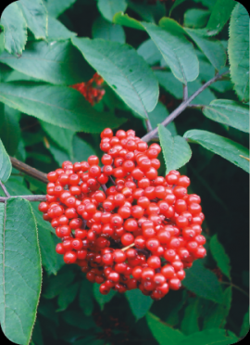
First Peoples in British Columbia knew how to use resources from nature for medicinal purposes.
plants, animals, and even clay deposits were used to treat various illnesses and conditions such as stomachaches, aching joints, sore eyes, fevers, nosebleeds and coughs and colds.

Slide 43
Medicine in your own backyard. CBC (3 min)
https://www.cbc.ca/news/canada/saskatoon/indigenous-medicinal-walk-1.4235900

Slide 44
Practice: Compare Vaccines and Antibiotics WS
What is it made out of?
How is it taken?
When is it taken?
What is it effective against?
What are some examples?
WS
Measles graphing activity
How do vaccines work? Ted ed: https://youtu.be/rb7TVW77ZCs
What are the pros and cons of getting vaccinated?
How vaccines work controversy https://www.youtube.com/watch?v=Y6E5Euli2Fc

Slide 45
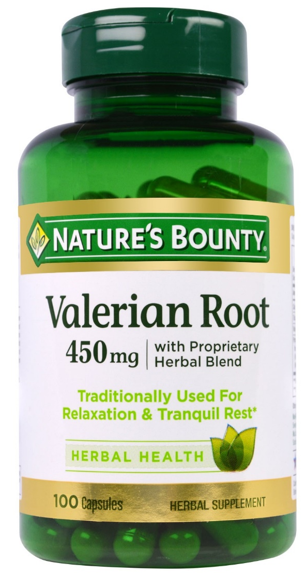
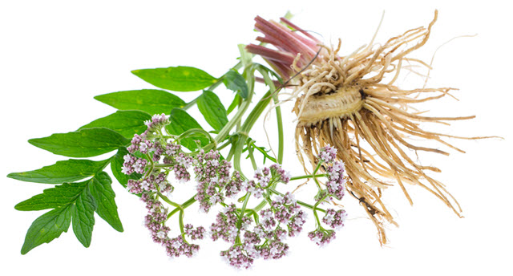
Valerian Root
helps with sleep problems

Slide 46
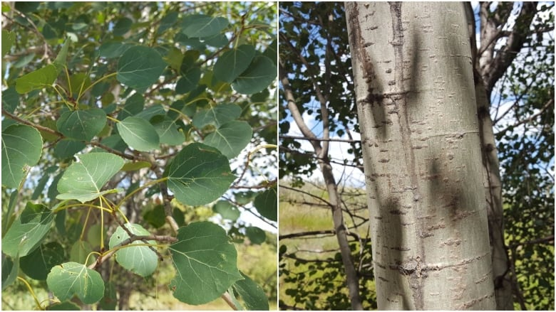
Trembling Aspen
Predict rain
Can be used as suncsreeen

Slide 47
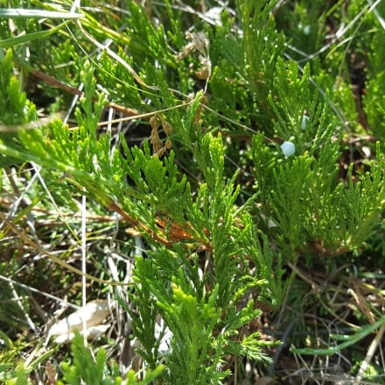
Creeping Juniper
Tea for back pain
Keeps out rodents
Berries were used for birth control

Slide 48
Stinging Nettle

Slide 49
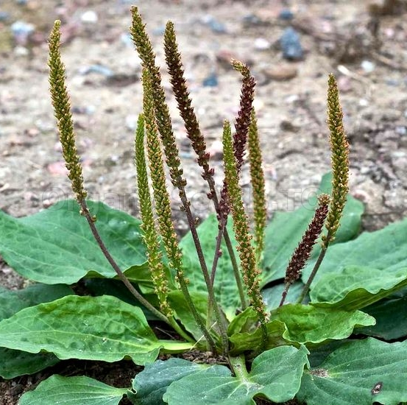
Plantain
Stops bleeding
Reduces pain and itching from bites

Slide 50
Yarrow
Insect repellent
Tea helps with fever, colds and flu

Slide 51
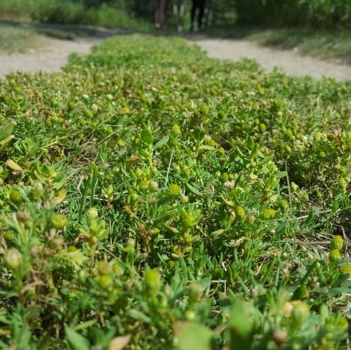
Pineapple Weed (chamomile)
Tea helps with insomnia

Slide 52
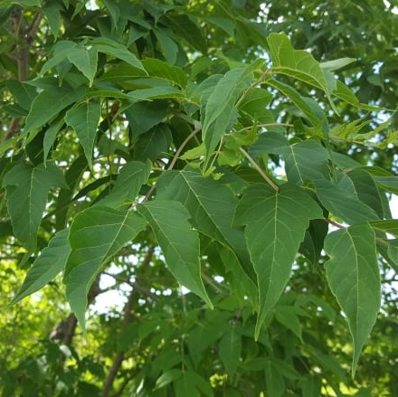
Manitoba Maple
Sap for sweetner, sore throat
Snow shoes and spears

Slide 53
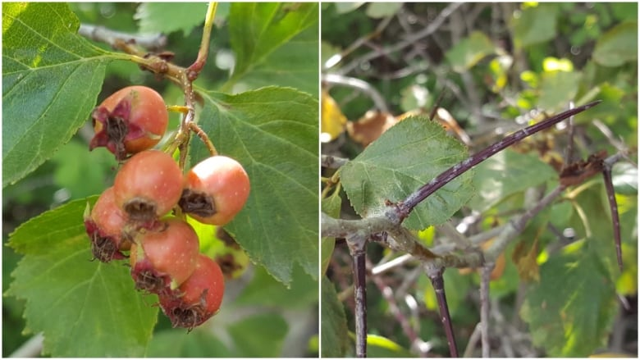
Hawthorn
Berries good for the heart
Thorn for fishing hooks, sewing needles

Slide 54
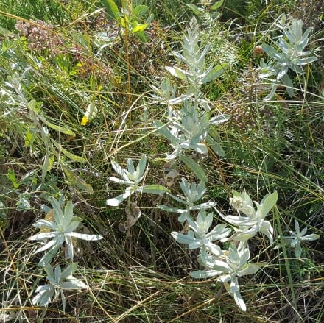
Female Sage
Deodorant, mosquito repellent
Tea for detoxify

Slide 55
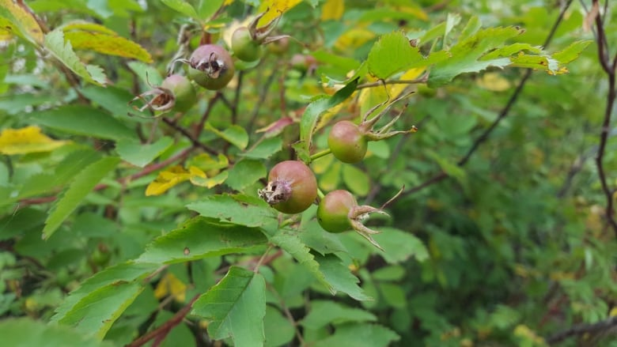
Rose Hips
High in Vit C

Slide 56
Lichen

Slide 57
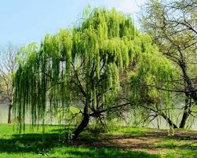
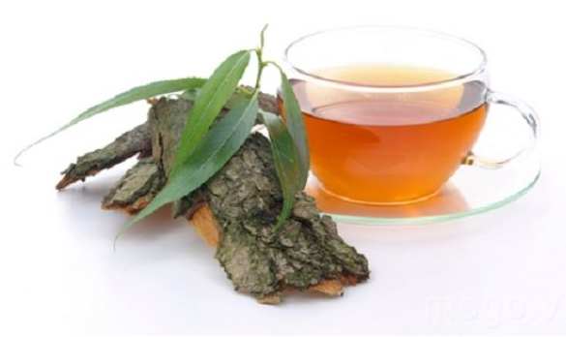
Willow bark
bark of white willow contains salicin, has pain-relieving and anti-inflammatory effects
Used to treat inflammation and injury
Today Western Medicine makes similar chemical, acetylsalicylic acid, the active ingredient in aspirin

Slide 58
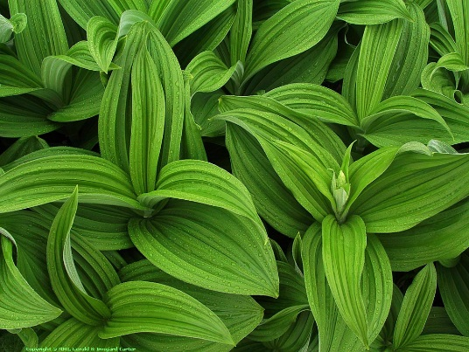
Indian Hellebore
Used by Nuxalk Nation to treat skin and scalp conditions.
When burned, smoke can be used as a decongestant

Slide 59
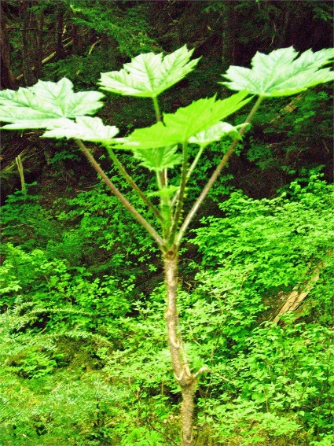
Devil’s Club
Inner bark used to treat breathing and digestive disorders as well as arthritis and diabetes
also used for emptying the bowels and causing vomiting.
Notes:
The plant has been used internally to treat a variety of conditions including influenza, measles, diabetes, cancer, arthritis, and rheumatism. Devil's club has been used as a purgative, emetic, and cathartic in higher doses.
arthritis, wounds, fever, tuberculosis, stomach trouble, cough, colds, sore throat, diabetes, low blood sugar, and pneumonia. It is also used foremptying the bowels and causing vomiting.

Slide 60
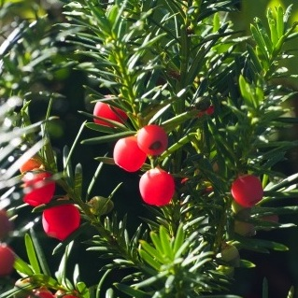
Pacific Yew
Tea from the needles and bark to treat pain and internal injuries
Bark also has cancer fighting chemicals

Slide 61
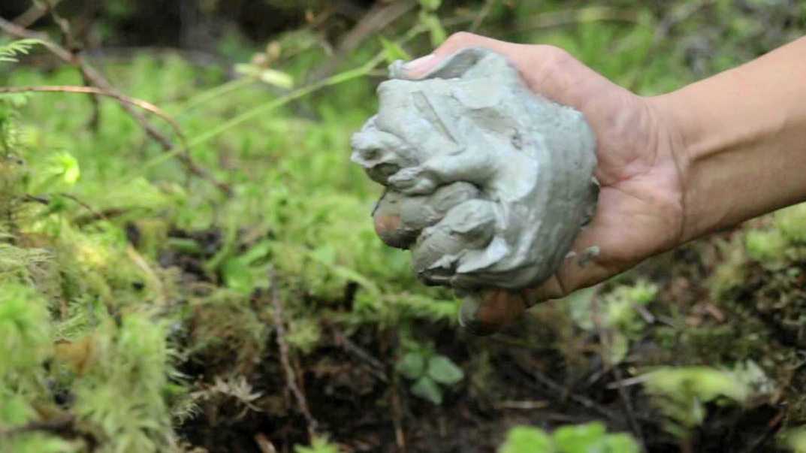
Kisameet Clay
Also called Kisolite, first discovered by the Heiltsuk people used to treat eczema, acne and psoriasis.
Also to treat a range of ailments, including ulcerative colitis, arthritis, neuritis, phlebitis, skin irritation, and burns.
found to kill bacteria resistant to antibiotics

Slide 62
Question:
Why might it be important to identify and preserve plants used for medicinal purposes?
Notes:
Some medicinal plants are at risk of being lost as the land they grow on is claimed for other uses, such as commercial farming or housing. It is estimated that 15 000 different types of medicinal plants are at risk for extinction due to overharvesting and habitat loss.

Slide 63
Why might it be important to identify and preserve plants used for medicinal purposes?
Some medicinal plants are at risk of being lost as the land they grow on is claimed for other uses, such as commercial farming or housing. It is estimated that 15 000 different types of medicinal plants are at risk for extinction due to overharvesting and habitat loss.
Notes:
Some medicinal plants are at risk of being lost as the land they grow on is claimed for other uses, such as commercial farming or housing. It is estimated that 15 000 different types of medicinal plants are at risk for extinction due to overharvesting and habitat loss.

Slide 64
Assignment
Immune System comic
Medicinal Plant Poster
Graphing Activity

Slide 65
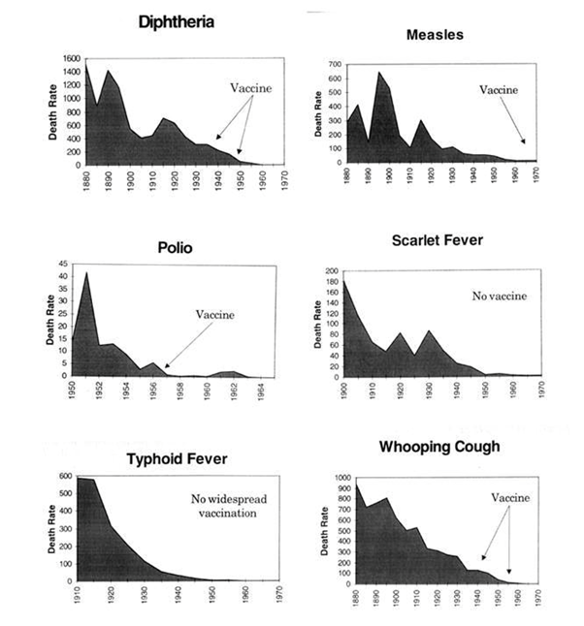
Vaccines and Public Health
Vaccines can help stop the spread of disease.
Small pox has been a devastating disease. But after worldwide vaccination, it was declared eradicated in 1980.
Notes:
spread of disease with/without vaccines:
http://www.theguardian.com/society/ng-interactive/2015/feb/05/-sp-watch-how-measles-outbreak-spreads-when-kids-get-vaccinated

Slide 66
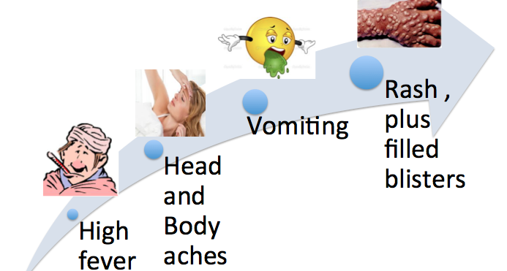
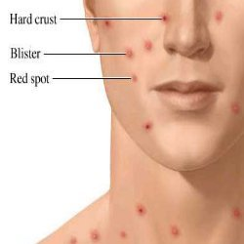
Small Pox

Slide 67
Small Pox
Killed Billions. 30 % of population.

Slide 68
Story of Lady Montagu:
How One Daring Woman Introduced the Idea of Smallpox variolation to England.
Variolation, the practice of infecting people with low doses of smallpox, dates back to 1000 BC in India.
It would generally induce a mild form of the disease, which would prevent the person from being re-infected.

Slide 69
About 26 diseases have vaccines
List of Vaccines, CDC https://www.cdc.gov/vaccines/vpd/vaccines-list.html
Why do we have so many vaccines?

Slide 70
Plant Diva
National Film Board
Library, online resources, NFB

