Slide 1
Factors Affecting Rates of Chemical Reactions

Slide 2
surface area of a solid reactant.
concentration or pressure of a reactant.
temperature.
nature of the reactants.
presence/absence of a catalyst.

Slide 3
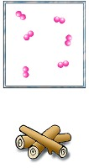
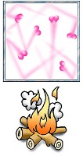
Temperature
Heating a substance give the particles more energy
The more energy particles have, the more they bump into each other and react

Slide 4
Examples
Cookies bake faster at higher temperatures.​
Bread dough rises more quickly in a warm place than in a cool one. ​
Low body temperatures slow down metabolism. In fact, warm-blooded animals regulate body temperature so that their biochemical reactions run at the correct rate.​
Light sticks glow more intensely when dropped into hot water.​
Fridge slows down food spoilage.​

Slide 5
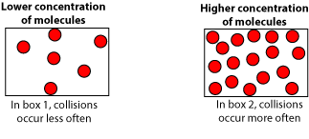
Concentration
Concentration refers to how much solute is dissolved in a certain volume of solute.​
Concentration is measured in mass per unit volume (g/L).​

Slide 6
Concentration
Usually, the higher the concentration of reactants, the faster the reaction occurs.​
Since there are more molecules per unit volume in high concentrations, there are more opportunities ​
for molecules to collide and react.​

Slide 7
Eg. a splint of wood glows brighter in highly concentrated oxygen than in normal air, with a lower concentration of oxygen Two antacid tablets will neutralize a given amount of acid faster than one tablet will.​
Higher concentrations of acid in rain erode marble faster than lower concentrations. ​
Fire extinguishers “remove” oxygen by smothering a fire, inhibiting combustion.

Slide 8
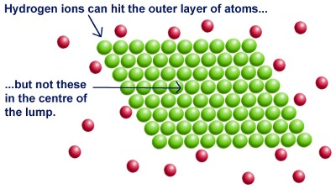
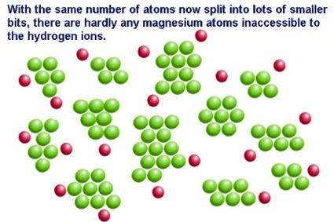
Surface Area
Surface area is the exposed surface of a solid substance
As more atoms are exposed to react, ​more reactions take place .
Eg. A powdered substance has far more surface area than one, large chunk.​
Kindling vs log.​
coffee mate​ demo

Slide 9
Lakeland Sawmill explosion April 2012​
The wood dust dispersed in the air was of sufficient concentration to explode. ​
Friction in machinery gear generated frictional heat, providing ignition source for wood dust explosion.​
Two workers dead and 22 other workers injured, many seriously.​
Coffee can demo
Coffee Mate contains Sodium Caseinate (C47H48N3O7S2Na) also known as casein. ​
Sodium Caseinate contains the flammable element sulphur . ​
When it is poured over a flame, individual particles ignite making the flame grow. ​

Slide 10
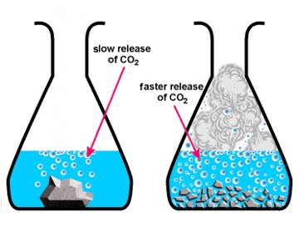

Slide 11
Catalyst
A catalyst is something that speeds up a reaction without being used up in it. ​
Eg. Biological Catalysts are enzymes.
Saliva has enzymes that help speed the breakdown of starches when they enter the mouth.
Notes:
Catalysts often lower the amount of energy necessary to break the bonds holding reactants together (activation energy).​

Slide 12
Enzymes are Catalysts
Protease is used commercially to soften the meat.​
Lactase to produce lactose-free milk.​
Maltase to hydrolyse starch ​
Beer and bread are typically made with yeast, a living organism containing enzymes.​

Slide 13
Catalysts
Chlorine from CFCs acts as a catalyst to transform ozone (O₃) in our atmosphere to elemental oxygen, which is not nearly as effective as ozone for shielding Earth from ultra-violet light. ​ ​ It is estimated that a single chlorine atom can destroy up to 1 million ozone molecules per second. ​

Slide 14
catalytic converter
A catalytic converter is a device installed in all cars to decrease pollution. ​
Car exhaust passes through the catalytic converter before leaving the car.​
A series of reactions involving catalysts, platinum, rhodium and palladium, convert toxic carbon monoxide into carbon dioxide.​
Poisonous nitrogen oxides are converted into nitrogen gas and oxygen gas. ​

Slide 15
Assignment
Research an important chemical reaction
Describe the type of reaction it is
Factors that affect it.

