Slide 1
Light, Wavelength and Colour

Slide 2
Colour Activity
Colour Wheel
https://www.youtube.com/watch?v=7iV1m4j2wJQ
Play with prisms

Slide 3
Regroup
What colour(s) do you see when the colour wheel spins?
What colour(s) do you see when you shine a light through a prism?
https://www.youtube.com/watch?v=9eEyTw4wylk
Explanation:
https://www.youtube.com/watch?v=Aggi0g67uXM

Slide 4
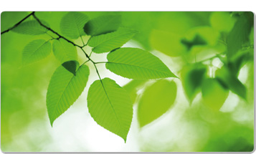
Why we see Colour
At one time people believed that colour was something added to light.
E.g. When white light struck a green leaf, people believed that leaf was adding green to the light.
Notes:
Story of Isaac. At one time people thought colour was something added to light. Green leaf added green to the light.

Slide 5
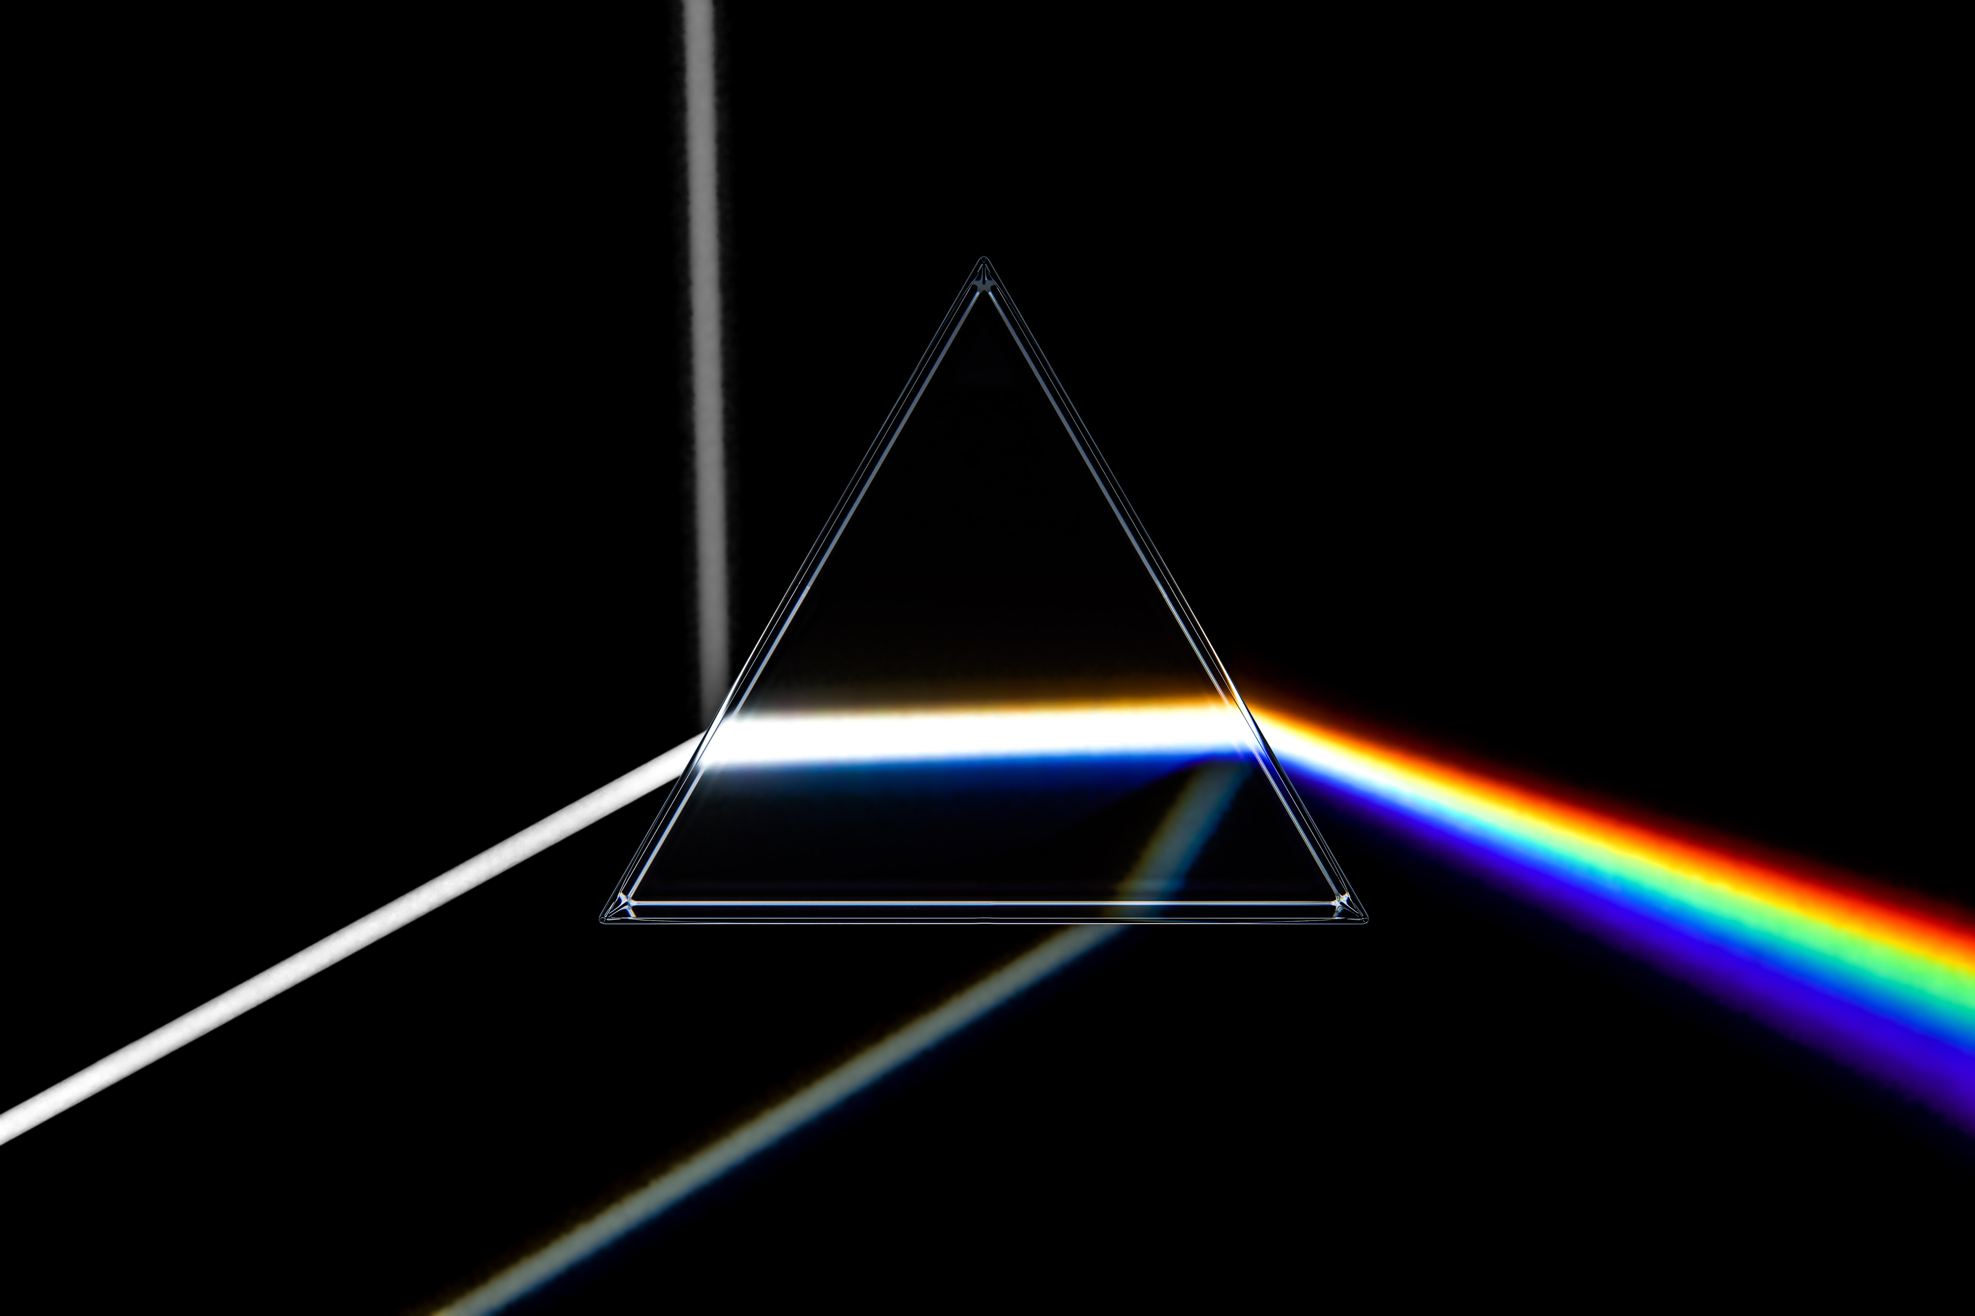
Producing Visible Spectrum
In the 17th century, Sir Isaac Newton did an experiment to prove that light contains colours.
He passed white light through a prism.
Notes:
Story of Isaac. At one time people thought colour was something added to light. Green leaf added green to the light.

Slide 6
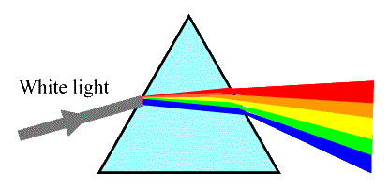
When white light travelled through the prism, he saw bands of colour.
He concluded that the prism was not the source of the colours, that the different colours were already present in the white light.

Slide 7
He then used a reverse prism to combine the colours into white light again.
Notes:
Story of Isaac. At one time people thought colour was something added to light. Green leaf added green to the light.

Slide 8
He proposed that white light, such as sunlight, is the result of mixing together all the different colours of light.

Slide 9
Why does this happen?
When light waves pass through the prism, they slow down, causing them to “bend” or change direction.
The bending of light when it passed through a different substance is called Refraction.

Slide 10
Why does this happen?
White light contains ALL colours.
Each colour has its own wavelength and frequency.
The different wavelengths are refracted by different amount, causing them to separate.

Slide 11
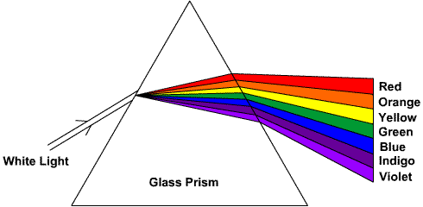
Visible Spectrum of Light
When white light is separated by a prism we see these colours (the VISIBLE SPECTRUM).

Slide 12
Summary
Isaac Newton proved visible light was all colours by passing a beam of light through a prism, and finding the white light separated into its component colours because each colour has different wavelengths.
Each wavelength “refracts” differently, allowing them to separate.

Slide 13
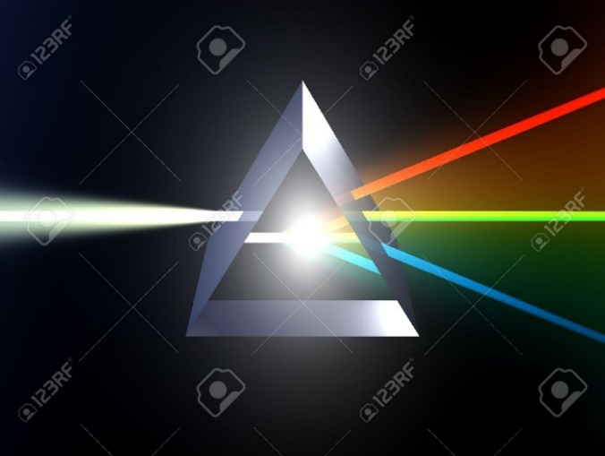
Why does this happen?
Shorter wavelengths refract more than longer wavelengths.

Slide 14
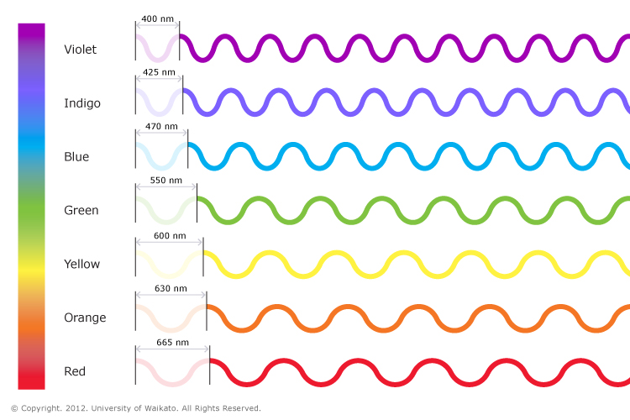
Which colour has the longest wavelength?
Which colour will refract the most?

Slide 15
red has the longest wavelength and lowest frequency. Refracts least.
Violet has the shortest wavelength and highest frequency. Refracts most.

Slide 16
Which has most energy?

Slide 17
Which has most energy?
A: Violet light has the greatest energy because it has the shortest wavelength and therefore highest frequency.

Slide 18
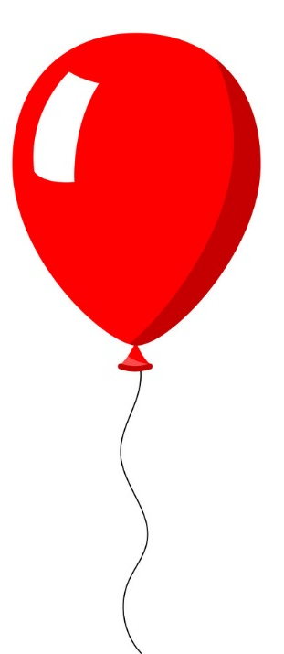
Colour and Reflection
When white light strikes an object, some colours are reflected and some are absorbed.
We see only reflected colours.
Which colour(s) are absorbed and which are reflected when we see a red balloon
See page 148

Slide 19
Practice

Slide 20
Extension

Slide 21
Activity 4-6 p149
Lights, CD, filters
Create a rainbow then “colour” it by holding a red filter between your eye and the CD
Try holding the filter in front of CD.
Try holding filter in front of eye.
Try with other colours.

Slide 22
Activity 4-6 p149
What colours do you see when you look at the rainbow made from white light?
What is the effect on the appearance when using the red filter?
Does it matter where the filter is held?
What does a coloured filter do to the light coming from the light source?

Slide 23
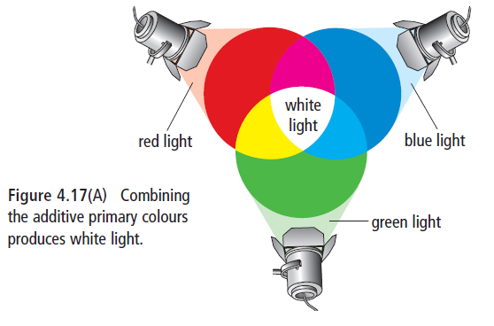
ADDITIVE PRIMARY COLOURS
Only three colours of light are needed to produce all the colours of the rainbow:
  red, green and blue.
They are called the three additive primary colours because adding all three together in proper amounts will make white light.
Yellow, Magenta and Cyan.

Slide 24
Secondary Colours
    The light of two additive primary colours will produce a secondary color.
    The three secondary colours
    are yellow, cyan, magenta.

Slide 25
Additive Colours
It takes three colours to make white light. Doesn’t have to be primary colours.
Could even be the secondary colours (yellow, magenta, cyan).

Slide 26
Homework
Check your Understanding p151
#1, 2, 3, 4, 5, 8, 9, 12

Slide 27
Check your understanding
Describe one way that a light wave is like a water wave. Describe one way that it isn’t.
One wave has a higher frequency than another wave. Which wave would have the longer wavelength? Explain your reasoning.

Slide 28
Investigation 3-E p218 new text
Or 3-F p219 Guided Inquiry

