Slide 1
Elements can be classified as Metals, Non-Metals and Metalloids

Slide 2
Elements Can be classified as Metals, Non-metals, or Metalloids

Slide 3
How are Elements classified?
Elements are classified according to their properties (chemical and physical) :
Metals
Non-metals
Metalloids

Slide 4
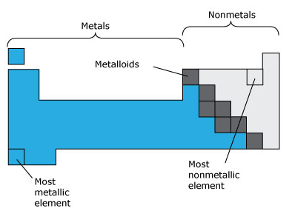

Slide 5
Notes:
First 18 elements make up most of earth

Slide 6
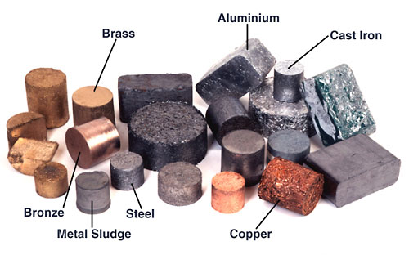
Metals

Slide 7
Characteristics of Metals
Most elements are metals
Lustrous - shiny
Malleable – can be pounded into a sheet
Ductile – can be drawn into a wire
Good conductors of heat and electricity.
Solid at room temperature (except mercury)
High density (are heavy for their size)
High tensile strength (resist being stretched)
High melting and boiling points.

Slide 8
Non metals

Slide 9
Non-Metals
Generally are either gas (hydrogen, oxygen, nitrogen)
Or brittle dull-looking solids (carbon, sulfur) under standard conditions.
Poor conductors of electricity or heat.
Not malleable or ductile.
Lower densities than metals.
Lower melting and boiling points than metals.
The one exception to this is carbon.

Slide 10
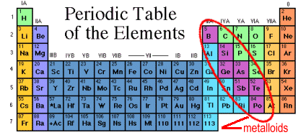
Metalloids or Semi-Metals

Slide 11
Metalloids or Semi-metals
Have some qualities of both metals and non-metals.
Mostly metallic in their physical appearance:
Eg. Shiny solids at room temperature
Mostly non-metallic in their chemical behaviour.
brittle, not ductile
Poor conductors or semiconductors.
Examples include: silicon, boron, arsenic.
Notes:
Some are called semiconductors. – conductors under special conditions.
Silicon is the 2nd most abundant element in Earth’s crust (after oxygen)
car grease, cookware, satellite parts, contact lenses, film props and prosthetics

Slide 12
Uses of Metalloids
Metalloids (or semiconductors) are important components of electronic devices.
Antimony is used as a flame retardant in plastics and other materials.
Boron is used as a bonding agent in magnets and other chemical substances

Slide 13
Hydrogen: A special case
Usually placed on the left side of PT, but is a non-metal.
Can either lose or gain an electron
Often called a proton
Smallest and lightest element,
Colourless, odorless, tasteless, highly flammable gas
Most abundant (plentiful) element on Earth (Makes up over 90 % of the atoms in the universe).
Notes:
On Earth, most hydrogen is found combined with water.

Slide 14
Check your understanding
Summarize characteristics of metals, non-metals, and semi-metals.
What makes hydrogen an unusual element?
Read Classifying Elements pages 189 - 191
Answer CYU p192 #9-15

Slide 15
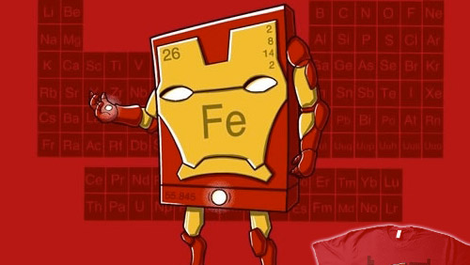

Slide 16
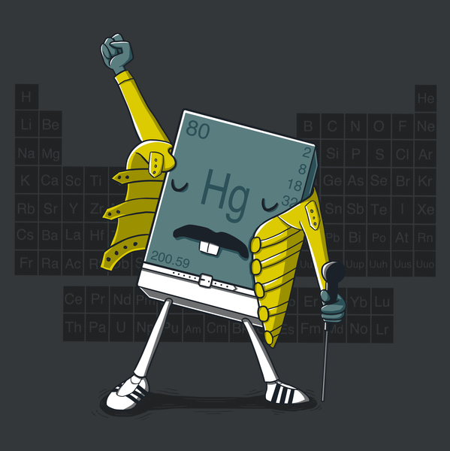

Slide 17
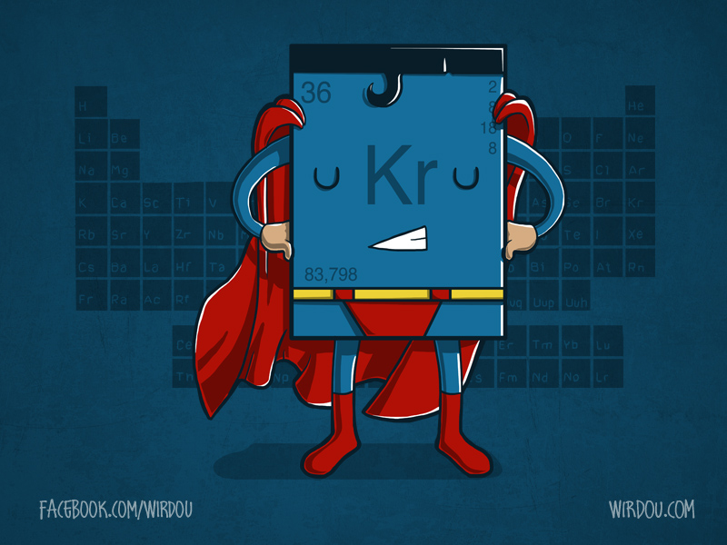

Slide 18
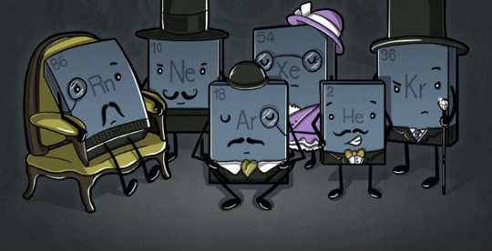

Slide 19
