Slide 1
The Scientific Method

Slide 2
Scientific Method
The scientific method is a process that scientists follow in order to answer questions about the world around us.
Big deal. WHY should I follow this so called “process”?

Slide 3
Why follow the Scientific Method?
It ensures that your experiment will actually answer your question
It shows the world how you acquired your results
It allows other scientists to reproduce your experiment to support/disapprove your conclusions
It allows other scientists to build on your research.

Slide 4
Steps of The Scientific Method
Question
CONCLUSION
HYPOTHESIS
ANALYSIS
EXPERIMENT
OBSERVATIONS
Notes:
Why Bother? It ensures your experiment will actually answer your question.
It shows the world how you obtained your results.
It allows other scientists to recreate your experiment to support/disprove your conclusions.
It allows other scientists to build and extend on your research

Slide 5
What is a theory?
A scientific theory is a well-substantiated explanation of observed phenomenon.
Can be supported or challenged by testing.
Eg. Theory of Continental Drift
Eg. Theory of Evolution
Eg. Quantum Theory
Eg. Heliocentrism (Copernicus, 1543)

Slide 6
What is a Law?
A law is a statement that describes some phenomenon or aspect of the universe and is based on repeated experimental evidence.
Implies a cause and effect between two things and ALWAYS applies under the same conditions.
Eg. Newton's Law of Gravity

Slide 7
Scientists use Models to describe the world around us.
A model is a representation of an idea, object, or process that is used to describe and explain phenomena that cannot be experienced directly.

Slide 8
It Starts with a Question
What do you want to know or explain?
Use observations/research you have made to write a question that address the problem or topic you want to investigate.

Slide 9
1. Question
What makes a good scientific question?
It’s specific and testable
It compares 2 things
Format:
“What is the effect of _________ on ________?”
independent dependent
variable variable
Notes:
Eg. Why is there air? Is not a testable question
How fast does a football fly through the air?
Why do leaves turn brown?
Does the amount of water or sun a plant receives affect the colour of the leaf?

Slide 10
Are these good questions?
Why do dogs bark?
How are students’ grades affected by the amount of television watched?
What temperatures cause bacteria to grow the fastest?
What chemicals will prevent cut apples from turning brown?
Why do leaves turn brown?
Does the amount of water or sun a plant receives affect the colour of the leaf?

Slide 11
What about these?
Why are oceans salty?
Is the bounciness of a basketball related to the temperature of the ball?
Is protein synthesis affected when cells are placed in hypotonic solutions?
What types of materials best reduce friction on a skateboard wheel?
Is the rate of hair growth affected by the amount of protein someone eats?
Does baking soda and vinegar react?
How often does the sun rise?

Slide 12
Hypothesis
What do you think will happen?
Predict the answer to your question or the outcome of the experiment.

Slide 13
First Identify the Variables

Slide 14
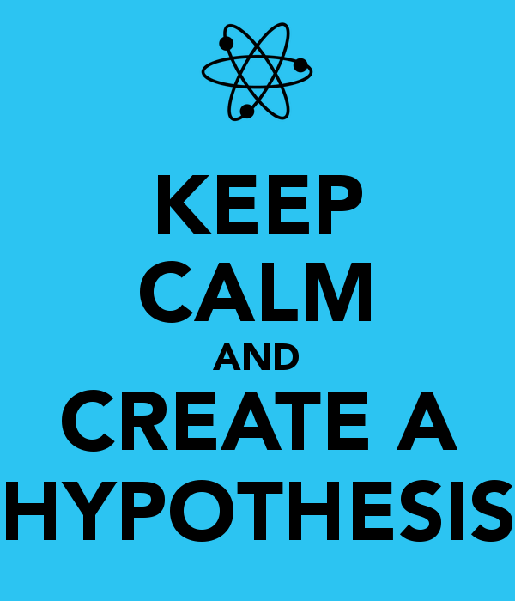
2. Hypothesis
A prediction based on prior knowledge.
An educated guess to explain a cause-effect relationship.
Format:
“If ____________, then __________ because _________________”
(If you do this to the I.V) (the D.V. changes like this)

Slide 15
Example #1.
Question: How does temperature (heat energy) affect the rate at which water boils?
Hypothesis: If more heat energy is added to water, then the water will come to a boil faster because the water particles will be moving faster.

Slide 16
Example #2.
Question: How does the amount of time a student spends studying affect their grades?
Hypothesis: If a student studies more, then their marks will improve because they have a better understanding of the material.

Slide 17
Write a hypothesis for each.
How does the amount of sunlight affect the growth of a plant?
Why do plastic lids no longer fit their containers after going through the dishwasher?

Slide 18
DESIGN THE EXPERIMENT
IDENTIFY THE VARIABLES
A variable is a factor that can change or be changed in an experiment.

Slide 19
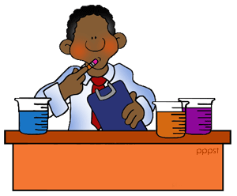
3. Identify the Variables
Independent Variable (I.V.): a factor that you manipulate
Dependent Variable (D.V.): a factor that depends on the I.V.
Often something you measure

Slide 20
Control Variables
Controlled variable(s) (C.V): factors that are kept the same (constant) for all groups
You can only change ONE variable at a time in an experiment.
Otherwise you can be sure which variable is responsible for the result.

Slide 21
Control Group
The “group” that stays under normal conditions

Slide 22
Format
IV has an effect on DV
DV depends on IV
Eg. Does the amount of fertilizer depend on the height of the plant or will the height of the plant depend on the amount of fertilizer added?

Slide 23
Example
If testing the effect of amount of light on the growth of seedling:
Question =
Independent Variable =
Dependent Variable =
Controls =
Hypothesis =

Slide 24
Question | Independent variable | Dependent variable | Controlled variables
How much water flows through a faucet at different openings? | Faucet openings (closed, half-open, fully open) | Amount of water flowing in litres per minute | Same faucet Same water pressure
Does heating a cup of water allow it to dissolve more sugar?
Does an electric motor turn faster if you increase the voltage?

Slide 25
Smithers thinks that a special juice will increase the productivity of workers. He creates two groups of 50 workers each and assigns each group the same task (in this case, they’re supposed to staple a set of papers). Group A is given the special juice to drink while they work. Group B is not given the special juice. After an hour, Smithers counts how many stacks of papers each group has made. Group A made 1,587 stacks, Group B made 2,113 stacks.
Problem: Smithers thinks that a special juice will increase productivity of workers.
Specific question: Will the special juice that Smithers has increase the productivity of workers?
Independent Variable | Dependent Variable | Controlled Variables

Slide 26
Homer notices that his shower is covered in a strange green slime. His friend Barney tells him that coconut juice will get rid of the green slime. Homer decides to check this out by spraying half of the shower with coconut juice. He sprays the other half of the shower with water. After 3 days of “treatment” there is no change in the appearance of the green slime on either side of the shower.
Problem: Homer’s shower is covered in a strange green slime.
Specific question: Will coconut juice remove the strange green slime that is covering Homer’s shower?
Independent Variable | Dependent Variable | Controlled Variables

Slide 27
Design your Experiment- add this to your notes
Materials:
What do you need to perform your experiment?
Procedure:
How will you carry out your experiment?
Step-by-step, point form.

Slide 28
Observations

Slide 29
Observations

Slide 30
Observations

Slide 31
Qualitative Observations
Information gathered through your senses
Described in words
Ex: colour, odour, taste, luster
“The rose is red and has a
sweet smell”

Slide 32
Quantitative Observations
Based on measurements
Described using numbers
Ex: Length, time, temperature, number of items
“The rose’s stem is 14cm long with 5 leaves”

Slide 34
Indicate whether each of the following is a quantitative or qualitative observation.
The concert was very loud
The water was cold
c. The reaction took 48 seconds to occur
The grass was green
e. The volume of the object was 4.9 L
f. The length of the trip was675 km
g. The sandpaper was rough.
h. The sugar plus sulfuric acid turned black, then grew to the height of 20 cm.

Slide 35
Observation vs Inference
Observation is data, exactly what you see.
Inference is your explanation of what you think is happening.
See Tricky Tracks activity

Slide 40
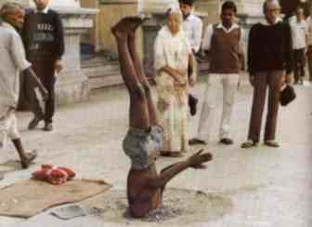
Observation vs Inference
List 3 Observations
List 3 Inferences

Slide 41
Observation vs Inference
List 3 Observations
List 3 Inferences

Slide 42
Observation vs Inference
List 3 Observations
List 3 Inferences

Slide 43
Observation vs Inference
Observation: what you see
Inference: what you think
Candle observation video: https://lah.elearningontario.ca/CMS/public/exported_courses/SNC1P/exported/SNC1PU01/SNC1PU01/SNC1PU01A02/_content.html

Slide 44
Analysis and Conclusion
Summarize your results
Was the Hypothesis correct? Explain why or why not.
Any problems you may have had. (Sources of Error”)
A future experiment that can build on your results
Notes:
DO NOT list “human error”

Slide 45
Analysis
Review the data you collected.
Look for averages and patterns. Drawing graphs and doing calculations typically helps.
Is the data reliable? Would you get the same data if you kept repeating the experiment?

Slide 46
Conclusion
Does your data support your hypothesis?
Should parts of the method be re-written so that more reliable data could be collected?
Give suggested improvements to the method.
Also suggest some extensions that could be tested in your next experiment.

Slide 47
Scientific Method

Slide 49
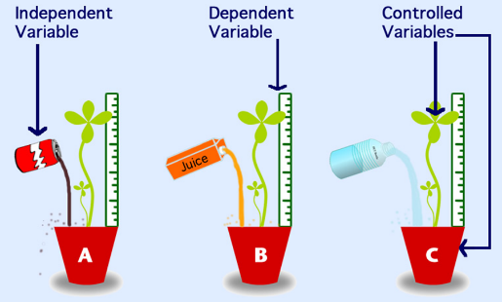
Components of an experiment: another example
Notes:
What would be the Question, Hypoth for this exp?

Slide 50
Practice

