Slide 1
Wellness
First Nations Perspective

Slide 2
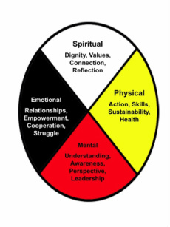

Slide 3
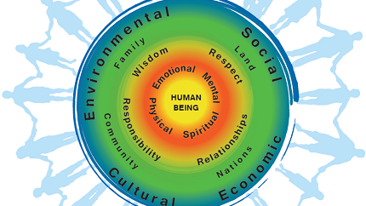

Slide 5
Balance (In Mind, Body, Spirit and Emotion)
Ultimately you are responsible for your health. ….one body for life, no one else can manage your health for you.
Facets of health: mental, emotional, spiritual, physical
What would it look like to be “healthy” in each of those 4 areas?
Create 2 positive health statements for each area for a total of 8.
Eg physical: (I am healthy because…) “ I exercise 3 or more times a week”
Do you agree that all 4 of the areas are important to your health?
Are some more important than others? Discuss (you don’t have to agree)
Why do you think this set of areas is closets to the center of the wellness picture? Look at whats on teh other reings. Do you agree with this placement?
Which questions do you have abou this model? (About your circle, or another one) Recoredd a few of your questions. Talk about them in your group.

Slide 6
Mental – Ability to be open minded to new ideas & experiences
Learn New Things
Live by GF teachings (Love, trust, honesty, humility, wisdom, bravery, respect)
Nurture your self esteem
Revive self-worth after rejection (affirmation of your meaningfulness)
Stay Positive
Be flexible – Schedules – work/home
Know when to ask for help
Physically taking care of yourself = mental health
Learn how to deal with stress
LAUGH

Slide 7
Emotional – Ability to understand self
Be mindful – live in the moment and pay attention
Journal
Be optimistic, have hope
Accept yourself
Stay connected to friends/family (supports)
Express gratitude
Set goals – find your purpose
Make a plan – time manage

Slide 8
Physical – Ability to live a healthy life
LIVE – Enjoy Life
BREATH
Make a point to get out and move every day
Exercise Regularly
Sleep
Know your own boundaries
Eat well – balanced diet
Take care of your personal self – hygiene

Slide 9
Spiritual – Ability to establish peace and harmony
Sing, dance, play music.
Ceremonies, Medicines, Socials
Take value in personal development
Meditate
Take time for yourself – self reflection
Forgive others
Be open to your experiences and feelings

