Slide 1
SEEDS
Chapter 22

Slide 2
Learning Guide
In what ways are seed pants able to survive on land?
In what ways are plants adapted to reproduce on land?
(Explain the advantages of seeds, reduced gametophyte, vascular tissue)
Notes:
Life on land:
Advantage: Abundant sunlight, continuous free movement of oxygen and CO2.
But water and nutrients only from soil. At risk of drying out. Need to keep photosynthetic tissues upright to capture sun. Need a way to reproduce not dependent on water.

Slide 3
Land Plants
Nonvascular: Mosses
Vascular: ferns
Vascular, (Naked) seeds in cones: Gymnosperms
Vascular, covered seeds, flowers: Angiosperms

Slide 4
KINGDOM PLANTAE
Vascular Plants Phylum Tracheophyta
Seeds
Subphylum Spermopsida
Seeds enclosed
Seeds ‘naked’
Class Angiospermidia
Class Gymnospermidia
Sub Class Magnoliopsida
DICOTS
Sub Class Liliopsida
MONOCOTS
Notes:
Spermatophyta
Adapted better to life on land. Not because they wanted to.
Evolution occurs slowly.
Much variation in organisms. Some are better adapted than others to survive the environment. Those are the ones that get to reproduce, passing on their genetic info (characteristics better suited to environment) to the next generation, etc

Slide 5
Life on land: Good, right?
Advantages:
Abundant sunlight,
Continuous free movement of oxygen and CO₂.

Slide 6
Life on land: Good, right?
BUT:
Water and nutrients only from soil.
Increased risk of drying out.
Need to keep photosynthetic tissues upright to capture sun.
Need a way to reproduce that doesn’t dependent on water.

Slide 7
Why the change? Why evolve?
Environments change.
Continents became drier, making it harder for spore-bearing plants to survive and reproduce.
Many mosses and ferns became extinct and were replaced by seed plants.

Slide 8
What Adaptations have Seed plants evolved?

Slide 9
Seed plants in General
Vascular tissue with True Roots, Stems, Leaves
Cell walls with cellulose (can be bigger)
Alternation of Generation:
Dominant sporophyte
Microscopic gametophyte – only a few cells
Don’t require water for reproduction: Produce Seeds
Notes:
True roots (with vascular tissue)
Improved conductive tissue (stronger, thicker xylem) →Taller

Slide 10
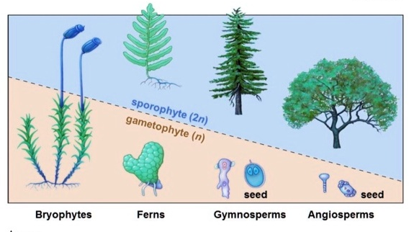
Evolutionary Trend: shrinking gametophyte
Notes:
The highly reduced seven-celled female gametophyte is considered to be a key innovation during the evolution of flowering plants. Because of the small size of the embryo sac compared with gymnosperm gametophytes consisting of more than 1000 cells, the ovules of flowering plants are tiny.

Slide 11
What’s New? Reduced Gametophyte
Gametophyte phase are only a few cells
Does NOT need water to function
But does depend on sporophyte for nutrition
Notes:
Gametophyte develops into food sources for baby sporophytes, thereby allowing plants to have seeds, which as a form of dispersal, can be far more successful than spores.

Slide 12
What’s New?
Male gametophyte is microscopic and contained in a pollen grain.
Entire pollen grain is carried by wind/insects/animals eliminating the need for water.
Female gametophyte is nourished and protected within the moist reproductive tissue of the sporophyte.
Female gametophyte produces an egg inside an ovule.
Zygote develops into an embryo (baby sporophyte) develops inside protective seed.

Slide 13
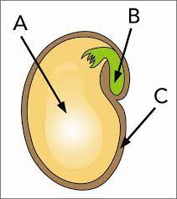
Parts of a Seed
Stored food (gametophyte tissue
Embryo
Seed Coat – from parental sporophyte tissue – protects from dryness, salt water, digestive enzymes.

Slide 14
Why are seeds so great?
Seed coat protects seed: drying out, extreme heat, or cold.
Enables embryo to go dormant and wait until conditions for germination are right.
Seeds also provides stored nutrients for developing embryo when germinating until it can produce true leaves for photosynthesis to make its own food.
Seeds aid in dispersal → reduced competition for resources with parents.
Notes:
No water needed.
Important adaptation - Seeds allow plants to survive in habitats where mosses and ferns cannot.

Slide 15
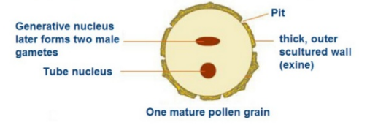
How a seed is made
The process of pollen grains getting to female gametophyte is called pollination.
The process of the two gametes fusing is fertilization
Gametes fuse to make a zygote
Zygote develops into embryo (baby sporophyte) within the seed.
Female gametophyte tissue becomes food storage
Parental sporophyte produces seed coat.

Slide 16
Sexual Reproduction in Angiosperms (Flowering Plants)
Most are terrestrial and all are sessile (fixed in place).
This poses some problems:
Notes:
Flowers solve both of these problems.

Slide 17
Sexual Reproduction in Angiosperms
Need a way for the two tiny, delicate gametes to reach each other safely.
Need a way to disperse their offspring far enough away from the parent so that they do not compete with the parent for light, water, and soil minerals.
The functions of the flower solves both of these problems. How do you think?
Notes:
Gametes are delicate single cells. For two plants to cross fertilize,
Flowers solve both of these problems.
Pollen, attractive flower
seeds

Slide 18
Flowers Solve Problems
Flowers provide a mechanism for the two gametes to reach each other safely.
Gametophyte in pollen grain, transfer
Gives mechanism to disperse their offspring so they do not have to compete with the parent for resources.
Embryo encased in seed
Notes:
Pollen, attractive flower
seeds

Slide 19
Why are flowers so Successful?
Have evolved mechanisms for dispersal of both pollen and seeds
Pollen Dispersal: co-evolution of flowers that provide nectar which increases the probability of successful pollination
Seed Dispersal: co-evolution of fruits covering seeds which increases distance of seed dispersal from the parent plant
Notes:
Made improvements to occupy areas vacated by the ferns by adapting to more moderate climates; the main improvements were in the area of reproduction.
Flowering plants are not as dependent on wind as a means of reproduction. This increased their chances of survival

Slide 21
Co-evolution p 476-481
Process by which two organisms evolve structures and behaviors in relation to or complementary to one another .
Flowering plants evolved about the same times as mammals, birds, insects.
Why do you think?
Notes:
Giraffe gets longer neck, trees get taller.
Smaller critters could pollinate
Later, mass extinction of dino’s and gymno’s opened up niched for angiosperms.

Slide 22
Methods of pollination
Vectors: Eg: birds, animals, Insects (mostly bees)
Wind
Pollination 1 min
https://www.youtube.com/watch?v=ge3EM8AERV0

Slide 23
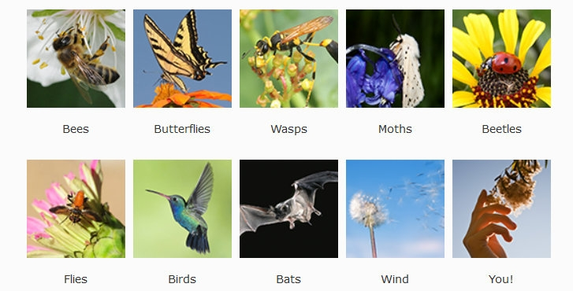
Vector Pollination
Eg: birds, animals, Insects (mostly bees)

Slide 24
Strategies for Vector Pollination
Provide pleasing scent, nectar, colour, shape to attract pollinators.
Notes:
Bees can see UV, need place to land
Moths can’t see colours well but can smell. Active at night. Longer tubes.
Hummingbirds can see red
Flies like the smell of rotting meat.

Slide 25
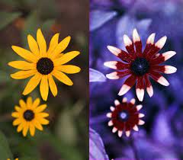
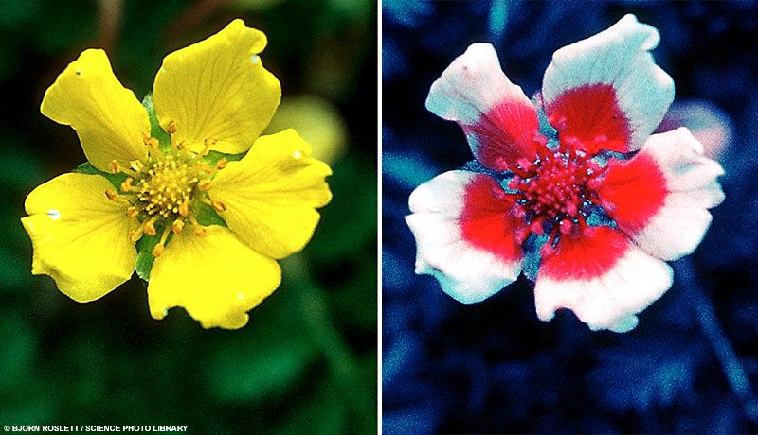
Coevolution. Strategies for Pollinators
For Bees: Flowers provide landing platform and markings to point the way.
Eg. Bees remember shape, colour, scent, location of flower. Communicate location to hive members.

Slide 26
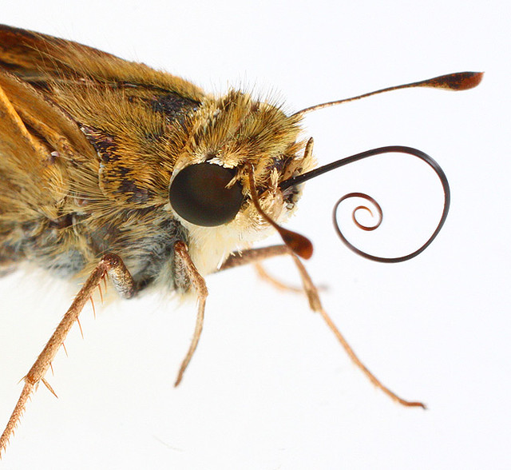
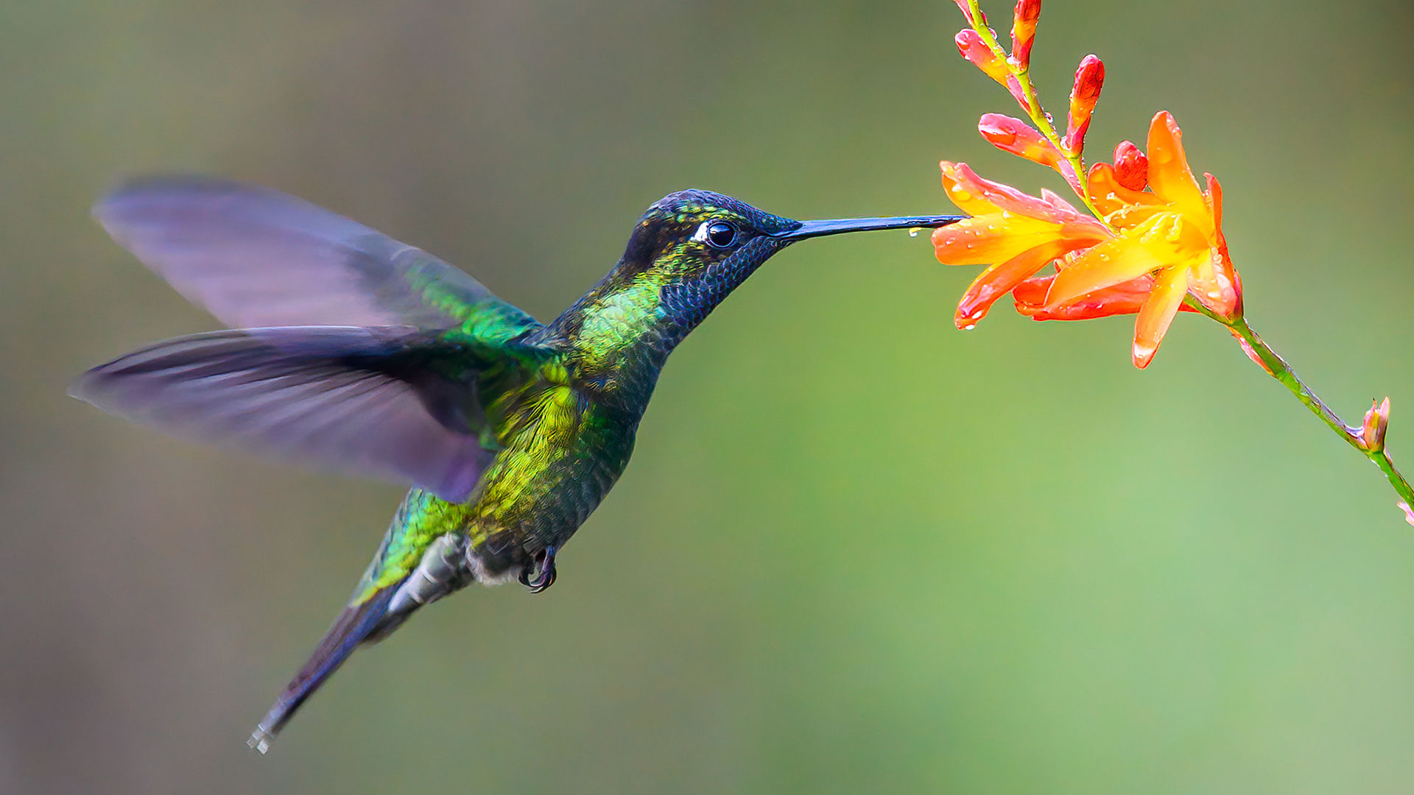
Coevolution
Moths: Release fragrance at night.
Humming birds developed long beaks, ability to hover
Notes:
Insects develop long tongues

Slide 27
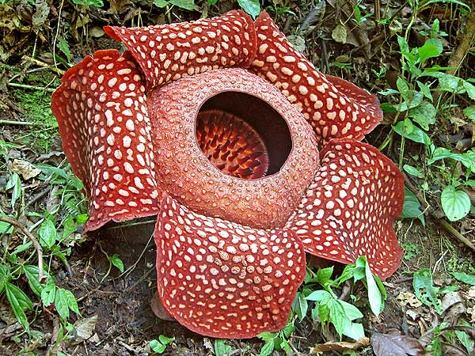
Coevolution
Flies lay eggs on rotting meat.
Carrion flower developed scent of rotting meat to attract flies

Slide 28
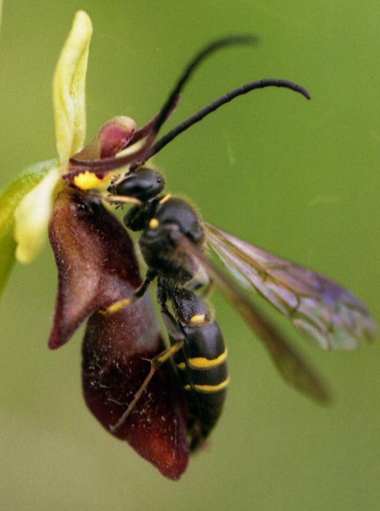
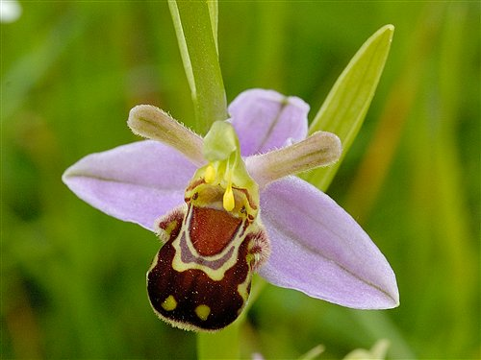
Mimicry

Slide 29
Strategies for Wind Pollination
How would you ensure your pollen gets to a flower if distributed by wind?
Notes:
Mass quantities,
Reachable by wind, stamens
Capture – sticky or feathery
No need for showy petals, etc to attract pollinators

Slide 30
Strategies for Wind Pollination
Shed vast amounts of pollen
Pollen may be smaller, or have wings
Anthers should be accessible by wind
Effective capture – sticky, feathery
No need to attract pollinators ( no showy petals, nectar)

Slide 31
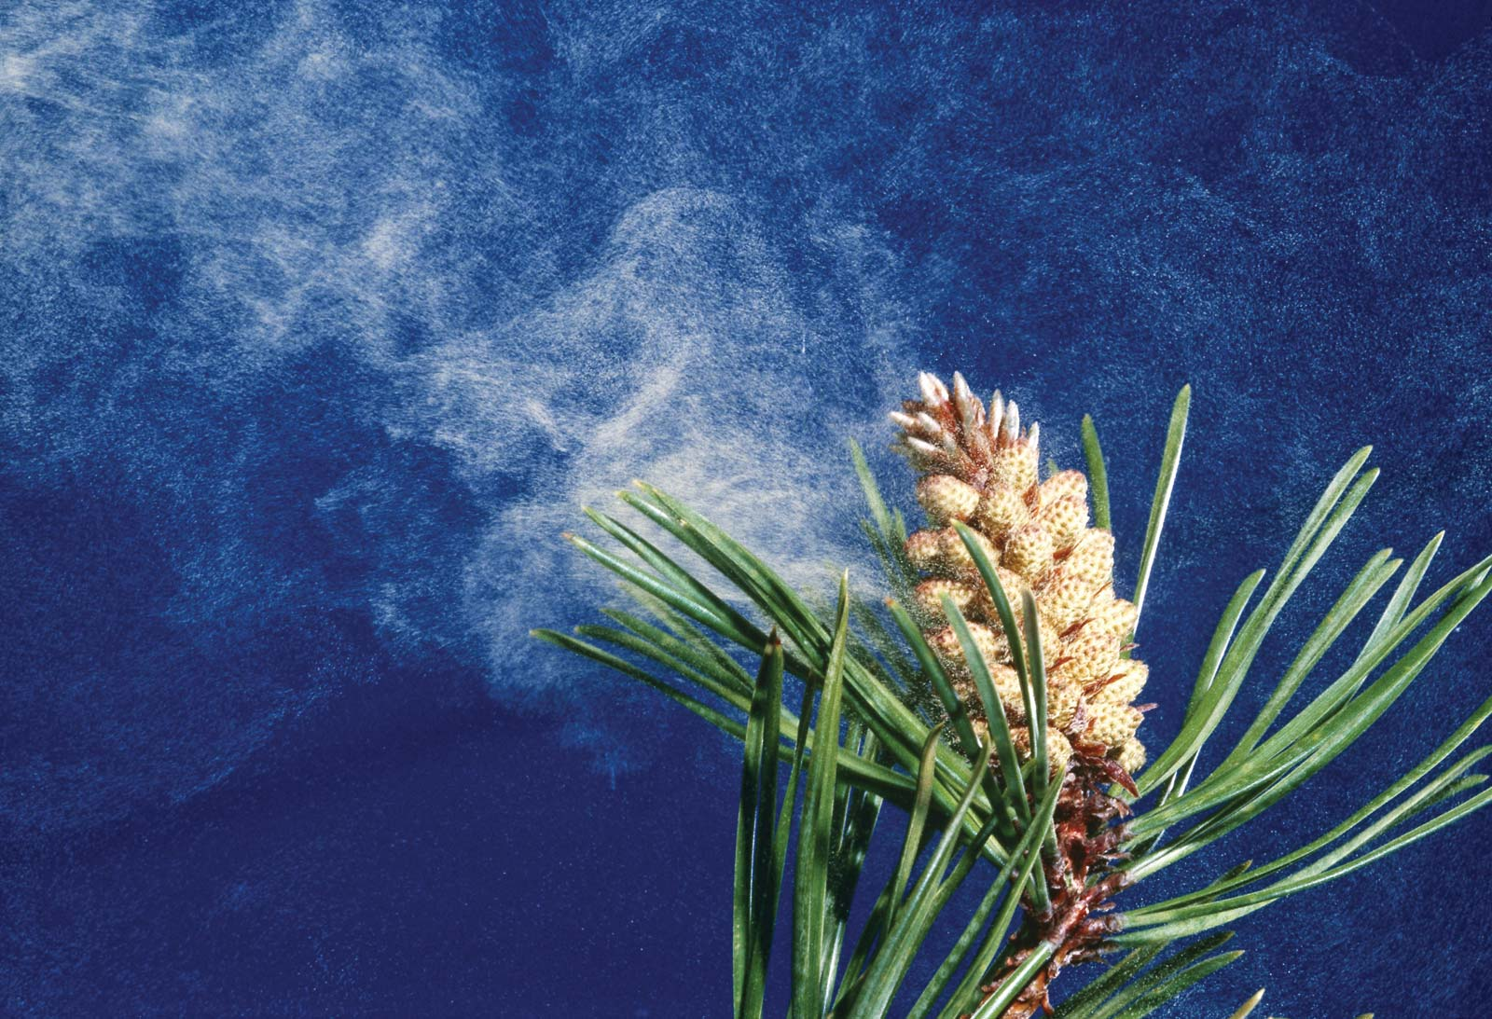
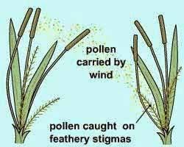
c

Slide 32
Grasses –
Notes:
include image into notes

Slide 33
Getting to the Party: Pollination = Transfer of pollen to stigma
Self-pollination (on same flower)
Cross-pollination (from one flower to another flower of another plant)
Which is better? Advantages and Disadvantages.

Slide 34
Self Pollination Cross-pollination
Pollinated by same flower
Ensures pollination (and therefore fertilization and therefore seed production) when there is no other flower/vector around
(pollinated by flower on separate plant)
Mixing of genetic material improved genetic diversity, enhanced chance of survival if conditions change.

Slide 35
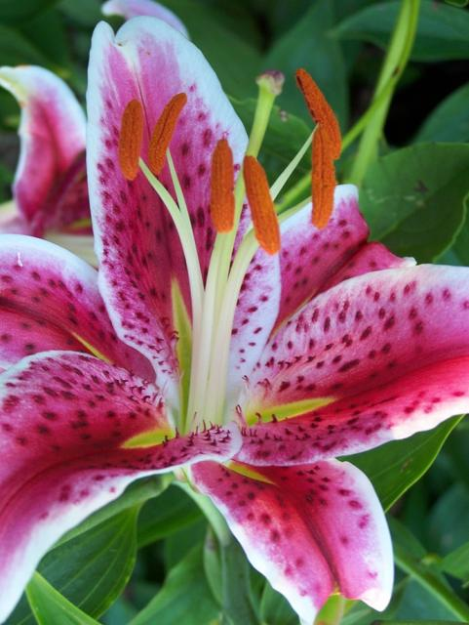
Self-incompatibility
Most angiosperms have mechanisms by which they avoid self-fertilization.
Why?
Notes:
Mixing genetic material from another individual creates Diversity – better enables an organism to adapt to changing environment.

Slide 36
Post Fertilization
Parts of ovule toughen → seed coat.
Ovary wall thickens → fruit
Embryo develops inside seed

Slide 37
SEED (fertilized ovule)
Contains embryo (2n), food source, seed coat:
Gametophyte tissue becomes food storage
Parental sporophyte tissue forms seed coat.
Multicellular (in contrast to spore)
Pine Life cycle:
https://youtu.be/2gWEgrMwMe0
Notes:
Seeds are the mature, fertilized ovules of flowers that contain dormant embryos and food stores awaiting germination.
Protection is provided by a seed coat (testa) that develops from the layers of integument cell(s) of the ovary inside the nucellus (megasporangium).The ovule hardens, becoming a seed:
Each seed is protected by a seed coat, but the seed in not covered by the cone.
Seeds sits naked on the scales
Gymno – means naked
Sperm - means seed
literal meaning of the Greek word gymnasion was “school for naked exercise.”
Eventually the scales spread, allowing the seeds to fall. If conditions are favourable where it falls, the embryo inside the pine seed will grow into a new tree.

Slide 38
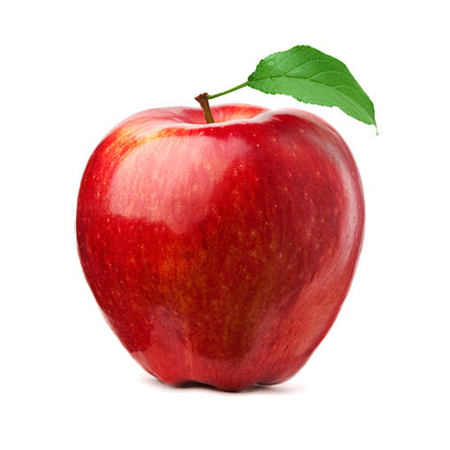
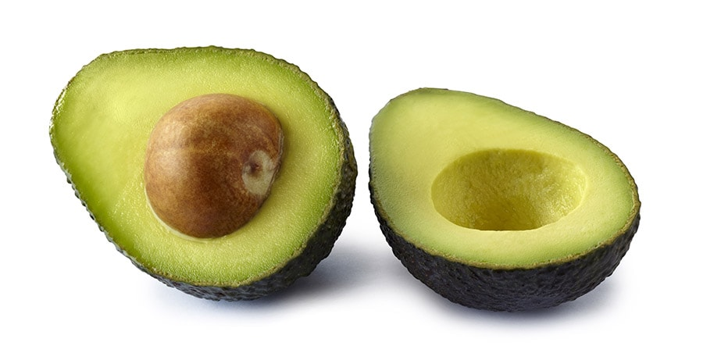
Ovary → Fruit
Unlike gymnosperms, the ovary containing the ovules in angiosperms develops into a fruit after fertilization.
Why bother?
Notes:
Don’t all look like apples
Why bother?
Dispersal

Slide 39
Why Bother?
Advantage:
The fruit gives the embryos the double benefit of:
Protects seeds during development and against desiccation
Aids in seed dispersal, since it is eaten by far-ranging animals who then excrete the seeds
Why disperse?
Notes:
Unripe fruit is Green and bitter – less noticeable, less tastey

Slide 40
Why Bother?
→ Less competition. → do not have to compete with the parent for resources (light, water, nutrients, space).
Allows for colonization of new environment
Notes:
Unripe fruit is Green and bitter – less noticeable, less tastey

Slide 41
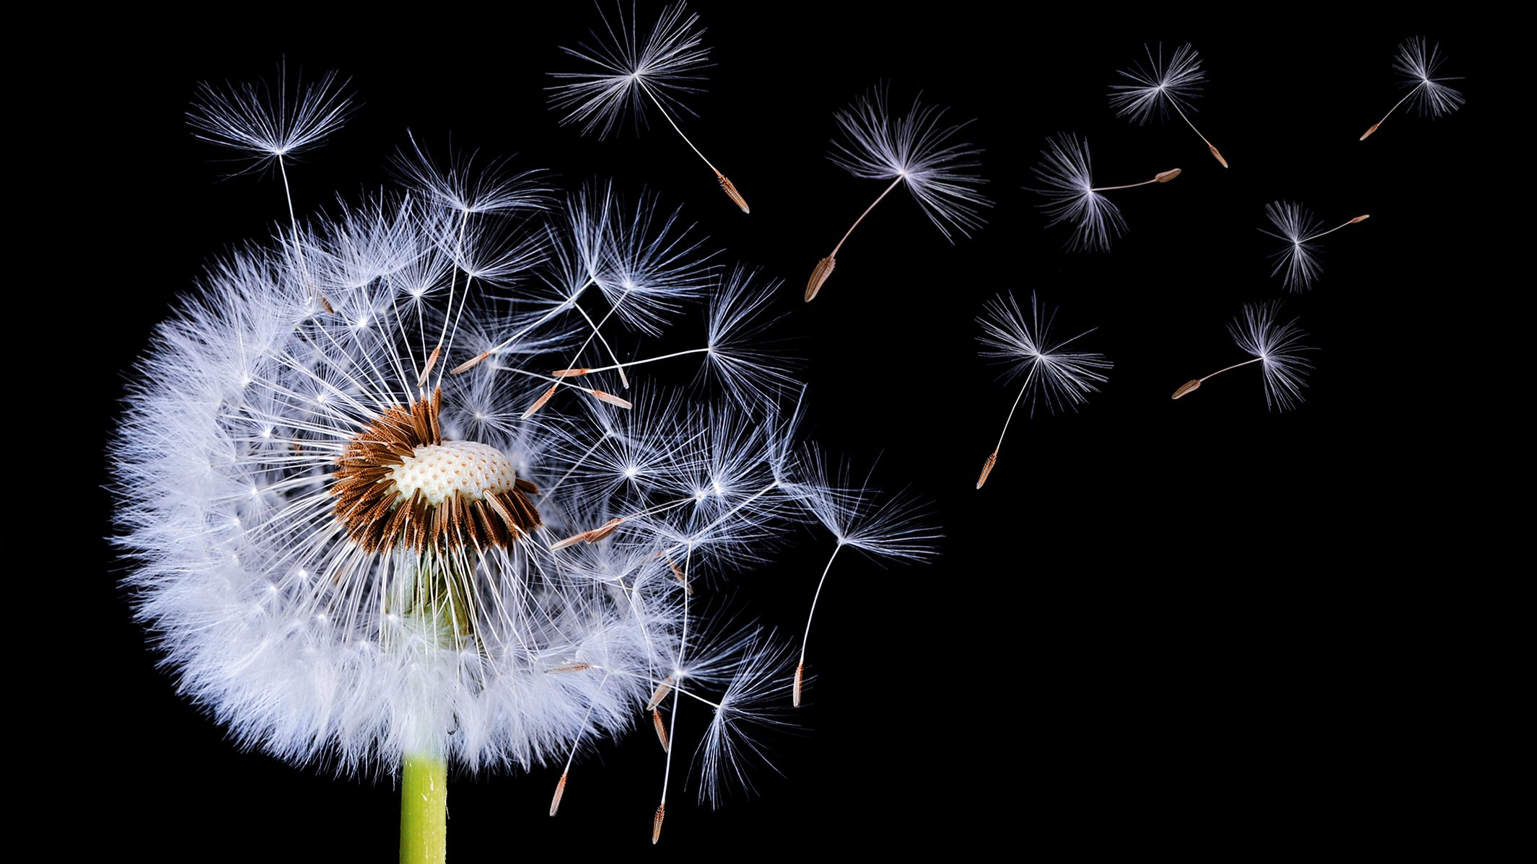
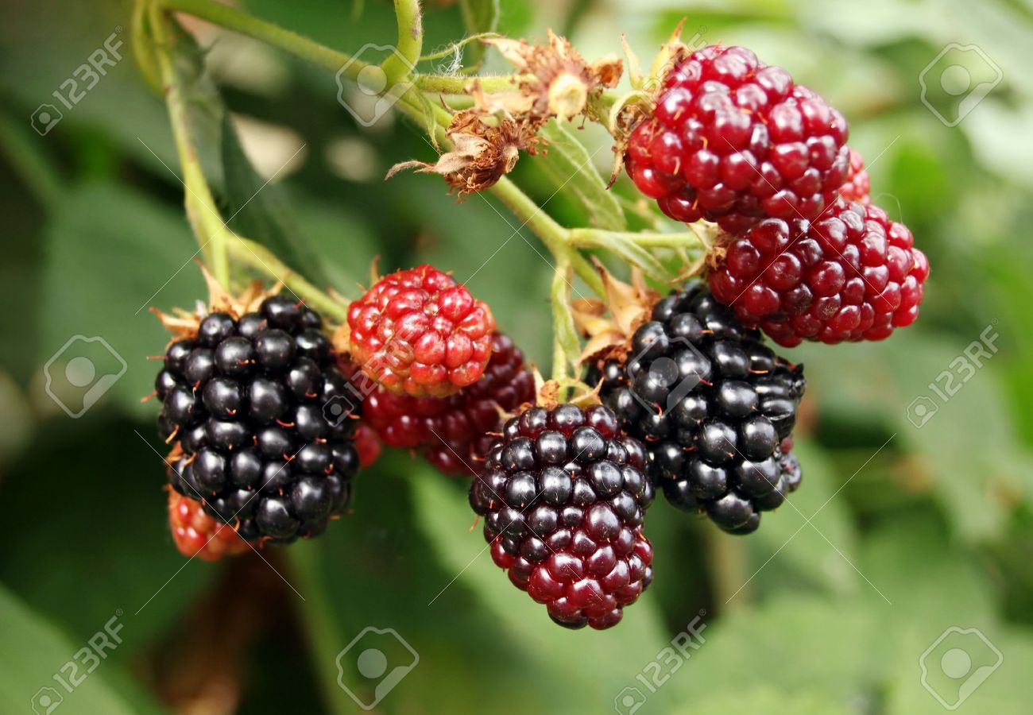
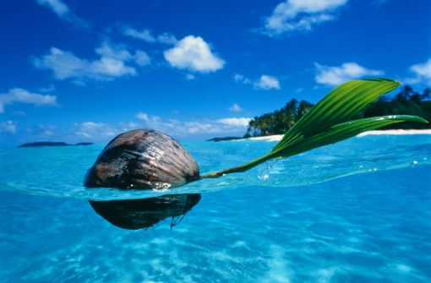
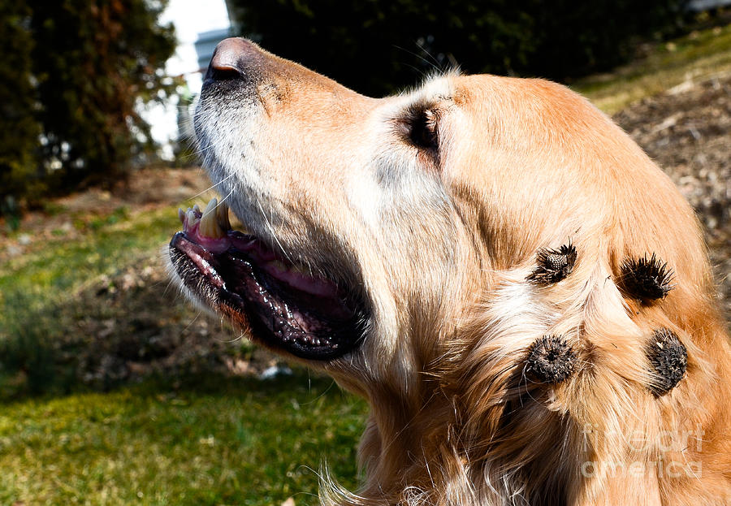
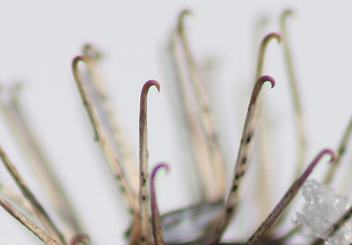
Types of Seed Dispersal
Wind
Water
Fur – hooks, sticky
Humans/animals – yummy fruit
Explosion https://www.youtube.com/watch?v=OB0P3mx_lxY
Notes:
Violets, poisonous squirting cucumbers, and touch-me-nots or Impatiens capensis (not to be confused with these touch-me-nots) have an effective way of dispersing their seeds: They burst! The forceful ejection sends the seeds flying as far away as possible from the original plant.

Slide 42
Seed Dispersal
Notes:
Velcro

