Slide 1
ATOMIC STRUCTURE

Slide 2
Review: What is an atom?
Atom: smallest particle of an element
Element: Pure substance that cannot be broken down into simpler substances

Slide 3
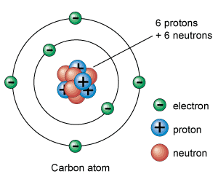
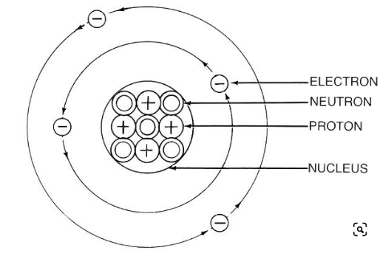
Structure of the atom
Notes:
Electrons circle the nucleus in special pathways called energy levels or shells.
This region is big (it takes up 99.99% of the atom).
An electron is like a spread-out negative charge that exists in the whole region at once- it is not a fast-moving particle racing around the nucleus.
Protons and Neutrons are composite particles and are made up of Quarks and Gluons

Slide 4
Structure of the atom
Subatomic particles:
Protons – positive charge
Electrons – negative charge
Neutrons - no charge
Notes:
Electrons circle the nucleus in special pathways called energy levels or shells.
This region is big (it takes up 99.99% of the atom).
An electron is like a spread-out negative charge that exists in the whole region at once- it is not a fast-moving particle racing around the nucleus.
Protons and Neutrons are composite particles and are made up of Quarks and Gluons

Slide 5
Charge and Mass of Subatomic Particles
Notes:
protons (+) are attracted to electrons (-)
Atoms are neutral: number of electrons equals the number of protons.
e.g. 5 + and 5 – makes 0 charge
protons and neutrons have much more mass than electrons (about 1800 times more!)

Slide 6
Which particles make up most of the mass of the atom? ________________
Which particle make up most of the mass of the atom? ________________

Slide 7
Which particles make up most of the mass of the atom? Protons and neutrons
Which particle make up most of the mass of the atom? electrons

Slide 8
Check your Understanding
What are the three subatomic particles?
Compare and contrast the electron and proton in terms of location and charge.
What accounts for an atom`s mass?
What accounts for an atoms volume?

Slide 9
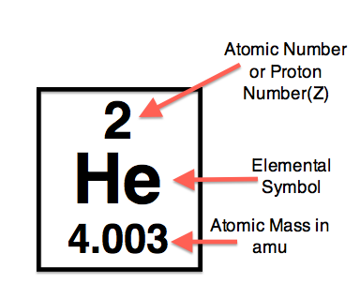

Slide 11
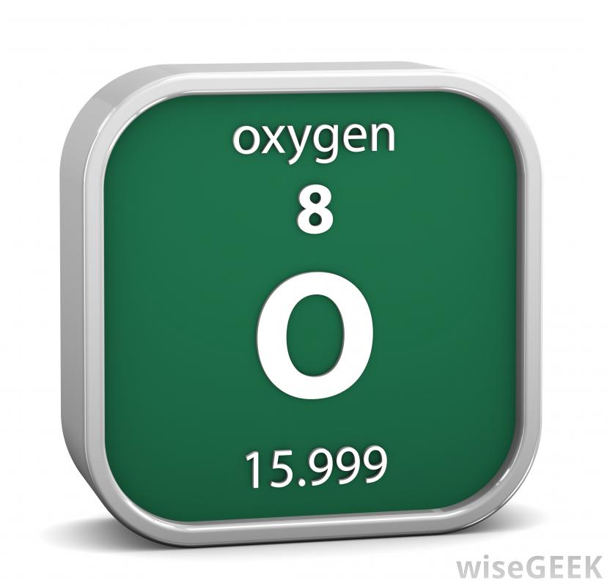
Try this:
What is the atomic number of Oxygen ?
How many protons does it have ?
What is the atomic mass ?
How many neutrons does it have ?

Slide 12
Practice
Element | Symbol | Mass # | # Protons | # Neutrons
Hydrogen
Chromium
Carbon
Barium
Iron

Slide 13
Practice
Element | Symbol | Mass # | # Protons | # Neutrons
Hydrogen | H | 1 | 1 | 0
Chromium | Cr | 52 | 24 | 28
Carbon | C | 12 | 6 | 6
Barium | Ba | 137 | 56 | 109
iron | Fe | 56 | 26 | 30

Slide 14
Practice
Atom WS

Slide 15
Representing Atoms: Bohr Model

Slide 16
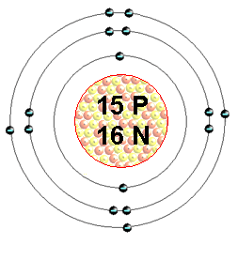
Bohr Model
A Bohr Model is a diagram of the number of electrons in each of the energy level (shell) around the nucleus of an atom.

Slide 17
Bohr Model
Each shell can only hold a CERTAIN NUMBER of electrons:
First shell can only hold a maximum of 2 electrons
2nd shell = 8, 3rd shell = 8, 4th = 18.
The outermost shell is called the VALENCE SHELL.

Slide 18
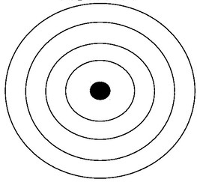
Practice: Draw a Bohr Diagram of Potassium

Slide 19
Practice: Draw a Bohr Diagram of Potassium
First find the number of protons by looking at its atomic number (19)
Now you know the number of electrons (19).
Place the electrons in corresponding shells at compass points (North, East, West, South).
Remember that the first shell can only hold 2 electrons, next shell 8, 8, etc

Slide 20
Bohr Model of Potassium

Slide 21
Draw a Bohr Diagram of Nitrogen

Slide 22
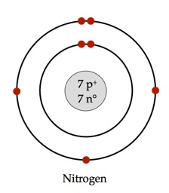
Draw a Bohr Diagram of Nitrogen

Slide 23
Draw a Bohr Diagram of Phosphorous

Slide 24
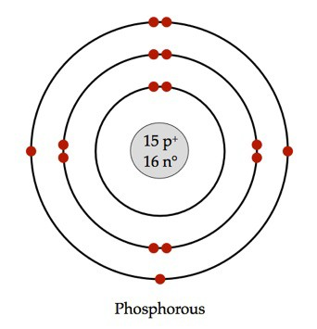
Bohr Model of Phosphorous:

Slide 25
What element is this?
_{18 p}
^{22 n}
Notes:
Argon

Slide 26
What element is this?
_{18 p}
^{22 n}
If you know the number of protons, you know it’s atomic number.
Or count the electrons…
Notes:
Argon

Slide 27
What element is this?
_{18 p}
^{22 n}
It has 2 + 8 + 8 = 18 electrons, and therefore 18 protons.
The element with atomic number of 18 is Argon.
Notes:
Argon

Slide 28
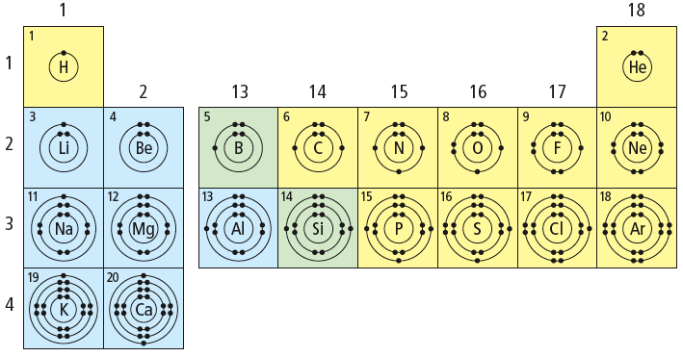
What patterns do you notice?

Slide 29
Patterns of Electron Arrangement in the Periodic Table
Have a look at the three Bohr models you drew.
What relationship can you find between number of OCCUPIED SHELLS and the ROW that it is found on the periodic table?

Slide 30
Patterns of Electron Arrangement in the Periodic Table
Have a look at the three Bohr models you drew.
What relationship can you find between number of OCCUPIED SHELLS and the ROW that it is found on the periodic table?
ROW = # of OCCUPIED SHELLS

Slide 31
Patterns of Electron Arrangement in the Periodic Table
Look at the Alkali Metals (Group 1).
What relationship can you find between number of VALENCE ELECTRONS and the COLUMN that it is found on the periodic table?

Slide 32
What patterns do you notice?

Slide 33
Patterns of Electron Arrangement in the Periodic Table
Look at the Alkali Metals (Group 1).
What relationship can you find between number of VALENCE ELECTRONS and the COLUMN that it is found on the periodic table?
GROUP/COLUMN # = #VALENCE ELECTRONS

Slide 34
Group number determines the number of valence electrons

Slide 35
What about Argon?
_{18 p}
^{22 n}
It has 3 electron shells, so it is in period 3
It has 8 electrons in the outer (valence) shell, therefore it is a noble gas.
Notes:
Argon

Slide 36
Patterns in the Periodic Table regarding electron arrangement
Elements in same family (group) have same number of valence electrons
Period (Row) = the number of occupied shells.

Slide 37
Homework
Atomic structure WS
Notes:
Read p14-15 of handout, complete atomic history chart in notes.

