Slide 1
Matter
How and why do we study Matter?

Slide 2
Vocabulary
Matter,
mixture, pure substance,
element, compound,
Homogeneous, heterogeneous
chemical reaction
Solute, solvent, solution

Slide 3
Matter can be classified by its composition

Slide 5
THERE ARE TWO TYPES OF MATTER

Slide 6
Pure Substances
Have only ONE kind of particle
Properties are consistent (same) throughout
Can be either an element or a compound

Slide 7
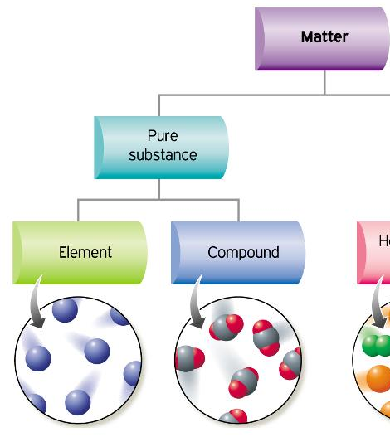
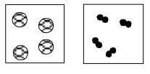
ELEMENTS:
contain only ONE type of ATOM
CANNOT be broken down into anything smaller.
Eg: anything on the periodic table:
Gold, copper, silver, sulfur, oxygen, helium, etc.

Slide 8
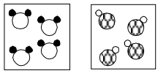
COMPOUNDS:
consist of 2 or more types of elements chemically bound together
Eg: water (H2O),
Salt (NaCl),
Carbon dioxide (CO2)

Slide 9
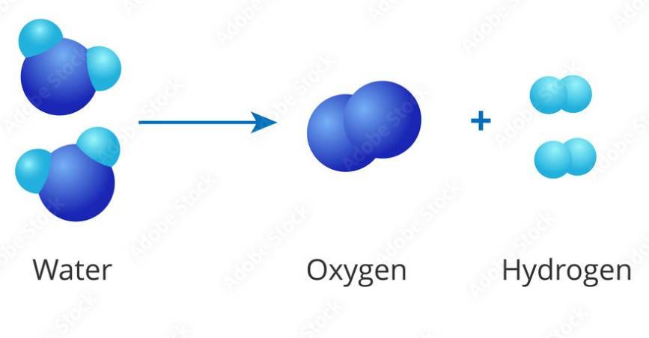
COMPOUNDS
Because compounds are made of different elements bound together, ENERGY like heat or electricity can be used to break the chemical bonds between elements.
Can be broken down using ENERGY – to break chemical bonds

Slide 10
How can we tell the difference between elements and compounds?
Elements cannot be broken down into anything simpler by ANY means.
Compounds can be broken down into simpler units using ENERGY like heat or electricity (to break the chemical bonds between elements).
eg. Water can be broken down into hydrogen and oxygen from water
video: http://www.youtube.com/watch?v=OTEX38bQ-2w

Slide 12
MIXTURES (are NOT pure substances)
A mixture contains two or more pure substances NOT CHEMCIALLY joined.

Slide 13
Heterogeneous Mixtures:
“Hetero” means different
Composition NOT uniform
Different properties throughout
(Looks different, different properties)

Slide 14
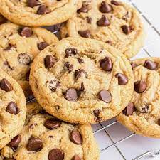
Heterogenous Mixtures: Mechanical Mixtures
You can SEE the different particles.
E.g. chocolate chip cookie
E.g. mixture of salt and pepper.

Slide 15
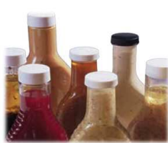
Heterogenous Mixture: Suspension
A suspension is a cloudy mixture in which tiny particles of one substance are suspended within another.
E.g. Tomato juice– the particles can be separated when the mixture is poured through filter paper.
A salad vinaigrette is a mixture of oil, vinegar, and spices.
When shaken, they form a suspension but after a while the components will separate.

Slide 16
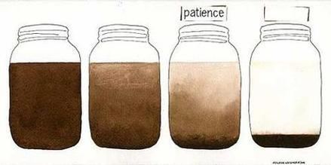
Heterogeneous Mixtures: Suspensions
Particles may settle out over time
Suspensions contain particles >500nm
eg. Muddy water, hot chocolate, oil and water

Slide 17
Homogeneous Mixtures
“Homo-” (means “same”).
Composition is uniform (Looks same throughout)
Properties are same throughout.
The components are indistinguishable from each other (can’t tell them apart) because they are microscopic (too small to see with human eye).
Can be solid, liquid, gas

Slide 18
Homogeneous Mixtures: Solutions
Particles too small to be seen or settle out
Solutions contain particles that are < 2 nm
Eg. Sugar dissolved in water

Slide 19
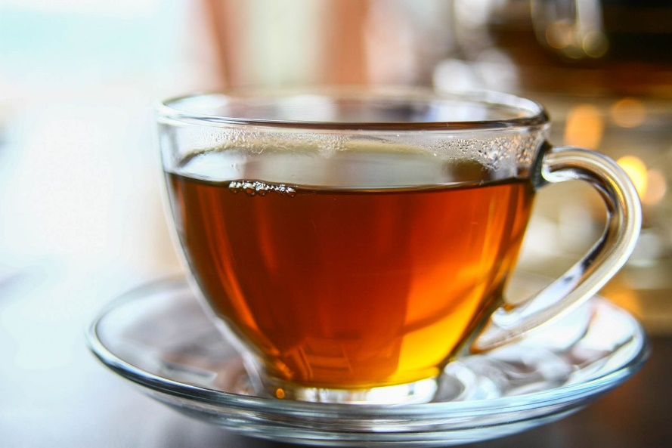
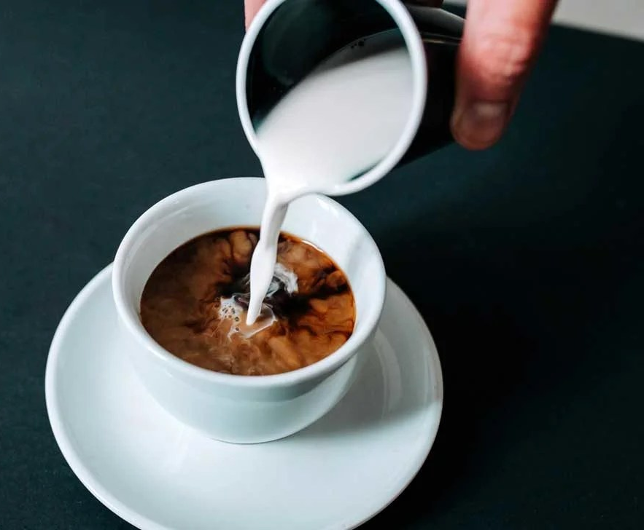
Examples of Homogeneous Mixtures in liquid
Honey and Tea, coffee and cream

Slide 20
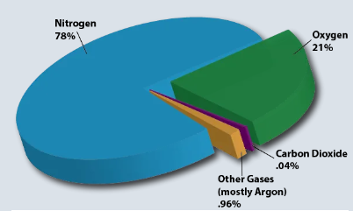
Homogeneous Mixtures in Gas form
Air is a mixture of gasses:
oxygen,
nitrogen,
argon,
carbon dioxide,
etc

Slide 21
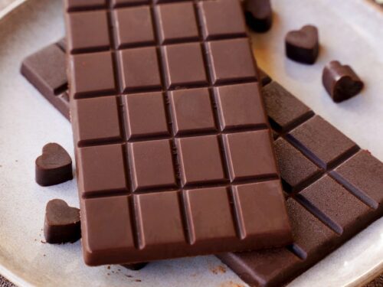
Solid Homogeneous Mixture
Chocolate is a solid mixture.
cacao powder,
cocoa butter,
sugar;

Slide 22
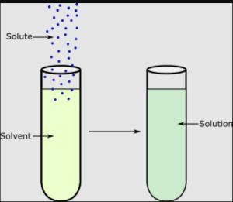
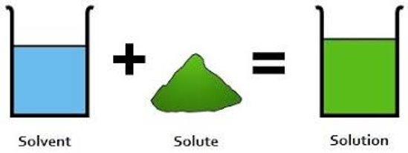
Homogeneous Mixtures: Solutions
Solute + solvent = Solution

Slide 23
Practice
Classify each of the following as either a pure substance or a mixture. If it is a pure substance, is it an element or a compound? If it is a mixture, is it heterogeneous (i.e. a mechanical mixture/suspension) or homogeneous (i.e. a solution)?
(a) sand – white & black grains of sand
(b) water – hydrogen & oxygen atoms chemically combined
(c) pop – water, sugar, & carbon dioxide
(d) pencil lead – carbon atoms
(e) pizza – pepperoni, cheese, & sauce
(f) silver – silver atoms
(g) salt – sodium & chlorine atoms chemically combined

Slide 25
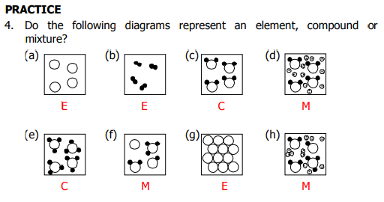

Slide 27
Practice
Create a mind map on how to classify matter
Answer questions

Slide 28
Extra slides beyond here

Slide 29
Solutions
Components (particles) are not individually visible from each other.
One substance is dissolved in another, creating a homogeneous mixture.
Properties are consistent throughout
Particles DO NOT settle out
components are evenly and microscopically mixed together.
Eg sugar dissolved in coffee or
E.g. clear apple juice
E.g. Atmosphere – a mixtures of gases

Slide 30
Classify these

Slide 35
Solutions have 2 parts
Solutions contain:
solute (substance being dissolved, eg sugar)
Solvent (often a liquid, like water)

Slide 36
Practice
Identify each of the following as either a mechanical mixture or a solution.
(a) a pane of clear glass
(b) chocolate chip ice cream
(c) clear apple juice
(d) garbage in a garbage can
(e) a garden salad
(f) tea

Slide 37
Practice
Identify each of the following as either a mechanical mixture or a solution.
(a) a pane of clear glass compound
(b) chocolate chip ice cream hetero
(c) clear apple juice solution
(d) garbage in a garbage can mechanical
(e) a garden salad mechanical
(f) tea solution

Slide 38
Practice
Using the words outlined below, make a flow chart summarizing how matter can be organized. Start your chart with the word, “MATTER”.
• element •
compound •
heterogeneous mixture •
homogeneous mixture •
mechanical mixture •
mixture •
pure substance •
solution •
suspension

Slide 39
Practice
Classify each of the following as either a pure substance or a mixture. If it is a pure substance, is it an element or a compound? If it is a mixture, is it heterogeneous (i.e. a mechanical mixture/suspension) or homogeneous (i.e. a solution)?
(a) sand – white & black grains of sand
(b) water – hydrogen & oxygen atoms chemically combined
(c) pop – water, sugar, & carbon dioxide
(d) pencil lead – carbon atoms
(e) pizza – pepperoni, cheese, & sauce
(f) silver – silver atoms
(g) salt – sodium & chlorine atoms chemically combined

Slide 43
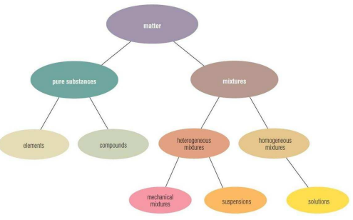

Slide 45
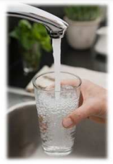
Is a compound, such as water from the tap, a pure substance or a mixture? Explain.

Slide 46
Is a compound, such as water from the tap, a pure substance or a mixture? Explain.
water from the tap is a mixture because it contains various minerals and, in some cases, particulates (i.e. shine a laser light through water to see the particulates, if there are any)

Slide 47
Lead is not often used in solder anymore. Explain why not.
Before the toxic effects of lead were understood, the seams of metal cans for preserving food were sealed using lead solder. When the cans were heated, a high level of lead leached into the food, particularly if the contents were acidic, such as tomatoes or citrus fruits. It is likely that sailors suffered from lead poisoning on long trips. Fresh meat and vegetables were not available, so sailors ate mostly canned foods. Even today, you should never drink hot water directly from the tap, in case there is lead solder in the plumbing that may be absorbed into the hot water.

Slide 48
Describe one way to separate the following mechanical mixtures.
(a) metals in a scrap yard
(b) salt and sand
(c) sand and gravel
(d) sand and water

Slide 49
Some air purification systems include filters. What is the difference between a filter and a sieve?
sieve - device used to separate the components of a mixture, with many visible holes that allow smaller solid pieces and liquids to pass through while blocking the larger solid pieces
filter - device with many small holes that trap solid pieces of a mixture but allow liquids and gases to pass through

Slide 50
Separating Matter

Slide 51
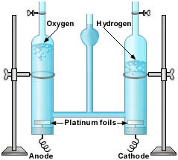
Separating Compounds
Compounds can be separated using ENERGY, because energy is needed to break chemical bond
Eg. Electrolysis
Separation technique would be based on chemical properties.

Slide 52
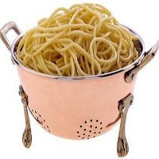
Separating Mixtures
Mixtures can be separated by PHYSICAL means, based on their physical properties.

Slide 53
Mechanical Mixtures (Insoluble)
Eg: Sand and Marbles→
Eg. Sand and water →
Eg. Salt and water →
E.g. Iron nails from zinc screws→

Slide 54
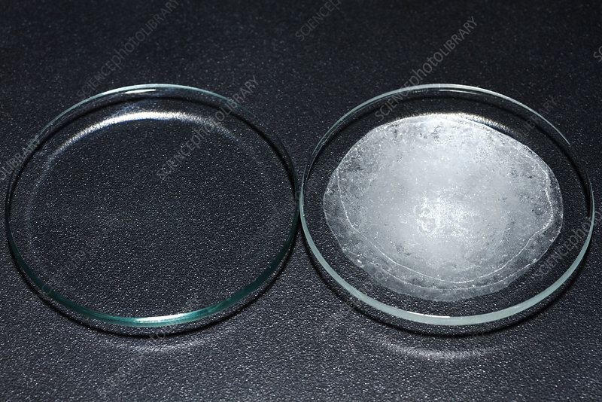
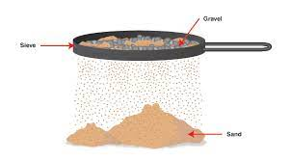
Mechanical Mixtures (Insoluble)
Eg: Sand and STone→ using fingers ( Based on size), seive
Eg. Sand and water → filter (solubility)
Eg. Salt and water → Evaporation ( evaporation rate, boiling pt
Iron nails from zinc screws →

Slide 55
Methods of Separation
There are numerous ways to separate a mixture. List six of them.
sorting (used when substances are large)
floating & settling (used for substances that float/sink)
centrifuge (used for suspensions)
magnet (used for magnetic/nonmagnetic substances)
sieves & filters (used for different sized substances)
dissolving (used when a substance dissolves easily in a solvent)
Chromatography -

Slide 56
Solutions have 2 parts
Solutions contain:
solute (substance being dissolved, eg sugar)
Solvent (often a liquid, like water)

Slide 58
Practice
Read p152-155
Answer #2,4,5,7-11, p156
Extending 12-13
Extra slides beyond here

Slide 59
Homogeneous Mixtures

Slide 60
Homogeneous Mixtures: Solutions
Solutions contain particles that are < 2 nm

Slide 61
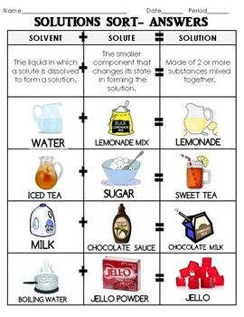

Slide 62
Homogenous Mixtures: Colloids
Particles are bigger but still can’t see them with naked eye (particles between 2-500nm), But scatters light. Tyndall effect
particles stay suspended, don't settle out.
Eg. Milk, Jello, fog (water molecules in air), smoke
cannot be separated out by ordinary filtering or centrifuging like those in a suspension.

Slide 63
Tyndall Effect
also called Tyndall phenomenon,
scattering of a beam of light by a colloid.
e.g., smoke or dust in a room, which makes visible a light beam entering a window. ...
Notes:
The effect is named for the 19th-century British physicist John Tyndall, who first studied it extensively.

Slide 67
Heterogeneous Mixtures:
Components can be VISIBLY distinguished.
DIFFERENT properties throughout
Notes:
Composition NOT uniform
Mechanical mixtures have two or more particle types that are not mixed evenly and can be seen as different kinds of matter in the mixture.

Slide 68
Heterogeneous Mixtures:
Mechanical Mixtures
Can be separated by mechanical means
Ex. Granola, sulfur and iron, sand and marbles, salsa, blood
Notes:
Composition NOT uniform
Mechanical mixtures have two or more particle types that are not mixed evenly and can be seen as different kinds of matter in the mixture.

Slide 69
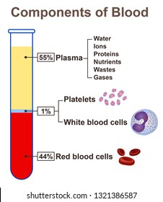
Blood? Yes

Slide 70
Heterogeneous Mixtures

Slide 71
Mechanical Mixtures
chocolate chip cookies,
granola
pepperoni pizza.
beach sand (various minerals, shells, bacteria, plankton, seaweed and much more)
concrete (sand gravel, cement, water).

Slide 72
Heterogeneous Mixtures: SUPSENSIONS
Have solids or liquids that may settle out over time
Suspensions contain particles >500nm. Can be FILTERED
Do not transmit light (can’t see through)
eg. raw milk, salad dressing, fresh squeezed orange juice and muddy water, hot chocolate
Notes:
Suspensions are mixtures that have solid or liquid particles scattered around in a liquid or gas. Common examples of suspensions are raw milk, salad dressing, fresh squeezed orange juice and muddy water. If left undisturbed the solids or liquids that are in the suspension may settle out and form layers. You may have seen this layering in salad dressing that you need to shake up before using them. After a rain fall the more dense particles in a mud puddle may settle

Slide 73
Check your understanding
How can you tell the difference between a homogenous mixture and a compound?

Slide 74
Properties of Mixtures
1) Components can be separated by physical means (filtration, evaporation, sublimation, distillation)
2) Mixtures show properties of all its constituents.
3) Formation of a mixture is a physical change (energy is neither given off nor absorbed).
4) Constituents are present in any portion by mass.
5) Do not have a definite melting point or boiling point.
6) Can be homogeneous or heterogeneous

Slide 75
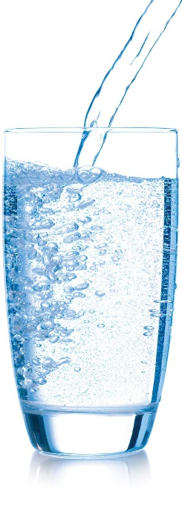
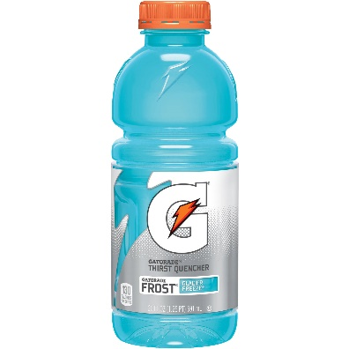
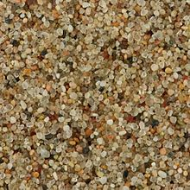
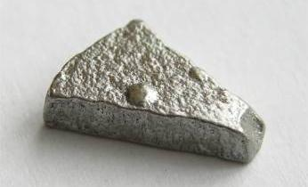
Let’s practice some
Classify the following as:
an element, compound, solution or mechanical mixture
Water Sand Iron Gatorade

Slide 76
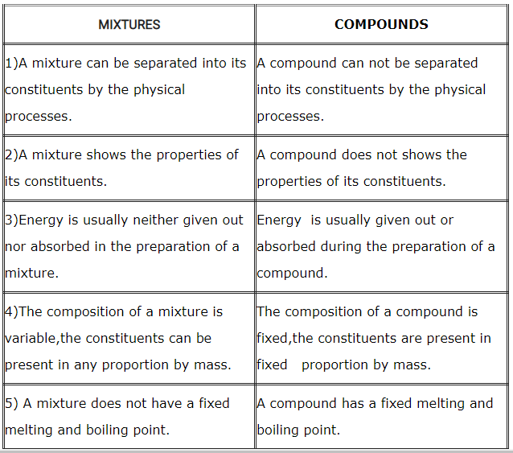
Difference between Compound and Mixture

Slide 77
How can we separate a SOLUBLE (dissolved) substance from a solution (homogeneous mixture)?
Eg. Salt and water →

Slide 78
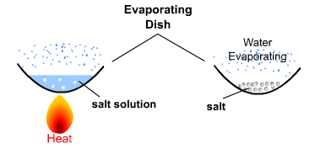
How can we separate a SOLUBLE (dissolved) substance from a solution (homogeneous mixture)?
Eg. Salt and water →Evaporation,
https://www.youtube.com/watch?v=XC1RxloV0Mo

Slide 79
How can we separate a SOLUBLE (dissolved) substance from a solution (homogeneous mixture)?
Eg. Dye and water

Slide 80
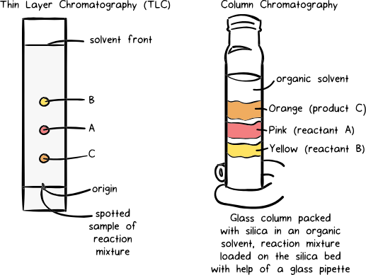
How can we separate a SOLUBLE (dissolved) substance from a solution (homogeneous mixture)?
Eg. Dye and water →chromatography

Slide 81
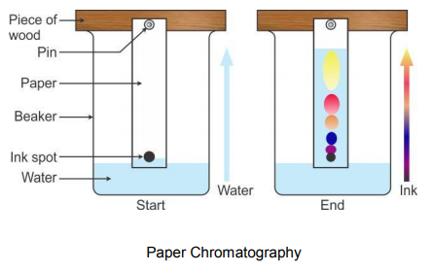
Chromatography – technique used to separate a mixture:
The mixture is dissolved in a fluid (mobile phase), which carries it through a structure holding another material (stationary phase).
The various parts of the mixture travel at different speeds, causing them to separate.

Slide 83
Activity: Candy Chromatography

Slide 84
Extras

Slide 90
Summary

Slide 91
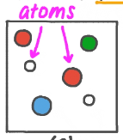
Atoms, Molecules, Compounds
Atom - smallest unit of an element:
Molecule - two or more atoms bonded together. Atoms may be the same or different:
Compound - two or more different elements

