Slide 1
Properties of Matter
How and why do we study Matter?

Slide 2
Learning goal:
To DESCRIBE and EXPLAIN matter based on its PROPERTIES and INTERACTIONS

Slide 3
Vocabulary
Quantitative
Qualitative
Physical
chemical reaction
Intensive
Extensive
All descriptive terms for properties of matter...

Slide 4
THE STUDY OF MATTER
CHEMISTRY is the study of matter, its organization and how it behaves

Slide 5
What is matter?
Matter is anything that has
MASS (amount of matter in a substance)
and
VOLUME (amount of space matter takes up)
What isn’t matter?

Slide 6
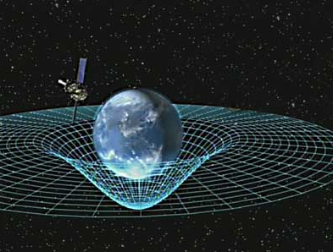
What ISN'T matter?
Energy (light, sound, heat)
Energy has no mass or volume

Slide 7
How can we Describe Matter?
Matter can be described by its Physical and Chemical Properties

Slide 8
What is a property?
Property: a characteristic of a substance that can be observed.
Properties can be used to describe a substance’s appearance or behaviour.

Slide 9
Properties of Matter
Properties can be classified as either
PHYSICAL or CHEMICAL

Slide 10
PHYSICAL PROPERTIES OF MATTER
Physical properties can be measured or observed without changing matter to a different substance.
Notes:
Describe properties of a strawberry

Slide 11
Physical Properties
Colour - red, blue,….
Odour - putrid, burnt, spicy,…
TASTE - sweet, salty, sour, bitter
Notes:
Lustre: (how shiny a solid is) - shiny, dull, metallic, pearly
Clarity - Transparent (clear), cloudy, opaque, translucent

Slide 12
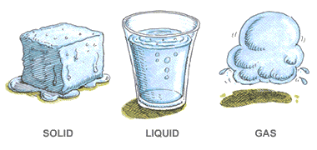
State: solid, liquid, gas

Slide 13
Review Changing States of Matter

Slide 14
Texture - coarse, smooth, fine, gritty, rough, slippery, sticky, feathery, bumpy, fluffy, …

Slide 15
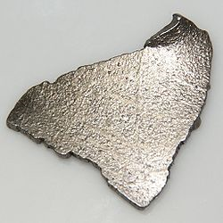
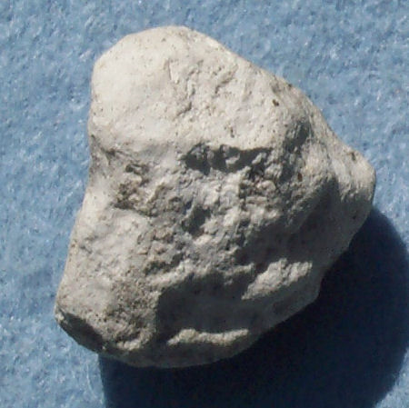
Luster - (how shiny a solid is) - shiny, dull, metallic, pearly, glassy, etc

Slide 16
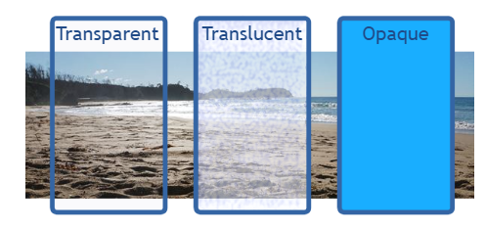
CLARITY - Transparent (clear), cloudy, opaque, translucent

Slide 17
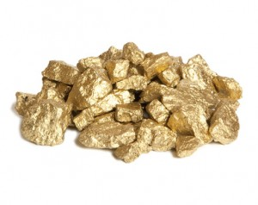
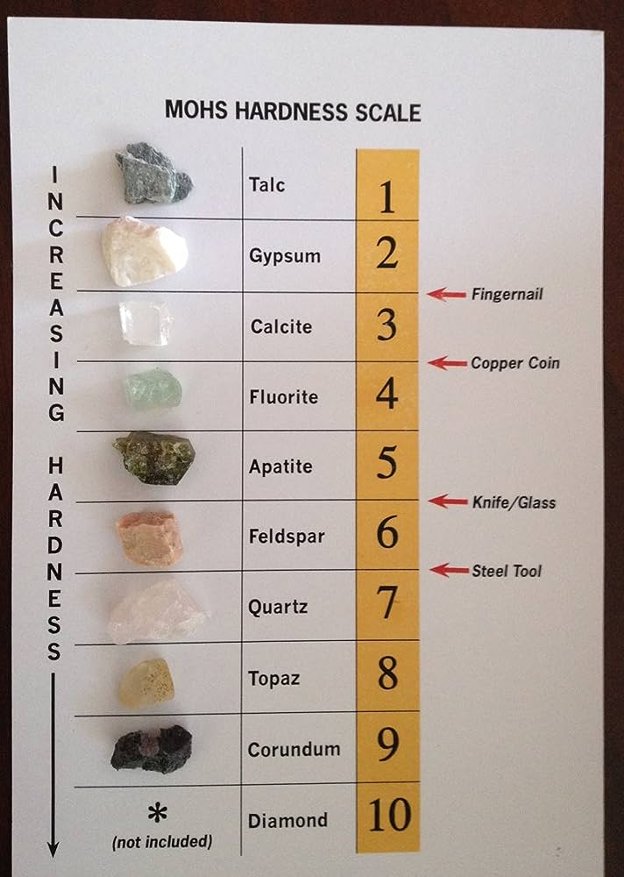
Hardness: resistance to being scratched or dented

Slide 18
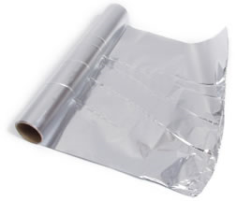
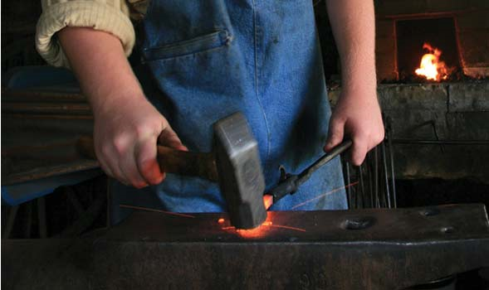
Malleability
Substance’s ability to be hammered into a thin sheet
Notes:
MALLEABILITY: ability to be pressed or bent into different shapes

Slide 19
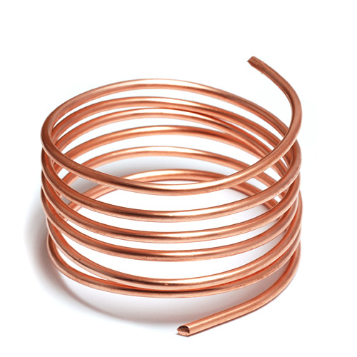
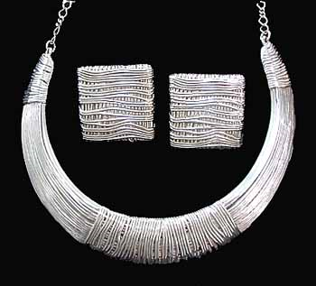
Ductility
Substance’s ability to be stretched into a wire.
Notes:
Single ounce (28g, equal weight to about 2 Tablespoons of sugar) can be stretch into a gold thread 8 km long

Slide 20
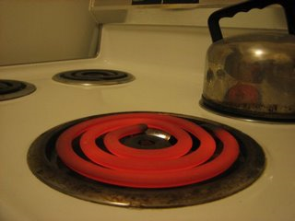
Conductivity – ability to conduct Heat or Electricity
Notes:
Metals are good conductors

Slide 21
Melting Point - the temperature at which a substance changes from a solid to a liquid

Slide 22
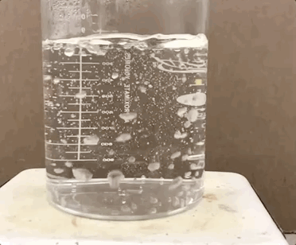
Boiling Point - the temperature at which a substance changes from a liquid to gas.

Slide 23
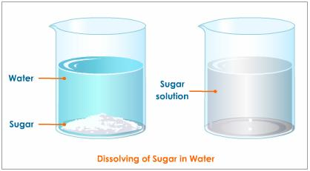
Solubility – substance’s ability to dissolve into another substance

Slide 24
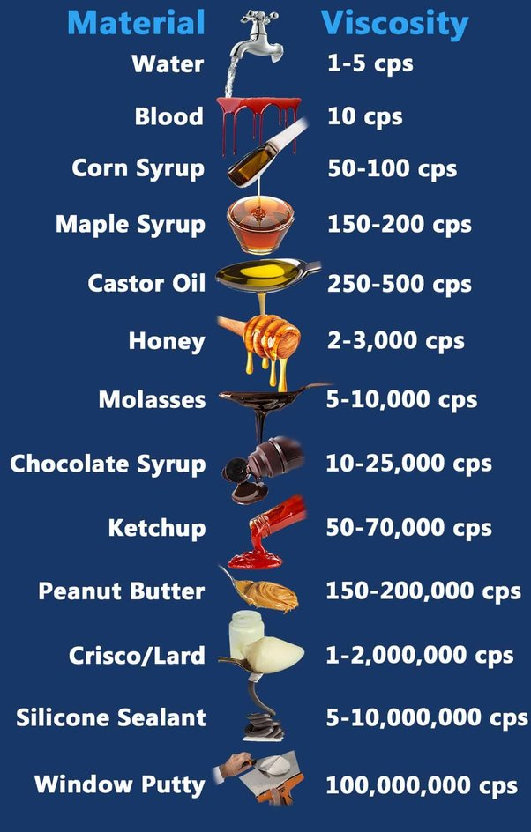
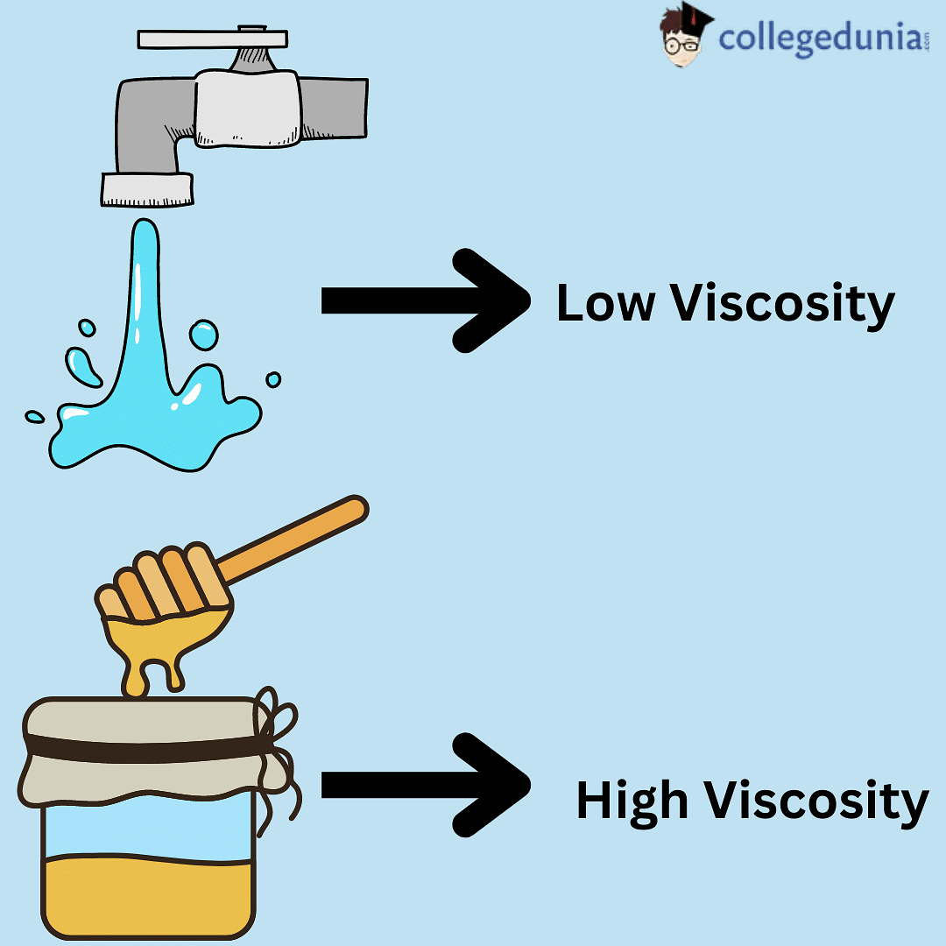
Viscosity – a substance’s resistance to flow

Slide 25
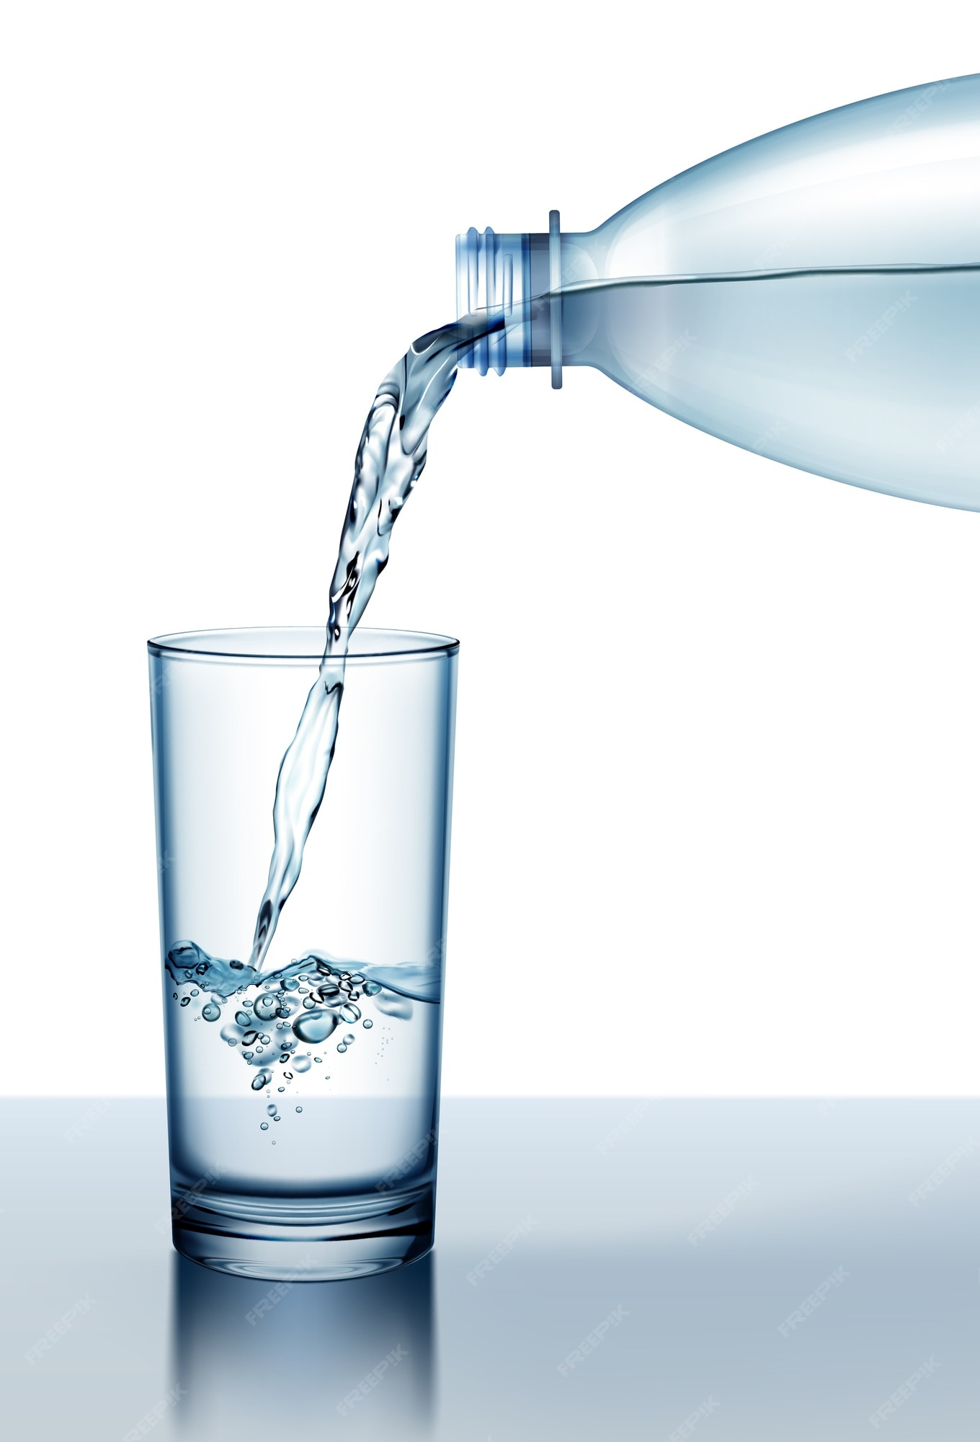
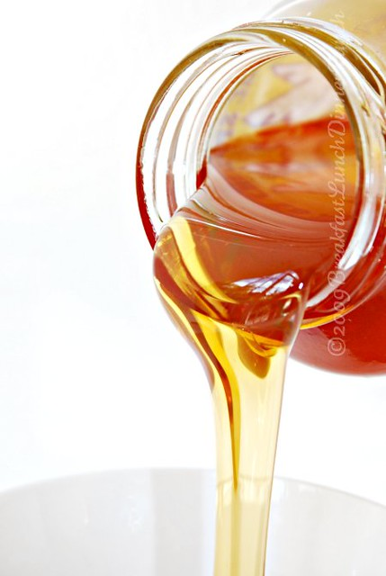
Viscosity
Honey is more viscous than water

Slide 26
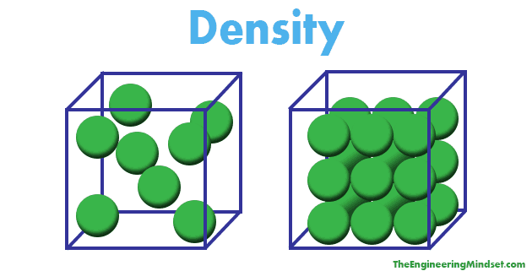
Density: how tightly packed the particles are

Slide 27
Mass and Volume are properties

Slide 28
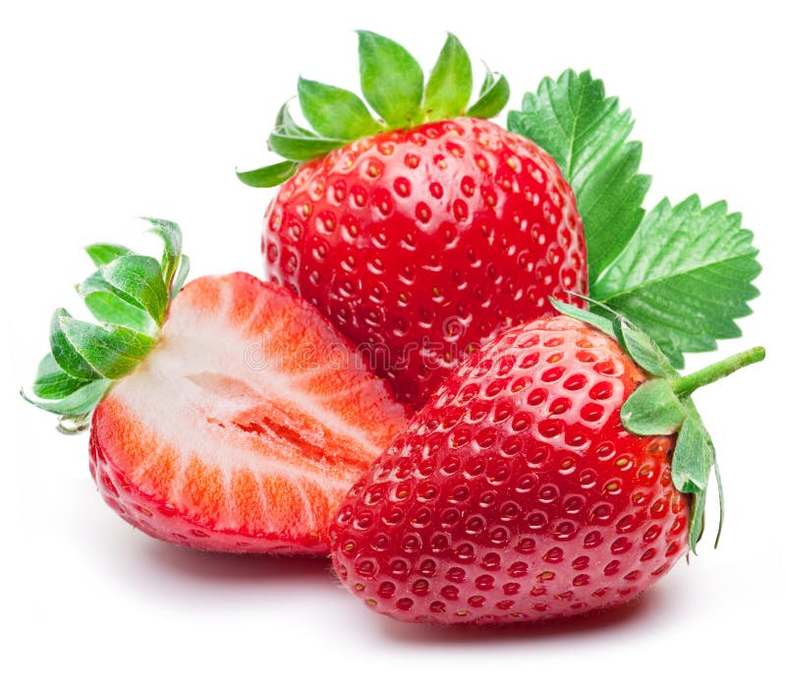
How many can you use to describe a strawberry?
Notes:
How many
Colour -
Odour -
Texture -
Lustre:
Clarity -
TASTE can you use?

Slide 29
PROPERTIES OF MATTER can be Qualitative or Quantitative
Qualitative properties – Description using words
Eg. Flavor, colour, texture, hardness, sound, phase
Eg. the strawberry is red, sweet, soft
Quantitative properties – description using numbers
Eg. mass, volume, melting point, solubility, boiling point.
Eg. the strawberry has a mass of 23g, a volume of 2.5 ml, and density of 9.3 g/ml
Notes:
Describe properties of a strawberry

Slide 30
Practice
Vocabulary

Slide 31
Chemical Properties of Matter
A Chemical property is a characteristic that can only be measured or observed as matter transforms (changes or turns into) into a different type of matter.
Notes:
This occurs when a substance REACTS with another substance.

Slide 32
Chemical Properties of Matter
Example: To see if something is flammable, you must burn it. Then the substance is changed.
Is Paper flammable?

Slide 33
Chemical Properties of Matter
Is Paper flammable?
Yes, we can see it burn and the paper has changed from White → black
Flammability is a chemical property of paper

Slide 34
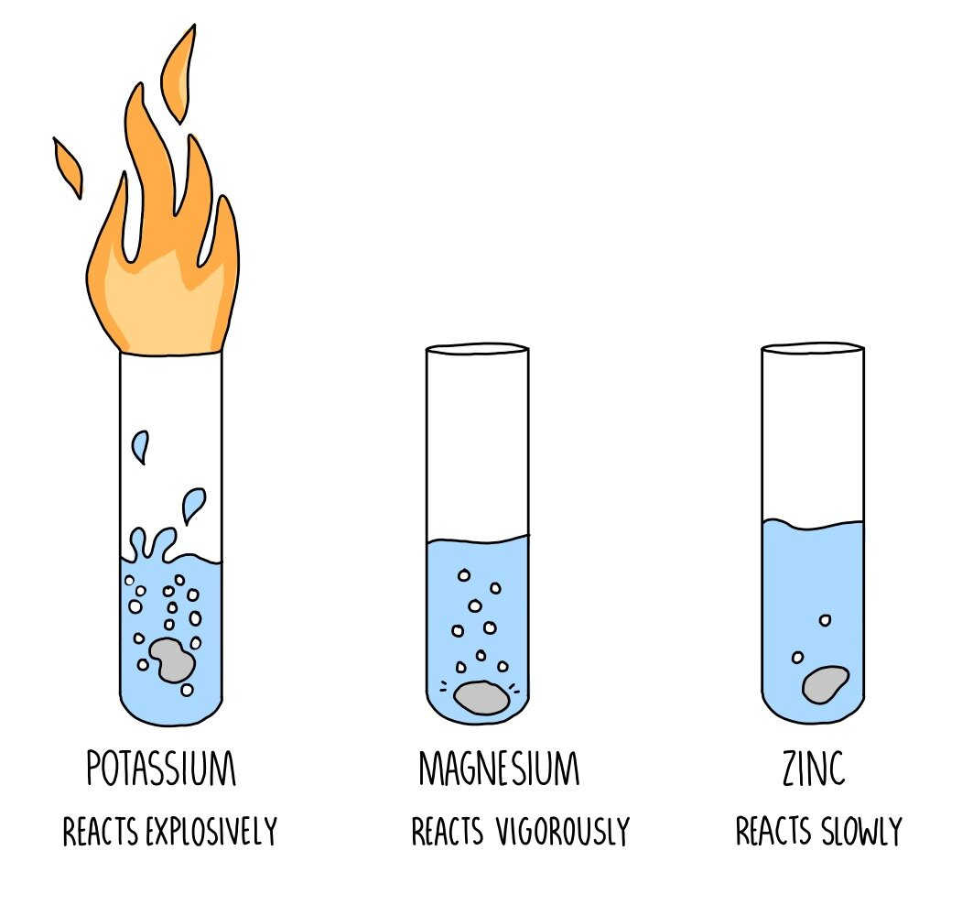
Chemical Properties of Matter
Reactivity – ability to combine chemically with another substance.
Certain materials are highly reactive, whereas others are extremely inactive.

Slide 35
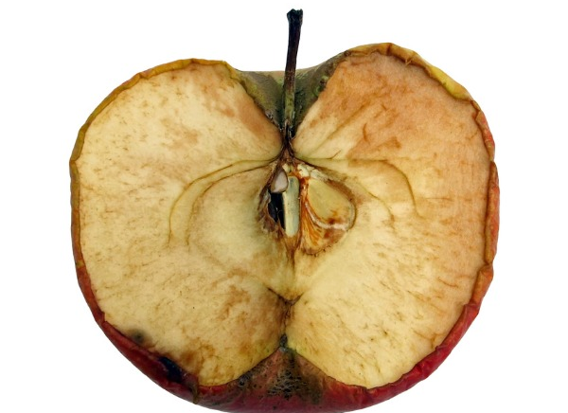
Reactivity example
When an apple is cut, it reacts with oxygen making it go brown (oxidation).

Slide 36
REACTIVITY
Notes:
the dlfkaldkfkldf
bility of matter to react with another substance to form one or more new substances with different properties.

Slide 37
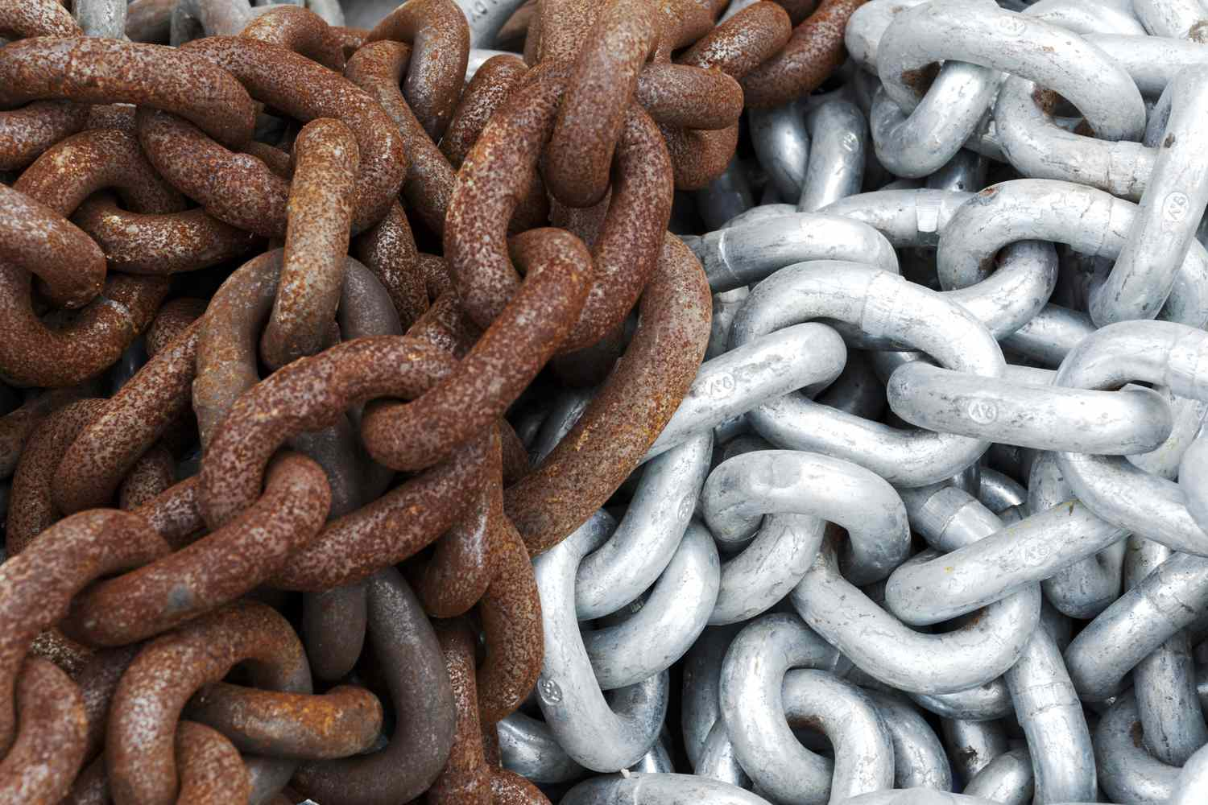
Oxidation - Ability to react with oxygen Example: RUST
Iron is capable of combining with oxygen to form iron oxide (rust).
Ability to rust is a property of iron but not aluminum.
Notes:
A chemical property of iron is that it is capable of combining with oxygen to form iron oxide, the chemical name of rust. A more general term for rusting and other similar processes is corrosion

Slide 38
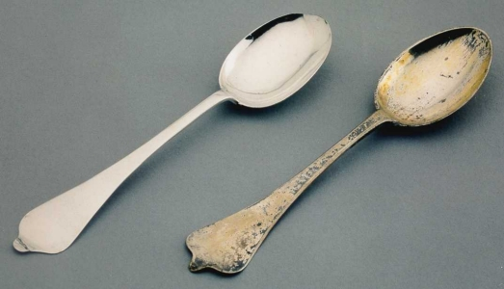
Oxidixation

Slide 39
Chemical Properties of Matter
Flammability - ability to burn.
As matter burns, it reacts with oxygen and transforms into various substances.
E.g. wood is flammable

Slide 40
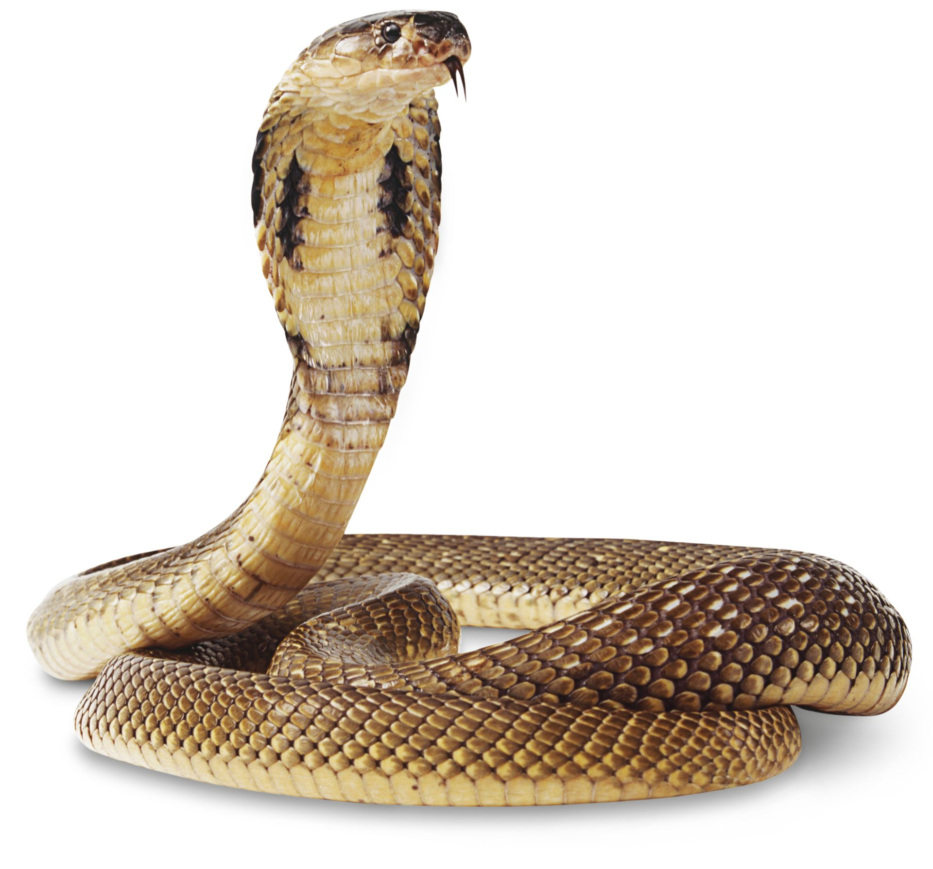
Chemical Properties of Matter
Toxicity- ability of a substance to harm an organism.

Slide 41
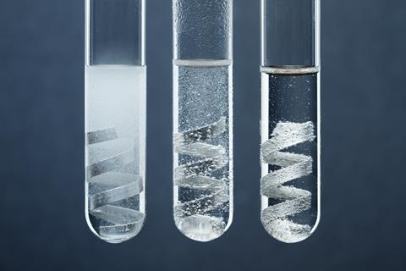
Chemical Properties of Matter
Acidity – A substance’s ability to react with acid
Some metals form compounds when they react with different acids.
Acids react with bases to create water, which neutralizes the acid.

Slide 42
Intensive and Extensive Properties of Matter
Properties of matter are either EXTENSIVE or INTENSIVE.

Slide 43
EXTENSIVE Properties of Matter
depend on the amount of matter present
Notes:
E.g. mass and volume.

Slide 44
Intensive Properties of Matter
Does NOT matter how much matter you have
Notes:
E.g. density, temperature, colour

Slide 45
Check your understanding
Classify these properties as either INTENSIVE or EXTENSIVE:
Colour malleability
Mass
Density
Volume
Temperature
Boiling point

Slide 46
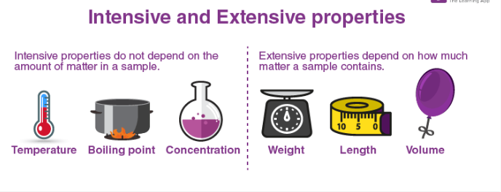

Slide 48
Practice
Properties of matter worksheet
vocabulary
Video: Examples of Physical and Chemical Properties https://www.youtube.com/watch?v=oF0lN0jZYx0
Properties Song!:
https://www.youtube.com/watch?v=uJOGy0dgmUU

