Slide 1
INTRUSIVE AND EXTRUSIVE VOLCANIC FEATURES

Slide 2
Volcanic Landforms
Volcanic landforms are divided into: extrusive and intrusive landforms
based on weather magma cools within the crust or above the crust.

Slide 3
Extrusive Landforms
Extrusive landforms are formed from material thrown out during volcanic activity:
Volcanoes
Craters, calderas, lava domes and lava plateaus, columnar jointing
Mid-Ocean Ridges

Slide 4
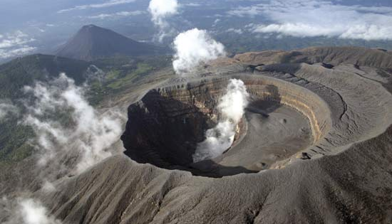
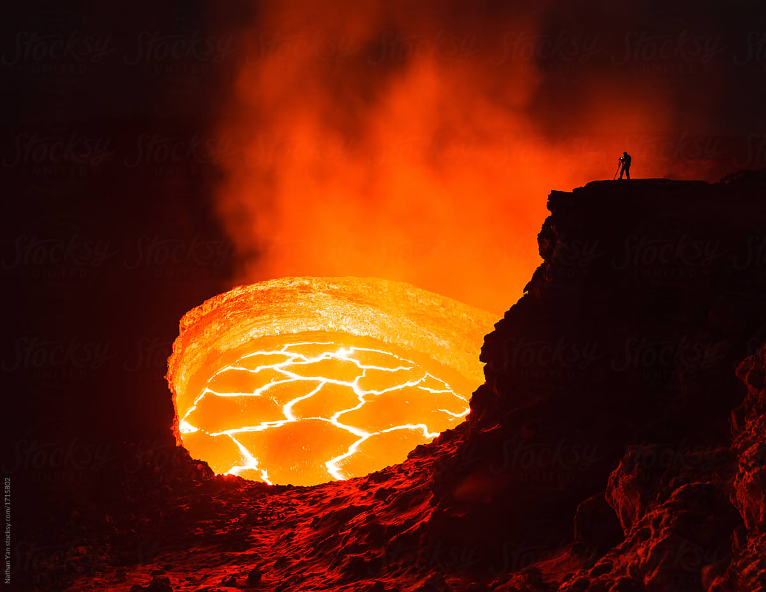
Craters
Funnel-shaped pit at the top of a volcanic vent
Formed when material is blown out of the volcano by explosions
Becomes wider by weathering and erosion

Slide 5
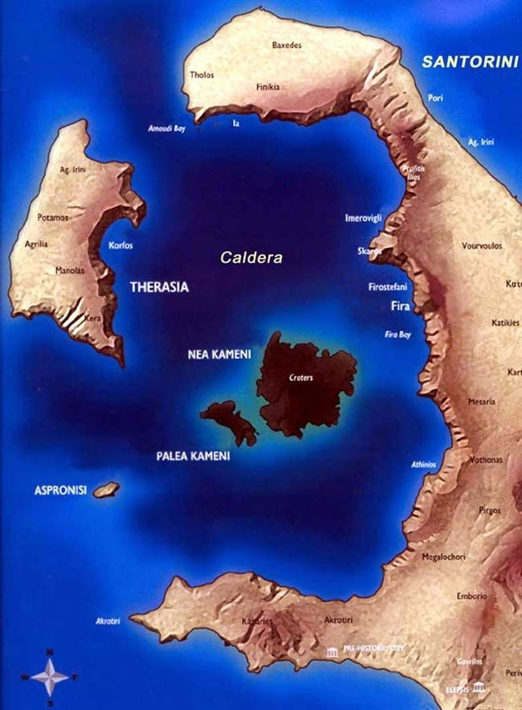
Calderas
Calderas form when a volcanic cone collapses or by discharge of large amounts of magma
Eg. Santorini

Slide 6
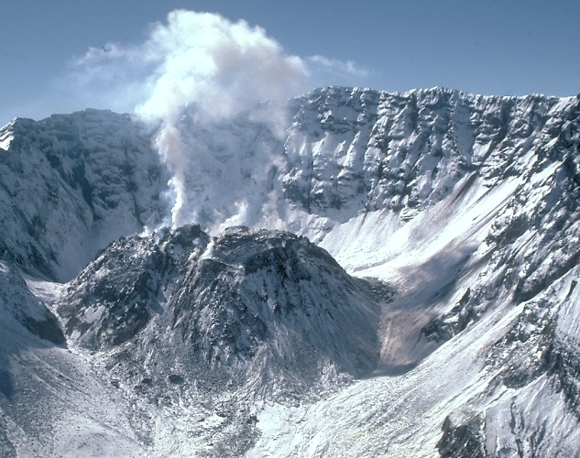
Lava Domes
A lava dome is a roughly circular mound-shaped protrusion resulting from the slow extrusion of viscous lava from a volcano.

Slide 7
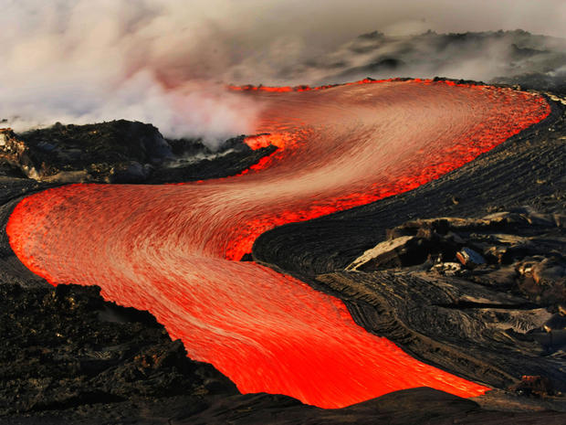
Lava Flows

Slide 8
Columnar Jointing

Slide 9
The Giant's Causeway is an area of about 40,000 interlocking basalt columns, the result of an ancient volcanic fissure eruption.

Slide 10
Giant’s Causeway, Northern Ireland

Slide 11
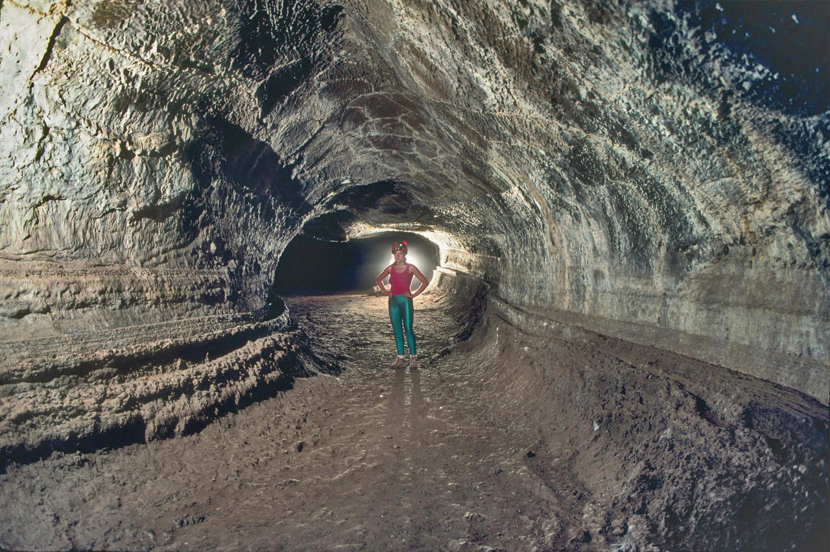
Lava Tubes
Natural conduit formed by flowing lava which moves beneath the hardened surface of a lava flow.

Slide 12
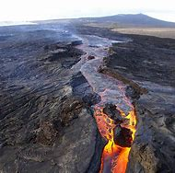
Rift Zone
A set of linear cracks in a volcano.
Rift volcanoes form when magma rises into the gap between diverging plates.
Rift zones are areas where the volcano is rifting or splitting apart..

Slide 13
Intrusive Landforms (Below the crust)
When magma is forced to the surface only a small amount of the mass actually reaches that level.
Most of the magma is intruded into the crust where it solidifies into a range of features.
These are often exposed at the surface by later erosion.
https://www.youtube.com/watch?v=Nboq5zsLxFE

Slide 14
Intrusive Features: Plutons
Pluton is a body of intrusive rock formed from magma that cooled slowly below the surface.
Plutons include batholiths, stocks, dikes, sills, laccoliths, lopoliths, and other igneous formations.

Slide 15
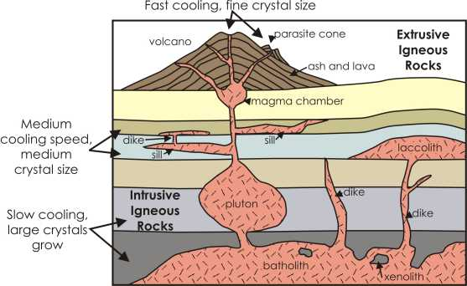
Intrusive and Extrusive Igneous Features
1. Intrusive features = parts of volcanic activity found inside the earth
Plutons = Intrusive igneous rocks of any size. Formed inside the earth.

Slide 16
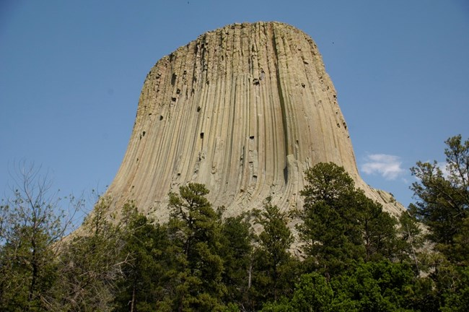
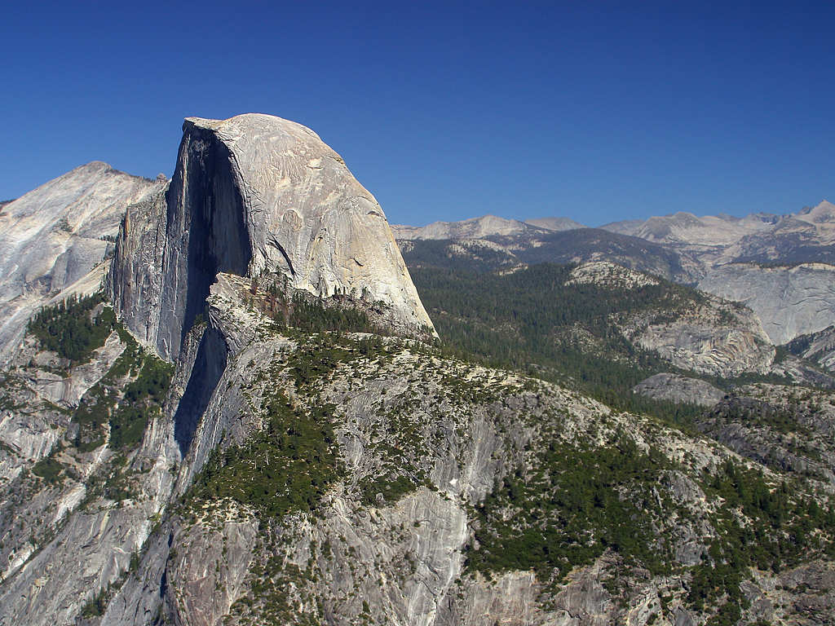
Batholiths
Batholiths are Plutons that have been exposed on the surface through uplift and erosion.
Large (>100 km²)
Batholiths are often dome-shaped and exposed by later erosion.
Notes:
Batholiths Greek bathos – depth, lithos - rock)

Slide 17
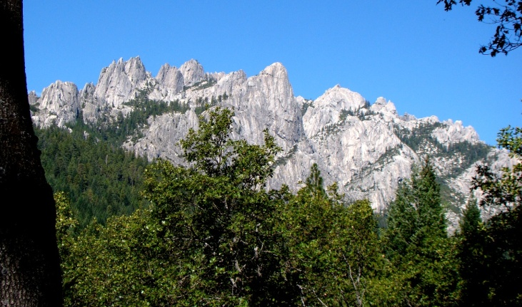
Stocks (Smaller than batholith: <10 km²)

Slide 19
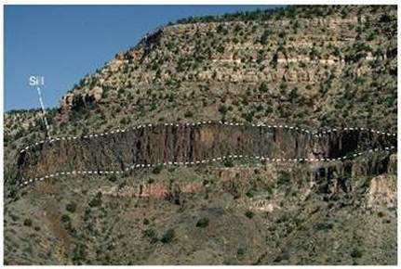
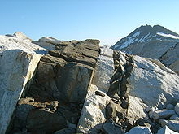
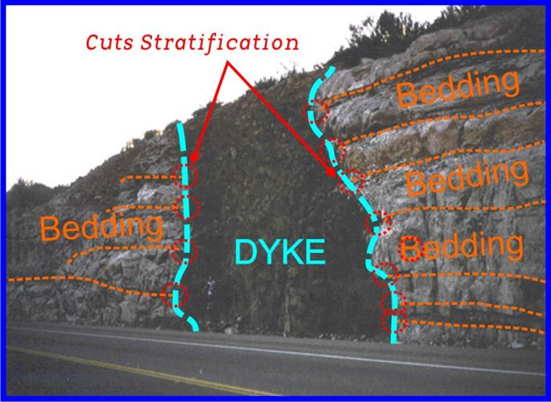
Sills and Dikes
Sills and Dikes are bodies of magma that intrude into a fracture.
Sills follow bedding planes (horizontal), whereas dikes cross-cut beds (vertical).

Slide 20
Sills and Dikes

Slide 21
Activity
Melting Temperature of Rocks Graphing Exercise

