Slide 2
Volcanology: The Study of Volcanoes
Magma (molten rock) forms at plate boundaries, where friction between the plates can create intense heat and pressure.

Slide 3
Magmas contain dissolved gases
(water vapour, carbon dioxide)
As magma reaches the surface, dissolved gas come out as bubbles of gas.
Bubbles expand and explode…therefore…
LOTS OF GAS = MORE EXPLOSIVE ERUPTIONS

Slide 4
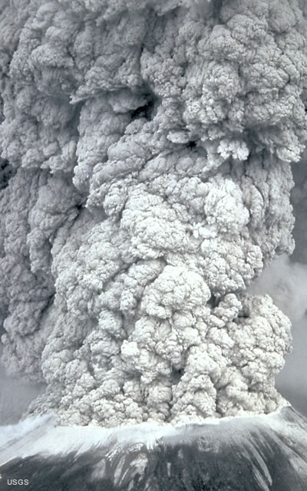
Volcano Hazards
1. Ash
Gritty sand-sized particles blasted from erupting volcano
Can reach very high altitudes and block sunlight, causing world temperatures to drop.
Can destroy crops and, buildings, clog rivers, damage machines.

Slide 5
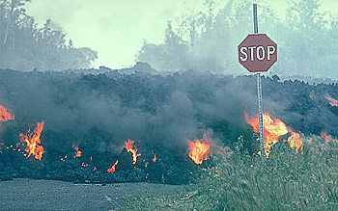
2. Lava
Molten rock may flow over large areas, destroying everything in its path.

Slide 6
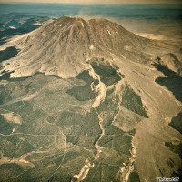
3. Lahar
Flow of mud, water, ash and debris that can result when snow-covered volcanoes erupt.

Slide 7
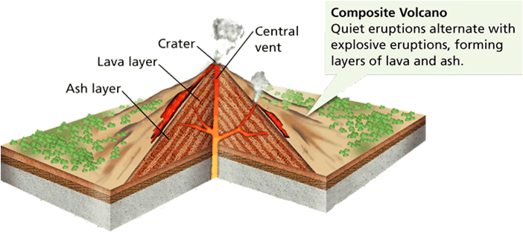
1. Composite volcanoes (formed by Convergent boundaries)
As ocean plate sinks beneath the continental (or less dense oceanic) plate, increasing heat melts the rock, forming magma.
Magma is lighter than the surrounding solid rock, so it rises up through the edge of the continental plate to form a volcano.
Tall cone shape results from layers of ash and lava building up over time
Magma is usually very thick and traps gas producing explosive eruptions
Mt. St. Helen’s, Mt. Baker, Mt. Garibaldi

Slide 8
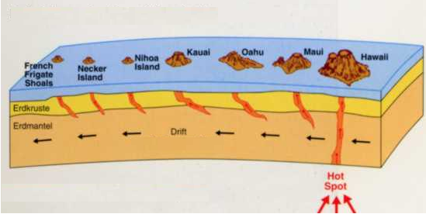
2. Shield volcanoes (found at Hot Spots )
Not at plate boundaries
Magma much thinner than in composite volcanoes
The thinner magma flows more easily resulting in fewer, less explosive eruptions and more gentle slope (low wide cone).
As the plate moves, it carries the hot spot with it, so that chains of volcanic islands are formed
Largest volcanoes
i.e., Hawaii

Slide 9
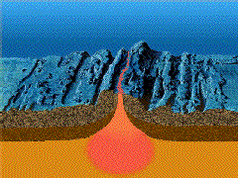
3. Rift eruptions (formed by Divergent boundaries):
Magma flows through long cracks in lithosphere at mid-ocean ridges;
Usually not very explosive
occasionally, volcanoes grow high enough to rise above the surface of the ocean and produce islands.
Eg. Iceland

Slide 10
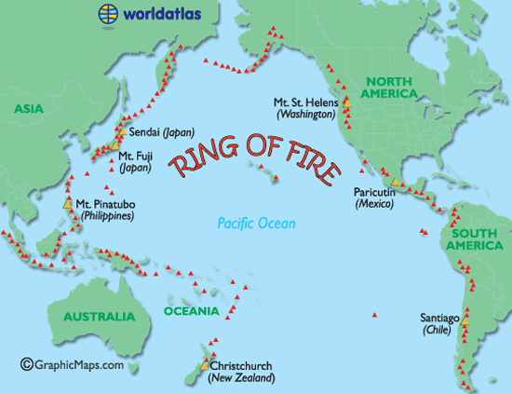
Pacific Ring of Fire
Region surrounding the Pacific Ocean, where many volcanoes and earthquake activity.
total of 452 volcanoes, and has 75% of the Earth's active and dormant volcanoes.
Mostly subduction zones

