Slide 1
Chemical and Physical Changes of Matter

Slide 2
Review: Describe a piece of paper.
Which properties are physical?
Which properties are chemical?
Whichare qualitative?
Which are quantitative?
Which are intensive? Extensive?

Slide 3
Physical Properties of Paper
Mass = 28g
Length = 28 cm, width = 21.5 cm
Colour = white
Texture = smooth
Vertical line is red, Horizontal lines are blue

Slide 4
Physical Properties of Paper
Mass = 28g Quantitative
Length = 28 cm, width = 21.5 cm Quantitative
Colour = white Qualitative
Textures = smooth Qualitative

Slide 5
Physical Properties of Paper
Mass = 28g Extensive
Length = 28 cm, width = 21.5 cm Extensive
Colour = white Intensive
Textures = smooth Intensive

Slide 6
Crumpled... Is it still paper?

Slide 7
IN A PHYSICAL CHANGE:
Substance keeps (retains) its original properties
No new substance is formed.
The change is usually reversible (can change back)
a cut strawberry is still as sweet
Rip a paper in half – still white, still can write on it...

Slide 8
Examples of Physical Change:
Change in shape

Slide 9
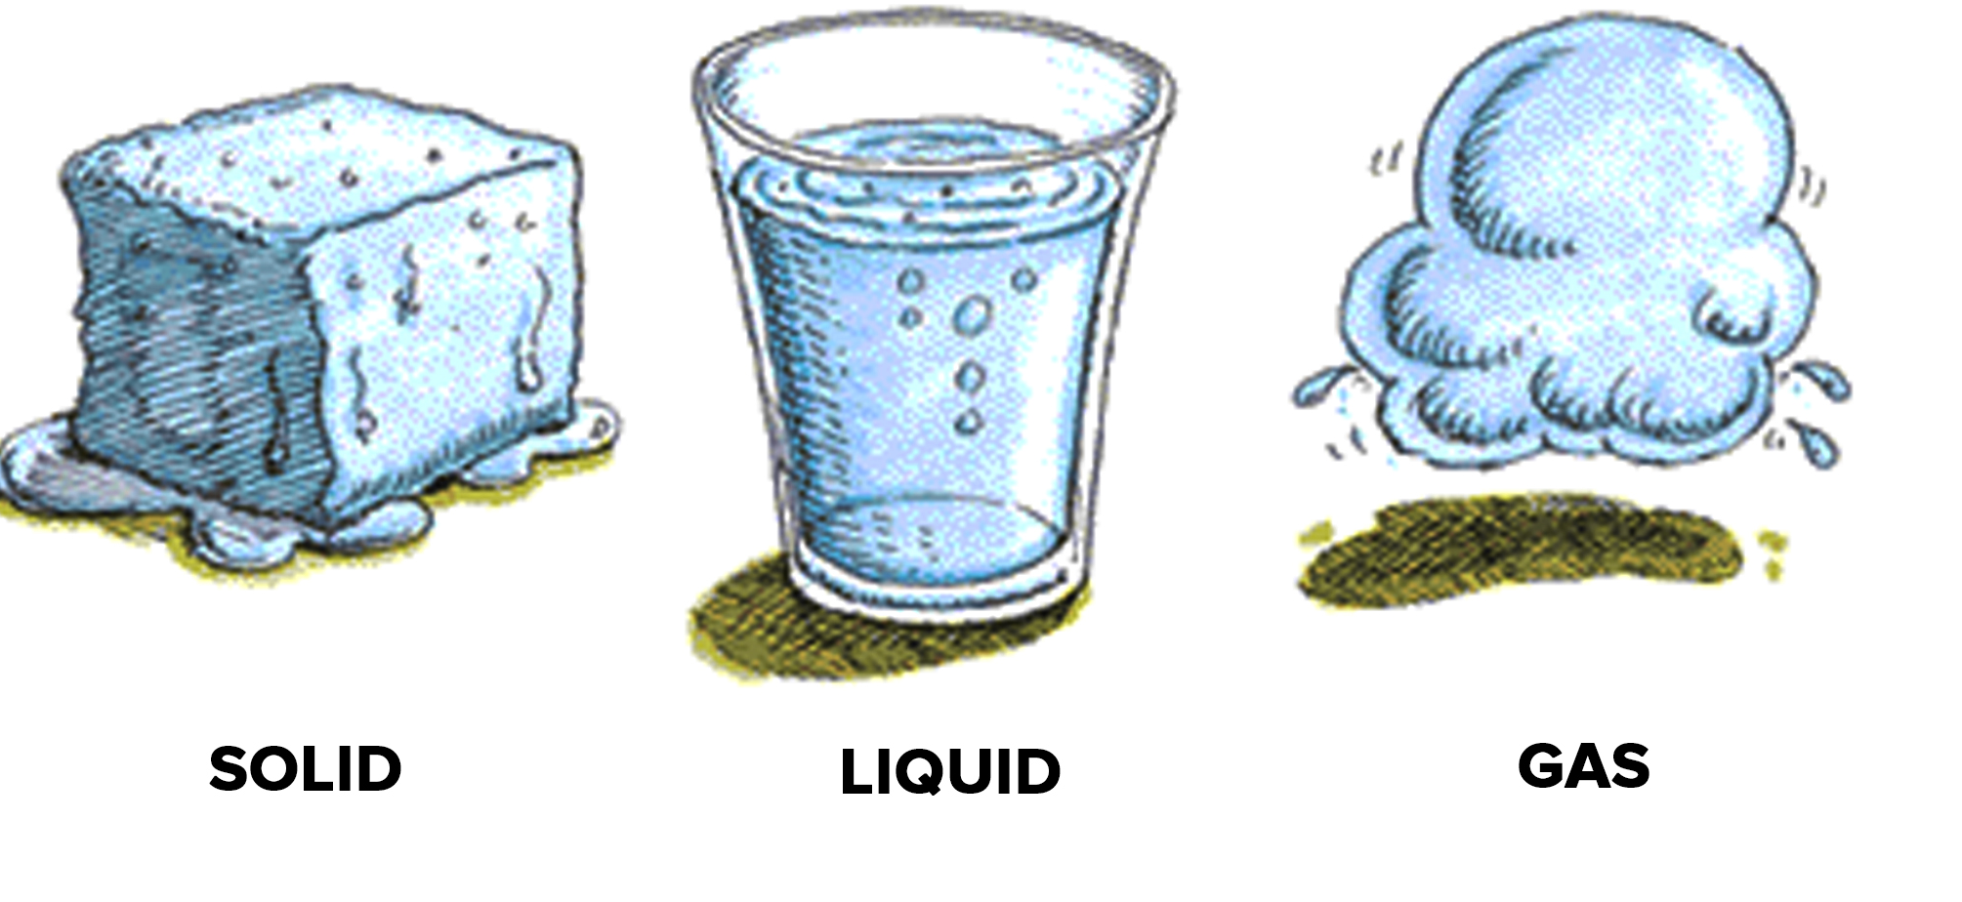
Examples of Physical Change:
Change of state (phase change)

Slide 10
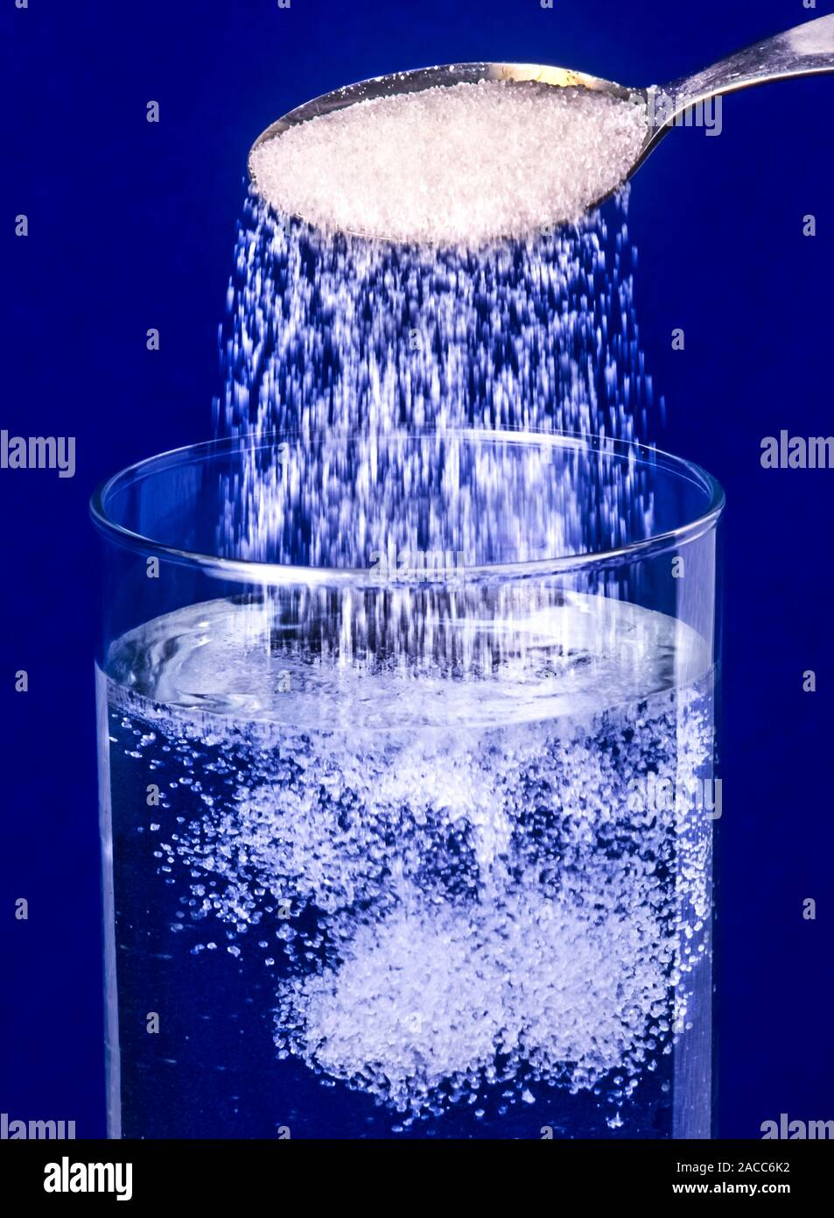
Examples of Physical Change:
Dissolving

Slide 11
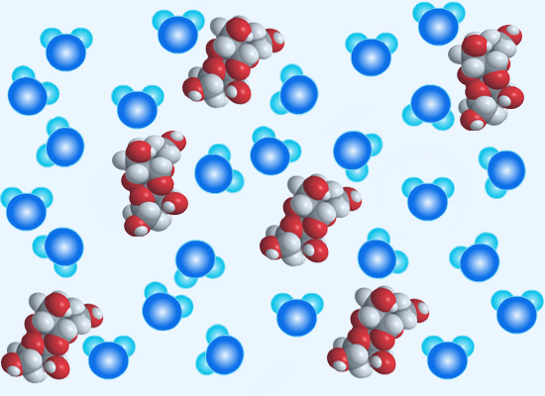
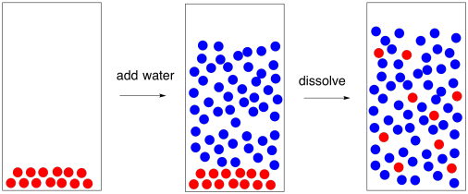
Examples of Physical Change:
Dissolving - mixing one substance into another
when sugar dissolves in water, the sugar particles separate from each other and spread in between the water particles.
The sugar can be separated from the water by evaporating the water.

Slide 12
Then what is a chemical Change?
Demo – testing chemical properties of paper.
Remember: to see chemical property, the substance usually changes.
What has changed?
Is there something new that wasn’t there before?

Slide 13
Chemical Change
A NEW substance is produced with NEW properties
Often IRREVERSIBLE (can’t be reversed)
Bonds between atoms within a molecule are created or destroyed (chemical reaction)

Slide 14
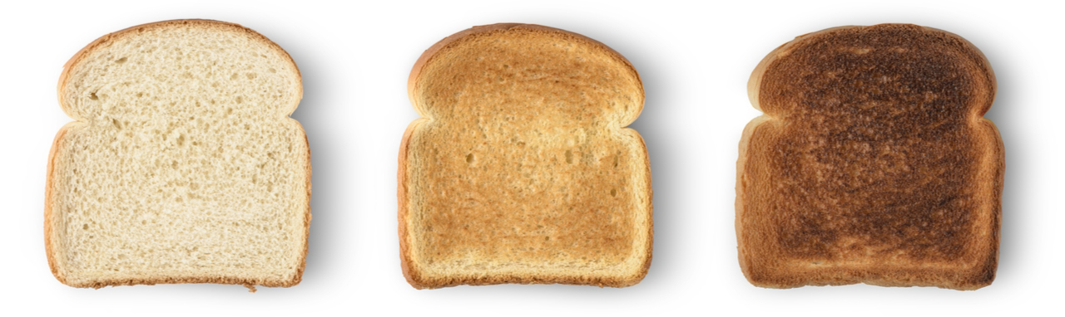
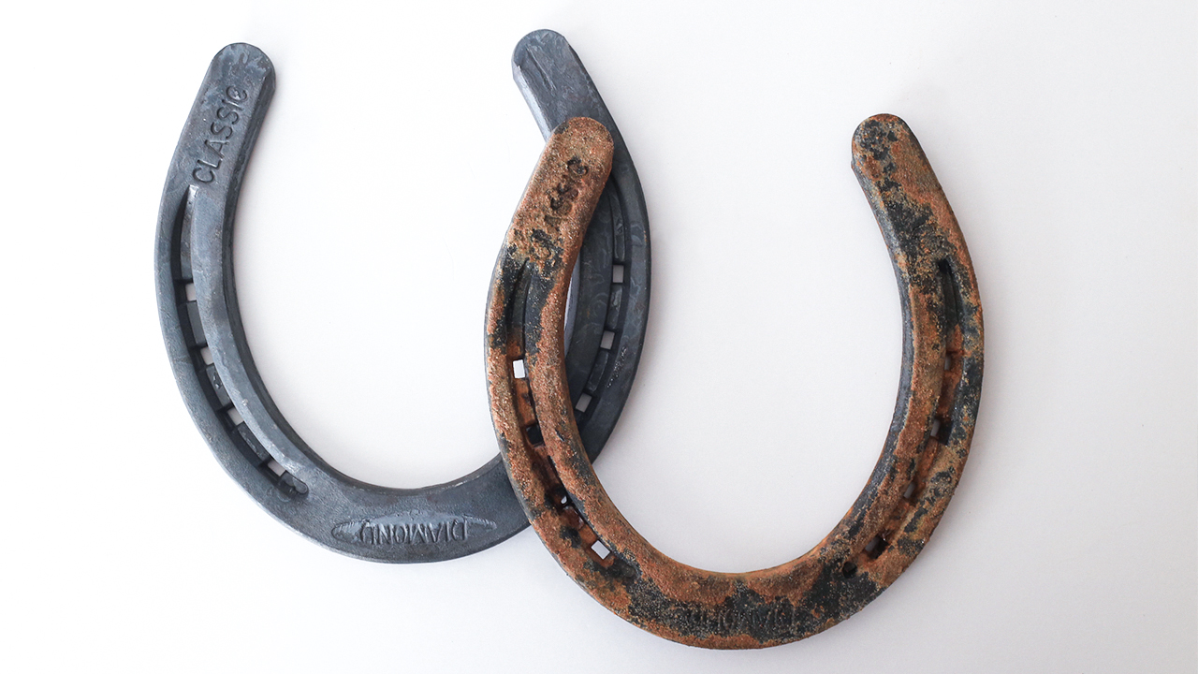
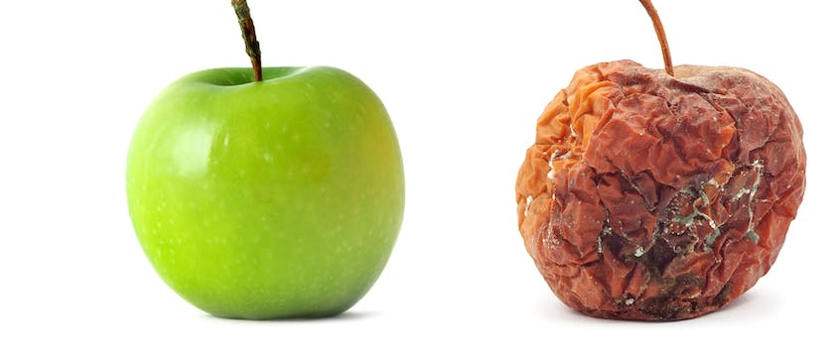
Examples of chemical changes
Burning
Rusting,
rotting food,
Digesting food

Slide 15
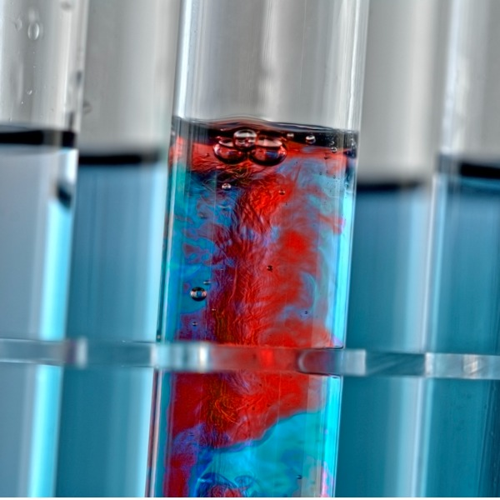
How do we know a chemical change occurred? What is the Evidence?
When a chemical change occurs, you will see something that wasn’t there before.
You will observe one or more of the following:

Slide 16
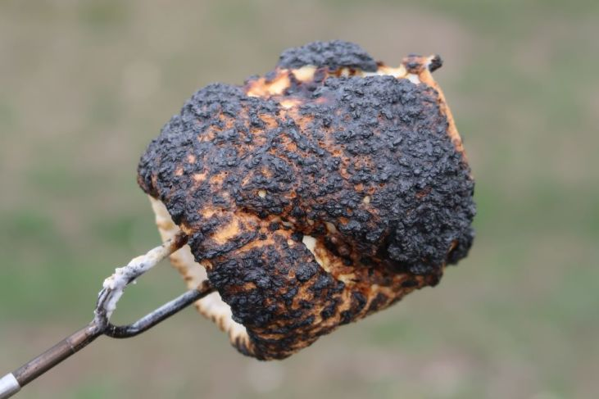
Evidence that a Chemical change occurred:
Change colour,

Slide 17
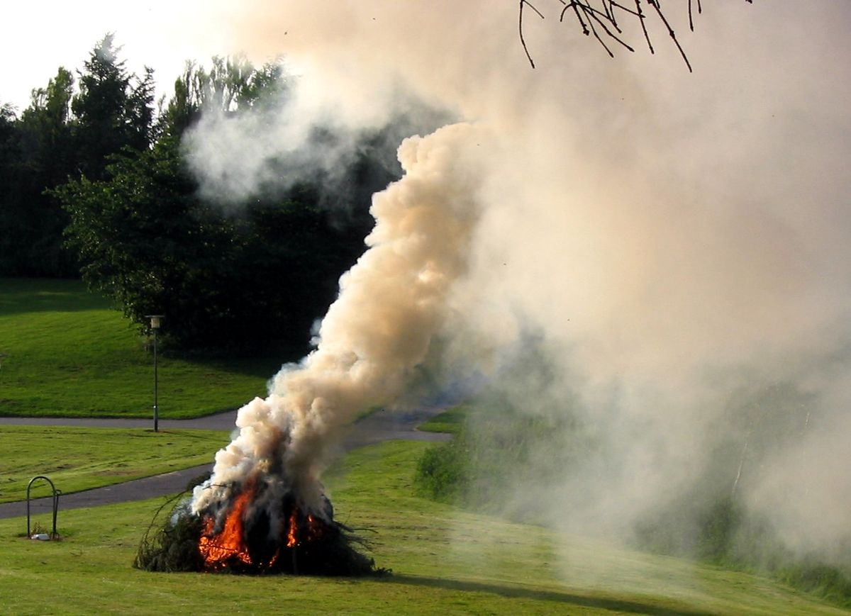
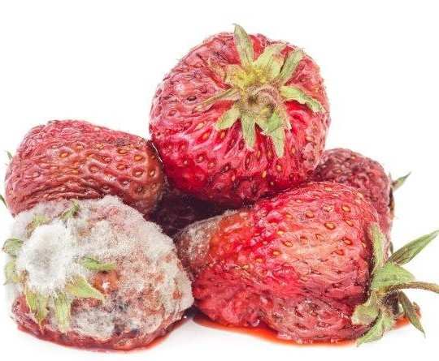
Evidence that a Chemical change occurred:
Change colour,
Change in odour (smell)

Slide 18
Evidence that a Chemical change occurred:
Change in Energy (energy is given off or absorbed (change temperature or light)

Slide 19
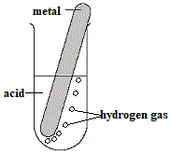
Evidence that a Chemical change occurred:
Production of Gas (bubbles),

Slide 20
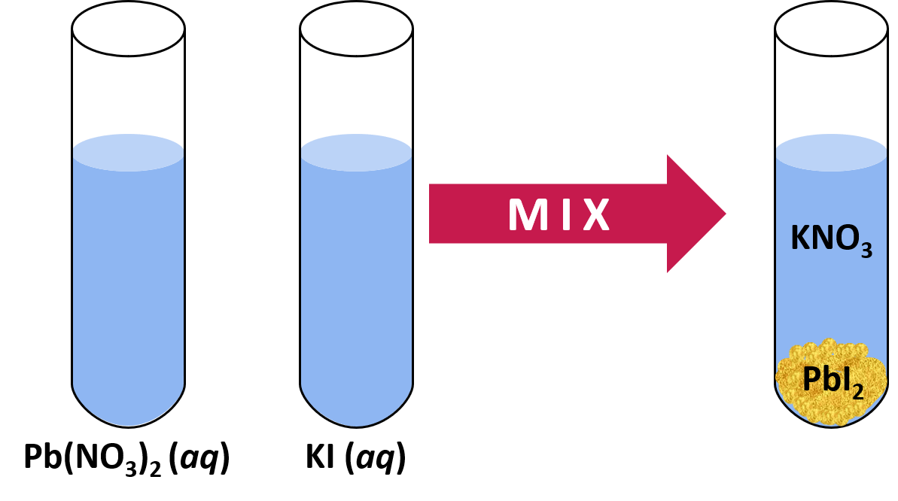
Evidence that a Chemical change occurred:
Production of a solid (precipitate settles out of solution)

Slide 21
Evidence that a Chemical change occurred:

Slide 22
Which is a physical or chemical change?
Tearing paper
Burning paper
Wetting paper
fireworks
Melting ice cube
Frying bacon
Sublimation of dry ice
Baking a cake
Bicycle chain rusting
Vinegar and baking soda volcano
Digestion of cheeseburger

Slide 23
What is the main difference between a physical change and a chemical change?

Slide 24
What is the main difference between a physical change and a chemical change?
A physical change in a substance doesn't change what the substance is.
Water freezing into ice is still H2O
In a chemical change, there is a chemical reaction and a new substance is formed and energy is either given off or absorbed.

Slide 25
Examples of Physical Changes

Slide 26
Examples of Chemical Changes

Slide 27
Practice
Physical and chemical change Worksheet
Lab

Slide 28
Chemical Change POE
 | Element | Element | Compound
 | iron | sulphur | iron sulphide
colour | silvery grey | yellow | black
is it attracted to a magnet? | yes | no | no
reaction with hydrochloric acid | hydrogen formed | no reaction | smelly hydrogen sulphide formed

