Slide 1
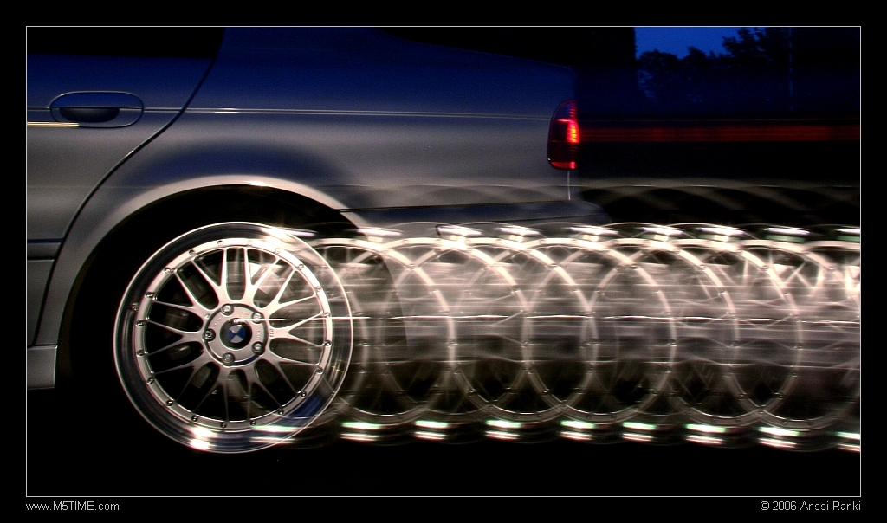
Acceleration (a)
Non Uniform Motion

Slide 2
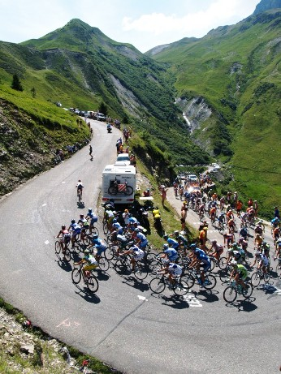
Recall
An object travelling with uniform
motion travels in a straight line
at a constant speed.
Not all objects exhibit uniform motion.
When an object changes SPEED or DIRECTION it changes its velocity
ACCELERATION is the rate of change velocity

Slide 3
Calculating a Change in Velocity
A change in velocity ( ) can be calculated by:
ν_{f}= Final Velocity
ν_{i}= Initial Velocity
Δν= Change in velocity

Slide 4
Ex: A car speeds up from 1 m/s forward (positive) to 10m/s forward (positive)
ν_{f}= 10m/s
ν_{i}= 1 m/s
Δν= 10m/s -1m/s = 9m/s

Slide 5
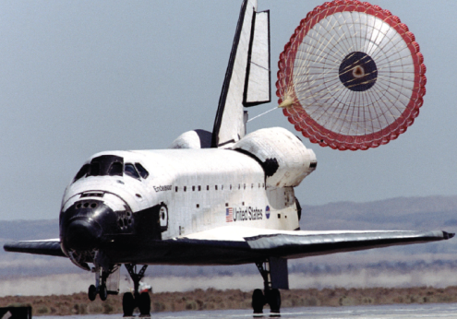
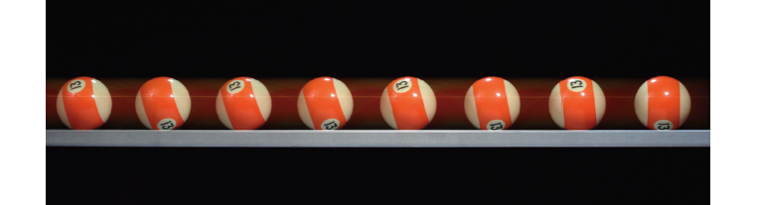
  If the change in velocity is the SAME DIRECTION (+, -) as the initial velocity, the speed of the object is INCREASING.
  If the change in velocity is the OPPOSITE DIRECTION (+, -) of the initial velocity, the speed of the object is DECREASING.
  If the change in velocity is ZERO the object is traveling
  with uniform motion.

Slide 6
Acceleration (a)
Acceleration is a change in velocity (due to a change in speed and/or direction). Means motion is not uniform
Acceleration can be positive or negative
Notes:
Even if object is slowing down.

Slide 7
Acceleration (a)
Two objects with the same change in velocity can have different accelerations.
  This is because acceleration describes the rate at which velocity is changing.
Suppose both of these vehicles, starting from rest, speed up to 60 km/h. They will have the same change in velocity, but, since the dragster can get to 60 km/h faster than the old car, the dragster will have a greater acceleration.

Slide 8
Acceleration depends on speed
When object’s speed is increasing, it has positive acceleration
When object’s speed is decreasing (while travelling in same direction) it has negative acceleration.
Notes:
Why does it have to be same direction?

Slide 9
Positive Acceleration
Positive Acceleration occurs when the direction of the acceleration is the same as the direction of the change in velocity.
Eg. 1. A car speeding up in the forward direction
  IF forward direction is positive (+),
  THEN change in velocity is positive (+),
  THEREFORE the acceleration is positive (+).

Slide 10
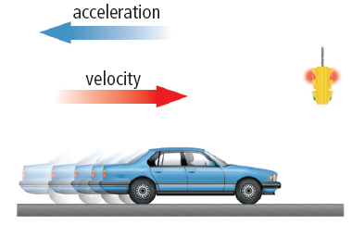
Negative Acceleration
A car slowing down in the forward direction:
  If we designate the forward direction as positive
  then the change in velocity is negative (-)
  therefore the acceleration is negative (-).
Notes:
Example: original velocity is 60k/h, slows down to 30km/hr...vf - vi = 30-60=-30

Slide 11
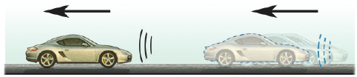
Slowing down while in reverse is also Positive Acceleration
If we designate the backward direction as negative (-) then the change in velocity is positive (+).
Acceleration is positive (+) even though the car is decreasing its speed.
  Remember positive (+) and negative (-) refer to directions.
Notes:
Car speeding up is acceleration
Initial speed is –60 slows down to –30, change in V is –30 - -60 = +30

Slide 12
Negative Acceleration
  Ex 4: A car speeding up in while in reverse
  If we designate the backward direction as negative (-) then the change in velocity is negative (-).
  This means that the acceleration is negative (-) even though the car is increasing its speed.
  Remember positive (+) and negative (-) refer to directions.

